Slide 1
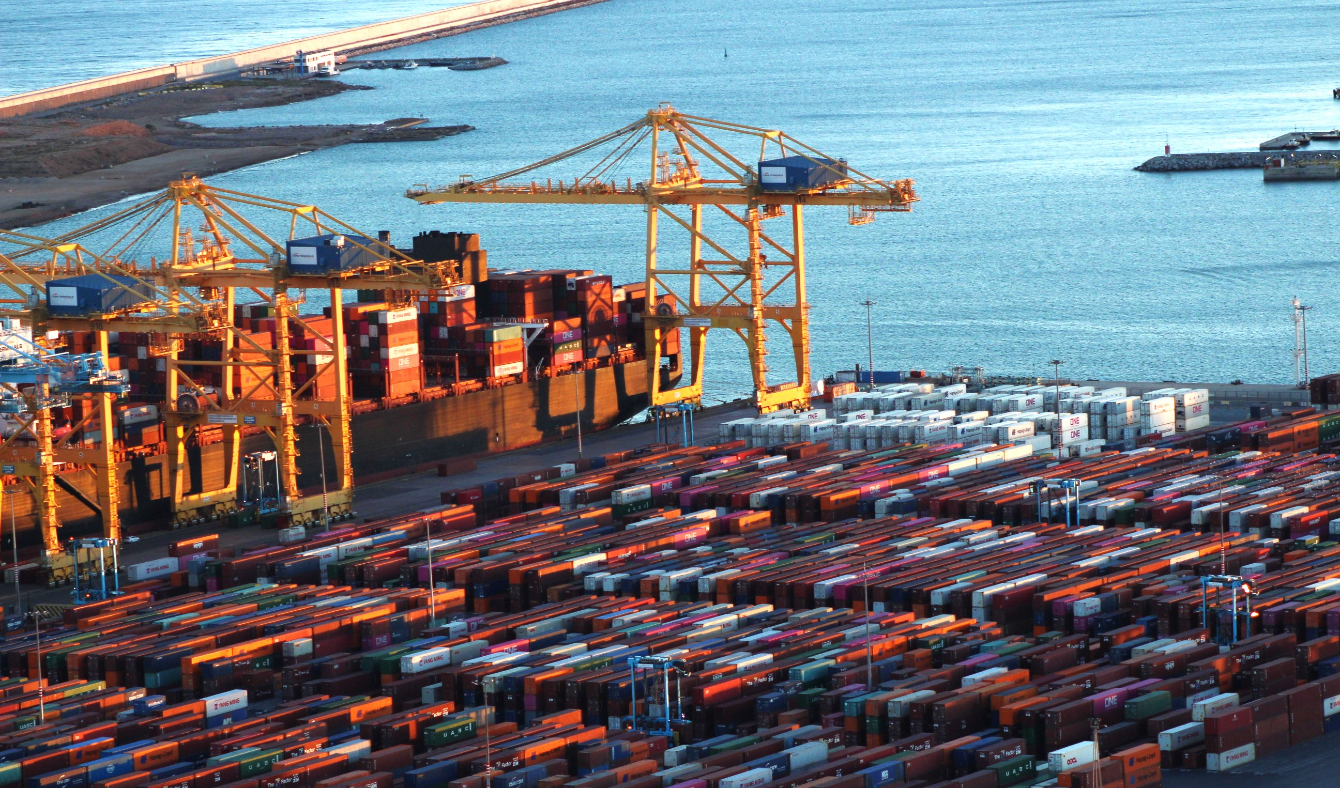
Barcelona-2023_byBpiereck

Slide 2



Know more
Introduction to Docker for
reproducible analysis
Introduction to Docker for
reproducible analysis

Slide 3
What are CONTAINERS ?
Common definition: Object to HOLD and TRANSPORT something
How are containers related to informatics ?
Co-relation in informatics: It is a PORTABLE package HOLDING applications and all its necessary means.

Slide 4
What is a DOCKER ?
Common definition: Person working in a port, responsible for LOADING and UNLOADING containers.
How is a DOCKER related to (bio)informatics?
Co-relation in informatics: It is an open-source platform to
CREATE (loading),
MANAGE (running)
SHIP (sharing) containers with their applications.

Slide 5

What is a container ?
“
A container image is a lightweight, stand-alone, executable package of a piece of software that includes everything needed to run it: code, routine, system, tools, libraries, settings
”
- https://www.docker.com/what-container -
p.s: Commercial use of Docker Desktop requires a paid subscription
Notes:
Logo guideline: https://www.docker.com/company/newsroom/media-resources/

Slide 6

“Well, it works on my machine…”
by @Freepik
Potential general barriers
Different Operational system
Different hardware
Different software versions
Technical ability
Notes:
From the perspective before containers
https://www.freepik.com/icon/settings_6541015#fromView=search&page=1&position=78&uuid=a1d1dccf-4f18-4f35-8009-683e1222c59f

Slide 7





Docker use cases
Web application
Galaxy, GitLab
Analysis pipeline
Nextflow, Snakemake
Testing & continuous integration
Jenkins, Drone CI
Difficult to compile apps
PennCNV, hap.py
Need for reproducible environments
Jupyter notebooks
by @Freepik
by @Irfansusanto20
by @kerismaker
by @Freepik
by @Creaticca Creative Agency
Notes:
[www global icon] - https://www.freepik.com/icon/world-wide-web_1927656
[workflow icon] - https://www.freepik.com/icon/prioritize_12283476
[continuos integration icon ] - https://www.freepik.com/icon/proactive_4824225
[difficult to compile icon] - https://www.freepik.com/icon/confused_5662983
[jupyter notebook icon] - https://www.freepik.com/icon/notebook_503635

Slide 8
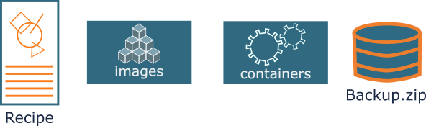
How does it work?
Important concepts
Dockerfile: Your recipe
Docker image: Static artifact
Container: Running image (functional)
Backup.tar: Compacted file
Docker engine: ‘Manager’
File you can create using the docker engine (rarely used)
your recipe to build the Docker image

Slide 9
How does it work?
Important concepts
Dockerfile: Your recipe
Docker image: Static artifact
Container: Running image (functional)
Backup.tar: Compacted file
Docker engine: ‘Manager’
Used as base
Long-term storage
Based on image
Short lived

Slide 10
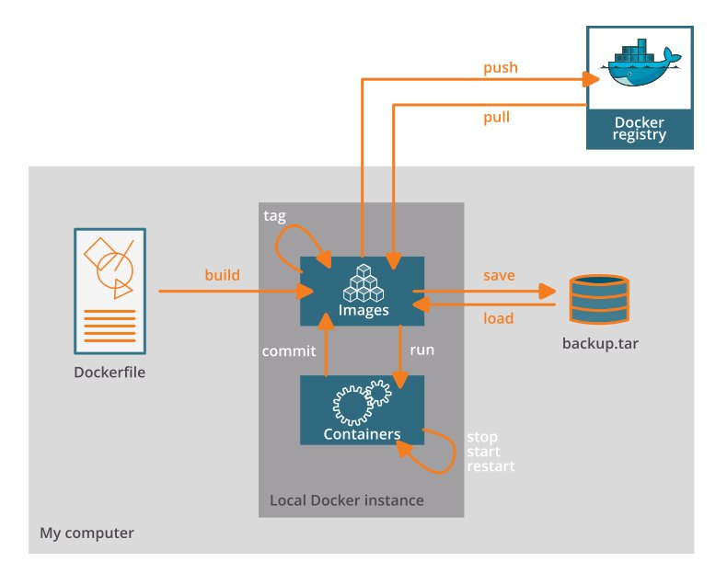
How does it work?
Important concepts
Dockerfile: Your recipe
Docker image: Static artifact
Container: Running image
Backup.tar: Compacted file
Docker engine: ‘Manager’
p.s: Commercial use of Docker Desktop requires a paid subscription

Slide 11
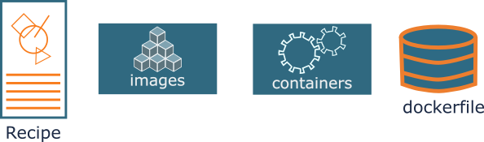
How does it work?
Important concepts
Dockerfile: Your recipe
Docker image: Static artifact
Container: Running image
Backup.tar: Compacted file
Docker engine: ‘Manager’
p.s: Commercial use of Docker Desktop requires a paid subscription

Slide 12
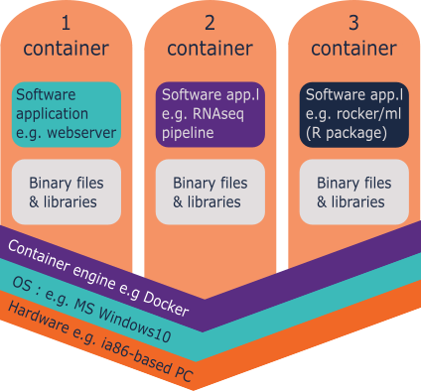
How is it organized?
General components
Docker images layers
Recipe
Image
Image
FROM ubuntu:18.04
RUN apt update && apt –y upgrade
RUN apt install –y wget
3
2
1

Slide 13
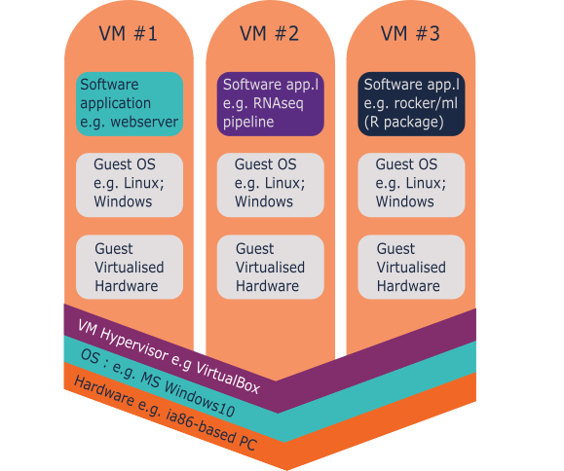
How is it organized?
General components
Docker images layers

Slide 14
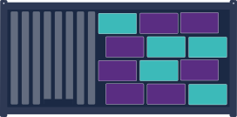




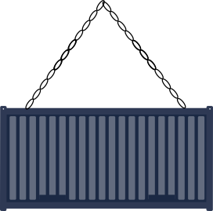
Advantages
Bundled Dependencies
Contain all their dependencies = installing hurdles
Cross-platform Installation
Contain their own operating system = run on any platform (even Windows!)
Easy Distribution
Shared on Docker Hub or as ‘image.tar’ file
by @Roundicons Premium
by @Freepik
by @Freepik
Notes:
------- Links and references for images and content -------
https://www.freepik.com/icon/social_14051772 [Windows icon by Roundicons Premium]
https://www.freepik.com/icon/apple_546060 [Apple icon by Freepik]
https://www.freepik.com/icon/linux_546061 [Linux icon by Freepik]

Slide 15


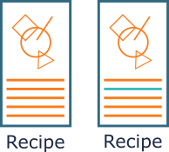
Advantages
Safety
Can’t access files on the host machine
Ease-of-Use
Can always be run using one single command
Easy Upgrades
Easily swapped out for newer versions
All persistent data can be retained in a data volume

Slide 16




Other container software

Slide 17
Using and Reusing
available docker images
Using and Reusing
available docker images
Barcelona-2023_byBpiereck

Slide 18


Where can we storage and find Docker images?
Local storage
Registry

Slide 19
Where can we storage and find Docker images?
Local storage
Registry
Preferable

Slide 20


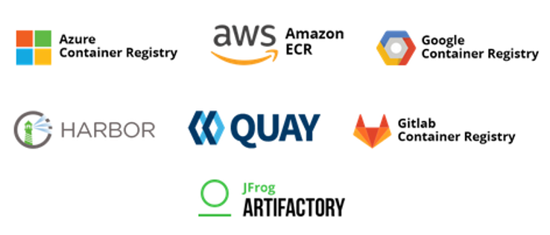


Container Registries
Main registry for DOCKER containers
Alternative registries

Slide 21

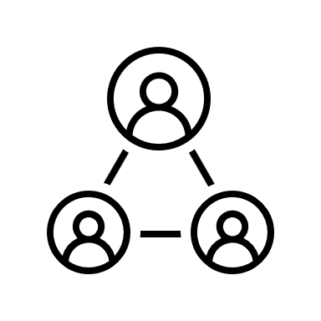
Container Registries
Main registry for DOCKER containers
Alternative registries

Slide 22
How do we get a container image?
p.s: Commercial use of Docker Desktop requires a paid subscription

Slide 23

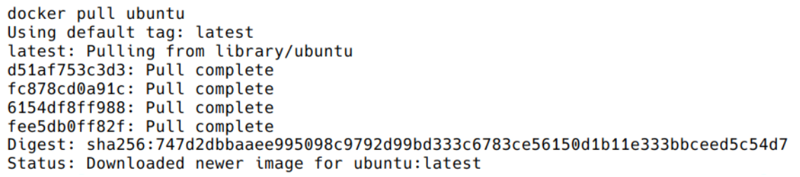
How do we get a container image?
docker pull <image>
docker pull <registry/image>
Example: getting Ubuntu image
$ docker pull ubuntu

Slide 24
How do we get a container image?
docker pull <image>
docker pull <registry/image>
Example: getting Ubuntu image
Example: Get a specific version
$ docker pull ubuntu
$ docker pull ubuntu:18.04

Slide 25
How do we get a container image?
Is there a better way to ‘pull’ ??
If yes, which one?
docker pull ubuntu
docker pull ubuntu:18.04
Why?

Slide 26
How do we get a container image?
Pull ubuntu in your computer:
Version 18.04
Pull from Docker hub
Fastqc (A quality control tool for high throughput sequence data)
Version 0.11.9_cv7

Slide 27
What else can we do?
Check all images that you have
$ docker images
$ docker image ls $ docker images -a
Run a container with your analysis
$ docker run [docker_options] <container> [container_arguments]
run

Slide 28
List your imaged
List all the images you have pulled or build

Slide 29
Run your 1st image
You can execute any program/command that is stored inside the image. What happens if you execute ls in your current working directory: is the result the same?
List all the images you have pulled or build
You can execute any program/command that is stored inside the image.
Run your 1st container
$ docker run ubuntu:18.04 /bin/ls $ docker rum ubuntu:18.04 /bin/whoami $ docker run ubunu:18.04 /

Slide 30

Run your 1st image
List all the images you have pulled or build
You can execute any program/command that is stored inside the image.
Run your 1st container
$ docker run ubuntu:18.04 /bin/ls
If you run ls in your current directory, do you have the same?
Why?
Computer
Docker engine
ls
ls

Slide 31
Docker detach, what does It do?
Note: Question for them … let them answer

Slide 32
Docker detach, what does It do?
Run in the background
Detached from the shell
$ docker run [docker_options] <container> [container_arguments] $ docker run --detach <container> [container_arguments]
Name your container to check later
$ docker run --detach --name <my_ctn_name> <container> [container_arguments]

Slide 33
Run the following without naming it:
$ docker run --detach nginx
Check the name of your container by checking the process status - Challenge: How do you list running containers?

Slide 34
Run the following without naming it:
$ docker run --detach nginx
Check the name of your container by checking the process status - Challenge: How do you list running containers?
List running containers (process status)
$ docker ps
List all containers (whether or not running)
$ docker ps -a

Slide 35
Run again naming the container
$ docker run --detach --name MyUbuntu nginx
Check the name of your container by checking the process status
$ docker ps
$ docker ps -a

Slide 36
Why are IDs and Names useful for?

Slide 37
Why are IDs and Names useful for?
Stop a container
Restart a container
run
stop
restart

Slide 38
Tagging
Define image Name and Version!
docker tag <image ID> <container:tag_name>
Let’s try to do it!

Slide 39
Tagging
Define image Name and Version!
docker tag <image ID> <container:tag_name>
Let’s try to do it!
Check the ID of your images
Chose one of them to change or add a tag

Slide 40
Naming objects in Docker
What is the difference between … ?
Tag
--name

Slide 41
Naming objects in Docker
What is the difference between … ?
Tag
--name
Name the container (docker run –name ….)
One image can create +1 container
Name an image
Define the version of an image (docker tag <image ID> …..)

Slide 42
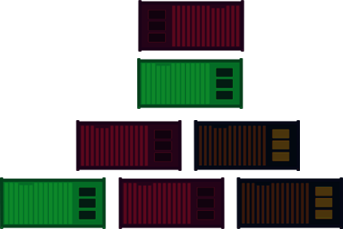
Docker and disk space
Check space usage (Disk inFo)
Output
Type object
Total number of objects
Size
etc
$ docker system df

Slide 43
Docker and disk space
Docker objects are not automatically removed
Images
Containers
Networks
Volumes
Check system space
Pruning the system
The whole system
Dangling images
Not tagged
No references
All images not associated to a container
My_image
Notes:
Dangling images, when you update and (re)build an image and haven’t changed the tagging, the old one that is still hanging around is no longer linked to any running containers, and it has no tag. Can be shown as tag-none in the list. This are dangling images that still take storage space and need to be pruned (erased).

Slide 44
Docker and disk space
Docker objects are not automatically removed
Images
Containers
Networks
Volumes
Check system space
Pruning the system
The whole system
Dangling images
Not tagged
No references
All images not associated to a container
???
+
My_image

Slide 45
Docker and disk space
Dangling image
Docker objects are not automatically removed
Images
Containers
Networks
Volumes
Check system space
Pruning the system
The whole system
Dangling images
Not tagged
No references
All images not associated to a container
???
+
My_image

Slide 46
Docker and disk space
Docker objects are not automatically removed
Images
Containers
Networks
Volumes
Check system space
Pruning the system
The whole system
Dangling images
Not tagged
No references
All images not associated to a container
run

Slide 47
Docker and disk space
Image:version
Docker objects are not automatically removed
Images
Containers
Networks
Volumes
Check system space
Pruning the system
The whole system
Dangling images
Not tagged
No references
All images not associated to a container
run
Ref: Image:version

Slide 48

Docker and disk space
Clean up
Remove (rm)
Specify
Image
Container
Check space usage (Disk inFo)
Output
Type object
Total number of objects
Size
etc
$ docker system df
$ docker rm –f <container>
$ docker rmi <image>

Slide 49
Docker and disk space
Clean up
Remove (rm)
Specify
Image
Container
Major clean up
Clean all dangling objects
$ docker system prune
Clean all dangling images
$ docker image prune
Clean unused containers
$ docker container prune
Check space usage (Disk inFo)
Output
Type object
Total number of objects
Size
etc
$ docker system df
$ docker rm –f <container>
$ docker rmi <image>

Slide 50
Docker and disk space
Clean up
Remove (rm)
Specify
Image
Container
$ docker rm –f <container>
$ docker rmi <container>
Major clean up
Clean all dangling objects
$ docker system prune
Clean all dangling images
$ docker image prune
Clean unused containers
$ docker container prune
Check space usage (Disk inFo)
Output
Type object
Total number of objects
Size
etc
$ docker system df
Clean all UNUSED objects
$ docker system prune –a
Use it carefully !!!

Slide 51
Check and clean
Check how much disk space you’ve used
Clean stopped or unused containers
Can you combine docker options?
run
rm
prune
tag

Slide 52
Working interactively
When to do it?
Debug
How to do it:
Enter the container and interact:
docker run –it <image> <command>
dokcer run –it –rm <image> <command>
Execute a command in a running container
dockcer exec <containerr>
Notes:
Docker run: creates and starts a new container from image
Docker exec: executes a command in a running container

Slide 53
Activity 1.1
Get the data (https://github.com/vibbits/containers-workshop/)
You will need fastqc
check all your images
Pull image if needed
Fastqc, version 0.11.9_cv7
Docker hub
Run fastqc –h
Activity 1.2
Check for running containers
Remove the container
Run the container interactively
Start it with bash
docker run –it <image> <command>
dokcer run –it –rm <image> <command>

Slide 54

Docker a closed environment

Slide 55

Docker a closed environment
Mounting volumes
Using Ports

Slide 56
Volume mounting: I/O
Container is isolated from host
X
DATA

Slide 57
Volume mounting: I/O
Container is isolated from host
Data in the container is NOT kept
DATA

Slide 58
Volume mounting: I/O
Container is isolated from host
Data in the container is NOT kept
Solution:
Biding volume -v /path/in/host:/path/in/container docker run --detach \ --volume path/in/host/datatest:/path/in/container/dataset \ --name <container_name> <container:version> <container_options>
Working directory -w /path/in/host
docker run –w /path/in/host
–volume path/in/host/datatest:/path/in/container/dataset \ --name <container_name> <container:version> <container_options>
DATA

Slide 59
Activity 2.1
Run interactively and mount the local data/ folder to the container /data
biocontainers/ fastqc:v0.11.9_cv7.
Remove the container after it has run
Activity 2.2
Do a quality control on the WT samples
Use the command
Why do we need to add /data/ in the fastqc command?
fastqc /data/WT_lib1_R1.fq.gz or fastqc /data/ecoli_1.fastq.gz.
Binding volume -v /path/in/host:/path/in/container

Slide 60
3
Who is the default user within the container?
Run interactively and mount the local data/ directory to /scratch in the container
biocontainers/ fastqc:v0.11.9_cv7
In the container directory
Create a temporary file file1.txt in the scratch/
Quit the interactive session.
On your host, check the file permissions.
On the host
Create a temporary file file2.txt in the data/ directory.
Run interactively and inspect the file permissions of this file
the fastqc container
Check the file permissions of this file in the container (scratch/ directory).
On the host, find out which UID and GID you have.
Tip: you can find your UID and GID with: id -u and id -g.
Run a docker container by using the -u parameter
In the meantime creating a temporary file file3.txt with touch.
Mount your current directory to /data
Within quay.io/biocontainers/fastqc:0.11.9--0.
Check the file permissions of this file in the container.

Slide 61
3
Who is the default user within the container?
Run interactively and mount the local data/ directory to /scratch in the container
biocontainers/ fastqc:v0.11.9_cv7
In the container directory
Create a temporary file file1.txt in the scratch/
Quit the interactive session.
On your host, check the file permissions.
Host:
ls –ls
-rw-r--r-- 3 u0088910 u0088910 file1.txt
Container:
ls –ls
-rw-r--r-- 3 root root file1.txt

Slide 62
4
Exercise 4.2
Execute the container: quay.io/biocontainers/fastqc:0.11.9_cv7
Use your user and group ID running
Do quality control of the file WTXXX.fq.gz.
mount your current directory to the default working directory within the Docker container
Verify that the HTML report is created with the correct file permissions.
Exercise 4.1
Execute the container: quay.io/biocontainers/fastqc:0.11.9_cv7
Use working directory option -w for a directory scratch/
Create a temporary file file4.txt with touch.
Mount your current directory to scratch/ within the Docker container
Check the file location of this file on the host.
Version 0.11.9_cv7​
Extra:
Can you analyze all fastq files using a glob-pattern (WT*.fq.gz)?
What do you need to change to make this work?

Slide 63
Ports
Establish communication with webserver
$ docker run --detach --name webserver nginx $ curl localhost:80
Computer
Docker engine

Slide 64
Ports
Stablish communication with webserver
$ docker run --detach --name webserver nginx $ curl localhost:80
Nginx (Engine-x) : creates a local webserver
curl : Client URL
Enables communication between the host and the server

Slide 65
$ docker run --detach --name webserver nginx $ curl localhost:80
Computer
Docker engine

Slide 66
Ports
Stablish communication with webserver
$ docker run --detach --name webserver nginx $ curl localhost:80
Container X external environment
Computer
Docker engine

Slide 67
What is the difference between run and exec ?
$ docker run --detach --name webserver nginx $ docker exec webserver curl localhost:80
Computer
Docker engine

Slide 68

Ports
Stablish communication with webserver
$ docker run --detach --name webserver nginx $ curl localhost:80
Container X external environment
exec : execute inside the container
Open the door for host communication
$ docker exec webserver curl localhost:80
Computer
Docker engine

Slide 69
Ports
Computer
Docker engine
To keep the door open
$ docker run --detach --name webserver --publish 80:80 nginx $ curl localhost:80

Slide 70
Ports
Computer
Docker engine
To keep the door open
$ docker run --detach --name webserver --publish 80:80 nginx $ curl localhost:80
$ docker run --detach --name webserver -p 8080:80 nginx $ curl localhost: ???? $ docker exec webserver curl localhost: ???
FYI
--publish
=
-p

Slide 71
What happens? Why?
$ docker run --detach --name webserver --publish 80:80 nginx $ curl localhost:80
What should you use? Why ?
$ docker run --detach --name webserver -p 8080:80 nginx $ curl localhost: ???? $ docker exec webserver curl localhost: ???
Remember to remove these containers docker rm -f <name>

Slide 72
Inspect
Check a recipe
How others do
Potential security issues
$ docker inspect <image_name\image_ID>

Slide 73
Find trimmomatic in docker hub
dceoy/trimmomatic
Pull and inspect

Slide 74
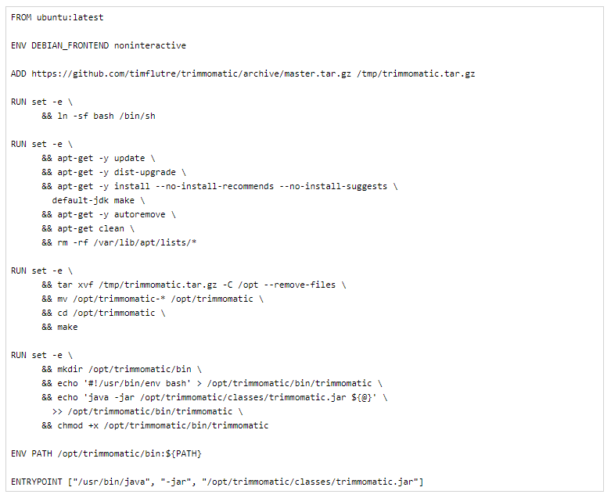

Slide 75
4.3 + challange
Inspect the image biocontainers/fastqc:0.11.9_cv7
Extract the working directory (WorkingDir) using grep.
HINT:
cmd | grep “keyword”

Slide 76
Summary of 1st part: Reusing containers
PULL
INSPECT
TAG
RUN --detach <>
-- name
-- publish
- it
IMAGES / PRUNE
PS / DF / RM / RMI
STOP
RESTART
MOUNT (--volume)
My computer
EXEC
Docker engine

Slide 77
Building your own
docker image
Building your own
docker image
Barcelona-2023_byBpiereck

Slide 78
Recipes
The default recipe is called Dockerfile
FROM ubuntu:18.04 RUN apt update && apt -y upgrade RUN apt install -y wget

Slide 79
Building images
Create a Dockerfile with the content below in a folder of your preference and save it.
FROM ubuntu:18.04 RUN apt update && apt -y upgrade RUN apt install -y wget
How many layers should be created?

Slide 80
Building images
Let’s test it and build the image with
docker build .
How many layers should be created?
docker history <id>
Notes:
docker history <id>/name:tag
docker image history <id>/name:tag
What does the output means?

Slide 81
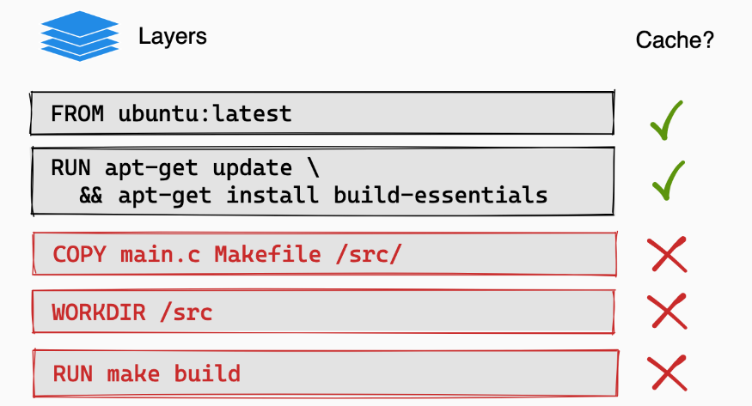
Building images
Create a Dockerfile with the content below in a folder of your preference and save it.
FROM ubuntu:18.04 LABEL org.opencontainers.image.authors=”training@vib.be"
WORKDIR / RUN apt update && apt -y upgrade RUN apt install -y wget ENTRYPOINT ["/usr/bin/wget"] CMD ["https://cdn-images-1.medium.com/max/1600/1*_NQN6_YnxS29m8vFzWYlEg.png"]
Build the image with and without caching.
Notes:
Check exercise to edit
Add in repo

Slide 82
Recipes
More advanced image building
Different ways to build images.
Know your base system and their packages. Popular ones:
Debian
CentOS
Alpine
Conda. Anaconda, Conda-forge, Bioconda, etc.

Slide 83
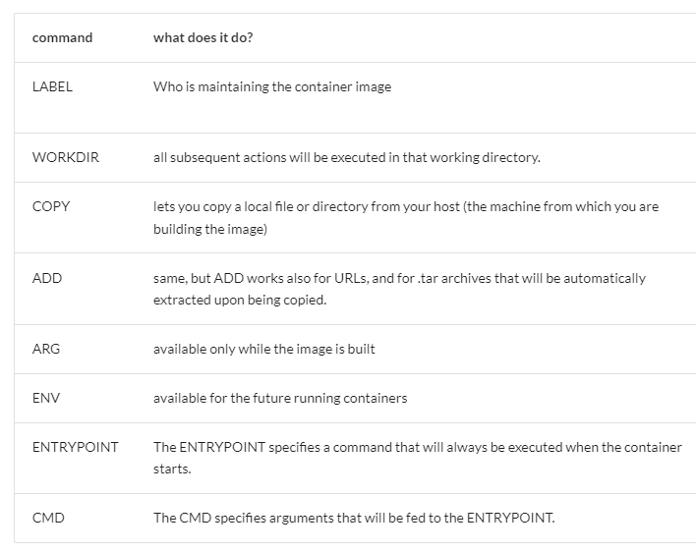
What do you expect your container to do?
Makes easier to maintain the container.

Slide 84
Recipes
One tool, one image or some tools, one image
Different ways to build images.
start from packages e.g. pip/PyPI, CPAN, or CRAN
use versions for tools and images
reduce size as much as possible
keep data outside the image/container
check the license
make your container discoverable e.g. biocontainers, quay.io, docker hub

Slide 85
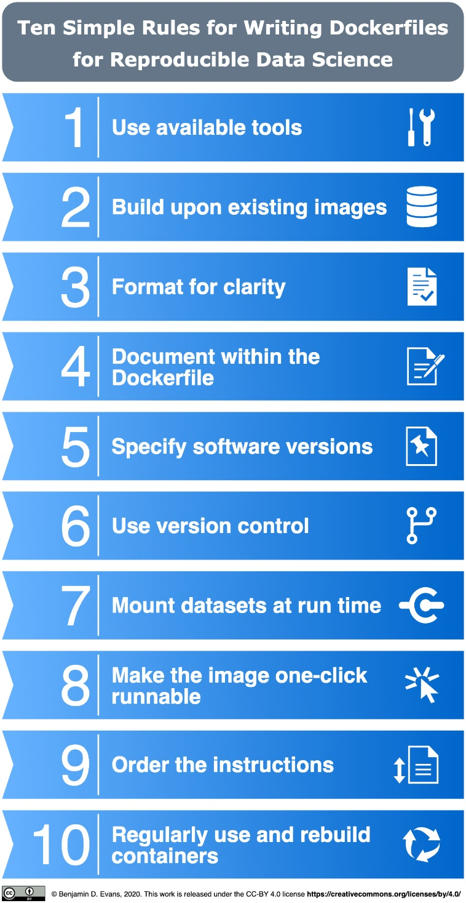
Published: November 10, 2020
https://doi.org/10.1371/journal.pcbi.1008316
Ten simple rules for writing Dockerfiles for reproducible data science
Daniel Nüst ,
Vanessa Sochat,
Ben Marwick,
Stephen J. Eglen,
Tim Head,
Tony Hirst,
Benjamin D. Evans
https://docs.docker.com/engine/userguide/eng-image/dockerfile_best-practices/

Slide 86
https://github.com/vibbits/containers-workshop/blob/main/exercises/02_building_dockerfiles.md
Exercise 5.2
You need to pull jupyter/scipy-notebook:python-3.11.5
Once you have it, run the script from outside the container codereppy_min_batch.py
Reach out to your neighbour(s) in case you need help.

Slide 87
docker run --detach --rm -v ./data:/home/jovyan/ jupyter/scipy-notebook:python-3.11.5 python ./data/codereppy_min_batch.py
docker run --detach --rm -w /data -v ./data:/data jupyter/scipy-notebook:python-3.11.5 python ./data/
docker run --detach --rm -w /data -v ./data:/data jupyter/scipy-notebook:python-3.11.5 python codereppy_min_batch.py
docker run -it --rm -w /data -v ./data:/data jupyter/scipy-notebook:python-3.11.5 bash || python codereppy_min_batch.py
docker run -it -u root -w /data -v ./data:/data jupyter/scipy-notebook:python-3.11.5 bash || python codereppy_min_batch.py

Slide 88
https://github.com/vibbits/containers-workshop/blob/main/exercises/02_building_dockerfiles.md
Exercise 6
You “found” a Dockerfile on github – now in the docker folder
Dockerfile.deploy-cloud
Try to build the image
Run the Docker image – what does the container do?
Test the container
You need the Python script test_query.py which is in the data folder
Reach out to your neighbour(s) in case you need help.

Slide 89
Recipes
One tool, one image or some tools, one image
Different ways to build images.
start from packages e.g. pip/PyPI, CPAN, or CRAN
use versions for tools and images
reduce size as much as possible
keep data outside the image/container
check the license
make your container discoverable e.g. biocontainers, quay.io, docker hub

Slide 90
Know more
Short intro to HPC
preparing for Apptainer
Short intro to HPC
preparing for Apptainer

Slide 91
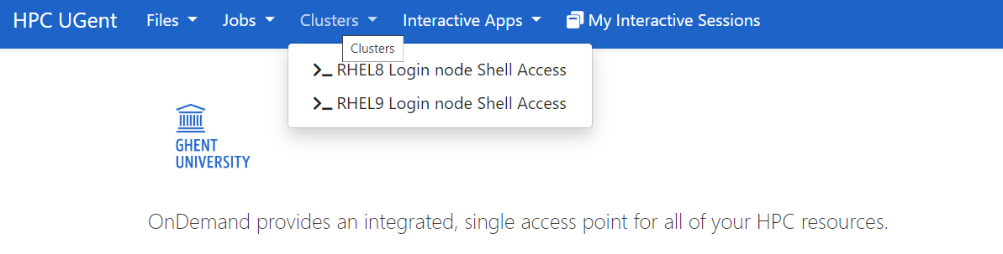
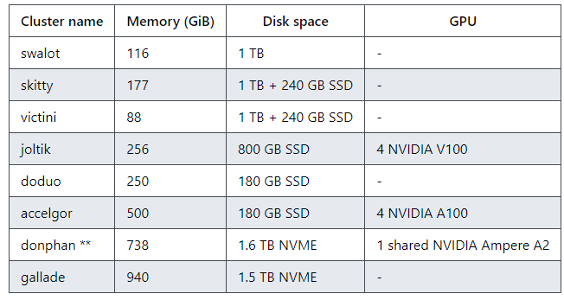
Ugent : Ondemand - https://login.hpc.ugent.be
UGent TIER1 clusters

Slide 92
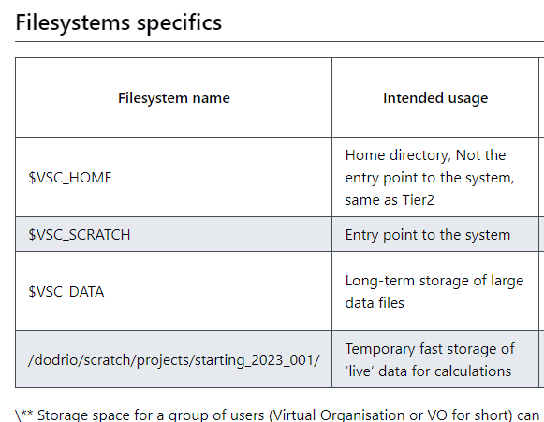
VSC - UGent
Usually where you arrive when login in
Not much space
Not for running analysis
More space
Where you run analysis (input/output)
Long term storage
Archive also
Large files

Slide 93
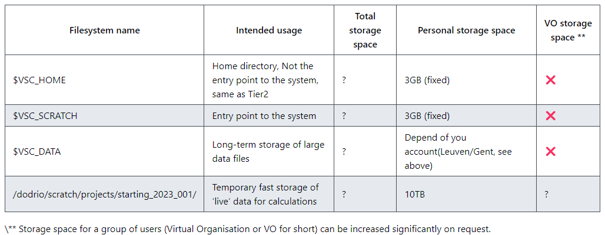
UGent TIER1
Source : https://docs.vscentrum.be/gent/tier1_hortense.html#system-specific-aspects

Slide 94
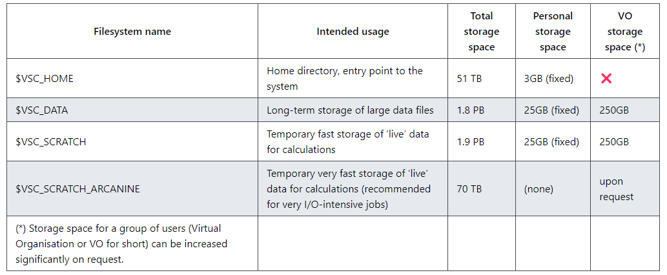
UGent TIER2
Source : https://docs.vscentrum.be/en/latest/gent/tier2_hardware.html?highlight=VSC_DATA#shared-storage

Slide 95
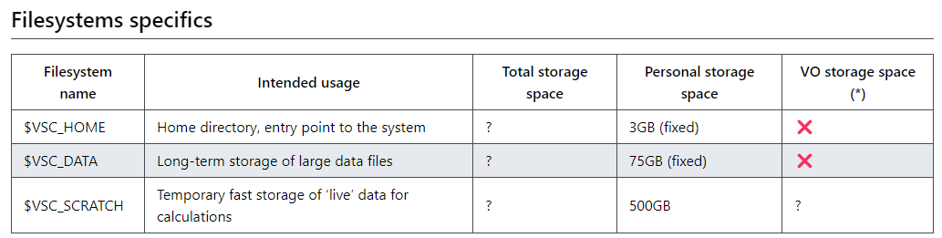
KULeuven TIER2
Source https://docs.vscentrum.be/en/latest/leuven/tier2_hardware/kuleuven_storage.html?highlight=VSC_DATA#ku-leuven-storage

Slide 96
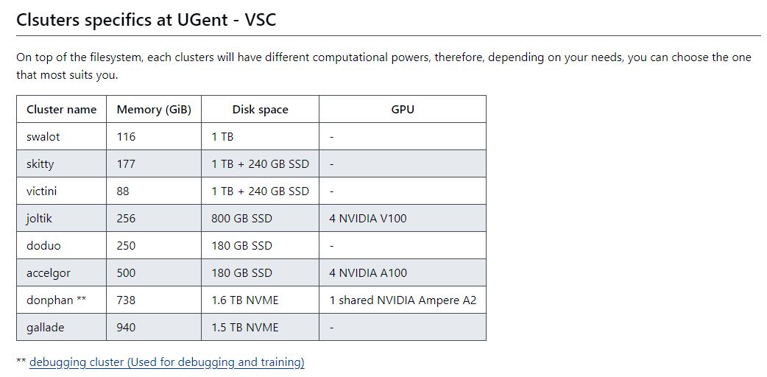
KULeuven – TIER2 clusters
Using KULeuven ondemand:
https://ondemand.hpc.kuleuven.be

Slide 97
VSC - UGent
#!/bin/bash
#SBATCH --job-name= Apptainer-donphan
#SBATCH --output= raboti_vistro.out
#SBATCH --ntasks= 1
#SBATCH --time= 1:00:00
#SBATCH --mem-per-cpu= 16G
#SBATCH --partition= cluster/dodrio/gpu_rome_a100
#SBATCH --gres= gpu:1
#SBATCH --cpus-per-task= 16
#SBATCH --error= raboti_vistro.%j.err
#SBATCH --account= starting_2023_001
module swap cluster/dodrio/gpu_rome_a100
module load scikit-image/0.19.3-foss-2022a
module load n2v/0.3.2-foss-2022a-CUDA-11.7.0
python /dodrio/scratch/users/vsc33625/00_02_prediction_denoising_batch.py
Submission command
qsub submission_script.sh
sbacth submission_script.sh

Slide 98
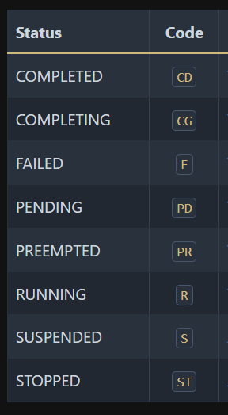
VSC - UGent
Commands in the HPC
module avail : list all available modules
module spider <key word> : search specific modules
module swap cluster/donphan : Swap to specific cluster
Checking your JOB submission
squeue : check status
Scancel <job ID> : kill a job
https://curc.readthedocs.io/en/latest/running-jobs/squeue-status-codes.html
For more: https://docs.vscentrum.be/jobs/job_management.html

Slide 99
Know more
Introduction to Apptainer for
reproducible analysis
Introduction to Apptainer for
reproducible analysis

Slide 100
How does it work?
Important concepts
Text file: Your recipe
Apptainer image: Static file
Container: Running image (functional)
File you can ship ☺
your recipe to build the Apptainer image

Slide 101
Comparing from yesterday’s session
…
PULL
“INSPECT”
mv
ls / rm
EXEC
ps
SHELL
My computer
MOUNT (-B)

Slide 102
Docker vs Apptainer
Strengths
No dependency of a daemon
Can be run as a simple user
Avoid permission headaches and hacks
Image/container is a file (or directory)
More easily portable
Two type of images
Read-only (production)
Writable (development, via sandbox)
Weaknesses
At the time of writing only good support in Linux
For some features you need root account (or sudo)
by @Roundicons Premium
by @Freepik
by @Freepik
Notes:
https://www.freepik.com/icon/social_14051772 [Windows icon]
https://www.freepik.com/icon/apple_546060 [Apple icon]
https://www.freepik.com/icon/linux_546061 [Linux icon]

Slide 103
How does it work?
By default, Apptainer uses $HOME/.apptainer/cache as the location for the cache. This will not work on the VSC. You can change the location of the cache by setting the $APPTAINER_CACHEDIR environment variable to the cache location you want to use.
Please set the variable $APPTAINER_CACHEDIR to $VSC_SCRATCH.
Notes:
Add ./bashrc APPTAINER fix variable
depot.galaxyproject
Opensamas letters change

Slide 104
1
Exercise 1
In the hello world container, try editing (for example using the editor vi which should be available in the container) the /rawr.sh file. What do you notice?
Exercise 2:
In your home directory within the container shell, try and create a simple text file. Is it possible to do this? If so, why? If not, why not?! If you can successfully create a file, what happens to it when you exit the shell and the container shuts down?

Slide 105
Downloading images
$ mkdir $VSC_DATA/apptainer-course
$ cd $VSC_DATA/apptainer-course
$ apptainer pull hello-world.sif shub://vsoch/hello-world
Analysis with FASTqC $ apptainer pull --name fastqc-0.11.9--0.sif https://depot.galaxyproject.org/singularity/fastqc:0.11.9--0 $ file fastqc-0.11.9--0.cif $ $VSC_SCRATCH > git clone https://github.com/vibbits/containers-workshop
$ run > bash data/downl-data.sh
$ run fastqc via singularity image in at least one file example.

Slide 106
Binding folders
singularity shell [-B /data/leuven/315/vsc315XX] hello-world.sif Singularity> ls /data/leuven/315/vsc315XX
$ singularity shell -B /data/leuven/315/vsc315XX :/shared-data hello-world.sif Singularity> ls /shared-data
There are folders like this /staging/leuven/stg007/vrc/…

Slide 107
Downloading images or pulling or building images
Pulling images may take a while, so we need to run this as a job.
qsub pull-image.pbs
… APPTAINER_CACHEDIR=$VSC_SCRATCH \ APPTAINER_TMPDIR=$VSC_SCRATCH \ apptainer build --fakeroot $VSC_SCRATCH/tensorflow-23.06-tf2-py3.sif \ docker://nvcr.io/nvidia/tensorflow:23.06-tf2-py3 …

Slide 108
And now really building images
Pulling images may take a while, so we need to run this as a job.
qsub build-image.pbs
… APPTAINER_CACHEDIR=$VSC_SCRATCH \ APPTAINER_TMPDIR=$VSC_SCRATCH \ apptainer build --fakeroot $VSC_SCRATCH/test_image_ubuntu.sif \ $VSC_SCRATCH/test_image_ubuntu.def …

Slide 109
To be added or made more clear
Should we add cases where Docker is not the best option?
When not to use ???
Good practice
Instructions for recipe
1 tool = 1 image vs ++ tools = 1 image
Add quizzes!!!
ondemand.hpc.kuleuven.be
tier1.hpc.ugent.be/
login.hpc.ugent.be/

