Slide 1
Bayesian integrated population modeling using JAGS Multistate capture-recapture models
Notes:
Will show two approaches

Slide 2
Multistate capture histories
State = individual, time-specific categorical covariate
Examples of states:
Geographical locations
Breeding status
Disease status
ID | 1992 | 1993 | 1994 | 1995 | 1996 | 1997 | 1998 | 1999
1 | 0 | 1 | 2 | 2 | 0 | 2 | 0 | 0
2 | 1 | 1 | 1 | 0 | 0 | 0 | 0 | 0
3 | 0 | 2 | 0 | 0 | 0 | 0 | 0 | 0
4 | 0 | 0 | 2 | 1 | 0 | 2 | 0 | 0
5 | 0 | 0 | 0 | 1 | 1 | 2 | 1 | 1
6 | 0 | 0 | 0 | 2 | 2 | 1 | 2 | 0

Slide 3
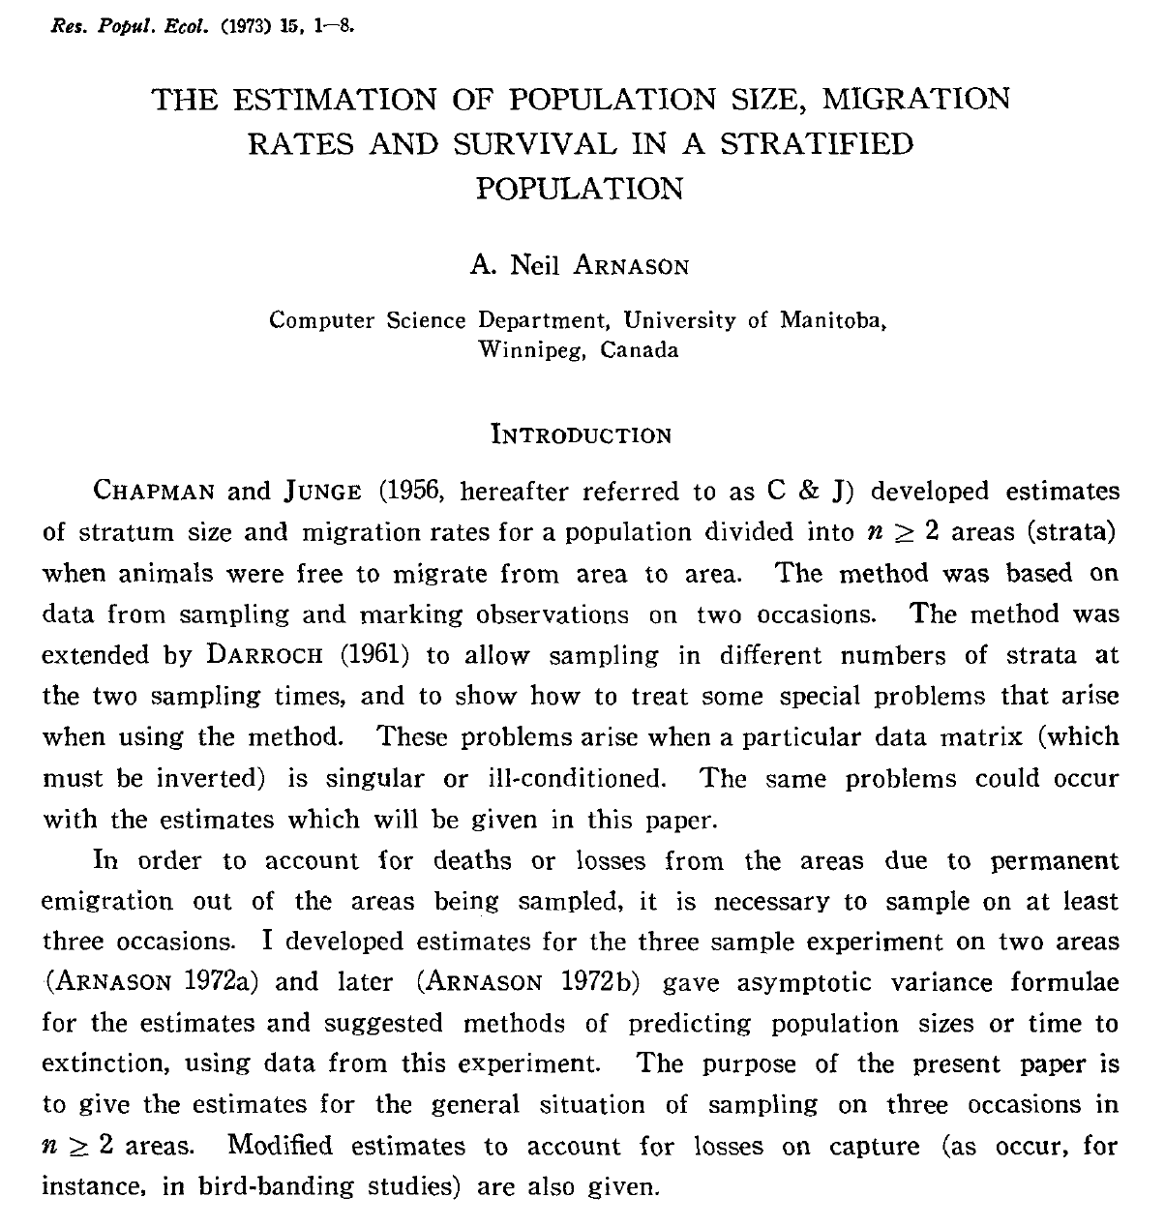
A bit of history

Slide 4
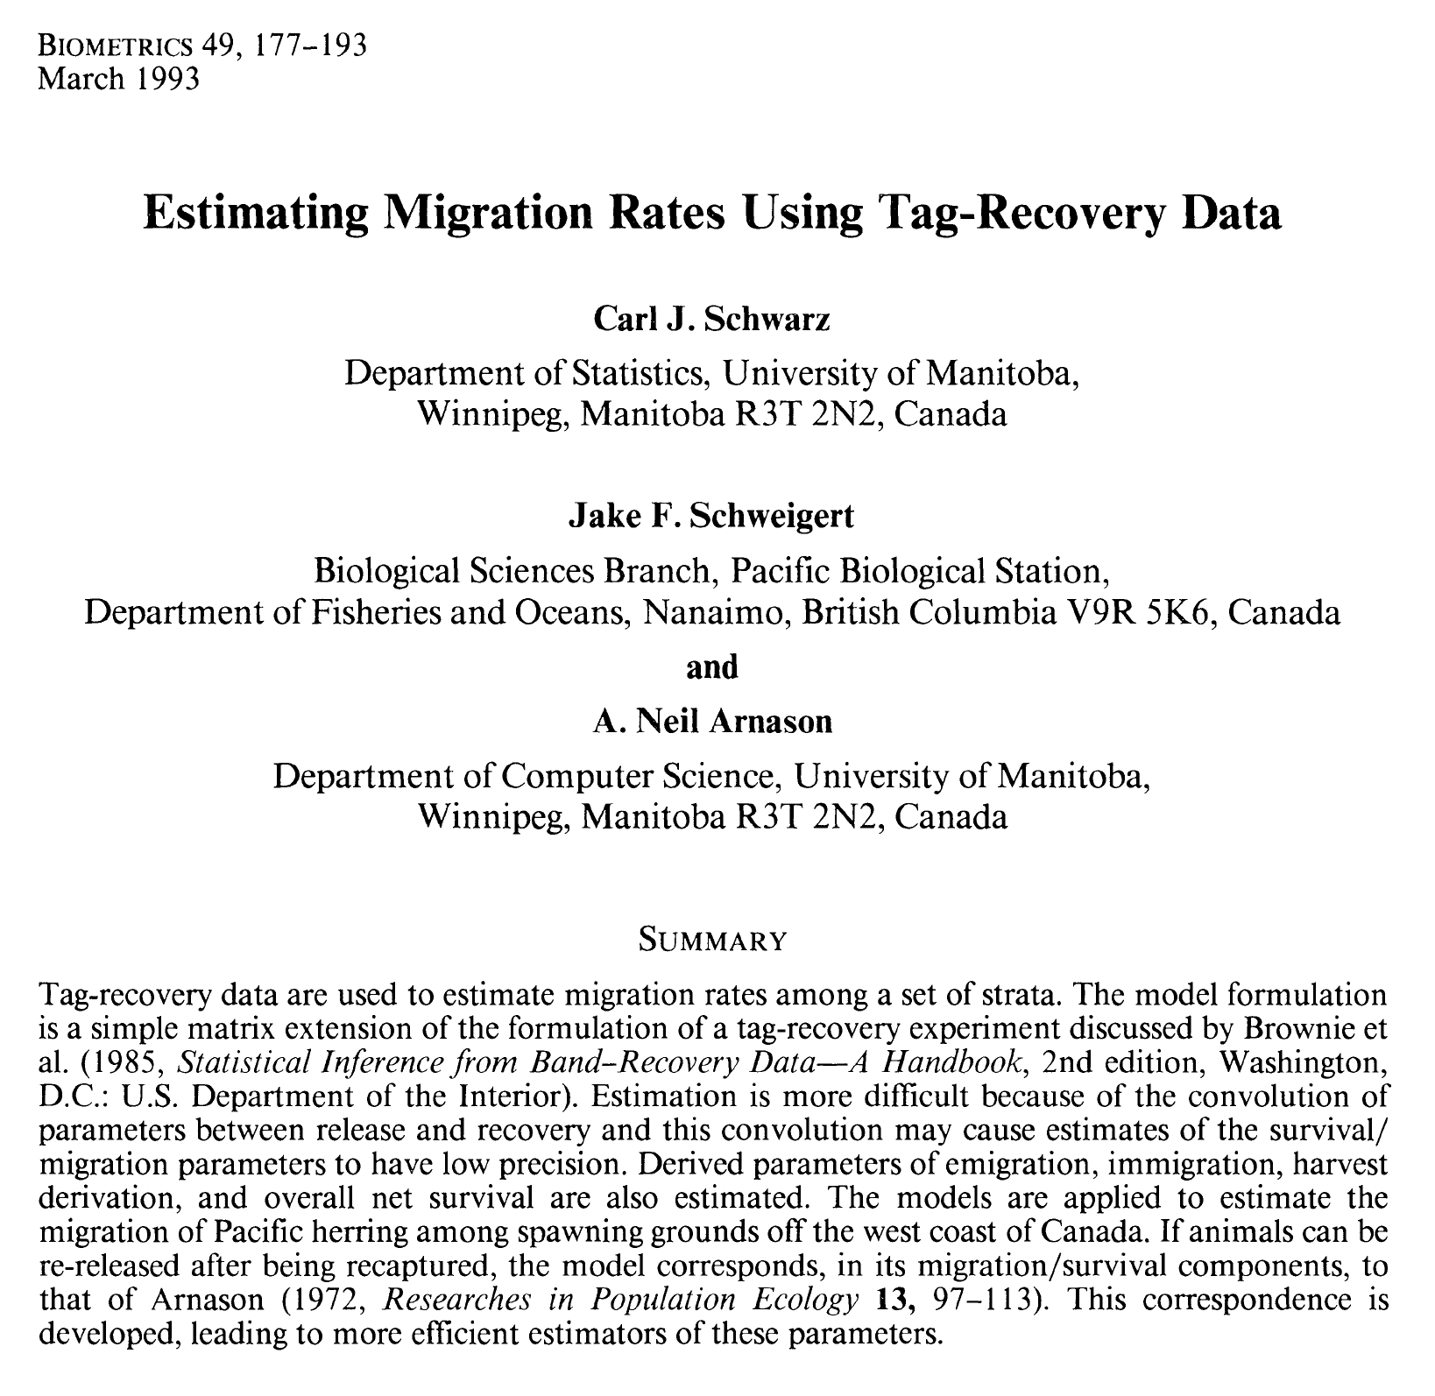
A bit of history

Slide 5
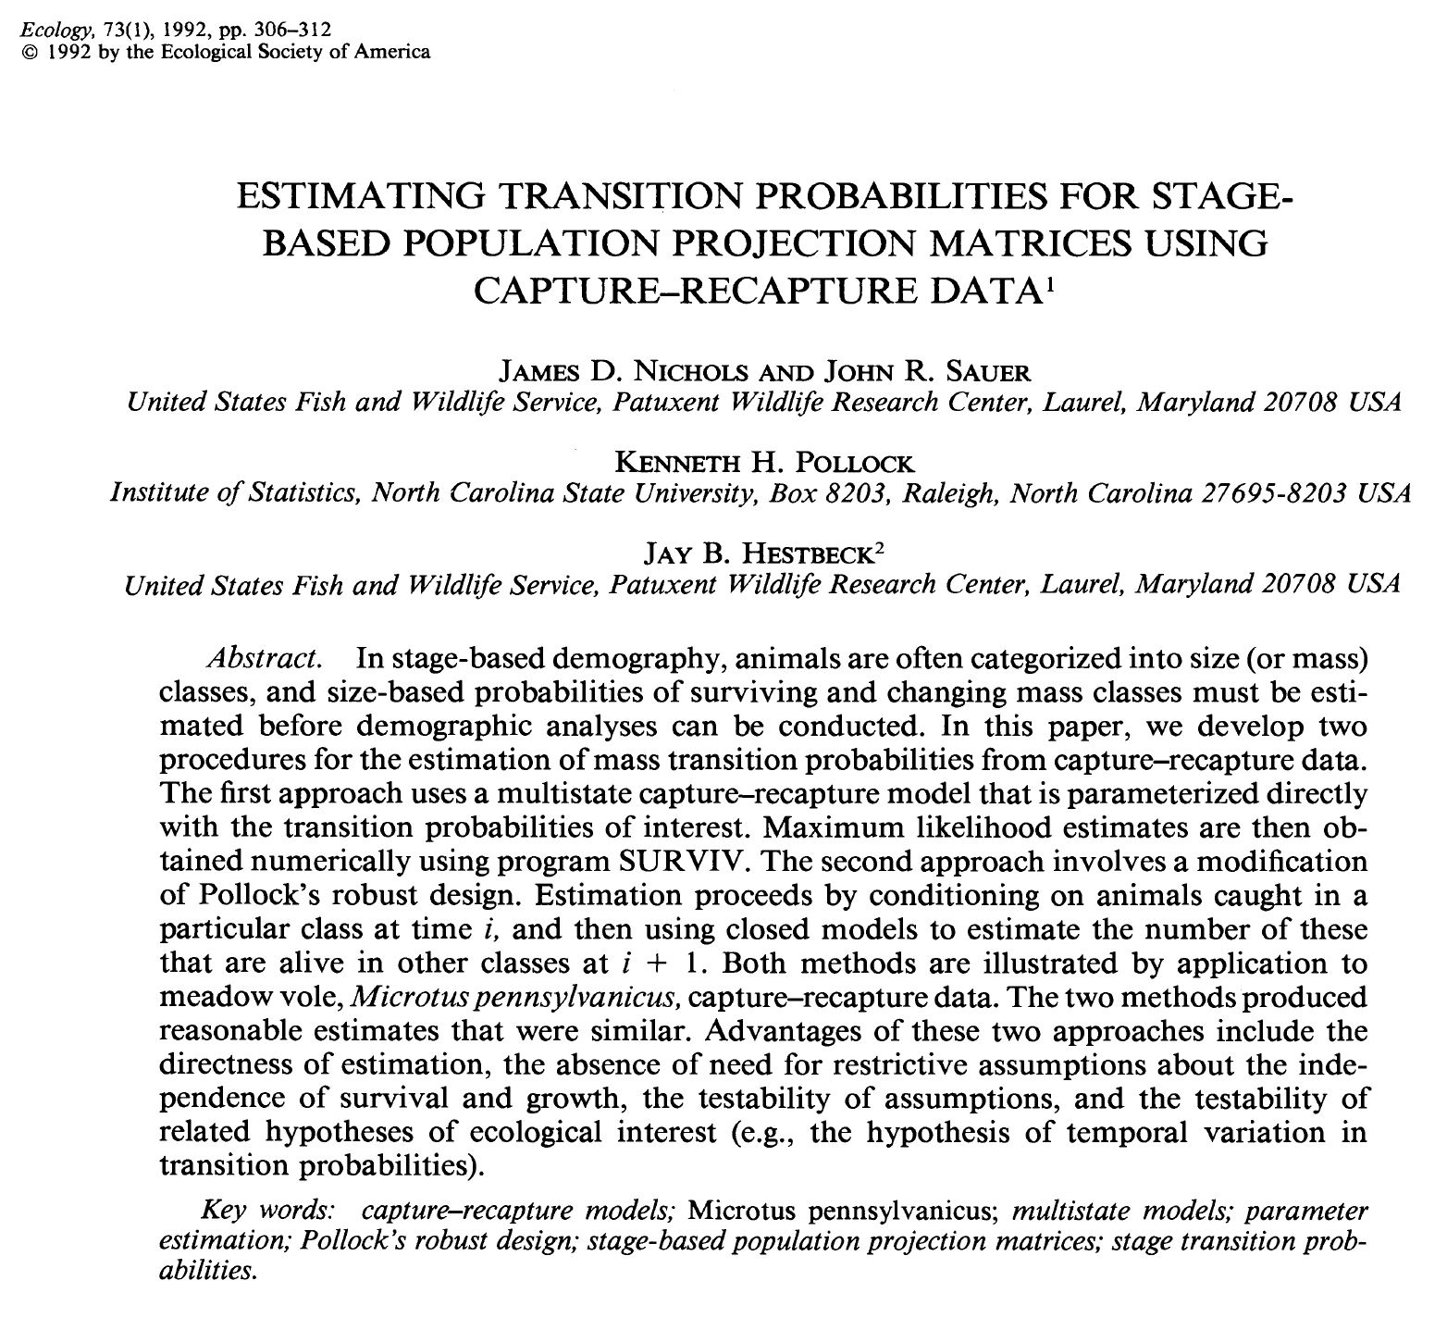
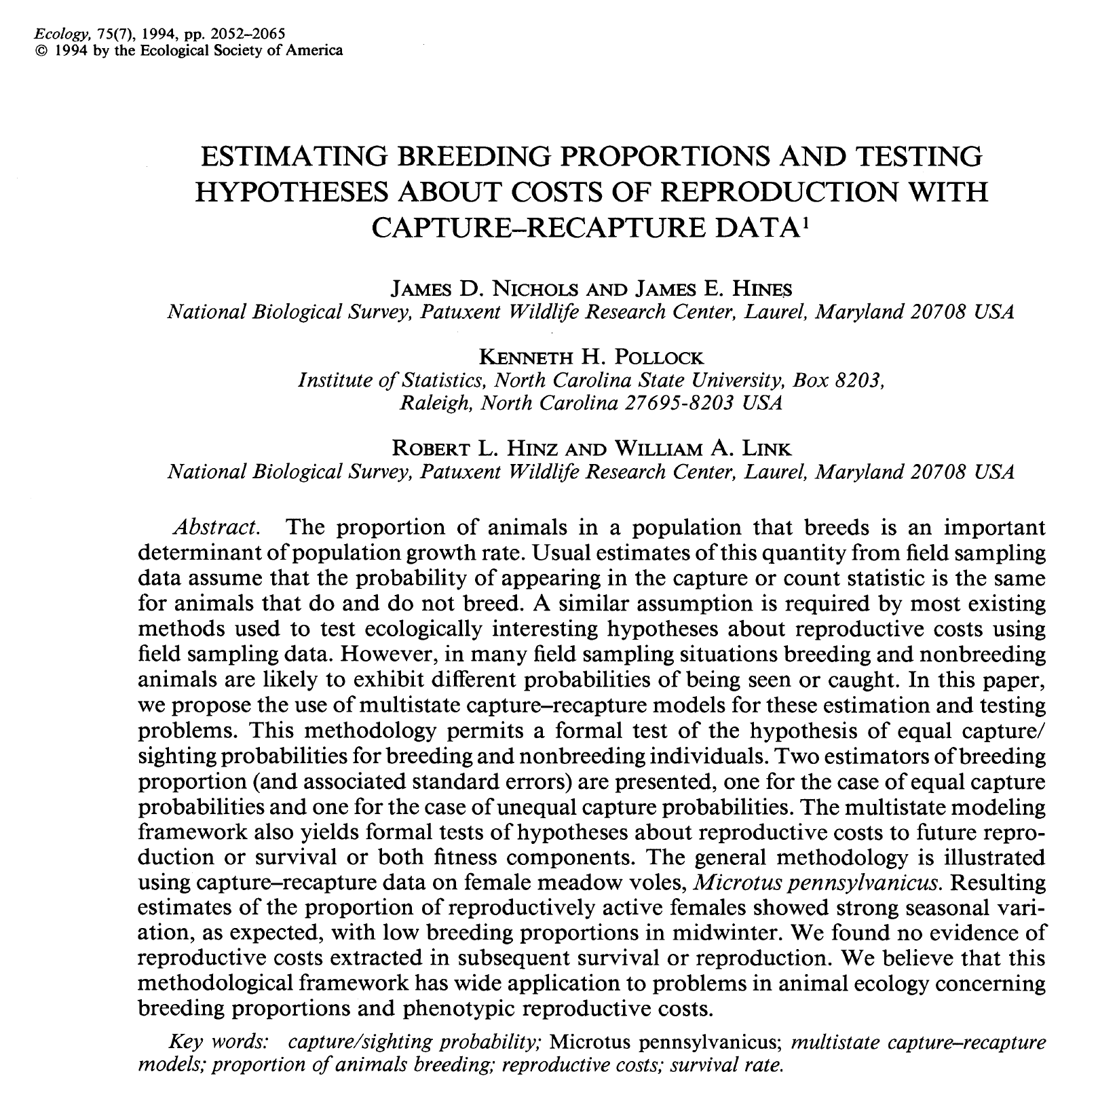
A bit of history

Slide 6
Conditional nature of the 2 processes
State process
Site A
Site B
Dead
Stochastic process
Deterministic process
Notes:
6
Note that at the occasion of release, there is no recapture possible and the state „alive“ is sure without uncertainty

Slide 7
Conditional nature of the 2 processes
State process
Site A
Site B
Dead
Seen at A
Seen at B
Not seen
Observation process
Stochastic process
Deterministic process
Notes:
7
Note that at the occasion of release, there is no recapture possible and the state „alive“ is sure without uncertainty

Slide 8
dead
site B
site A
State process
States at time t+1
site A
site B
dead
States at time t
Φ_{xy,t} is probability to be in state y at time t+1, given presence in state x at time t
Notes:
State dead needs to be included, because the transition matrices need to be row stochastic (sum of probabilities in a row is 1)

Slide 9
dead
site B
site A
State process
States at time t+1
site A
site B
dead
States at time t
Observation process
Observations at time t
Not seen
Seen at B
Seen at A
site A
site B
dead
States at time t
Notes:
State dead needs to be included, because the transition matrices need to be row stochastic (sum of probabilities in a row is 1)

Slide 10
State process
Site A
Site B
Dead
Notes:
10
Note that at the occasion of release, there is no recapture possible and the state „alive“ is sure without uncertainty

Slide 11
State process
dead
site B
site A
States at time t+1
Site A
Site B
Dead
site A
site B
dead
States at time t
Notes:
11
Note that at the occasion of release, there is no recapture possible and the state „alive“ is sure without uncertainty

Slide 12
State process
dead
site B
site A
States at time t+1
Site A
Site B
Dead
site A
site B
dead
States at time t
z_{i,t+1} is state of individual i at time t+1; either alive in site A, in site B or dead.
Notes:
12
Note that at the occasion of release, there is no recapture possible and the state „alive“ is sure without uncertainty

Slide 13
State process
dead
site B
site A
States at time t+1
Site A
Site B
Dead
site A
site B
dead
States at time t
BUGS language:
z_{i,t+1} is state of individual i at time t+1; either alive in site A, in site B or dead.
Notes:
13
Note that at the occasion of release, there is no recapture possible and the state „alive“ is sure without uncertainty

Slide 14
State process
dead
site B
site A
States at time t+1
Site A
Site B
Dead
site A
site B
dead
States at time t
BUGS language:
dcat() is categorical distribution = multinomial distribution with a single trial
Takes a vector of probabilities for each category as argument
Notes:
14
Note that at the occasion of release, there is no recapture possible and the state „alive“ is sure without uncertainty

Slide 15
Observation process
Site A
Site B
Dead
Seen at A
Seen at B
Not seen
Notes:
15
Note that at the occasion of release, there is no recapture possible and the state „alive“ is sure without uncertainty

Slide 16
Observation process
Observations at time t
Site A
Site B
Dead
Not seen
Seen at B
Seen at A
site A
site B
dead
States at time t
Seen at A
Seen at B
Not seen
Notes:
16
Note that at the occasion of release, there is no recapture possible and the state „alive“ is sure without uncertainty

Slide 17
Observation process
Observations at time t
Site A
Site B
Dead
Not seen
Seen at B
Seen at A
site A
site B
dead
States at time t
Seen at A
Seen at B
Not seen
y_{i,t} is observation of individual i at time t; either seen in site A, in site B or not seen.
Notes:
17
Note that at the occasion of release, there is no recapture possible and the state „alive“ is sure without uncertainty

Slide 18
Observation process
Observations at time t
Site A
Site B
Dead
Not seen
Seen at B
Seen at A
site A
site B
dead
States at time t
Seen at A
Seen at B
Not seen
BUGS language:
Notes:
18
Note that at the occasion of release, there is no recapture possible and the state „alive“ is sure without uncertainty

Slide 19
Usual re-parameterisation
Φ_{xy,t}: probability to be in state y at time t+1, given presence in state x at time t

Slide 20
Usual re-parameterisation
Φ_{xy,t}: probability to be in state y at time t+1, given presence in state x at time t
φ_{x}: probability to survive from time t to time t+1, given presence in state x at time t
ψ_{xy,t}: probability to move from state x to state y shortly before time t+1, given survival from time t to time t+1

Slide 21
Model implementation in JAGS
# Likelihood
for (i in 1:nind){
# Define latent state at first capture
z[i,f[i]] <- y[i,f[i]]
for (t in (f[i]+1):n.occasions){
# State process: draw S(t) given S(t-1)
z[i,t] ~ dcat(ps[z[i,t-1], i, t-1,])
# Observation process: draw O(t) given S(t)
y[i,t] ~ dcat(po[z[i,t], i, t-1,])
} #t
} #i
# Define state-transition and observation matrices
for (i in 1:nind){
# Define probabilities of state S(t+1) given S(t)
for (t in f[i]:(n.occasions-1)){
ps[1,i,t,1] <- phiA[t] * (1-psiAB[t])
ps[1,i,t,2] <- phiA[t] * psiAB[t]
ps[1,i,t,3] <- 1-phiA[t]
ps[2,i,t,1] <- phiB[t] * psiBA[t]
ps[2,i,t,2] <- phiB[t] * (1-psiBA[t])
ps[2,i,t,3] <- 1-phiB[t]
ps[3,i,t,1] <- 0
ps[3,i,t,2] <- 0
ps[3,i,t,3] <- 1
# Define probabilities of O(t) given S(t)
po[1,i,t,1] <- pA[t]
po[1,i,t,2] <- 0
po[1,i,t,3] <- 1-pA[t]
po[2,i,t,1] <- 0
po[2,i,t,2] <- pB[t]
po[2,i,t,3] <- 1-pB[t]
po[3,i,t,1] <- 0
po[3,i,t,2] <- 0
po[3,i,t,3] <- 1
} #t
} #i
# Priors and constraints
for (t in 1:(n.occasions-1)){
phiA[t] <- mean.phi[1]
phiB[t] <- mean.phi[2]
psiAB[t] <- mean.psi[1]
psiBA[t] <- mean.psi[2]
pA[t] <- mean.p[1]
pB[t] <- mean.p[2]
}
for (u in 1:2){
mean.phi[u] ~ dunif(0, 1) # Priors for mean state-spec. survival
mean.psi[u] ~ dunif(0, 1) # Priors for mean transitions
mean.p[u] ~ dunif(0, 1) # Priors for mean state-spec. recapture
}

Slide 22
Model implementation in JAGS
# Likelihood
for (i in 1:nind){
# Define latent state at first capture
z[i,f[i]] <- y[i,f[i]]
for (t in (f[i]+1):n.occasions){
# State process: draw S(t) given S(t-1)
z[i,t] ~ dcat(ps[z[i,t-1], i, t-1,])
# Observation process: draw O(t) given S(t)
y[i,t] ~ dcat(po[z[i,t], i, t-1,])
} #t
} #i

Slide 23
Model implementation in JAGS
# Likelihood
for (i in 1:nind){
# Define latent state at first capture
z[i,f[i]] <- y[i,f[i]]
for (t in (f[i]+1):n.occasions){
# State process: draw S(t) given S(t-1)
z[i,t] ~ dcat(ps[z[i,t-1], i, t-1,])
# Observation process: draw O(t) given S(t)
y[i,t] ~ dcat(po[z[i,t], i, t-1,])
} #t
} #i

Slide 24
Model implementation in JAGS
# Likelihood
for (i in 1:nind){
# Define latent state at first capture
z[i,f[i]] <- y[i,f[i]]
for (t in (f[i]+1):n.occasions){
# State process: draw S(t) given S(t-1)
z[i,t] ~ dcat(ps[z[i,t-1], i, t-1,])
# Observation process: draw O(t) given S(t)
y[i,t] ~ dcat(po[z[i,t], i, t-1,])
} #t
} #i

Slide 25
Model implementation in JAGS
# Likelihood
for (i in 1:nind){
# Define latent state at first capture
z[i,f[i]] <- y[i,f[i]]
for (t in (f[i]+1):n.occasions){
# State process: draw S(t) given S(t-1)
z[i,t] ~ dcat(ps[z[i,t-1], i, t-1,])
# Observation process: draw O(t) given S(t)
y[i,t] ~ dcat(po[z[i,t], i, t-1,])
} #t
} #i

Slide 26
Model implementation in JAGS
# Likelihood
for (i in 1:nind){
# Define latent state at first capture
z[i,f[i]] <- y[i,f[i]]
for (t in (f[i]+1):n.occasions){
# State process: draw S(t) given S(t-1)
z[i,t] ~ dcat(ps[z[i,t-1], i, t-1,])
# Observation process: draw O(t) given S(t)
y[i,t] ~ dcat(po[z[i,t], i, t-1,])
} #t
} #i

Slide 27
Model implementation in JAGS
# Likelihood
for (i in 1:nind){
# Define latent state at first capture
z[i,f[i]] <- y[i,f[i]]
for (t in (f[i]+1):n.occasions){
# State process: draw S(t) given S(t-1)
z[i,t] ~ dcat(ps[z[i,t-1], i, t-1,])
# Observation process: draw O(t) given S(t)
y[i,t] ~ dcat(po[z[i,t], i, t-1,])
} #t
} #i
Written generally, no changes needed, regardless model fitted

Slide 28
Model implementation in JAGS
# Define state-transition and observation matrices
for (i in 1:nind){
# Define probabilities of state S(t+1) given S(t)
for (t in f[i]:(n.occasions-1)){
ps[1,i,t,1] <- phiA[t] * (1-psiAB[t])
ps[1,i,t,2] <- phiA[t] * psiAB[t]
ps[1,i,t,3] <- 1-phiA[t]
ps[2,i,t,1] <- phiB[t] * psiBA[t]
ps[2,i,t,2] <- phiB[t] * (1-psiBA[t])
ps[2,i,t,3] <- 1-phiB[t]
ps[3,i,t,1] <- 0
ps[3,i,t,2] <- 0
ps[3,i,t,3] <- 1
# Define probabilities of O(t) given S(t)
po[1,i,t,1] <- pA[t]
po[1,i,t,2] <- 0
po[1,i,t,3] <- 1-pA[t]
po[2,i,t,1] <- 0
po[2,i,t,2] <- pB[t]
po[2,i,t,3] <- 1-pB[t]
po[3,i,t,1] <- 0
po[3,i,t,2] <- 0
po[3,i,t,3] <- 1
} #t
} #i
Define the structure of the multistate model

Slide 29
Model implementation in JAGS
# Define state-transition and observation matrices
for (i in 1:nind){
# Define probabilities of state S(t+1) given S(t)
for (t in f[i]:(n.occasions-1)){
ps[1,i,t,1] <- phiA[t] * (1-psiAB[t])
ps[1,i,t,2] <- phiA[t] * psiAB[t]
ps[1,i,t,3] <- 1-phiA[t]
ps[2,i,t,1] <- phiB[t] * psiBA[t]
ps[2,i,t,2] <- phiB[t] * (1-psiBA[t])
ps[2,i,t,3] <- 1-phiB[t]
ps[3,i,t,1] <- 0
ps[3,i,t,2] <- 0
ps[3,i,t,3] <- 1
# Define probabilities of O(t) given S(t)
po[1,i,t,1] <- pA[t]
po[1,i,t,2] <- 0
po[1,i,t,3] <- 1-pA[t]
po[2,i,t,1] <- 0
po[2,i,t,2] <- pB[t]
po[2,i,t,3] <- 1-pB[t]
po[3,i,t,1] <- 0
po[3,i,t,2] <- 0
po[3,i,t,3] <- 1
} #t
} #i
Define the structure of the multistate model

Slide 30
Model implementation in JAGS
# Define state-transition and observation matrices
for (i in 1:nind){
# Define probabilities of state S(t+1) given S(t)
for (t in f[i]:(n.occasions-1)){
ps[1,i,t,1] <- phiA[t] * (1-psiAB[t])
ps[1,i,t,2] <- phiA[t] * psiAB[t]
ps[1,i,t,3] <- 1-phiA[t]
ps[2,i,t,1] <- phiB[t] * psiBA[t]
ps[2,i,t,2] <- phiB[t] * (1-psiBA[t])
ps[2,i,t,3] <- 1-phiB[t]
ps[3,i,t,1] <- 0
ps[3,i,t,2] <- 0
ps[3,i,t,3] <- 1
# Define probabilities of O(t) given S(t)
po[1,i,t,1] <- pA[t]
po[1,i,t,2] <- 0
po[1,i,t,3] <- 1-pA[t]
po[2,i,t,1] <- 0
po[2,i,t,2] <- pB[t]
po[2,i,t,3] <- 1-pB[t]
po[3,i,t,1] <- 0
po[3,i,t,2] <- 0
po[3,i,t,3] <- 1
} #t
} #i
Define the structure of the multistate model

Slide 31
Model implementation in JAGS
# Priors and constraints
for (t in 1:(n.occasions-1)){
phiA[t] <- mean.phi[1]
phiB[t] <- mean.phi[2]
psiAB[t] <- mean.psi[1]
psiBA[t] <- mean.psi[2]
pA[t] <- mean.p[1]
pB[t] <- mean.p[2]
}
for (u in 1:2){
mean.phi[u] ~ dunif(0, 1)
mean.psi[u] ~ dunif(0, 1)
mean.p[u] ~ dunif(0, 1)
}
Define linear contraints on parameters & specify the needed priors

Slide 32
Model implementation in JAGS
# Priors and constraints
for (t in 1:(n.occasions-1)){
phiA[t] <- mean.phi[1]
phiB[t] <- mean.phi[2]
psiAB[t] <- mean.psi[1]
psiBA[t] <- mean.psi[2]
pA[t] <- mean.p[1]
pB[t] <- mean.p[2]
}
for (u in 1:2){
mean.phi[u] ~ dunif(0, 1)
mean.psi[u] ~ dunif(0, 1)
mean.p[u] ~ dunif(0, 1)
}
Define linear contraints on parameters & specify the needed priors

Slide 33
Model implementation in JAGS
# Priors and constraints
for (t in 1:(n.occasions-1)){
phiA[t] <- mean.phi[1]
phiB[t] <- mean.phi[2]
psiAB[t] <- mean.psi[1]
psiBA[t] <- mean.psi[2]
pA[t] <- mean.p[1]
pB[t] <- mean.p[2]
}
for (u in 1:2){
mean.phi[u] ~ dunif(0, 1)
mean.psi[u] ~ dunif(0, 1)
mean.p[u] ~ dunif(0, 1)
}
Define linear contraints on parameters & specify the needed priors

Slide 34


CJS models are multistate models w/ 2 states: alive and dead
# Define state-transition and observation matrices
for (i in 1:nind){
# Define probabilities of state S(t+1) given S(t)
for (t in f[i]:(n.occasions-1)){
ps[1,i,t,1] <- phi[t]
ps[1,i,t,2] <- 1 - phi[t]
ps[2,i,t,1] <- 0
ps[2,i,t,2] <- 1
# Define probabilities of O(t) given S(t)
po[1,i,t,1] <- p[t]
po[1,i,t,2] <- 1 - p[t]
po[2,i,t,1] <- 0
po[2,i,t,2] <- 1
} #t
} #i
$$\left[\begin{matrix}φ & 1−φ \\ 0 & 1\end{matrix}\right]$$
$$\left[\begin{matrix}p & 1−p \\ 0 & 1\end{matrix}\right]$$
Some code here: https://github.com/oliviergimenez/multievent_jags_R

Slide 35
Exercise 3

Slide 36
Multistate models are very flexible: some examples
1. Breeder vs. non-breeders
dead
non-br.
breeding
State-space likelihood
States at time t+1
breeding
non-breeding
dead
States at time t
Observations at time t
not seen
seen, non-br.
seen, br.
breeding
non-breeding
dead
States at time t
Notes:
36
Sometimes the non-breeders may not be seen. Then we have a model with an unobservable state (non-breeders).
Such a model has identifiability issues, namely that survival of breeders and non-breeders cannot be estimated seperately and that transitions much be Markovian (non-random).
The model is then also identical to a model for temporary emigration which we will see shortly

Slide 37
Multistate models are very flexible: some examples
2. Movement among 3 sites
,
States at time t+1
State process
States at time t
Notes:
37

Slide 38
Multistate models are very flexible: some examples
2. Movement among 3 sites
,
States at time t+1
State process
States at time t
Observations at time t
Observation process
States at time t
Notes:
38

Slide 39
Multistate models are very flexible: some examples
2. Movement among 3 sites
,
States at time t+1
State process
States at time t
The parameters ψ_{AB} and ψ_{AC} (as well as ψ_{BA} & ψ_{BC} and ψ_{CA} & ψ_{CB}) must be in the interval [0, 1] and their sum must be ≤ 1. Two possible options:
Multinomial logit link function (ch 10 Kéry & Schaub 2012, Guéry et al. 2018)
Dirichlet prior (ch 10 Kéry & Schaub 2012)
Notes:
39

Slide 40
dead
breeder
2y NB
1y NB
juvenile
Multistate models are very flexible: some examples
3. Access to reproduction
States at time t+1
State process
juvenile
1y NB
2y NB
breeder
dead
States at time t
Notes:
40
Key question: in which age start the individuals with reproduction. What is the mean age at first reproduction?
Here is a model where we assume that at age 3 all reproduce. These models need such a constraint (age at which all reproduce). But this is not really restrictive, since it is always possible to include many age classes.
Observation model: here we assume that p are different for the first time and experienced breeders.
Model can only include individuals of known age.

Slide 41
dead
breeder
2y NB
1y NB
juvenile
Multistate models are very flexible: some examples
3. Access to reproduction
States at time t+1
State process
juvenile
1y NB
2y NB
breeder
dead
States at time t
Observations at time t
not seen
seen, breeder
seen, 2y NB
seen, 1y NB
Observation process
juvenile
1y NB
2y NB
breeder
dead
States at time t
Notes:
41
Key question: in which age start the individuals with reproduction. What is the mean age at first reproduction?
Here is a model where we assume that at age 3 all reproduce. These models need such a constraint (age at which all reproduce).
But this is not really restrictive, since it is always possible to include many age classes.
Observation model: here we assume that p are different for the first time and experienced breeders.
Model can only include individuals of known age.

Slide 42
Multistate models are very flexible: some examples
4. Temporary emigration
Notes:
42

Slide 43
Multistate models are very flexible: some examples
4. Temporary emigration
dead
outside
inside
States at time t+1
State process
inside
outside
dead
States at time t
Notes:
43

Slide 44
Multistate models are very flexible: some examples
4. Temporary emigration
dead
outside
inside
States at time t+1
State process
inside
outside
dead
States at time t
Observations at time t
Observation process
Not seen
Seen
inside
outside
dead
States at time t
Notes:
44

Slide 45
Multistate models are very flexible: some examples
5. Immediate trap response
Notes:
45

Slide 46
Multistate models are very flexible: some examples
5. Immediate trap response
dead
a, not s
a, seen
States at time t+1
State process
alive, seen
alive, not seen
dead
States at time t
Notes:
46

Slide 47
Multistate models are very flexible: some examples
5. Immediate trap response
dead
a, not s
a, seen
States at time t+1
State process
alive, seen
alive, not seen
dead
States at time t
Observations at time t
Observation process
Not seen
Seen
alive, seen
alive, not seen
dead
States at time t
Notes:
47

Slide 48
Multistate models are very flexible: some examples
6. Combination of life and dead encounters
Notes:
48

Slide 49
Multistate models are very flexible: some examples
6. Combination of life and dead encounters
States at time t+1
dead
rec. dead
alive
State process
alive
recently dead
dead
States at time t
Notes:
49

Slide 50
Multistate models are very flexible: some examples
6. Combination of life and dead encounters
States at time t+1
dead
rec. dead
alive
State process
alive
recently dead
dead
States at time t
Observations at time t
not seen
recovered
seen
Observation process
alive
rec. dead
dead
States at time t
Notes:
50

Slide 51
Multievent models
Is a multistate model that allows for state assignment errors (state uncertainty)
All capture-recapture models introduced so far can be seen as a special case of a multievent model
Most general capture-recapture model
Seminal paper: Pradel (2005), Biometrics
We need a model of state assignment at the first encounter
Additional parameters (state assignment probabilities)
Ecological examples:
Sex assignment uncertainty (Pradel et al. 2008, Can. J. Stat.)
Disease status uncertainty (Cooch & Conn 2009, J. Appl. Ecol.)
Memory models (Rouan et al. 2009, JABES)
Heterogeneity / finite mixtures (Gimenez et al. 2018, Oikos)
Notes:
51
- Problem of memory models: It is possible that the state is unknown because it has not been observed.

Slide 52
Conditional nature of the 2 processes
State process
State 1
State 2
Dead
Stochastic process
Deterministic process
Notes:
52
Initial state is uncertain.
Yet, the model is still conditional on first capture (i.e. it is sure that the individual is captured, but the state might have been recorded wrongly).
After first capture, the observation process contains 2 kinds of uncertainty: first the individual may or may not be recaptured, and, given recapture, ist state may or may not be recorded correctly.
Therefore the stochastic process is different (at first capture it is simpler and consists just of the state assignment error).

Slide 53
Conditional nature of the 2 processes
State process
State 1
State 2
Dead
Seen 1
Seen 2
Not seen
Observation process
Stochastic process
Deterministic process
Notes:
53
Initial state is uncertain.
Yet, the model is still conditional on first capture (i.e. it is sure that the individual is captured, but the state might have been recorded wrongly).
After first capture, the observation process contains 2 kinds of uncertainty: first the individual may or may not be recaptured, and, given recapture, ist state may or may not be recorded correctly.
Therefore the stochastic process is different (at first capture it is simpler and consists just of the state assignment error).

Slide 54
At first encounter
Initial state probability
dead
state 2
state 1
States at first encounter
Notes:
Explain parameters:
Pi: prob. to be in state 2 at first encounter
Beta1: prob. to correctly assign an indiv. that is in state 1 to state 1
Beta2: prob. to correctly assign an indiv. that is in state 2 to state 2

Slide 55
At first encounter
Initial state probability
dead
state 2
state 1
States at first encounter
State assignment
Observations at first encounter
not seen
seen at 2
seen at 1
state 1
state 2
dead
States at first encounter
Notes:
Explain parameters:
Pi: prob. to be in state 2 at first encounter
Beta1: prob. to correctly assign an indiv. that is in state 1 to state 1
Beta2: prob. to correctly assign an indiv. that is in state 2 to state 2

Slide 56
After first encounter
dead
state 2
state 1
States at time t+1
State process
state 1
state 2
dead
States at time t

Slide 57
After first encounter
dead
state 2
state 1
States at time t+1
State process
state 1
state 2
dead
States at time t
not seen
seen at 2
seen at 1
Observation process
Observations at time t
state 1
state 2
dead
States at time t

Slide 58
An example: uncertain disease status
If an individual is seen that does not have the disease, we will never diagnose that the individual is infected.
Yet, we may fail to diagnose the disease in infected individuals.
Interest: disease dependent survival
Disease state dynamics
States:
Alive, without disease (Alive -)
Alive, with disease (Alive +)
Dead
Observations:
Seen, no disease recorded (Seen -)
Seen, disease recorded (Seen +)
Not seen

Slide 59
At first encounter
Dead
Alive +
Alive -
Initial state probability
Disease state:
π: Probability of being infected at first encounter

Slide 60
At first encounter
Dead
Alive +
Alive -
Initial state probability
Disease state:
π: Probability of being infected at first encounter
BUGS language:

Slide 61
At first encounter
Observations at first encounter
State assignment
Not seen
Seen +
Seen -
Alive -
Alive +
Dead
States at first encounter
β: Probability of not diagnosing the disease

Slide 62
At first encounter
Observations at first encounter
State assignment
Not seen
Seen +
Seen -
Alive -
Alive +
Dead
States at first encounter
β: Probability of not diagnosing the disease
BUGS language:

Slide 63
Dead
Alive +
Alive -
After first encounter
State process
States at time t+1
Alive -
Alive +
Dead
States at time t
φ_{H}: survival probability of healthy individuals
φ_{D}: survival probability of individuals infected with the disease
ψ_{HD}: infection probability
ψ_{DH}: recovery probability (probability to become healthy)
Notes:
63

Slide 64
Dead
Alive +
Alive -
After first encounter
State process
States at time t+1
Alive -
Alive +
Dead
States at time t
φ_{H}: survival probability of healthy individuals
φ_{D}: survival probability of individuals infected with the disease
ψ_{HD}: infection probability
ψ_{DH}: recovery probability (probability to become healthy)
BUGS language:
Notes:
64

Slide 65
After first encounter
Not seen
Seen +
Seen -
Observation process
Observations at time t
Alive -
Alive +
Dead
States at time t
p_{H}: probability to encounter a healthy individual
p_{D}: probability to encounter an individual infected with the disease
β: Probability of not diagnosing the disease
Notes:
65

Slide 66
After first encounter
Not seen
Seen +
Seen -
Observation process
Observations at time t
Alive -
Alive +
Dead
States at time t
p_{H}: probability to encounter a healthy individual
p_{D}: probability to encounter an individual infected with the disease
β: Probability of not diagnosing the disease
BUGS language:
Notes:
66

Slide 67
Exercise 4

Slide 68
Bonus

Slide 69
Multistate models are very flexible: some examples
1. Age-dependent survival
State-space likelihood
dead
adult
juvenile
States at time t+1
juvenile
adult
dead
State process
States at time t
Observations at time t
Not recapt.
Recapt. as ad
Recap. as juv
juvenile
adult
dead
Observation
process
States at time t
Notes:
69
Model is described in the appendix of BPA
If the data set includes only individuals that are marked as juv., then the observation states could consist only of „seen“ and „not seen“

Slide 70
Multinomial model for multistate capture-recapture data
As for single state capture-recapture, we can summarize multistate capture-recapture data in multistate m-array format
Data analysed using the multinomial likelihood

Slide 71
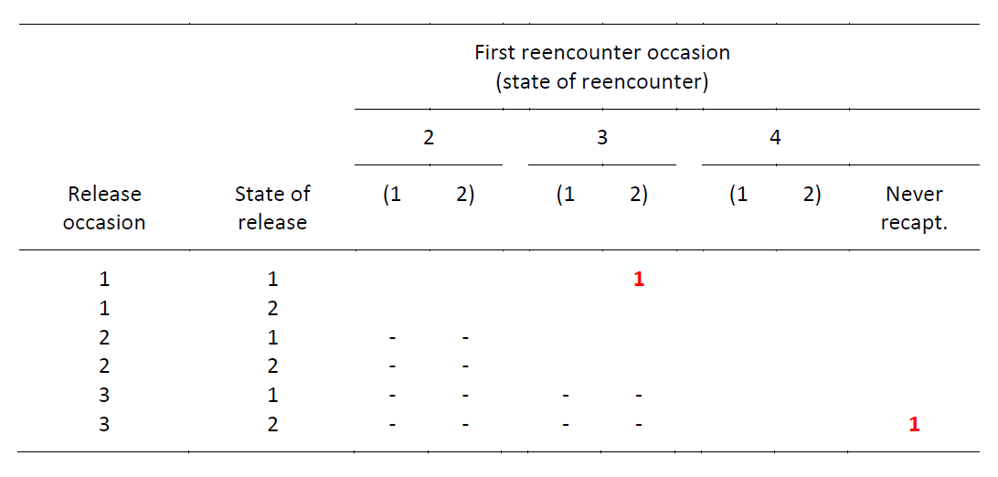
Multinomial model for multistate capture-recapture data
From the capture-histories to the m-array data format
Multistate capture histories
1 0 2 0
2 2 0 0
1 0 2 1
0 1 0 0
Multistate m-array

Slide 72
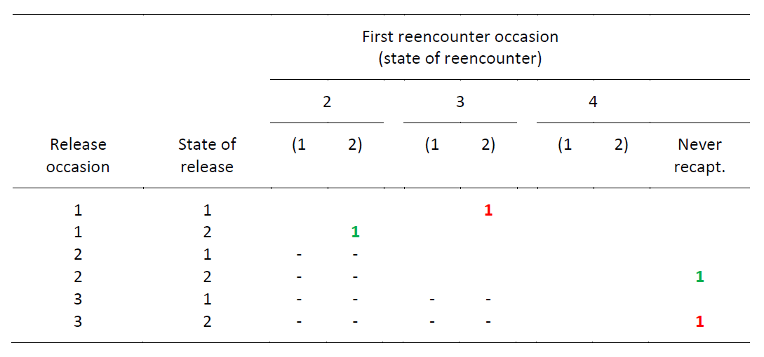
Multinomial model for multistate capture-recapture data
From the capture-histories to the m-array data format
Multistate capture histories
1 0 2 0
2 2 0 0
1 0 2 1
0 1 0 0
Multistate m-array

Slide 73
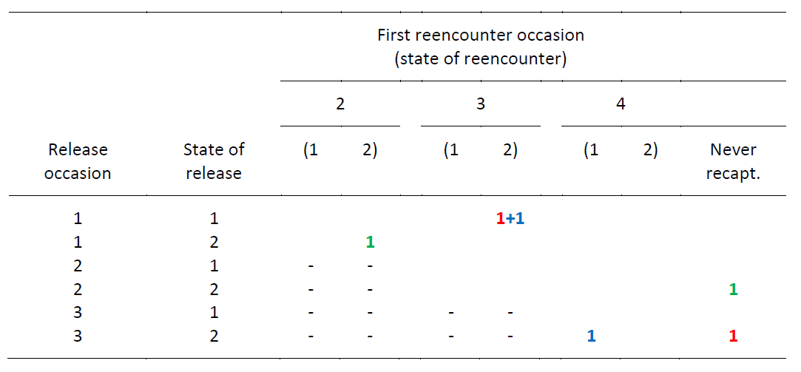
Multinomial model for multistate capture-recapture data
From the capture-histories to the m-array data format
Multistate capture histories
1 0 2 0
2 2 0 0
1 0 2 1
0 1 0 0
Multistate m-array

Slide 74
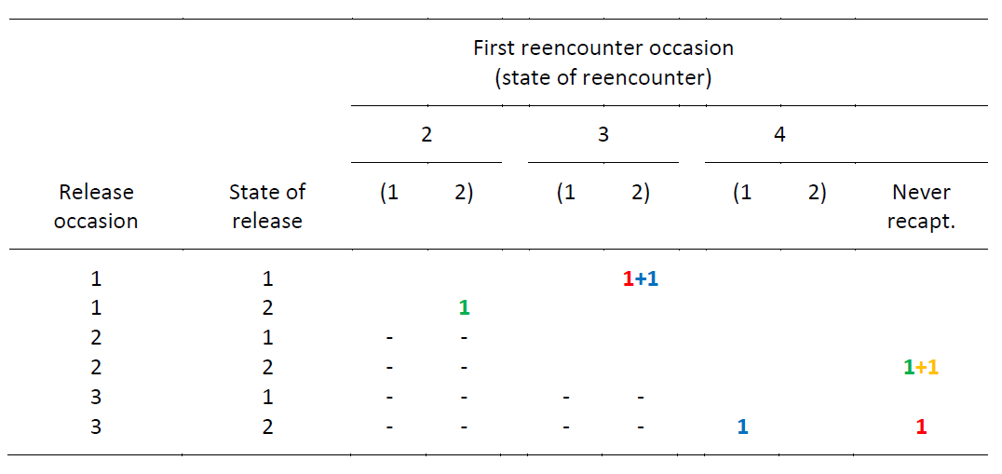
Multinomial model for multistate capture-recapture data
From the capture-histories to the m-array data format
Multistate capture histories
1 0 2 0
2 2 0 0
1 0 2 1
0 2 0 0
Multistate m-array

Slide 75
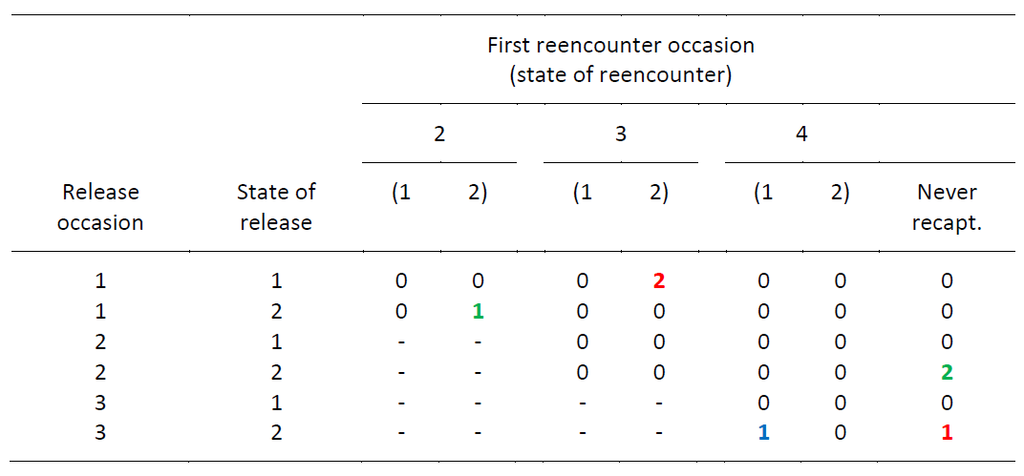
Multinomial model for multistate capture-recapture data
From the capture-histories to the m-array data format
Multistate capture histories
1 0 2 0
2 2 0 0
1 0 2 1
0 2 0 0
Multistate m-array

Slide 76
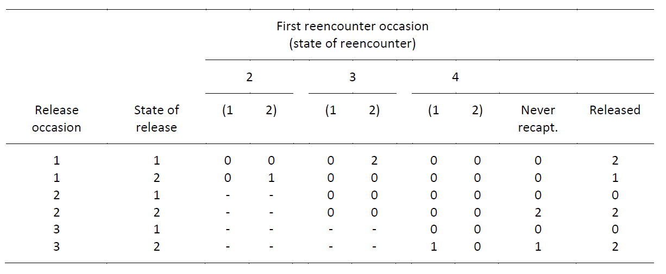
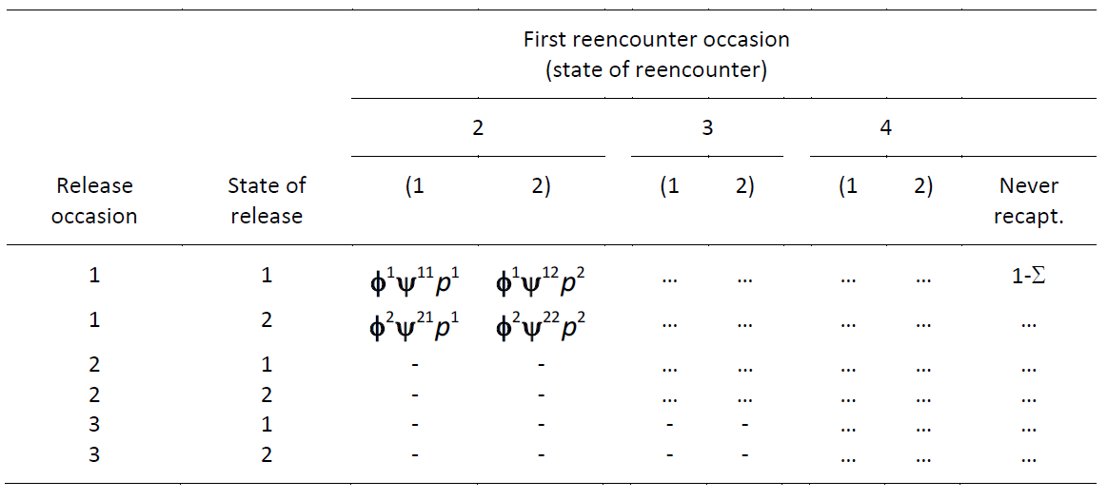

Slide 78
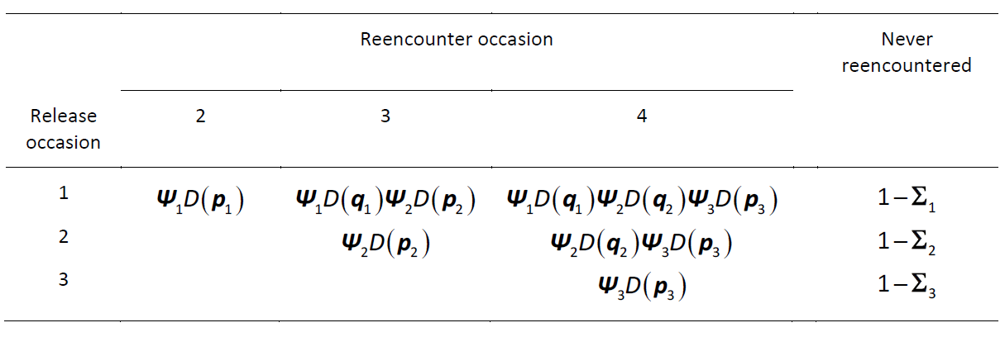
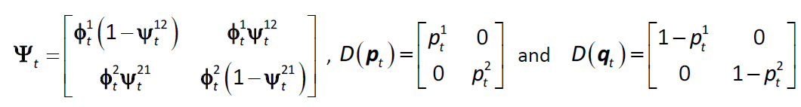
How to write the probabilities of the multistate m-array?

Slide 79
Comparison of approaches
State-space likelihood
Very intuitive, very flexible modelling
State transition matrix must include the death state
Observation matrix must include the observation not seen
Rows of transition and observation matrices must sum to 1
Computationally demanding
Multinomial likelihood
Reduced flexibility in modelling (no individual random effects)
The definition of transition matrix and of recapture vector very similar to the corresponding definitions in MARK or E-SURGE
Computational advantages (shorter run-time, faster convergence)

