Slide 1
Local minima and capture-recapture models
Olivier Gimenez

Slide 2
Multistate capture-recapture models
Individual data on marked animals/plants
Repeated sampling in time
Survival, movement between states
States = sites, breeding, disease, behavior
Individual detectability < 1, heterogeneous
Lebreton, J.-D., Nichols, J.D., Barker, R.J., Pradel, R. & Spendelow, J.A. (2009) Modeling Individual Animal Histories with Multistate Capture-Recapture Models. Advances In Ecological Research, 41, 87–173.

Slide 3
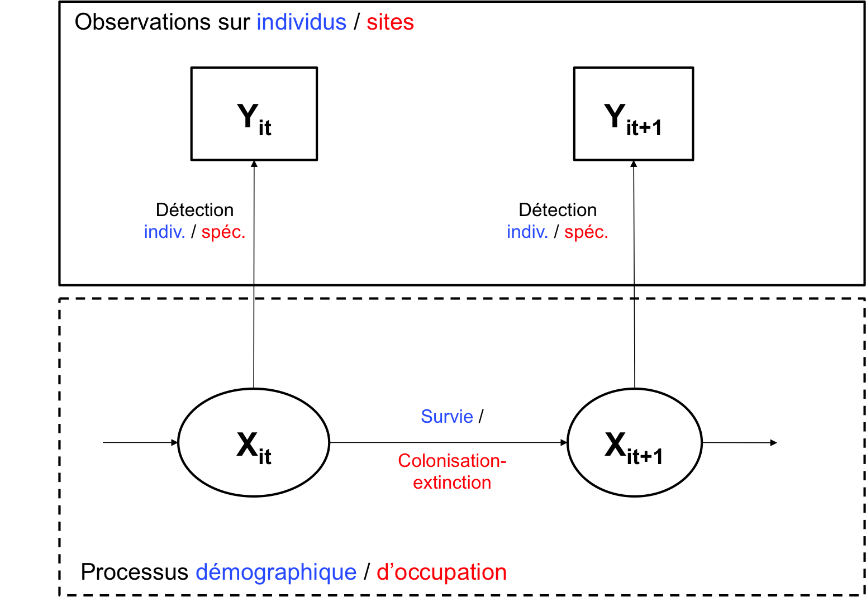
CR models are hierarchical
Gimenez, O., Lebreton, J.-D., Gaillard, J.-M., Choquet, R. & Pradel, R. (2012) Estimating demographic parameters using hidden process dynamic models. TPB, 82, 307–316.
Gimenez, O., Rossi, V., Choquet, R., Dehais, C., Doris, B., Varella, H., Vila, J.-P. & Pradel, R. (2007) State-space modelling of data on marked individuals. Ecol Mod, 206, 431–438.

Slide 4
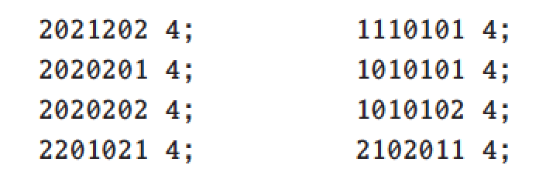
Simulated data
2 states, 7 occasions
Survival = 1, detection = 0.6
Transition 1 -> 2 = 0.6
Transition 2 -> 1 = 0.85
Courtesy of J. Dupuis; cf. Gimenez, O., Choquet, R., Lamor, L., Scofield, P., Fletcher, D., Lebreton, J.-D. & Pradel, R. (2005) Efficient profile-likelihood confidence intervals for capture-recapture models. Journal of Agricultural, Biological, and Environmental Statistics, 10, 184–196.

Slide 5
Deviance as a function of transition 2->1

Slide 6
Initial values lead to local minimum

Slide 7
Initial values lead to global minimum

Slide 8
Influence of link function?
Ψ¹² = 0.6; Ψ²¹ = 0.85

Slide 9
Influence of link function?
Sin link function: Ψ¹² = 0.25; Ψ²¹ = 0.34 !
E. Cooch, G. White 2012, Gentle introduction to MARK, ch 9
Ψ¹² = 0.6; Ψ²¹ = 0.85

Slide 10
Influence of link function?
Sin link function: Ψ¹² = 0.25; Ψ²¹ = 0.34 !
Logit link function: Ψ¹² = 0.60; Ψ²¹ = 0.84
E. Cooch, G. White 2012, Gentle introduction to MARK, ch 9
Ψ¹² = 0.6; Ψ²¹ = 0.85

Slide 11
BFGS vs. simulated annealing
Sin link function BFGS: Ψ¹² = 0.25; Ψ²¹ = 0.34
E. Cooch, G. White 2012, Gentle introduction to MARK, ch 9
Ψ¹² = 0.6; Ψ²¹ = 0.85

Slide 12
BFGS vs. simulated annealing
Sin link function BFGS: Ψ¹² = 0.25; Ψ²¹ = 0.34
Sin link function SA: Ψ¹² = 0.60; Ψ²¹ = 0.84
E. Cooch, G. White 2012, Gentle introduction to MARK, ch 9
Ψ¹² = 0.6; Ψ²¹ = 0.85

Slide 13
BFGS vs. simulated annealing
Sin link function BFGS: Ψ¹² = 0.25; Ψ²¹ = 0.34
Sin link function SA: Ψ¹² = 0.60; Ψ²¹ = 0.84
But: SA is much (much) slower than BFGS
E. Cooch, G. White 2012, Gentle introduction to MARK, ch 9
Ψ¹² = 0.6; Ψ²¹ = 0.85

Slide 14
MCMC
detection = 0.6; Ψ²¹ = 0.85

Slide 15
MCMC
detection = 0.6; Ψ²¹ = 0.85

Slide 16
Implementation
Mark called from R using package Rmark
Jags called from R using package R2jags
Code and slides available on GitHub:
https://github.com/oliviergimenez/multistate_local_minima

Slide 17
Ongoing work
Local minima in dynamic occupancy models?

Slide 18
CR models are hierarchical
Gimenez, O., Lebreton, J.-D., Gaillard, J.-M., Choquet, R. & Pradel, R. (2012) Estimating demographic parameters using hidden process dynamic models. TPB, 82, 307–316.
Gimenez, O., Rossi, V., Choquet, R., Dehais, C., Doris, B., Varella, H., Vila, J.-P. & Pradel, R. (2007) State-space modelling of data on marked individuals. Ecol Mod, 206, 431–438.

Slide 19
Occupancy models are hierarchical
Gimenez, O., Blanc, L., Besnard, A., Pradel, R., Doherty, P.F., Marboutin, E. & Choquet, R. (2014) Fitting occupancy models with E-SURGE: Hidden Markov modelling of presence-absence data. Methods in Ecology and Evolution, 5, 592–597.

Slide 20
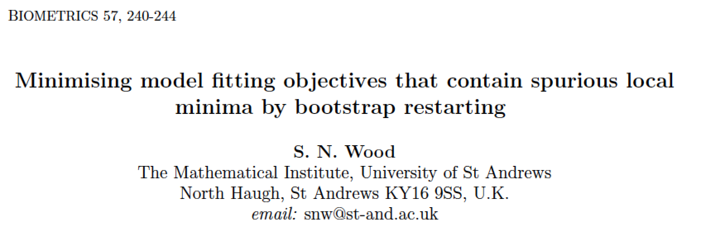
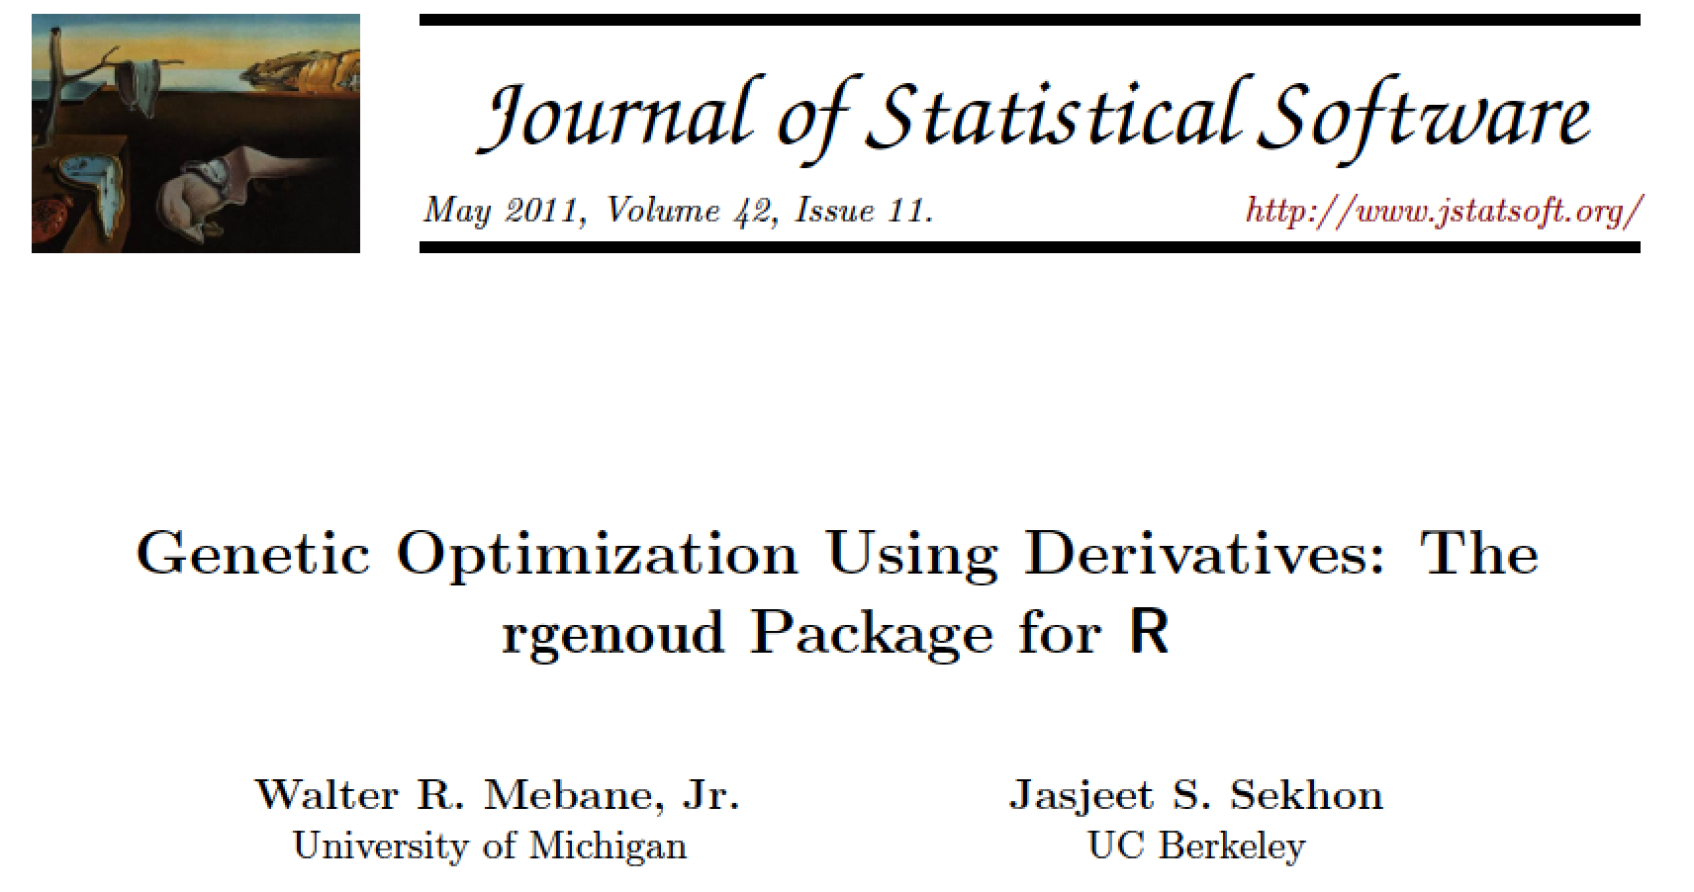
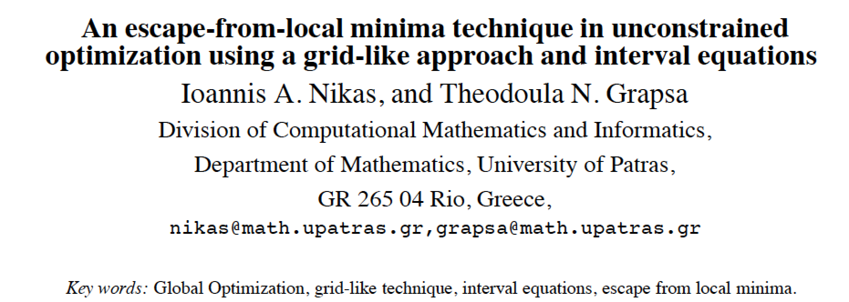
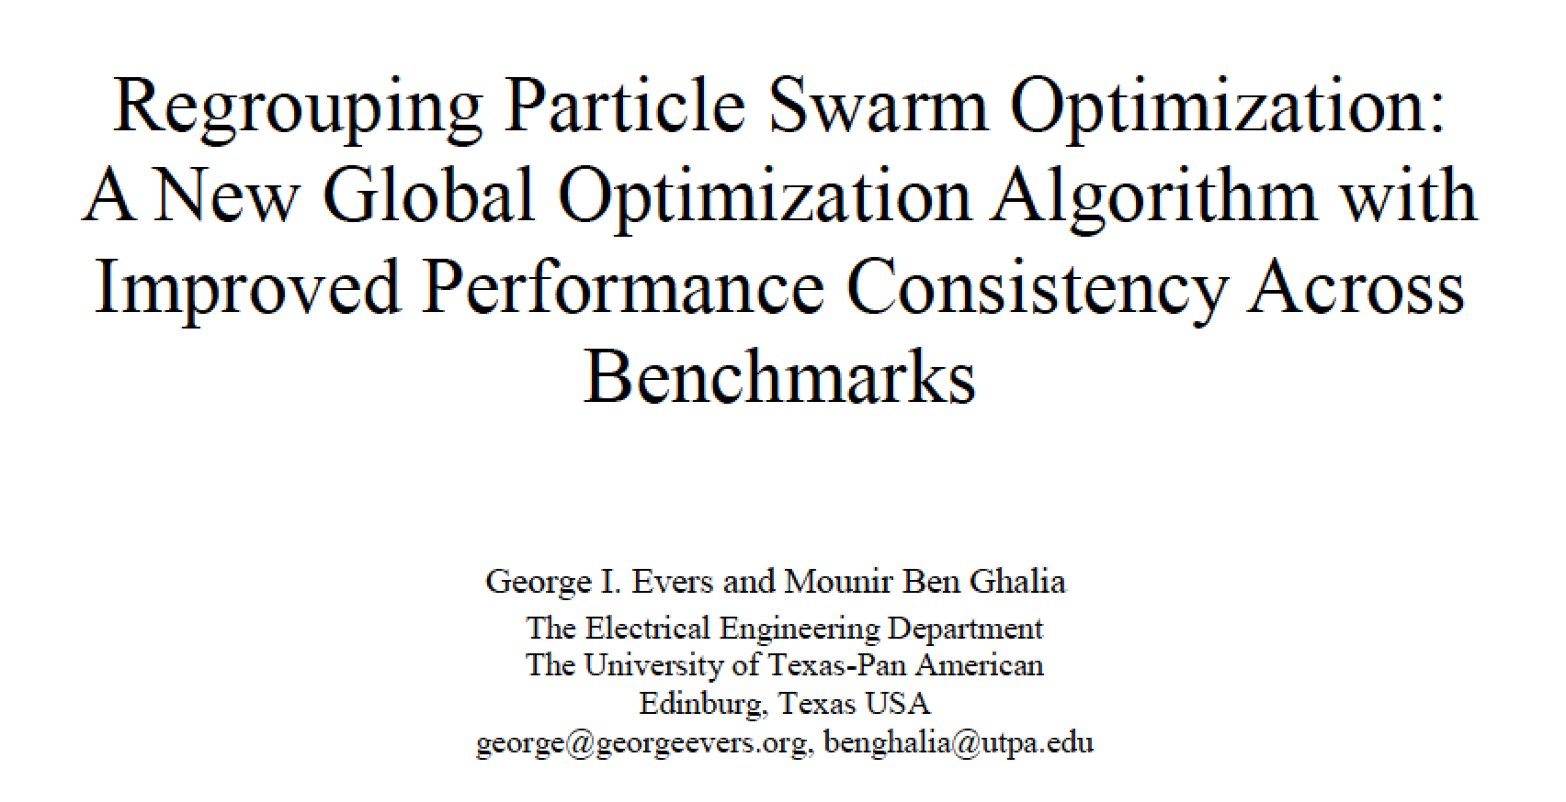
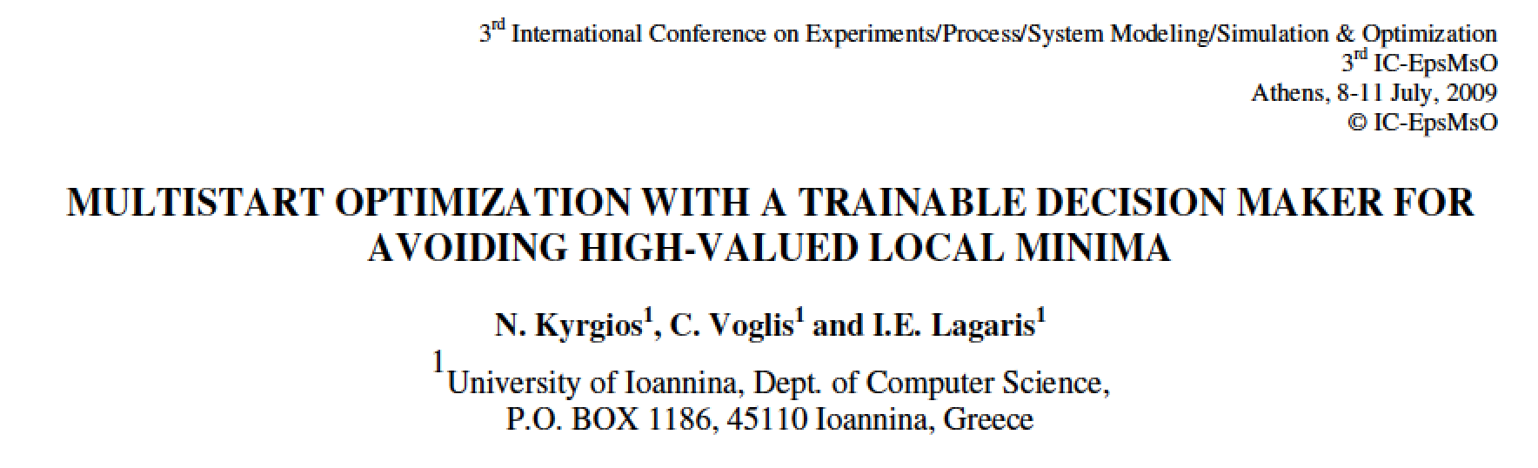
Explore other avenues…

