Slide 1
Customer Retention Analysis
Here are some import points we are going to discuss in the analysis
Problem statement
Problem definition
Data analysis
Model Building

Slide 2
Problem statement
Customer satisfaction has emerged as one of the most important factors that guarantee the success of online store; it has been posited as a key stimulant of purchase, repurchase intentions and customer loyalty. A comprehensive review of the literature, theories and models have been carried out to propose the models for customer activation and customer retention. Five major factors that contributed to the success of an e-commerce store have been identified as: service quality, system quality, information quality, trust and net benefit. The research furthermore investigated the factors that influence the online customers repeat purchase intention. The combination of both utilitarian value and hedonistic values are needed to affect the repeat purchase intention (loyalty) positively. The data is collected from the Indian online shoppers. Results indicate the e-retail success factors, which are very much critical for customer satisfaction.

Slide 3
Problem Definition
The customer common retention in the competitive markets as the customers naturally tend to choose the firms which offers a reasonable deal and ditch the ones which doesn’t. The companies do not want to lose customers as bringing the new lot would cost extra as it takes a lot for advertising. In order to keep the firm from losing money, they’ll have to retain customers as much as possible. The following problem is to check the factors that make the customer to stay loyalty and we’ll have to analyse the factors given to come up with a feasible solution possible to retain the customers.

Slide 4
Data Analysis
The data is collected from the Indian online shoppers. Results indicate the e-retails success factors, which are very much critical for customer satisfaction.
There are 44 independent variable which are like factors influencing the customer intention and boost to repeat the purchase with the same company.
I first extract the encoded data from the excel sheet which I will be using for numerical analysis and loaded it on the Jupiter Netbook. The data was in excel format so I converted into csv format(comma-separated values).

Slide 5
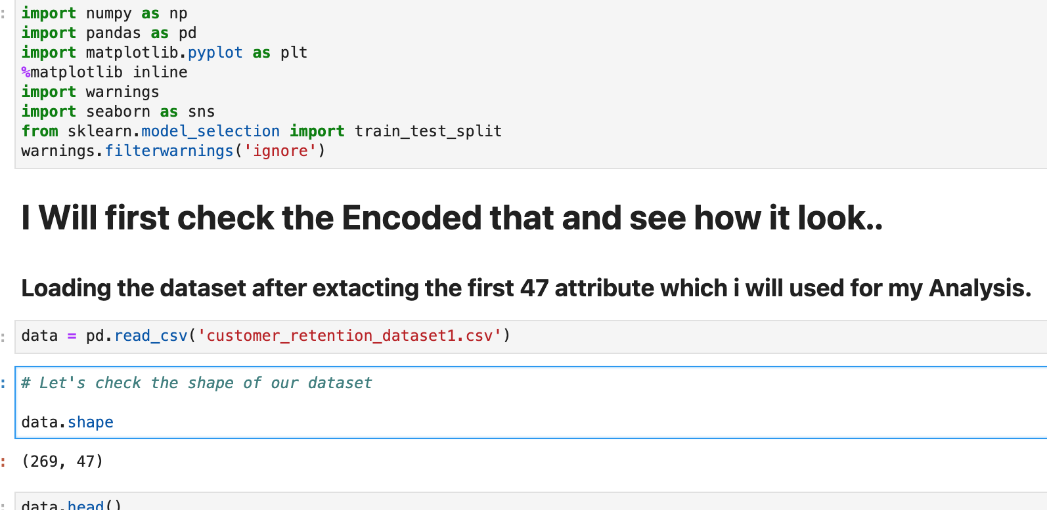
Loading the data

Slide 6
Checking the shape and null values
Check the shape of the dataset:
The shape of the dataset is something very import after loaded the dataset since it help you see the number of records and the attributes are in the dataset. Here we can see that our dataset has 269 records and 47 attributes.
Null values checking: The null values is something important check since it is since any dataset can contain Null/nan/missing values as we do in our every day life while we filling the online forms. Those field we ignore while we are fill are consider as null values or missing values. So those values can be filled by the data scientist using several techniques after they have been identified. As we can see here our dataset has no missing values.

Slide 7
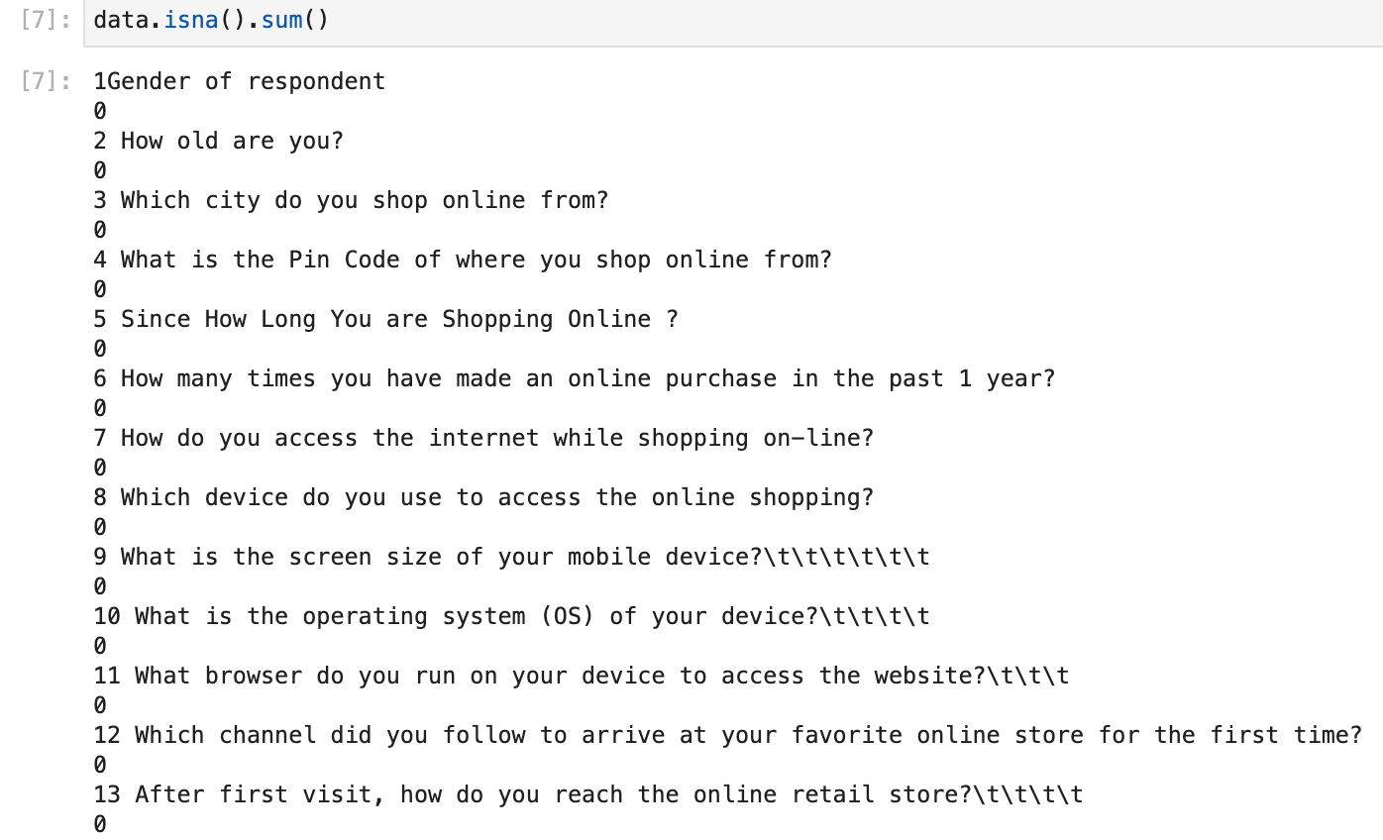
Checking using isna() and sum() method.

Slide 8
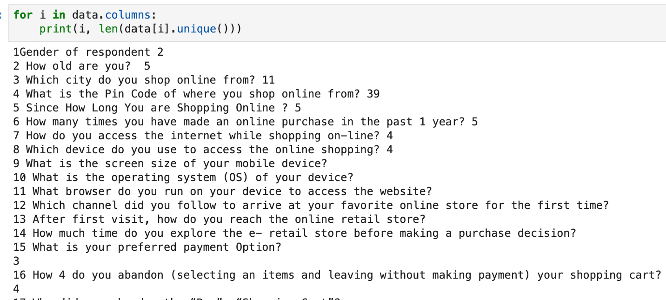
Number of classes in each columns checking
This technique help us to see how is the data in each column and whether the column contain continuous data or categorical data, since there are different way to deal with the continuous and categorical data.

Slide 9
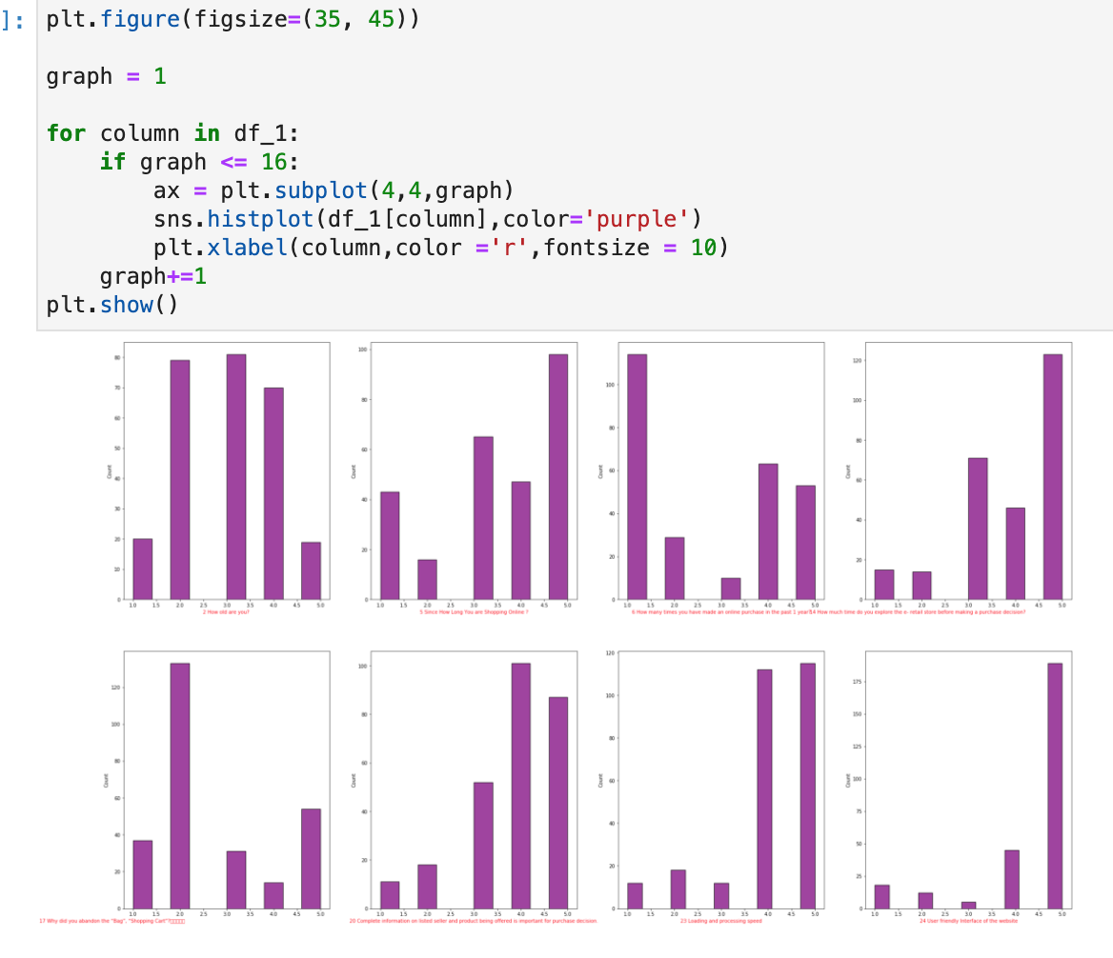
Here we will check for a specific question what is the customers points of view

Slide 10
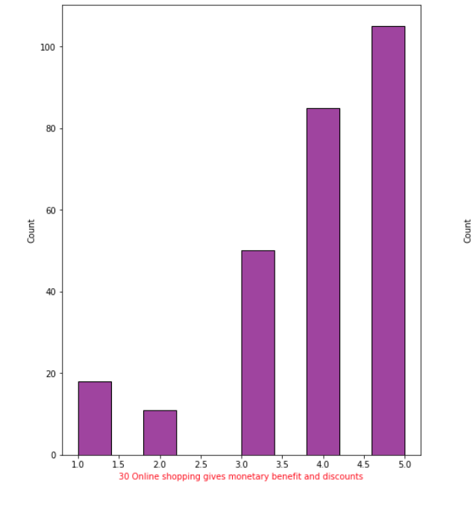
Here we will check for a specific question what is the customers points of view

Slide 11
Comments of the above two graphs
From the above histplot we can see that the majority of the customers answers is 3,4,5 since those 3 answers mean the customer is satisfied with the service provided by the company. The company can study those customers profile and see how can it compare with those customer who are not satisfied and try to overcome their satisfaction if the customer want them stay.
So using this analysis we do the same for other attributes.

Slide 12
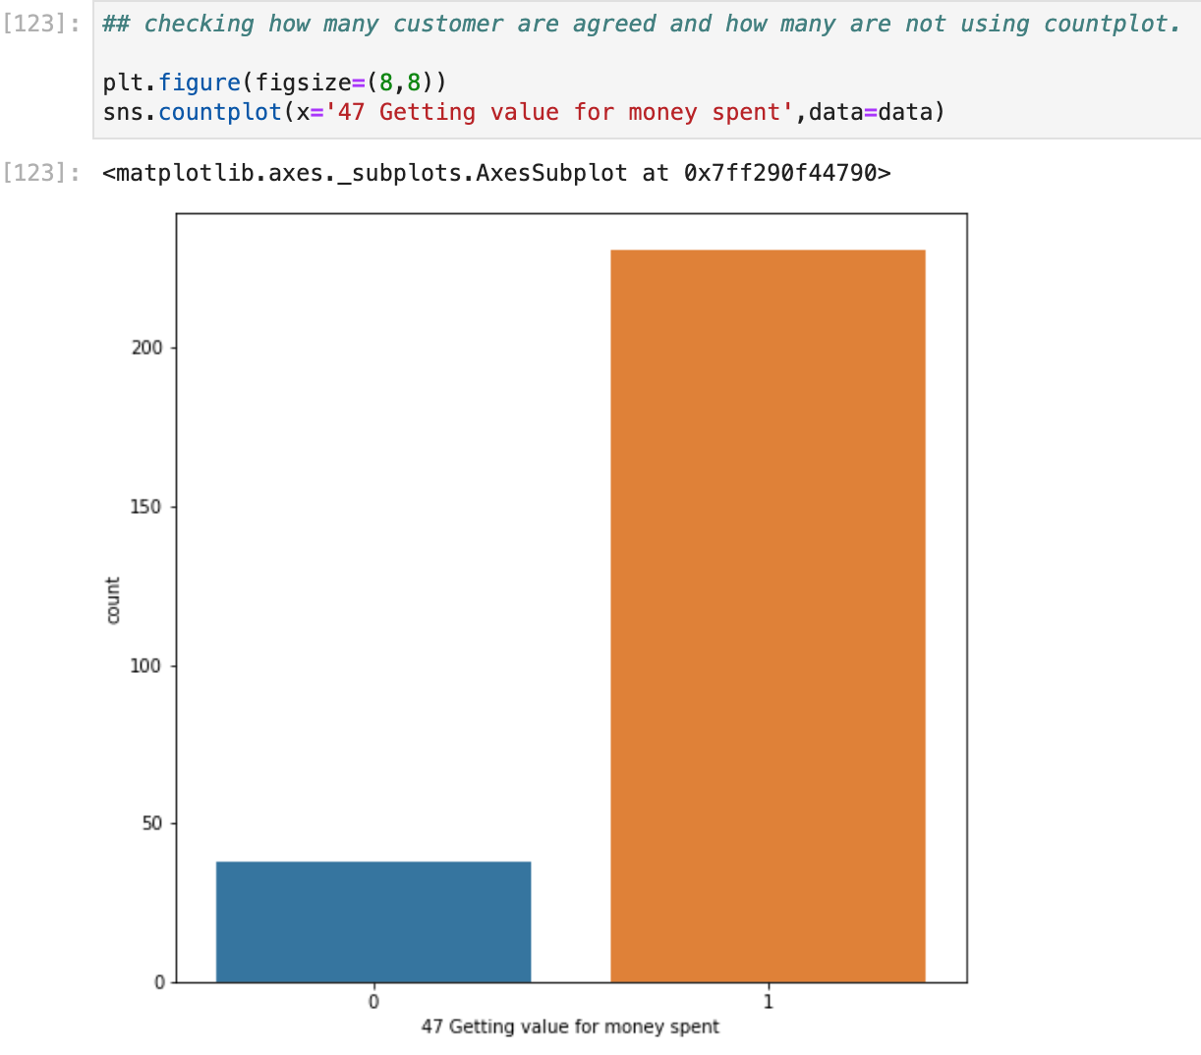
Checking how many customer are satisfied and how many are not using countplot.

Slide 13
Comment above of the above graph
We can see by considering the column 47 as target variable we can see that most of customers who getting value for money spent ( satisfied customer ) is majority since the rate is above 200 and for minority is for those who are approved for the affirmation is under 50.

Slide 14
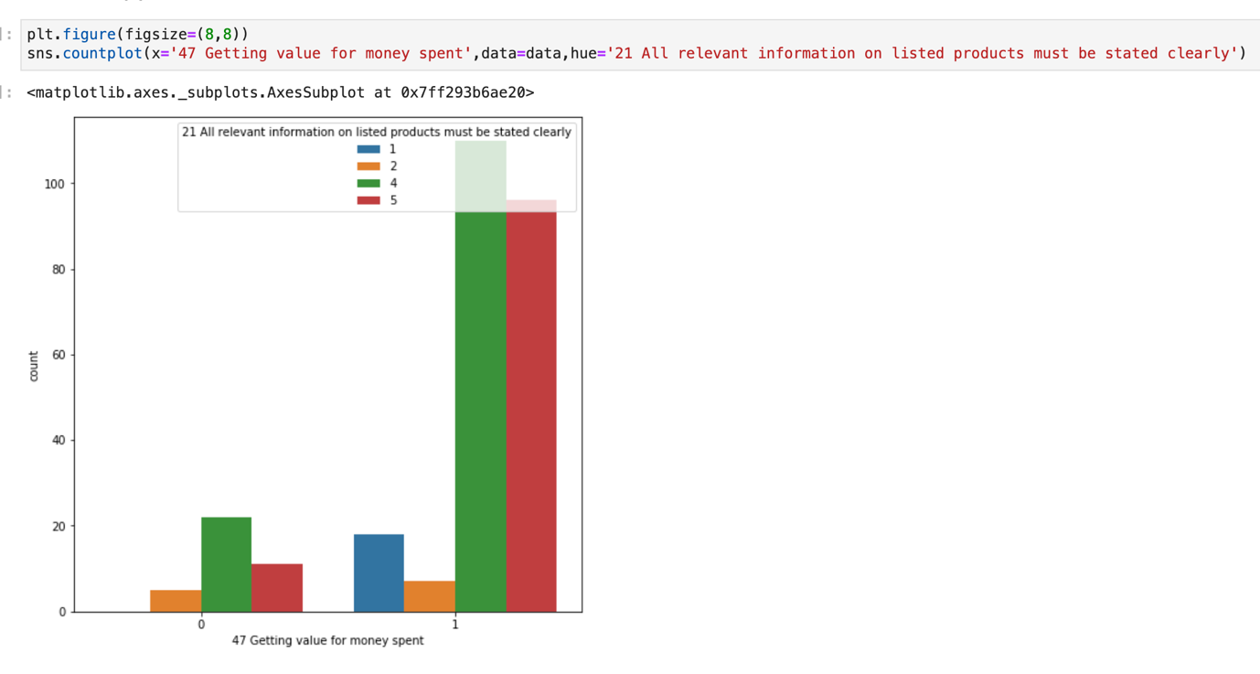
Since we are considering the attribute [47 Getting value for money spent] as dependent variable, let’s see others attributes effect on it.

Slide 15
Comment of the above graph.
It’s clearly shown from the above count plot rate of the customers who agreed and strongly agreed (satisfied customers ) is very positive highest than those who are disagreed for the affirmation(unsatisfied customers) and we say in conclusion that if the company make some effort it can satisfied all his customer

Slide 16
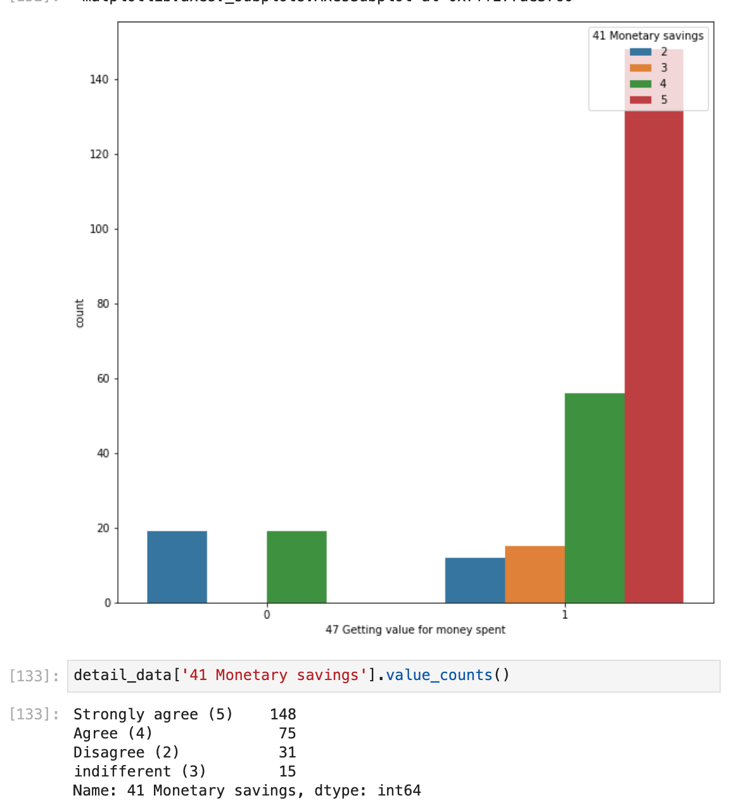
Checking the effect of [41 monetary saving on ] on the target variable.

Slide 17
Comment of the above graph
From the above graph we can see that all the customers “strongly agree “ and “indifferent” with the affirmation 41 are all belong to customers satisfied class[1] but for those customers who “agree” and “disagree” some belong to customers satisfied [1] as well customer unsatisfied[0]. So here we can say the that the attribute [41 Monetary savings] have effect to our dependent variable but not 100% percent.

Slide 18
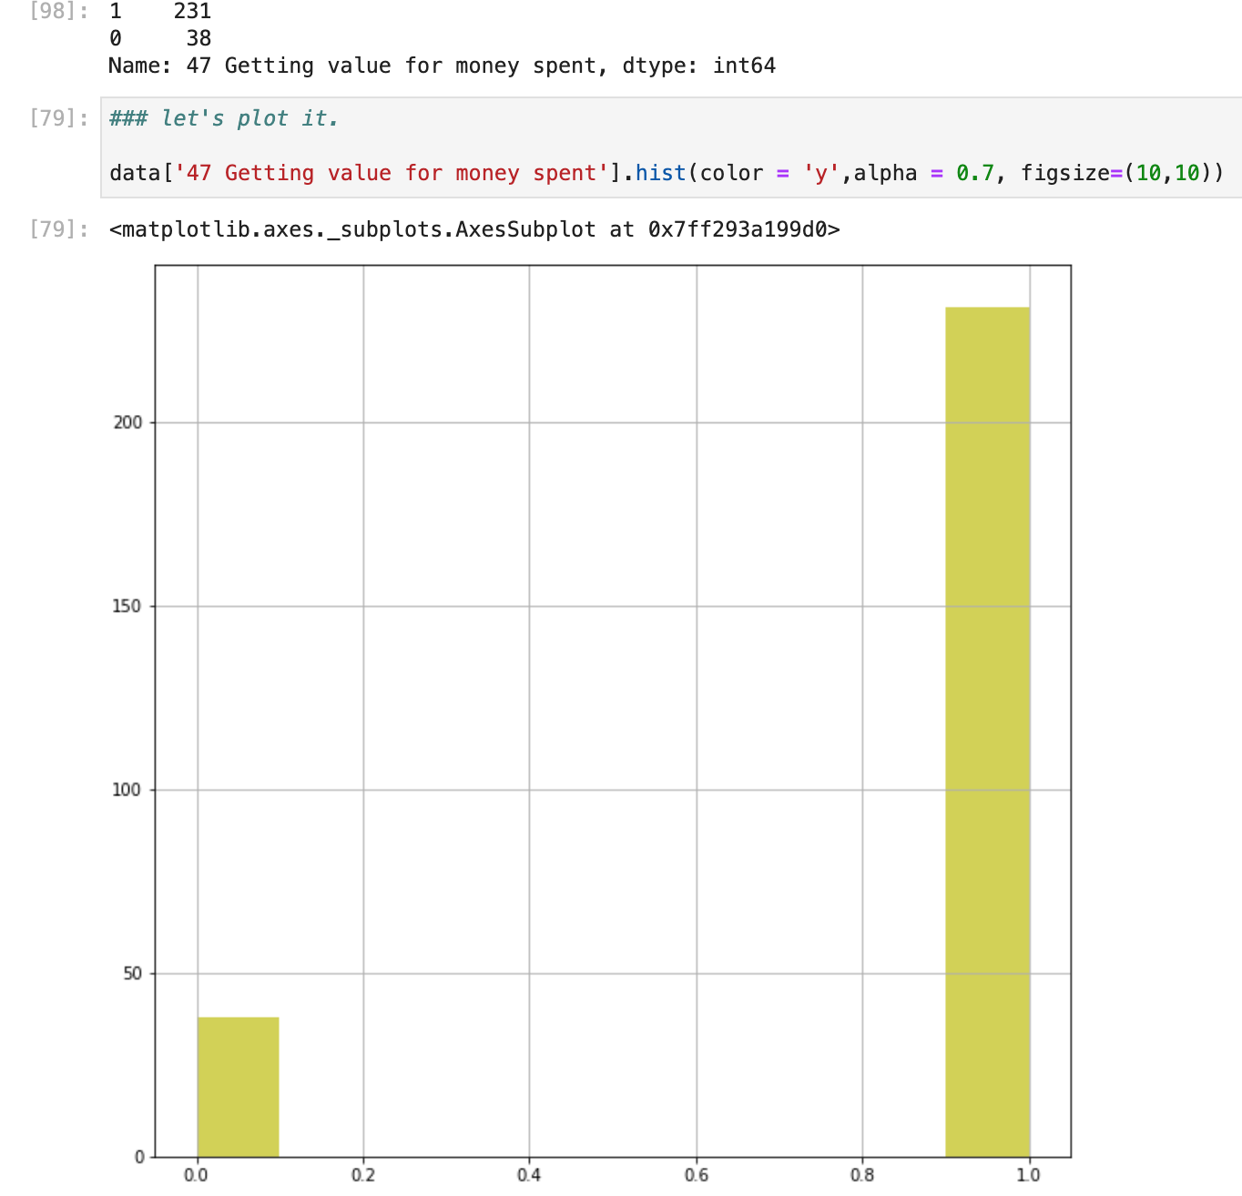
Over-sampling

Slide 19
Comment of above graph
The target variable is imbalanced as we can see the distribution data is unequal.

Slide 20
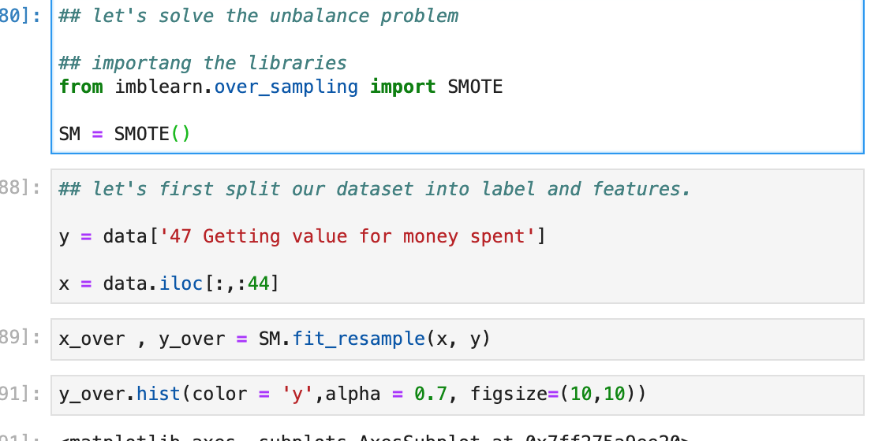
Solving imbalanced using Oversampling

Slide 21
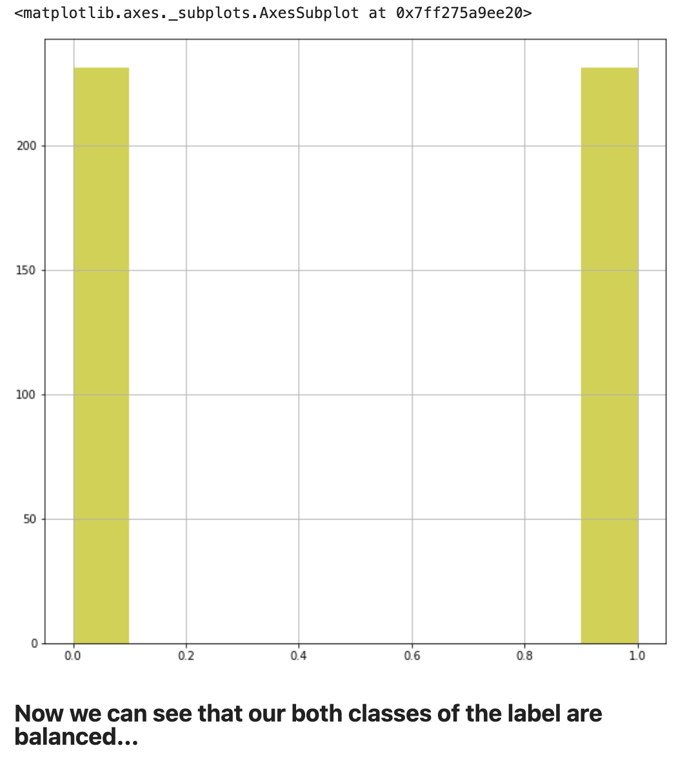
The result after oversampling

Slide 22
Comment of the above graphs
From the above histogram we can see that the imbalanced problem is solved

Slide 23
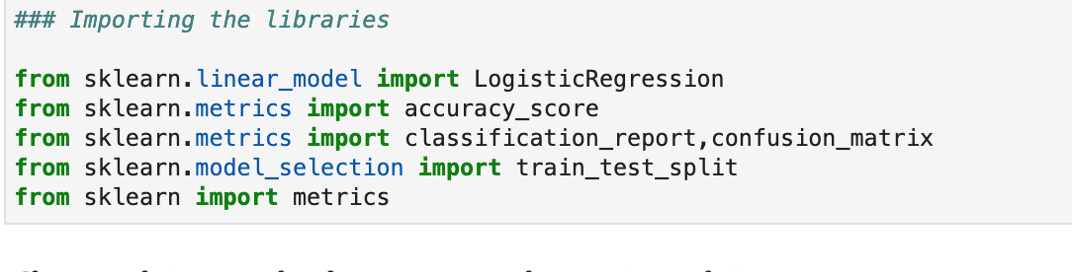
Building Machine learning Models.
Importing the libraries

Slide 24
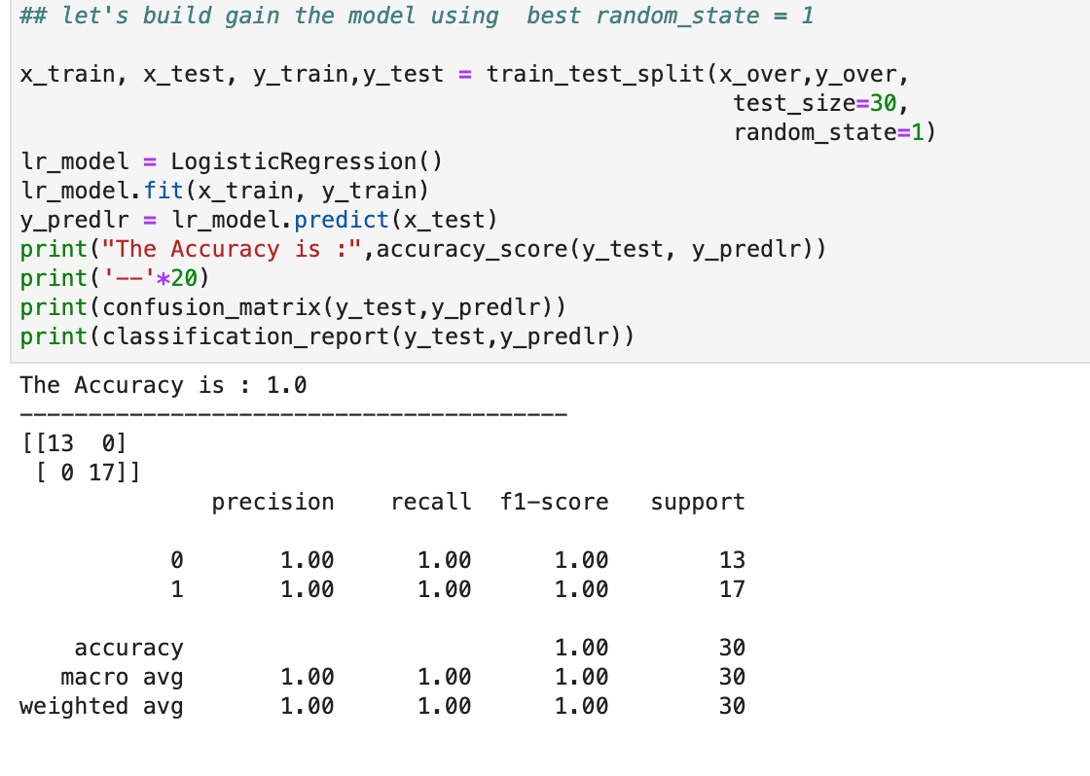
build the first model using the Logistic Regression Algorithm.

Slide 25
Explanation of the above image
As we can see above , we build again the same model using the best random state and we evaluate the metrics for the model performance.

Slide 26
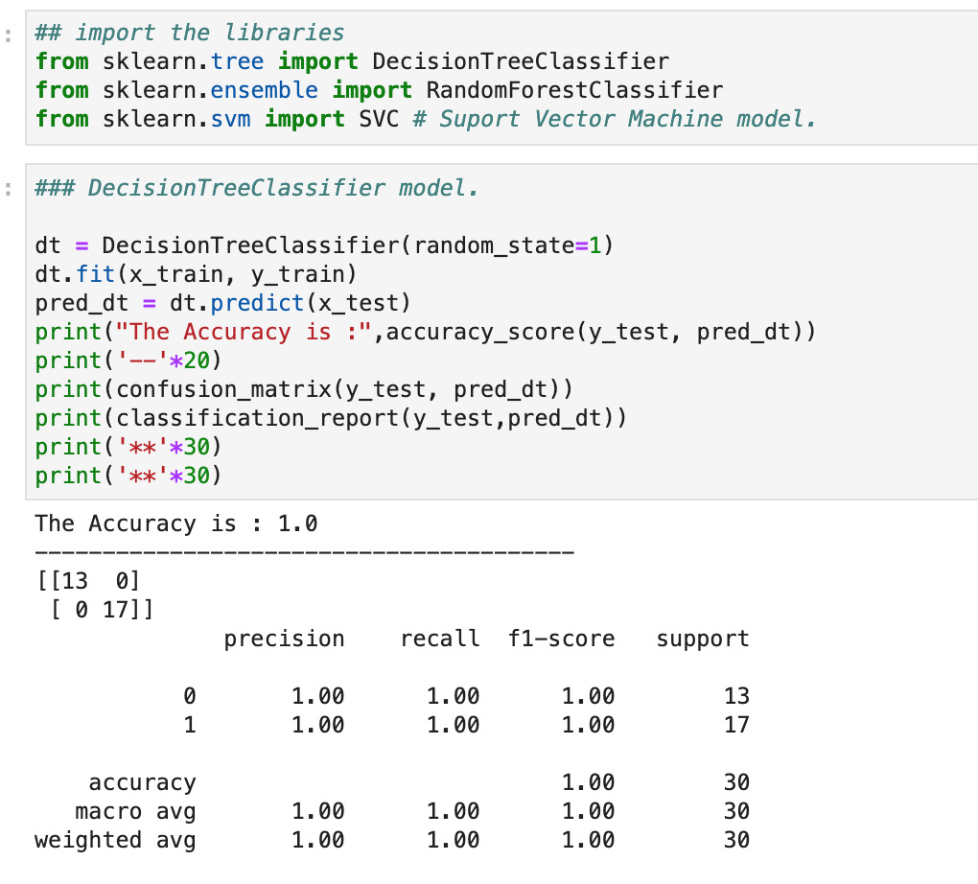
Building the second model using DecisionTreeClassifier algorithm.

Slide 27
Comment of the above model.
The DecisionTreeClassifier model gives 100% accuracy and this the company can used the above model while take decision to satisfied the customers.

Slide 28
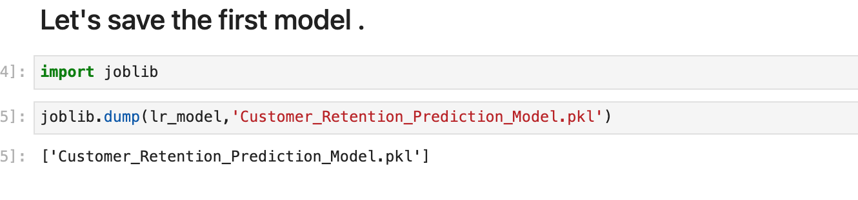
Model Saving

Slide 29
CONCLUSION
We will give this model to the company so that the company can know if a specific customer is satisfied or not and if the company knows there information about the customer while using the model to predict it and help the company to keep is customers.

