Slide 1



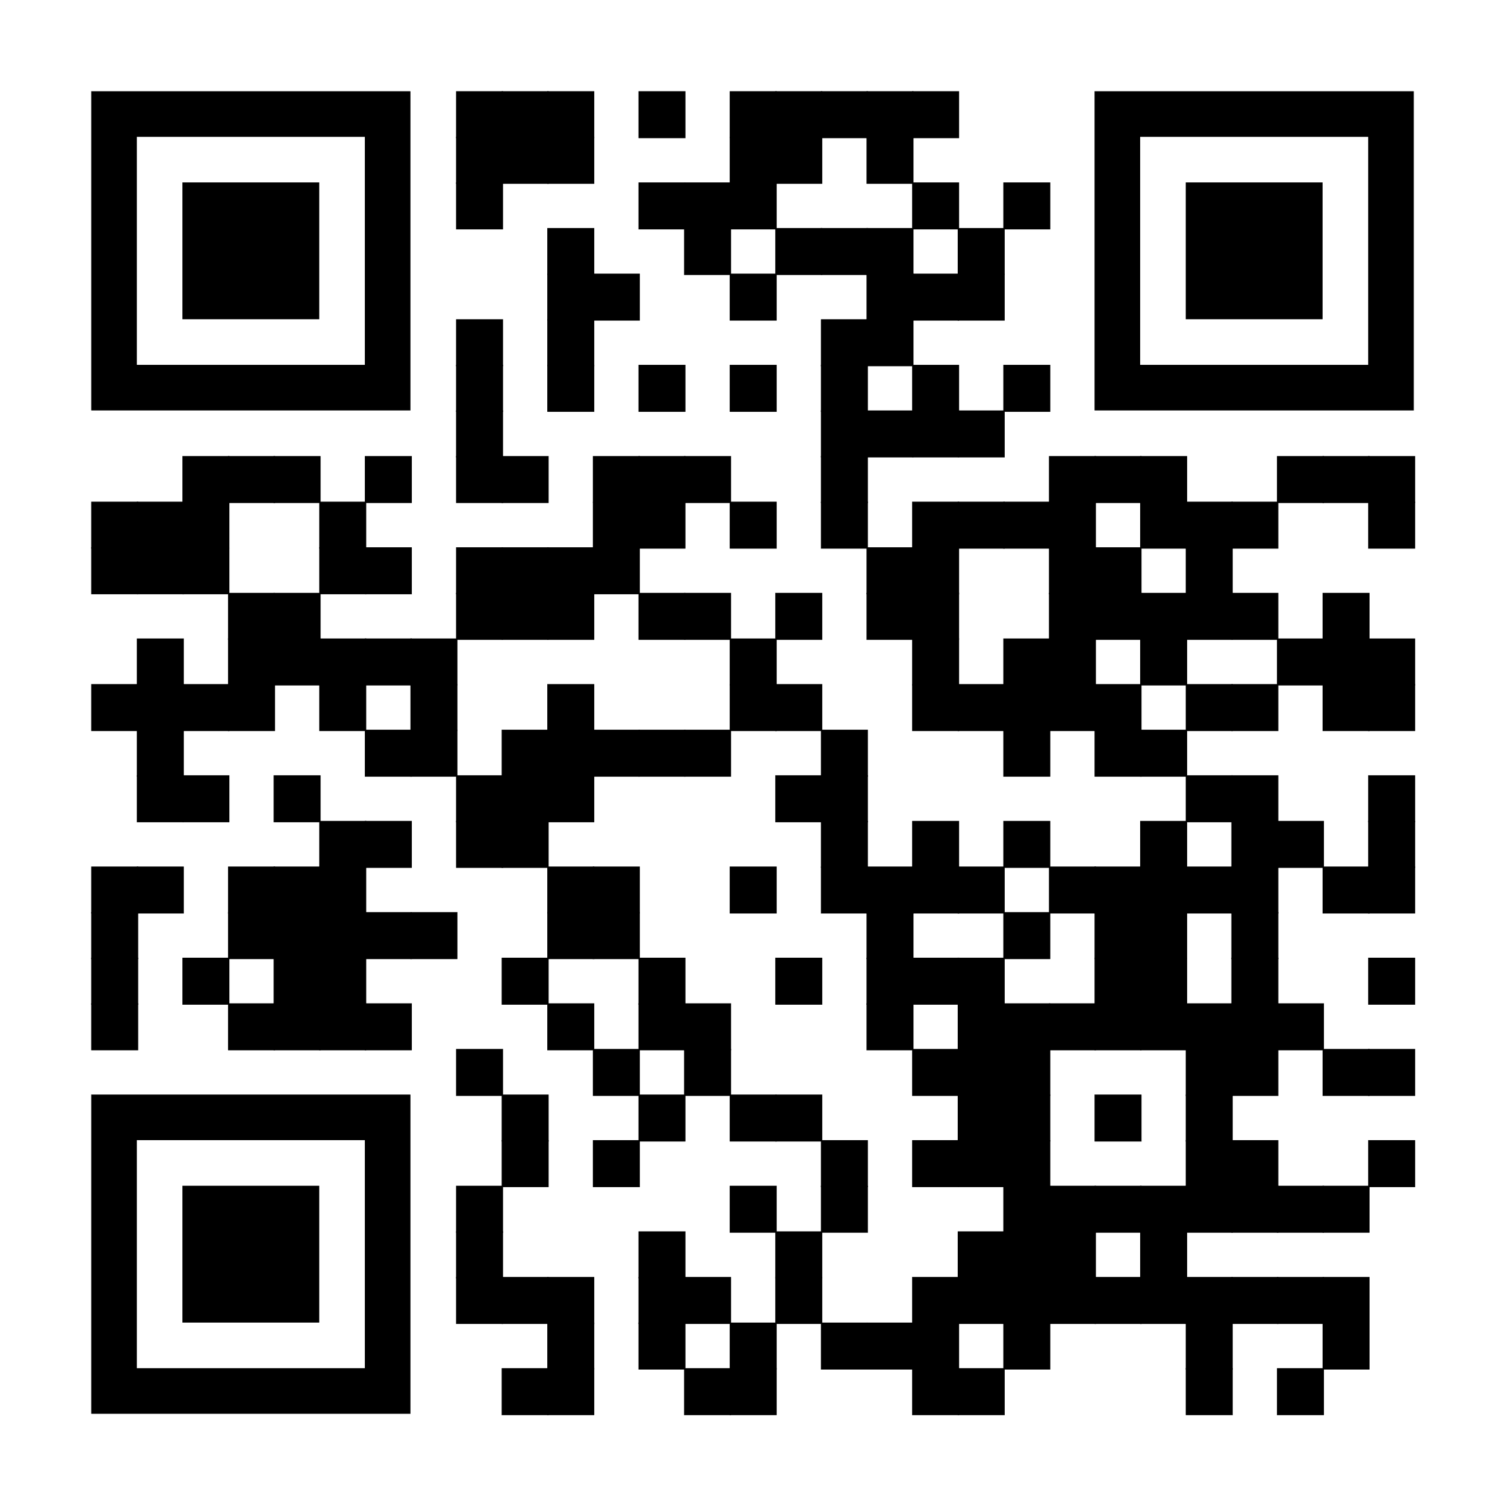

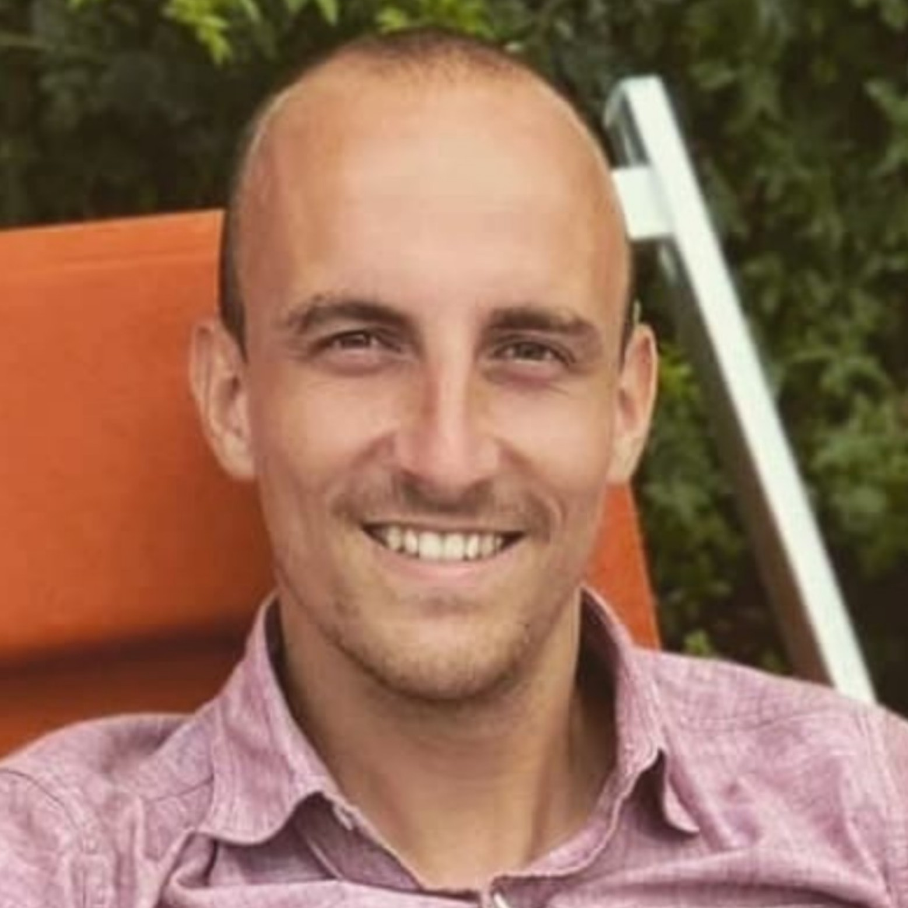
Inkscape Tutorial
When: Monday 12th February, 4.30pm
Where: A.03 Sciences
On Teams
Example with Inkscape.
Given by Olivier Leblanc.

