Slide 1
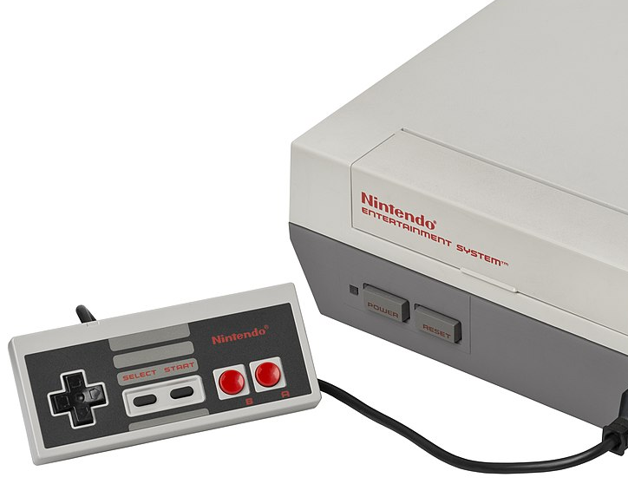
NES Emulator
CAOS Project 2020
Matias Carballo – Colin Fingerlin – Olivier Mattmann

Slide 2
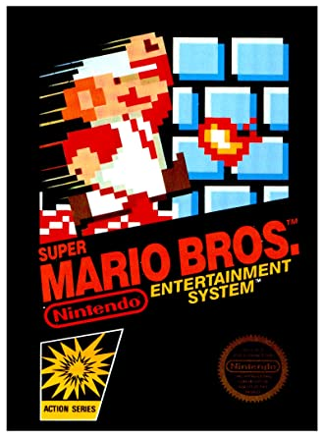
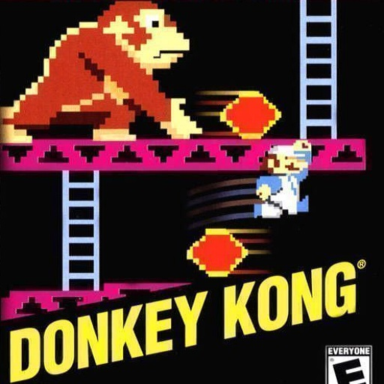
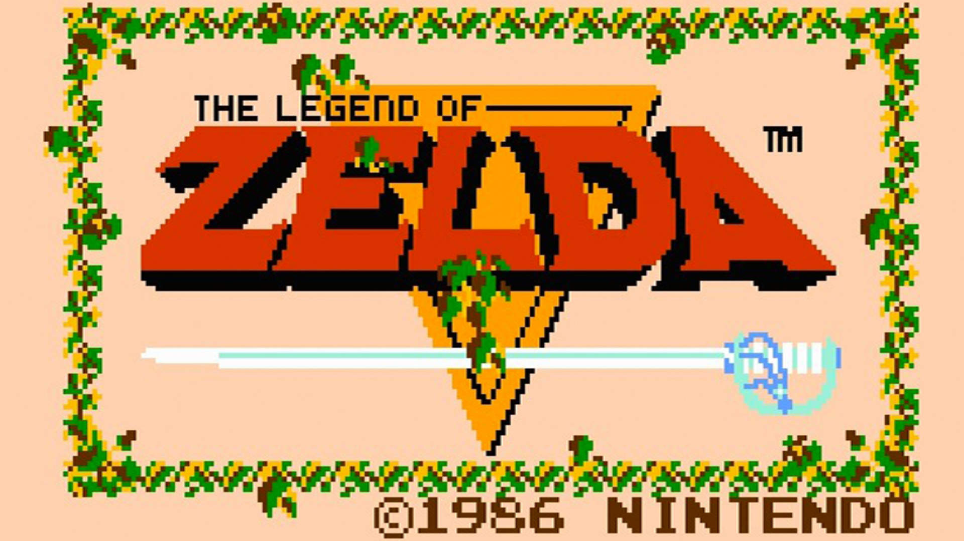
Examples of Titles
Super Mario Bros.
Legend of Zelda
Donkey Kong
And many more!

Slide 3
Goals
Learn how to implement an emulator
Software <-> Hardware
Console structure
What is unique or different to other systems
Final Goal:
Have a working NES emulator for most games

Slide 4
Challenges
New programming Language (C++)
Understanding the hardware architecture and documentation.
Teamwork, distribution of tasks
Time management

Slide 5
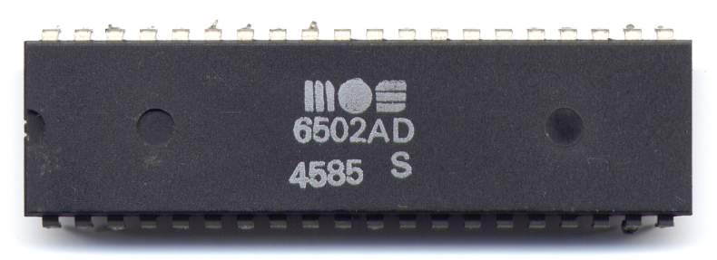
Rough Implemenation
y
C++
Windows OS
VisualStudio, Github, Zoom
How will this.... ...look like in code?
6502 Mos Technologies CPU

Slide 6
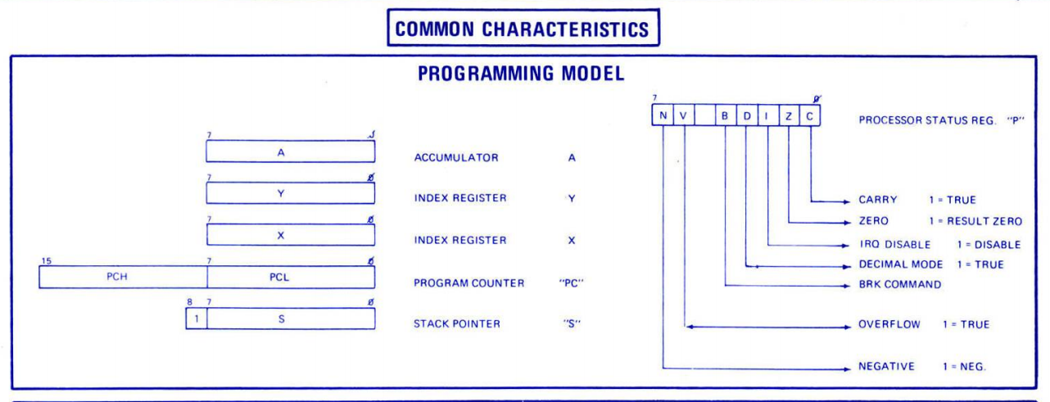
Rough Implemenation
y
...it will look familiar.
OO-Programming with classes being busses and components.
Attributes are our byte ranges to read from and write to.
CPU
http://archive.6502.org/datasheets/mos_6501-6505_mpu_preliminary_aug_1975.pdf

Slide 7
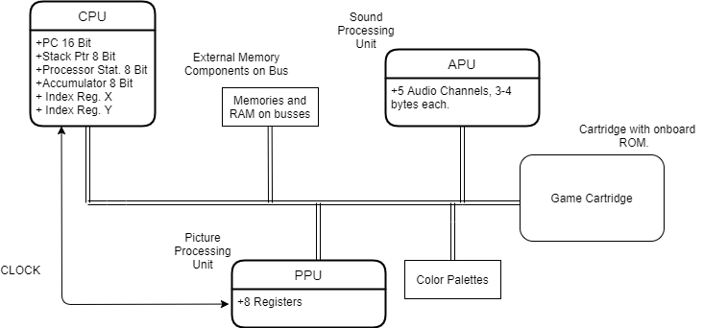
Rough Implemenation

Slide 8
Material/Resources
No additional Hardware needed and no costs
VS Code/CLion
NesDev Wiki

Slide 9

Hardware References
CPU Memory Map, CPU Instructions, …
Emulation Tests
CPU, PPU, APU, …

Slide 10
Thank you for your Attention

