Slide 1
Xenstore impact on boot time of (a lot of)
unikernels

Slide 2
Motivaion

Slide 3
Why so slow ?
Measurement infrastructure
Perf → no luck
I instrumented the code of the xenstore interface
  for all xenstore functions
  to measure the execution time of each call to a xenstore function (read, write, create, rm, etc.)
  And log each call to the xenstore
Then I re-launched the unikernel boot experiments and looked at the results

Slide 4
Why so slow ?
General xenstore impact on boot time

Slide 5
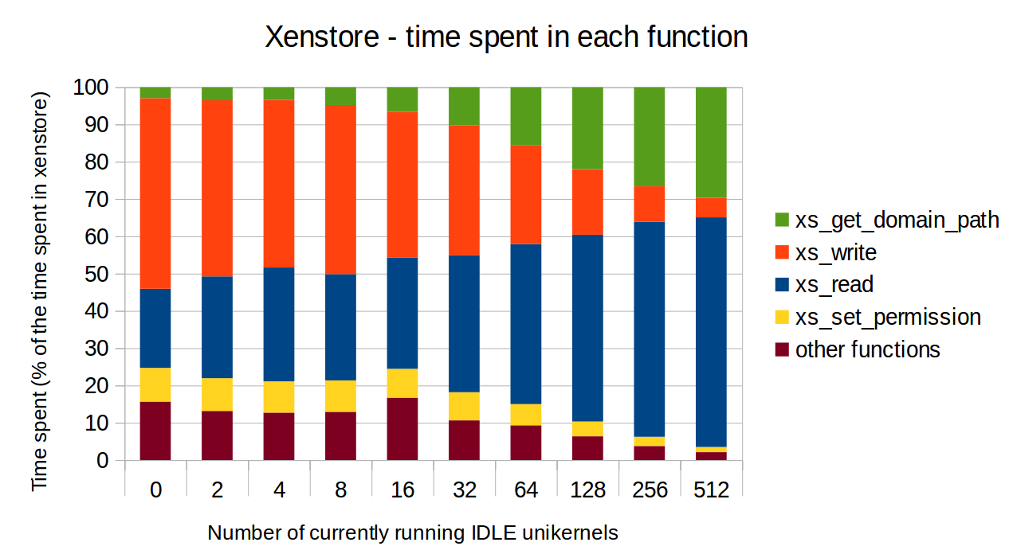
Why so slow ?
Xenstore impact broken down by call type (function)

Slide 6
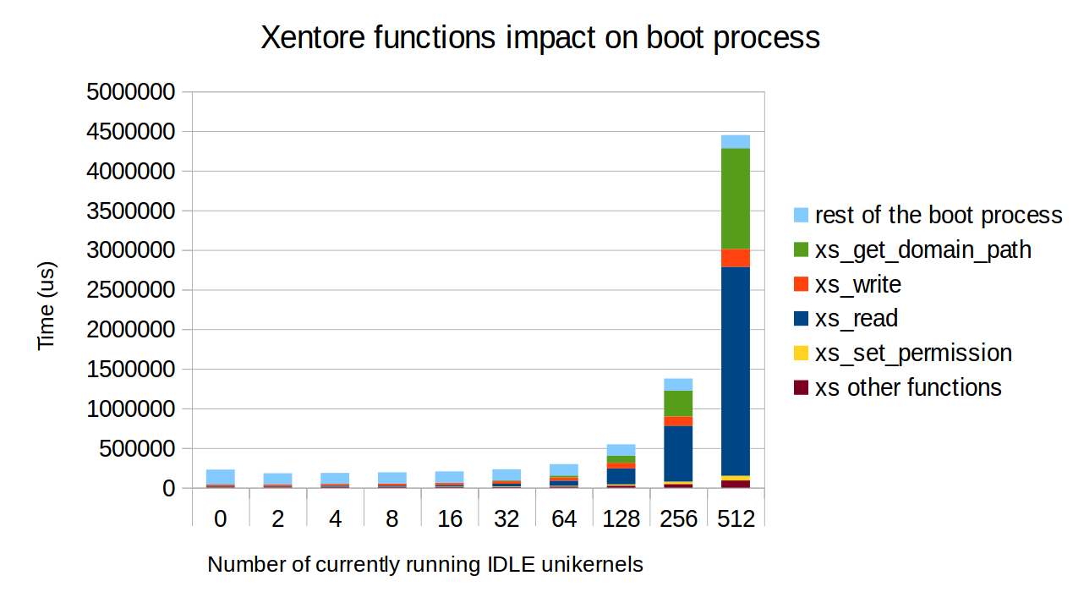
Why so slow ?
Xenstore impact broken down by call type (function) - 2

Slide 7
Why so slow ?
Average xenstore call execution time
The reason here is that each xl process (we have one running in the background for each
running unikernel) maintains a connection with the xenstore.
In the xenstore daemon server loop, there is a loop over all the current connections that
takes more and more time as the number of connections increases.
delays the upcoming calls
I’m working on it

Slide 8
Why so slow ?
Number of calls for each xenstore functions
In conclusion:
- more calls +
- longer calls

Slide 9
Why so slow ?
Number of calls for each xenstore functions (2)
xs_read:
  Called in loops from xl create on the number of currently running Vms
    Checking if each vm is a stubdomain
    Checking if the name is unique
  Potential solution: maintaining these info in a cache
  (shared memory page between all xl instances) that
  you can access faster than the xenstore
    I have a student working on it

