Slide 1

Essential Tools of Modern Cryptography
Hash Functions • Diffie-Hellman Key Exchange • Asymmetric Cryptography • Hands-on Exercises
0xMilica
ZK & Privacy Lead @dev3pack
PhD researcher in ZK

Slide 2
Agenda
Hash Functions & Properties
Symmetric Cryptography
Key Exchange
Asymmetric Cryptography
Diffie-Hellman Key Exchange
Summary + Discussion

Slide 3

Why Cryptography Matters
Data security
Privacy
Authentication
Blockchain relevance

Slide 4
What is a Hash Function?
Fixed size output - for any input
Deterministic - same input always produces the same output
Irreversible output

Slide 5
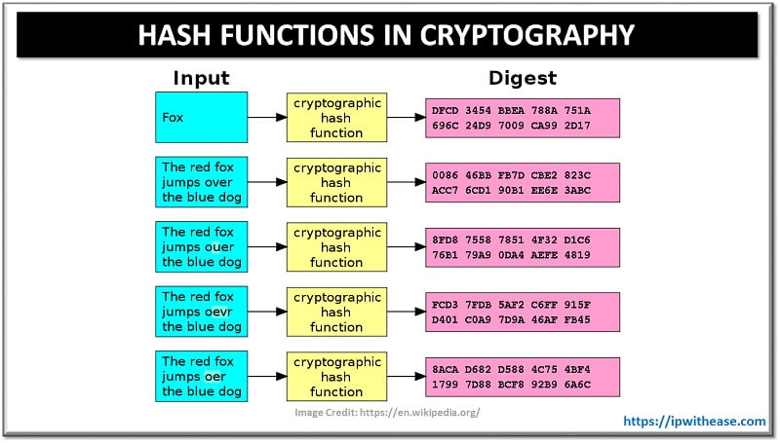
Hash Function Properties
Collision resistance
Avalanche effect - one small change, huge effect

Slide 6
Examples of Hash Algorithms
MD5, SHA-1 (broken)
SHA-256 (secure)
SHA-3 (modern standard)

Slide 7
Applications of Hashes
Password storage
File integrity checking
Digital signatures
Blockchain

Slide 8
Visual Example
“bootcamp” vs “Bootcamp” → very different hash outputs
https://emn178.github.io/online-tools/sha256.html

Slide 9
Exercise: Toy Hash by Hand
Hash = ASCII sum mod 100
Example: CAT → 67+65+84=216 → 216 mod 100 = 16
Exercise: a gentleman, elegant man
(use notebook and pencil)

Slide 10
Hash Collision Challenge
Exercise: Try to create two different words with same hash - smaller hash pool

Slide 11
Avalanche Effect (Demo)
Hash 'hello' vs 'Hello' → drastically different (‘H’ and ‘h’ have different ASCII values)

Slide 12
Mini Game: Proof-of-Work
Exercise: Find a word that hashes to something starting with '00'
Mimics Bitcoin mining difficulty
https://andersbrownworth.com/blockchain/blockchain

Slide 13
What is Symmetric Cryptography?
Same key for encryption and decryption

Slide 14
Algorithms
AES (current standard)
DES (deprecated)

Slide 15
Example (Encryption/Decryption)
Plaintext → Ciphertext → Plaintext
https://www.devglan.com/online-tools/aes-encryption-decryption

Slide 16
Pros & Cons
Pros: Fast, efficient
Cons: Key distribution problem

Slide 17

The Key Exchange Problem
How to share a secret key securely?

Slide 18
Historical Methods
Trusted couriers
Pre-shared secrets

Slide 19
Modern Solutions
Diffie-Hellman
RSA

Slide 20
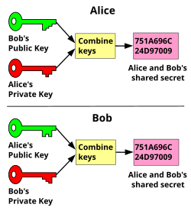
Asymmetric Cryptography
Public key / Private key pairs

Slide 21
Core Algorithms
RSA
Elliptic Curve Cryptography (ECC)

Slide 22
Applications
Digital signatures
SSL/TLS
Blockchain
Examples: email signature, HTTPS

Slide 23
Pros & Cons
Pros: Solves distribution problem
Cons: Slower than symmetric

Slide 24
Diffie - Hellman Key Exchange
Invented 1976 by Diffie & Hellman
First practical key exchange
Relies on Discrete Logarithm Problem

Slide 25
Why We Need It
No safe channel required
Security from discrete log problem

Slide 26
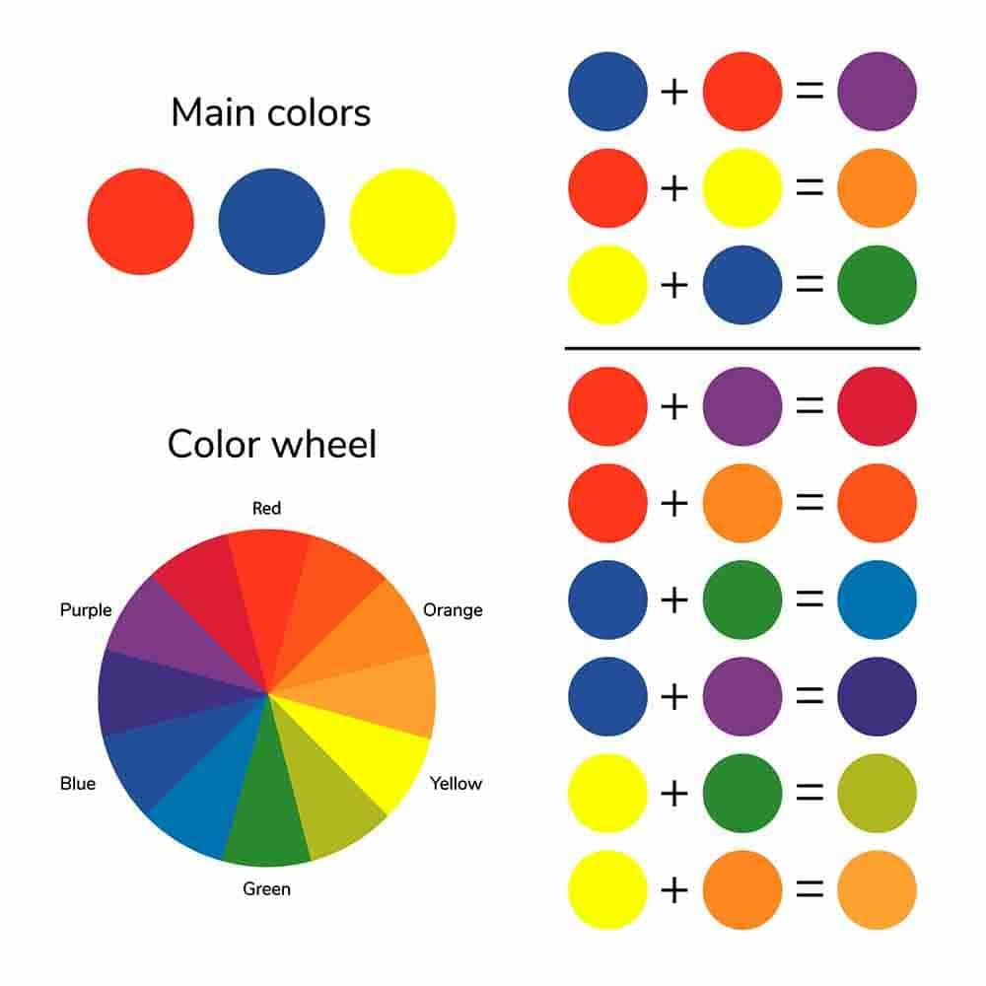
Visual Analogy
Colour mixing:

Slide 27
The Protocol (Step by Step)
1. Public numbers p, g
2. Alice chooses a
3. Bob chooses b
4. Compute A and B
5. Exchange
6. Compute shared secret

Slide 28
Example Calculation
Alice and Bob agree publicly on a prime modulus and a generator: 17 and 3 3 mod 17
Alice selects private, random number 15
calculates 3^15 mod 17 = 6
sends 6 to Bob
Bob selects private, random number 13
calculates 3^13 mod 17 = 12
sends 12 to Alice
Alice takes Bob’s public result 12 and her private key 15 and calculates 12^15mod 17 = 10
Bob takes Alice’s public result 6 and his private key 13 and calculates 6^13 mod 17 = 10
Shared secret is 10 :)

Slide 29
Exercise: Diffie-Hellman by Hand
Compute A = g^a mod p
Compute B = g^b mod p
Exchange, compute shared secret

Slide 30
Result Check
A=8, B=19, shared=2

Slide 31
Pair Challenge
Work in pairs, choose a and b
Compute shared key

Slide 32

Discussion
Why cannot eavesdropper compute secret?
What if p is too small?
Connections: TLS, VPNs, messaging

Slide 33
Summary
Hashes = integrity & security
Symmetric = fast, distribution problem
Asymmetric = solves distribution
Diffie-Hellman = secure key exchange

Slide 34
Essential Tools of Modern Cryptography
Hash Functions • Diffie-Hellman Key Exchange • Asymmetric Cryptography • Hands-on Exercises
0xMilica
ZK & Privacy Lead @dev3pack
PhD researcher in ZK

