Slide 1

Zero-Knowledge Proofs
Multi Party Computation
KZG commitments
MPC • Commitment Scheme • KZG • Prover, Verifier, Witness • Hands-on Exercises
0xMilica
ZK & Privacy Lead @dev3pack
PhD researcher in ZK

Slide 2
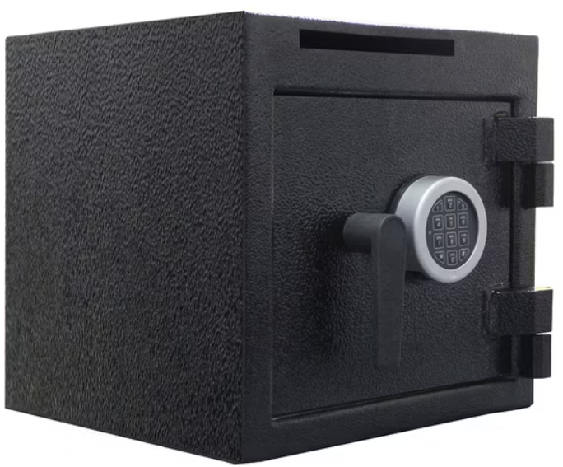
Why ZKPs?
Privacy & scalability for blockchain
“Prove without revealing’’
Example: a safe box with a key

Slide 3
ZKP Building Blocks
Prover
Verifier
Witness
Statement
Relation

Slide 4
Relation (R)
(S, w) ∈ R if witness matches statement
ZKP = prove (S, w) ∈ R without revealing w

Slide 5
Role-Play Demo: Let’s try it out!
Prover: “I know a secret number that hashes to 4.”
Verifier: “Prove it, but don’t tell me the number.”
Prover shows alternative valid number (e.g. 32).
Verifier is convinced, without learning the witness.

Slide 6
Why Not Reveal Directly?
Revealing x = 25 → zero-knowledge lost
Trick with x+r leaks witness (35 – 10 = 25)
Real ZKPs use commitments

Slide 7
Example: Hash Preimage
Statement: h = 4
Witness: x = 25
hash: H(x) = x mod 7
Check: 25 mod 7 = 4 ✅
Prover: “I know some x that hashes to h = 4.”

Slide 8
Non-Interactive Proofs
Fiat-Shamir transform
One message only
Blockchain use

Slide 9
Multi-Party Computation (MPC)
Multiple parties compute a function without revealing inputs
Inputs stay private
Everyone learns only the result

Slide 10
Classroom Exercise: Our Ages
Start with your age + random offset (e.g. 30 + 50 = 80)
Pass number around, each adds age:
1st: 103, 2nd: 130, 3rd: 161, 4th: 190
Final = 190, subtract offset (50) → 140 total
Sum revealed, no individual ages leaked

Slide 11
Multi-Party Computation (MPC)
MPC: group hides inputs, reveals function result
ZKP: one hides witness, reveals statement truth
Both: privacy-preserving computation

Slide 12
Properties of ZKPs
Completeness: If true, honest Prover convinces Verifier
Soundness: If false, cheating Prover fails
Zero-Knowledge: Verifier learns nothing about witness

Slide 13
Why Commitments?
Needed for scalability
Bind to polynomial, open later
Properties: binding, hiding, succinct verification

Slide 14
What is KZG?
named after Kate, Zaverucha and Goldberg
polynomial commitment scheme based on pairings
Commit(p(x)) → C
Prove p(z) = y without revealing full p(x)

Slide 15
KZG - Key Properties
Compact: Constant-size commitments and proofs
Efficient: Fast verification
Trusted Setup: Needs structured reference string (SRS)

Slide 16
Polynomial Setup
Let’s say you have polynomial:
p(x) = a₀ + a₁x + a₂x² + ... + aₙxⁿ
the coefficients are secret
you want to commit to p(x) and later prove p(z) = y

Slide 17
The Trusted Setup
Generate SRS:
{g, g^s, g^{s²}, ..., g^{s^n}}
no one must know s
if s is leaked → security breaks
SRS can be universal or per circuit

Slide 18
Procedure

Slide 19
KZG steps
Setup
Commitment
Evaluation
Verification

Slide 20
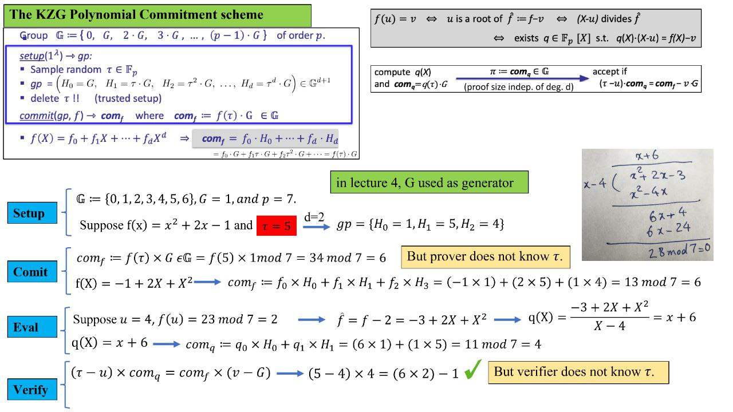
Setup

Slide 21
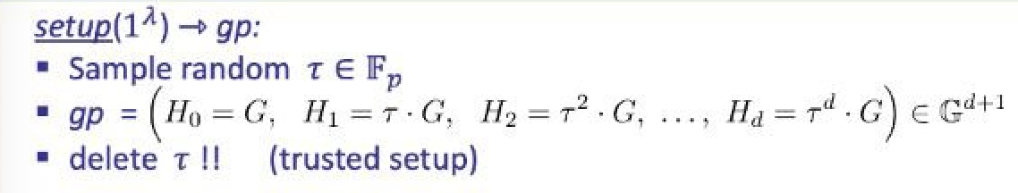
Setup

Slide 22
Commitment

Slide 23
Commitment

Slide 24
Let’s go through it with an example!

Slide 25
Setup

Slide 26
Setup

Slide 27
Setup
Reminder:

Slide 28
Setup
Reminder:

Slide 29
Commitment

Slide 30
Commitment

Slide 31
Commitment
Check:

Slide 32
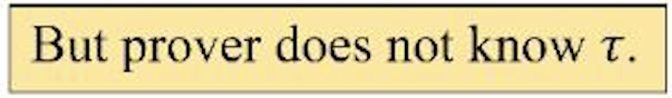
Commitment
Check:

Slide 33
Math
or
magic?

Slide 34
Summary
Witness, statement, relation
Interactive vs. non-interactive + MPC
Completeness, soundness, zero-knowledge
Commitments & KZG = ZKP foundations

Slide 35
Next up:
Next steps: Groth16, Plonk, STARKs

Slide 36
Zero-Knowledge Proofs
Multi Party Computation
KZG commitments
MPC • Commitment Scheme • KZG • Prover, Verifier, Witness • Hands-on Exercises
0xMilica
ZK & Privacy Lead @dev3pack
PhD researcher in ZK

