Slide 1

Hexagonal Architecture

Slide 2


Slide 3

Coverage
Confidence
Understanding

Slide 4

Effort to write
Maintenance
Time to run

Slide 5
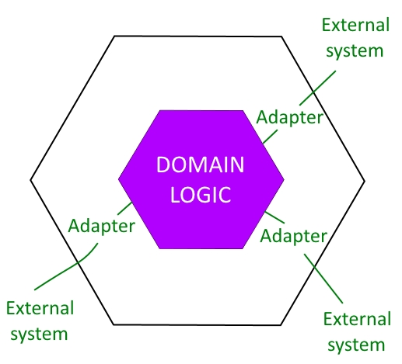

Slide 6


Slide 7


Slide 8
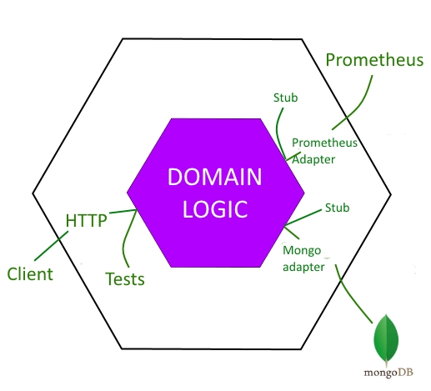

Slide 9
Ian Cooper – NDC Talk on vimeo.com

