Slide 1

Danish Labour Market Dynamics
An analysis of wage and employment trends across Danish industries, 2013-2024
Danmarks Statistik (LONS40, RAS300) • Oliwier Ferenc • August 2026

Slide 2
Mapping Danish labour market growth and challenging assumptions
Case context and approach – methodology
Problem statement:
Which Danish industries are experiencing the strongest labour market growth – and does the data challenge conventional assumptions about which sectors are leading?
Data & Scope:
Two Danmarks Statistik datasets with data pulled live via API:
Hourly earnings by industry (LONS40)
Employment by industry (RAS300)
Integrated to model annual payroll spend across 10 industries, 2013-2024
Payroll = hourly wage × employees × 1,600 hrs annually (roughly 40 hours/week * 40 weeks)
How to read this deck:
Each slide surfaces one finding – moving from what is growing to highest pay versus fastest growth, to what the trajectory over time actually shows. Final slide translates findings into strategic implications for workforce planning.
Note: Industry highlights follow the four labour market profiles defined in the positioning analysis (slide 5).

Slide 3
Deconstructing the public narrative: four intuitions the data challenges
Case context and approach – assumptions challenged
Assumption
01
The tech-first illusion
Widespread media coverage assumes software, AI, and digital knowledge sectors drive modern labour markets.
Assumption
02
The wage-growth equivalence
It is intuitive to assume that high-wage industries are also expanding their payroll fastest – this analysis tests whether that intuition holds in Danish data.
Assumption
03
The “old economy” fallacy
Sectors like Manufacturing perceived as belonging to Denmark’s industrial past rather than its economic future, overshadowed by green energy and digital narratives.
Assumption
04
The absolute size myth
Payroll dominance is a natural proxy for payroll momentum – Denmark’s largest employer by payroll spend is assumed to also be its most dynamic.
Source: Invest in Denmark – Denmark’s Digitalisation Strategy 2023 (investindk.com) • CEPR – Deconstructing Deindustrialization, Smeets et al. (cepr.org/voxeu) • Assumptions 2 and 4 reflect intuitive economic priors tested empirically in this analysis

Slide 4
Heavy sectors like Manufacturing outpace traditional Tech & Finance expectations
Average annual payroll growth by industry, 2013-2024 (%)
Reading the chart
Construction and Business Services lead long-term payroll expenditure growth at 5.10% and 5.00%, driven by high project-based demand.
Manufacturing climbs at 4.69%, outpacing software-driven knowledge sectors such as Info & Comms (4.38%).
Financial & Insurance sits lower at 4.01%, indicating that capital-light industries are expanding payrolls more conservatively.
Key takeaway: Structural growth is concentrated in physical infrastructure and production rather than digital services.
Source: Danmarks Statistik (LONS40 x RAS300) • Payroll growth = average annual rate 2013-2024 • Excludes industry aggregate

Slide 5
Manufacturing has quietly become Denmark’s fastest-growing payroll sector
Annual payroll growth by industry, 2024 Snapshot (%)
At a glance
Manufacturing leads:
Manufacturing takes the #1 position at 7.82%, driving a wider surge alongside Financial and Real estate payrolls.
The finance and property rally:
Financial & Insurance (6.93%) and
Real Estate (6.68%) jump straight into the upper tier in the recent years, reversing their historical positions.
Broader economic impact:
The 2024 data reveals that labour expansion is heavily anchored in capital-extensive fields rather than digital or service-oriented sectors.
The same pattern follows: Asset-backed industries are driving labour growth, rewriting expectations of what sectors lead in the modern Danish economy.
Source: Danmarks Statistik (LONS40 x RAS300) • 2024 data • Excludes industry aggregate

Slide 6
Labour market positioning – high wages don’t always predict high growth
Hourly wage (DKK) vs annual payroll growth (%) by industry, Snapshot 2024 • Reference lines at median wage (400 DKK) and median growth (5%)
What this tells us
Manufacturing – top right
417 DKK/hr, 7.82% growth, 369,716 employees – the only sector combining both wage strength, payroll momentum and large-scale employment.
Financial & Insurance – top right
539 DKK/hr and 6.93% growth – same quadrant, opposite strategy, with premium compensation concentrated in a small workforce (90,420).
Info & Comms – bottom right (alone)
457 DKK/hr, but only 3.38% growth – digital talent is well-compensated but not expanding.
Others – left quadrants
Lower wages, but varied growth.
Low Wage / High Growth
High Wage / High Growth
Low Wage / Low Growth
High Wage / Low Growth
Industry | Employees | Hourly Wage (DKK) | Annual Growth (%)
Financial & Insurance | 90,420 | 539 | 6.93%
Info & Comms | 129,007 | 457 | 3.38%
Manufacturing | 369,716 | 417 | 7.82%
Source: Danmarks Statistik (LONS40 x RAS300) • 2024 data • Excludes industry aggregate

Slide 7
Public Sector dominates Danish payroll – but Manufacturing grew by nearly two-thirds since 2013
Total annual payroll expenditure by industry, 2013 vs 2024 (DKK Billions) •
Solid bar = 2024 • Tinted bar = 2013
11 years of absolute growth
Manufacturing – Biggest proportional mover
150B -> 247B DKK (+65%). Grew by nearly 2/3 of its starting baseline, leading in expansion speed across its relatives.
Public Sector – Dominant but decelerating
390B -> 558B DKK (+43%). Slow-expanding sector at a massive baseline (390B). Generated largest structural increase at +168B DKK.
Info & Comms – Strong relative
59B -> 94B DKK (+60%). Solid growth above group average but a smaller sector – absolute gain is modest compared to its relatives.
Financial & Insurance – Steady performer
51B -> 78B DKK (+53%). Although the growth is robust in isolation, it represents steady, expected benchmark expansion.
Note: Payroll and growth data rounded to nearest full number/percentage
Source: Danmarks Statistik (LONS40 x RAS300) • Calculated as: hourly wage × employees × 1,600 hrs

Slide 8
Indexed growth confirms Manufacturing’s acceleration – expected leaders fall behind
Payroll growth index by industry • 2013 = 100 • Higher value = faster growth relative to its own baseline
Reading the index
Manufacturing – 165
The steepest trajectory. Accelerating consistently since 2016 and pulling ahead of the comparison industries by 2024
Financial & Insurance – 154
Strong growth despite being the smallest major sector. Trajectory moderate in comparison with Manufacturing.
Info & Comms – 160
Strong growth until 2021, then decelerating noticeably as post-pandemic tech hiring stabilised.
Public Sector – 143
The flattest trajectory despite large workforce, differentiating between scale and momentum.
Note: The index removes the size advantage – Public Sector’s 558B DKK payroll no longer dominates visually.
Source: Danmarks Statistik (LONS40 x RAS300) • Industries selected to represent four distinct Labour market profiles

Slide 9
The bottleneck is assumption, not data
Synthesis and implications for workforce strategy – for organizations making hiring, compensation, or investment decisions in the Danish market, three implications stand out:
Implication 1
Don’t overlook manufacturing talent as a competitor
With the fastest payroll growth and above-average wages, advanced manufacturing is actively competing for skilled labour, particularly in engineering, operations, and data-driven production roles.
Organizations in adjacent sectors should expect increasing wage pressure from this direction.
Implication 2
Financial services sets the wage benchmark for high-skill talent
At 539 DKK/hr, Financial & Insurance defines the upper boundary of labour market compensation.
Any organization competing for quantitative, analytical, or strategic talent is implicitly competing against this benchmark whether they recognize it or not.
Implication 3
Tech hiring in Denmark is a quality game
Slow headcount growth in Information & Communication despite high wages suggests Danish tech employers are selective rather than expensive.
Organizations looking to hire from this talent pool should expect strong candidates but a limited supply of available movers at any given time.
Key takeaway: Conventional assumptions understate the payroll momentum in manufacturing and construction, shifting where the real talent competition lies.
Full analysis and live data pipeline: https://github.com/oliwier-ferenc/danish-payroll-analysis

Slide 10
APPENDICES

Slide 11
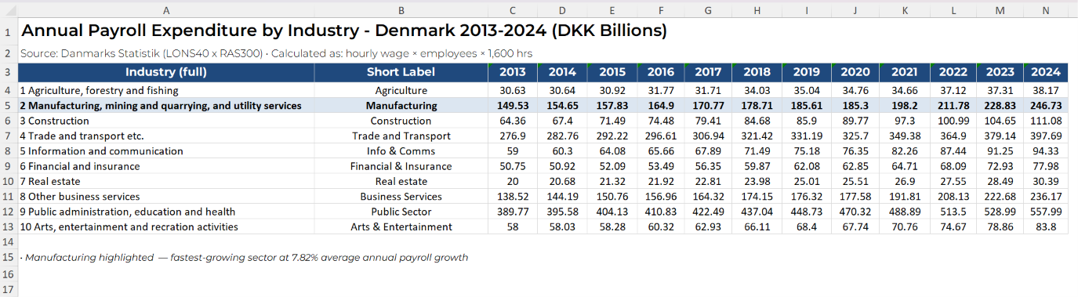
Appendix 1 – Payroll Trends (Absolute)

Slide 12
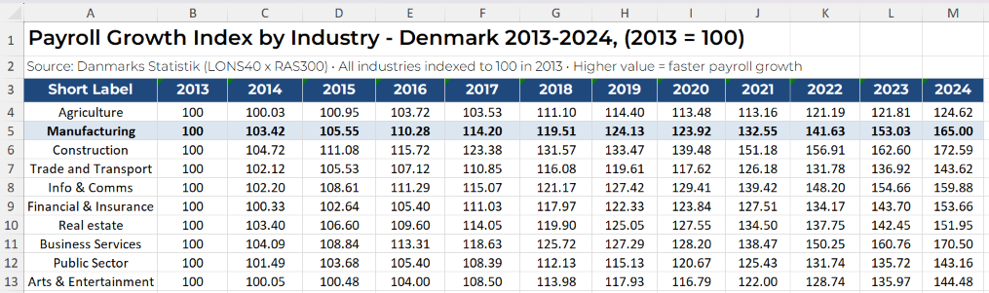
Appendix 2 – Payroll Indexed

Slide 13
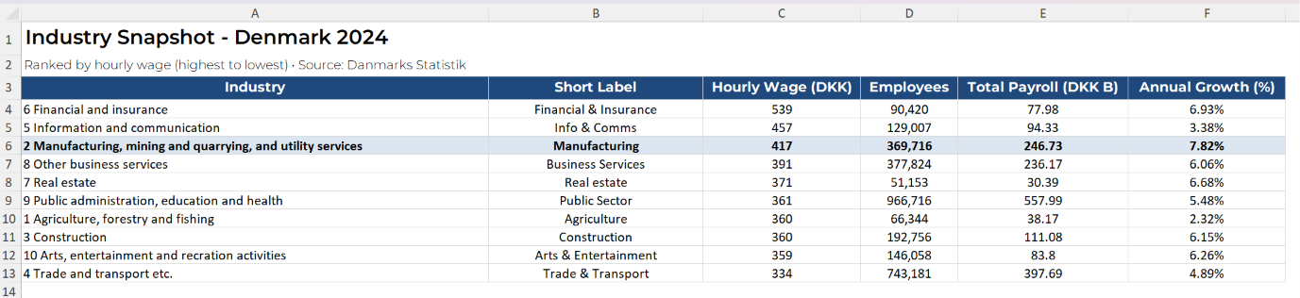
Appendix 3 – 2024 Snapshot

Slide 14
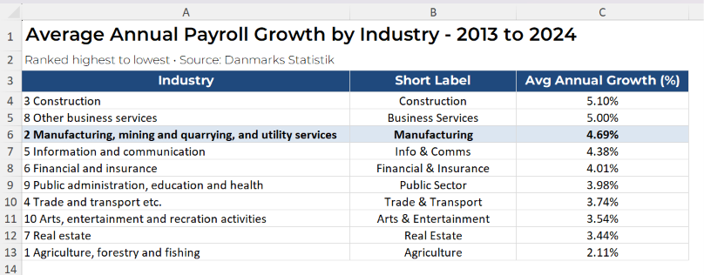
Appendix 4 – Growth Rates

