Slide 1
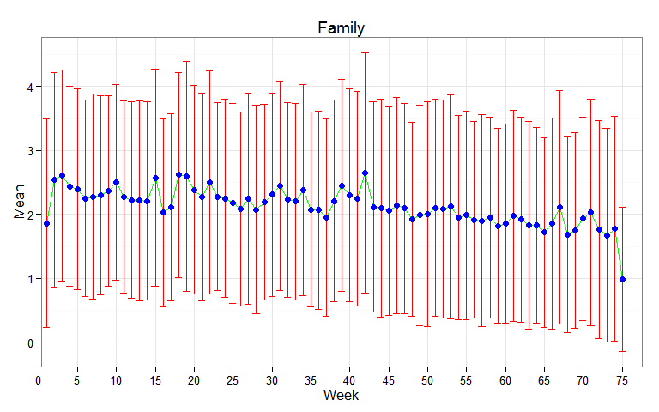
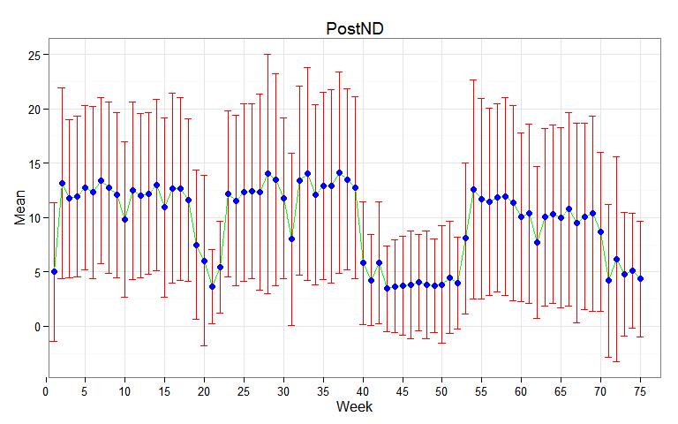
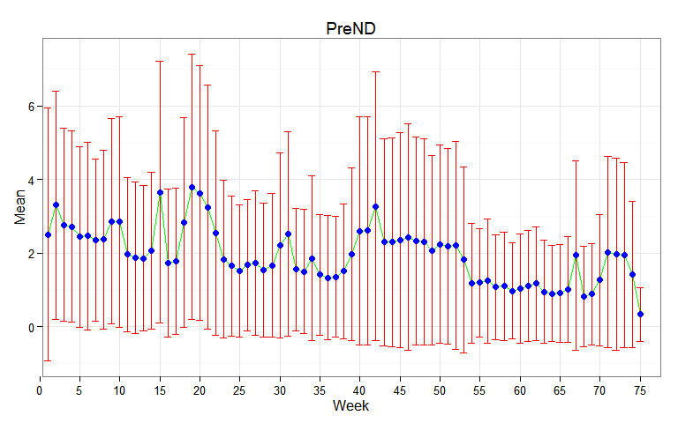
The Effects of Individual Traits on the Formation of Social Networks Among First-Year College Students
Research Issues & Questions
Social Network Dynamics: Network ties formed, dissolved and re negotiated in relatively narrow time windows
Time Scales: If networks change at a faster rate than behaviors and traits, then we need to look at how traits affects network tie formation and maintenance
Insight: There are strong seasonal effects on active number of contacts for new social ties but not for old (family) ties.
We examine interactions between study participants (i) and their contacts (j) aggregated by week (t)
Aij = 1 if we observe an interaction between i and j during time period t (mutual edges only)
We assign neighbors to disjoint groups l (whether jth person is preND, postND, or family)
Aijlt = 1 if we observe an interaction between i and a neighbor j of type l during time period t
NetSense Study
Two-year data collection effort (now extended to 4), NSF-funded study subsidized by Sprint
~200 first-year students given a smartphone and free voice/text/data plans.
Capture all communicative interactions: sender number, receiver number, time, date, communication form (voice, text). Not content.
PIs: Omar Lizardo (ARL)
1
Notes:
INSTRUCTIONS: This template is the 2-slide version for presenting a highlighted technical result (includes this slide and the following one). Please keep this layout and subheadings.
Note that the emphasis must be on work and results from the current program year (Y4, which started 28 Sep 2012). Be sure to include any
substantive collaboration with government researchers or use of government resources, data, or expertise.
You may choose whether to use the 2-slide or the 1-slide version for each technical highlight; please provide at least two but no more
than three technical highlights.

Slide 2
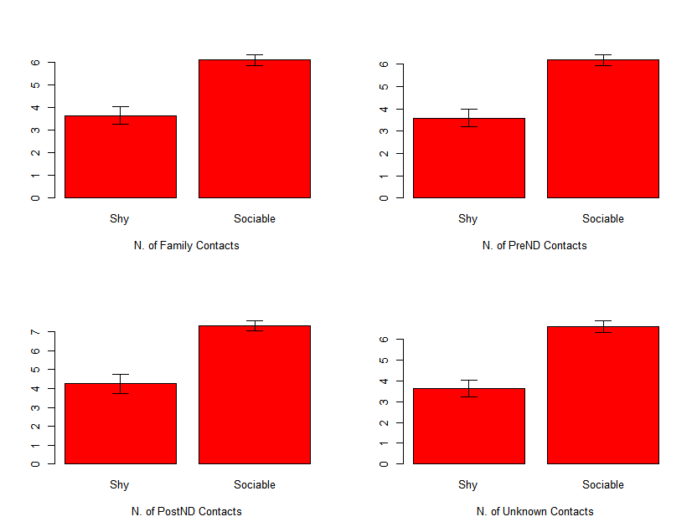
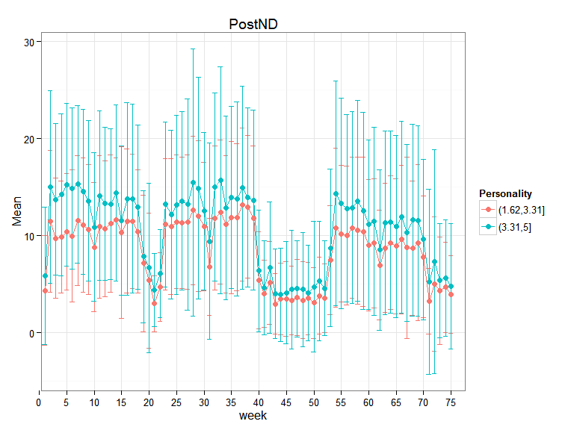
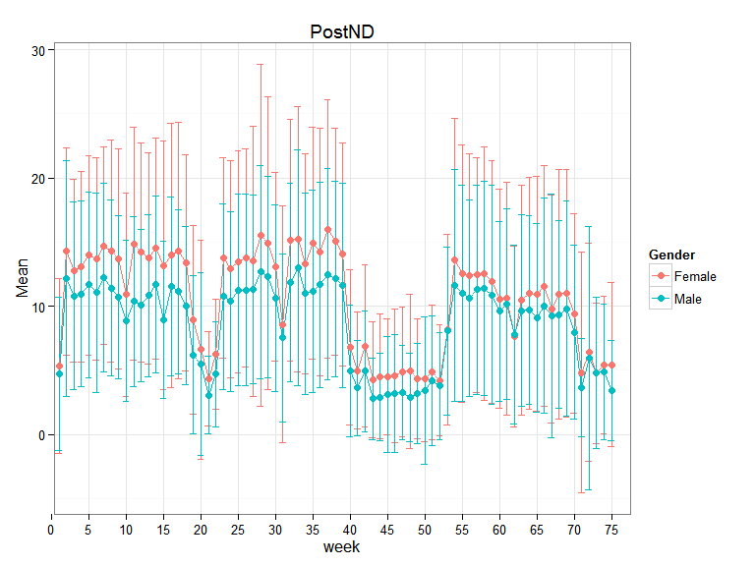
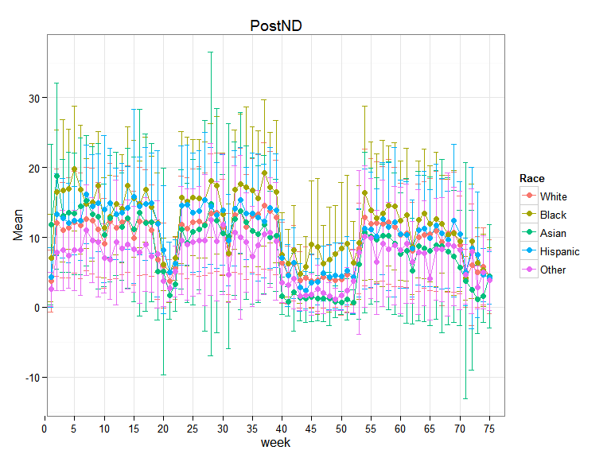
The Effects of Individual Traits on the Formation of Social Networks Among First-Year College Students
Result: There are strong personality, race, and gender effects on active network size. Personality effects persist through the observation period but gender effects decline.
Female students have larger active Post-ND networks than male students.
African-American and Hispanic students have larger active Post-ND networks than White and Asian students
Extraverted students have larger active post-ND networks than introverted students
These findings give us insight on the types of individual characteristics that modulate network dynamics
2
Notes:
INSTRUCTIONS This is slide 2 of the standard 2-slide technical highlights example. Please keep this layout and subheadings. List significant recent publications in the notes section of this slide.
P. Basu, F. Yu, and A. Bar-Noy, “Low expected latency routing in dynamic networks”, Under review at ACM MobiCom 2013. (BBN, CUNY)**

Slide 3
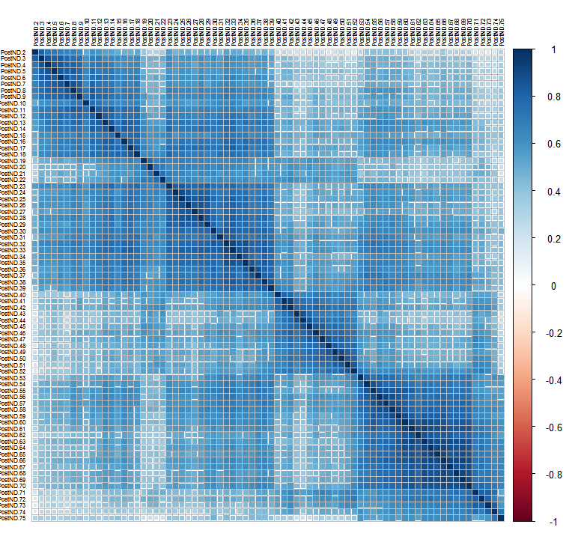
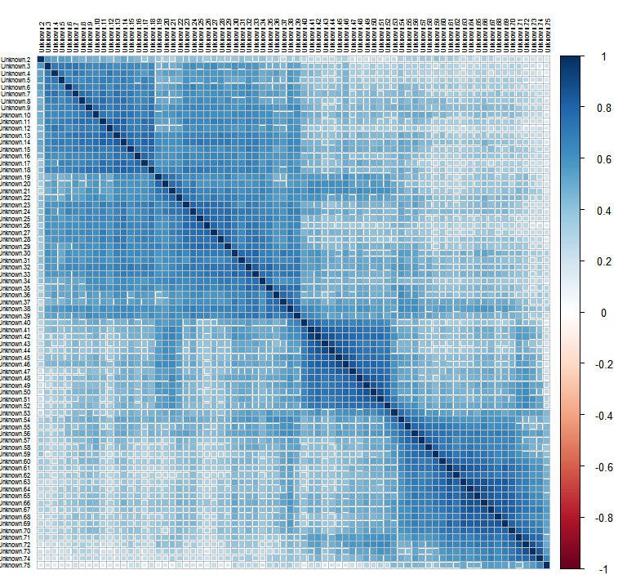
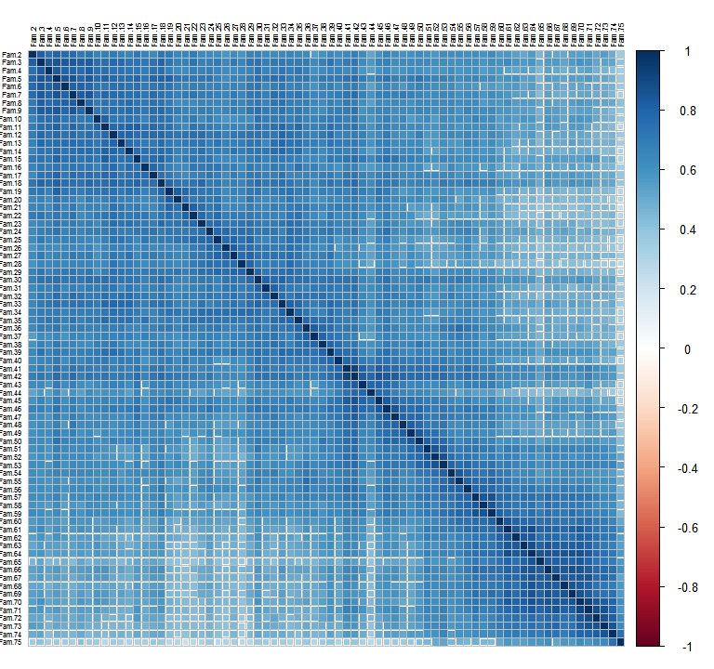
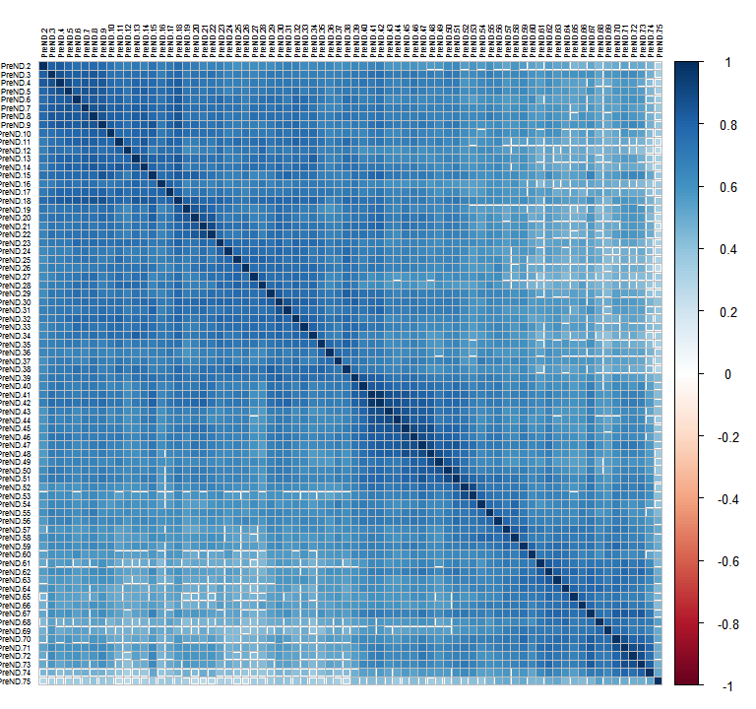
The Effects of Individual Traits on the Formation of Social Networks Among First-Year College Students
Inter-Temporal Rank Correlations
in Active Degree
Result: There are strong personality, race, and gender effects on active network size. Personality effects persist through the observation period but gender effects decline.
Female students have larger active Post-ND networks than male students.
African-American and Hispanic students have larger active Post-ND networks than White and Asian students
Extraverted students have larger active post-ND networks than introverted students
These findings give us insight on the types of individual characteristics that modulate network dynamics
3
Notes:
INSTRUCTIONS This is slide 2 of the standard 2-slide technical highlights example. Please keep this layout and subheadings. List significant recent publications in the notes section of this slide.

