Slide 1
Incubators or Diffusers?
Examining the Dynamic Coupling of Context and Social Ties Across Multiple Foci
Brandon Sepulvado, NORC at the University of Chicago
sepulvado-brandon@norc.org
Cheng Wang, Wayne State University
chengwang@wayne.edu
Omar Lizardo, University of California, Los Angeles
olizardo@soc.ucla.edu
David Hachen, University of Notre Dame
dhachen@nd.edu

Slide 2
Background

Slide 3


Focus Theory
Church
Family
School
One of the “Classic” ones!
You

Slide 4
Foci FAQ
Church
Family
School
What are foci anyway?
You
[A]ny “social, psychological, legal, or physical entity around which joint activities are organized” (1981, p. 1016)

Slide 5
Foci FAQ
What do foci do all day?
Church
Family
School
Generate Ties
You
Create Similarities
Account for “endogenous” effects

Slide 6
Foci FAQ
Are foci just groups?
Church
Family
School
Nope!
You
They could be any “social, psychological, legal, or physical” entity that organizes activities
So tastes, genres, interests, etc. also count

Slide 7
Foci FAQ
Do foci just make interpersonal ties happen?
Church
Family
School
Yes and no
You

Slide 8
Foci FAQ
Do foci just make interpersonal ties happen?
Church
Family
School
Feld Prop 1:
“[t]wo individuals who are related to the same focus are more likely to be tied than two people not so related” (Feld 1981: 1026)
You

Slide 9
Foci FAQ
But!
Church
Family
School
Also Feld:
“...it is important to remember that the formation of social networks and the relations to foci are interdependent. Once there is a tie between two individuals, these individuals will tend to find and develop new foci around which to organize their joint activity” 1981:1019).
You

Slide 10
Club
School
You
So foci can be “generated” via interpersonal ties
Person-to-focus layer
Rap
You
How best to think of this?
Interpersonal layer
Multilayer Networks!

Slide 11
Generalized Focus Theory
Club
School
You
Patterns of crosslayer dependence across coupled networks
Person-to-focus layer
Rap
Prop 1 is a special case!
You
Interpersonal layer
GFT is a dynamic theory

Slide 12
Generalized Foci Effects

Slide 13
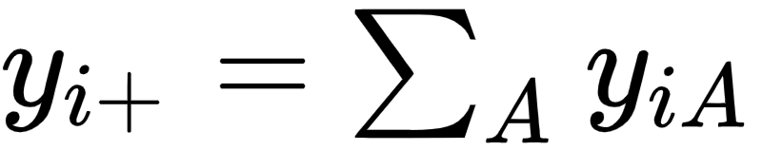
i
A
Affiliation tendency

Slide 14
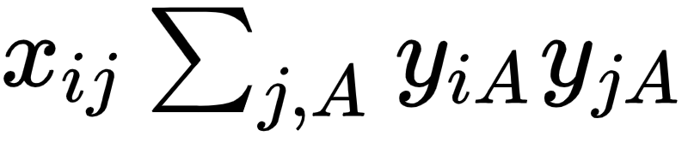
i
A
j
Classic Focus Effect

Slide 15
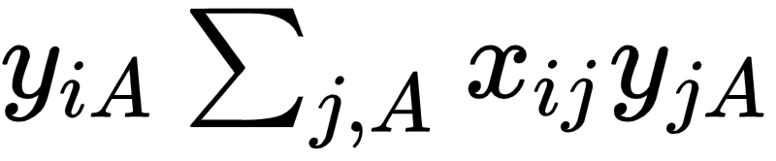
i
A
j
Direct Focus “Diffusion”

Slide 16
i
A
j
“Association-Based Closure” (Lomi and Stadtfeld 2014)

Slide 17
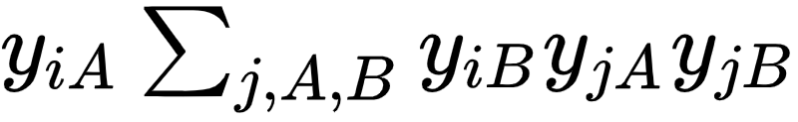
i
A
j
B
Indirect Focus “Diffusion”

Slide 18
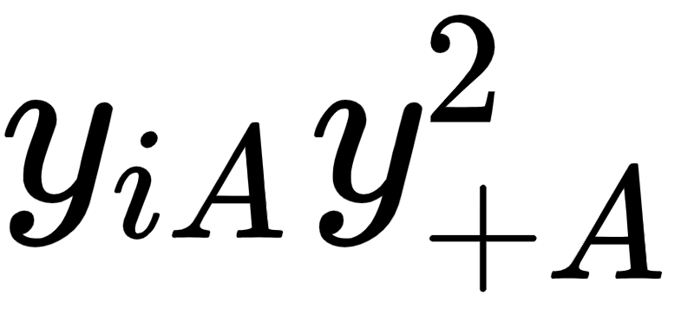
i
j
A
k
Focus Attractiveness

Slide 19
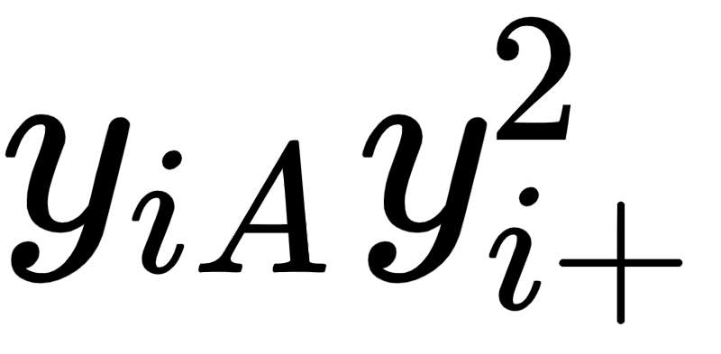
A
i
B
C
Joining Activity

Slide 20
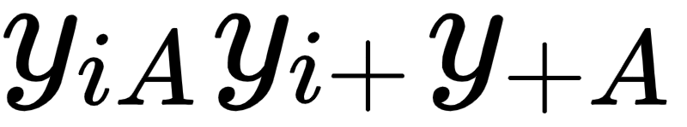
i
A
j
B
k
C
Attractive Foci Attract Joiners

Slide 21
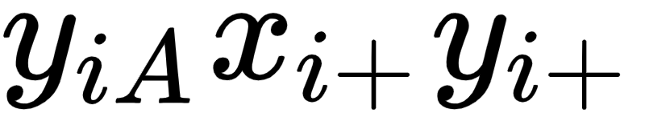
j
A
k
i
B
h
C
Popular Kids are Also Joiners

Slide 22
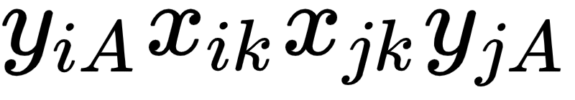
i
k
A
j
Two-Step Focus Diffusion

Slide 23
Data

Slide 24
Data and methods
NetSense Study
  Network and affiliation information over a 70-week period
  196 University of Notre Dame undergraduate students
  Begins fall of 2011.
  Data are aggregated into two waves, covering 17 weeks:
    Fall 2011 semester 2011 (i.e., week 1 to week 17)
    Spring 2012 semester 2012 (i.e., week 22 to week 38).
NetHealth Study
Network and affiliation information over a 104 week period
483 University of Notre Dame undergraduate students.
Begins fall of 2015
Data are aggregated into two waves, covering 17 weeks:
  Fall 215 semester 2011 (i.e., week 1 to week 17)
  Spring 2016 spring semester 2016 (i.e., week 21 to week 37).

Slide 25
Data and methods
NetSense and NetHealth Studies
  Interpersonal networks:
    Texts collected from Android-powered smartphone backed up to a server administered by the project team
  Affiliation Networks:
    Obtained from periodic (once a semester) surveys and admin records:
      Musical preferences (NetSense Only)
      Courses taken
      Club memberships (Recoded into types)
      Preferred activities (Up to nine)

Slide 26
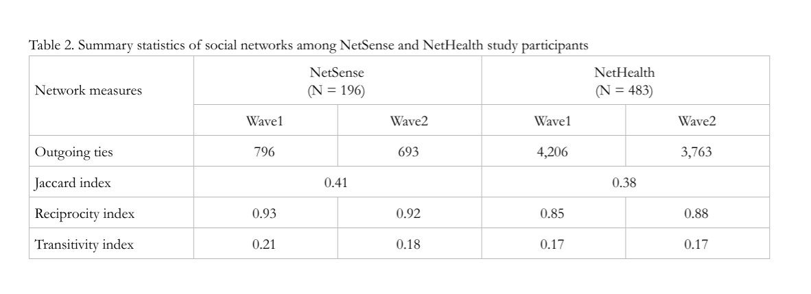

Slide 27
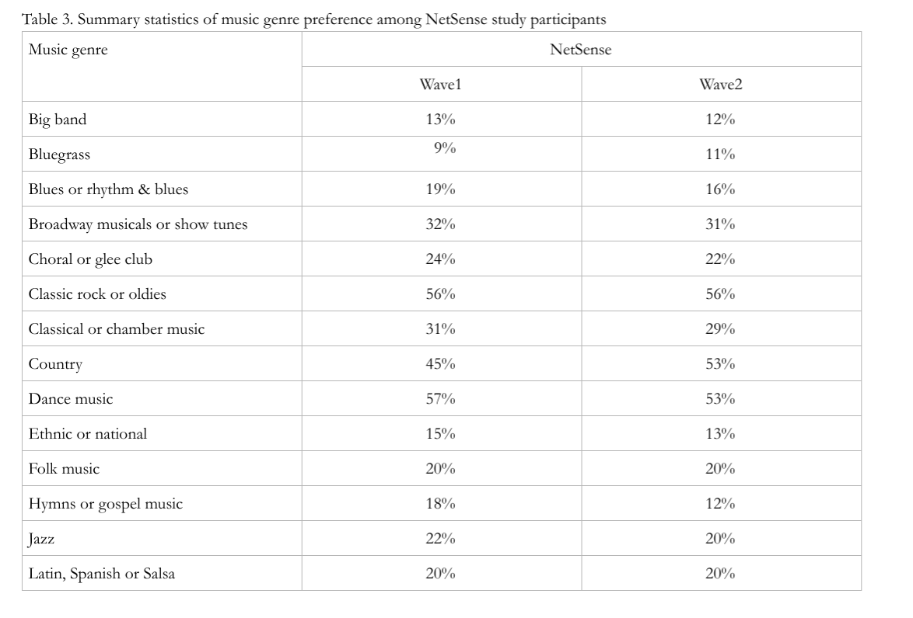

Slide 28
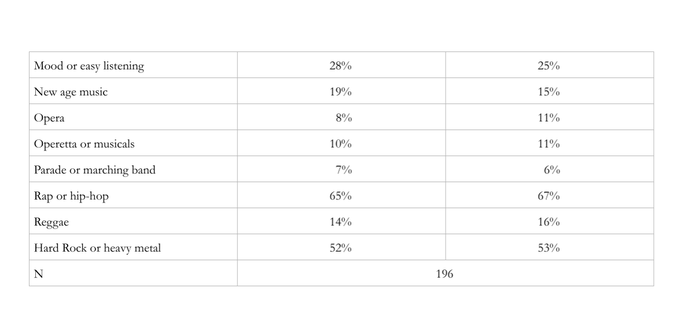

Slide 29
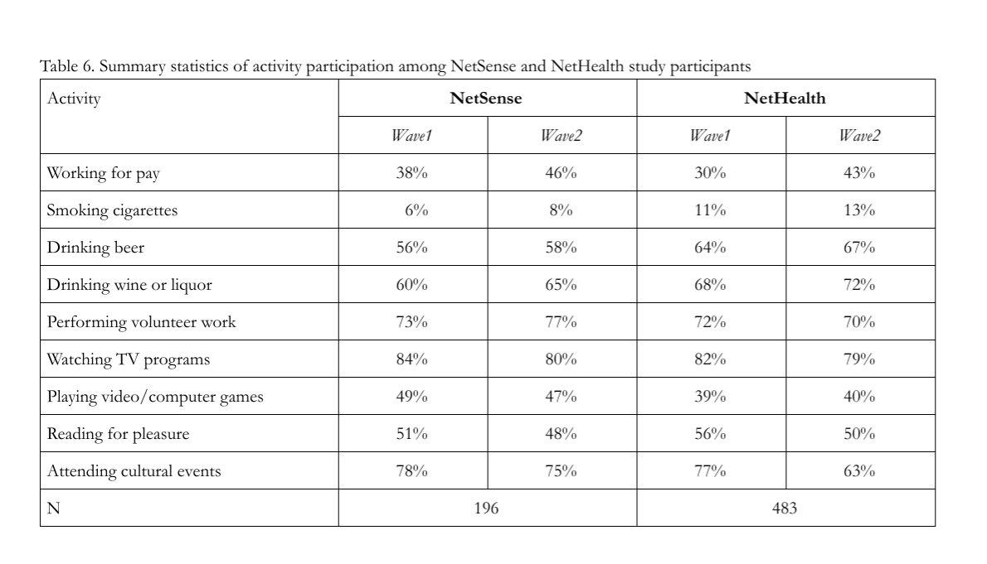

Slide 30
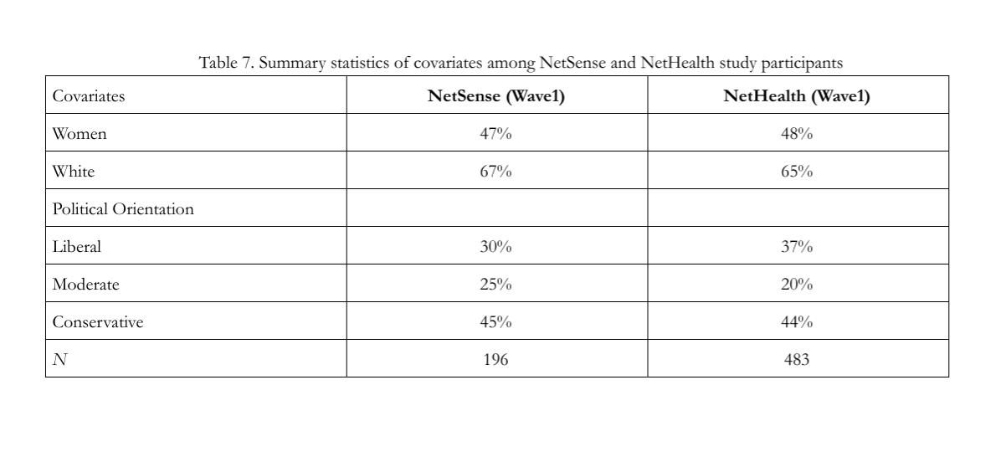

Slide 31
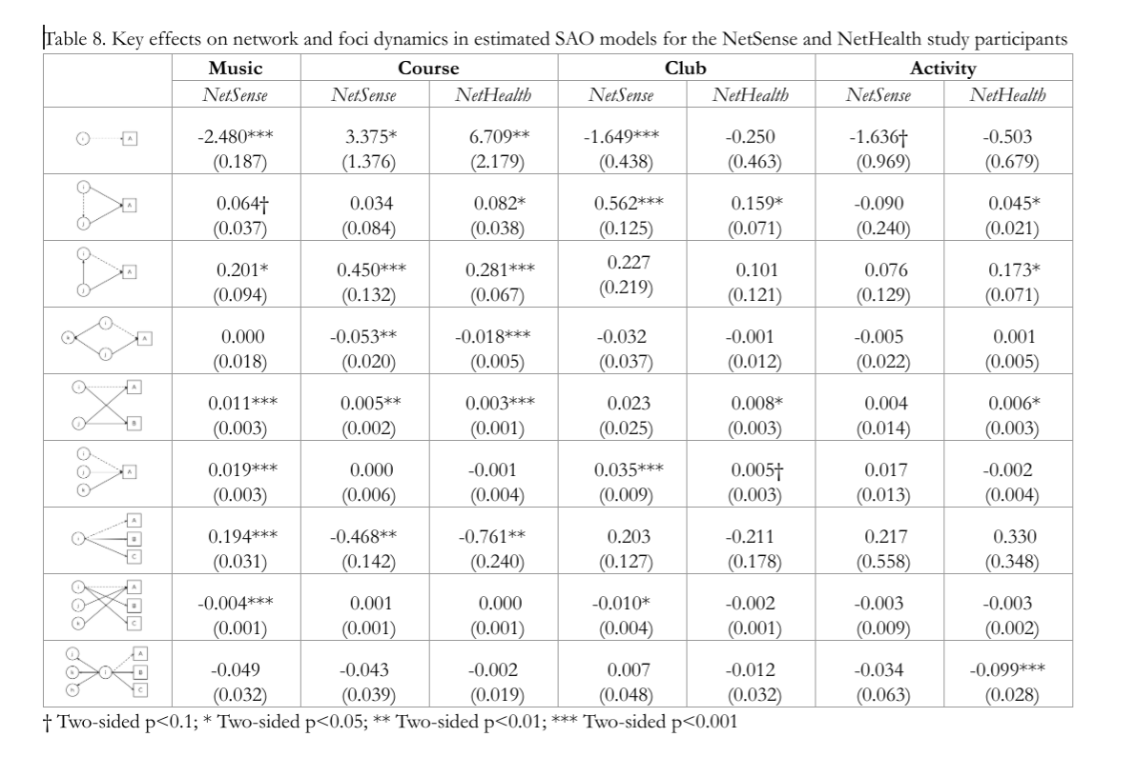

Slide 32
Conclusions

Slide 33
Generalized Focus Theory
Club
School
You
Both “standard” and “reverse” focus effects
Person-to-focus layer
Rap
Depends on the type of focus
You
Interpersonal layer
Indirect focus diffusion!

