Slide 1
Roles and positions in networks
Network methods are good for providing concrete specifications of originally fuzzy concepts
  The graph-theoretic notion of equivalence and social position does for the classic notion notion of roles (taken from functionalist sociology and social anthropology) what centrality does for prominence.
  Equivalence can be thought of as a partition of the set of vertices in a graph into a set of disjoint classes.
  Each subset of vertices in the same class can be thought of as playing the same role or occupying the same position.

Slide 2
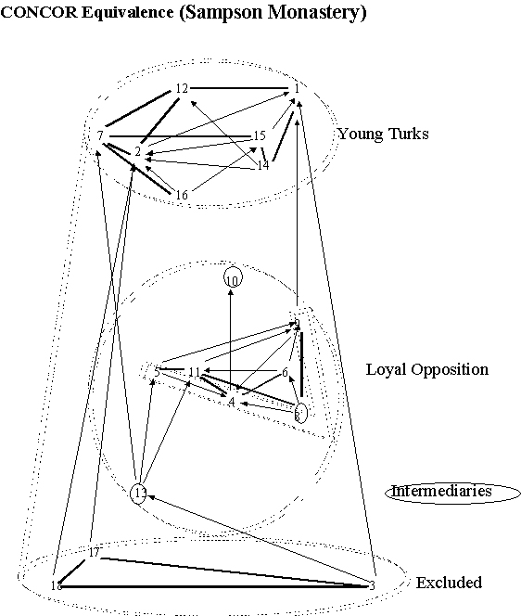
Roles and positions in networks
Ascertaining equivalence relations among vertices can thus be thought of as imposing a classification on the vertex set.
  Given a graph
    G = (V, E)
  Find a partition of V compatible with E

Slide 3
Roles and positions in networks
A Partition P = {C₁...C_{k}} of V is a set of non-empty, disjoint subsets such that:
  V=U_{i} C_{i}
  Each vertex v belongs to exactly one class or block
  An equivalence relation (reflexive, symmetric) on V defines a partition

Slide 4
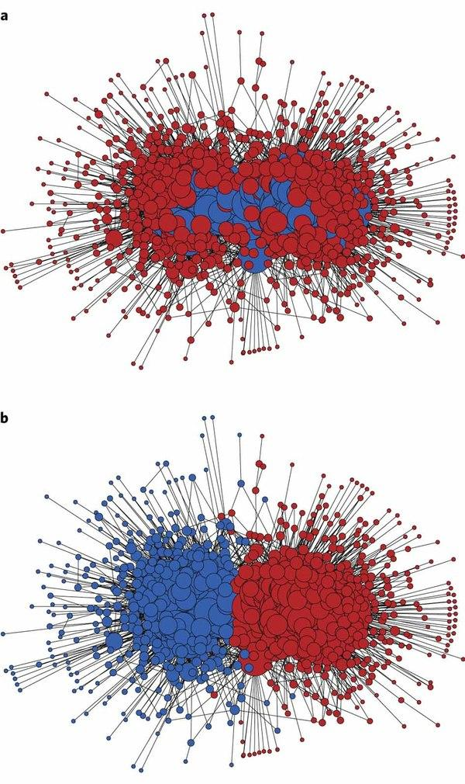
Roles and positions in networks
Given a partitioning of the set of vertices into disjoint classes
We may be interested in the connection across the blocks
  Two blocks are connected via the adjacency relations of their respective vertices to one another in the original graph

Slide 5
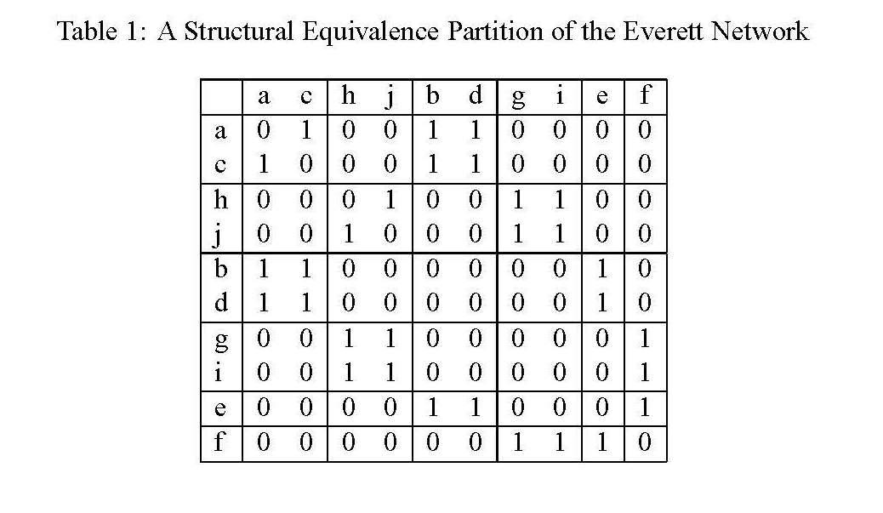
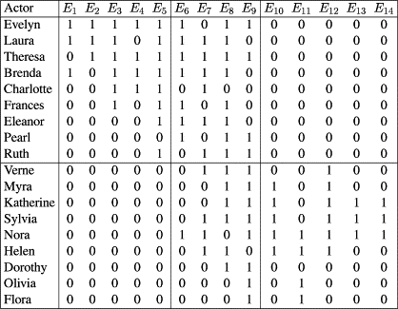
Roles and positions in networks
A reduced representation showing the roles and their relations is called a role graph or image graph
  Role assignment can thus be thought of as a "data reduction" technique for networks
  Thus, vertex classification defines "similarity" and reduces network complexity

Slide 6
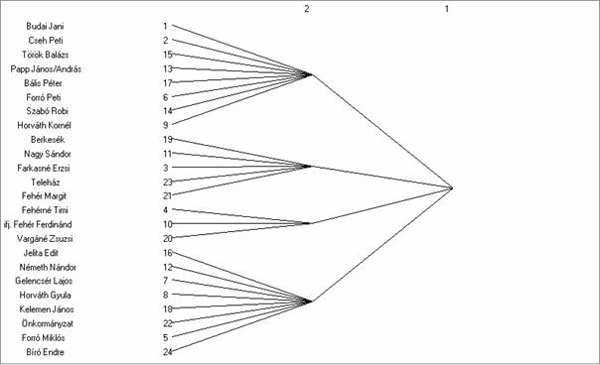
Roles and positions in networks
A reduced representation showing the roles (or blocks) and their relations is called a role graph or image graph
  This may be particularly appropriate for large, irregular graphs
  Meaningful structure may be captured at the image or role graph level rather than at the "individual" vertex level

Slide 7
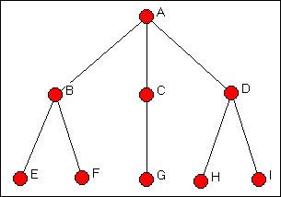
Roles and positions in networks
A reduced representation showing the roles (or blocks) and their relations is called a role graph or image graph
  Vertex behavior may display regularities at the level of role or position that it fails to display at the individual level (Parsons 1951; Nadel 1957; Burt 1976; White, Boorman and Breiger 1976)

Slide 8
Notions of Equivalence
The simplest conceptualization of role equivalence is structural equivalence
  Two vertices u and v are structural equivalent iff they have the same pattern of relations with other actors
If G = (V, E) and V -> W is a role assignment, the relation R is a structural equivalence iff for all u, v in V:
  uRv implies that the outgoing set of neighbors of u and the outgoing set of neighbors of v are the same
  uRv implies that the incoming set of neighbors of u and the incoming set of neighbors of v are the same.

Slide 9



Notions of Equivalence

Slide 10
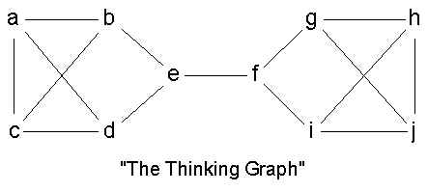
Notions of Equivalence
Defining roles via a structural equivalence is an admittedly strong definition unlikely to be met in real world data
  Theoretically, the notion of role implies similar patterns of connectivity to similarly positioned actors not to literally the same actors

Slide 12
Notions of Equivalence
Defining roles via a structural equivalence is an admittedly strong definition unlikely to be met in real world data
  Theoretically, the notion of role implies similar patterns of connectivity to similarly positioned actors not to literally the same actors

Slide 13
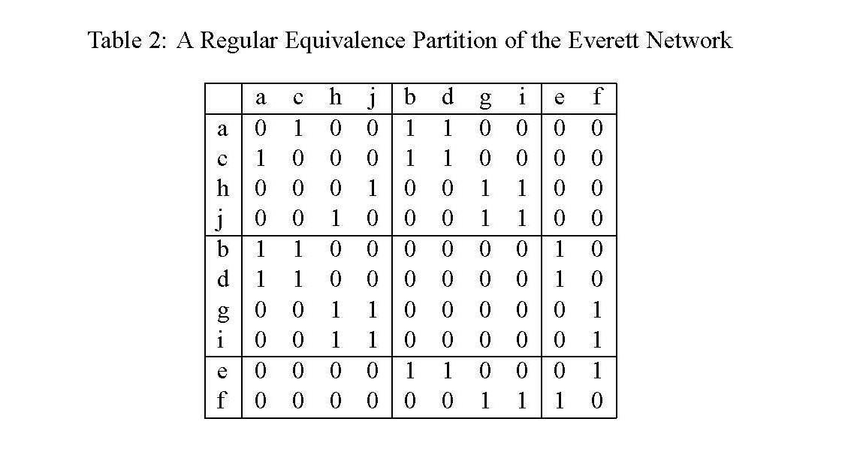

Slide 14
Notions of Equivalence
Defining roles via a structural equivalence is an admittedly strong definition unlikely to be met in real world data
  Theoretically, the notion of role implies similar patterns of connectivity to similarly positioned actors not to literally the same actors

Slide 15
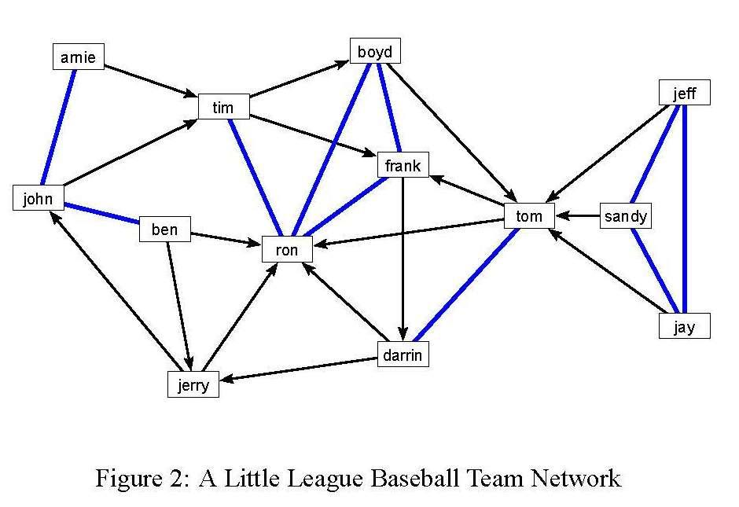

Slide 16
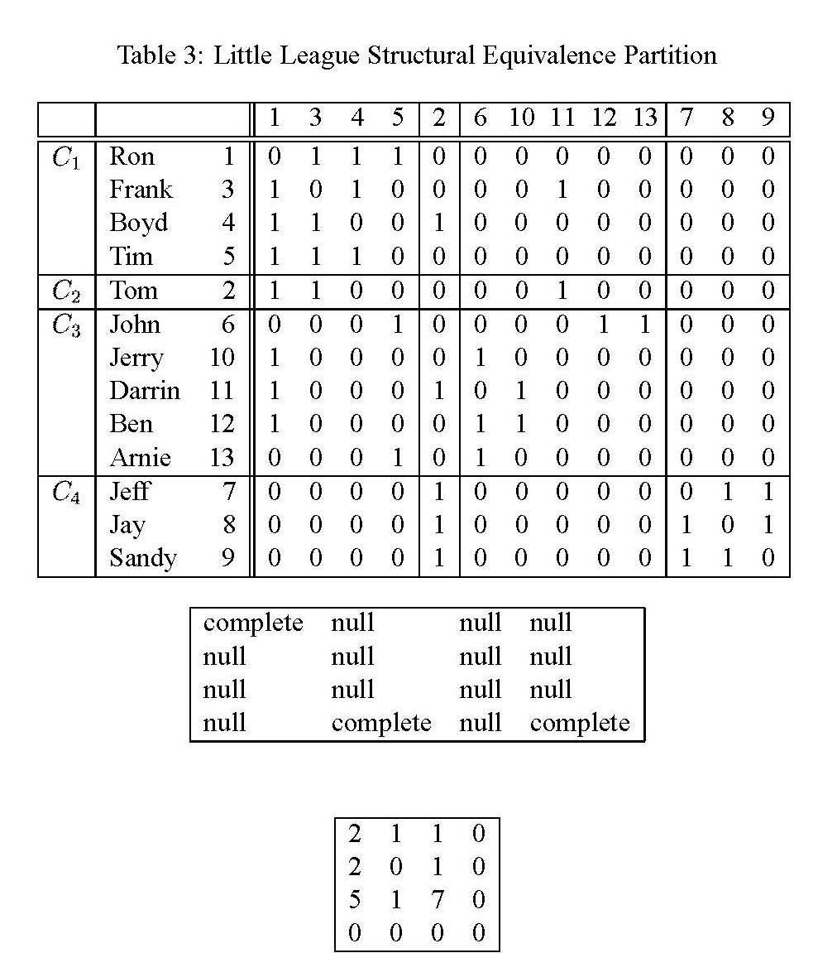

Slide 17

Blockmodeling
In most real world applications the strong graph-theoretic definitions of structural or regular equivalence are unlikely to hold
  Attempts to come up with stochastic approximations of equivalence relations for the purposes of vertex classification is called blockmodeling

Slide 18
Blockmodeling
For a given graph G, a blockmodel consists of two parts:
  A partition P = {P₁, P₂, ...P_{k}} into k disjoint subsets called the positions of G
  A set of matrices B (called image matrices) that represent hypotheses on the relations between positions

Slide 19
Blockmodeling
A blockmodel is thus a simplified representation of the original network whose basic elements are the positions
  The basic task is to ascertain to what extent the observed network approximates some idealized (theoretical) image of the "underlying" role relations

Slide 20
Blockmodeling
Blockmodels build on minimal relaxations of structural equivalence that still correspond to some minimal numbers of positions in the network

Slide 21
Blockmodeling
From the point of view of the adjacency matrix A a blockmodel is defined as:
  A permutation (shuffling of the rows and columns) of A
  Such that vertices in the same position end up in consecutive rows and columns

Slide 22
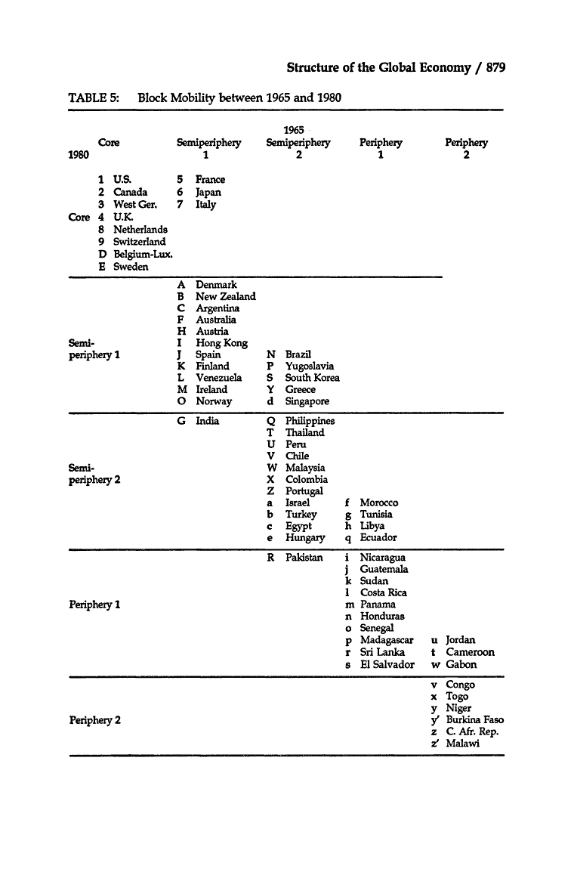
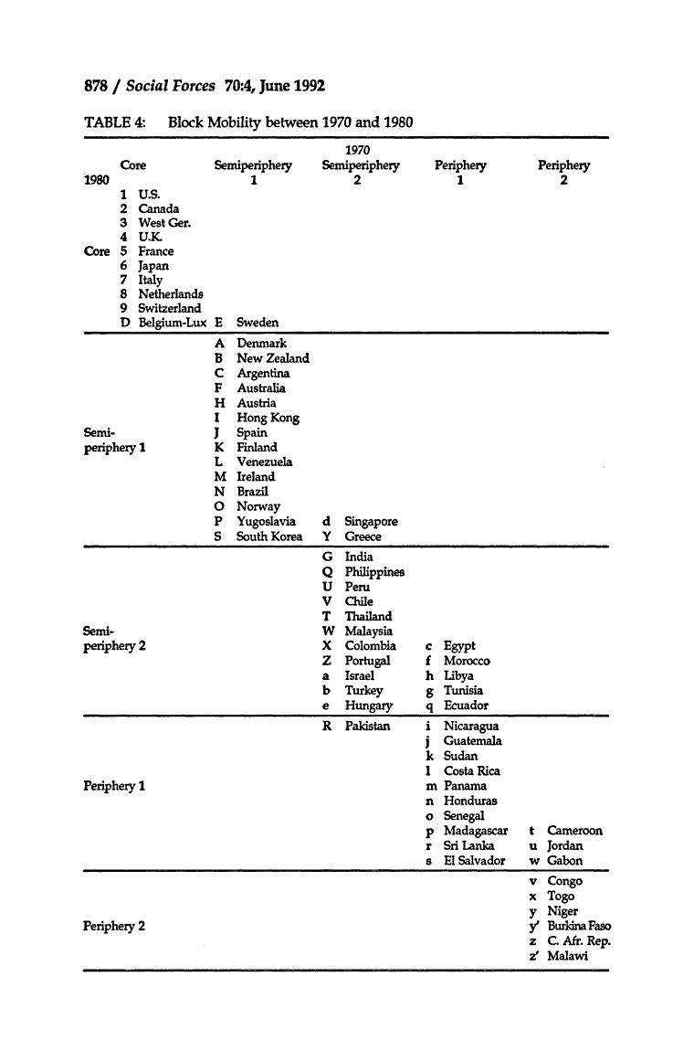

Slide 23
Blockmodeling
Two basic approaches to blockmodeling:
  So-called "deterministic" approaches (bottom-up, inductive)
  So-called "stochastic" approaches (top-down, deductive)

Slide 24
Blockmodeling (Deterministic)
Basic task in deterministic blockmodeling is to come up with a criterion for "approximate" equivalence:
  The Euclidean distance (Burt 1976)
  The Pearson product-moment correlation (Breiger, Boorman and Arabie 1975)

Slide 25

Blockmodeling (Deterministic)
For two actors i and j, the Euclidean distance is defined as:

Slide 26
Blockmodeling (Deterministic)
For a given adjacency matrix A, the correlation matrix C is the matrix containing the Pearson product moment correlations between the respective row and columns for two actors r_{ij}

Slide 27
Blockmodeling (Deterministic)
In Burt's (1976) Euclidean distance approach, the basic idea is to:
  Generate the distance matrix D
  And the use a scaling method (e.g. MDS, PCA, hierarchical clustering) to come up with a reduced form representation of the various groups

Slide 28
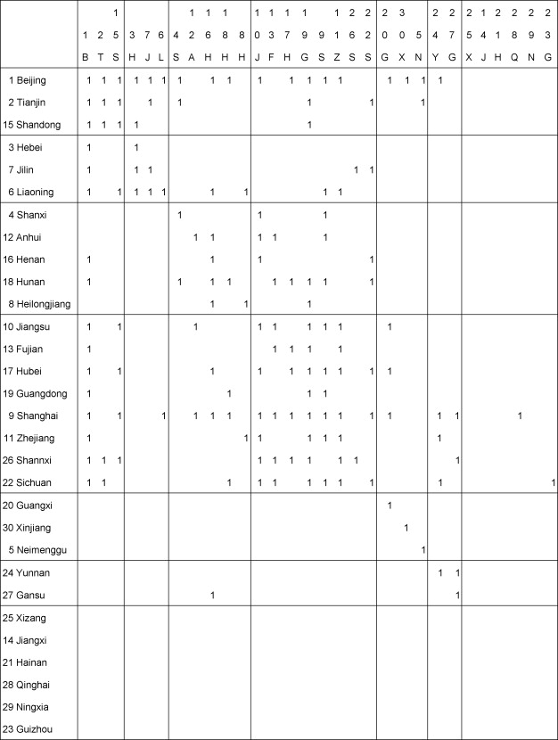
Blockmodeling (Deterministic)
In Breiger, Boorman and Arabie's CONCOR strategy, the basic idea is to:
  Generate the (initial) correlation matrix C₁ from A
  Iteratively obtain further correlation matrices {C_{2,} C₃, ...}
  until we have a "final" correlation matrix C_{k} that contains only +1 and -1 entries

Slide 29
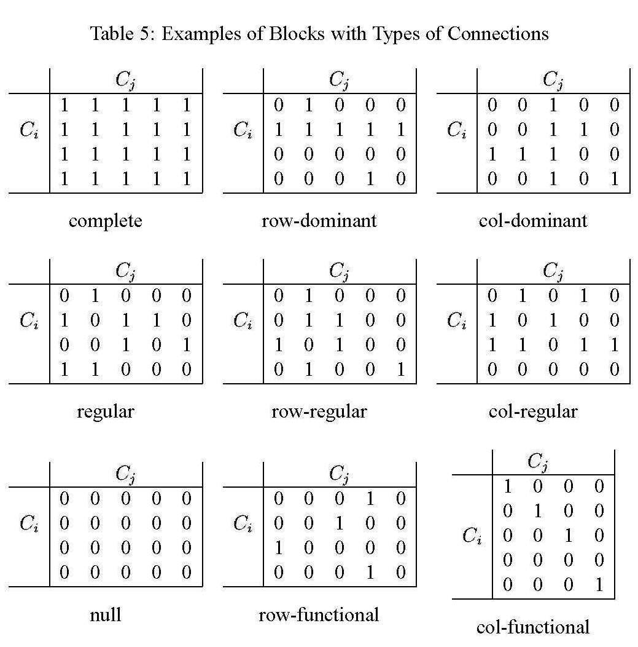
Generalized blockmodeling
In generalized blockmodeling, an idealized "image" of the role structure is pre-specified in advance
  The analyst then uses statistical techniques to ascertain how close the observed network is to the specified structure
  We may choose from a "canned" list of theoretically interesting patterns of role relations

Slide 31
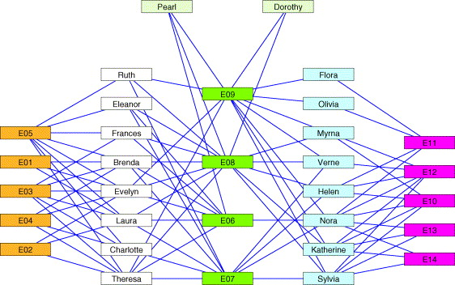
Generalized blockmodeling (Two Mode Networks)

Slide 32
Generalized blockmodeling (Two Mode Networks)

Slide 33
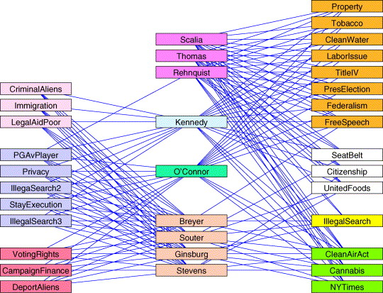
Generalized blockmodeling (Supreme Court Decisions)

Slide 34
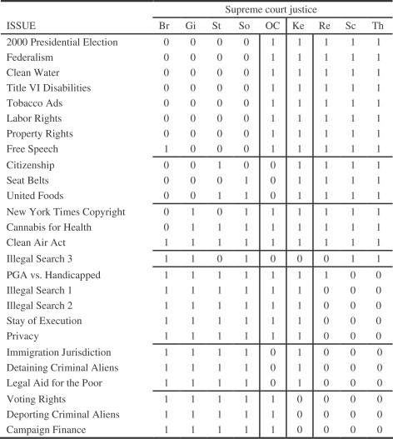
Generalized blockmodeling (Supreme Court Decisions)

Slide 35
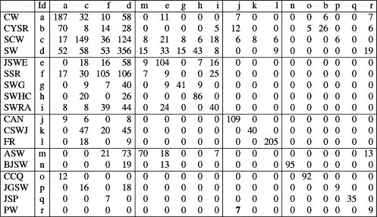
Generalized blockmodeling (Citation Networks)

