Slide 1
Diffusion

Slide 2
What is diffusion?
Spread of objects, ideas, information, concepts, fashions, tastes, practices etc. in a social network
  Elements of diffusion:
    Actors
      Usually people but also groups, organizations, etc.
    Flow
      From source to adopter
    Mechanism
      Imitation, influence, transfer, etc.
    Outcome
      Adoption, conversion, infection

Slide 3

Question: Why do things diffuse?
Three Factors Accounting for Why Things Spread
  Characteristics of the object being diffused
    Familiar/unfamiliar
    High risk (consequential) v. low risk
    Cost/benefit ratio
  Characteristics of the source and adopter
    Individual versus collective actor
    High status v. Low status actor
    Similar v. dissimilar
  Environmental Context
    Proximity
    Social Foci
    Network Structure

Slide 4
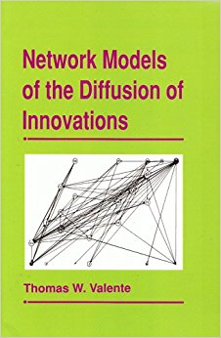
Social network models of diffusion
Diffusion via cohesion
  (Coleman et al 1966)
Diffusion via opinion leaders (two-step)
  (Katz and Lazarsfeld 1966; Rogers 1962)
Diffusion via positional equivalence
  (Burt 1987)
Diffusion via long (weak) ties
  (Granovetter 1973)
Global and Network Threshold Models
  (Granovetter and Soong 1983; Valente 1995)
Complex Contagion Models
  (Centora and Macy 2007)

Slide 5
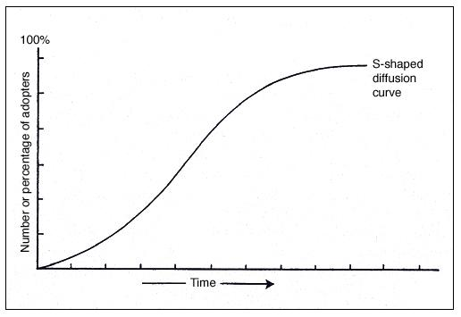
How do things spread? The S curve
Typical S-shaped pattern of cumulative adoptions
  Initial slow uptake
  Rapid spread
  Final slow saturation

Slide 6

How do things spread? The S curve
Typical S-shaped pattern of cumulative adoptions
  Initial slow uptake
  Rapid spread
  Final slow saturation
Ryan, B. and N.C. Gross (1943) The Diffusion of Hybrid Seed Corn in Two Iowa Communities, Rural Sociology, 8: 15-24.

Slide 7
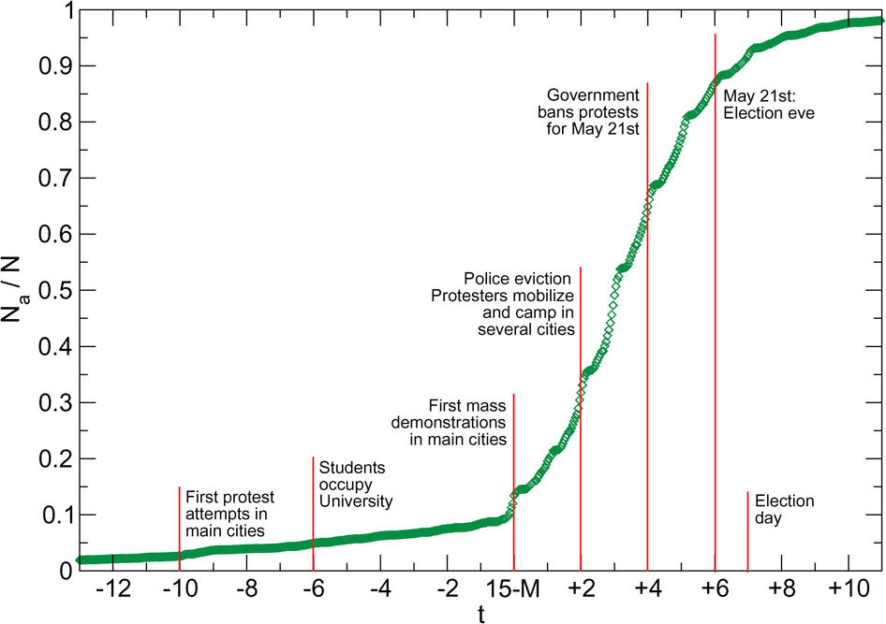
How do things spread? The S curve
Typical S-shaped pattern of cumulative adoptions
  Initial slow uptake
  Rapid spread
  Final slow saturation
González-Bailón, S., Borge-Holthoefer, J., Rivero, A., & Moreno, Y. (2011). The dynamics of protest recruitment through an online network. Scientific Reports, 1, 197.

Slide 8
Granovetter and Soong’s threshold model
If your friend jumped off a bridge would you?
  Better question:
    How many of your friends would have to jump before you did?
  What is your q?
Each actor (i) has a “threshold” for adoption q(i)
    0 > q(i) < 1
  (i) adopts when the proportion of people who have adopted (p) is equal to q(i)
Notes:
Contagion no network

Slide 9
Granovetter and Soong’s threshold model
If your friend jumped off a bridge would you?
  Better question:
    How many of your friends would have to jump before you did?
  What is your q?
Each actor (i) has a “threshold” for adoption q(i)
    0 > q(i) < 1
  i adopts when the proportion of people who have adopted (p) = q(i)

Slide 10
Granovetter and Soong’s threshold model
Persons with low thresholds are high risk early adopters
Persons with high thresholds are risk averse late adopters
  People have different q values
    Some high
    Some Low
    Most in the Middle (a bell curve)
    This explains the S-shaped pattern
      Slow uptake when adoption is concentrated among a few low q people
      Faster as the majority of middle q people join in
      Slow again as the last few high q people finally adopt
Variance in thresholds across people explains the typical S-shaped pattern of cumulative adoptions with initial slow uptake, rapid spread and slow saturation

Slide 11
Granovetter and Soong’s threshold model
Persons with low thresholds are high risk early adopters
Persons with high thresholds are risk averse late adopters
  People have different q values
    Some high
    Some Low
    Most in the Middle (a bell curve)
    This explains the S-shaped pattern
      Slow uptake when adoption is concentrated among a few low q people
      Faster as the majority of middle q people join in
      Slow again as the last few high q people finally adopt
Shape of the threshold distribution determines the time to (or whether) the cascade becomes global (everybody adopts)
  E.g. Uniform, bell-shaped, skewed, etc.

Slide 12

The Rogers Classification of Adopters
Rogers, E.M.(1962) The Diffusion of Innovations, Free Press, New York.

Slide 13
The Rogers Classification of Adopters
Tipping point
Rogers, E.M.(1962) The Diffusion of Innovations, Free Press, New York.

Slide 14
The Rogers Classification of Adopters
Failed Innovations die before reaching the tipping point
Rogers, E.M.(1962) The Diffusion of Innovations, Free Press, New York.

Slide 15
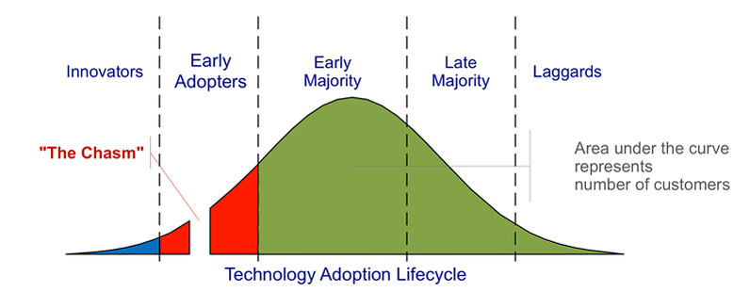
The Rogers Classification of Adopters
Area under the curve represents number of adopters
Kastelle, T (2012) Two Problems Caused by the Innovation Diffusion Curve
http://timkastelle.org/blog/2012/02/two-problems-caused-by-the-innovation-diffusion-curve/ (last accessed October 9th 2014)

Slide 16
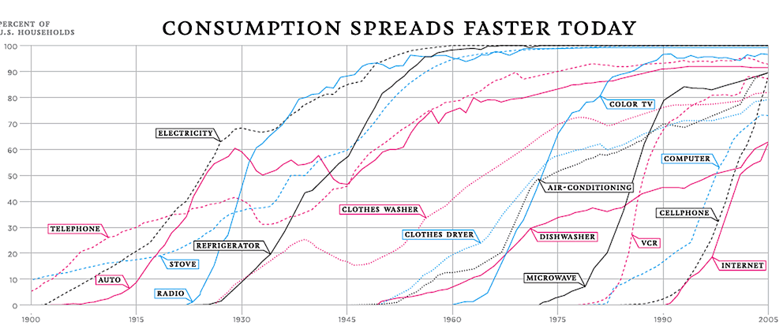
Thompson, D. (2012) The 100-Year March of Technology in 1 Graph. http://www.theatlantic.com/technology/archive/2012/04/the-100-year-march-of-technology-in-1-graph/255573/ (last accessed October 9th 2014)

Slide 17
The Rogers Classification
Innovators and Early adopters
  Individuals whose time-of-adoption is greater than one standard deviation earlier than the average time-of-adoption
Early and late majorities
  Individuals whose time-of-adoption is bounded by one standard deviation earlier and later than the average
Laggards
  Individuals who adopted later than one standard deviation from the average

Slide 18
Burt’s positional equivalence model
Reanalysis of Coleman et. al. (1957, 1966) study of diffusion of a new drug, tetracycline
Coleman claimed that diffusion patterns indicative of contagion
Burt hypothesized that structural equivalence could explain diffusion pattern
  Study
    4 Illinois cities
    130 (of 152, 85%) general practitioners, internists, pediatricians (and 4 specialists)
    pharmacy records used to code when physician first prescribed tetracycline
    network data from 2 name generators (advice and discuss) in physician surveys

Slide 19
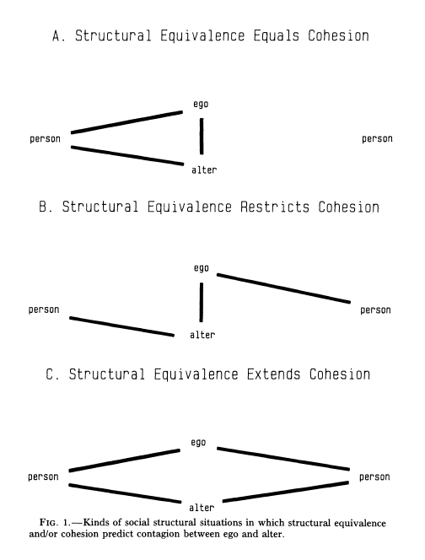
Cohesion (influence) vs. Equivalence (similarity)
Both Equivalence (similar relations with same people) and Cohesion (via strong tie between ego and alter) predict diffusion
  Cohesion but not Equivalence predicts restricted contagion (because of conflicting affiliations)
  Equivalence predicts contagion via competition for status
Mechanisms:
  Physical proximity: can "see" alters behaviors
  Cohesion: communication, social proximity
  Competition, relative standing: structural equivalence
  2 similar physicians keeping up with each other

Slide 20

Diffusion or Contagion?
k = probability of adopting independently
y = proportion who have not adopted
Diffusion:
  Equal probability (k) of adopting in each time period and for each person
  not a function of exposure (p)
Contagion:
  Equal probability of adopting (k) but also adoption a function of number of others who have adopted.

Slide 21
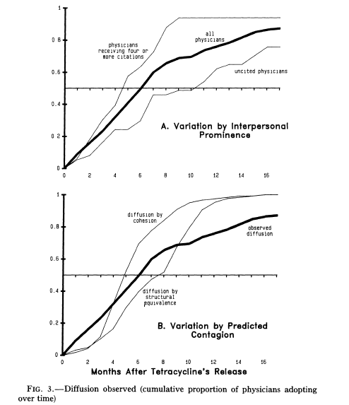
Cumulative Adoption Results
Diffusion by Cohesion:
  Adoption pattern when ego adopts after alter adopts
Diffusion by Structural Equivalence:
  Adoption pattern when ego adopts after peers adopt
  In both cases rate of adoption early on is higher than expected by contagion
  Contagion is not the only process at work
  High early adoption rate indicative of diffusion without contagion

Slide 22
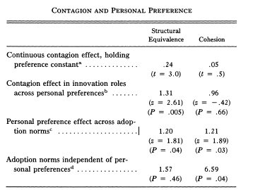
Results
Cohesion:
  Tie between ego and alter
Structural Equivalence:
  Euclidean distance between ego and alter (d_{ij}), i.e. how similar their patterns of ties are to others in the network

Slide 23
Results
Results from regressions:
  No evidence of contagion from advisors and discussion partners
  Strong evidence of diffusion between month in which peers adopted (structurally equivalent doctors) and ego adopting
  Personal factors determined adoption, i.e. predisposition to adopt
  Contagion independent of personal preference

Slide 24
Implications
Diffusion not via contagion (adjacency) but equivalence
  Why? Relative standing competition. Do not want to be a late adopter.
Heterogeneity in predisposition to adopt leads to critical mass needed to get diffusion by equivalence to take off

Slide 25
Valente’s Network Threshold Model
Global threshold models are appropriate for adoptions of behaviors that are public and observable
  Not always the case
Global threshold models make informational demands of individuals that are not always realistic
    Ego must know the actual proportion of population who has adopted
The network threshold model relaxes the assumption that persons have global information on all adoptions
  They only know what their direct contacts are doing
  Individuals adopt when some proportion of their contacts adopt
    More appropriate for the adoption of practices, behaviors and ideas that entails some sort of risk or uncertainty (complex contagion)

Slide 26
Valente’s Network Threshold Model
Each person (i) has some exposure e(i)
e(i) = proportion of i’s friends who adopted
When proportion of neighbors who adopt equals q(i), ego adopts
Person 1: q = 0.25
Person 2: q = 0.75
Time 1
Time 2
Time 1
Time 2
Time 3
Time 4
Time 3
Time 4

Slide 27
Valente’s Network Threshold Model
Just like before, everybody has a threshold q(i)
  When the proportion of neighbors who have adopted equals q(i), the person adopts
We can then redefine adopter categories (e.g. innovators) as either
  System Relative
    Whole network
  Network Relative
    Ego-network
For instance you can be an innovator in the grand scheme of things
  But be a relative laggard compared to your friends
  If all of your friends are innovators
You can be a laggard in the grand scheme of things
  But be an innovator among your friends
  Because you are surrounded by even bigger laggards!

Slide 28
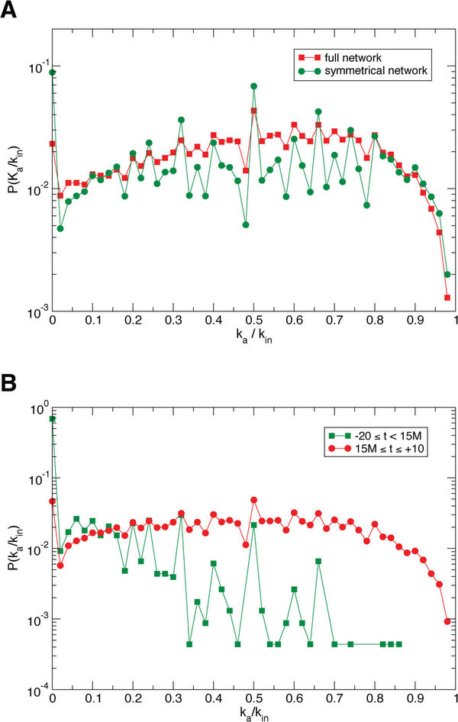
González-Bailón, S., Borge-Holthoefer, J., Rivero, A., & Moreno, Y. (2011). The dynamics of protest recruitment through an online network. Nature Scientific reports, 1, 97.

Slide 29
Valente’s Network Threshold Model
Revisiting the Roger’s classification using Valente’s model:
Who's an “opinion leader”?
  Early adopters who convince those with high network thresholds (but similar system threshold) to adopt
Whole Network Threshold
Low High
Personal Network Threshold
Low
High
True innovators (influentials) | Isolates
Connected Bandwagon | Resistant rearguard

Slide 30
Valente’s Network Threshold Model
The network threshold model makes sense of a lot of classic findings
  For instance, early adopters adopt from media or weak ties, late adopters adopt from their friends/strong ties
    This seems to reflect a Local/Cosmopolitan split
Whole Network Threshold
Low High
Personal Network Threshold
Low
High
True innovators (influentials) | Isolates
Connected Bandwagon | Resistant rearguard

Slide 31
Valente’s Network Threshold Model
The network threshold model makes sense of a lot of classic findings
  For instance, early adopters adopt from media or weak ties, late adopters adopt from their friends/strong ties
    Cosmopolitan innovators tend to be early adopters relative to the system and have very low threshold relative to their network
Whole Network Threshold
Low High
Personal Network Threshold
Low
High
True innovators (influentials) | Isolates
Connected Bandwagon | Resistant rearguard

Slide 32
Basic findings of research on innovation diffusion
Early adopters (innovators, opinion leaders) are well-connected
  Central, well-integrated, prominent
  Well connected persons more likely to adopt innovations with low cost/benefit ratios
Peripheral persons more likely to adopt risky innovations
  Cost/benefit ratio is high; uncertainty in payoff
  Risk-taking linked to reputation
Social isolates more likely to be “laggards”
Being a bridge is associated with early adoption
  Betweenness
  Structural holes

Slide 33
Complex versus simplex contagion
Heterogeneity in the propensity to adopt an innovation can be modeled as a threshold process
  However, thresholds may not be fixed for individuals regardless of what is being diffused
  Thresholds may depend on the characteristics of what is being diffused
    Low threshold -> Low risk
    High threshold -> High risk
Innovations that entail risk, ostracism, potential loss of resources, may elicit higher thresholds from all actors in the network
  Persons require exposure to multiple sources to adopt
Innovations (e.g. gossip) that carry little risk may in their turn elicit a very low threshold
  In the limiting case, the person adopts as soon as one of their neighbors adopts

Slide 34
Complex versus simplex contagion
Innovations that entail risk, ostracism, potential loss of resources, may elicit higher thresholds from all actors in the network
  Persons require exposure to multiple sources to adopt
This is the difference between simplex and complex contagion
  The basic idea is that certain innovations can only diffuse via complex contagion
Candidates for simplex contagion:
  Information, gossip, disease
Candidates for complex contagion:
  High risk social movement participation, religious conversion, migration, etc.

Slide 35
Complex versus simplex contagion
Weakness of long ties argument (Centola and Macy 2007):
  Long (weak) ties help to spread things in networks faster
    But only for things that spread via simplex contagions!
  They are not up to task when it comes to complex contagion
    Why?
      In addition to length, complex contagions require bridges to be wide with high bandwidth (Aral and Van Alstyne 2011)
      Complex contagions require multiple redundant contacts; a single bridge (even if high bandwidth) won’t do

Slide 36
Complex versus simplex contagion
Four social mechanisms that require that innovations diffuse via complex contagion:
  Strategic complementarity: (adoption cost declines as a function of existing adopters)
  Legitimacy: Resistance to challenge, collective acceptance, and taken-for-grantedness increases in the number of adopters
  Credibility: Innovations appears to be more trustworthy and less risky when high status members of the community also adopt
  Emotional contagion: Cumulative interaction with a large number of adopters leads persons to adopt

Slide 37
Question: Why do things diffuse?
Overall something diffuses faster if:
  It is familiar rather than unfamiliar
  It is relatively inconsequential
  Benefits outweigh costs
  The source is high status
  Source and target share social attributes
  Source and target are geographically proximate
  Source and target share overlapping social foci
  The network structure is conducive to diffusion
    Centralization v. Decentralization
    Connectivity v. Segmentation
    Density v. Sparseness
    Strong ties v. Weak ties
    Bridging v. Redundant Ties

