Slide 1
A two-mode network and its one-mode projections
A two-mode (or affiliation) network consists of:
  Two types of nodes.
  There are edges that make connections between types but not within types.
Examples
  Actors and movies.
  Scientists and papers.
  Persons and Events.

Slide 2
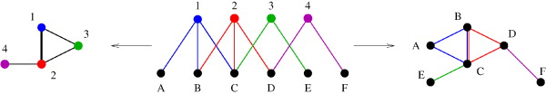
A two-mode network and its one-mode projections

Slide 3
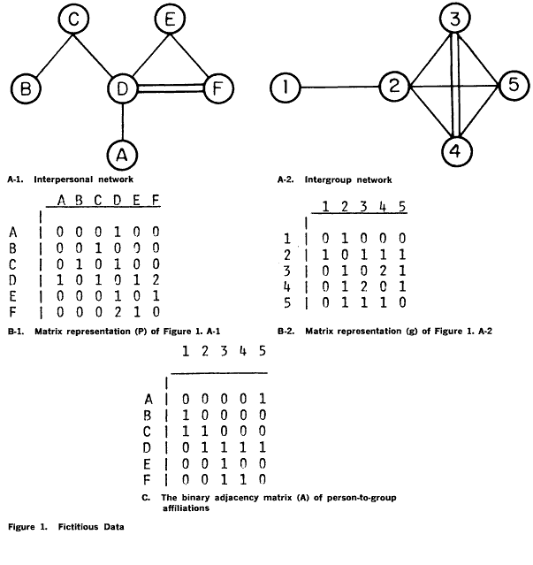
A two-mode network and its one-mode projections

Slide 4
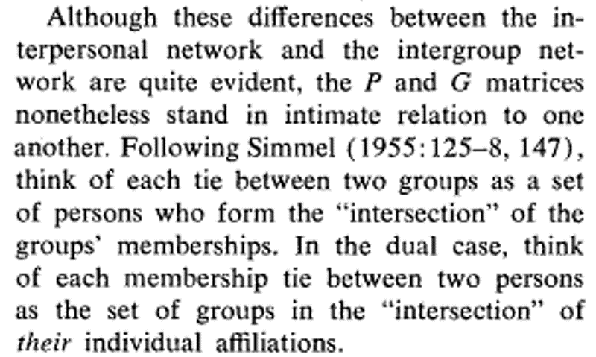
A two-mode network and its one-mode projections (Breiger 1974: 182).

Slide 5
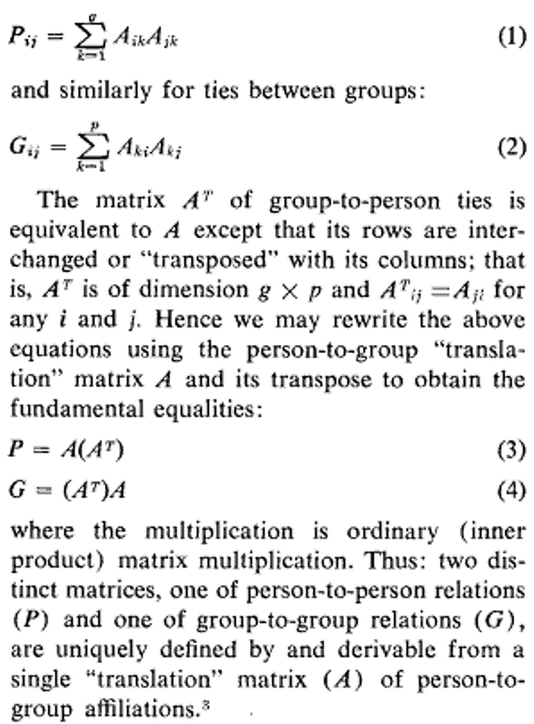
A two-mode network and its one-mode projections (Breiger 1974: 182).

Slide 6
Advantages of the two-mode to one-mode projection
We can analyze the network using all of the tricks that we have learned so far :
  We can study characteristics of the “ego-network” of one of the node types (e.g. the diversity of organizations that a person belongs to or the diversity of membership in an organization [McPherson 1982; McPherson and Smith-Lovin 1987]).
  We can calculate centrality measures for each node type (Bonacich 1991]).
  We can find cohesive subgroups.

Slide 7
Disadvantages of the two-mode to one-mode projection
Information encoded in the bipartite structure is lost after projection.
Edge inflation: The number of links in the one-mode graph is much larger than in the bipartite graph.
Artifactual properties: clustering the one-mode projection may not reflect actual clustering in the two-mode network.

Slide 8
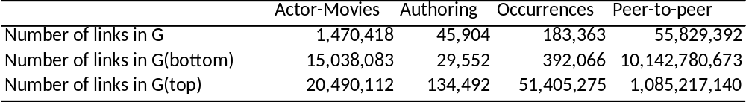
A two-mode network and its one-mode projections

Slide 9
Latapy et al’s Basic Statistics in Two-Mode Networks
Number of (top) Nodes: n↑
Number of (bottom) Nodes: n↓
Number of edges: m.
Average (top) degree: k↑= m/n↑
Average (bottom) degree: k↓ = m/n↓
Average Degree in the “Bipartite” graph:
  k=(2m/(n↑n↓)
Density in the two-mode graph:
  δ(G)=(m/ n↑n↓)
Density in the “Bipartite” Graph:
  δ(G’)= 2m/((n↑+ n↓)(n↑+ n↓-1))

Slide 10
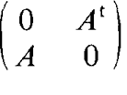
The bipartiate graph
Groups Persons
Groups Persons

Slide 11
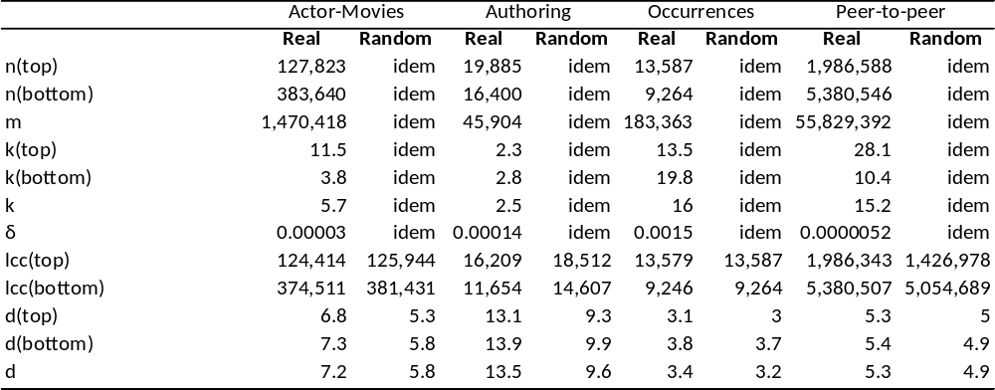
Basic Statistics in two-mode networks

Slide 12
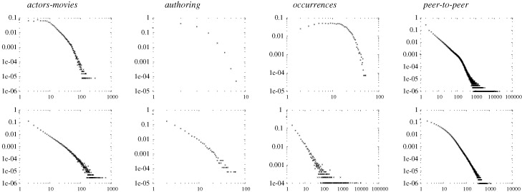
Degree Distributions in two-mode networks

Slide 13
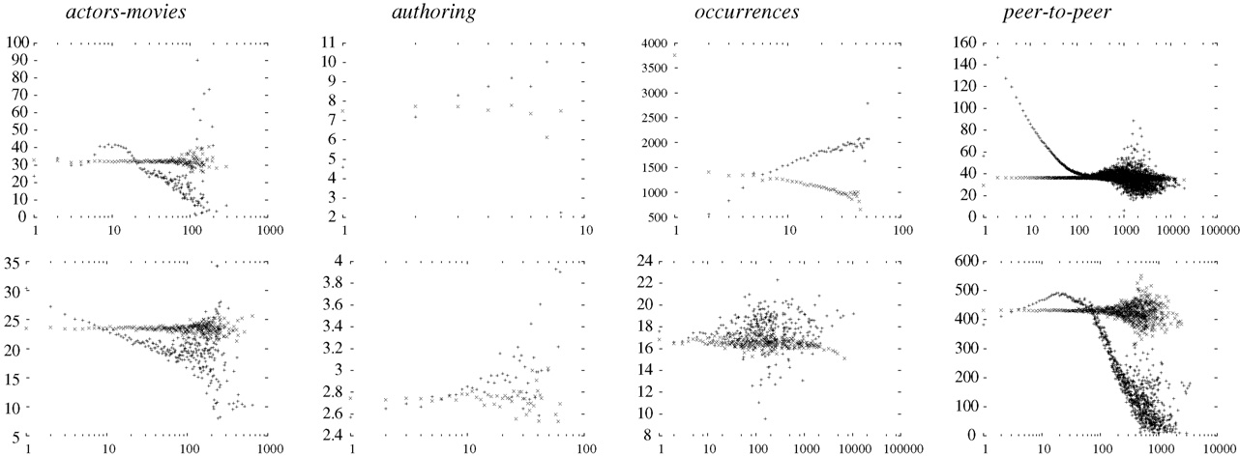
Degree-Correlations in Two-Mode Networks

Slide 14
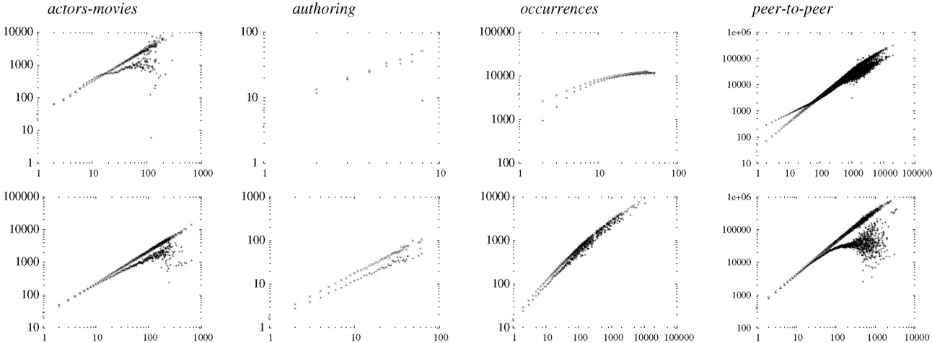
Degree against distance-2 Neighbors

Slide 15
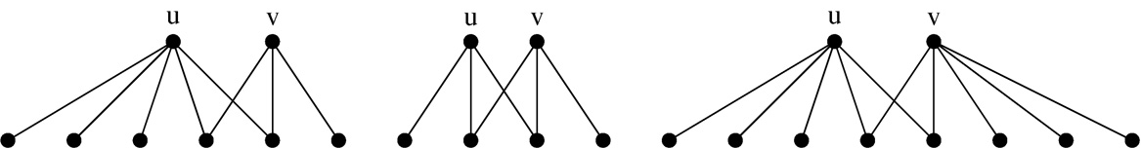
Bipartite Clustering
First definition: The clustering between any two nodes which belong to the same set (top or bottom) is given by the intersection of their one-step neighborhood divided by their union.

Slide 16
Bipartite Clustering
First definition: The clustering coefficient between any two nodes [cc.(u, v) which belong to the same set (top or bottom) is given by the intersection of their one-step neighborhood divided by their union.

Slide 17
Bipartite Clustering
A generalization: for any (top or bottom) node u, its clustering coefficient (cc.(↑) or cc.(↓)) is given by its average overlap with other nodes of the same type (vj) for which the overlap does not equal zero.
Total graph clustering:
  cc(G)=(n↑cc.(↑)+n↓cc.(↓)/n↑n↓)

Slide 18
Bipartite Clustering
A probabilistic formulation of two-mode clustering:
  CCN(G)=(number of realized quadruplets)/(number of possible ones)
Realized
Possible
?

Slide 19
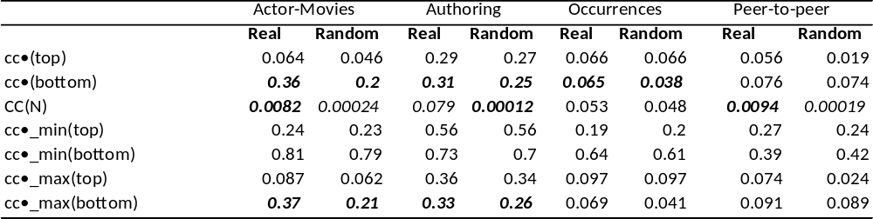
Clustering in two-mode networks

Slide 20
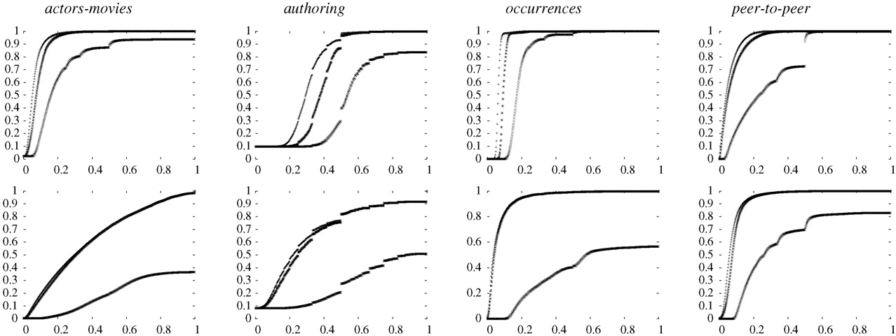
Cumulative Distribution of Clustering in two-mode networks

Slide 21
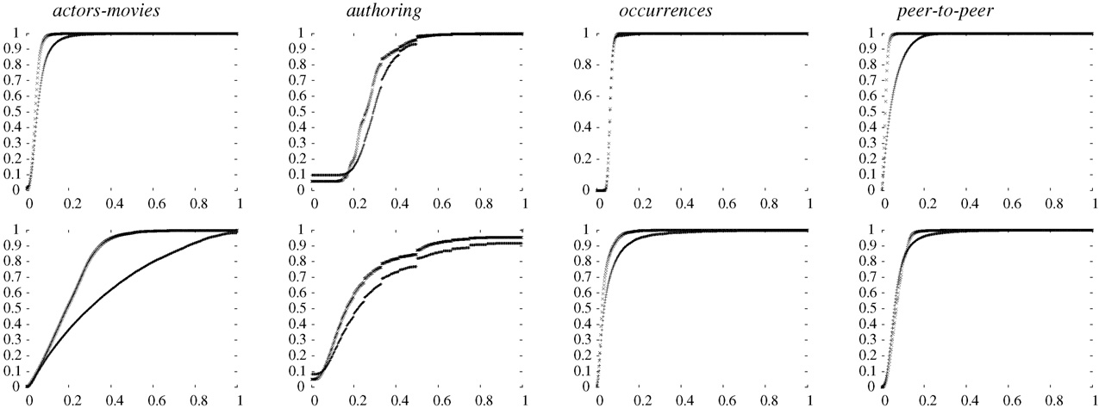
Cumulative Distribution of Clustering in two-mode networks (Versus Random)

Slide 22
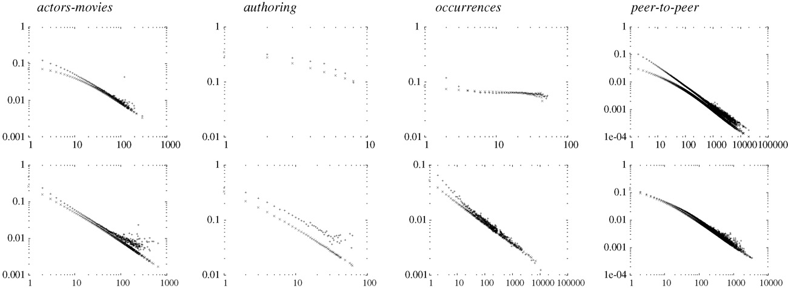
Correlation between node degree and clustering

Slide 23
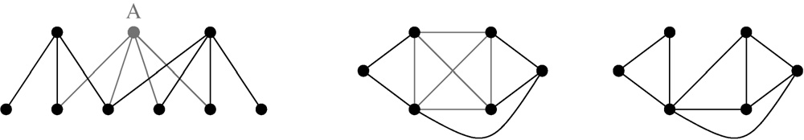
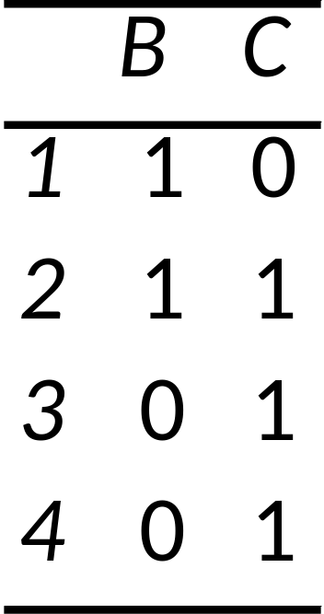
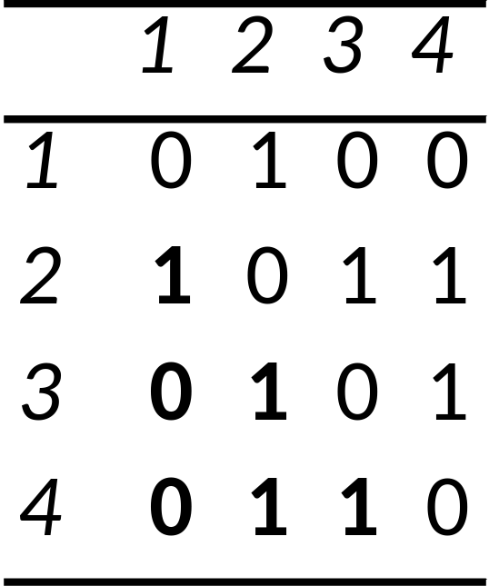
Redundancy in two mode networks
B C
1 2
1 2
1 2 3 4
3 4
3 4
4/6=0.66

Slide 24
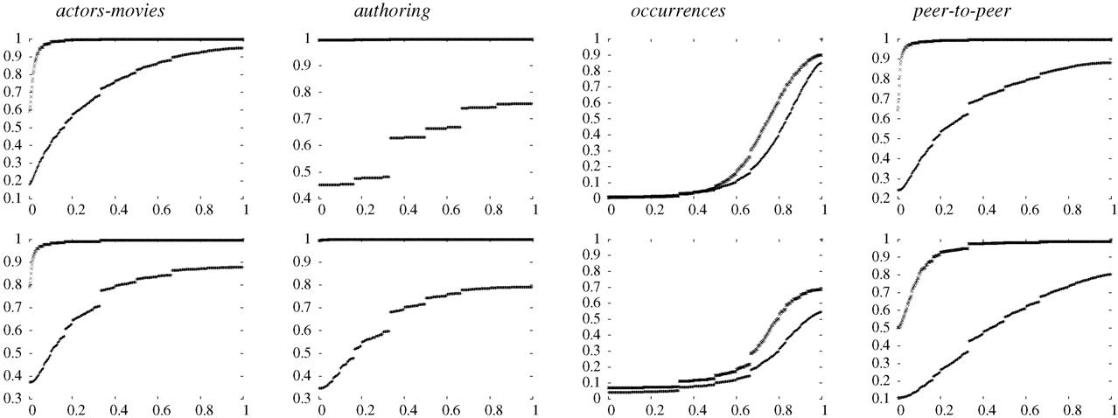
Redundancy Cumulative Distribution (versus random)

