Slide 1
Triadic processes
Triadic configurations exhibit properties not reducible to (but still dependent on) dyadic processes (Simmel 1908)
  "Simplest" configuration that exhibit "group" properties (e.g. factionalization, alliance formation, brokerage
A series of behavioral theories in social science rely on triadic processes:
  Structural Balance Theory
  Granovetter's "Strength of Weak Ties" (SWT) theory
  Power-dependence Exchange Theories
  Brokerage Theories
  Structural Holes (SH) Theory

Slide 2
Clustering in complex networks
Link between micro-processes and macro-signatures of complex networks
  Micro-process: "friends of friends become friends."
  Macro-signature: Global clustering coefficient deviates significantly from that characteristic of random networks
This has implications for:
  Diffusion dynamics within networks
  Overall cohesion within the social structure (e.g. Community structure)
  Brokerage and information control opportunities
  Innovation and the generation of novel ideas

Slide 3
Triads: Six triples
A
B
C

Slide 4
Triads: Six triples
A
1
B
C

Slide 5
Triads: Six triples
A
2
B
C

Slide 6
Triads: Six triples
A
3
B
C

Slide 7
Triads: Six triples
A
4
B
C

Slide 8
Triads: Six triples
A
5
B
C

Slide 9
Triads: Six triples
A
6
B
C

Slide 10
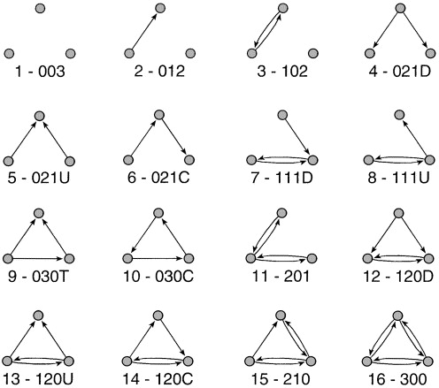
Triad census

Slide 11
Triad census (balance)

Slide 12
Triad census (clustering)

Slide 13
Triad census (ranked clustering)

Slide 14
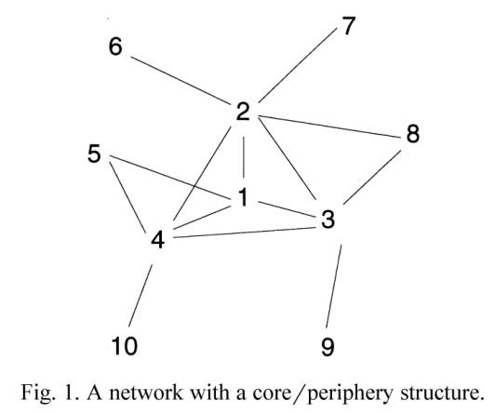
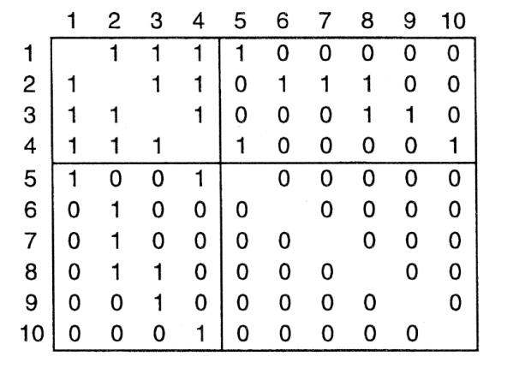
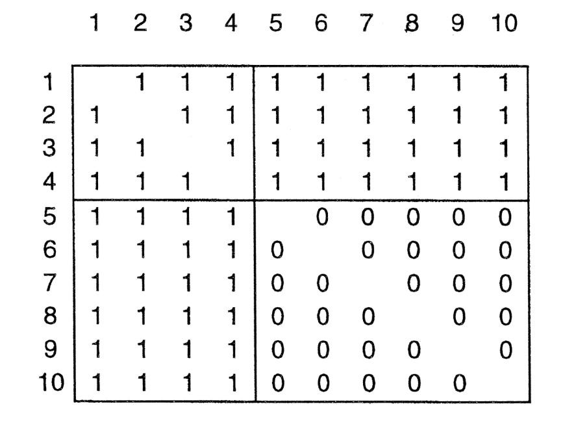
?
Observed Adjacency Matrix
Ideal Adjacency Matrix

Slide 15

Structural balance theory
Building blocks
  A set of actors
  A set of (directed) relationships defined on those actors
  For example: Likes and Dislikes

Slide 16
Structural balance theory
Considering triads containing directional arcs only simplifies things a bit.
  This is the key to balance theory
    Solid lines are positive sentiments
    Null (dashed) lines are negative sentiments

Slide 17
Structural balance theory
In structural balance theory, each vertex in the configuration is given a designation
  Person (P): "The individual whose behavior is being predicted by the theory" (Davis 1963: 445).

Slide 18
Structural balance theory
In structural balance theory, each vertex in the configuration is given a designation
  Other (O): An object (e.g another individual) towards which P is oriented.

Slide 19
Structural balance theory
In structural balance theory, each vertex in the configuration is given a designation
  Q: A third object (a value, group or another individual) towards which P and O are oriented.

Slide 20
Structural balance theory
The basic premise of the theory is that people are motivated to seek balance in the triadic configurations in which they are embedded.

Slide 21
Structural balance theory
Balance is formally defined as the sign of the product of the weights attached to each edge in the cycle.
  Positive triads are balanced
  Negative triads are imbalanced

Slide 22
Structural balance theory
PQ |  | OQ |  | PO |  | POQ

Slide 23
Structural balance theory
Balance is formally defined as the sign of the product of the weights attached to each edge in the cycle.
  Balance reduced tension and is experienced as satisfactory (stable equilibrium)

Slide 24
Structural balance theory
Balance is formally defined as the sign of the product of the weights attached to each edge in the cycle.
  Imbalance is experienced as tension and discomfort (unstable state) that must be resolved (balanced)

Slide 25

Structural balance theory

Slide 26
Structural balance theory
(Republican Party)
(You)
(Clint Eastwood)

Slide 27
Structural balance theory
(Cancer)
(You)
(Smoking)

Slide 28
Structural balance theory
(Taxes)
(You)
(Public Education)

Slide 29
Structural balance theory
Balance "rules"
  If P likes O, and O likes Q, P likes Q
  If P likes O, and O dislikes Q, P dislikes Q
  If P dislikes O, and O likes Q, P dislikes Q
  If P dislikes O and O dislikes Q, P likes Q

Slide 30
Structural balance theory
Balance "rules"
  If P likes O, and O likes Q, P likes Q
  If P likes O, and O dislikes Q, P dislikes Q
  If P dislikes O, and O likes Q, P dislikes Q
  If P dislikes O and O dislikes Q, P likes Q

Slide 31
Structural balance theory
Balance "rules"
  If P likes O, and O likes Q, P likes Q
  If P likes O, and O dislikes Q, P dislikes Q
  If P dislikes O, and O likes Q, P dislikes Q
  If P dislikes O and O dislikes Q, P likes Q

Slide 32
Structural balance theory
Balance "rules"
  If P likes O, and O likes Q, P likes Q
  If P likes O, and O dislikes Q, P dislikes Q
  If P dislikes O, and O likes Q, P dislikes Q
  If P dislikes O and O dislikes Q, P likes Q

Slide 33
Structural balance theory
Balance "rules"
  Friend of a friend is a friend
  Friend of an enemy is an enemy
  Enemy of a friend is an enemy
  Enemy of an Enemy is a friend

Slide 34
Structural balance theory
Balance "rules"
  Friend of a friend is a friend
  Enemy of an Enemy is a friend
  Friend of an enemy is an enemy
  Enemy of a friend is an enemy

Slide 35
Structural balance theory
Balance "rules"
  Friend of a friend is a friend
  Enemy of an Enemy is a friend
  Friend of an enemy is an enemy
  Enemy of a friend is an enemy

Slide 36
Structural balance theory
Balance "rules"
  Friend of a friend is a friend
  Enemy of an Enemy is a friend
  Friend of an enemy is an enemy
  Enemy of a friend is an enemy

Slide 37
Structural balance theory
(+ friends; - enemies)
OX |  | PX |  | PO

Slide 38

Structural balance theory

Slide 39

Structural balance theory
Q(tweet)
P(retweeter)
O(tweeter)

Slide 40
Distal measures of balance (Bonacich and Lloyd 2004)
The orientation toward an object may be affected by orientations that other actors have towards that object.
Persons seek to increase their status in the eyes of the group (balance) and avoid losing status (imbalance)
  Liked persons are liked
  Disliked persons are disliked
Friends of friends are friends: A positive connection with a high status individual increases one's status.
Friends of enemies are enemies: A positive connection to a disvalued individual reduces one's status.
Enemies of friends are enemies: A negative relation to a high status individual reduces one's status.
Enemies of enemies are friends: A negative relation to a disvalued individual increases one status.

Slide 41
Distal measures of balance (Bonacich and Lloyd 2004)
Group
Friends of friends are friends: A positive connection with a high status individual increases one's status.
Friends of enemies are enemies: A positive connection to a disvalued individual reduces one's status.
Enemies of friends are enemies: A negative relation to a high status individual reduces one's status.
Enemies of enemies are friends: A negative relation to a disvalued individual increases one status.
P
O
Group
P
O

Slide 42
Distal measures of balance (Bonacich and Lloyd 2004)
Group
Friends of friends are friends: A positive connection with a high status individual increases one's status.
Friends of enemies are enemies: A positive connection to a disvalued individual reduces one's status.
Enemies of friends are enemies: A negative relation to a high status individual reduces one's status.
Enemies of enemies are friends: A negative relation to a disvalued individual increases one status.
P
O
Group
P
O

Slide 43
Distal measures of balance (Bonacich and Lloyd 2004)
Group
Friends of friends are friends: A positive connection with a high status individual increases one's status.
Friends of enemies are enemies: A positive connection to a disvalued individual reduces one's status.
Enemies of enemies are friends: A negative relation to a disvalued individual increases one status.
Enemies of friends are enemies: A negative relation to a high status individual reduces one's status.
P
O
Group
P
O

Slide 44
Distal measures of balance (Bonacich and Lloyd 2004)
Group
Friends of friends are friends: A positive connection with a high status individual increases one's status.
Friends of enemies are enemies: A positive connection to a disvalued individual decreases one's status.
Enemies of enemies are friends: A negative relation to a disvalued individual increases one status.
Enemies of friends are enemies: A negative relation to a high status individual reduces one's status.
P
O
Group
P
O

Slide 45
Distal measures of balance (Bonacich and Lloyd 2004)
Group
Friends of friends are friends: A positive connection with a high status individual increases one's status.
Friends of enemies are enemies: A positive connection to a disvalued individual decreases one's status.
Enemies of enemies are friends: A negative relation to a disvalued individual increases one status.
Enemies of friends are enemies: A negative relation to a high status individual reduces one's status.
P
O
Group
P
O

