Slide 1
Triadic processes
Triadic configurations exhibit properties not reducible to (but still dependent on) dyadic processes (Simmel 1908)
  "Simplest" configuration that exhibit "group" properties (e.g. factionalization, alliance formation, brokerage
A series of behavioral theories in social science rely on triadic processes:
  Structural Balance Theory
  Granovetter's "Strength of Weak Ties" (SWT) theory
  Power-dependence Exchange Theories
  Brokerage Theories
  Structural Holes (SH) Theory

Slide 2
Clustering in complex networks
Link between micro-processes and macro-signatures of complex networks
  Micro-process: "friends of friends become friends."
  Macro-signature: Global clustering coefficient deviates significantly from that characteristic of random networks
This has implications for:
  Diffusion dynamics within networks
  Overall cohesion within the social structure (e.g. Community structure)
  Brokerage and information control opportunities
  Innovation and the generation of novel ideas

Slide 3
Structural balance theory
Building blocks
  A set of actors
  A set of (directed) relationships defined on those actors
  Likes versus Dislikes (Choosing versus Not choosing)
At the dyadic level (all possible sub-digraphs of size 2) such a setup leads to three "dyad" classes:
  Mutual (both actors like; both actors choose)
  Asymmetric (only one actor chooses; one dislikes the other likes)
  Null (neither actors chooses; both actors dislike)

Slide 4
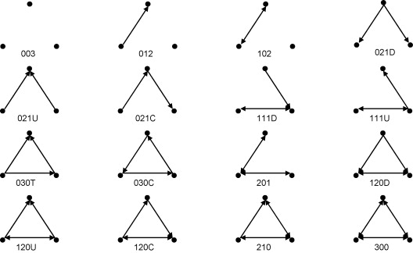
Structural balance theory
Using the same building blocks, but now considering subgraphs of size 3 adds a layer of complexity:
  Sixteen possible sub-digraphs:

Slide 5

Structural balance theory
Considering triads containing directional arcs only simplifies things a bit.
  This is the key to balance theory
    Solid lines are positive sentiments
    Null (dashed) lines are negative sentiments

Slide 6
Structural balance theory
In structural balance theory, each vertex in the configuration is given a designation
  Person (P): "The individual whose behavior is being predicted by the theory" (Davis 1963: 445).

Slide 7
Structural balance theory
In structural balance theory, each vertex in the configuration is given a designation
  Other (O): An object (e.g another individual) towards which P is oriented.

Slide 8
Structural balance theory
In structural balance theory, each vertex in the configuration is given a designation
  Q: A third object (a value, group or another individual) towards which P and O are oriented.

Slide 9
Structural balance theory
The basic premise of the theory is that people are motivated to seek balance in the triadic configurations in which they are embedded.

Slide 10
Structural balance theory
Balance is formally defined as the sign of the product of the weights attached to each edge in the cycle.
  Positive triads are balanced
  Negative triads are imbalanced

Slide 11
Structural balance theory
PQ |  | OQ |  | PO |  | POQ

Slide 12
Structural balance theory
Balance is formally defined as the sign of the product of the weights attached to each edge in the cycle.
  Balance reduced tension and is experienced as satisfactory (stable equilibrium)

Slide 13
Structural balance theory
Balance is formally defined as the sign of the product of the weights attached to each edge in the cycle.
  Imbalance is experienced as tension and discomfort (unstable state) that must be resolved (balanced)

Slide 14

Structural balance theory

Slide 15
Structural balance theory
(Republican Party)
(You)
(Clint Eastwood)

Slide 16
Structural balance theory
(Cancer)
(You)
(Smoking)

Slide 17
Structural balance theory
(Taxes)
(You)
(Public Education)

Slide 18
Structural balance theory
Balance "rules"
  If P likes O, and O likes Q, P likes Q
  If P likes O, and O dislikes Q, P dislikes Q
  If P dislikes O, and O likes Q, P dislikes Q
  If P dislikes O and O dislikes Q, P likes Q

Slide 19
Structural balance theory
Balance "rules"
  If P likes O, and O likes Q, P likes Q
  If P likes O, and O dislikes Q, P dislikes Q
  If P dislikes O, and O likes Q, P dislikes Q
  If P dislikes O and O dislikes Q, P likes Q

Slide 20
Structural balance theory
Balance "rules"
  If P likes O, and O likes Q, P likes Q
  If P likes O, and O dislikes Q, P dislikes Q
  If P dislikes O, and O likes Q, P dislikes Q
  If P dislikes O and O dislikes Q, P likes Q

Slide 21
Structural balance theory
Balance "rules"
  If P likes O, and O likes Q, P likes Q
  If P likes O, and O dislikes Q, P dislikes Q
  If P dislikes O, and O likes Q, P dislikes Q
  If P dislikes O and O dislikes Q, P likes Q

Slide 22
Structural balance theory
Balance "rules"
  Friend of a friend is a friend
  Friend of an enemy is an enemy
  Enemy of a friend is an enemy
  Enemy of an Enemy is a friend

Slide 23
Structural balance theory
Balance "rules"
  Friend of a friend is a friend
  Enemy of an Enemy is a friend
  Friend of an enemy is an enemy
  Enemy of a friend is an enemy

Slide 24
Structural balance theory
Balance "rules"
  Friend of a friend is a friend
  Enemy of an Enemy is a friend
  Friend of an enemy is an enemy
  Enemy of a friend is an enemy

Slide 25
Structural balance theory
Balance "rules"
  Friend of a friend is a friend
  Enemy of an Enemy is a friend
  Friend of an enemy is an enemy
  Enemy of a friend is an enemy

Slide 26
Structural balance theory
(+ friends; - enemies)
OX |  | PX |  | PO

Slide 27

Structural balance theory

Slide 28
Structural balance theory
Cartwright and Harary (1956) proved that if all of the triads in a signed value matrix are balanced, then
  The matrix can be blocked into two mutually exclusive groups such that:
  All edges with positive weights are within blocks
  All edges with negative weights are between blocks.
This "generalized balance" formalizes a key intuition between balance processes at the micro-level and macro-level group structure
  Balance seeking at the micro-level leads to group polarization at the macro-level

Slide 29
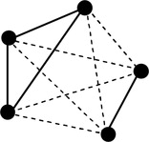
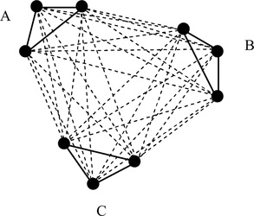
Structural balance theory
This is not the only possibility; more likely we will find mixed states that satisfy generalized balance but not structural balance
  These are so-called "jammed states"
  Any sign change to balance a triad would imbalance other triads increasing generalized imbalance

Slide 30
Structural balance theory
Jammed states:
  "...represent situations in which divided loyalties obscure group boundaries" (van de Rijt 2011: 97-98)
  Suggest that the pursuit of structural balance at the micro-level does not necessarily result in generalized balance at the macro-level

Slide 31

Structural balance theory
Q(tweet)
P(retweeter)
O(tweeter)

Slide 32
Distal measures of balance (Bonacich and Lloyd 2004)
Structural balance theories deal only with the case of an individual orienting him/herself toward two other objects
However, an individual's orientation toward an object may be affected by orientations that other actors have towards that object.
Friends of friends are friends: A positive connection with a high status individual increases one's status.
Friends of enemies are enemies: A positive connection to a disvalued individual reduces one's status.
Enemies of friends are enemies: A negative relation to a high status individual reduces one's status.
Enemies of enemies are friends: A negative relation to a disvalued individual increases one status.

Slide 33
Distal measures of balance (Bonacich and Lloyd 2004)
This brings the logic of "radial" measures of centrality to thinking about signed relations in a graph.
Provides a different motivational mechanism that the traditional balance account.
Friends of friends are friends: A positive connection with a high status individual increases one's status.
Friends of enemies are enemies: A positive connection to a disvalued individual reduces one's status.
Enemies of friends are enemies: A negative relation to a high status individual reduces one's status.
Enemies of enemies are friends: A negative relation to a disvalued individual increases one status.

Slide 34
Distal measures of balance (Bonacich and Lloyd 2004)
This brings the logic of "radial" measures of centrality to thinking about signed relations in a graph.
Instead of considering Other's orientation to a third object, persons take into account the overall distribution of orientations impinging on Other to decide on their own sentiment
Friends of friends are friends: A positive connection with a high status individual increases one's status.
Friends of enemies are enemies: A positive connection to a disvalued individual reduces one's status.
Enemies of friends are enemies: A negative relation to a high status individual reduces one's status.
Enemies of enemies are friends: A negative relation to a disvalued individual increases one status.

Slide 35
Distal measures of balance (Bonacich and Lloyd 2004)
This brings the logic of "radial" measures of centrality to thinking about signed relations in a graph.
Persons seek to increase their status in the eyes of the group (balance) and avoid losing status (imbalance)
  Liked persons are liked
  Disliked persons are disliked
Friends of friends are friends: A positive connection with a high status individual increases one's status.
Friends of enemies are enemies: A positive connection to a disvalued individual reduces one's status.
Enemies of friends are enemies: A negative relation to a high status individual reduces one's status.
Enemies of enemies are friends: A negative relation to a disvalued individual increases one status.

Slide 36
Distal measures of balance (Bonacich and Lloyd 2004)
Group
Friends of friends are friends: A positive connection with a high status individual increases one's status.
Friends of enemies are enemies: A positive connection to a disvalued individual reduces one's status.
Enemies of friends are enemies: A negative relation to a high status individual reduces one's status.
Enemies of enemies are friends: A negative relation to a disvalued individual increases one status.
P
O
Group
P
O

Slide 37
Distal measures of balance (Bonacich and Lloyd 2004)
Group
Friends of friends are friends: A positive connection with a high status individual increases one's status.
Friends of enemies are enemies: A positive connection to a disvalued individual reduces one's status.
Enemies of friends are enemies: A negative relation to a high status individual reduces one's status.
Enemies of enemies are friends: A negative relation to a disvalued individual increases one status.
P
O
Group
P
O

Slide 38
Distal measures of balance (Bonacich and Lloyd 2004)
Group
Friends of friends are friends: A positive connection with a high status individual increases one's status.
Friends of enemies are enemies: A positive connection to a disvalued individual reduces one's status.
Enemies of enemies are friends: A negative relation to a disvalued individual increases one status.
Enemies of friends are enemies: A negative relation to a high status individual reduces one's status.
P
O
Group
P
O

Slide 39
Distal measures of balance (Bonacich and Lloyd 2004)
Group
Friends of friends are friends: A positive connection with a high status individual increases one's status.
Friends of enemies are enemies: A positive connection to a disvalued individual decreases one's status.
Enemies of enemies are friends: A negative relation to a disvalued individual increases one status.
Enemies of friends are enemies: A negative relation to a high status individual reduces one's status.
P
O
Group
P
O

Slide 40
Distal measures of balance (Bonacich and Lloyd 2004)
Group
Friends of friends are friends: A positive connection with a high status individual increases one's status.
Friends of enemies are enemies: A positive connection to a disvalued individual decreases one's status.
Enemies of enemies are friends: A negative relation to a disvalued individual increases one status.
Enemies of friends are enemies: A negative relation to a high status individual reduces one's status.
P
O
Group
P
O

Slide 41

The Clustering Coefficient (Again)
One place to begin is with the simple clustering coefficient at the ego-network level:
Where g_{jk} = 1 if i's j^{th} neighbor is connected to her k^{th} neighbor, and k_{i} is i's total number of neighbors.

Slide 42

The (global) clustering coefficient
We can then characterize the global network structure by computing:
  The Average Clustering Coefficient
  Ascertaining the relationship between k_{i} and C(k_{i}) (vertex degree and the average clustering for vertices of degree k)
    Strong Negative dependence of C(k) on k may indicate that the network relies on hubs as connectors between disparate worlds.

Slide 43
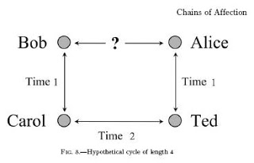
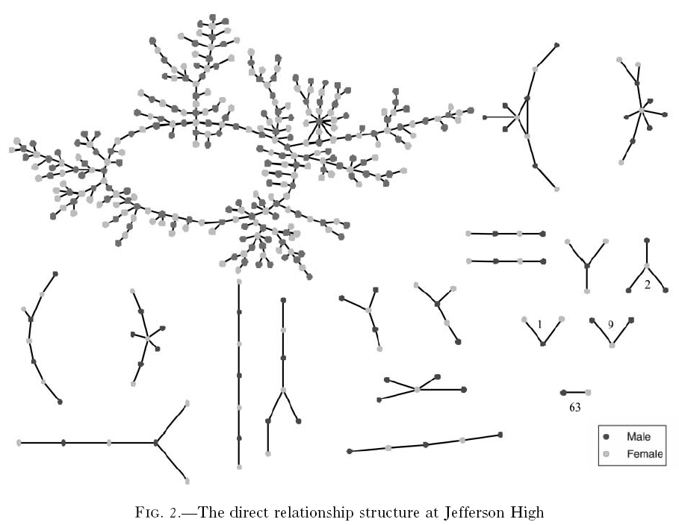
Chains of Affection

Slide 44
Chains of Affection

Slide 45
Chains of Affection

