Slide 1
ERGMs
Exponential Random Graph Models
Recent “paradigm shift” (or paradigm reversion) in network modeling
  From “indices” to p-values (let’s get published!)
Statistical techniques (and even statistical thinking) slow to take off in network analysis
  Relational data structures, complex interdependencies, and confusion as to what the unit of observation is make a mockery of traditional statistical techniques built on the conditional independence assumption

Slide 2
ERGMs (ergums) Exponential Random Graph Models
In a traditional (rectangular, persons by variables) data set:
  the value of the response variable Y for the ith (Yi) person (should be) conditionally independent from the corresponding value of the response for the jth person (Yj) given their observed scores on a vector of predictors (X):

Slide 3
ERGMs (ergums) Exponential Random Graph Models
It is clear that this assumption will not hold in a relational data set where the response variable is the existence of a tie between persons (Aij):
  Unless the network dynamics are fully explained by exogenous characteristics (no endogenous processes)
Forms of (endogenous) dependence include, reciprocity, transitivity, community structure, degree assortativity, and others.

Slide 4
ERGMs (ergums) Exponential Random Graph Models
Promise to finally get at the generative processes that govern tie formation in network; from static “pictures of structure” to a window on “generative dynamics.”
  But can't really do that; statistical models don't get at generative mechanism
Promises to "model" the way in which local processes give rise to global processes
  But can't really do that either (see Toivonen et al 2009)
  Same ERGM compatible with a multiplicity of global structures

Slide 5
ERGMs (ergums) Exponential Random Graph Models
Allows us to conceive of the observed relational data as a (stochastic) realization of some (unspecified) underlying data generating process (DGP)
  A useful way to look at all data not just “network” or “relational” data.
Allow us to separate endogenous, from exogenous and stochastic (random) effects on the tie formation process
  Network = Systematic (Endogenous + Exogenous) + Random

Slide 6
ERGMs (ergums) Exponential Random Graph Models
The basic insight: breaking free from The Matrix.
  Thought you had a “network”?
  Think again. You actually just have a binary response variable.
The variable is just presented in a funky format (a g x g matrix). So just “string the matrix out” into a ([g(g-1)] x 1] vector.”
Does it look like a nail now? Then you know what to do: use the social scientist's hammer on it.

Slide 7

ERGMs (ergums) Exponential Random Graph Models
Where Y, is the binary vector of "responses" (o, 1)
Theta is a coefficient vector
g(y) is a vector of "graph statistics"
k is a normalizing constant

Slide 8

ERGMs (ergums) Exponential Random Graph Models
A more intuitive way to understand the systematic (g(y)) part of the ERGM model is via the notion of change statistics
In an undirected graph a change statistic vector can be defined as:
  Where y⁺ is the network realized when we Yij= 1 and y_ is the network realized when Yij = 0, while keeping the rest of the graph intact

Slide 9
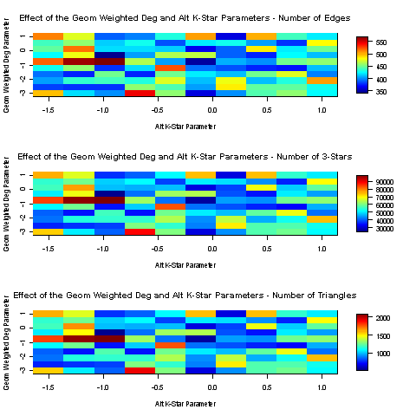
ERGMs (ergums) Exponential Random Graph Models
Constructing an “ergum”
  The dependent variable is the absence or presence of a tie.
Two classes of predictor variables:
  Dyad independent (or intra-dyadic) processes
    Triadic balance
  Dyad dependent (or inter-dyadic) processes
    Reciprocity, Homophily

Slide 10
ERGMs (ergums) Exponential Random Graph Models
Constructing an “ergum”
  The dependent variable is the absence or presence of a tie.
Two classes of predictor variables:
  Dyad independent (or intra-dyadic) processes
    Triadic balance
  Dyad dependent (or inter-dyadic) processes
    Reciprocity, Homophily

Slide 11
ERGMs (ergums) Exponential Random Graph Models
Models that presume that the network is generated through intra-dyadic processes can be built “the dumb way:”
  Run a logistic regression on the strung out network with change-score indicators (e.g. “dummy variables”) for the relevant configuration of interest as predictors
The classic Erdos-Renyi “Bernoulli” model is a dyad independent
  The classic Holland-Leindhart “p1 model” is a (more interesting) dyad independent model

Slide 12

ERGMs (ergums) Exponential Random Graph Models
Edge formation probability
Expansiveness
Mutuality
Popularity

Slide 13
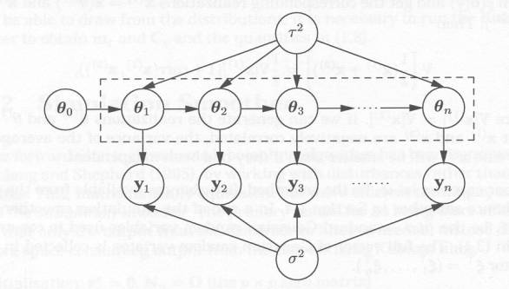
ERGMs (ergums) Exponential Random Graph Models
Models that presume that the network is generated through intra-dyadic and inter-dyadic processes have to built the “smart” way.
  Markov Chain Monte Carlo (MCMC) Estimation.
  Why the complication?

Slide 14

ERGMs (ergums) Exponential Random Graph Models
Predictors are direct functions of the response variable
  The existence of a triadic or higher order structure is dependent on the i->j link).
  Makes this class of ERGMs an autoregressive model.

Slide 15
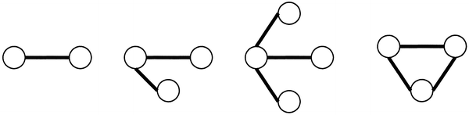
ERGMs (ergums) Exponential Random Graph Models
Predictors are direct functions of the response variable
  These models are somewhat cumbersome to build, because the specification of each “variable” requires some sort of cycling through the network.

Slide 16
