Slide 1
Ego Networks
Alter and k egos
Nodal degree (k)
How diverse is an ego’s network?
Correlates of “diversity”
  Degree
  heterogeneity (composition)
  weak ties
  redundancy/density

Slide 2
Marsden Findings
  core network is dense (.61)
  core network is more homogenous on age, education, race, sex
    though there is age and education heterogeneity
  Age, Education, Sex, Race and Place Correlates of network size, density and heterogeneity (Tables 3 & 4)

Slide 3
Burt – Discussion Groups
More diverse network is one in which ties with alters vary in their content
Form and Content
Form: Three dimensions: Frequency, Closeness, and Kin

Slide 4
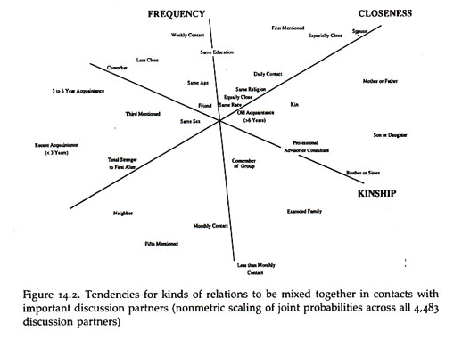
Burt Discussion Groups

Slide 5
Burt Findings
The predominant character of core discussion groups is that they connect people to alters that a person sees more often, are close to, and are kin
Distinction between different types of alters increases with status and declines with age
  High status people have kin, but they also have nonkin they see frequency (co-workers) AND close people beyond family and coworkers.
  Younger people have kin, but also no-kin that they see frequently and close people who are not kin
    middle aged keep kin (but now children), less daily contact

Slide 6
Burt - Range
Degree (number of alters)
Number of types of alters
Redundancy

Slide 7
Granovetter – Strength of Weak Ties
Getting a better job
Job Search & Information
How do people get jobs – contacts
Measure whether job is better and type of contact used to find job
Type of contact: family/friend vs. acquaintance
Finding: Odd getting better job increases when a person heard about the job through an acquaintance (weak tie)

Slide 8
Granovetter
Acquaintance = Weak Tie
Weak Tie = Non-redundant tie

Slide 9
Burt – Structural Holes
High degree and high density → less diverse network
Dense networks are redundant, i.e. not diverse
Structural Hole: Separation (lack of direct or indirect ties) between non redundant contact
  Network benefits of each alter additive (no overlap)
  Tie between ego and non-redundant alter is a bridge

Slide 10
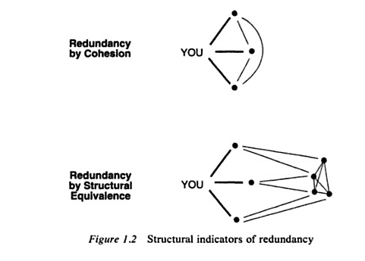
Redundancy
Notes:
Older people's nets are composed of people who are both close, seen frequently and kin
Low status people’s nets are composed of people who are close, frequent and kim (so relations are ambiguous)
‹#›

Slide 11
Efficiency & Effectiveness
Efficiency: Maximize the number of non-redundant alters
Effectiveness: Draw your alters from different social worlds
Notes:
Who is likely to have more diverse networks
Why diversity important
‹#›

Slide 12
Weak Ties & Structural Holes
Hypothesis: The ties with non-redundant alters that form a structural hole tend to be weak

Slide 13

Structural Holes & Weak Ties

Slide 14
Redundancy: 2 Steps
Calculate how important each alter is to ego (relative strength of a tie)
Calculate redundancy of each alter

Slide 15

Redundancy
Burt defines redundancy as:

