Slide 1
Ego Networks
Alter (j) and k egos
Nodal degree (k)
How diverse is an ego’s network?
Correlates of “diversity”
  Degree
  heterogeneity (composition)
  weak ties
  redundancy/density

Slide 2
Marsden Findings
Core network is dense (.61)
Core network is more homogenous on age, education, race, sex
  though there is age and education heterogeneity
Age, Education, Sex, Race and Place Correlates of network size, density and heterogeneity (Tables 3 & 4)
Notes:
discuss important matters
‹#›

Slide 3
Burt – Discussion Groups
A more diverse network is one in which ties with alters vary in their content
Form and Content
Three dimensions: Frequency, Closeness, and Kin

Slide 4
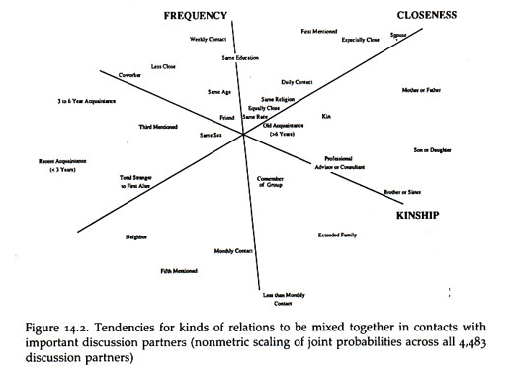
Burt Discussion Groups

Slide 5
Burt Findings
The predominant character of core discussion groups is that they connect people to alters that a person sees more often, are close to, and are kin
Distinction between different types of alters increases with status and declines with age
  High status people have kin, but they also have nonkin they see frequency (co-workers) AND close people beyond family and coworkers.
  Younger people have kin, but also non-kin that they see frequently and close people who are not kin
    middle aged keep kin (but now children), less daily contact

Slide 6
Burt - Range
Degree (number of alters)
Number of types of alters
Redundancy

Slide 7
Granovetter:
Strength of Weak Ties
Getting a better job
Job Search & Information
How do people find out about jobs?
Measure whether job is better and type of contact used to find a job
Type of contact: family/friend vs. acquaintance
Finding: Odds of getting better job increases when a person hears about the job through an acquaintance (weak tie)
Explanation: weak ties are to non-redundant alters who are more likely to know about jobs than ego’s strong ties
Notes:
Older people's nets are composed of people who are both close, seen frequently and kin
Low status people’s nets are composed of people who are close, frequent and kim (so relations are ambiguous)
‹#›

Slide 8
Granovetter Assumptions
Acquaintance = Weak Tie
Weak Tie = Non-redundant tie

Slide 9
Burt – Structural Holes
High degree and high density → less diverse network
Dense networks are redundant, i.e. not diverse
Structural Hole: Separation (lack of direct or indirect ties) between non redundant contact
  Network benefits of each alter additive (no overlap)
  Tie between ego and non-redundant alter is a bridge
Notes:
Who is likely to have more diverse networks
Why diversity important
‹#›

Slide 10
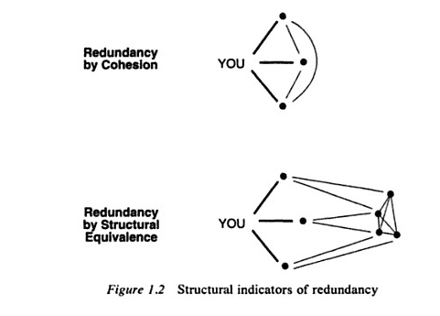
Redundancy

Slide 11
Efficiency & Effectiveness
Efficiency: Maximize the number of non-redundant alters
Effectiveness: Draw your alters from different social worlds
Notes:
for types need a variable trait of alters, like education, SES
2 litres of same type count only once
caveat – cohesiveness of status group
‹#›

Slide 12
Weak Ties & Structural Holes
Hypothesis: The ties with non-redundant alters that form a structural hole tend to be weak

Slide 13

Structural Holes & Weak Ties
Notes:
redundancy and vomiting
‹#›

Slide 14
Redundancy: 2 Steps
Calculate how important each alter is to ego (relative strength of a tie)
Calculate redundancy of each alter

Slide 15


Relative Strength of a Tie
Total volume of interaction between i and q divided by total volume of interaction of i with all the other j alters
In the case of 1,0 ties: numerator = 1, denominator = i’s degree - 1
Notes:
Different ways to find out about jobs: newspapers, signs, word of mouth
‹#›

Slide 16
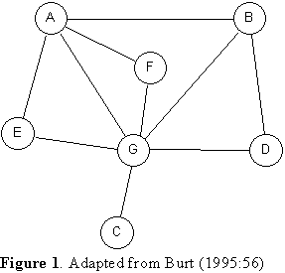
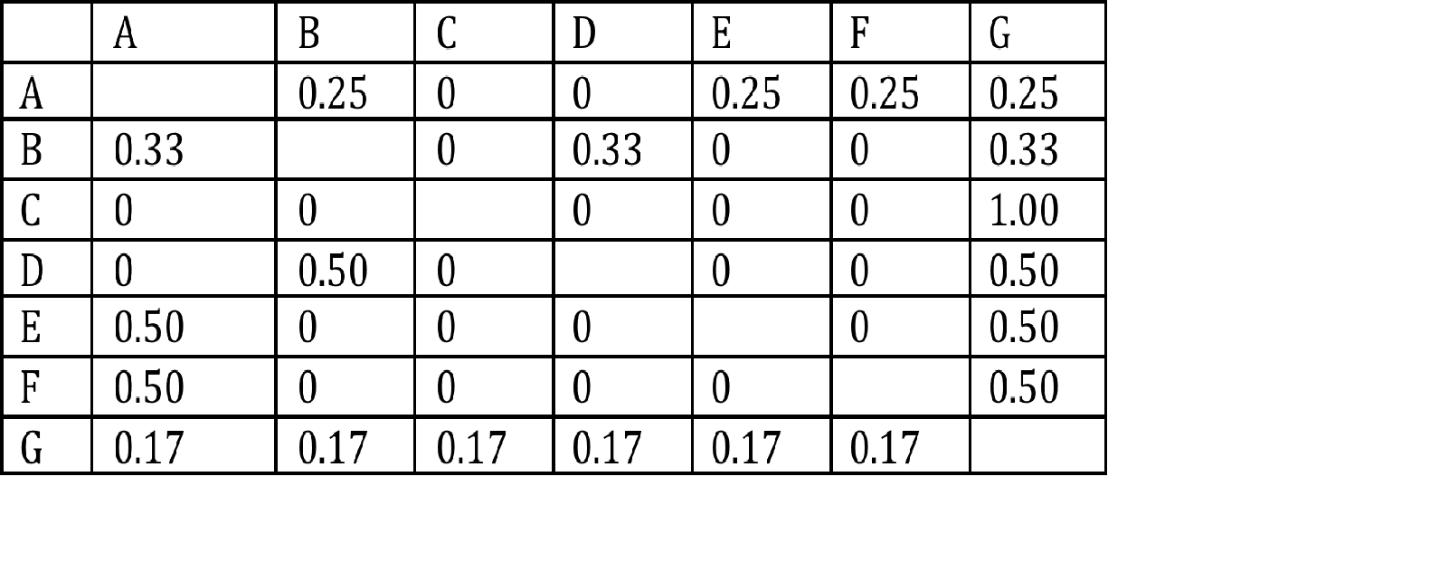
Example

Slide 17


Redundancy of an Alter
Total volume of interaction between j and q (i.e. two of i’s alters) divided by maximum volume of interaction between any of i’s two alters
In simple case of 0,1 ties: whether tie exists between two alters, i.e. Z_{jq}

Slide 18



Redundancy of Ego Network
The summation over q is the key here
p_{iq} = 1/d_{i}, i.e. inverse of i’s degree
= 1/d_{i} m_{jq}
So sum 1/d_{i} N times, where N is number of connections of j to all other alters
WHAT IS THIS?
Degree of alter j – 1, i.e d_{j} -1
Notes:
does struct equiv lead to cohesion as triangle close
‹#›

Slide 19
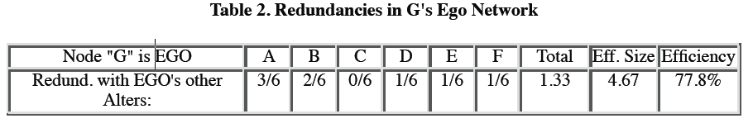
Redundancy of Ego Network (cont’d)
= 1/d_{i} m_{jq} = (d_{j} -1)/d_{i}
So the redundancy of alter j is j’s degree -1 divided by i’s degree
1
1
1
1/6
Example: Redundancy of Alter A for Ego G = 1/6*3 = (4-1)/6 = .5
Notes:
Effectiveness concerns connecting to hubs within a cluster
reachability : number of 2 degree neighbors.
‹#›

Slide 20

Redundancy of Ego Network (cont’d)
[ 1 - (d_{j} -1)/d_{i}]
So we are summing N terms, where N is the degree of i
d_{i} - (d_{j} -1)/d_{i} = d_{i} – mean(d_{j})
Where mean(d_{j}) is the average degree of all of i’s alters
Note: do not include ego in the degree calculations
Example: Total redundancy when G is Ego = 6 – (3+2+0+1+1+1)/6 = 4.67

Slide 21
Redundancy & Density
Δ = Mean(d)/n-1
Mean(d) = Δ (n-1)
In the case of alters of an ego, the density is of the graph among all the alters
Effective size = d_{i} – mean(d_{j}) = d_{i} - Δ (n-1) where n is the # of alters
Δ = 2L/n(n-1) Note: This is the clustering coefficient
effective size = d_{i} – 2L/d_{i} = n – [2L/n]
where L is the number of ties among ego’s alters
Example: Node G’s effective size = 6 – (2*4)/6 = 4.67

Slide 22
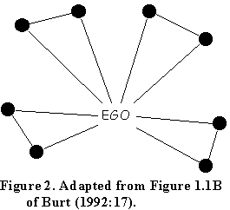
Redundancy and Reach
Effective Size = 8 – (2*4)/8 = 7
Efficiency = 7/8 = .875
Reach efficiency = size of 2nd order neighborhood divided by sum of degrees of alters = 8/16 = .5

Slide 23
Other Issues
Intermediation (Bridges)
Core/Periphery Network
  Alters with different edge weights

