Slide 1
Social Network Seminar
Introductions: Me & You
The Seminar
  Objectives
  Topics & Readings
  Requirements
  Software
My Interests in Networks
  Social class, relational sociology
  Job mobility, vacancy chains, event history analysis
  Granovetter & Burt: Finding jobs
  Web Group: Barabasi and others
  iCeNSA
  Research Projects

Slide 2
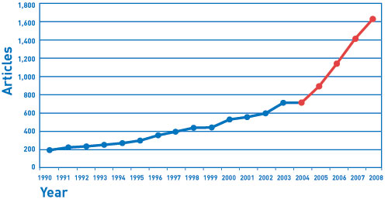
Social Networks are In
Facebook
Networking
Exponential growth in network research, papers, articles, journals, conferences
http://www.researchtrends.com/issue16-march-2010/research-trends-8/

Slide 3
Social Networks Have Always Existed
Kinship networks
Friendship networks
trading networks
transportation networks
alliances among countries
Social Networks Have Been Studied for a While
Social Network Analysis (since the 1950s)
Network Science (the 2000s)
Computational Social Science

Slide 4
The Network Field: Five Sources
Mathematics – Graph Theory
Anthropology (kinship networks)
Social Networks (INSNA)
Network Science (NetSci)
Computational Social Science (International Conference) (Big Data)

Slide 5
Why Study Networks?
Determinants of human behavior
Standard theories: Categories (taxonomies)
Network Theory: network effects, social influence
Non-independence
Intermediation & indirect ties
Sociology in not just about determinants of human behavior
Also about how people connect to other people -- Social Organization
Group, Organizations, Social Relationships & Roles, Networks

Slide 6
Current State of Research
Exponential Growth
Interdisciplinary
Game changing
  complex, dynamic, distributed systems
Social Media (Facebook, Twitter)
Dynamics

Slide 7
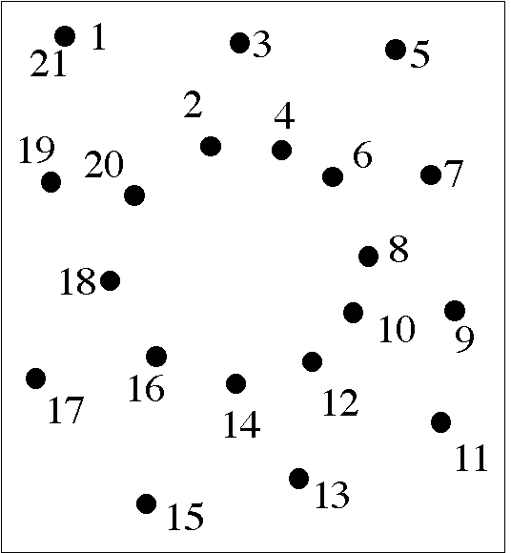
Seeing Networks
Connect the dots metaphor
  Dots: Nodes (vertices)
    People, organizations, places, ideas
  Lines: Ties (edges)
    Interaction, friendship, exchange, authority, lineage
  Flows
    information, resources, evaluations (like, dislike), people

Slide 8
Levels of Analysis
Node (Vertices)
Dyad (Ties, Edges)
Triad
Clusters (communities)
Whole Network

Slide 9
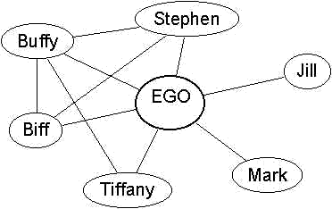
Node (Vertices) – Ego Networks
Degree (network size, neighbors, popularity, in & out degree)
Centrality
Gregariousness (activity level)
Composition (percentage of friends that are women)
Redundancy, Clustering (ties among alters)

Slide 10
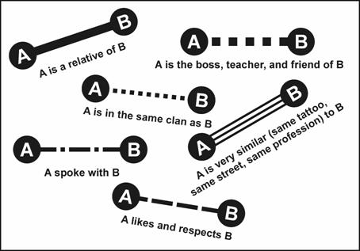
Dyads (Ties, Edges)
Strength (Weight)
  Frequency, duration, closeness
Reciprocity (Mutuality, Symmetry)
Social Distance, Homophily
Hierarchy
Persistence/Decay
Formation

Slide 11
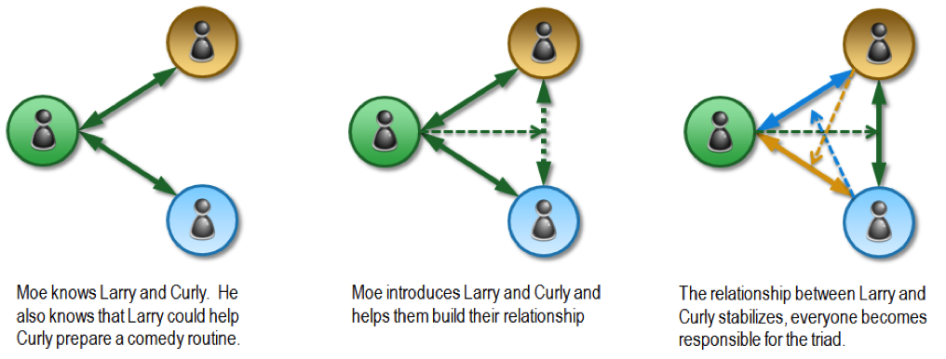
Triads
Transitivity (a friend of a friend is my friend)
Triadic closure
Tie embededness
Triadic Census
Brokerage (intermediation)

Slide 12
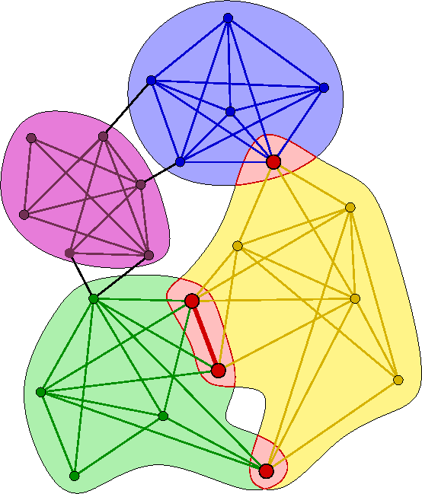
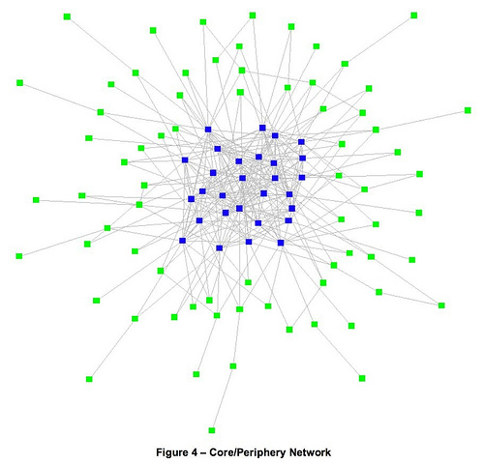
Clusters (Communities)
Cliques
Distinct communities with bridges
Core-Periphery Structures

Slide 13
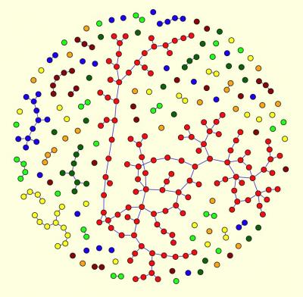
Whole Network
Size
Density
Degree distribution
Clustering
Connectivity
  giant component
  resilience
Geodesic distance/size/diameter
  Small World
Mixing Patterns (assortativity)
  degree assortativity
Stability

Slide 14
Research Issues
Strength of weak ties
  Structural Holes
  Cross-cutting ties
  Bridging and bonding social capital
Intermediation & Brokerage
Scale-free networks
  not normally distributed but power laws
  Hubs and star configuration
Core/Periphery structures
  motifs
Weights and Reciprocity
Notes:
Models
Path Model
Evolutionary Model
Generative Model: simple rules governing processes which generate observed patterns (emerge); grow network
Demographic models (states and flows)
Distributions
e.g. normal, gassian, gen process random variation

Slide 15
Research Issues (continued)
Emergence, self-organization
  local → global
  Agent based models
Network Evolution
  Tie Formation vs. Persistence
  Assembling Networks
  Generative Models
Diffusion, influence, contagion
  Selection vs. influence
  Network effects

Slide 16
Research Issues (continued)
What is different about social networks?
What is a “good” network? What properties can networks maximize?
Connections among networks (social, technical, information, semantic)

