Slide 1
Networks Defined
Nodes (vertices, points, actors): N
  N = {n₁, n₂… , n_{g}}
  G = number of nodes in N
Ties (arcs, edges, lines): L
  Ordered pairs <n_{i}, n_{j}> or n_{i} 🡪 n_{j}
  g(g-1) = total number of ordered pairs (L) in L
  Non-directed graph: L = g(g-1)/2
Graph G = (N , L)
b
d
a
c
e
‹#›

Slide 2
Ties & Graph Types
Binary (1,0) or valued (tie strength)
Directed or Undirected
b
d
b
d
a
c
e
a
c
e
Undirected, binary
Directed, binary
b
d
b
d
1
3
1
2
a
c
4
e
a
c
e
Undirected, Valued
Directed, Valued
‹#›

Slide 3
Network Components
Global-Net
Primary
Group
Ego-Net
Best Friend
Dyad
2-step
Partial network
‹#›

Slide 4
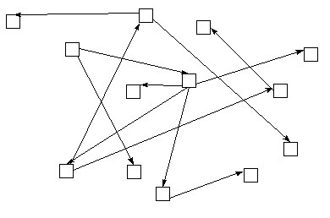
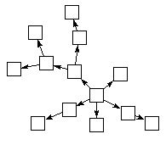
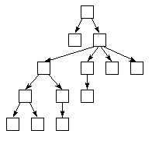
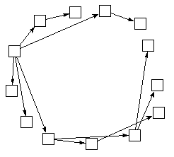
Sociograms
No standard way to draw a sociogram: each of these are equal
‹#›

Slide 5
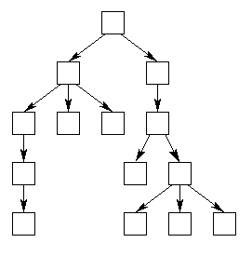
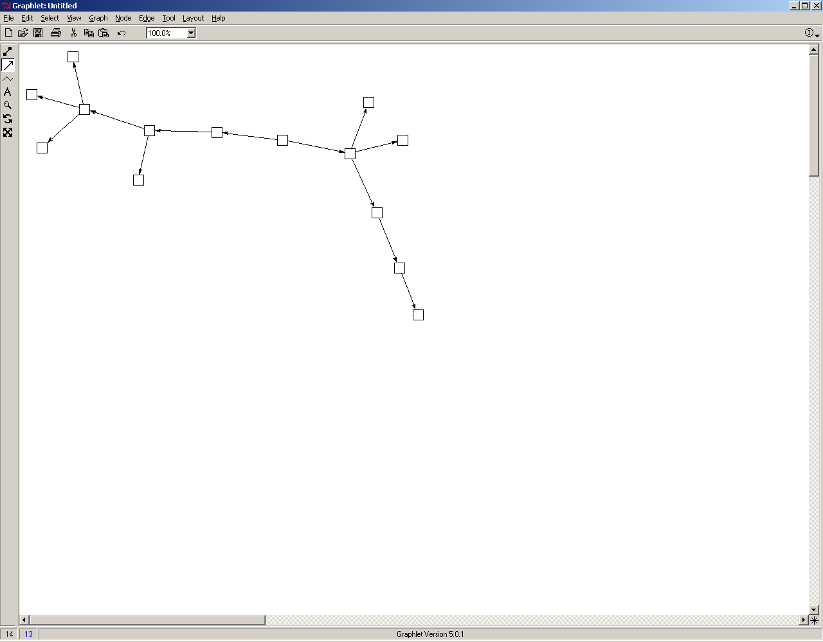
Network Visualization
Network visualization helps build intuition, but you have to keep the drawing algorithm in mind:
Tree-Based layouts
Spring-embeder layouts
Most effective for very sparse, regular graphs. Very useful when relations are strongly directed, such as organization charts, internet connections,
Most effective with graphs that have a strong community structure (clustering, etc). Provides a very clear correspondence between social distance and plotted distance
‹#›
Two images of the same network

Slide 6
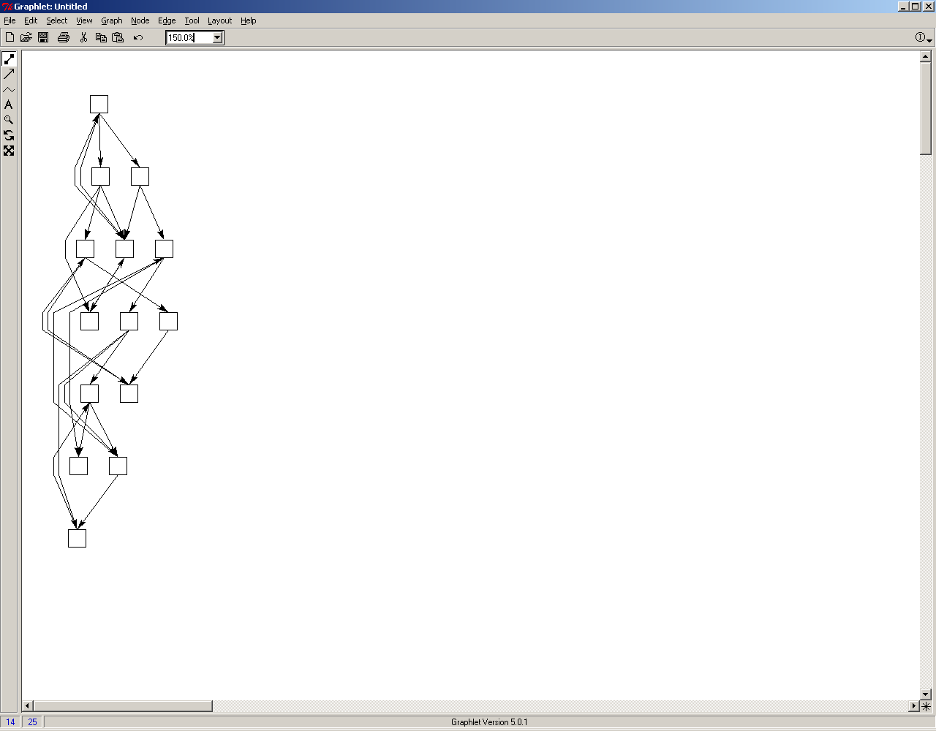
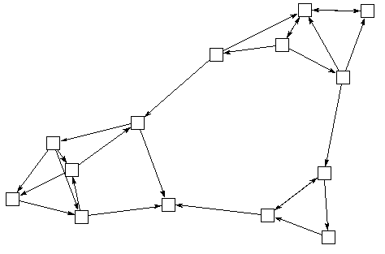
Network Visualization
Network visualization helps build intuition, but you have to keep the drawing algorithm in mind:
Tree-Based layouts
Spring-embeder layouts
‹#›
Two images of the same network

Slide 7
Sociomatrices
  N = {n₁, n₂… , n_{g}}
  X : A single valued, directional relationship, e.g., gives advice to, places a telephone call to.
  X: Sociomatrix
    Elements of X are x_{ij}
    x_{ij} = the value of the tie from n_{i} to n_{j} on relation X
  Adjacency Matrix: when x_{ij} = 1,0
‹#›

Slide 8
Pictures and Matrices
b
d
b
d
a
c
e
a
c
e
Undirected, binary
Directed, binary
a
b
c
d
e
a
b
c
d
e
a
1
a
1
b
1
1
b
1
c
1
1
1
c
1
1
1
d
1
1
d
e
1
1
e
1
1
‹#›

Slide 9
From matrices to lists
a
b
c
d
e
Arc List
Adjacency List
a
1
a b
b a
b c
c b
c d
c e
d c
d e
e c
e d
b
1
1
a b
b a c
c b d e
d c e
e c d
c
1
1
1
d
1
1
e
1
1
‹#›

Slide 10
Graph Theory Concepts:
Undirected Graphs
  Degree; d(n_{i})
  Mean (d) = Sum d(n_{i})/ g = 2L/g
  Density = Δ = Sum x_{ij}/[g(g-1) /2]
  = L/[g(g-1) /2]
  = 2L/g(g-1)
  = mean (d)/g-1
‹#›

Slide 11
Graph Theory Concepts:
Directred Graphs
  Indegree: d_{I}(n_{i}) number of arcs terminating at n_{i}
  Outdgree: d_{O}(n_{i}) number of arcs originating from n_{i}
  Density = L/g(g-1)
  Mean(d_{I}) = Mean(d_{O}) = L/g
‹#›

Slide 12
Example
a
b
c
d
e
Node | In-Degree | Out-Degree
a | 1 | 1
b | 2 | 1
c | 1 | 3
d | 2 | 0
e | 1 | 2
Mean | 7/5 | 7/5
a
1
b
1
c
1
1
1
d
e
1
1
L = 7
Δ = 7/20
In-Degree: sum of the row
Out-Degree: sum of the column
‹#›

Slide 13
Indirect Connections
Directed walk: sequence of ordered pairs
Directed trail: no arc is included more than once
Directed path: no arc nor no node included more than once
  Path Lengh: number of arcs in the path
Cycle: Closed direct walk of at least three nodes
a
b
d
b
f
a
c
e
c
f
d
e
‹#›

Slide 14
Matrix Algebra
One of the key advantages to storing networks as matrices is that we can use all of the tools from linear algebra on the socio-matrix.
  A matrix is any rectangular array of numbers. We refer to the matrix dimension as the number of rows and columns
a
b
c
d
e
W B
1 0
1 0
0 1
0 1
0 1
1 0
Age
13
10
7
8
16
11
a
0
1
0
0
0
b
1
0
0
0
0
c
0
1
0
1
1
d
0
0
0
0
0
e
0
0
1
1
0
‹#›
(5 x 5)
(5x2)
(5x1)

Slide 15
Matrix Algebra
Matrix operations work on the elements of the matrix in particular ways. To do so, the matrices must be conformable. That means the sizes allow the operation.
For addition (+), subtraction (-), or elementwise multiplication (#), both matrices must have the same number of rows and columns. For these operations, the matrix value is the operation applied to the corresponding cell values.
1 3
4 7
2 5
2 3
7 1
0 4
3 6
11 8
2 9
-1 0
-3 6
2 1
A=
B=
A+B =
A-B =
2 9
28 7
0 20
3 9
12 21
6 15
A#B =
Multiplication by a scalar: 3A =
‹#›

Slide 16
Matrix Algebra
The transpose (` or ^{T}) of a matrix reverses the row and column dimensions.
A^{t}_{ij}=A_{ji}
So a M x N matrix becomes an N x M matrix.
T
a b
c d
e f
a c e
b d f
=
‹#›

Slide 17
Matrix Algebra
The matrix multiplication (x) of two matrices involves all elements of the matrix, and will often result in a matrix of new dimensions. In general, to be conformable, the inner dimension of both matrices must match. So:
A_{3x2} x B_{2x3} = C_{3 x 3}
But
A_{3x3} x B_{2x3} is not defined
Substantively, adding ‘names’ to the dimensions will help us keep track of what the resulting multiplications mean:
So multiplying (send x receive)x (send x receive) = (send x receive), giving us the two-step distances (the sender’s recipient's receivers).
‹#›

Slide 18
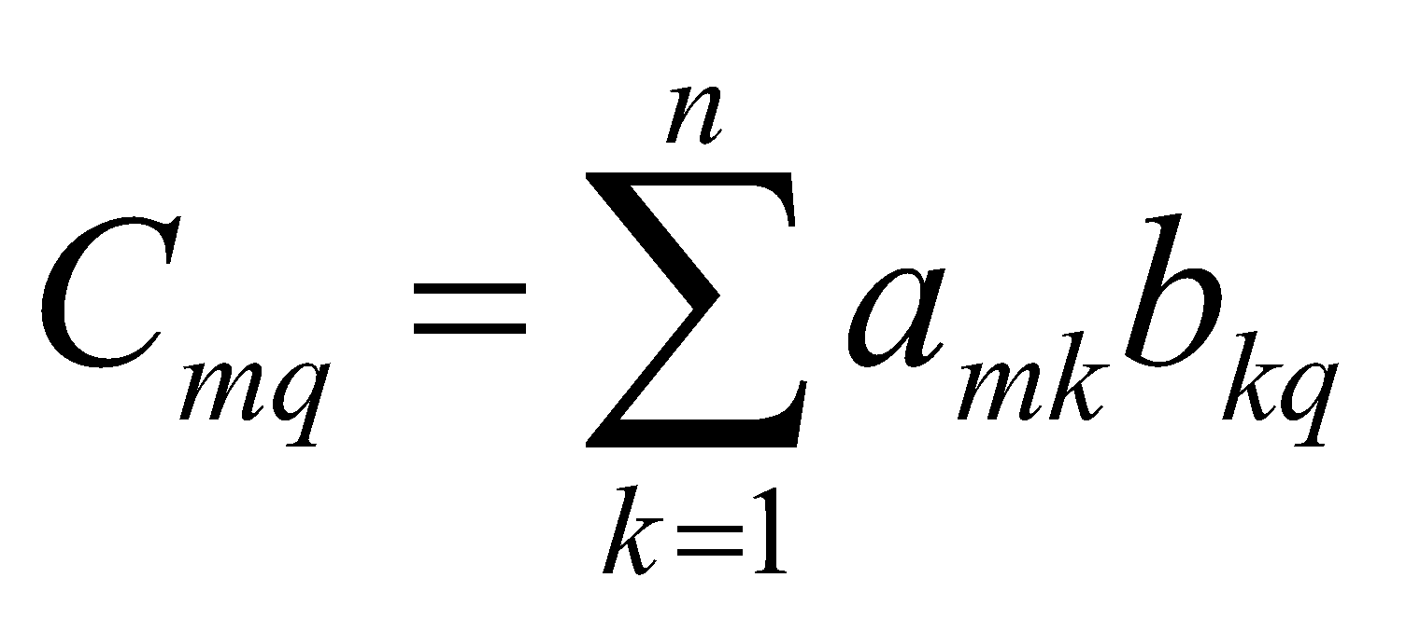
Matrix Algebra
The multiplication of two matrices A_{mxn} and B_{nxq} results in C_{mxq}
a b
c d
e f
g h
ae+bg af+bh
ce+dg cf+dh
=
a b
c d
e f
g h i
j k l
ag+bj ah+bk ai+bl
cg+dj ch+dk ci+dl
eg+fg eh+fk ei+fl
=
‹#›
(3x2) (2x3)
(3x3)

Slide 19
Matrix Algebra
The powers (square, cube, etc) of a matrix are just the matrix times itself that many times.
A² ⁼ AA or A³ = AAA
We often use matrix multiplication to find types of people one is tied to, since the ‘1’ in the adjacency matrix effectively captures just the people each row is connected to.
‹#›

Slide 20
Reachability
Geodesic Distance: Shortest path between i and j
Component: A connected graph with at least one path connecting every pair of nodes
‹#›

Slide 21
Calculating Reachability
(see p. 162 of W&F)
d(i,j) = min_{p}x^{[p]}_{ij} > 0
X
0 1 0 0 0 1
1 0 1 0 0 0
0 1 0 1 1 1
0 0 1 0 1 0
0 0 1 1 0 0
1 0 1 0 0 0
X²
2 0 2 0 0 0
0 2 0 1 1 2
2 0 4 1 1 0
0 1 1 2 1 1
0 1 1 1 2 1
0 2 0 1 1 2
X³
0 4 0 2 2 4
4 0 6 1 1 0
0 6 2 5 5 6
2 1 5 2 3 1
2 1 5 3 2 1
4 0 6 1 1 0
e
d
c
f
Distance
. 1 2 0 0 1
1 . 1 2 2 2
2 1 . 1 1 1
0 2 1 . 1 2
0 2 1 1 . 2
1 2 1 2 2 .
Distance
. 1 2 3 3 1
1 . 1 2 2 2
2 1 . 1 1 1
3 2 1 . 1 2
3 2 1 1 . 2
1 2 1 2 2 .
b
a
‹#›

Slide 22
Mixing Patterns
Matrices make it easy to look at mixing patterns: connections among types of nodes. Simply multiply an indicator of category by the adjacency matrix.
e
X
0 1 0 0 0 1
1 0 1 0 0 0
0 1 0 1 1 1
0 0 1 0 1 0
0 0 1 1 0 0
1 0 1 0 0 0
Race
1 0
1 0
0 1
0 1
0 1
1 0
X(Race)
2 0
1 1
2 2
0 2
0 2
1 1
d
c
f
b
R G
R
G
4 2
2 6
Race`(X)Race=
‹#›
a

Slide 23
Symmetry & Transitivity
To transform an asymmetric graph to a symmetric graph, add it to its transpose.
X
0 1 0 0 0
1 0 0 0 0
0 1 0 1 1
0 0 0 0 0
0 0 1 1 0
X^{T}
0 1 0 0 0
1 0 1 0 0
0 0 0 0 1
0 0 1 0 1
0 0 1 0 0
Max Sym MIN Sym
0 1 0 0 0 0 1 0 0 0
1 0 1 0 0 1 0 0 0 0
0 1 0 1 1 0 0 0 0 1
0 0 1 0 1 0 0 0 0 0
0 0 1 1 0 0 0 1 0 0
0 2 0 0 0
2 0 1 0 0
0 1 0 1 2
0 0 1 0 1
0 0 2 1 0
Transitivity: If iRj and jRk, then iRk
X²: Number of walks of length 2, e.g., n_{i} 🡪 n_{k} 🡪 n_{j}
Compare X² and X
‹#›

