Slide 1
SABM
Modeling the Co-evolution of Networks and Behaviors

Slide 2
When SABM applies?
network and behavior data captured at two or more points in time
try understanding the co-evolution of network-behavior dynamics
Networks Behaviors

Slide 3
When SABM apply?
network size is reasonable
enough changes in network and behaviors
usually directed networks

Slide 4
Some assumptions of SABM
as agents, each ego is only allowed to change her/his own outgoing ties and behaviors/attributes
egos have full knowledge about the network and behaviors/attributes of others
the evolution is seen as an outcome of a Markov process
the first observation is not modeled but treated as starting value
each ego follows a mini-step strategy

Slide 5
Social selection and social influence
Social selection: I become your friend because we share certain characteristics
Social influence: I come to share your characteristics because we are friends
The two are very difficult to distinguish looking at a single point in time.
Time 1 Time 2
i j i j
i j i j
i j i j
i j i j
Social selection
(homophily)
Social Influence
(assimilation)

Slide 6
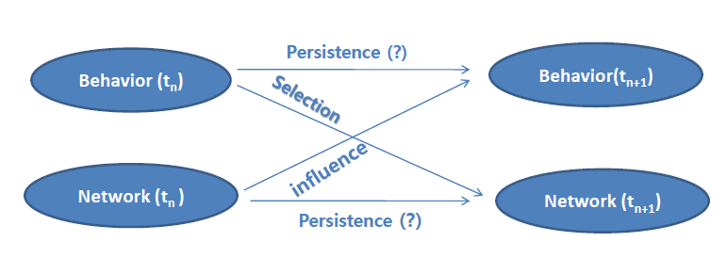
Modeling

Slide 7
Rate function
‘how fast is change / opportunity for change ?’
Rate of change of the network by ego i is denoted λ_{i}: expected frequency of changes by ego i between observations
Simple specification: rate functions are constant within periods
More generally, rate functions can depend on observation period (t_{m-1}, t_{m}), ego covariates, and network position (degrees etc.), through an exponential link function.

Slide 8
Objective function
‘what is the direction of change?’
The objective function f_{i}(β, x) indicates preferred ‘directions’ of change, here β is a statistical parameter, i is the ego (node), x the network
When ego i gets an opportunity for change, s/he has the possibility to change one outgoing tie variable x_{ij} , or leave everything unchanged
Higher values of the objective function indicate the preferred direction of changes

Slide 9
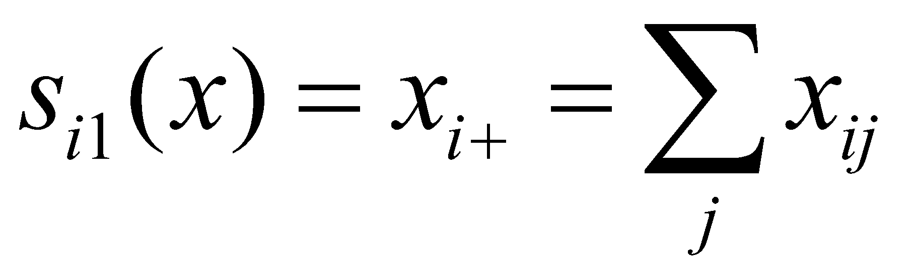
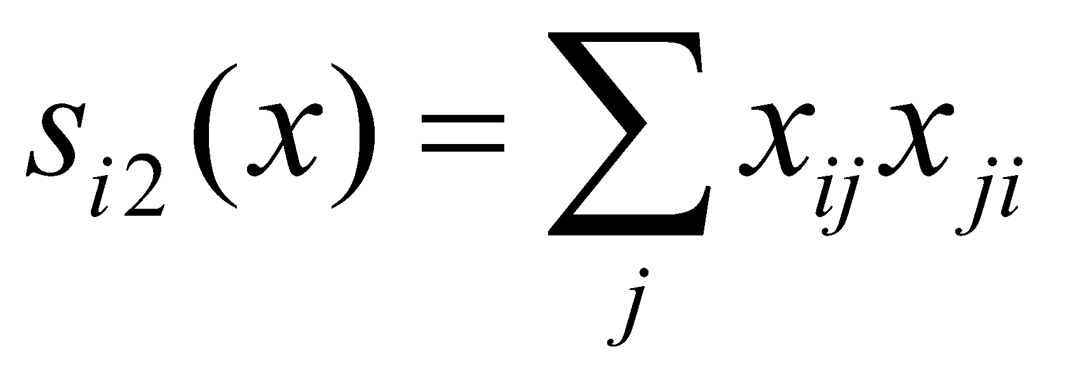
Possible network effects
out-degree effect, controlling the density / average degree,
reciprocity effect, number of reciprocated ties

Slide 10
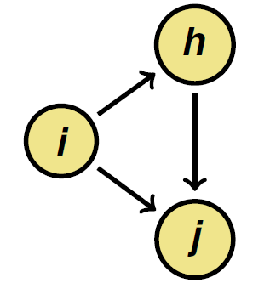
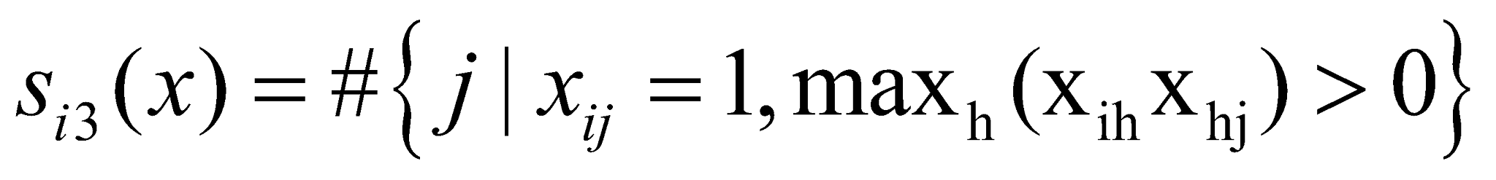
Possible network effects
transitive ties effect,
number of alters j to whom i is tied indirectly
(through at least one intermediary: x_{ih} = x_{hj} = 1,
and also directly x_{ij} = 1),

Slide 11
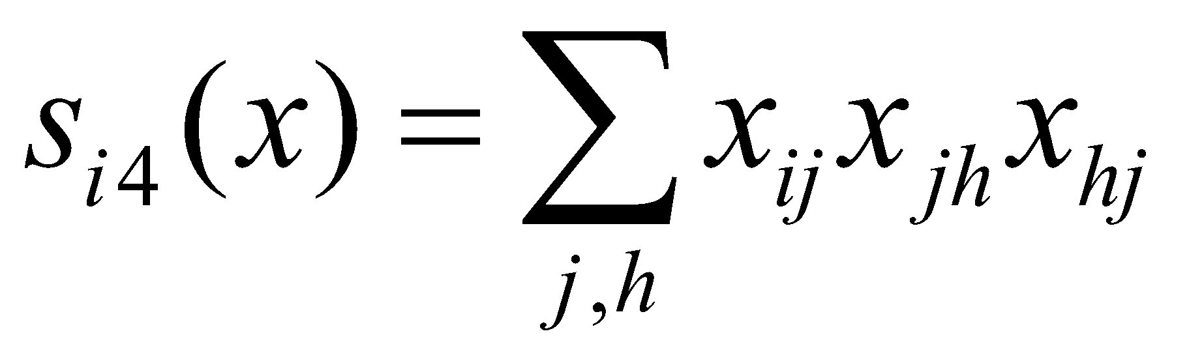
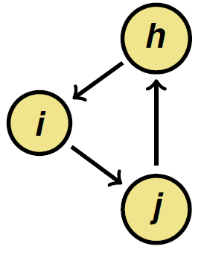
Possible network effects
three cycles effect, number of three-cycles in i’s ties (i → j; j → h; h → j)
This represents a kind of generalized reciprocity,
and absence of hierarchy

Slide 12
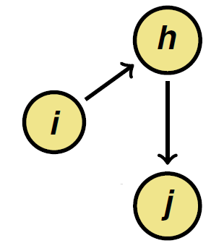
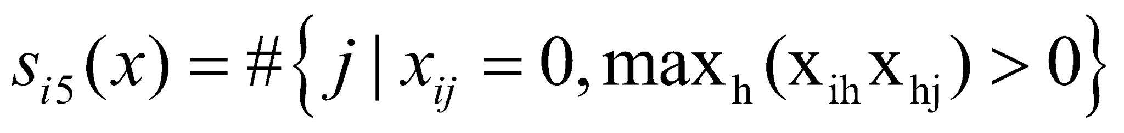
Possible network effects
indirect ties effect,
number of alters j to whom i is tied indirectly
(through at least one intermediary: x_{ih} = x_{hj} = 1 )
but not directly x_{ij} = 0),
= number of geodesic distances equal to 2,

Slide 13
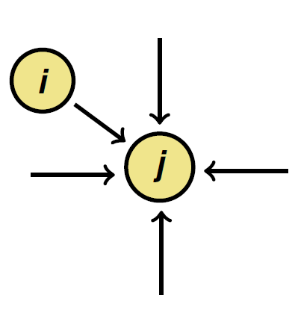
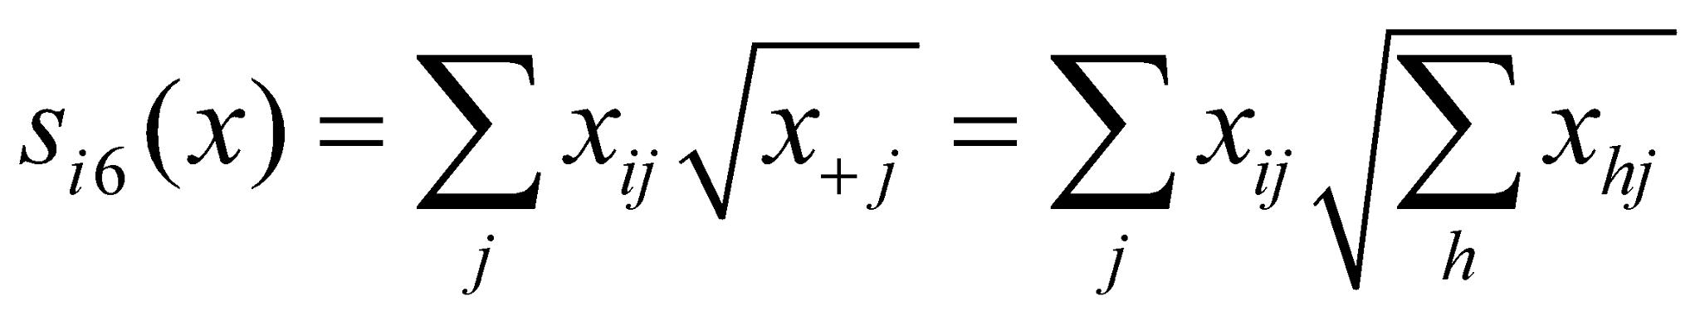
Possible network effects
in-degree related popularity effect, sum friends’ in-degrees
related to preferential attachment
(Barabási & Albert, 1999)
... and potentially many others ...

Slide 14
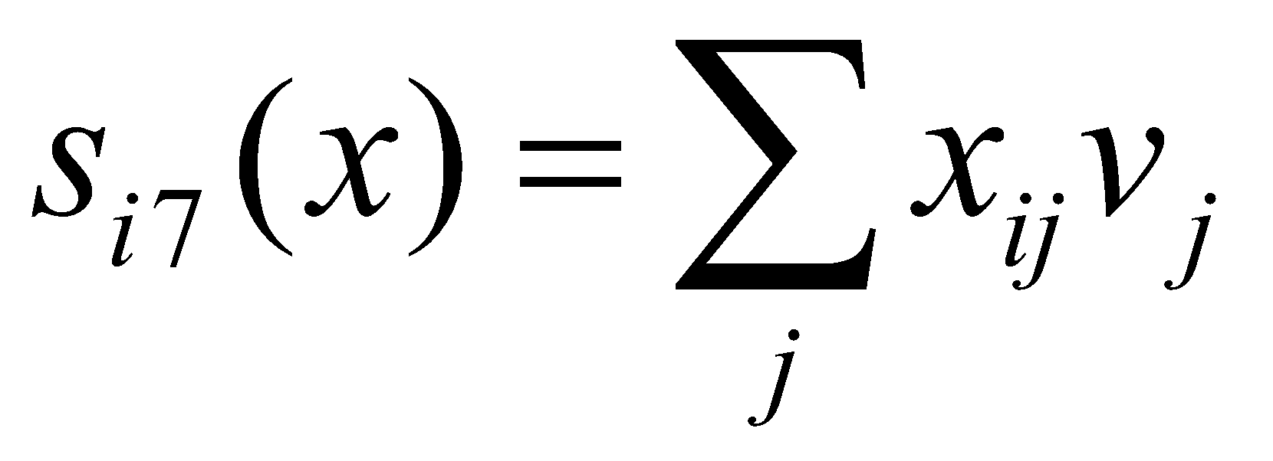
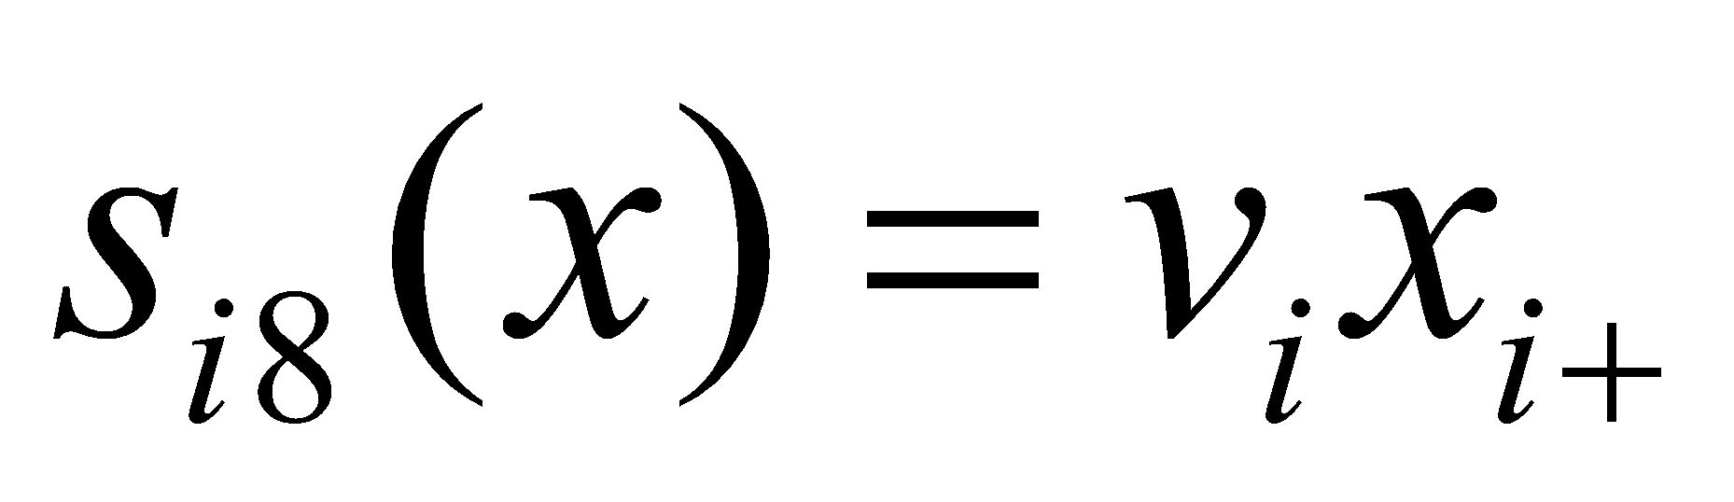
Evaluation function effect with ego covariate
covariate-related popularity, ‘alter’
sum of covariate over all of i ’s friends
covariate-related activity, ‘ego’
i’s out-degree weighted by covariate

Slide 15
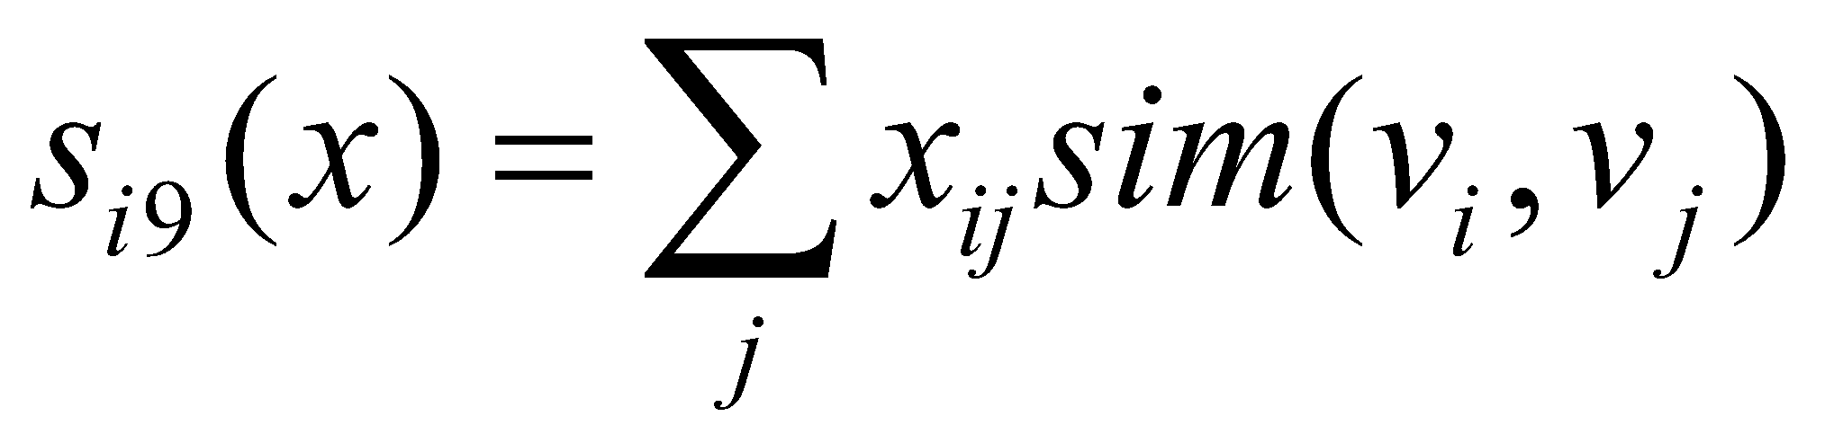
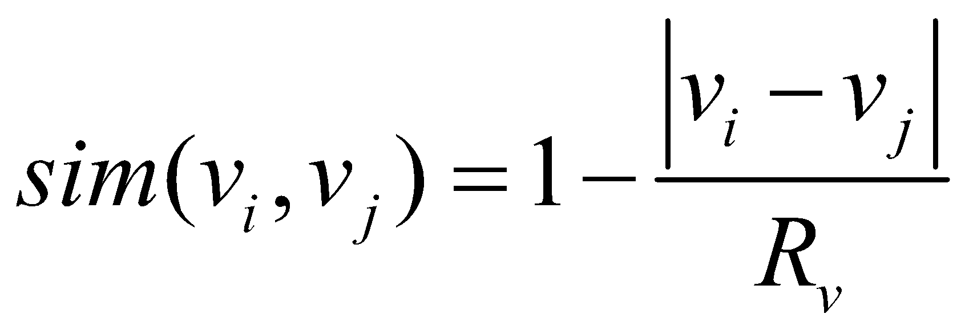
Evaluation function effect with ego covariate
covariate-related similarity,
sum of measure of covariate similarity
between i and her/his alters,
where sim(v_{i} , v_{j} ) is the similarity between v_{i} and v_{j} ,
R_{V} being the range of v

Slide 16
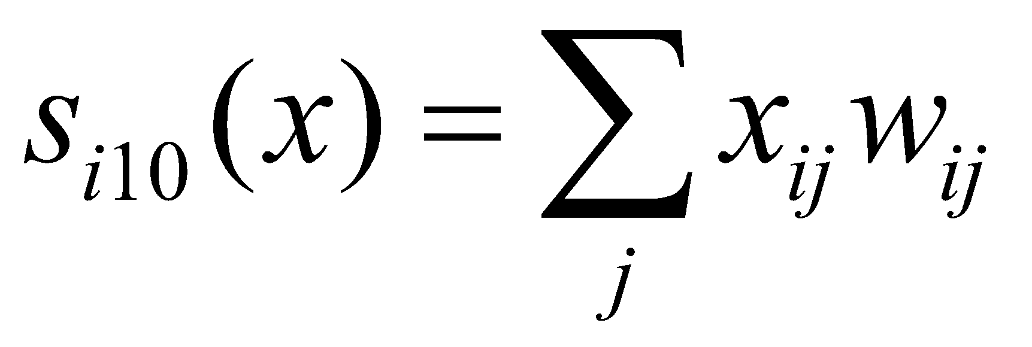
Evaluation function effect for dyadic covariates
covariate-related preference,
sum of covariate over all of i’s friends,
i.e., values of w_{ij} summed over all others to whom i is tied,
If this has a positive effect, then the value of a tie i → j
becomes higher when w_{ij} becomes higher.

Slide 17
Examples
The NetSense project
- 196 ND students
- 4 semesters: Fall 2011, Spring 2012, Summer 2012, & Fall 2012
- Networks through SMS & voice calls
- Behavior surveys through limesurvey on-line

Slide 18
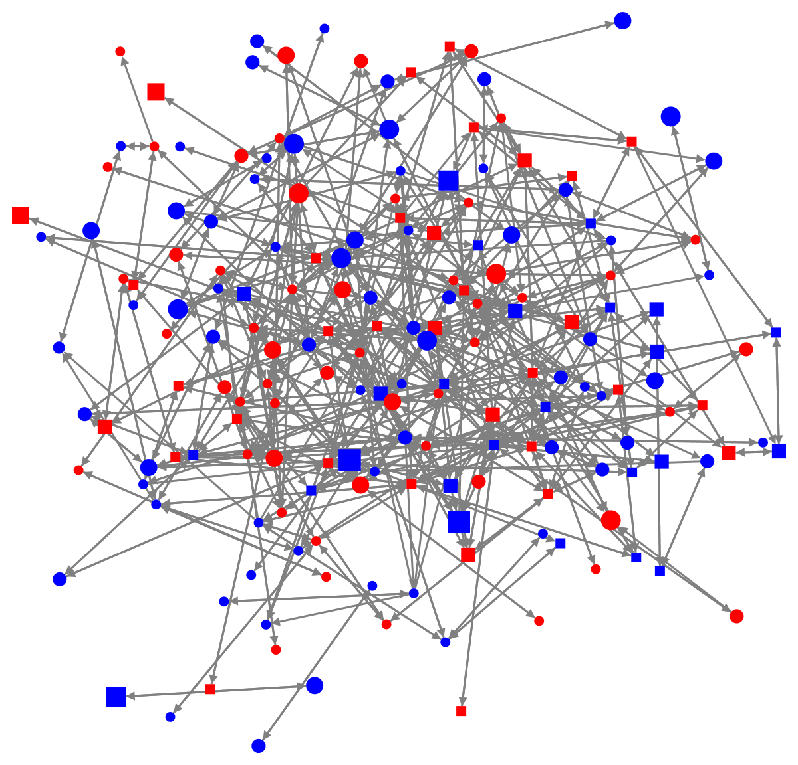
Net1 – Fall 2011
n=196 (17 isolates)
l=790
∆=0.021
Gender (node color)
Red – Female
Blue – Male
Race (node shape)
Circle – White
Square – non-white
Drinking frequency (node size)
0~4

Slide 19
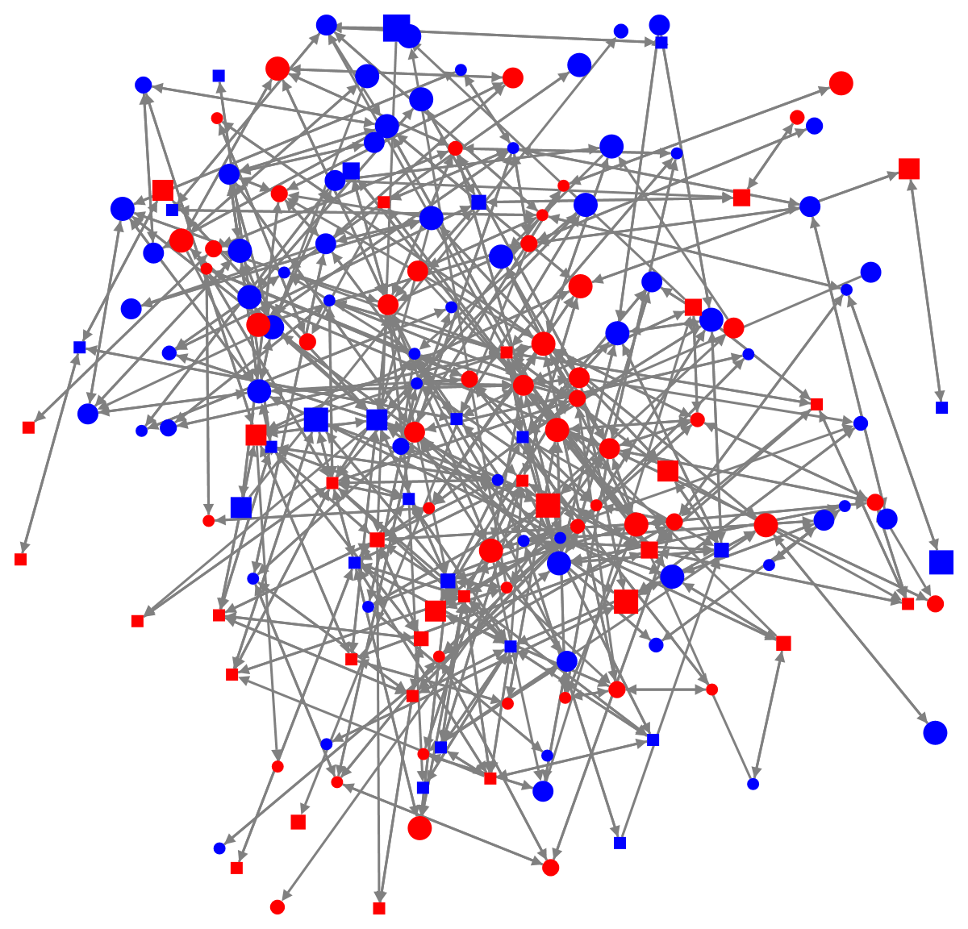
Net2 – Spring 2012
n=196 (25 isolates)
l=670
∆=0.018
Gender (node color)
Red – Female
Blue – Male
Race (node shape)
Circle – White
Square – non-white
Drinking frequency (node size)
0~4

Slide 20
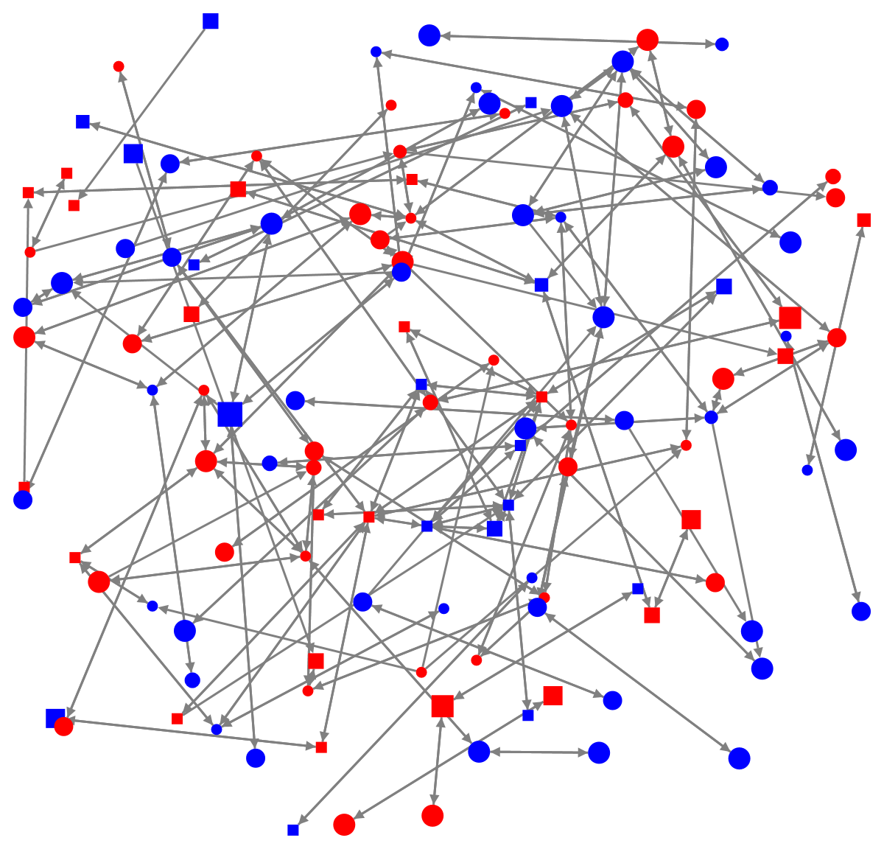
Net3 – Summer 2012
n=196 (70 isolates)
l=269
∆=0.007
Gender (node color)
Red – Female
Blue – Male
Race (node shape)
Circle – White
Square – non-white
Drinking frequency (node size)
0~4

Slide 21
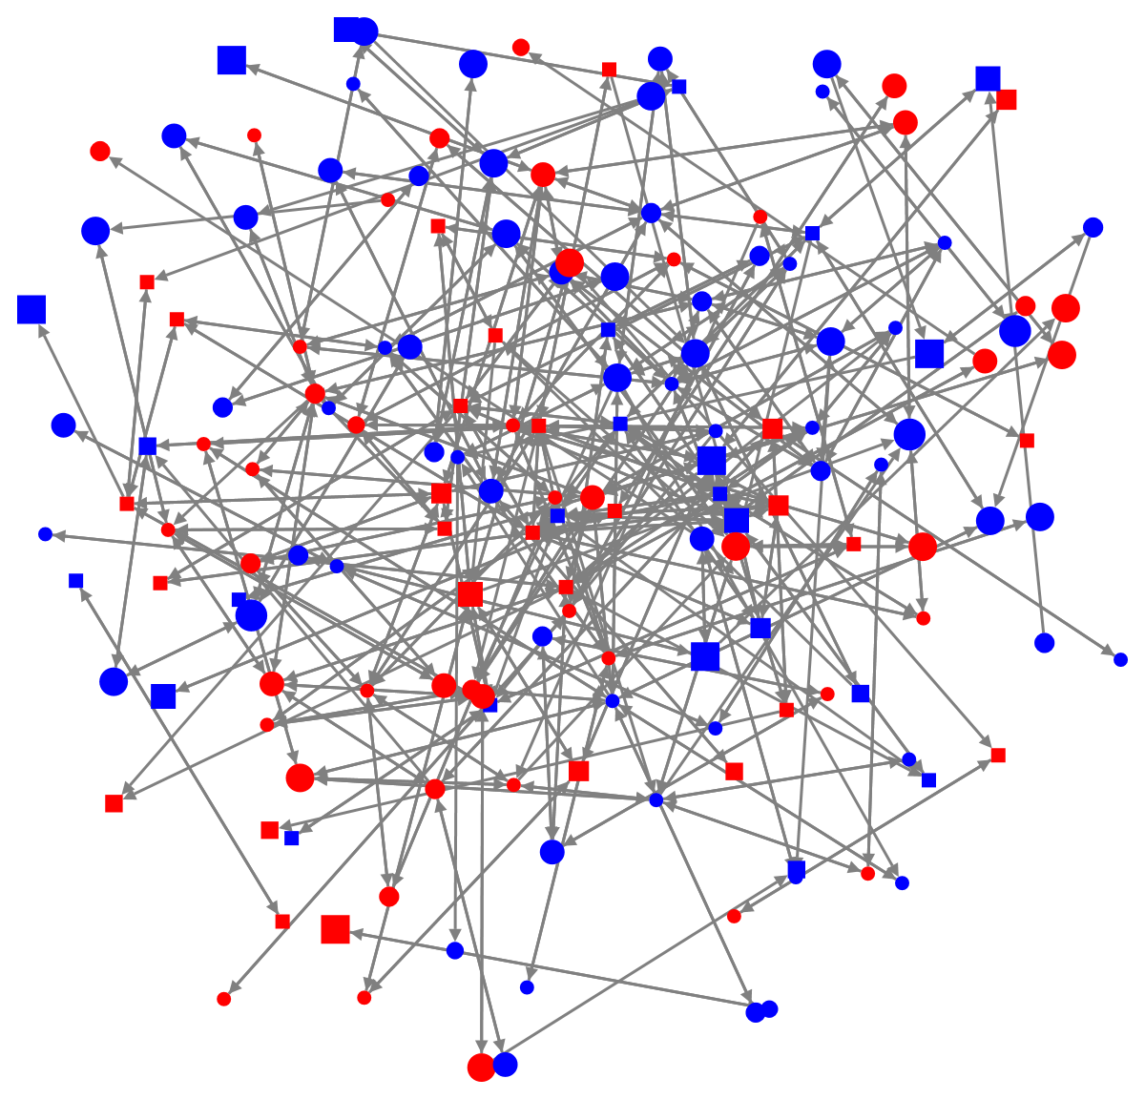
Net4 – Fall 2012
n=196 (34 isolates)
l=495
∆=0.013
Gender (node color)
Red – Female
Blue – Male
Race (node shape)
Circle – White
Square – non-white
Drinking frequency (node size)
0~4

Slide 22
Very simple model: only out-degree and reciprocity effects
rate parameters:
per node about 12 opportunities for change between the first two observations;
it decreases to about 8 opportunities at later waves
 | Model 1a
Effect | par. | (s.e.)
Rate t₁ – t₂ | 11.91 | 0.96
Rate t₂ – t₃ | 8.43 | 0.78
Rate t₂ – t₄ | 8.62 | 1.36
Out-degree | -6.09 | 0.20
Reciprocity | 7.76 | 0.33

Slide 23
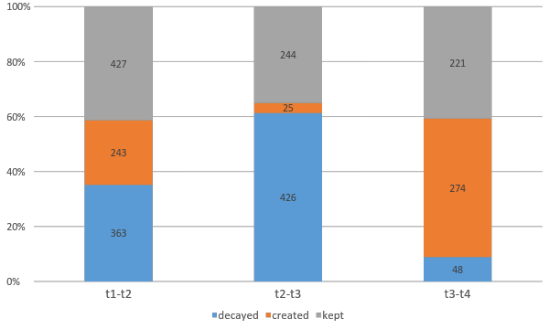

Slide 24
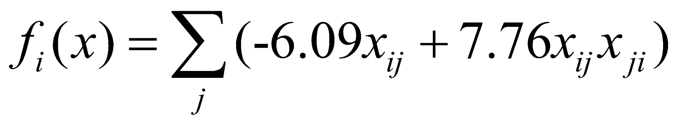
out-degree parameter negative:
on average, cost of friendship ties higher than their benefits;
reciprocity effect strong and highly significant (t=7.76/ 0.33=23.52)
Evaluation function is
Adding a reciprocated tie (i.e., for which x_{ji} = 1) gives
-6.09+7.76= 1.67
Adding a non-reciprocated tie (i.e., for which x_{ji} = 0) gives
-6.09,
i.e., this has negative benefits.

Slide 25
reciprocated ties are valued positively, unreciprocated ties negatively;
egos will be reluctant to form unreciprocated ties;
by ‘chance’ (the random term), such ties will be formed nevertheless
and these are the stuff on the basis of which reciprocation by others can start.

Slide 26
Structural model with one network closure effect
 | Model 2a
Effect | par. | (s.e.)
Rate t₁ – t₂ | 13.98 | 1.24
Rate t₂ – t₃ | 9.60 | 1.01
Rate t₂ – t₄ | 10.92 | 1.73
Out-degree | -6.16 | 0.18
Reciprocity | 7.40 | 0.30
Transitive ties | 0.92 | 0.06

Slide 27
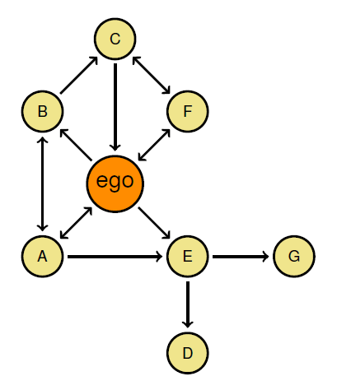
Example: Personal network of ego
for ego:
out-degree x_{i+} = 4,
#{recip. ties} = 2,
#{trans. ties } = 3.

Slide 28
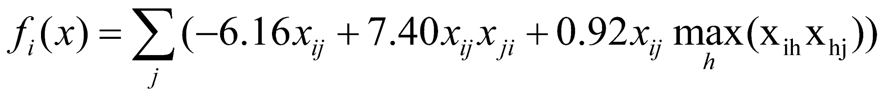
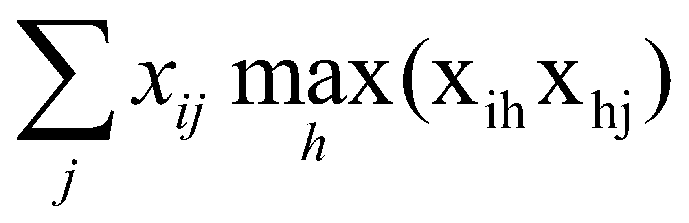
The evaluation function is
(note: is #{trans. ties }
so its current value for this actor is

Slide 29
Options when ‘ego’ has opportunity for change:
 | out-degree | reciprocity | Transitive ties | value | gain | exp(gain) | probability
current | 4 | 2 | 3 | -7.08 | 0.00 | 1.00 | 0.35%
new ties to C | 5 | 3 | 5 | -4 | +3.08 | 21.76 | 7.58%
new ties to D | 5 | 2 | 4 | -12.32 | -5.24 | 0.01 | 0.00%
new ties to G | 5 | 2 | 4 | -12.32 | -5.24 | 0.01 | 0.00%
drop ties to A | 3 | 1 | 0 | -11.08 | -4.00 | 0.02 | 0.01%
drop ties to B | 3 | 2 | 1 | -2.76 | +4.32 | 75.19 | 26.20%
drop ties to E | 3 | 2 | 2 | -1.84 | +5.24 | 188.67 | 65.75%
drop ties to F | 3 | 1 | 3 | -8.32 | -1.24 | 0.29 | 0.10%

Slide 30
Model with more structural effects
 | Model 2b
Effect | par. | (s.e.)
Rate t₁ – t₂ | 14.5568 | 1.1001
Rate t₂ – t₃ | 9.7021 | 0.7518
Rate t₂ – t₄ | 11.1766 | 1.1702
Out-degree | -5.8730 | 0.3709
Reciprocity | 7.3459 | 0.2350
Transitive ties | 0.5525 | 0.1066
Three-cycles | 0.6524 | 0.1632
Number of distance at 2 | 0.1347 | 0.0840
Indegree popularity (sqrd) | -0.3288 | 0.3006

Slide 31
Add effects of residence, gender, race, and age
 | Model 3
Effect | par. | (s.e.)
Rate t₁ – t₂ | 15.91 | 1.22
Rate t₂ – t₃ | 10.25 | 0.75
Rate t₂ – t₄ | 13.24 | 1.38
Out-degree | -5.84 | 0.38
Reciprocity | 7.20 | 0.28
Transitive ties | 0.50 | 0.10
Three-cycles | 0.66 | 0.15
Number of distance at 2 | 0.17 | 0.07
Indegree popularity (sqrd) | -0.41 | 0.28
 | Model 3
Effect | par. | (s.e.)
Same hall | 0.86 | 0.10
Sex (F) alter | -0.10 | 0.12
Sex (F) ego | 0.16 | 0.13
Sex similarity | -0.03 | 0.07
Race (W) alter | 0.15 | 0.14
Race (W) ego | -0.13 | 0.14
Race similarity | 0.26 | 0.08
Age alter | -0.09 | 0.14
Age ego | -0.02 | 0.13
Age similarity | 0.12 | 0.14

Slide 32
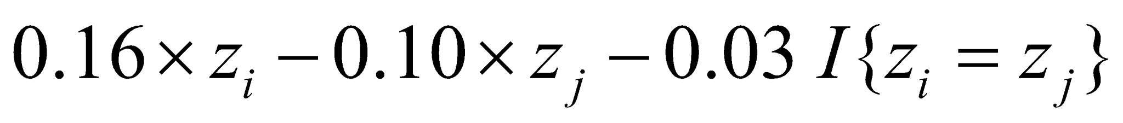
The joint effect of the gender-related effects for the tie variable x_{ij} from i to j is
men seem not to like female friends...?
i \ j | Male | Female
Male | -0.03 | -0.13
Female | 0.16 | 0.03

Slide 33
Behavior model with shape effect
 | Model 1a
Effect | par. | (s.e.)
Rate t₁ – t₂ | 4.82 | 1.57
Rate t₂ – t₃ | 1.07 | 0.19
Rate t₂ – t₄ | 2.28 | 0.34
Linear shape | -0.41 | 0.07
Quadratic shape | 0.10 | 0.03
Negative linear shape: an overall tendency for actors to adopt low levels of alcohol use
Positive quadratic shape: the higher the level of alcohol consumption of a student already is, the more likely it is that it will increase further (i.e., a positive feedback effect)

Slide 34
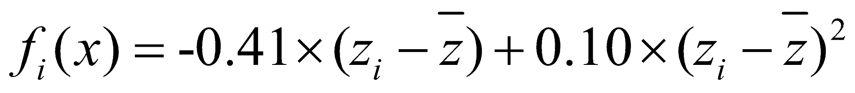
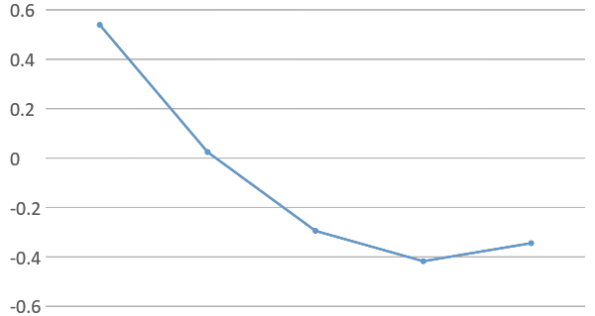
Evaluation function is
z: 0~4, mean=1.06
0 1 2 3 4

Slide 35
 |  | value | gain | exp(gain) | probability
0 | -1 | na | na | na | na
 | Stay same | 0.54 | 0.00 | 1.00 | 62.60%
 | +1 | 0.02 | -0.51 | 0.60 | 37.40%
1 | -1 | 0.54 | 0.51 | 1.67 | 49.21%
 | Stay same | 0.02 | 0.00 | 1.00 | 29.41%
 | +1 | -0.29 | -0.32 | 0.73 | 21.38%
2 | -1 | 0.02 | 0.32 | 1.38 | 42.20%
 | Stay same | -0.29 | 0.00 | 1.00 | 30.68%
 | +1 | -0.42 | -0.12 | 0.88 | 27.13%
3 | -1 | -0.29 | 0.12 | 1.13 | 35.26%
 | Stay same | -0.42 | 0.00 | 1.00 | 31.19%
 | +1 | -0.34 | 0.07 | 1.08 | 33.55%
4 | -1 | -0.42 | -0.07 | 0.93 | 48.17%
 | Stay same | -0.34 | 0.00 | 1.00 | 51.83%
 | +1 | na | na | na | na

Slide 36
Add average alter effect
 | Model 4
Effect | par. | (s.e.)
Rate t₁ – t₂ | 5.70 | 1.56
Rate t₂ – t₃ | 1.09 | 0.19
Rate t₂ – t₄ | 2.40 | 0.38
Linear shape | -0.39 | 0.06
Quadratic shape | 0.03 | 0.04
Average alter | 0.29 | 0.14
Positive and significant average alter effect: additional tendencies for ego to change their drinking behaviors to be reinforced by the average drinking behaviors of their friends.

Slide 37
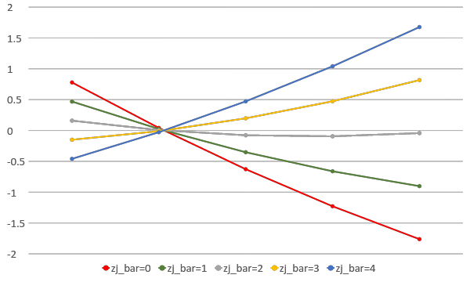
Evaluation function is
0 1 2 3 4

Slide 38
 |  | 0 | 1 | 2 | 3 | 4
0 | -1 | na | na | na | na | na
 | Stay same | 67.64% | 60.94% | 53.81% | 46.51% | 39.36%
 | +1 | 32.36% | 39.06% | 46.19% | 53.49% | 60.64%
1 | -1 | 58.02% | 48.06% | 37.77% | 28.05% | 19.68%
 | Stay same | 27.76% | 30.80% | 32.43% | 32.25% | 30.32%
 | +1 | 14.22% | 21.13% | 29.80% | 39.70% | 49.99%
2 | -1 | 55.78% | 45.67% | 35.43% | 25.96% | 17.99%
 | Stay same | 28.57% | 31.33% | 32.55% | 31.95% | 29.66%
 | +1 | 15.66% | 23.00% | 32.02% | 42.09% | 52.35%
3 | -1 | 53.48% | 43.26% | 33.12% | 23.95% | 16.40%
 | Stay same | 29.32% | 31.77% | 32.58% | 31.55% | 28.94%
 | +1 | 17.20% | 24.97% | 34.30% | 44.50% | 54.66%
4 | -1 | 63.02% | 55.99% | 48.71% | 41.49% | 34.61%
 | Stay same | 36.98% | 44.01% | 51.29% | 58.51% | 65.39%
 | +1 | na | na | na | na | na

Slide 39
Full model – Network part
 | Model 4
Effect | par. | (s.e.)
Rate t₁ – t₂ | 15.67*** | 1.79
Rate t₂ – t₃ | 10.28*** | 0.87
Rate t₂ – t₄ | 13.78*** | 1.98
Out-degree | -5.87*** | 0.41
Reciprocity | 7.22*** | 0.22
Transitive ties | 0.50*** | 0.11
Three-cycles | 0.65*** | 0.17
Number of distance at 2 | 0.18* | 0.08
Indegree popularity (sqrd) | -0.42 | 0.30
 | Model 4
Effect | par. | (s.e.)
Same hall | 0.90*** | 0.10
Sex (F) alter | -0.11 | 0.13
Sex (F) ego | 0.13 | 0.13
Sex similarity | -0.05 | 0.07
Race (W) alter | 0.19 | 0.18
Race (W) ego | -0.11 | 0.17
Race similarity | 0.24*** | 0.08
Age alter | -0.08 | 0.15
Age ego | -0.01 | 0.13
Age similarity | 0.14 | 0.14
Drinking similarity | 0.96*** | 0.27

Slide 40
Full model – Behavior part
 | Model 4
Effect | par. | (s.e.)
Rate t₁ – t₂ | 5.70*** | 1.56
Rate t₂ – t₃ | 1.09*** | 0.19
Rate t₂ – t₄ | 2.40*** | 0.38
Linear shape | -0.39*** | 0.06
Quadratic shape | 0.03 | 0.04
Average alter | 0.29* | 0.14
Effect from age | 0.03 | 0.11
Effect from gender (F) | -0.15 | 0.11
Effect for race (W) | 0.16 | 0.12

Slide 41
The relative contribution of drinking-based selection and influence
Spatial autocorrelation, i.e., when assessed alone, development indicators are robust predictors of democracy, but their predictive power fades with the inclusion of diffusion variables. In particular,
diffusion predictors of spatial proximity and networks are robust predictors of democratic growth in both the world and across all regions (Wejnert, 2005).
Network autocorrelation, can be the result of selection, influence, or both simultaneously

Slide 42
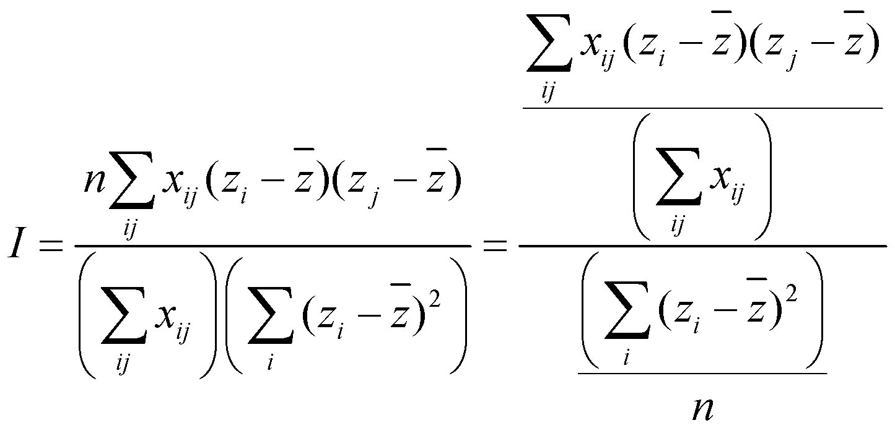
Moran's I: cross-products of behavioral scores of relational partners (Moran, 1948, see also Geary's C, 1954)
Values close to zero indicate that relational partners are not more similar than one would expect under random pairing, while values close to one indicate a very strong network autocorrelation.

Slide 43
 | null / baseline | trend | control | selection / no influence | Influence / no selection | full
Network model
Rate function |  | √ | √ | √ | √ | √
Out-degree |  |  | √ | √ | √ | √
Reciprocity |  |  | √ | √ | √ | √
Other network factors |  |  | √ | √ | √ | √
Individual covariates |  |  | √ | √ | √ | √
Drinking similarity |  |  |  | √ |  | √
Behavior model
Rate function |  | √ | √ | √ | √ | √
Linear shape |  | √ | √ | √ | √ | √
Quadratic shape |  | √ | √ | √ | √ | √
Average alter drinking |  |  |  |  | √ | √
Other network factors |  |  | √ | √ | √ | √
Individual covariates |  |  | √ | √ | √ | √
The expected value in the null model is -1/(n-1) (the n is number of actors)

Slide 44
 | t2 |  | t3 |  | t4
Model | Moran’s I | s.d. | Moran’s I | s.d. | Moran’s I | s.d.
Null | -0.005 |  | -0.005 |  | -0.005
Trend | -0.003 | 0.032 | 0.123 | 0.031 | 0.090 | 0.052
Control | 0.027 | 0.059 | 0.181 | 0.060 | 0.131 | 0.092
no influence | 0.076 | 0.057 | 0.299 | 0.061 | 0.292 | 0.097
no similarity | 0.134 | 0.074 | 0.250 | 0.063 | 0.290 | 0.106
Full | 0.174 | 0.072 | 0.373 | 0.061 | 0.468 | 0.101

Slide 45
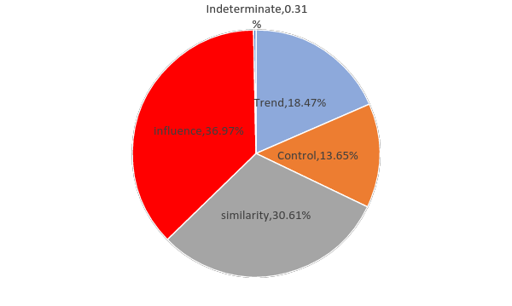
Selection – the proportion of similarity attributed to drinking-based friendship selection processes
Influence – the proportion of similarity
attributed to influence from egos’ friendship networks
Control – all selection and influence mechanisms except for drinking-based
selection and influence of friends
Trend – the consequences of the similarity observed in the preceding wave

Slide 46
Other work
Score tests
Time heterogeneity test
Goodness of fit
Bayesian estimation; Maximum Likelihood estimation
Non-directed networks
Bipartite networks
Multilevel network analysis (meta analysis approach)
Multivariate relations

Slide 47
Some sources
A lot of material
– programs, manuals, scripts, sample data, papers, workshop
announcements –
can be found at the Siena website:
http://www.stats.ox.ac.uk/siena/
There is also a user’s group:
http://groups.yahoo.com/groups/stocnet/

