Slide 1
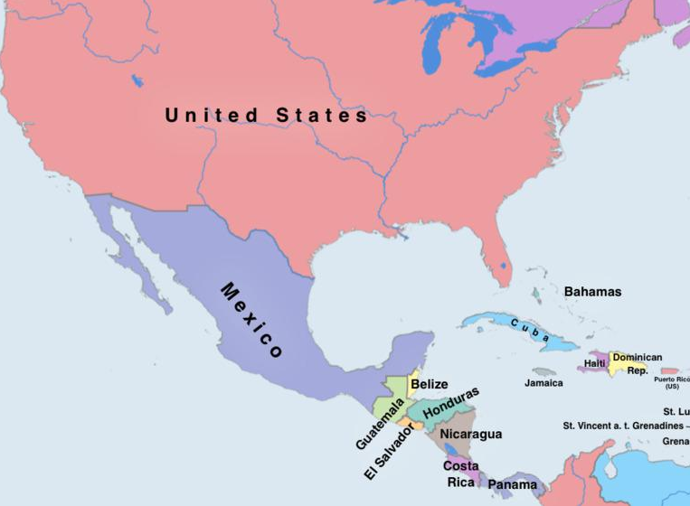
Born: New York City
Raised: La Romana, Dominican Rep.
College: Brooklyn College (Psych)
Grad School: Arizona (Soc)
First Job: Notre Dame
Second Job: UCLA
Research Interests: Social Networks, Culture, Social Theory
A little about me

Slide 2
Born: New York City
Raised: La Romana, Dominican Rep.
College: Brooklyn College (Psych)
Grad School: Arizona (Soc)
First Job: Notre Dame
Second Job: UCLA
Research Interests: Social Networks, Culture, Social Theory
A little about me

Slide 3
Born: New York City
Raised: La Romana, Dominican Rep.
College: Brooklyn College (Psych)
Grad School: Arizona (Soc)
First Job: Notre Dame
Second Job: UCLA
Research Interests: Social Networks, Culture, Social Theory
A little about me

Slide 4
Born: New York City
Raised: La Romana, Dominican Rep.
College: Brooklyn College (Psych)
Grad School: Arizona (Soc)
First Job: Notre Dame
Second Job: UCLA
Research Interests: Social Networks, Culture, Social Theory
A little about me

Slide 5
Born: New York City
Raised: La Romana, Dominican Rep.
College: Brooklyn College (Psych)
Grad School: Arizona (Soc)
First Job: Notre Dame
Second Job: UCLA
Research Interests: Social Networks, Culture, Social Theory
A little about me

Slide 6
Born: New York City
Raised: La Romana, Dominican Rep.
College: Brooklyn College (Psych)
Grad School: Arizona (Soc)
First Job: Notre Dame
Second Job: UCLA
Research Interests: Social Networks, Culture, Social Theory
A little about me

Slide 7
Born: New York City
Raised: La Romana, Dominican Rep.
College: Brooklyn College (Psych)
Grad School: Arizona (Soc)
First Job: Notre Dame
Second Job: UCLA
Research Interests: Social Networks, Culture, Social Theory
A little about me

Slide 8
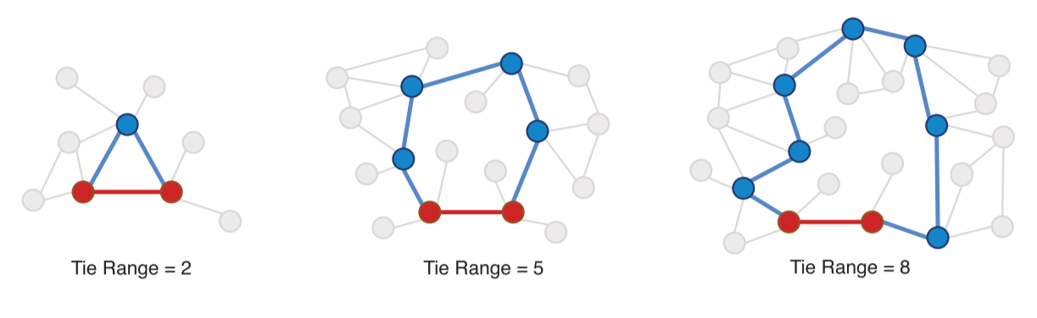
Dyad properties: Range
The range of tie is given by the second shortest path connecting the nodes in a dyad
Range is a non-local property
  Depends on other links beyond the dyad

Slide 9
Dyads properties: Bandwidth
https://www.sciencedirect.com/science/article/pii/S0378873318300194

Slide 10
How do you measure tie strength?
One approach: Use role relations as a proxy for strength
  Family and Friends are strong ties, acquaintances, co-workers, and neighbors are weak ties
  What’s the problem with this?
Another approach: Use interaction frequencies as a proxy for strength:
  People you see or interact with frequently are strong ties, people who you do not see or interact with frequently are weak ties
  What’s the problem with this?
Yet another approach: Use the number of different types of ties linking people as a proxy for strength:
  Multiplex ties are strong and “uniplex” ties are weak
  What’s the problem with this?

Slide 11
How do you measure tie strength?
Predictors
Best approach:
  Marsden and Campbell’s (1984) Indicator/Predictor Model
Combines different criteria
Distinguishes between tie properties that:
  Predict Strength (Predictors)
  Are Caused by Strength (Indicators)
Role Relations
Similarities
Tie Strength
Sentiment
Interaction
Exchange
Indicators

Slide 12
How do you measure tie strength?
Predictors
Best approach:
  Marsden and Campbell’s (1984) Indicator/Predictor Model
Indicators:
  Closeness/Intimacy (Sentiments)
  Frequency (Interaction)
  Duration
  Exchange/Support (Exchange)
Predictors:
  Role relations (Friend, Co-worker)
  Common memberships and Social Position (Similarities)
Role Relations
Similarities
Tie Strength
Sentiment
Interaction
Exchange
Indicators

Slide 13
How do you measure tie strength?
Predictors
Best approach:
  Marsden and Campbell’s (1984) Indicator/Predictor Model
Predictors tell us that a strong tie is more or less likely to form
  E.g., people who are similar are more likely to form strong ties
Indicators tell us that an existing tie is more or less strong
  The more indicators the stronger
    Closeness + Interaction + Support
Role Relations
Similarities
Tie Strength
Sentiment
Interaction
Exchange
Indicators

Slide 14
Basic Concepts in Social Network Analysis I
From graphs to matrices

Slide 15


Social networks, graphs, matrices
Basic Concepts
“The Graph”
Matrix Algebra
“The Matrix”
Social Systems
“The Network”

Slide 16
Social networks, graphs, matrices
Basic Concepts
“The Graph”
Matrix Algebra
“The Matrix”
Linkage
Social Systems
“The Network”

Slide 17
Social networks, graphs, matrices
Basic Concepts
“The Graph”
Matrix Algebra
“The Matrix”
Linkage
Analogy
Social Systems
“The Network”

Slide 18
Social networks, graphs, matrices
Basic Concepts
“The Graph”
Matrix Algebra
“The Matrix”
Linkage
Analogy
Social Systems
“The Network”
Measurement

Slide 19
Basic Concepts
“The Graph”
Matrix Algebra
“The Matrix”
Linkage
Analogy
Social Systems
“The Network”
Measurement

Slide 20
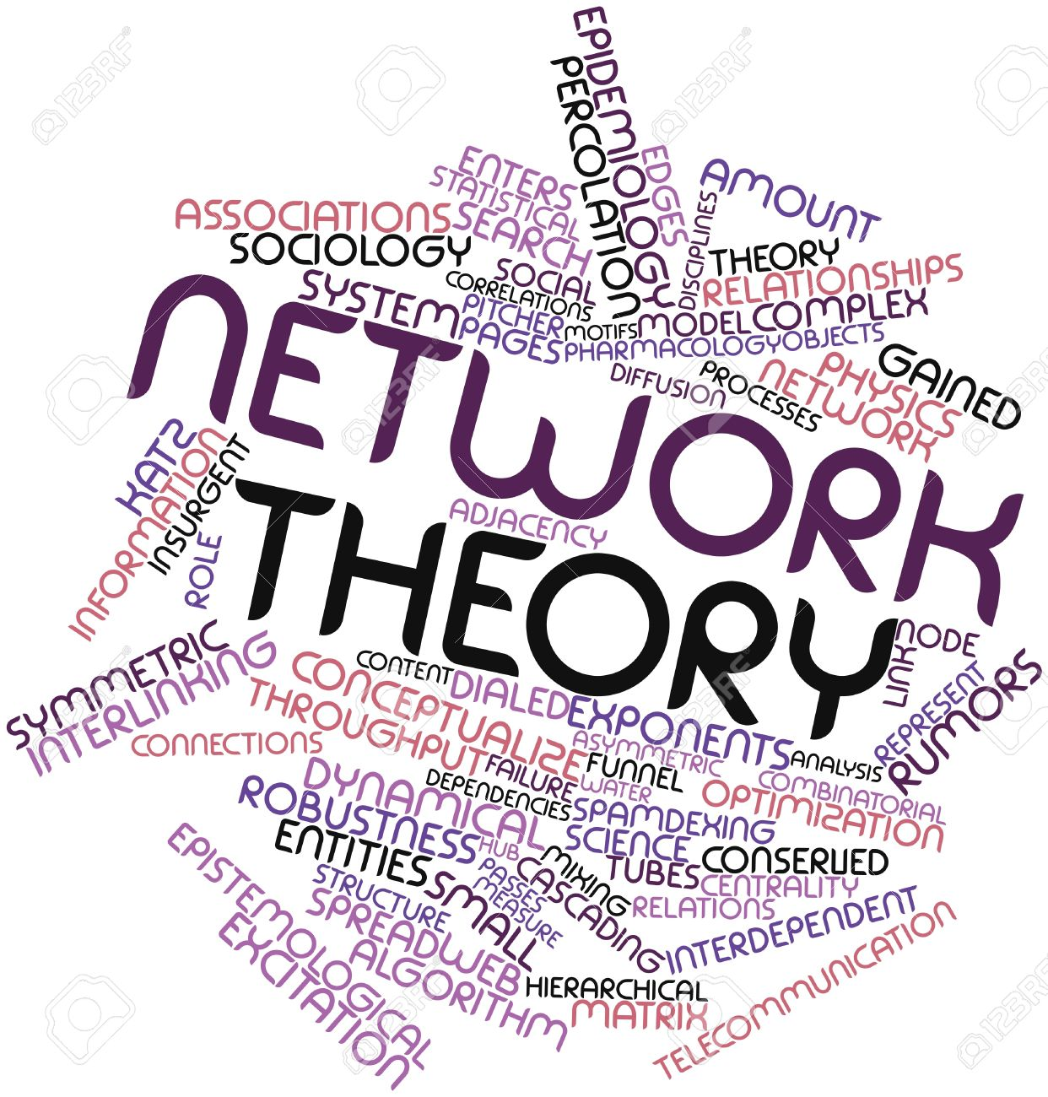
Three ways of talking about "social networks"
Social network theory is a branch of social science
  Social network theories tell us:
    What networks do
    How networks make a difference in the world
    Where networks come from and how they change
    Why networks look they way they do
  Example of social network theories we will look at:
    Strength of Weak Ties Theory
    Structural Holes Theory
    Balance Theory
    Theory of Cognitive Social Structures
    Theories of Network Diffusion and Contagion

Slide 21
Three ways of talking about "social networks"
Social network theory is a branch of social science
  Social network theories tell us:
    What networks do
    How networks make a difference in the world
    Where networks come from and how they change
    Why networks look they way they do
Graph Theory is a branch of pure mathematics
  We use an analogies to link social network theory concepts to graph theory concepts
    People → points (nodes, vertices)
    Relations between people → lines (links, ties, edges)
    Popularity → Number of edges attached to a node
    Groups → Subsets of nodes and ties in a graph

Slide 22
Three ways of talking about "social networks"
Social network theory is a branch of social science
  Social network theories tell us:
    What networks do
    How networks make a difference in the world
    Where networks come from and how they change
    Why networks look they way they do
Matrix algebra is a branch of applied mathematics
  “Easy” way of measuring (attaching numbers to) graph theory concepts
    People → rows and columns
    Relations between people → entries in the matrix
    Popularity → Sum of row entries in adjacency matrix

Slide 23
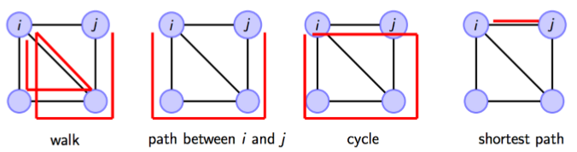
Walks, Paths, and Cycles
A walk is an alternating sequence of vertices and edges starting with an origin vertex u_{i} ending with a destination vertex u_{j} such that:
  There is an edge linking each successive vertex in the sequence
  Excluding the origin and destination vertices

Slide 24
Walks, Paths, and Cycles
A walk is an alternating sequence of vertices and edges starting with an origin vertex u_{i} ending with a destination vertex u_{j} such that:
  There is an edge linking each successive vertex in the sequence
  Excluding the origin and destination vertices
A walk is called a path if all edges and all vertices appear only once in the sequence

Slide 25
Walks, Paths, and Cycles
A walk is an alternating sequence of vertices and edges starting with an origin vertex u_{i} ending with a destination vertex u_{j} such that:
  There is an edge linking each successive vertex in the sequence
  Excluding the origin and destination vertices
A walk is called a path if all edges and all vertices appear only once in the sequence
A path of length 3!

Slide 26
Walks, Paths, and Cycles
A walk is an alternating sequence of vertices and edges starting with an origin vertex u_{i} ending with a destination vertex u_{j} such that:
  There is an edge linking each successive vertex in the sequence
  Excluding the origin and destination vertices
A path is called a cycle if it begins and ends with the same vertex
A cycle of length 4!

Slide 27
Basic Concepts: Walks, Paths, and Cycles
A walk is an alternating sequence of vertices and edges starting with an origin vertex u_{i} ending with a destination vertex u_{j} such that:
  There is an edge linking each successive vertex in the sequence
  Excluding the origin and destination vertices
For any pair of vertices i and j, the shortest path between them is the smallest length path that starts with u_{i} and ends with u_{j}

Slide 28
Basic Concepts: Walks, Paths, and Cycles
A walk is an alternating sequence of vertices and edges starting with an origin vertex u_{i} ending with a destination vertex u_{j} such that:
  There is an edge linking each successive vertex in the sequence
  Excluding the origin and destination vertices
Shortest paths are also called geodesics

Slide 29
Basic Concepts: Walks, Paths, and Cycles
A walk is an alternating sequence of vertices and edges starting with an origin vertex u_{i} ending with a destination vertex u_{j} such that:
  There is an edge linking each successive vertex in the sequence
  Excluding the origin and destination vertices
Two vertices u_{j} and u_{q} are k-connected if there is a shortest path of length k that begins in u_{j} and ends with u_{q}
u_{j} and u_{q} are 2-connected!
q

Slide 30

What is a graph?
Graphs can either be undirected or directed:
  In undirected graphs if an edge between c and d exists, by definition, so does the link between d and c
    {v_{c}v_{d}} = {v_{d}v_{c}}
Undirected Graph
Directed Graph

Slide 31
What is a graph?
Graphs can either be undirected or directed:
  In undirected graphs if an edge between c and d exists, by definition, so does the link between d and c
    {v_{c}v_{d}} = {v_{d}v_{c}}
  In directed graphs, the existence of an edge does not imply the existence of the one going in the opposite direction
    {v_{c}v_{d}} can exist but not {v_{d}v_{c}}
Undirected Graph
Directed Graph

Slide 32
What is a graph?
Graphs can either be undirected or directed:
  In undirected graphs if a link between c and d exists, by definition, so does the link between d and c
    {v_{c}v_{d}} = {v_{d}v_{c}}
  In directed graphs, the existence of a link does not imply the existence of the one going in the opposite direction
    {v_{c}v_{d}} can exist but not {v_{d}v_{c}}
  Undirected graphs are also called simple graphs
  Directed graphs are also called digraphs
Undirected Graph
Directed Graph

Slide 33
Centrality: From network concepts to measures
Some notion of prominence, importance, brokerage, being “in the middle of things,” being in a favorable exchange position, etc.
Translate the concept from natural language to the “language” of graph theory to develop a graph-theoretic concept
(e.g. points and lines)
Link graph-theoretic concept to matrix algebra to develop a measure of original concept (e.g. matrix operations)
V_{1(First)}
V₂
V₃
.
.
.
.
.
.
V_{N(Last)}
Result: A ranking of the nodes in the network based on centrality measure

Slide 34
Graphs and subgraphs
A subgraph G' = (V', E') of a graph G = (V, E) exists when:
  V' is a subset of V and E' is a subset of E
A subgraph is maximal with respect to a given property:
  (e.g., connectivity)
If adding more nodes or links to the subgraph will mean it no longer has that property
This is a maximal connected subgraph of order 7

Slide 35
Graphs and subgraphs
A subgraph G' = (V', E') of a graph G = (V, E) exists when:
  V' is a subset of V and E' is a subset of E
A subgraph is maximal with respect to a given property:
  (e.g., connectivity)
If adding more nodes or links to the subgraph will mean it no longer has that property
This is a maximal connected subgraph of order 8

Slide 36
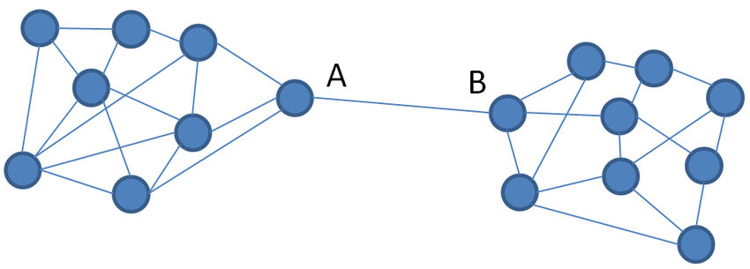
Betweenness C_{between}(v_{i})
First proposed by Freeman (1977)
  Social Network Concept: What share of the entire network flow goes through a given person?
  Graph theoretic concept: Sum of of the proportion of shortest paths in the graph between all other pairs of vertices {v_{j}, v_{k}} that contain v_{i}
C
E
D

Slide 37
Betweenness C_{between}(v_{i})
First proposed by Freeman (1977)
  Social Network Concept: What share of the entire network flow goes through a given person?
  Graph theoretic concept: Sum of of the proportion of shortest paths in the graph between all other pairs of vertices {v_{j}, v_{k}} that contain v_{i}
C
E
D

Slide 38
Betweenness C_{between}(v_{i})
First proposed by Freeman (1977)
  Social Network Concept: What share of the entire network flow goes through a given person?
  Graph theoretic concept: Sum of of the proportion of shortest paths in the graph between all other pairs of vertices {v_{j}, v_{k}} that contain v_{i}
C
E
The shortest path between A and C includes B!
D

Slide 39
Betweenness C_{between}(v_{i})
First proposed by Freeman (1977)
  Social Network Concept: What share of the entire network flow goes through a given person?
  Graph theoretic concept: Sum of of the proportion of shortest paths in the graph between all other pairs of vertices {v_{j}, v_{k}} that contain v_{i}
C
E
The shortest path between A and D also includes B!
D

Slide 40
Betweenness C_{between}(v_{i})
First proposed by Freeman (1977)
  Social Network Concept: What share of the entire network flow goes through a given person?
  Graph theoretic concept: Sum of of the proportion of shortest paths in the graph between all other pairs of vertices {v_{j}, v_{k}} that contain v_{i}
C
E
The shortest path between A and E includes both B and C!
D

Slide 41
Betweenness C_{between}(v_{i})
First proposed by Freeman (1977)
  Social Network Concept: What share of the entire network flow goes through a given person?
  Graph theoretic concept: Sum of of the proportion of shortest paths in the graph between all other pairs of vertices {v_{j}, v_{k}} that contain v_{i}
High betweenness actors can “broker” between different people
C
E
The shortest path between A and E includes both B and C!
D

Slide 42
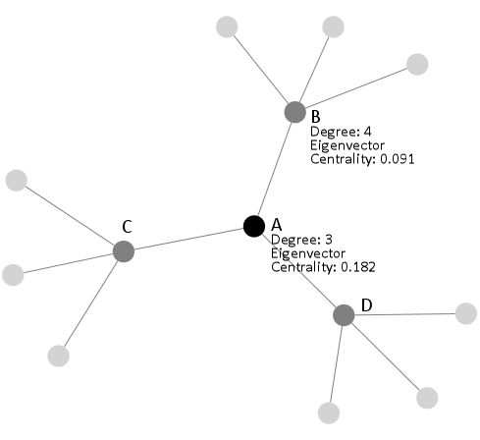
Eigenvector Centrality
Basic idea: A vertex is more central, the more central its neighbors are
With Degree Centrality, each alter carries equal weight
  What if a person has friends who have lots of other friends versus a person whose friends have few friends?
Solution:
  Give each vertex more “centrality points” when for links to central people!

Slide 43
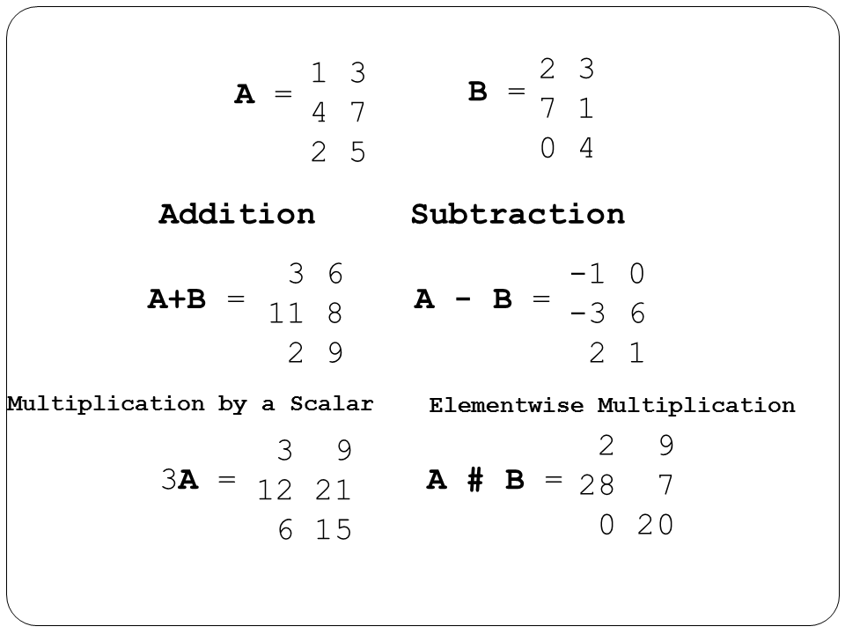
What is a matrix?
The main advantage of matrices is that you can do simple mathematical operations on them
    Addition
    Multiplication
    Subtraction

Slide 44
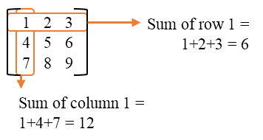
What is a matrix?
The main advantage of matrices is that you can do simple mathematical operations on them
  Row sums
  Column sums
This creates measures of graph theory concepts that have been connected to social network theory concepts!

Slide 45
The social network analysis three-step shuffle
Think up or grab an “off the shelf” fuzzy concept from social science to develop a network-theoretic concept
(e.g. popularity, brokerage, reciprocity, role, status)
Translate the concept from natural language to the “language” of Basic Concepts to develop a graph-theoretic concept
(e.g. points and lines)
Link the graph-theoretic concept to matrix algebra to develop a network-analytic measure of the network-theoretic concept
(e.g. indegree centrality as a measure of popularity)

Slide 46
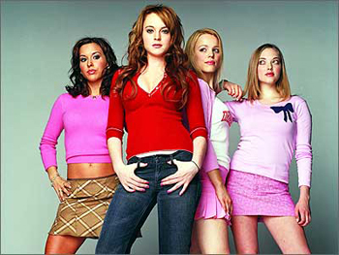
The network theory three-step shuffle: Example
How can we specify the social science concept of popularity In network terms ?
  Step 1: Define the concept in natural language network-theoretic terms:
    “A person who is well known among her peers”

Slide 47
The network theory three-step shuffle: Example
How can we specify the social science concept of popularity In network terms ?
  Step 1: Define the concept in natural language network-theoretic terms:
    “A person who is well known among her peers”
  Step 2: Decide what type of tie best represents that concept:
    Ties that don’t have direction
    Ties that have directionality

Slide 48
The network theory three-step shuffle: Example
How can we specify the social science concept of popularity In network terms ?
  Step 3: Represent the network using a graph that goes with that type of tie:
    Ties with inherent directionality (exchange, advice, likes) -> Directed graph
  Step 4: Translate the network concept into a graph theoretic concept
    Popularity -> Number of incoming edges landing on an node
Directed Graph
 | a | b | c | d | e
a | -- | 1 | 0 | 0 | 0
b | 1 | -- | 0 | 0 | 0
c | 0 | 1 | -- | 1 | 1
d | 0 | 0 | 0 | -- | 0
e | 0 | 0 | 1 | 1 | --

Slide 49
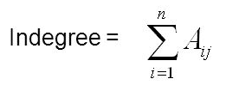
The network theory three-step shuffle: Example
How can we specify the social science concept of popularity In network terms ?
  Step 5: Come up with a matrix operation that translates that into a number:
    Sums of the column of the matrix gives the indegree (“popularity”) of each node
  Step 6:
    You are done!
 | a | b | c | d | e
a | -- | 1 | 0 | 0 | 0
b | 1 | -- | 0 | 0 | 0
c | 0 | 1 | -- | 1 | 1
d | 0 | 0 | 0 | -- | 0
e | 0 | 0 | 1 | 1 | --
1 | 2 | 1 | 2 | 1

Slide 50
Summary of topics
Generalizing the notion of adjacency:
  In the last lecture we discussed the difference between adjacent and nonadjacent vertices in a graph
  Today we generalize notions of adjacency to consider indirect or multiple connectivity between two nodes
Considering additional types of graphs:
  Weighted graphs
  Multigraphs
  Signed graphs
  Bipartite graphs
Considering an important matrix operation:
  Matrix multiplication

Slide 51

Weighted graphs
Weighted graphs are a special type of graph featuring:
  Numerical values associated with each edge
  This is called the edge weight (w_{uv})
  G = {E, V, w}
We can go from weighted to simple binary graphs by using a cutoff:
  a_{ij} = 1 if w_{ij} > ϴ, else a_{ij} = 0
  Binary graphs can be thought of as a special (truncated) case of weighted graphs

Slide 52
Weighted graphs
Weighted graphs are a special type of graph featuring:
  Numerical values associated with each edge
  This is called the edge weight (w_{uv})
  G = {E, V, w}
We can go from weighted to simple binary graphs by using a cutoff:
  a_{ij} = 1 if w_{ij} > ϴ, else a_{ij} = 0
  Weighted graphs can be directed or undirected
Weighted Directed Graph

Slide 53
Weighted graphs
Weighted graphs can be used to represent weighted networks
  In a weighted network we not only measure the presence/absence of a tie, but also the strength of the relationship:
    Proportion of time i and j spend together
    Number of texts from i to j
    Number of times i retweets j
    Number of times i goes to j for help or advice
Weighted Directed Graph

Slide 54
Weighted graphs: Matrix Representation
 | a | b | c | d | e | f
a | --
b |  | --
c |  |  | --
d |  |  |  | --
e |  |  |  |  | --
f
Weighted Directed Graph

Slide 55
Weighted graphs: Matrix Representation
 | a | b | c | d | e | f
a | --
b |  | --
c |  |  | --
d |  |  |  | --
e |  |  |  |  | --
f
Weighted Directed Graph

Slide 56
Weighted graphs: Matrix Representation
 | a | b | c | d | e | f
a | --
b | 0.3 | --
c |  |  | --
d |  |  |  | --
e |  |  |  |  | --
f
Weighted Directed Graph

Slide 57
Weighted graphs: Matrix Representation
 | a | b | c | d | e | f
a | --
b | 0.3 | -- | 0.3
c |  |  | --
d |  |  |  | --
e |  |  |  |  | --
f
Weighted Directed Graph

Slide 58
Weighted graphs: Matrix Representation
 | a | b | c | d | e | f
a | --
b | 0.3 | -- | 0.3 | 0.4 | 0 | 0
c |  |  | --
d |  |  |  | --
e |  |  |  |  | --
f
Weighted Directed Graph

Slide 59
Weighted graphs: Matrix Representation
 | a | b | c | d | e | f
a | -- | 0 | 0 | 0 | 0.1 | 0.9
b | 0.3 | -- | 0.3 | 0.4 | 0 | 0
c | 0 | 0 | -- | 0.6 | 0.4 | 0
d | 0 | 0 | 0 | -- | 1.0 | 0
e | 0.55 | 0 | 0 | 0 | -- | 0.45
f | 0 | 0 | 0 | 1.0 | 0 | --
Weighted Directed Graph

Slide 60
Bipartite Graphs
A bipartite graph is a special kind of graph featuring:
  Two disjoint sets of vertices, U, V
    Two sets are disjoint when they don’t share members
  One edge set (E)
    G = {U, V, E}
  Edges link vertices between sets but not within sets
  The two vertex sets can be of different cardinality (size)!
    |U| = 6, |V| = 5
U
V
Gabriela
Super Smash Bros.
Parker
Cheese
Brandon
Nerdfighters
Marie
Magic
Rahul
Fashion
Minjoo

Slide 61
Bipartite Graphs
Bipartite graphs can be used to represent the social network concepts of affiliation or membership
In Affiliation Networks people are linked to other (usually larger) entities that are not people
  Actors and movies
  Scientists and papers
  Persons and events
U
V
Gabriela
Super Smash Bros.
Parker
Cheese
Brandon
Nerdfighters
Marie
Magic
Rahul
Fashion
Minjoo

Slide 62
Ego networks
Ego: Central node
Alters: Nodes around ego
  Obligatory links from ego to every alter
  Optional links from alter to alter
b
a
c
Ego
h
d
g
e
f

Slide 63
Types of ties in ego networks
Role relations (states)
  Friends, kin, business partners
Interpersonal sentiments and cognitions
  Liking, trusting, acquaintanceship
Behavioral Social Interactions
  Calling, texting, citing, supporting, resource exchange
b
a
c
Ego
d
h
g
e
f

Slide 64
Measuring ego networks: Four steps
Pick a type of relation you are interested in
  This defines your name generator
Pick a maximum number
  E.g. 5-20
Pick a set of altern and tie-level characteristics you are interested in
  This defines your name interpreter
Collect information about relations between alters (optional)
b
a
c
Ego
d
h
g
e
f

Slide 65
Name generators: Four approaches
Role-Relation Approach
  Neighbors, friends, kin, co-authors
Interaction Approach
  Frequency, duration of contact
Affective Approach
  Significant, close, enemies
Exchange Approach
  Information, favors, support, resources
    Different approaches can produce ego-networks with different structural characteristics!
b
a
c
Ego
d
h
g
e
f

Slide 66
Name generators: Four approaches
Role-Relation Approach
  “list the names of up to [X] [friends, co-workers, co-authors, pub-mates, etc.]”
Interaction Approach
  “list the names of up to [X] of the people you most frequently interact with
Affective Approach
  “list the names of up to [X] of the people you [feel closest to, trust most, etc.]”
Exchange Approach
  “list the names of up to [X] of the people you would go to for [advice, financial support, etc.]
b
a
c
Ego
d
h
g
e
f

Slide 67
Name generators: Four approaches
Famous examples:
  Wellman’s (1979) East York Study:
    “Name the six persons outside your home that you feel closest to.”
  Fischer’s (1982) Northern California Communities Study:
    “Name all persons who would provide any of eight types of aid”
  Marsden’s (1987) General Social Survey:
    “Named all persons with whom you have discussed matters important to you”
b
a
c
Ego
d
h
g
e
f

Slide 68

Name interpreters
Follow up questions designed to get information on named alters
  Socio-demographic characteristics of alter
    Gender
    Age
    Race
    Years of Education
    Relationship to the organization
    Religion
    Etc.

Slide 69

Name interpreters
Follow up questions designed to get information on named alters
  Socio-demographic characteristics of alter
    Sex/Gender
    Age
    Race
    Years of Education
    Relationship to the organization
    Religion
    Etc.

Slide 70

Name interpreters
Follow up questions designed to get information on named alters
  Socio-demographic characteristics of alter
    Gender
    Age
    Race
    Years of Education
    Relationship to the organization
    Religion
    Etc.

Slide 71

Name interpreters
Follow up questions designed to get information on named alters
  Socio-demographic characteristics of alter
    Gender
    Age
    Race
    Years of Education
    Relationship to the organization
    Religion
    Etc.

Slide 72

Name interpreters
Follow up questions designed to get information on elicited relations
  Role-relations
    Friends, co-workers, co-authors, pub-mates
  Sentiments
    Loving, exciting, significant, negative sentiments (difficult person)
  Exchanges and Support
    Advice, would go to for financial help, discuss important matters, etc.

Slide 73

Name interpreters
Follow up questions designed to get information on elicited relations
  Role-relations
    Friends, co-workers, co-authors, pub-mates
  Sentiments
    Closeness, negative sentiments (difficult person)
  Exchanges and Support
    Advice, would go to for financial help, discuss important matters, etc.

Slide 74

Name interpreters
Follow up questions designed to get information on elicited relations
  Role-relations
    Friends, co-workers, co-authors, pub-mates
  Sentiments
    Closeness, negative sentiments (difficult person)
  Exchanges and Support
    Advice, would go to for financial help, discuss important matters, etc.

Slide 75

Name interpreters
Follow up questions designed to get information on elicited relations
  Relationship age or duration
  Subjective similarity
  “Cultural matching”
    Does alter share tastes, attitudes, practices with ego?

Slide 76

Name interpreters
Follow up questions designed to get information on elicited relations
  Relationship age or duration
  Subjective similarity
  “Cultural matching”
    Does alter share tastes, attitudes, practices with ego?

Slide 77

Name interpreters
Follow up questions designed to get information on elicited relations
  Relationship age or duration
  Subjective similarity
  Similarities/Matching in Cultural Pursuits
    Does alter share tastes, attitudes, practices with ego?

Slide 78
Alternatives: Position Generators
“Do you know anyone who is a/an….”
  Lawyer
  Doctor
  Mechanic
  Teacher
  Secretary
  Haridresser
  Cook
  Farmer
  Mailman
  Policeman
  [...] And whatever other occupations you can imagine

Slide 79

Alternatives: Position Generators

Slide 80
Alternatives: Resource Generators
“Do you know anyone who…”
  Can repair a car, bike, etc.
  Is handy repairing household equipment
  Can speak and write a foreign language
  Can work with a personal computer
  Has good contacts with a newspaper, radio or TV station
  Has knowledge about financial matters (taxes, subsidies)
  Can give advice concerning a conflict at work
  Can help when moving house (packing, lifting)
  Can help with small jobs around the house (carpentering, painting)
  [...] And whatever else you can imagine

Slide 81

Alternatives: Resource Generators

Slide 82
Weighted graphs
Often it is useful to associate numerical values with the edges (uv) of a graph:
  This is called the edge weight (w_{uv})
    The strength of the relationship j
    the amount of something (e.g. information, support) that flows
Graphs that featured edge weights are called weighted (valued) graphs:
  Binary graphs can be thought of as a constrained case of weighted graphs

Slide 83
Weighted graphs
Often it is useful to associate numerical values with the edges (uv) of a graph:
  This is called the edge weight (w_{uv})
    The strength of the relationship j
    the amount of something (e.g. information, support) that flows
Sometimes people “binarize” weighted graphs using a cutoff to simplify analysis
  a_{ij} = 1 if w_{ij} > ϴ, else a_{ij} = 0
Weighted graphs can be directed or undirected
Weighted Directed Graph

Slide 84
Weighted graphs: Matrix Representation
 | a | b | c | d | e | f
a | --
b |  | --
c |  |  | --
d |  |  |  | --
e |  |  |  |  | --
f
Weighted Directed Graph

Slide 85
Weighted graphs: Matrix Representation
 | a | b | c | d | e | f
a | -- | 0 | 0 | 0 | 0.1 | 0.9
b | 0.3 | -- | 0.3 | 0.4 | 0 | 0
c | 0 | 0 | -- | 0.6 | 0.4 | 0
d | 0 | 0 | 0 | -- | 1.0 | 0
e | 0.55 | 0 | 0 | 0 | -- | 0.45
f | 0 | 0 | 0 | 1.0 | 0 | --
Weighted Directed Graph

Slide 86
Triadic processes
Triadic configurations exhibit properties not reducible to (but still dependent on) dyadic processes (Simmel 1908)
  "Simplest" configuration that exhibit "group" properties (e.g. factionalization, alliance formation, brokerage, etc.)
A series of social network theories in rely on triadic processes:
  Balance Theory
  Granovetter's "Strength of Weak Ties" (SWT) theory
  Simmelian Ties Theory
  Structural Holes (SH) Theory

Slide 87
Introduction to Social Network Analysis
Winter 2021

Slide 88

Balance theory
Building blocks
  A set of actors
  A set of (directed) relationships defined on those actors
  For example: Likes and Dislikes

Slide 89
Balance theory
Considering triads containing directional arcs
  This is the key to balance theory

Slide 90
Balance theory
In balance theory, each vertex in the configuration is given a designation
  Person (P): "The individual whose behavior is being predicted by the theory" (Davis 1963: 445).

Slide 91
Balance theory
In balance theory, each vertex in the configuration is given a designation
  Other (O): An object (e.g another individual) towards which P is oriented.

Slide 92
Balance theory
In balance theory, each vertex in the configuration is given a designation
  Q: A third object (a value, group or another individual) towards which P and O are oriented.

Slide 93
Balance theory
The basic premise of the theory is that people are motivated to seek balance in the triadic configurations in which they are embedded.

Slide 94
Balance theory
Balance is formally defined as the sign of the product of the weights attached to each edge in the cycle.
  Positive triads are balanced
  Negative triads are imbalanced

Slide 95
Balance theory
Balance is formally defined as the sign of the product of the weights attached to each edge in the cycle.
  Balance reduces “tension” and is experienced as satisfactory (stable equilibrium)

Slide 96
Balance theory
Balance is formally defined as the sign of the product of the weights attached to each edge in the cycle.
  Imbalance is experienced as tension and discomfort (unstable state) that must be resolved (balanced)

Slide 97

Balance theory
Balance is formally defined as the sign of the product of the weights attached to each edge in the cycle.
  Imbalance is experienced as tension and discomfort (unstable state) that must be resolved (balanced)

Slide 98
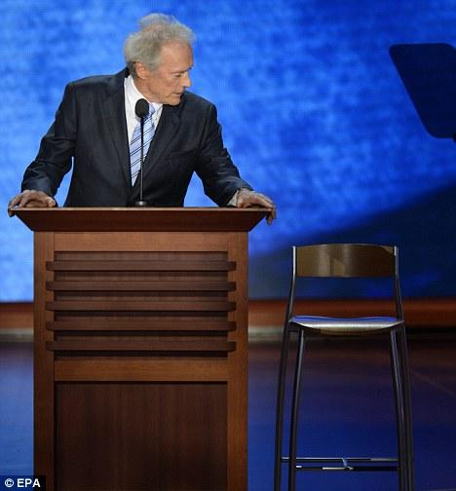
Balance theory
Balance is formally defined as the sign of the product of the weights attached to each edge in the cycle.
  Imbalance is experienced as tension and discomfort (unstable state) that must be resolved (balanced)
Republican Party
You
Clint Eastwood

Slide 99
Balance theory
Balance is formally defined as the sign of the product of the weights attached to each edge in the cycle.
  Imbalance is experienced as tension and discomfort (unstable state) that must be resolved (balanced)
You either become a Republican and keep liking Clint Eastwood movies
Or
Decide that Clint Eastwood was an overrated hack anyways!
Republican Party
You
Clint Eastwood

Slide 100
Balance theory
Balance "rules"
  If P likes O, and O likes Q, P likes Q
  If P likes O, and O dislikes Q, P dislikes Q
  If P dislikes O, and O likes Q, P dislikes Q
  If P dislikes O and O dislikes Q, P likes Q

Slide 101
Balance theory
Balance "rules"
  If P likes O, and O likes Q, P likes Q
  If P likes O, and O dislikes Q, P dislikes Q
  If P dislikes O, and O likes Q, P dislikes Q
  If P dislikes O and O dislikes Q, P likes Q

Slide 102
Balance theory
Balance "rules"
  If P likes O, and O likes Q, P likes Q
  If P likes O, and O dislikes Q, P dislikes Q
  If P dislikes O, and O likes Q, P dislikes Q
  If P dislikes O and O dislikes Q, P likes Q

Slide 103
Balance theory
Balance "rules"
  If P likes O, and O likes Q, P likes Q
  If P likes O, and O dislikes Q, P dislikes Q
  If P dislikes O, and O likes Q, P dislikes Q
  If P dislikes O and O dislikes Q, P likes Q

Slide 104

Balance theory
Considering relations of multiple others in relation to the same object can lead to more complex mixtures of balance and imbalance:
  The “cross-pressure” situation
Q

Slide 105
Social Networks and Status Attainmnent

Slide 106
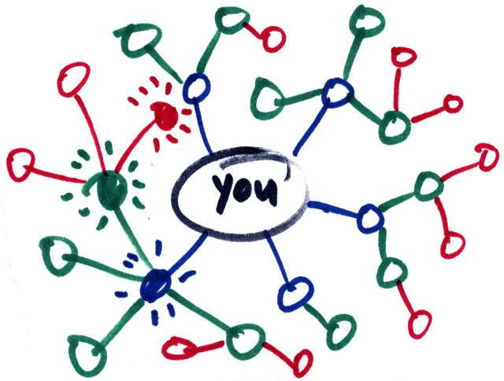
What is social capital?
Social capital:
  Benefits accrued as the result of your connections
    People who are better connected do better
What can you get from your connections?
  Some benefits comes from strong, dense networks:
    Social and emotional support
      Trusting somebody with an intimate secret
    Companionship
      Having somebody to hang out with
    Material support
      knowing where to go in a time of need

Slide 107
What is social capital?
Social capital:
  Benefits accrued as the result of your connections
    People who are better connected do better
What can you get from your connections?
  Some benefits come weakly connected, diverse networks:
    Novel information
      Finding out about things that your close contacts might not know
    New or cutting edge ideas
      Combining different ideas into a new idea
    New people
      Being introduced to people who can help

Slide 108
What is social capital?
What you get from your connections depends on how you are connected to others
  Two arguments:
    Social capital as closure (Coleman 1990)
      Having a core group of intimate friends who also know one another
    Social capital as brokerage (Burt 2005: 4)
      “Advantage created by a person’s location in a structure of relations”
  Which one is the better form of capital?
    Depends on what you want!
Here we will focus on the second:
  Social capital from being a connector (or being connected to people who connect) between different worlds

Slide 109
Granovetter’s strength of weak ties theory
Concept:
  Granovetter-transitivity (g-transitivity)
    Rule 1: if two people are strongly connected they are likely to have a lot of other friends in common
A
B
Strong Tie

Slide 110
Granovetter’s strength of weak ties theory
Concept:
  Granovetter-transitivity (g-transitivity)
    Rule 1: if two people are strongly connected:
      They are likely to have a lot of other friends in common
    Rule 2: if A and B have a strong tie and B and C have a strong tie:
      There should be at least a weak tie between A and C
Good probability of
existing tie!
C
Strong Tie
A
B
Strong Tie

Slide 111
Granovetter’s strength of weak ties theory
Concept:
  Granovetter-transitivity (g-transitivity)
    Rule 1: if two people are strongly connected:
      They are likely to have a lot of other friends in common
    Rule 2: if A and B have a strong tie and B and C have a strong tie:
      There should be at least a weak tie between A and C
  Reasons for g-transitivity:
    Demographic similarity (homophily)
    Shared foci
    Propinquity
C
At least a little similar
Similar
A
B
Similar

Slide 112
Granovetter’s strength of weak ties theory
Concept:
  Granovetter’s weak tie principle:
    Weak ties allow for a violation of g-transitivity
    You don’t have to be connected to the people who are connected to the people whom you only have a weak tie connection to
Good probability of
no tie!
C
Strong Tie
A
B
Weak Tie

Slide 113
Strength of weak ties theory
Application of the g-transitivity principle to ego-network layers:
  G-transitivity more likely to apply to strong ties in your support clique and sympathy group
Implication:
  Weak ties in you active network less likely to be connected to one another
G-transitive ties
G-transitivity violations

Slide 114
Strength of weak ties theory
Application of the g-transitivity principle to ego-network layers:
  Weak ties can function as bridges to parts of social structure to which you wouldn’t have access
Implication:
  Absent weak ties:
    You will not have access to distant parts of the social system
    Information will tend to be local
    Will put you at a disadvantage when novel information is valuable

Slide 115
Strength of weak ties theory
People who may know something your close friends don’t know
Application of the g-transitivity principle to ego-network layers:
  Weak ties can function as bridges to parts of social structure to which you wouldn’t have access
Implication:
  Absent weak ties:
    You will not have access to distant parts of the social system
    Information will tend to be local
    Will put you at a disadvantage when novel information is valuable
Broker
Bridging tie

Slide 116
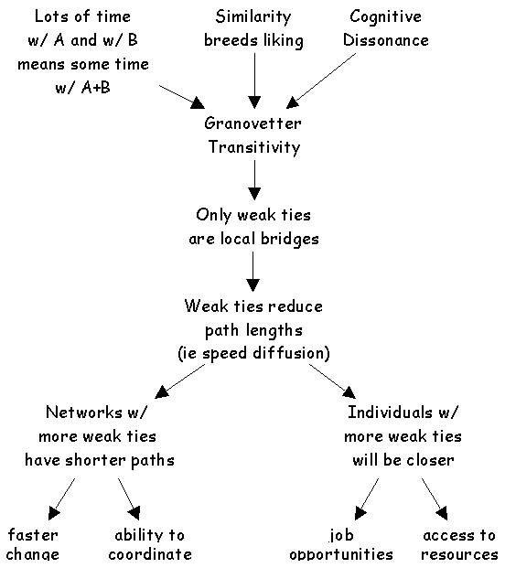
Application: Getting a job
If social mobility (e.g. finding new job opportunities) depends on (new) information access:
  Then having weak ties will be correlated with mobility and other forms of success
  Contacts with whom you are weakly connected will be more likely to know something you don’t know
  Weak ties help you insofar as they connect you to others with access to both information and resources

Slide 117
Structural holes theory
People who may know something your close friends don’t know
Strength of weak ties theory is a theory about how you can connect to brokers by developing bridging ties
  It is a theory of social capital as information access
But note that here the powerful person is the broker not you
  She controls the information
What if you want to be the broker in control?
Broker
Bridging tie

Slide 118
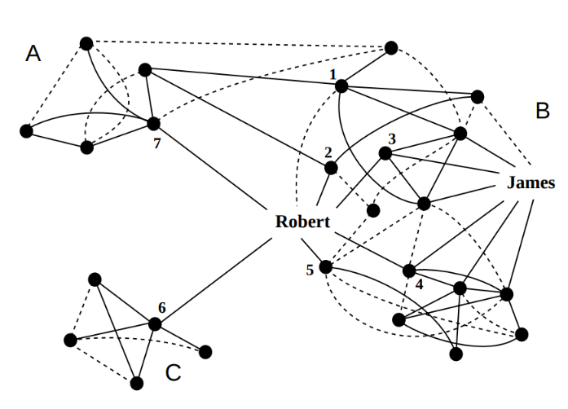
Structural holes theory
Structural holes theory is a theory about how to configure your network so that you control the information:
  Others depend on you for access
  You maximize social capital when you occupy a position “in between” others:
    Violations of g-transitivity create “holes” in social structure
  Who has the most social capital?
    James or Robert?

Slide 119
Structural holes theory
Structural holes in networks provide two kinds of benefits:
  Passive exposure effect:
    You get to know what other people know (a la Granovetter)
  Active control effect (Burt 1995):
    You decide whether some people know some things or not
    You shape the way other people perceive others
    You can play people against one another

Slide 120
Structural holes theory
Structural holes rich networks provide two kinds of benefits:
  Passive exposure effect:
    You get to know what other people know (a la Granovetter)
  Active control effect (Burt 1995):
    You are less bound by the norms and expectations of any one group
    You are free to move across the social structure
      Be different things to different people

Slide 121
Structural holes theory
The opposite of having structural holes is what Burt calls Network Constraint
  In a high constraint network:
    Your contacts are connected to one another
    You are subject to the strong expectations of a single group
    You depend on others for information access

Slide 122
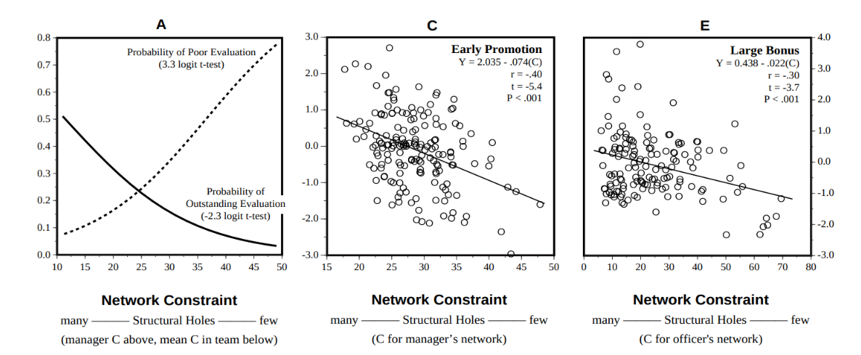
Structural holes theory
Evidence for structural holes argument (Burt 2005):
  In corporate settings people who have networks rich in structural holes (low constraint):
    Receive higher salaries
    Get promoted faster
    Receive better performance evaluations

Slide 123
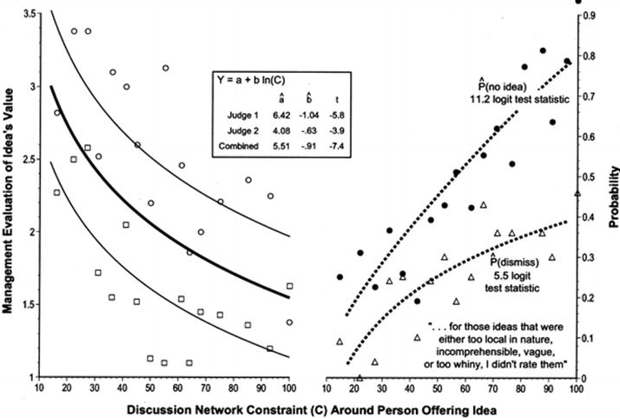
Structural holes theory
Why do people located in between structural holes do better?
  They have better ideas (Burt 2005)
Why do they have better ideas?
  They can combine elements from different sources to create novel combinations

Slide 124
Ego networks: Clustering Coefficient
a
b
a
b
a
b
Ego
Ego
Ego
c
d
c
d
c
d
 | a | b | c | d
a | -- | 0 | 0 | 0
b | 0 | -- | 0 | 0
c | 0 | 0 | -- | 0
d | 0 | 0 | 0 | --
 | a | b | c | d
a | -- | 1 | 1 | 0
b | 1 | -- | 0 | 0
c | 1 | 0 | -- | 1
d | 0 | 0 | 1 | --
 | a | b | c | d
a | -- | 1 | 1 | 1
b | 1 | -- | 1 | 1
c | 1 | 1 | -- | 1
d | 1 | 1 | 1 | --
CC_{ego}= 0
CC_{ego}= 0.5
CC_{ego}= 1.0
Unclustered
Clustered

Slide 125
Diagnosing your ego network
Theories of social capital as brokerage recommend that ego-network diversity is better than homogeneity
  Kinds of diversity in ego-networks:
    Range (Size, Degree)
    Demographic diversity of alters
    Ego network segmentation
    Average tie strength
  Burt measures:
    Clustering Coefficient
    Redundancy
    Effective Size
    Efficiency

Slide 126
Diagnosing your ego network
Theories of social capital as brokerage recommend that ego-network diversity is better than homogeneity
  Alter demographic diversity:
    Index of qualitative variation:
      IQV = H / (1 - 1/r) where r is the number of different types of categories
    So let’s say your network is 25% black and 50% white 10% Asian and 15% hispanic
    Then IQV for race/ethnic ties is:
      (1 - 0.25² - 0.50²- 0.10²- 0.15²) ÷ (1 - 1/4) = 0.87
        Very diverse!
    But if was 0% black and 80% white 15% Asian and 5% hispanic
      (1 - 0² - 0.80²- 0.15²- 0.05²) ÷ (1 - 1/4) = 0.45
        No so much

Slide 127

Diagnosing your ego network
Burt Measures
  N = 7, E = 6
  Avg. Degree = 2E/N = 2*6/7 = 1.7
  Clustering Coefficient (CC):
    Density of ego network
      2E/(N(N-1)) = (2*6)/(7*6) = .286
  Redundancy: CC(N-1)
    .286(6) = 1.7
  Effective Size (ES):
    N - (2E/N) = N - CC(N-1) = N - Av. D
    7-(2*6/7) = 7 - .286*6 = 7- 1.7 = 5.285
  Efficiency: ES/N = 5.285/7 = .755
  Stata demonstration

Slide 128

Diagnosing your ego network
Efficiency:
  Maximize the number of non-redundant alters
Effectiveness:
  Draw your alters from different social worlds
Redundancy: 2 Steps
  Calculate how important each alter is to ego (relative strength of a tie)
  Calculate redundancy of each alter

Slide 129
Diversity-bandwidth tradeoff
Original Granovetter argument conceives of the properties of ties (e.g. strength) in static terms
  Yet information transmission/access are events that happen in time
In original SWT argument:
  Weak ties: Novel information
  Strong ties: Old/redundant information

Slide 130
High
Network Clustering
Low
Clustered Network of Strong, High-Bandwidth Ties
Unclustered Network of Weak, Low-Bandwidth Ties
Channel Bandwidth
High
Low

Slide 131
Diversity-bandwidth tradeoff
When taking into account temporal flow:
  “Weak” ties: Information transmission at slower rates (less frequency)
  “Strong” ties: Information transmission at higher rates (more frequency)
When seeking information via social networks
  There is a tradeoff between novelty/diversity of information and tie “bandwidth”

Slide 132
Diversity-bandwidth tradeoff
What about information complexity?
  Low bandwidth ties: Novel but “simple” information
    Who’s hiring? What’s the best messaging app?
  But what about novel but complex information?
    How to do network analysis in R
  In that case higher bandwidth ties are better!

Slide 133
Diversity-bandwidth tradeoff
The strength of high bandwidth ties:
  More trust, intimacy, and cooperativeness
  Better memory of who knows what
  More effective at transferring complex, interdependent information
  Creating new knowledge (e.g. bringing together rather than keeping apart)
  Commonality of interests and experience (homophily)

Slide 134
Diversity-bandwidth tradeoff
In thinking about preferences between low and high bandwidth ties we must take into account properties of the information environment
  Who knows what?
  At what frequency is knowledge transmitted?
Low bandwidth works better when contacts are diverse in information
1, 2, 3, 4
1, 2, 3, 4
5, 6, 7, 8
1, 2, 3, 4

Slide 135
Diversity-bandwidth tradeoff
1, 2, 3, 4
1, 2, 3, 4
This is better!
5, 6, 7, 8
1, 2, 3, 4
When your contacts have diverse pools of information (different people you know different things)
  Weak low bandwidth ties are better

Slide 136
Diversity-bandwidth tradeoff
1, 2, 3, 4
1, 2, 3, 4
This is redundant!
5, 6, 7, 8
1, 2, 3, 4
When your contacts do not have diverse pools information (the people you know all know the same thing because they talk to one another)
  Strong, high-bandwidth ties just give you the same information

Slide 137
Diversity-bandwidth tradeoff
In thinking about preferences between low and high bandwidth ties we have to consider properties of the information environment
  Who knows what?
  At what frequency is knowledge transmitted?
1, 2, 3, 4
1, 2, 3, 4
1, 2, 3, 4
5, 6, 7, 8
1, 2, 7, 8
1, 2, 3, 4

Slide 138
Diversity-bandwidth tradeoff
Low bandwidth works better when contacts are diverse in information
  Low bandwidth ties lose their advantage even when connecting ego to contacts with more homogeneous information, even if there is partial overlap of information across contacts
No Information Overlap
Some Information Overlap
Total Information Overlap
1, 2, 3, 4
1, 2, 3, 4
1, 2, 3, 4
5, 6, 7, 8
1, 2, 7, 8
1, 2, 3, 4
Low bandwidth ties are good here!
Low bandwidth ties not as good...
Low bandwidth ties are worse here!

Slide 139
Diversity-bandwidth tradeoff
1, 2, 3, 4
1, 2, 3, 4
This is better!
1, 2, 7, 8
1, 2, 3, 4
When your contacts do not have diverse pools information (the people you know all know the same thing because they talk to one another)
  Strong, high-bandwidth ties just give you the same information

Slide 140
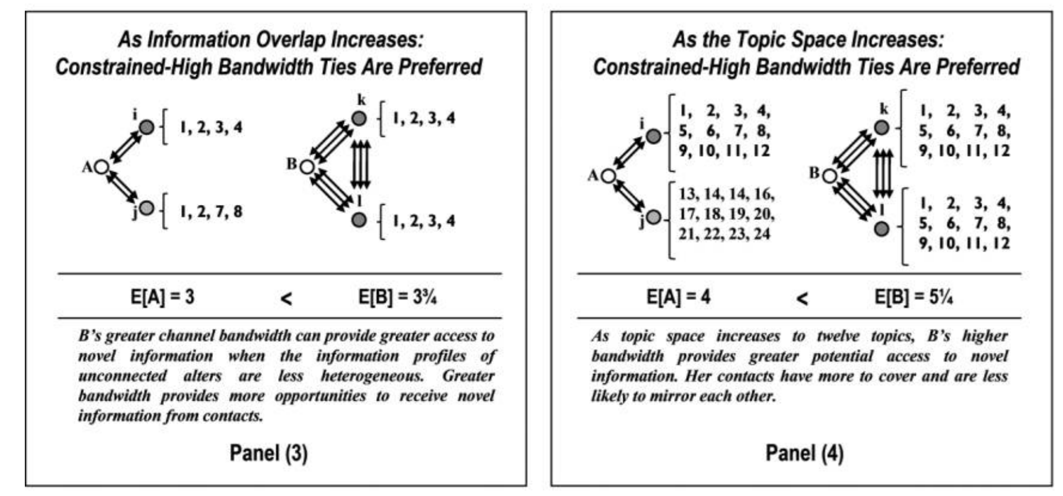
Diversity-bandwidth tradeoff
Advantage of low bandwidth ties is also compromised when:
  The information environment is richer and more complex
  When who knows what changes rapidly over time
Low bandwidth ties are only preferable when:
  Information is relatively static and there is high diversity in who knows what

Slide 141
Diversity-bandwidth tradeoff
Advantage of low bandwidth ties is also compromised when:
  There is even minimal overlap in information across contacts
  The information environment is richer and more complex
  When who knows what changes rapidly over time
Low bandwidth ties are only preferable when:
  Information is relatively static and there is high diversity in who knows what

Slide 142
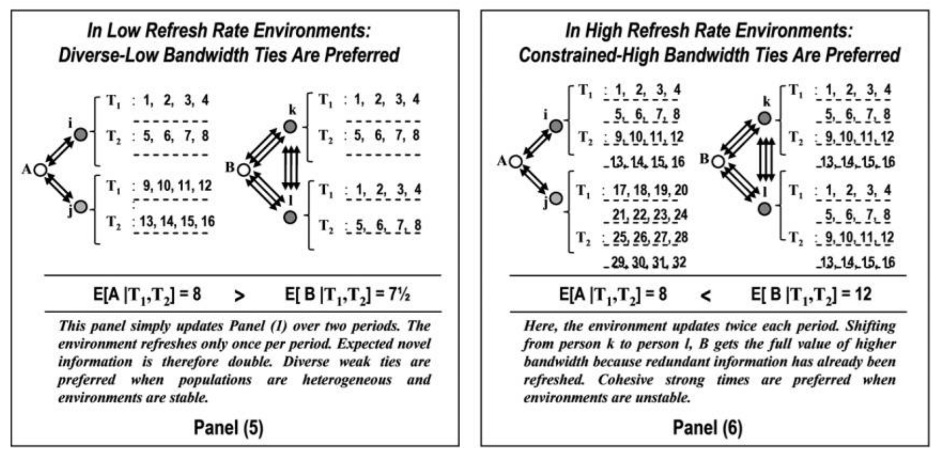
Diversity-bandwidth tradeoff
Advantage of low bandwidth ties is also compromised when:
  There is even minimal overlap in information across contacts
  The information environment is richer and more complex
  When who knows what changes rapidly over time
Low bandwidth ties are only preferable when:
  Information is relatively static and there is high diversity in who knows what

Slide 143
Diversity-bandwidth tradeoff
Advantage of low bandwidth ties is also compromised when:
  There is even minimal overlap in information across contacts
  The information environment is richer and more complex
  When who knows what changes rapidly over time
Low bandwidth ties are only preferable when:
  Information is relatively static and there is high diversity in who knows what

Slide 144
Diversity-bandwidth tradeoff
Bandwidth tradeoff propositions (revision of SWT theory):
  Channel bandwidth is positively associated with receiving more diverse information and more total non redundant information
  The greater the information overlap among alters, the less valuable structural diversity will be in providing access to novel information
  The broader the topic space, the more valuable channel bandwidth will be in providing access to novel information.
  The higher the refresh rate, the more valuable channel bandwidth will be in providing access to novel information.

Slide 145
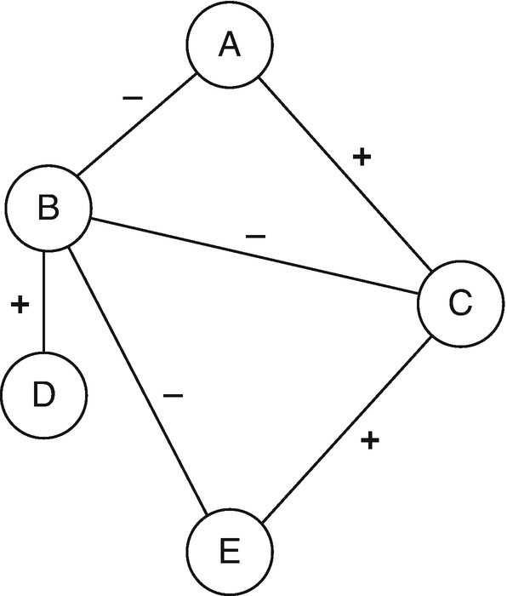
Valenced interactions
Most social network theories assume ties and network flows are usually positive or neutral:
  Ties
    Friendship
    Kinship
    Co-membership
  Flows
    Information
    Support
    Gossip
    Violence

Slide 146
Valenced interactions
Most real-world social networks feature a mix of:
  Positive and negative ties:
    Friends and enemies
    Liking and disliking
    Members of same group versus rival groups
  Positive and negative flows:
    Gossip versus compliments
    Helping versus violence
These are called valenced relationships

Slide 147
Valenced interactions
Core network concepts change meaning when ties are valenced!
  In-degree centrality:
    Friendship (good)
    Disliking (bad!)
    Support (good!)
    Enemies (bad?)
  The same goes for out-degree:
    A bully is a person who has lots of outgoing negative ties
  And other network metrics:
    Eigenvector centrality

Slide 148
Valenced interactions
We have seen on network theory (balance) designed to explain valenced relationships
But this is not the only approach!
  Status theory
    (an extension of balance theory)

Slide 149
Valenced interactions: Status theory
Ego
Other
Neg.
Pos.
Status Theory
  Designed to explain distribution of positive and negative ties in valenced networks with directed ties
First principle:
  Status in valenced networks is determined by sign of ties received
    High status
      Lots of incoming positive ties
    Low status
      Lots of incoming negative ties
    Directed positive tie from i →j:
      I thinks of j as higher status
High Status
Low Status

Slide 150
Valenced interactions: Status theory
Ego
Other
Neg.
Pos.
Status Theory
  Designed to explain distribution of positive and negative ties in valenced networks with directed ties
First principle:
  Status in valenced networks is determined by sign of ties received
    High status
      Lots of incoming positive ties
    Low status
      Lots of incoming negative ties
    Directed negative tie from i →j:
      I thinks of j as lower status
High Status
Low Status

Slide 151
Valenced interactions: Status theory
Ego
Other
Neg.
Pos.
Status Theory
  Designed to explain distribution of positive and negative ties in valenced networks with directed ties
Second principle:
  Status of nodes is also determined by the sign of their connections to (high and low status) others
    Positive ties to high status others increase status
    Positive ties to low status others decrease status
Status Boost
Status Loss

Slide 152
Valenced interactions: Status theory
Ego
Other
Neg.
Pos.
Status Theory
  Designed to explain distribution of positive and negative ties in valenced networks with directed ties
Second principle:
  Status of nodes is also determined by the sign of their connections to (high and low status) others
    Positive ties to high status others increase status
    Positive ties to low status others decrease status
Status Boost
Status Loss

Slide 153
Valenced interactions: Status theory
Ego
Other
Neg.
Pos.
Status Theory
  Designed to explain distribution of positive and negative ties in valenced networks with directed ties
Second principle:
  Status of nodes is also determined by the sign of their connections to (high and low status) others
    Negative ties to high status others decrease status
    Negative ties to low status others increase status
Status Loss
Status Boost

Slide 154
Valenced interactions: Status theory
Ego
Other
Neg.
Pos.
Status Theory
  Designed to explain distribution of positive and negative ties in valenced networks with directed ties
Second principle:
  Status of nodes is also determined by the sign of their connections to (high and low status) others
    Negative ties to high status others decrease status
    Negative ties to low status others increase status
Status Loss
Status Boost

Slide 155
Valenced interactions: Status theory
Ego
Other
Neg.
Pos.
Status Theory
  Designed to explain distribution of positive and negative ties in valenced networks with directed ties
Third principle:
  People aim to avoid status loss and seek status boosts:
    High status individuals will accumulate positive ties
      Rich get richer effect
Time 1
Time 2

Slide 156
Valenced interactions: Status theory
Ego
Other
Neg.
Pos.
Status Theory
  Designed to explain distribution of positive and negative ties in valenced networks with directed ties
Third principle:
  People aim to avoid status loss and seek status boosts:
    Low status individuals will accumulate negative ties
      “Gang up” effect
Time 1
Time 2

Slide 157
Valenced interactions: Status theory
Ego
Other
Neg.
Pos.
Status Theory
  Designed to explain distribution of positive and negative ties in valenced networks with directed ties
Third principle:
  People aim to avoid status loss and seek status boosts:
    High status individuals will lose negative ties
Time 1
Time 2

Slide 158
Valenced interactions: Status theory
Ego
Other
Neg.
Pos.
Status Theory
  Designed to explain distribution of positive and negative ties in valenced networks with directed ties
Third principle:
  People aim to avoid status loss and seek status boosts:
    Low status individuals will lose positive ties
Time 1
Time 2

Slide 159
Valenced interactions: Karma theory
Ego
Other
Neg.
Pos.
Karma Theory: You get what you spread out!
  Status theory is based on (negative and positive) popularity
    Graph theoretic indegree centrality
  Karma theory is based on (negative and positive) activity
    Graph theoretic outdegree centrality
Time 1
Time 2

Slide 160
Valenced interactions: Karma theory
Ego
Other
Neg.
Pos.
Karma Theory: You get what you spread out!
  Status theory is based on (negative and positive) popularity
    Graph theoretic indegree centrality
  Karma theory is based on (negative and positive) activity
    Predict valenced indegree (what you get) from valenced outdegree (what you spread)
Time 1
Time 2

Slide 161
Valenced interactions: Karma theory
Ego
Other
Neg.
Pos.
Karma Theory: You get what you spread out!
  Status theory is based on (negative and positive) popularity
    Graph theoretic indegree centrality
  Karma theory is based on (negative and positive) activity
    Predict valenced indegree (what you get) from valenced outdegree (what you spread)
Bullies get bullied!
Time 2
Time 1

Slide 162
Valenced interactions: Karma theory
Ego
Other
Neg.
Pos.
Karma Theory: You get what you spread out!
  Status theory is based on (negative and positive) popularity
    Graph theoretic indegree centrality
  Karma theory is based on (negative and positive) activity
    Predict valenced indegree (what you get) from valenced outdegree (what you spread)
Likers get liked!
Time 2
Time 1

Slide 163
Valenced interactions: Solidarity theory
Ego
Other
Neg.
Pos.
Solidarity Theory
  People in the same position in the valenced interaction network are likely to link via positive ties
Two types of solidarity:
  Status solidarity
  Karma solidarity
Time 1
Time 2

Slide 164
Valenced interactions: Solidarity theory
Ego
Other
Neg.
Pos.
Solidarity Theory
  People in the same position in the valenced interaction network are likely to link via positive ties
Two types of solidarity:
  Status solidarity
  Karma solidarity
Popular “in-crowd” effect
Time 2
Time 1

Slide 165
Valenced interactions: Solidarity theory
Ego
Other
Neg.
Pos.
Solidarity Theory
  People in the same position in the valenced interaction network are likely to link via positive ties
Two types of solidarity:
  Status solidarity
  Karma solidarity
The downtrodden stick together!
Time 2
Time 1

Slide 166
Valenced interactions: Solidarity theory
Ego
Other
Neg.
Pos.
Solidarity Theory
  People in the same position in the valenced interaction network are likely to link via positive ties
Two types of solidarity:
  Status solidarity
  Karma solidarity
Bullies stick together!
Time 2
Time 1

Slide 167
Valenced interactions: Solidarity theory
Ego
Other
Neg.
Pos.
Solidarity Theory
  People in the same position in the valenced interaction network are likely to link via positive ties
Two types of solidarity:
  Status solidarity
  Karma solidarity
Cool kids stick together!
Time 2
Time 1

Slide 168
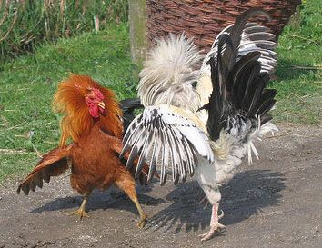
Dominance orders among animals
Dominance hierarchies:
  Observed across a number of species in the animal kingdom
  Including (most notably) among chickens
  You do not need a big brain to create a (complex) social network!
“Pure” dominance order:
  Directed
    A dominates B
  Anti-symmetric
    If A dominates B then B cannot dominate A

Slide 169
Dominance orders among animals
Dominance hierarchies:
  Observed across a number of species in the animal kingdom
  Including (most notably) among chickens
  You do not need a big brain to create a (complex) social network!
“Pure” dominance order:
  Complete (all ties present)
    Either A dominates B or B dominates A

Slide 170
Dominance orders among animals
Dominance hierarchies:
  Observed across a number of species in the animal kingdom
  Including (most notably) among chickens
  You do not need a big brain to create a (complex) social network!
“Pure” dominance order:
  Transitive (all ties present)
    If A dominates B, and B dominates C, then by necessity A dominates C

Slide 171
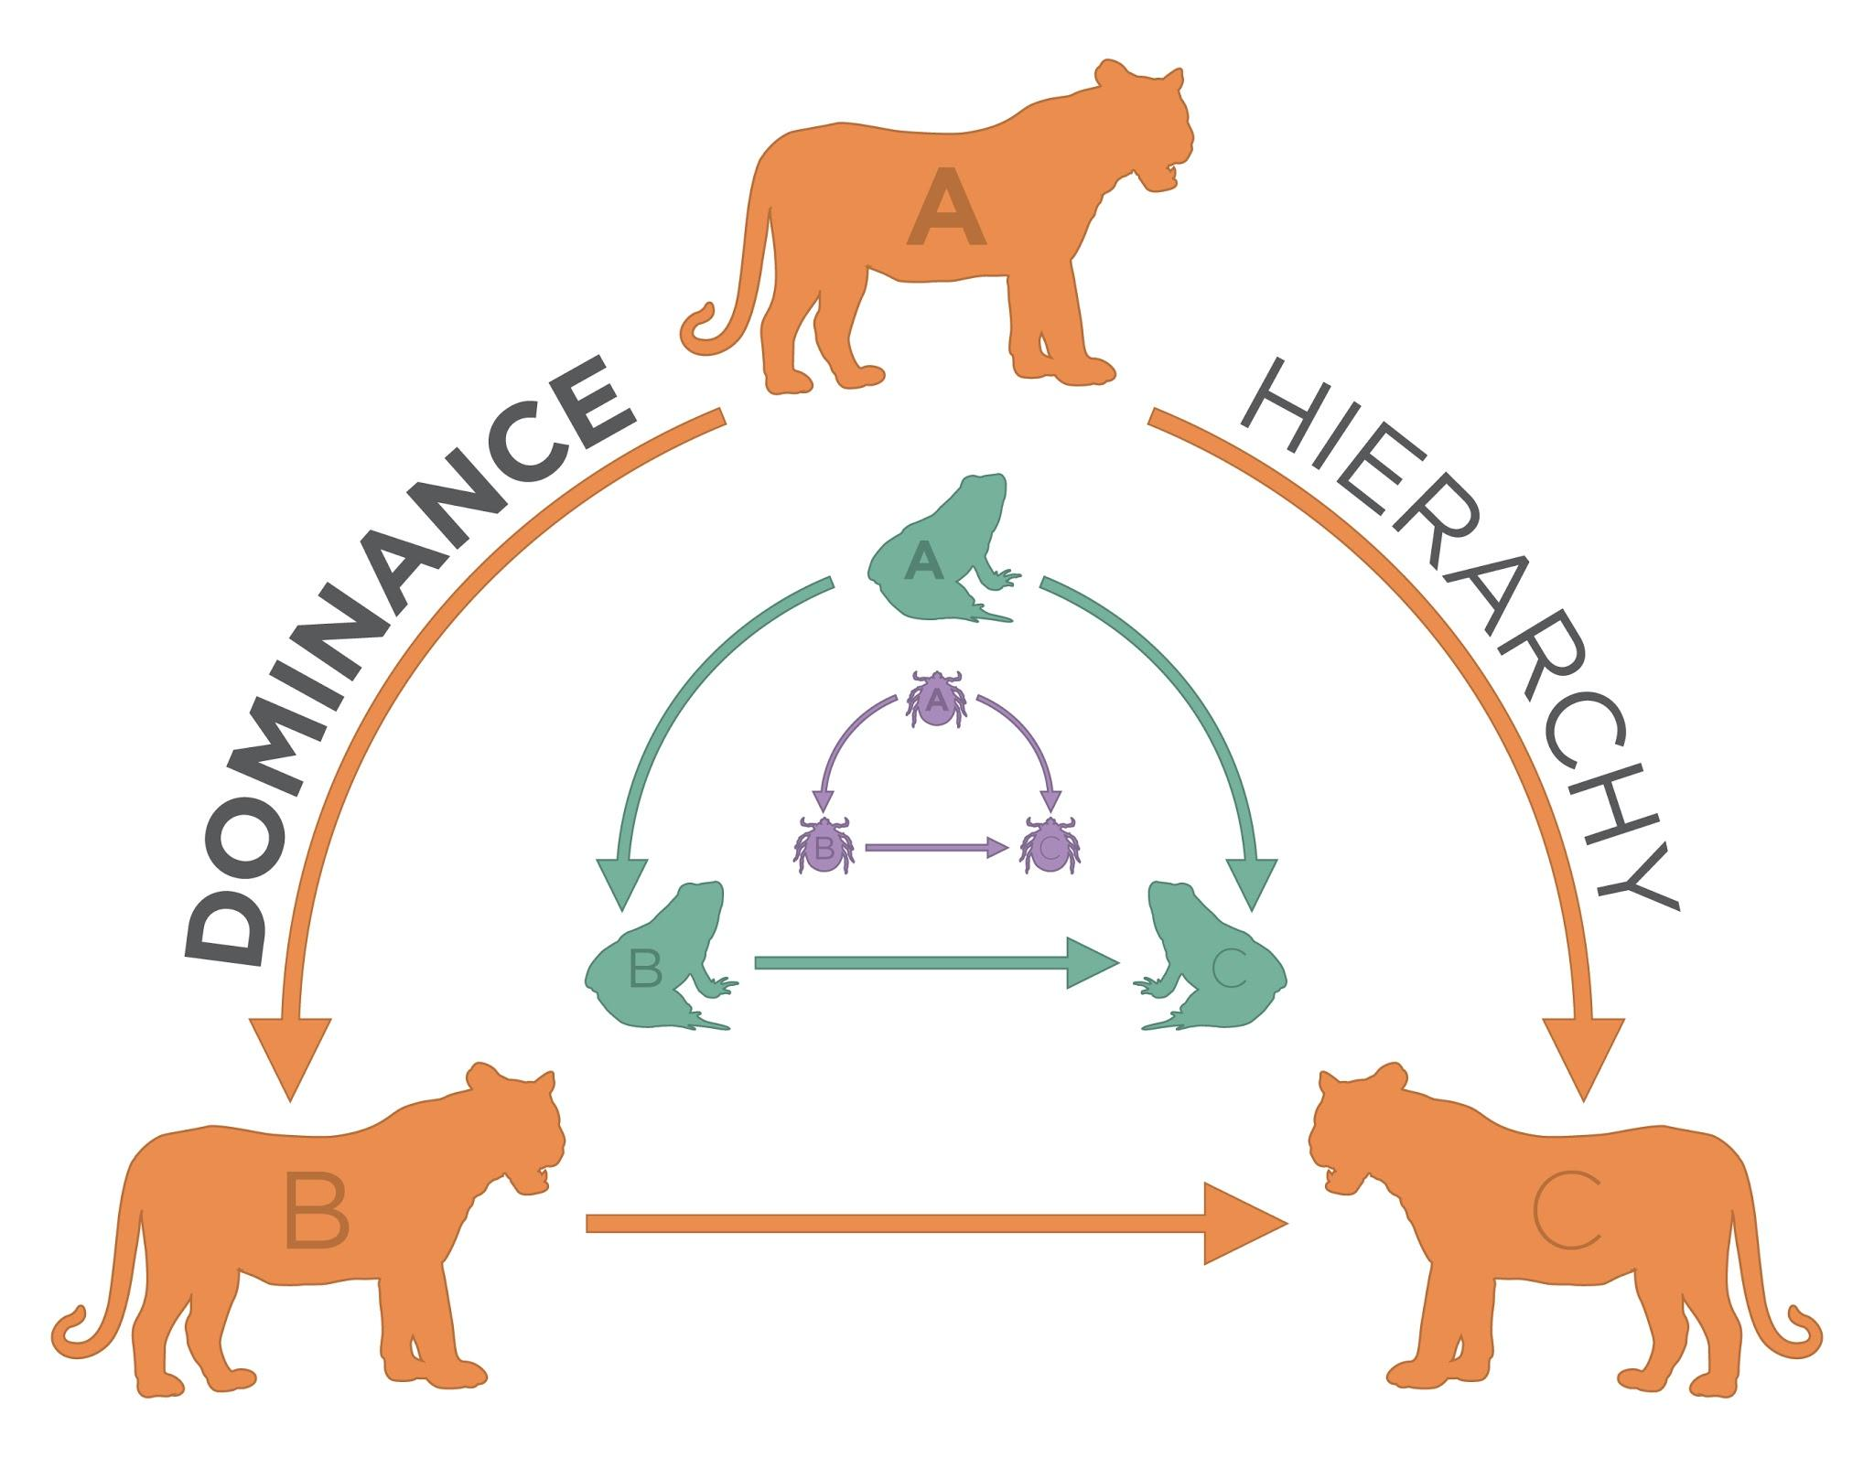
Algebraic Requirements for Dominance Order
A linear dominance order is transitive
Transitivity is a relation between node triples
  If a has dominates b, and b dominates c
  Then a necessarily dominates c
a
b
c
This arc has to exist!
Transitive Triad

Slide 172
Algebraic Requirements for Dominance Order
A linear dominance order contains no cyclical triads
  Flashback: A cycle is a path that begins and ends with the same node
a
b
c
This would be weird!
Cyclical Triad

Slide 173
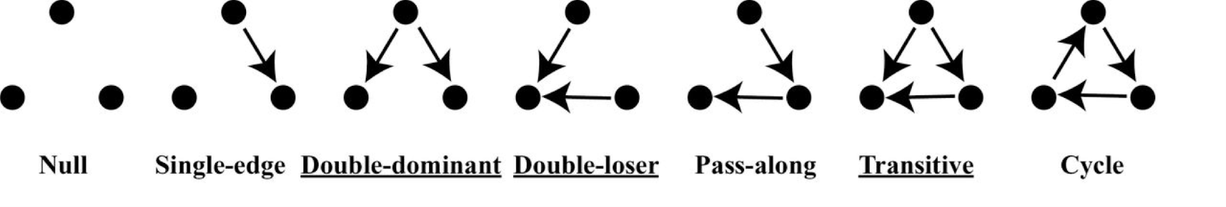
The emergence of dominance hierarchies
Dominance order can be represented as dominance network
  Nodes are animals (whether human or not)
  Directed, antisymmetric links indicate that animal i dominates animal j
Types of possible triads in dominance networks:

Slide 174
The emergence of dominance hierarchies
Dominance order can be represented as dominance network
  Nodes are animals (whether human or not)
  Directed, antisymmetric links indicate that animal i dominates animal j
Types of expected triads in dominance networks:

Slide 175
Different Types of Animal Orders
Macaques: Matrilineal Hierarchy
Gorillas, Chimpanzees: Female order more fluid than male, male hierarchy
Patas Monkeys: Female linear, one male
Vervets, Sykes Monkeys: Each sex has internal rankings
Wooly Spider Monkey: No dominance order
Lemur: Monogamous couples
Orangutan: Solitary
Homo Sapien: We’re working on it

Slide 176
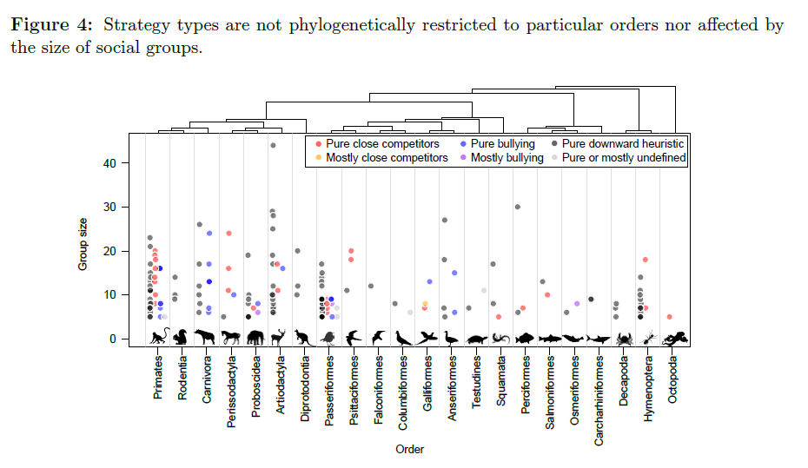
Hobson, Monster, DeDeo 2018

Slide 177
The emergence of dominance hierarchies
Chickens form perfectly linear hierarchies (breaks down at about 10)
How are these social structures formed?
  An attribute based-model says position in the hierarchy is a function of individual characteristics (size, age, strength, etc.)
How do we go from:
This
To this?

Slide 178
The emergence of dominance hierarchies
Chickens form perfectly linear hierarchies (breaks down at about 10)
How are these social structures formed?
  A interaction-based model says the hierarchie emerges from local network processes partially independently from attributes
How do we go from:
This
To this?

Slide 179
Agonistic Competition as Iterative and Social
Three possible mechanisms:
  Winner Effects
    Confidence, testosterone boost, experience
    Emergence of double-dominant triads
  Loser Effects
    Lowered confidence, injury
    Emergence of double-loser triads
  Bystander Effects
    Confidence vis-a-vis winner and loser changes
    From single-edge to either:
      Double-dominant triads
Winner Effects
Loser Effects
Bystander Effects
Time 1
Time 2

Slide 180
Agonistic Competition as Iterative and Social
Three possible mechanisms:
  Winner Effects
    Confidence, testosterone boost, experience
    Emergence of double-dominant triads
  Loser Effects
    Lowered confidence, injury
    Emergence of double-loser triads
  Bystander Effects
    Confidence vis-a-vis winner and loser changes
    From single-edge to either:
      Double-loser triads
Winner Effects
Loser Effects
Bystander Effects
Time 1
Time 2

Slide 181
Agonistic Competition as Iterative and Social
Three possible mechanisms:
  Winner Effects
    Confidence, testosterone boost, experience
    Emergence of double-dominant triads
  Loser Effects
    Lowered confidence, injury
    Emergence of double-loser triads
  Bystander Effects
    Bystanders almost never dominate initial dominant
Winner Effects
Loser Effects
Bystander Effects
Weird!
Time 1
Time 2

Slide 182
Agonistic Competition as Iterative and Social
Three possible mechanisms:
  Winner Effects
    Confidence, testosterone boost, experience
    Emergence of double-dominant triads
  Loser Effects
    Lowered confidence, injury
    Emergence of double-loser triads
  Bystander Effects
    Bystanders almost never dominate initial dominant
    Bystanders almost never get dominated by initial loser
Winner Effects
Loser Effects
Bystander Effects
Also
Weird!
Time 1
Time 2

Slide 183
Agonistic Competition as Iterative and Social
Three possible mechanisms:
  Winner Effects
    Confidence, testosterone boost, experience
    Emergence of double-dominant triads
  Loser Effects
    Lowered confidence, injury
    Emergence of double-loser triads
  Bystander Effects
    Bystanders almost never dominate initial dominant
    Bystanders almost never get dominated by initial loser
    This guarantees transitivity and linearity!
Winner Effects
Loser Effects
Bystander Effects
Also
Weird!
Time 1
Time 2

Slide 184
An Angle of What Sociology Is
Some scholars are still of the opinion that sociology is not only without form and void, but that it must forever remain so, because nothing in the nature of things sanctions it; and the name is therefore merely a device to give new theorists a place. These critics know little about the deep currents of present popular thought. It is a very callow sociologist who imagines that he and his colaborers are inventing the subject-matter of a new science. They are trying to perfect means of answering obtrusive questions about society which the ordinary man is proposing every hour (AJS Editors 1895:6, italics added).

Slide 185
Self-Confidence and Victory
Self confidence is associated with winning social contests, but comes from many other attributes
-Individual Characteristics
  Strength, age, intelligence, etc.
-Social Characteristics
  Past wins, family descent
Contestation is mostly about ritual, and so self-confidence is a great way to win at ritual contestation. Contestation is often a game of chicken.

Slide 186
Understanding Structure
We might, from the micro-foundations of agonistic encounters, build up to social structure (Chase 1982)
Key point is that intransitive triads become transitive in such situations

Slide 187
Intransitive to Transitive
Red is a really important node
https://www.youtube.com/watch?v=zTqmiJ4LW9c

Slide 188

Hierarchy as Exchange
Roger Gould’s Model of Relationship’s as Exchange
u is utility, a is the tie strength/deference, q is quality, s is desire for reciprocity
In end, the model is driven by the quality of actors and deference

Slide 189
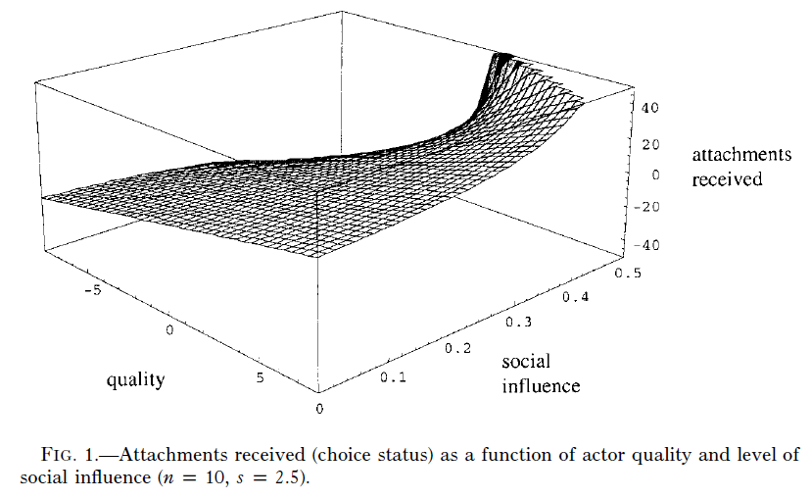
Find that Results Vary

Slide 190
You Always Hurt the One You Love
Obvious explanation: Bully’s target the weak because they themselves are insecure, mean people
Sociology explanation: Most bullying is done by your friends because they are insecure, mean people. But aren’t we all?
Recap of Felmlee and Faris 2016

Slide 191
Because It Works (But It’s Still Mean)
Why Go After Friends and Dating Partners?
We can think of rumors as agonistic encounters where we are interested in changing the symmetry of relationships
Felmlee and Faris 2016

Slide 192
The overlaying of positive and negative ties
Commonalities between positive and negative ties in social networks
  Friends and Enemies are:
    Socially close to us in some way
    We compete with them for the attention of others who we are also competing with (clubs, workplaces, teams)
    We also compete for socially close romantic partners, or remain socially close to them after a breakup
Felmlee and Faris 2016

Slide 193
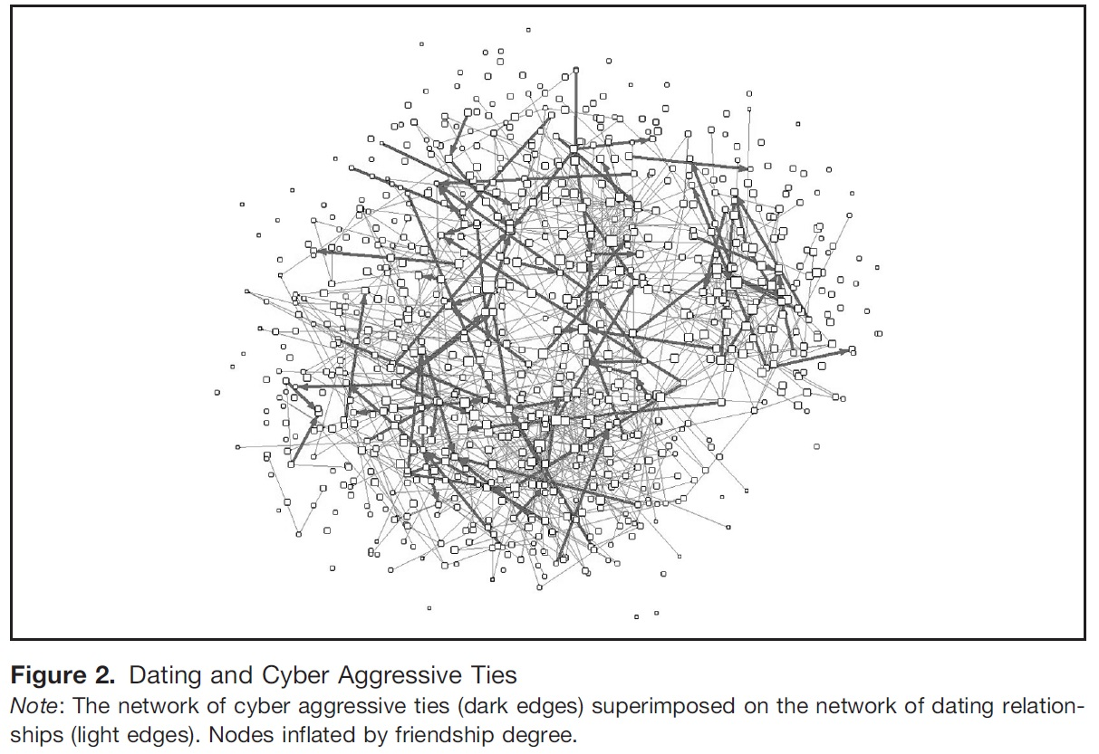
Felmlee and Faris 2016

Slide 194
The Great Debate of Our Time
Bradley Cooper
?
Lady Gaga
Lady Gaga’s Ex
Official
Irina Shayk
Bradley Cooper’s Ex Wife
Red ties indicate Instagram “likes” endorsing rumors about Cooper and Gaga

Slide 195
Who are Targets of Rumors?
-Same Grade 8-11 (not 12)
-In Grades 9-11 (not 12)
-Female
-LGBTQ
-Friends
-Dating Partners
Felmlee and Faris 2016

Slide 196
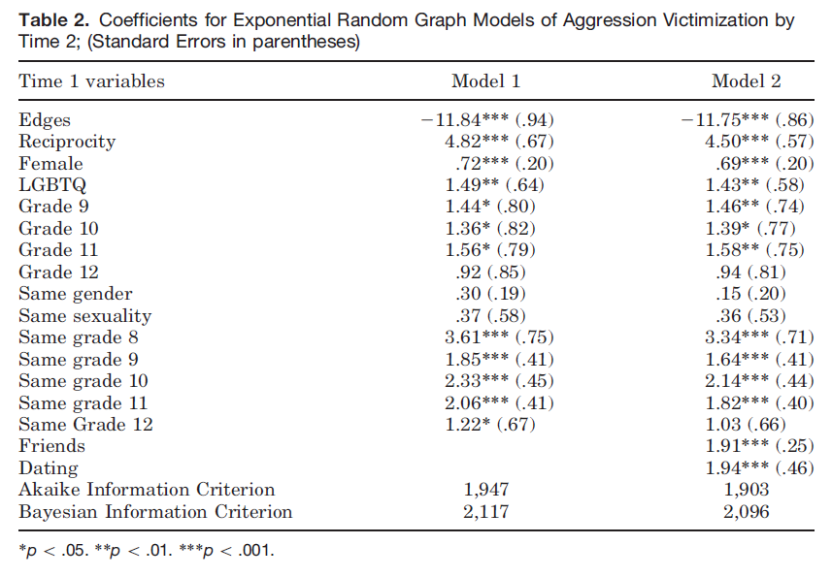
How can we make claims about these different social processes? Math beyond this class

Slide 197
Violence Never Solves Anything, Except Agonistic Encounters
Obvious explanation: Gangs fight over drug routes
Sociology explanation: Status competition between local groups
Recap of Papachristos 2009

Slide 198
Why Fighting Occurs
Gould- Ambiguity leads to violence as unclear hierarchy leads to competition
Implication that equals are more likely to have competition escalate
  Three types of competitive strategies to consider:
    Downward Competition: High status go after any lower status individual
    Close Competitors: Individuals fight those close in status to themselves
    Bullying: High individuals only fight those much lower than themselves

Slide 199
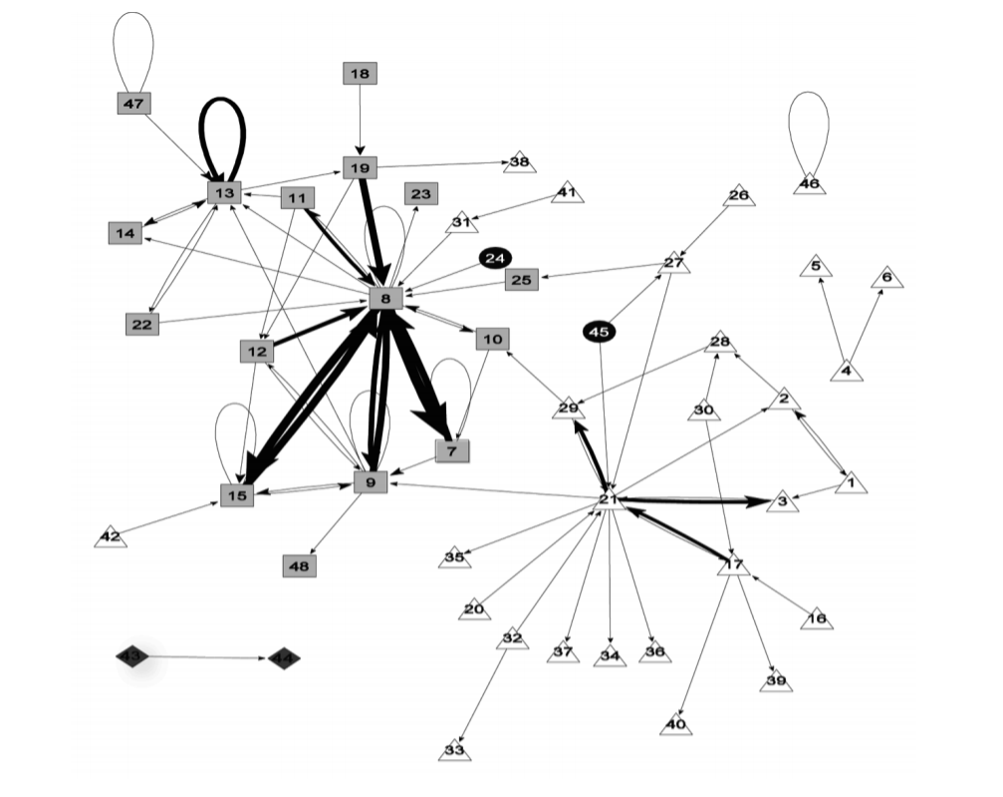
Black
Racial Homophily
Number of Nodes: 48
Density: 0.07
Reciprocal dyads: 36
Self-loops
Hispanic
Asian
White
The social structure of gang homicide in Chicago, 1994
Papachristos 2009

Slide 200
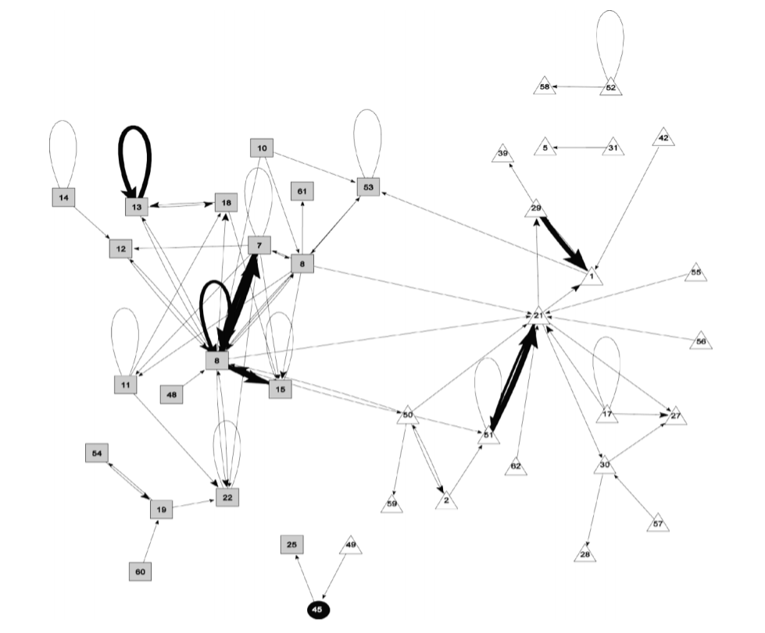
Black
Hispanic
Asian
White
The social structure of gang homicide in Chicago, 1998
Papachristos 2009

Slide 201
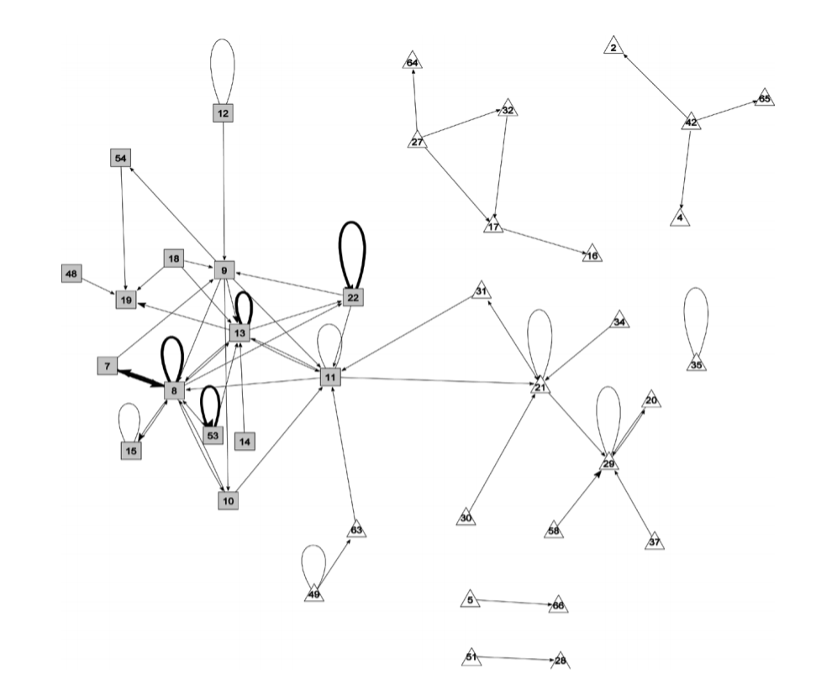
Black
Hispanic
Asian
White
The social structure of gang homicide in Chicago, 2002
Papachristos 2009

Slide 202
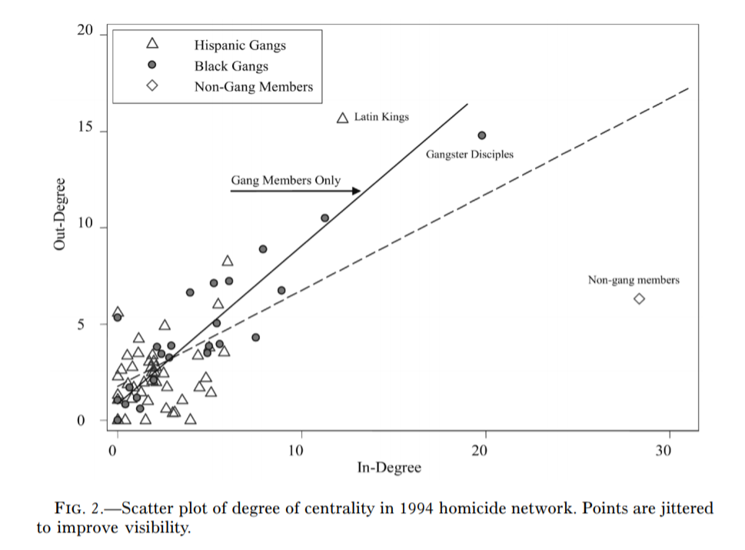
Black
Hispanic
Asian
White
The social structure of gang homicide in Chicago, 1994
Papachristos 2009

Slide 203
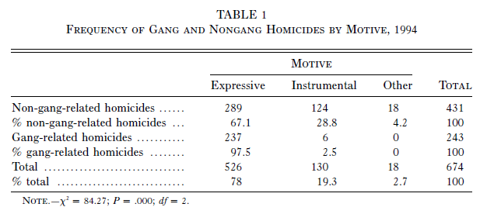
Rare for Instrumental Violence in Gangs

Slide 204
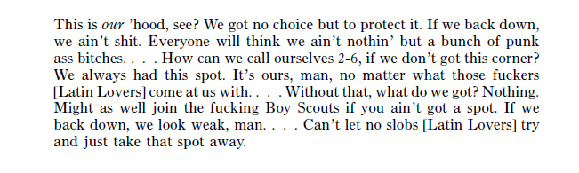
Melo

Slide 205
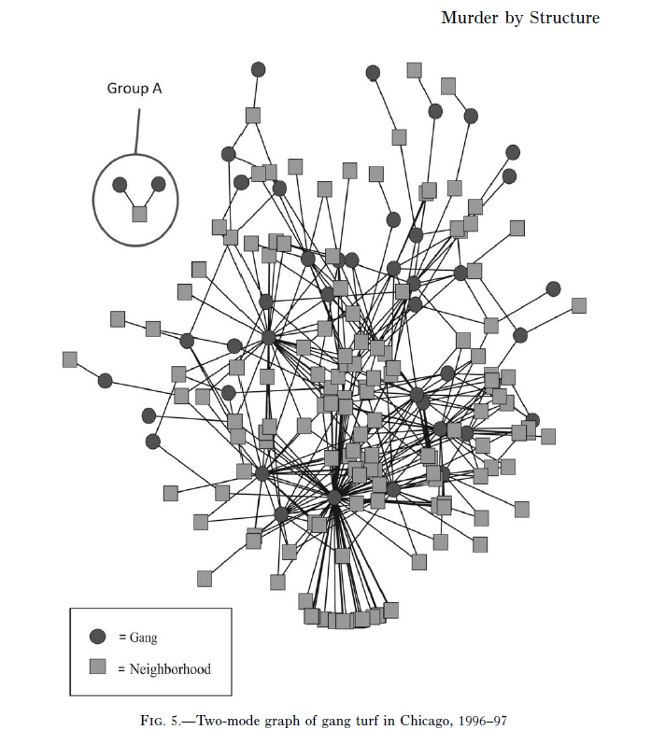
Papachristos 2009

Slide 206
When does violence occur?
Average overlap between 2 gangs: 10%
Overlap that results in murder: 25%+
Every 1% increase doubles the probability of a murder increasing
Not unusual, peace
Very bad things happen

Slide 207
When does violence occur?
Papachristos argues we can think of murder as a network phenomenon
Crime is not some individual in isolation responding to a set of deprivations, but inherently a social phenomena
Not unusual, peace
Very bad things happen

Slide 208
Two ways violence spreads
Murder
Murder
Gang 1
Gang 2
Gang 1
Gang 2
Payback
Gang 3
Gang 3
Time 1
Time 2
Direct Retaliation

Slide 209
Two ways violence spreads
Murder
Murder
Gang 1
Gang 2
Gang 1
Gang 2
Gang 3
Gang 3
Show of force
Time 1
Time 2
Generalized Violence

Slide 210
Negative Reciprocity-When More Likely?
Gould: Negative reciprocity more likely amongst equals (like high school)
Papachristos: Finds it actually more likely between unequally sized gangs
-part of this finding driven by Latin Kings and Gangster Disciple size
We don’t truly understand all the reasons and scope conditions as to why this is true...

Slide 211
Negative Reciprocity-When More Likely?
Gould: Negative reciprocity more likely amongst equals (like high school)
Papachristos: Finds it actually more likely between unequally sized gangs
-part of this finding driven by Latin Kings and Gangster Disciple size
We don’t truly understand all the reasons and scope conditions as to why this is true...

Slide 212
Sub-Groups, Cliques, Communities

Slide 213
Levels of Analysis in social networks
Individual
1
Dyads
2
Triads
3
Cliques, Communities
4
Whole Network
5
The first part of the course follows this organization!

Slide 214
Levels of Analysis in social networks
Individual
1
Dyads
2
Triads
3
Cliques, Communities
4
Whole Network
5
The first part of the course follows this organization!

Slide 215
Cohesion, connectivity, subgroups
Group level in networks:
  In between the micro:
    Dyads, triads
  And the macro:
    “Whole network”
Why groups?
  Important functional units in organizations
    Workplaces
    Creative industries
    Science
  Important units for solidarity and interaction in social systems
    Social foci
    Primary groups (family, support cliques)

Slide 216
Cohesion, connectivity, subgroups
Group level in networks:
  In between the micro:
    Dyads, triads
  And the macro:
    “Whole network”
Why groups?
  Important sources of:
    Ideational homogeneity
    Conformity
    Influence
    Information transmission

Slide 217
Cohesion, connectivity, subgroups
Group level in networks:
  In between the micro:
    Dyads, triads
  And the macro:
    “Whole network”
Questions:
  How can we translate the concept of a group into network terms?
  What are the most important group properties from a network perspective?
    Cohesion
    Polarization
    Fragmentation

Slide 218
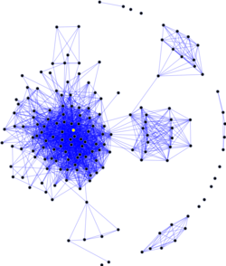
What are “groups” or “communities”?
“Group,” is a fuzzy social science concept, with many overlapping but sometimes contradictory verbal definitions
  As always graph theory to the rescue!
The graph theoretic concept of group/community is:
  A relatively dense subgraph featuring more links among the subset of vertices that belong to the subgraph than links to vertices in the rest of the graph

Slide 219
Graphs and subgraphs
A subgraph G' = (V', E') of a graph G = (V, E) exists when:
  V' is a subset of V and E' is a subset of E
A lot of network methods are designed to split a graph into subgraphs
  Subgraphs can be used to represent the social network concepts of groups, cliques, or communities

Slide 220
Graphs and subgraphs
A subgraph G' = (V', E') of a graph G = (V, E) exists when:
  V' is a subset of V and E' is a subset of E
A lot of network methods are designed to split a graph into subgraphs
  Subgraphs can be used to represent the social network concepts of groups, cliques, or communities
This is a subgraph

Slide 221
Graphs and subgraphs
A subgraph G' = (V', E') of a graph G = (V, E) exists when:
  V' is a subset of V and E' is a subset of E
A lot of network methods are designed to split a graph into subgraphs
  Subgraphs can be used to represent the social network concepts of groups, cliques, or communities
This is another subgraph

Slide 222
Graphs and subgraphs
A subgraph G' = (V', E') of a graph G = (V, E) exists when:
  V' is a subset of V and E' is a subset of E
A subgraph is connected if every node within it can reach every other one via a path of some length
This subgraph is connected :)

Slide 223
Graphs and subgraphs
A subgraph G' = (V', E') of a graph G = (V, E) exists when:
  V' is a subset of V and E' is a subset of E
A subgraph is connected if every node within it can reach every other one via a path of some length
  Otherwise is disconnected
This subgraph is disconnected :(

Slide 224
Graphs and subgraphs
A subgraph G' = (V', E') of a graph G = (V, E) exists when:
  V' is a subset of V and E' is a subset of E
A subgraph is maximal with respect to a given property:
  (e.g., connectivity)
If adding more nodes or links to the subgraph will mean it no longer has that property
This is a maximal connected subgraph of order 7

Slide 225
Graphs and subgraphs
A subgraph G' = (V', E') of a graph G = (V, E) exists when:
  V' is a subset of V and E' is a subset of E
A subgraph is maximal with respect to a given property:
  (e.g., connectivity)
If adding more nodes or links to the subgraph will mean it no longer has that property
This is a maximal connected subgraph of order 8

Slide 226
Graphs and subgraphs
A subgraph G' = (V', E') of a graph G = (V, E) exists when:
  V' is a subset of V and E' is a subset of E
A clique is a maximally complete subgraph (density = 1.0)
  The size of a clique is the number of nodes in it:
    Clique of size 2, clique of size 3, clique of size 4, etc.
This is a clique of size 4

Slide 227
Graphs and subgraphs
This is a clique of size 5
A subgraph G' = (V', E') of a graph G = (V, E) exists when:
  V' is a subset of V and E' is a subset of E
A clique is a maximally complete subgraph (density = 1.0)
  The size of a clique is the number of nodes in it:
    Clique of size 2, clique of size 3, clique of size 4, etc.

Slide 228
Graphs and subgraphs
A subgraph G' = (V', E') of a graph G = (V, E) exists when:
  V' is a subset of V and E' is a subset of E
A clique is a maximally complete subgraph (density = 1.0)
  The size of a clique is the number of nodes in it:
    Clique of size 2, clique of size 3, clique of size 4, etc.
A closed triad is a clique of size 3!

Slide 229
Graphs and subgraphs
A subgraph G' = (V', E') of a graph G = (V, E) exists when:
  V' is a subset of V and E' is a subset of E
A clique is a maximal complete subgraph (density = 1.0)
  The size of a clique is the number of nodes in it:
    Clique of size 2, clique of size 3, clique of size 4, etc.
The same actor can belong to multiple cliques!

Slide 230
Graphs and subgraphs
Some subgraphs are not complete graphs (cliques) but they are almost there!
  They are quasi-groups
We can relax the definition to accommodate
  An n-clique is a subgraph where each node is at least n steps away from each other node
    3-clique, 4-clique, 5-clique...k-clique

Slide 231
Graphs and subgraphs
Some subgraphs are not complete graphs (cliques) but they are almost there!
  They are quasi-groups
We can relax the definition to accommodate
  An n-clique is a subgraph where each node is at least n steps away from each other node
    3-clique, 4-clique, 5-clique...k-clique
This is a 2-clique!

Slide 232
Graphs and subgraphs
Some subgraphs are not complete graphs (cliques) but they are almost there!
  They are quasi-groups
We can relax the definition to accommodate
  An n-clique is a subgraph where each node is at least n steps away from each other node
    3-clique, 4-clique, 5-clique...k-clique
This is a 3-clique!

Slide 233
Graph connectivity
A graph is connected if there exists a (finite) path between each pair of nodes
This is a connected graph! :)

Slide 234
Graph connectivity
A graph is connected if there exists a (finite) path between each pair of nodes
  Otherwise the graph is disconnected
This graph is disconnected :(

Slide 235
Graph connectivity: Components
A graph is connected if there exists a (finite) path between each pair of nodes
  Otherwise the graph is disconnected
A maximal connected subgraph is called a component
  If a graph has more than one component it is by definition disconnected
These are two different components

Slide 236
Graph connectivity: Components
A graph is connected if there exists a (finite) path between each pair of nodes
  Otherwise the graph is disconnected
A maximal connected subgraph is called a component
  If a graph has more than one component it is by definition disconnected
These are three different components

Slide 237
Graph connectivity: Components
A graph is connected if there exists a (finite) path between each pair of nodes
  Otherwise the graph is disconnected
A maximal connected subgraph is called a component
  If a graph has more than one component it is by definition disconnected
  The connected subgraph containing the largest number of vertices in a graph is called the giant component
This is the giant component!

Slide 238
Graph connectivity: Components
A maximal connected subgraph is called a component
The connected subgraph that contains the largest proportion of vertices is called the giant component
  A component is k-connected if every node in the component can reach any other one via a path of length k or less
This component is 2-connected!

Slide 239
Graph connectivity: Components
A maximal connected subgraph is called a component
The connected subgraph that contains the largest proportion of vertices is called the giant component
  A bicomponent is a component in which every pair of nodes is connected by at least two paths that do not share any intervening nodes (except the start and end nodes)
This component is 2-connected!

Slide 240
Graph connectivity
We can disconnect a graph by removing edges

Slide 241
Graph connectivity
Oops! Disconnected!
We can disconnect a graph by removing edges

Slide 242
Graph connectivity
We can disconnect a graph by removing edges

Slide 243
Graph connectivity
We removed some edges
We can disconnect a graph by removing edges
Is this graph disconnected?

Slide 244
Graph connectivity
We can disconnect a graph by removing edges
Now it is!

Slide 245
Graph connectivity
This is a bridge
We can disconnect a graph by removing edges
In some graphs removing just one edge leads to disconnection
  Edges with the property of being able to disconnect the graph upon removal are called bridges

Slide 246
Graph connectivity
We can also disconnect a graph by removing nodes

Slide 247
Graph connectivity
Oops! Disconnected!
We can also disconnect a graph by removing nodes

Slide 248
Graph connectivity
Oops! Disconnected!
We can also disconnect a graph by removing nodes
  It can be easier to disconnect a graph this way because nodes take their links with them!

Slide 249
Graph connectivity
We can also disconnect a graph by removing nodes
  Some nodes are more “important” for because they serve as the connectors
  Can you guess what kind of centrality “connector” nodes are more likely to have?
VIP Node
Not VIP

Slide 250
Graph connectivity
We can also disconnect a graph by removing nodes
  Some nodes are more “important” because they serve as the connectors
A graph is k-connected if it takes removing k nodes to disconnect it
This graph is 1-connected

Slide 251
Graph connectivity
We can also disconnect a graph by removing nodes
  Some nodes are more “important” because they serve as the connectors
A graph is k-connected if it takes removing k nodes to disconnect it
This graph is 1-connected

Slide 252
Graph connectivity
We can also disconnect a graph by removing nodes
  Some nodes are more “important” because they serve as the connectors
A graph is k-connected if it takes removing k nodes to disconnect it
This graph is 2-connected

Slide 253
Graph connectivity
We can also disconnect a graph by removing nodes
  Some nodes are more “important” because they serve as the connectors
A graph is k-connected if it takes removing k nodes to disconnect it
This graph is 2-connected

Slide 254
Graph connectivity
We can also disconnect a graph by removing nodes
  Some nodes are more “important” because they serve as the connectors
A graph is k-connected if it takes removing k nodes to disconnect it
This graph is 3-connected

Slide 255
Graph connectivity
We can also disconnect a graph by removing nodes
  Some nodes are more “important” because they serve as the connectors
A graph is k-connected if it takes removing k nodes to disconnect it
This graph is 3-connected

Slide 256
Graph connectivity
We can also disconnect a graph by removing nodes
  Some nodes are more “important” because they serve as the connectors
A graph is k-connected if it takes removing k nodes to disconnect it
This graph is 3-connected

Slide 257
Graph connectivity: Cutsets
Some graphs are easy to disconnect
  Only require the removal of a few links or nodes
Others are hard to disconnect
  Requires the removal of a lot of links or nodes
The edge-cutset is the minimum number of edges required to disconnect a graph
  What’s the edge-cutset of the graph on the right?

Slide 258
Graph connectivity: Cutsets
Some graphs are easy to disconnect
  Only require the removal of a few links or nodes
Others are hard to disconnect
  Requires the removal of a lot of links or nodes
The edge-cutset is the minimum number of edges required to disconnect a graph
  What’s the edge-cutset of the graph on the right?
|Edge-cutset| = 2

Slide 259
Graph connectivity: Cutsets
Disconnected!
Some graphs are easy to disconnect
  Only require the removal of a few links or nodes
Others are hard to disconnect
  Requires the removal of a lot of links or nodes
The edge-cutset is the minimum number of edges required to disconnect a graph
  What’s the edge-cutset of the graph on the right?
|Edge-cutset| = 2

Slide 260
Graph connectivity: Cutsets
Some graphs are easy to disconnect
  Only require the removal of a few links or nodes
Others are hard to disconnect
  Requires the removal of a lot of links or nodes
The node-cutset is the minimum number of nodes required to disconnect a graph
  What’s the node-cutset of the graph on the right?

Slide 261
Graph connectivity: Cutsets
Some graphs are easy to disconnect
  Only require the removal of a few links or nodes
Others are hard to disconnect
  Requires the removal of a lot of links or nodes
The node-cutset is the minimum number of nodes required to disconnect a graph
  What’s the node-cutset of the graph on the right?
|node-cutset| = 1

Slide 262
Graph connectivity: Cutsets
Disconnected!
Some graphs are easy to disconnect
  Only require the removal of a few links or nodes
Others are hard to disconnect
  Requires the removal of a lot of links or nodes
The node-cutset is the minimum number of nodes required to disconnect a graph
  What’s the node-cutset of the graph on the right?
|node-cutset| = 1

Slide 263
Graph connectivity: Cutsets (for node pairs)
For any pair of non-adjacent nodes, u and v:
  The UV node cutset is the number of nodes that would have to be removed for them to be disconnected
U
V
K = 1
U
V
K = 2
U
V
K = 3

Slide 264
Graph connectivity: Menger’s Theorem
Menger’s theorem states that:
The graph on the right is three-connected!
(removing the three red nodes disconnects the graph)

Slide 265
Graph connectivity: Menger’s Theorem
Menger’s theorem states that:
  If a graph is k-connected there are at least k paths that don’t share other nodes connecting each non-adjacent pair of nodes
The graph on the right is three-connected!
(removing the three red nodes disconnects the graph)

Slide 266
Graph connectivity: Menger’s Theorem
Menger’s theorem states that:
  If a graph is k-connected there are at least k paths that don’t share other nodes connecting each non-adjacent pair of nodes
This means the two non-adjacent green nodes are indirectly connected in three separate (node-independent) ways!

Slide 267
Graph connectivity: Menger’s Theorem
Menger’s theorem states that:
  If a graph is k-connected there are at least k paths that don’t share other nodes connecting each non-adjacent pair of nodes
1
This means the two non-adjacent green nodes are indirectly connected in three separate (node-independent) ways!

Slide 268
Graph connectivity: Menger’s Theorem
Menger’s theorem states that:
  If a graph is k-connected there are at least k paths that don’t share other nodes connecting each non-adjacent pair of nodes
2
This means the two non-adjacent green nodes are indirectly connected in three separate (node-independent) ways!

Slide 269
Graph connectivity: Menger’s Theorem
Menger’s theorem states that:
  If a graph is k-connected there are at least k paths that don’t share other nodes connecting each non-adjacent pair of nodes
3
This means the two non-adjacent green nodes are indirectly connected in three separate (node-independent) ways!

Slide 270
Graph connectivity: Menger’s Theorem
Menger’s theorem states that:
  If a graph is k-connected there are at least k paths that don’t share other nodes connecting each non-adjacent pair of nodes
This is an important result in graph theory!

Slide 271
Graph connectivity: Cutsets
K-connectivity (graph theory) can represent concept of social cohesion (network theory):
  The larger the (edge, node) cutset the more cohesive (integrated) groups are with one another
  The smaller the (edge, node) cutset the less cohesive and more potentially fragmented the group structure is

Slide 272
Graph connectivity: Cutsets
K-connectivity (graph theory) can represent concept of social cohesion (network theory):
  The more k-connectivity the more cohesive (integrated) the group
    More people would have to be removed to disrupt the group
  Any graph can be split into subgraphs with any given level of k-connectivity

Slide 273
Graph connectivity: Cutsets
1
1
1
1
2
4
2
4
2
4
2
4
3
3
3
3
8
8
8
5
8
5
5
5
6
9
6
9
6
9
6
9
7
7
7
7
11
12
12
12
11
12
10
10
11
10
11
10
13
13
13
13
14
14
14
14

Slide 274
Graph connectivity: Cutsets
1
1
1
1
2
4
2
4
2
4
2
4
3
3
3
3
8
8
8
5
8
5
5
5
6
9
6
9
6
9
6
9
7
7
7
7
Already disconnected!
11
12
12
12
11
12
10
10
11
10
11
10
13
13
13
13
14
14
14
14
K = 0

Slide 275
Graph connectivity: Cutsets
1
1
1
1
2
4
2
4
2
4
2
4
3
3
3
3
8
8
8
5
8
5
5
5
6
9
6
9
6
9
6
9
7
7
7
7
Already disconnected!
11
12
12
12
11
12
10
10
11
10
11
10
13
13
13
13
14
14
14
14
K = 0

Slide 276
Graph connectivity: Cutsets
1
1
1
1
2
4
2
4
2
4
2
4
3
3
3
3
8
8
8
5
8
5
5
5
6
9
6
9
6
9
6
9
7
7
7
disconnected!
11
12
12
12
11
12
10
10
11
10
11
10
13
13
13
13
14
14
14
14
K = 0
K = 1

Slide 277
Graph connectivity: Cutsets
1
1
1
1
2
4
2
4
2
4
2
4
3
3
3
3
8
8
8
5
8
5
5
5
6
9
6
9
6
9
6
9
7
7
7
disconnected!
11
12
12
12
11
12
10
10
11
10
11
10
13
13
13
13
14
14
14
14
K = 0
K = 1

Slide 278
Graph connectivity: Cutsets
1
1
1
1
2
4
2
4
2
4
2
4
3
3
3
3
8
8
8
5
8
5
5
5
6
9
6
9
9
6
9
7
7
disconnected!
disconnected!
11
12
12
12
11
12
10
10
11
10
11
10
13
13
13
13
14
14
14
14
K = 0
K = 1
K = 2

Slide 279
Graph connectivity: Cutsets
1
1
1
1
2
4
2
4
2
4
2
4
3
3
3
3
8
8
8
5
8
5
5
5
6
9
6
9
9
9
7
disconnected!
disconnected!
Not yet!
11
12
12
12
11
12
10
10
11
10
11
10
13
13
13
13
14
14
14
14
K = 0
K = 1
K = 2

Slide 280
Graph connectivity: Cutsets
1
1
1
1
2
4
2
4
2
4
2
4
3
3
3
3
8
8
8
5
8
5
5
5
6
9
6
9
9
7
disconnected!
disconnected!
disconnected!
11
12
12
12
11
12
10
10
11
10
11
10
13
13
13
13
14
14
14
14
K = 0
K = 1
K = 2
K = 3

Slide 281

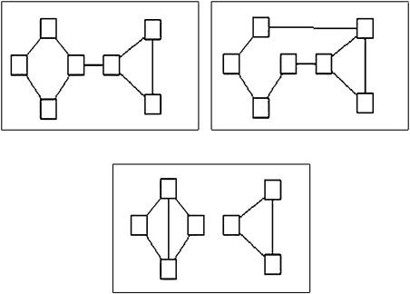
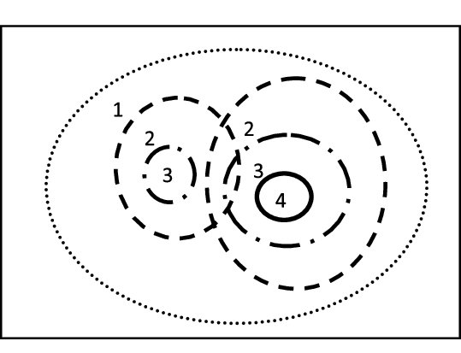
Cohesive Blocking
The idea of cutsets leads to the Cohesive Blocking approach for the identification of nested cohesive subgroups (Moody and White 2003):
  Identify the k-connectivity of the input graph
  Remove the k-cutset (vertices)
  Do the same on the resulting subgraphs until no more subdivisions can be obtained

Slide 282
Cohesive Blocking
Identify the k-connectivity of the input graph (G)
Remove the k-cutset (vertices)
Do the same on the resulting subgraphs until no more subdivisions can be obtained
2
1
3
9
10
4
8
G
5
7
13
11
12
6
14
15
17
16
18
19
20
21
22
23

Slide 283
Cohesive Blocking
Identify the k-connectivity of the input graph (G)
Remove the k-cutset (vertices)
Do the same on the resulting subgraphs until no more subdivisions can be obtained
2
1
3
9
10
4
8
G
5
7
13
11
12
6
14
15
17
16
18
19
This graph is 1-connected! Can you tell which node we need to remove?
20
21
22
23

Slide 284
Cohesive Blocking
Identify the k-connectivity of the input graph (G)
Remove the k-cutset (vertices)
Do the same on the resulting subgraphs until no more subdivisions can be obtained
2
1
3
9
10
4
8
G
5
7
13
11
12
6
14
15
17
16
18
19
This graph is 1-connected! Can you tell which node we need to remove?
20
21
22
23

Slide 285
Cohesive Blocking
Identify the k-connectivity of the input graph (G)
Remove the k-cutset (vertices)
Do the same on the resulting subgraphs until no more subdivisions can be obtained
2
1
3
9
10
4
8
G
5
13
11
12
6
14
15
17
16
1, 2, 3, 4, 5, 6, 7, 17, 18, 19, 20, 21, 22, 23
7, 8, 9, 10, 11, 12, 13, 14, 15, 16
18
19
20
21
22
23

Slide 286
Cohesive Blocking
Identify the k-connectivity of the input graph (G)
Remove the k-cutset (vertices)
Do the same on the resulting subgraphs until no more subdivisions can be obtained
2
1
3
9
10
4
8
G
5
13
11
12
6
14
15
17
16
1, 2, 3, 4, 5, 6, 7, 17, 18, 19, 20, 21, 22, 23
7, 8, 9, 10, 11, 12, 13, 14, 15, 16
18
19
Who’s next?
20
21
22
23

Slide 287
Cohesive Blocking
Identify the k-connectivity of the input graph (G)
Remove the k-cutset (vertices)
Do the same on the resulting subgraphs until no more subdivisions can be obtained
2
1
3
9
10
4
8
G
5
13
11
12
6
14
15
17
16
1, 2, 3, 4, 5, 6, 7, 17, 18, 19, 20, 21, 22, 23
7, 8, 9, 10, 11, 12, 13, 14, 15, 16
18
19
That’s right!
20
21
22
23

Slide 288
Cohesive Blocking
Identify the k-connectivity of the input graph (G)
Remove the k-cutset (vertices)
Do the same on the resulting subgraphs until no more subdivisions can be obtained
2
1
3
9
10
4
8
G
11
12
13
6
14
15
17
16
1, 2, 3, 4, 5, 6, 7, 17, 18, 19, 20, 21, 22, 23
7, 8, 9, 10, 11, 12, 13, 14, 15, 16
18
19
20
21
22
23
1, 2, 3, 4, 5, 6
17, 18, 19, 20, 21, 22, 23

Slide 289
Summary of key terms
Subgraph: A subset (G’) of the node and the edge set of a graph (G)
Connected subgraph: All nodes in the subgraph can reach other nodes in the subgraph via some path within the subset of edges
Maximal subgraph: A subgraph is maximal with respect to property p (e.d., completeness, connectivity) when no more nodes or edges can be added to the subgraph without losing that property
  Maximally connected subgraph, maximally complete subgraph, etc.
Clique: Maximally complete subgraph
Clique Size: Number of nodes in a clique
n-Clique: A subgraph in which every node can reach every other node inside the subgraph via a path of minimum length n

Slide 290
Summary of key terms
Connected graph: All nodes in the graph can reach every other node via a path regardless of length (l < ∞)
Disconnected graph: Some nodes in the graph cannot reach other nodes via any path (e.g., for at least one pair of nodes l _{uv}= ∞)
Components: Maximally connected subgraphs inside a disconnected graph
Giant Component: The maximally connected subgraph in a disconnected graph with the largest number of nodes
k-Connected component: A component in which every node can reach every other node inside the component via a path of minimum length k

Slide 291
Summary of key terms
Bridges: An edge that if it were removed would disconnect the graph
Edge cutset: Minimum number of edges whose removal would disconnect the graph
Node cutset: Minimum number of nodes whose removal would disconnect the graph
uv-cutset: Number of nodes whose removal would disconnect a pair of nodes (uv)
Menger’s Theorem: Important result in graph theory!
Cohesive Blocking: A way to find densely connected subgroups in a graph by removing nodes in the node cutset

Slide 292
Graph theory: Weighted graphs
Often it is useful to associate numerical values with the edges (uv) of a graph:
  This is called the edge weight (w_{uv})
  This may be used to represent:
    the strength of the relationship joining two people
    the amount of something (e.g. information) that flows via the ties
Graphs that featured edge weights are called weighted (valued) graphs:
  Binary graphs can be thought of as a constrained case of weighted graphs

Slide 293
One mode projections as weighted graphs
One mode projections of two mode networks can be thought of as matrix representations of weighted graphs
  People are linked to one another is they share memberships
    The more shared memberships the stronger the link (w_{ij})
  Groups are linked to one another if they share members
    The more shared members the stronger the link (w_{ij})
  We can binarize the weighted one-mode representation to get back to simple graphs
    c*_{ij} = 1 if c_{ij} > ϴ, else c*_{ij} = 0; g*_{ij} = 1 if g_{ij} > ϴ, else g*_{ij} = 0
      Note that co-membership and overlap relations are symmetric!
  We can then calculate degree, betweenness, closeness, eigenvector, and other indices of vertex prominence and position

Slide 294
Whole Network Level

Slide 295
Levels of Analysis in social networks
Individual
1
Dyads
2
Triads
3
Cliques, Communities
4
Whole Network
5
The first part of the course follows this organization!

Slide 296
Levels of Analysis in social networks
Individual
1
Dyads
2
Triads
3
Cliques, Communities
4
Whole Network
5
The first part of the course follows this organization!

Slide 297
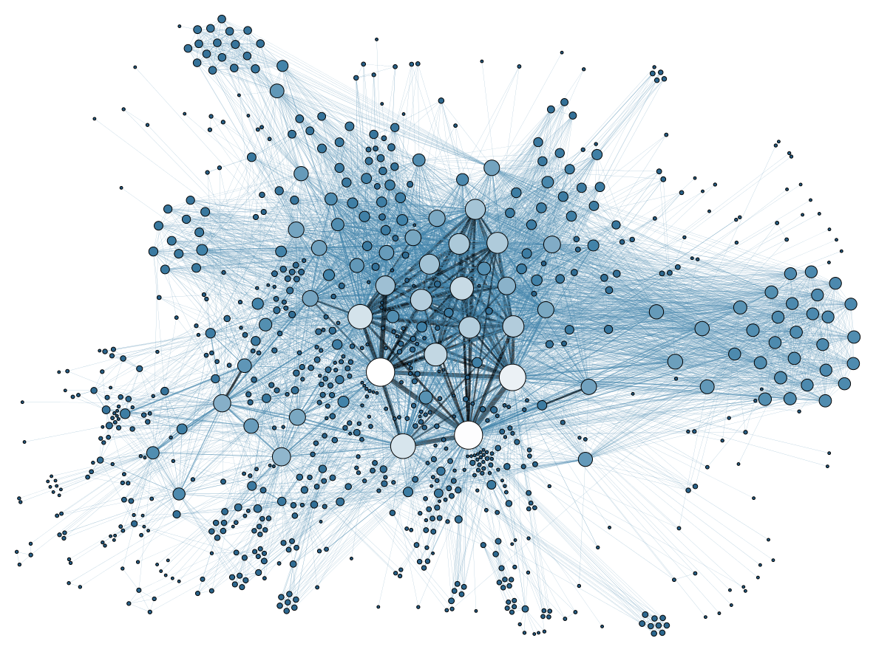
Key properties of whole networks
We have already seen three of the main ones:
  Number of nodes (graph order): N
  Number of links (graph size): E
  Density: E / (N(N-1)/2)

Slide 298
Key properties of whole networks
We will discuss additional ones:
  Degree based:
    Max/min degree
    Average degree: d_{avg}
    Degree distribution
    Degree Centralization: C_{d}
  Path based:
    Network Diameter: D
    Average shortest path: L
    Hierarchy: H
  Dyad based:
    Reciprocity: R
  Node based:
    Average clustering coefficient: c_{avg}

Slide 299
Degree-based network properties
A
A
E
B
C
E
B
C
D
D

Slide 300
Degree-based network properties
A
A
E
B
C
E
B
C
D
D
A | B | C | D | E
4 | 3 | 2 | 1 | 2
A | B | C | D | E
3 | 4 | 3 | 3 | 3
Degree Sequence
Degree Sequence

Slide 301
Degree-based network properties
A
d = (4 + 3 + 2 + 1 + 2) / 5
A
d = (3 + 4 + 3 + 3 + 3) / 5
E
B
C
E
B
C
D
D
A | B | C | D | E
4 | 3 | 2 | 1 | 2
Max degree: 4
Min degree: 1
A | B | C | D | E
3 | 4 | 3 | 3 | 3
Max degree: 4
Min degree: 3
Degree Sequence
Degree Sequence

Slide 302
Degree-based network properties
A
d = (4 + 3 + 2 + 1 + 2) / 5
A
d = (3 + 4 + 3 + 3 + 3) / 5
E
B
C
E
B
C
D
D
A | B | C | D | E
4 | 3 | 2 | 1 | 2
Max degree: 4
Min degree: 1
d = 2.4
A | B | C | D | E
3 | 4 | 3 | 3 | 3
Max degree: 4
Min degree: 3
d = 3.2
Degree Sequence
Degree Sequence

Slide 303
Degree-based network properties
A
d = (4 + 3 + 2 + 1 + 2) / 5
A
d = (3 + 4 + 3 + 3 + 3) / 5
E
B
C
E
B
C
D
D
A | B | C | D | E
4 | 3 | 2 | 1 | 2
Max degree: 4
Min degree: 1
d = 2.4
A | B | C | D | E
3 | 4 | 3 | 3 | 3
Max degree: 4
Min degree: 3
d = 3.2
Degree Sequence
Degree Sequence

Slide 304
Degree-based network properties
The degree distribution (p_{k}) is the probability of observing a node with degree k for each value of degree in the network!
A
A
E
B
C
E
B
C
D
D
1 | 2 | 3 | 4
1/5 | 2/5 | 1/5 | 1/5
0.2 | 0.4 | 0.2 | 0.2
Max degree: 4
Min degree: 1
d = 2.4
1 | 2 | 3 | 4
0/5 | 0/5 | 4/5 | 1/5
0 | 0 | 0.8 | 0.2
Max degree: 4
Min degree: 3
d = 3.2
Degree Distribution
Degree Distribution

Slide 305
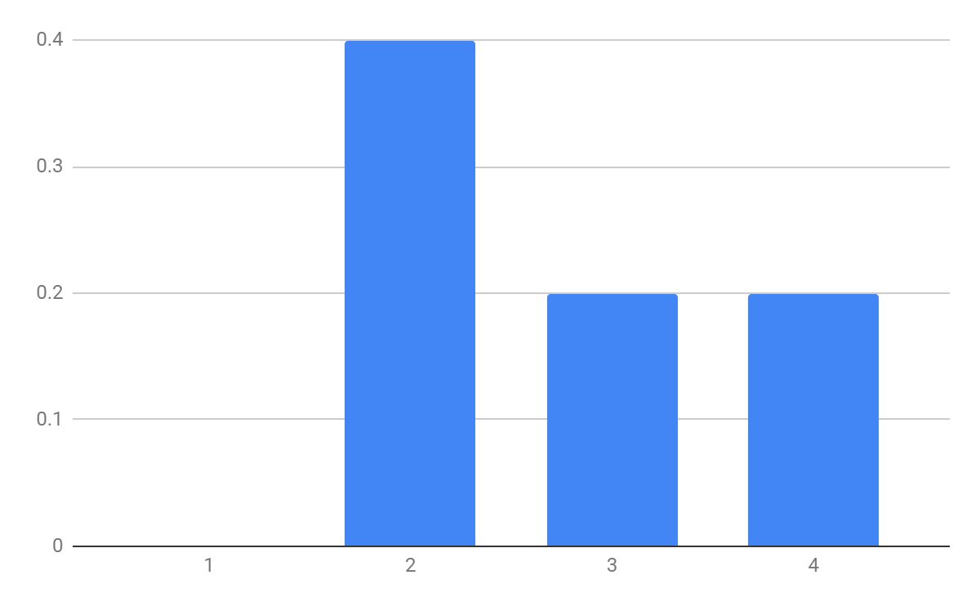
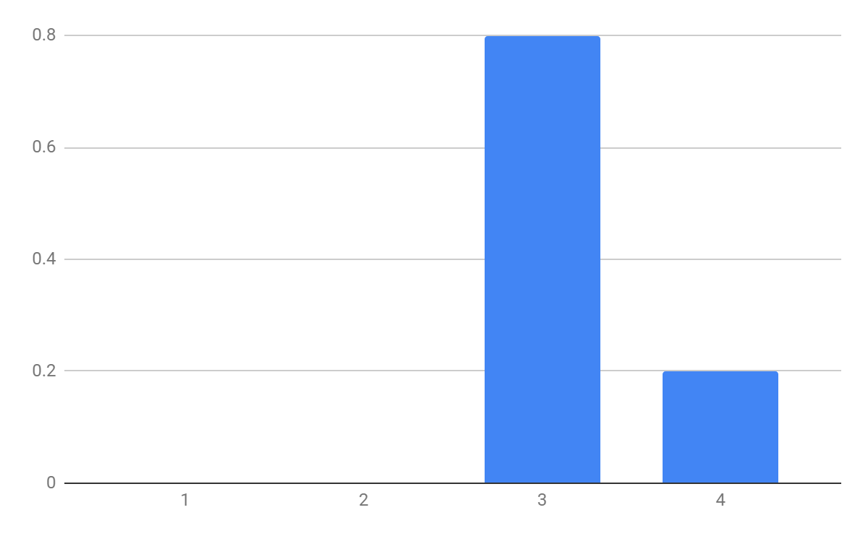
Degree-based network properties
1 | 2 | 3 | 4
0/5 | 2/5 | 1/5 | 1/5
0 | 0.4 | 0.2 | 0.2
Max degree: 4
Min degree: 1
d = 2.4
1 | 2 | 3 | 4
0/5 | 0/5 | 4/5 | 1/5
0 | 0 | 0.8 | 0.2
Max degree: 4
Min degree: 3
d = 3.2
Degree Distribution
Degree Distribution

Slide 306
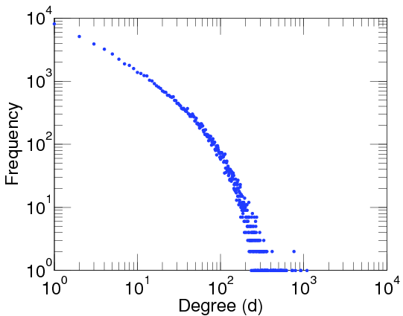
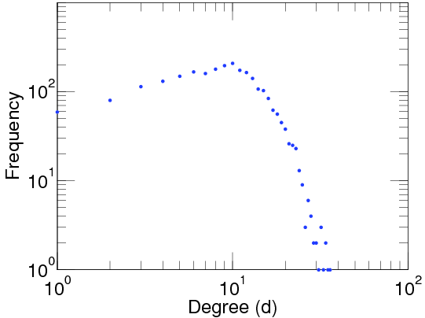
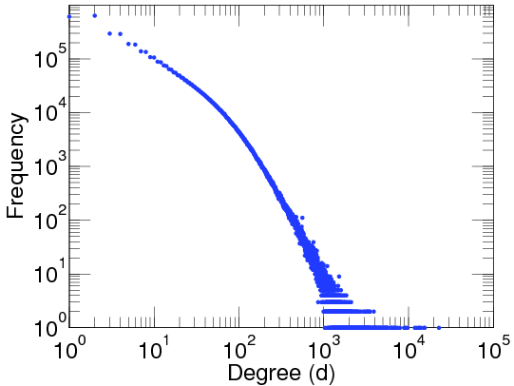
Degree-based network properties
Facebook Users
Add Health Study (High School)
LiveJournal Users
N = 63,731
E = 817,035
Max degree: 1,098
d = 25.6
N = 2539
E = 12,969
Max degree: 36
d = 10.2
N = 4,847,571
E = 68,475,391
Max degree: 22,887
d = 28.5

Slide 307
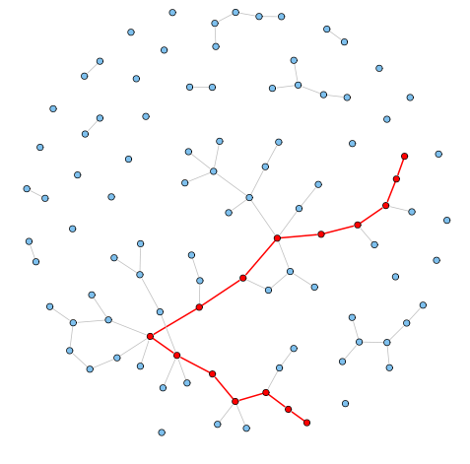
Path-based network properties
Flashback:
  In a network, shortest paths between two nodes are also called geodesics
The diameter (D) of a network is the length of the longest shortest path between two nodes
We can also compute the average shortest path length (L) between all pairs of nodes in a network
  Can only be computed for connected graphs or in the giant component of disconnected ones

Slide 308
Path-based network properties
Facebook Users
Add Health Study (High School)
LiveJournal
N = 63,731
E = 817,035
Max degree: 1,098
d = 25.6
D = 15
L = 4.3
N = 2539
E = 12,969
Max degree: 36
d = 10.2
D = 10
L = 4.5
N = 4,847,571
E = 68,475,391
Max degree: 22,887
d = 28.5
D = 20
L = 5.5

Slide 309
Path-based network properties
Facebook Users
Add Health Study (High School)
LiveJournal
N = 63,731
E = 817,035
Max degree: 1,098
d = 25.6
D = 15
L = 4.3
N = 2539
E = 12,969
Max degree: 36
d = 10.2
D = 10
L = 4.5
N = 4,847,571
E = 68,475,391
Max degree: 22,887
d = 28.5
D = 20
L = 5.5
L is small!

Slide 310
Dyad-based network properties
Facebook Users
Add Health Study (High School)
LiveJournal
N = 63,731
E = 817,035
Max degree: 1,098
d = 25.6
D = 15
L = 4.3
R = 1.0
N = 2539
E = 12,969
Max degree: 36
d = 10.2
D = 10
L = 4.5
R = 0.38
N = 4,847,571
E = 68,475,391
Max degree: 22,887
d = 28.5
D = 20
L = 5.5
R = 0.75

Slide 311


Node-based network properties
Flashback:
  Clustering coefficient at the ego-network level:
  Where g_{jk} = 1 if i's j^{th} neighbor is connected to her k^{th} neighbor, and k_{i} is i's total number of neighbors.
The Average Clustering Coefficient at the network level is just the sum of each node’s clustering coefficient divided by total number of nodes:

Slide 312
Node-based network properties
Facebook Users
Add Health Study (High School)
LiveJournal
N = 63,731
E = 817,035
Max degree: 1,098
d = 25.6
D = 15
L = 4.3
R = 1.0
C = 0.15
N = 2539
E = 12,969
Max degree: 36
d = 10.2
D = 10
L = 4.5
R = 0.38
C = 0.14
N = 4,847,571
E = 68,475,391
Max degree: 22,887
d = 28.5
D = 20
L = 5.5
R = 0.75
C = 0.12

Slide 313
Small World Networks

Slide 314
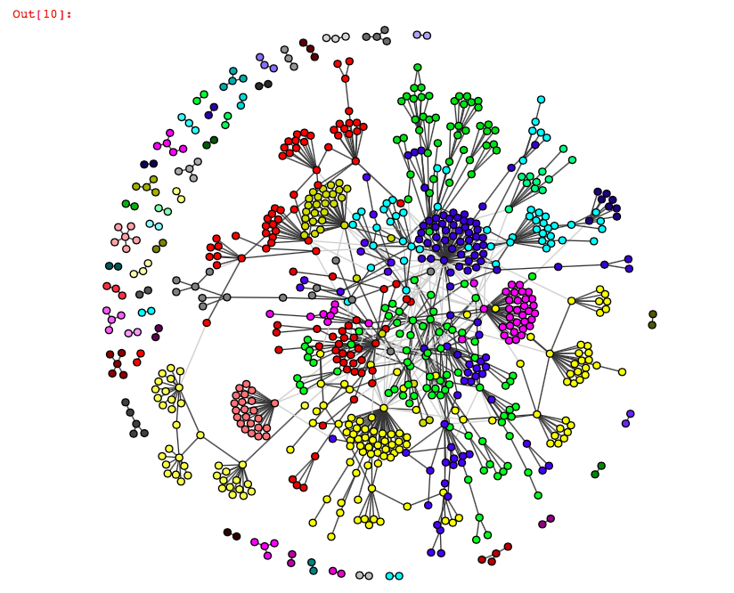
The world as a network
Imagine that the entire world (or a big place like the U. S.) as a network
  What can we deduce to be true of the graph the represents this network?

Slide 315
The world as a network
Imagine that the entire world (or a big place like the U. S.) as a network
  What can we deduce to be true of the graph the represents this network?
Order (N) is large
  7.8 billion as of March 2020!

Slide 316

The world as a network
Imagine that the entire world (or a big place like the U. S.) as a network
  What can we deduce to be true of the graph the represents this network?
Order (N) is large
Sparse
  Density (d) is low:
  Number of connected pairs of people in the world (E) is small relative graph size:

Slide 317
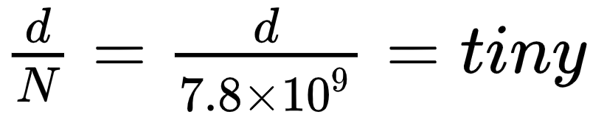
The world as a network
Imagine that the entire world (or a big place like the U. S.) as a network
  What can we deduce to be true of the graph the represents this network?
Order (N) is large
Sparse
  Average degree (d) is small relative to graph order

Slide 318
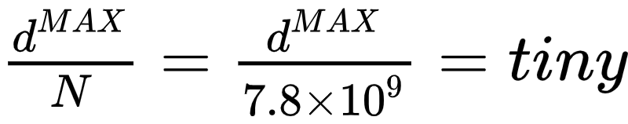
The world as a network
Imagine that the entire world (or a big place like the U. S.) as a network
  What can we deduce to be true of the graph the represents this network?
Order (N) is large
Sparse
Decentralized
  Maximum degree (d^{MAX}) is small relative to graph order:

Slide 319
The world as a network
Imagine that the entire world (or a big place like the U. S.) as a network
  What can we deduce to be true of the graph the represents this network?
Order (N) is large
Sparse
Decentralized
Clustered
  Transitivity: Friends of friends tend to be friends
  Most ego-networks have clustering coefficients above zero
  Average clustering coefficient is larger than zero

Slide 320
The world as a network
Imagine that the entire world (or a big place like the U. S.) as a network
  What can we deduce to be true of the graph the represents this network?
Order (N) is large
Sparse
Decentralized
Clustered
Subgroup structure
  Most connections in densely connected subgraphs
  Only a few between
  Graph can be split into cohesive subgroups

Slide 321
The world as a network
Imagine that the entire world (or a big place like the U. S.) as a network
  What can we deduce to be true of the graph the represents this network?
Order (N) is large
Sparse
Decentralized
Clustered
Subgroup structure
Six degrees of separation
  Average shortest path length between people is (relatively) small

Slide 322
The world as a network
Imagine that the entire world (or a big place like the U. S.) as a network
  What can we deduce to be true of the graph the represents this network?
Order (N) is large
Sparse
Decentralized
Clustered
Subgroup structure
Six degrees of separation
This last thing is weird!

Slide 323
The world as a network
Imagine that the entire world (or a big place like the U. S.) as a network
  What can we deduce to be true of the graph the represents this network?
In a large, sparse, decentralized graph, with clustering and subgroup structure:
  Any two random individuals should (on average) be separated by a long shortest paths
But real world shows “six degrees of separation” effect
  Six is a small number
  It’s a small world!

Slide 324

The small world phenomenon
Classic study by Travers and Milgram (1969)
Target (Boston stockbroker)
  296 participants ("starting persons")
  196 from Nebraska
    100 Stockbrokers
    96 Random
  100 from Boston
  217 forwarded packet so get to target person
  453 Intermediaries enlisted by the participants

Slide 325

The small world phenomenon
Target (Boston stockbroker)
  296 participants ("starting persons")
  196 from Nebraska
    100 Stockbrokers
    96 Random
  100 from Boston
  217 forwarded packet so get to target person
  453 Intermediaries enlisted by the participants
64 completed chains (29%)
    Mean path length: 5.2

Slide 326

The small world phenomenon
Target (Boston stockbroker)
  296 participants ("starting persons")
  196 from Nebraska
    100 Stockbrokers
    96 Random
  100 from Boston
  217 forwarded packet so get to target person
  453 Intermediaries enlisted by the participants
232 incomplete chains (71%)
  Mean path length: 2.6

Slide 327
The small world phenomenon
Out of the 64 completed chains 26 people made the final link
16 (25%) reached the target via a single neighbor: "Mr. G."
  Another accounted for 10
  Another for 5
  The top three account for 48% of completions
86% of “starters” sent the letter to friends and acquaintances
  14% send it to relatives
  age, gender, SES homophily in Intermediary choice

Slide 328
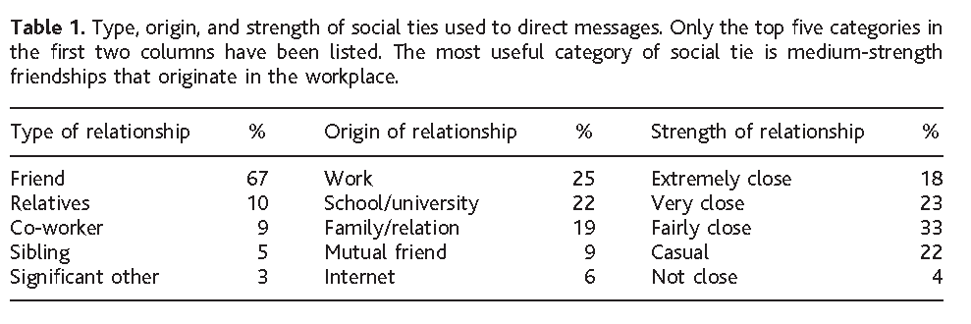
The small world phenomenon
Dodds, Muhammad and Watts (2003) Replication of Milgram
  Internet based social experiment
    18 target persons from 13 countries randomly allocated
    98,847 participants registered, 25% initiated a chain
    61,168 total participants from 166 countries (including intermediaries)

Slide 329
The small world phenomenon
Dodds, Muhamad and Watts (2003) Replication of Milgram
  More than half from North America
    Middle Class
    Professional, College Educated
    Largely Christian

Slide 330
The small world phenomenon
Dodds, Muhamad and Watts (2003) Replication of Milgram
  Strong preference for:
    Friends as role relations (rather than kin or co-workers)
    Ties embedded in work and school affiliations
    Ties of Intermediate strength (closeness)
    Same-gender ties

Slide 331
The small world phenomenon
Dodds, Muhamad and Watts (2003) Replication of Milgram
  Most effective chains more likely to feature:
    Professional ties (in contrast to friend and kin) as role relations
    Work or higher education ties as foci
    Either causal or “not close” ties in terms of strength
      Why this pattern?

Slide 332
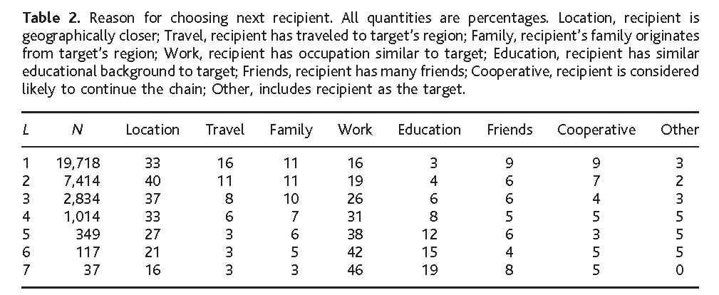
The small world phenomenon
Dodds, Muhamad and Watts (2003) Replication of Milgram
  Geographic proximity and similarity of occupation were the primary search heuristics
    Number of friends ("hub heuristic") almost never used
    Proximity declines and homophily increases in importance with chain length

Slide 333
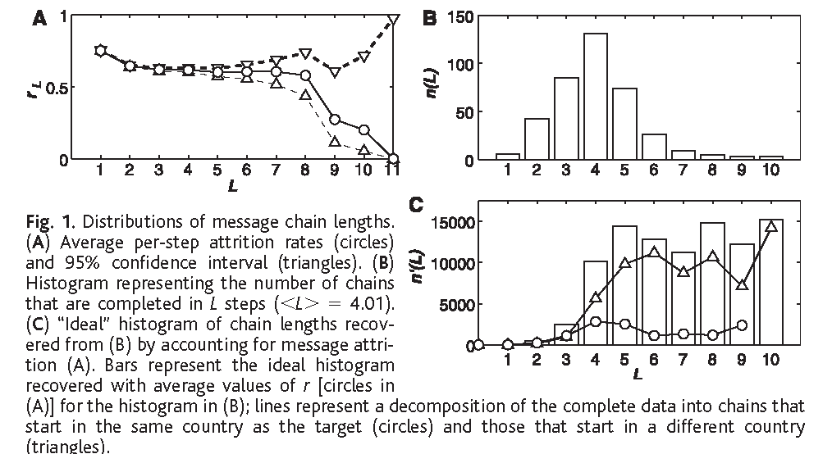
The small world phenomenon
384 completed chains (out 24,163); Average (L): 4.05
Corrected for attrition the median chain length is between 5 and 7

Slide 334
The small world phenomenon
Why are real human social networks (seemingly) searchable?
  Watts, Dodds and Newman (2002) propose a model in which organization around nested groups (communities) is key:
    Individuals interpret the world as a set of (nested) groups
    They bottom out at a (cognitively) manageable group size
Research on the search strategies used in natural contexts lead to a simple heuristic used to construct a path to a random person
  Use homophily on certain characteristics as a proxy for graph-theoretic distance between target and contact (proximity strategy)
Another useful heuristic
  Use characteristics associated with connectivity (e.g. high status characteristics) to select a contact (hub strategy)

Slide 335
The small world phenomenon
We may differentiate between the two facets of the SW phenomenon as providing answers to two different empirical questions:
  SW1: Why should there exist short chains of acquaintances linking together arbitrary pairs of strangers?
    This is the Small World Problem
  SW2: Given SW1, why should an agent be able to find short chains of acquaintances that links her to a random stranger?
    This is the Search Problem
The problem: not all small world networks are searchable
  Kleinberg (2000) showed that searchable SW structures exist for only a very limited range of random connectivity
  Too much randomness and navigability is lost

Slide 336
The small world phenomenon
We may differentiate between the two facets of the SW phenomenon as providing answers to two different empirical questions:
  SW1: Why should there exist short chains of acquaintances linking together arbitrary pairs of strangers?
    This is the Small World Problem
  SW2: Given SW1, why should an agent be able to find short chains of acquaintances that links her to a random stranger?
    This is the Search Problem
The two issues are distinct because SW1 can hold without SW2 being true
  Real human social networks are both “small” and “searchable” different theories apply:
    Structural
    Social psychological/heuristics

Slide 337
The small world phenomenon
SW1 |  | SW2
Contagion/Spread/ Transmission/Diffusion (unguided) | Process | Directed Search (guided)
Small World Structure (Big C plus Small L) | Structure | Searchable Network Structure
Agent-Level Representation of Whole Network Structure ("It's a small world!") | Cognition | Agent-Level Representation of Local Search Paths/Search Heuristics

Slide 338
The small world phenomenon
Why are real human social networks (seemingly) searchable?
  Watts, Dodds and Newman (2002) propose a model in which organization around nested groups (communities) is key:
    Individuals interpret the world as a set of (nested) groups
    They bottom out at a (cognitively) manageable group size
At the cognitive level individuals have two kinds of (partial) information:
  Social (group) distance (global but not equivalent to graph-theoretic distance)
    Each agent knows the his own and his neighbor's (plus target's) position in the group structure
    Otherwise ignorant of social distance between herself and others
    Each member i of a message chain forwards the message to the neighbor j who is closest to the target t in terms of social distance in the nested group hierarchy

Slide 339
The small world phenomenon
Why are real human social networks (seemingly) searchable?
  Watts, Dodds and Newman (2002) propose a model in which organization around nested groups (communities) is key:
    Individuals interpret the world as a set of (nested) groups
    They bottom out at a (cognitively) manageable group size
Research on the search strategies used in natural contexts lead to a simple heuristic used to construct a path to a random person
  Use homophily on certain characteristics as a proxy for graph-theoretic distance between target and contact (proximity strategy)
Another useful heuristic
  Use characteristics associated with connectivity (e.g. high status characteristics) to select a contact (hub strategy)

Slide 340
The small world phenomenon
Killworth and Bernard's (1979) "Reversal Small World" Experiment
  Useful for studying natural search strategies
    Instead of multiple starters and one target participants are presented with a (long, more than a thousand) list of targets
      Each target had a different mix of socio-demographic characteristics (gender, race, occupation, etc.)
      Participants are asked to name the contact that they would use as the first link in trying to reach that particular target
      Participants reported contact's gender, relationship to self, reason for selection
    This is a kind of “search name generator”

Slide 341
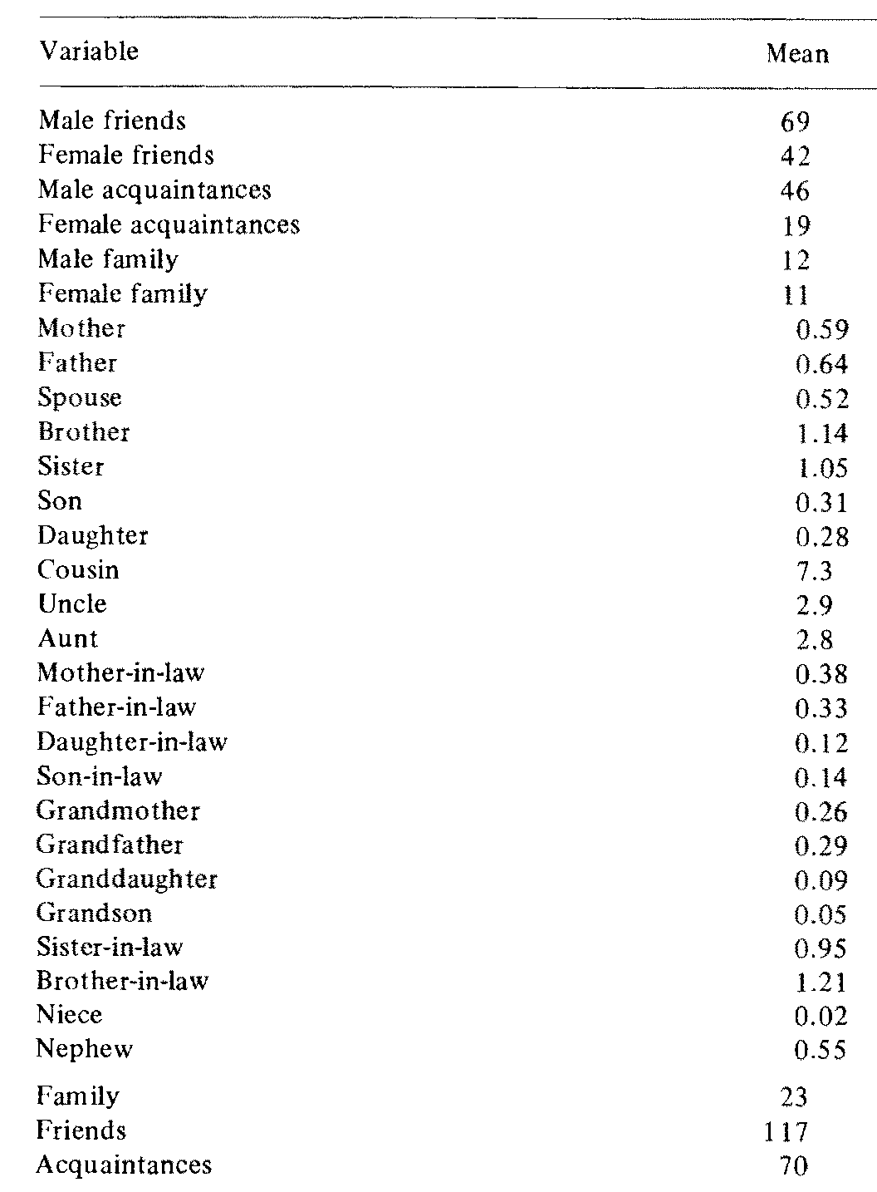
The small world phenomenon
Persons choose from three main category of contacts:
  Friends
  Acquaintances
  Family
82% of contacts were non-kin
Males more likely to be chosen
  Homophily by gender

Slide 342

The small world phenomenon
Men displayed stronger same gender bias
  Were more also more likely to use acquaintances
Women more likely to rely on kin

Slide 343

The small world phenomenon
What generates a small world?
  The Barabasi-Albert Model
    Incoming vertices connect to existing with ones with p ~ k(i)
      Where k(i) is i’s degree
  Generates: scale-free degree distribution (80-20, power distribution)
  Small World, small diameter
    WHY? Hubs
  But…
    low clustering coefficient

Slide 344

A (toy) model of the small world
What generates a small world?
  The Watts-Strogatz Model
    p - randomness parameter (proportion of links that are allowed to be non-local)
    G = (N, E) N vertices, E edges
    K = N. of neighbors assigned to each vertex
    L(p) = Average path length between two vertices
    C(p) = Average clustering coefficient

Slide 345

The small world phenomenon
What generates a small world?
  The Watts-Strogatz Model
    Random rewiring --> shortcuts
    high nonlinear effect on L
    only a linear effect on C
    Only need a small fraction of short cuts
    Range of p where L(p) is small world like AND C(p) is large (like in real social networks)
    Implications for diffusion

Slide 346

The small world phenomenon

Slide 347

The small world phenomenon

Slide 348
Social Position in Networks

Slide 349
Social position in networks
In standard social science social position is measured either:
  As a rank on some kind of ordinal or continuous scale
    Wealth, income, education
  As membership in some kind of nominal category
    Gender, race, marital status
  Standard social science measures social position as attribute similarity

Slide 350
Social position in networks
In standard social science social position is measured either:
  As a rank on some kind of ordinal or continuous scale
    Wealth, income, education
  As membership in some kind of nominal category
    Gender, race, marital status
  Standard social science measures social position as attribute similarity
    Two actors occupy the same social position is they have the same rank on scale (e.g., college educated) or are members of the same nominal category (e.g., gender)

Slide 351
Social position in networks
In standard social science social position is measured either:
  As a rank on some kind of ordinal or continuous scale
    Wealth, income, education
  As membership in some kind of nominal category
    Gender, race, marital status
  Standard social science measures social position as attribute similarity
    Two actors occupy the same social position is they have the same rank on scale (e.g., college educated) or are members of the same nominal category (e.g., gender)
In social network analysis social position is measured by the pattern of relations each actor has with other actor in the network
  Social network analysis measures social position as relational similarity

Slide 352
Social position in networks
In standard social science social position is measured either:
  As a rank on some kind of ordinal or continuous scale
    Wealth, income, education
  As membership in some kind of nominal category
    Gender, race, marital status
  Standard social science measures social position as attribute similarity
    Two actors occupy the same social position is they have the same rank on scale (e.g., college educated) or are members of the same nominal category (e.g., gender)
In social network analysis social position is measured by the pattern of relations each actor has with other actor in the network
  Social network analysis measures social position as relational similarity
    Two actors occupy the same social position is they have the same (or similar) sets of ties to other actors in the network

Slide 353
Social position in networks
Positional analysis is the branch of social network analysis in charge of:
  Defining different notions of network position
    Using graph theory
  Developing techniques to measure them:
    Using matrix algebra
  Our usual “three-step” shuffle
Directed Graph
 | a | b | c | d | e
a | -- | 1 | 0 | 0 | 0
b | 1 | -- | 0 | 0 | 0
c | 0 | 1 | -- | 1 | 1
d | 0 | 0 | 0 | -- | 0
e | 0 | 0 | 1 | 1 | --

Slide 354
Social position in networks
Positional analysis is the branch of social network analysis in charge of:
  Defining different notions of network position
    Using graph theory
  Developing techniques to measure them:
    Using matrix algebra
The position of actor b in the network is given by their pattern of relations to other actors
  How similar (or different) in terms of their connectivity pattern is b from other actors?
  Can we create groups or classes of actors based on their relational similarity?
Directed Graph
 | a | b | c | d | e
a | -- | 1 | 0 | 0 | 0
b | 1 | -- | 0 | 0 | 0
c | 0 | 1 | -- | 1 | 1
d | 0 | 0 | 0 | -- | 0
e | 0 | 0 | 1 | 1 | --

Slide 355
Social position in networks
Steps in positional analysis:
  Define a network-based notion of social position using graph theory
    This is usually an equivalence relation
  Translate that notion into a matrix representation
  Group actors (nodes) in the network based on whether they share the same position
  Rearrange the adjacency matrix so that actors in the same position are near one another
  Check to see how actors in the same position are connected to:
    Other actors that share the same position
    Other actors in different positions
  Come up with a simplified version of the network in which positions (cluster of actors) are the “nodes”

Slide 356
Social position in networks
Steps in positional analysis:
  Define a network-based notion of social position using graph theory
    This is usually an equivalence relation
  Translate that notion into a matrix representation
  Group actors (nodes) in the network based on whether they share the same position
  Rearrange the adjacency matrix so that actors in the same position are near one another
  Check to see how actors in the same position are connected to:
    Other actors that share the same position
    Other actors in different positions
  Come up with a simplified version of the network in which positions (cluster of actors) are the “nodes”
    This simplified structure is a network of relations between positions!
    But it is still based on the original relations between actors

Slide 357

Differences between positional and clique analysis
Positional analysis is both similar and different than cohesive subgroup (clique) analysis:
  Both partition the original set of actors (nodes) into subsets (subgraphs).
  However:
    In cohesive subgroup analysis the aim is to find clusters of actors that are strongly connected to one another
    In positional analysis the aim is to find cluster of actors who have the same pattern of connections to other actors

Slide 358
Differences between positional and clique analysis
Positional analysis is both similar and different than cohesive subgroup (clique) analysis:
  Both partition the original set of actors (nodes) into subsets (subgraphs). But
  Actors in the same position in a network don’t need to be directly connected to one another!
      Although they could
    Actors in the same subgroup need to be directly or indirectly connected to one another

Slide 359
What is an equivalence relation? (graph theory)
Given a graph G = E, V an equivalence relation imposes a partition on the vertex set V = {u₁, u_{2,}...,u_{n}}
  A Partition P = {C₁...C_{k}} of V is a set of non-empty, disjoint subsets called equivalence classes or blocks
  Nodes in an equivalence class share an (reflexive, symmetric, transitive) equivalence relation (≣)
    Reflexive: is vertex is equivalent to itself U_{i} ≣ U_{i}
    Symmetric: if U_{i} ≣ U_{j} then U_{j} ≣ U_{i}
    Transitive:U_{i} ≣ U_{j} and U_{j} ≣ U_{k} then U_{i} ≣ U_{k}

Slide 360



Notions of Equivalence: Structural Equivalence
Structural equivalence is the simplest of the equivalence notions in positional analysis
  Two nodes u and v are structurally equivalent if they are connected to the same others
  If N(a) is the set of vertices vertex is connected to (a’s neighborhood)
  If N(b) is the set of vertices vertex b is connected to (b’s neighborhood)
    Then a and b are structurally equivalent if N(a) = N(b)
      Without counting a or b!

Slide 361
Notions of Equivalence: Structural Equivalence
Structurally equivalent actors:
  Have the same ego-networks (they are connected to the same set of others)
  Are part of the same cohesive subset (they are connected by at least a path of length 2)
  Have the same graph theoretic attributes (e.g., centrality, clustering coefficient, etc.)
    But not necessarily the reverse!
      Two actors can have the same graph theoretic attributes but not be connected to the same others

Slide 362
Notions of Equivalence: Structural Equivalence
Kin and hierarchical relations provide the basic model of structural equivalence
  Parents are structural equivalent (in relation to offspring)
  Siblings are structurally equivalent (in relation to parents)
  In work settings people at the same level of the hierarchy are structurally equivalent
Parent
Parent
Supervisor
Supervisor
Son
Daughter
Worker
Worker

Slide 363
Notions of Equivalence: Structural Equivalence
A positional analysis finds a set of positions P = {l, m, n…}
  Where each position (blocks) is a subset of the nodes in the original network that are seen as equivalent
    The symbol for equivalence is ≣
      X ≣ Y reads as “X is (structurally) equivalent to Y”
a
b
g
h
e
f
c
d
i
j
Borgatti and Everett’s
“Thinking Graph”

Slide 364
Notions of Equivalence: Structural Equivalence
A positional analysis finds a set of positions P = {l, m, n…}
  Where each position (blocks) is a subset of the nodes in the original network that are seen as equivalent
  In the case of positions defined as structural equivalence below:
    P = {a ≣ c}, {b ≣ d}, {e ≣ e}, {f ≣ f}, {g ≣ i}, {h ≣ j}
a
b
g
h
e
f
c
d
i
j
Borgatti and Everett’s
“Thinking Graph”
Borgatti and Everett’s
“Thinking Graph”

Slide 365
Notions of Equivalence: Structural Equivalence
A positional analysis finds a set of positions P = {l, m, n…}
  Where each position (blocks) is a subset of the nodes in the original network that are seen as equivalent
  In the case of positions defined as structural equivalence below:
    P = {a ≣ c}, {b ≣ d}, {e ≣ e}, {f ≣ f}, {g ≣ i}, {h ≣ j}
a
b
g
h
e
f
c
d
i
j
Borgatti and Everett’s
“Thinking Graph”
Borgatti and Everett’s
“Thinking Graph”

Slide 366
Notions of Equivalence: Structural Equivalence
Structurally equivalent actors:
  Have the same ego-networks (they are connected to the same set of others)
  Are part of the same cohesive subset (they are connected by at least a path of length 2)
  Have the same graph theoretic attributes (e.g., centrality, clustering coefficient, etc.)
a
b
g
h
e
f
c
d
i
j
Borgatti and Everett’s
“Thinking Graph”

Slide 367
Notions of Equivalence: Structural Equivalence
Structurally equivalent actors:
  Have the same ego-networks (they are connected to the same set of others)
  Are part of the same cohesive subset (they are connected by at least a path of length 2)
  Have the same graph theoretic attributes (e.g., centrality, clustering coefficient, etc.)
    But not necessarily the reverse!
    Actors can have same graph theoretic attributes but not be connected to the same others
a
b
g
h
e
f
c
d
i
j
Borgatti and Everett’s
“Thinking Graph”

Slide 368
Notions of Equivalence: Structural Equivalence
Structurally equivalent actors:
  Have the same ego-networks (they are connected to the same set of others)
  Are part of the same cohesive subset (they are connected by at least a path of length 2)
  Have the same graph theoretic attributes (e.g., centrality, clustering coefficient, etc.)
    Actors can be structurally equivalent even if they are not connected to one another!
      b ≣ d even though b and d are not connected!
a
b
g
h
e
f
c
d
i
j
Borgatti and Everett’s
“Thinking Graph”

Slide 369
Roles and positions in networks (Graph Theory)
Once vertices are partitioned into positions or blocks (disjoint subsets of nodes) we may be interested in the connections among the blocks
  Two blocks are connected via the adjacency relations of their respective vertices in the original network
  A reduced representation showing the roles and their relations is called a role graph or image graph and its corresponding matrix an image matrix
a
b
g
h
e
f
c
d
i
j
Borgatti and Everett’s
“Thinking Graph”

Slide 370
Blockmodeling
What is a blockmodel?
  A procedure to reorder the rows of matrix (representing nodes and their relations) such that:
    Rows that are close together are closer to being (structural or regularly) equivalent than rows that are far apart
      The matrix can then be divided into blocks
    Blocks contain disjoint set of actors and thus define “positions” in the network
  Actors in block may or may not connections among themselves
    Diagonal blocks
  Actors in a block may have connections with actors in other blocks
    Off-diagonal blocks
We can think of blockmodeling as an attempt to reduce a matrix of N x N actors and their relations to a reduced matrix of B x B blocks and their relations

Slide 371
Blockmodeling based on structural equivalence
Original Adjacency Matrix
 | a | b | c | d | e | f | g | h | i | j
a | -- | 1 | 1 | 1 | 0 | 0 | 0 | 0 | 0 | 0
b | 1 | -- | 1 | 0 | 1 | 0 | 0 | 0 | 0 | 0
c | 1 | 1 | -- | 1 | 0 | 0 | 0 | 0 | 0 | 0
d | 1 | 0 | 1 | -- | 1 | 0 | 0 | 0 | 1 | 0
e | 0 | 1 | 0 | 1 | -- | 1 | 0 | 0 | 0 | 0
f | 0 | 0 | 0 | 0 | 1 | -- | 1 | 0 | 1 | 0
g | 0 | 0 | 0 | 0 | 1 | 0 | -- | 1 | 0 | 1
h | 0 | 0 | 0 | 0 | 0 | 0 | 1 | -- | 1 | 1
i | 0 | 0 | 0 | 0 | 0 | 1 | 0 | 1 | -- | 1
j | 0 | 0 | 0 | 1 | 0 | 0 | 1 | 1 | 1 | --
a
b
g
h
e
f
c
d
i
j

Slide 372
Blockmodeling based on structural equivalence
Structural Equivalence Blocked Matrix
 | a | c | h | j | b | d | g | i | e | f
a | -- | 1 | 0 | 0 | 1 | 1 | 0 | 0 | 0 | 0
c | 1 | -- | 0 | 0 | 1 | 1 | 0 | 0 | 0 | 0
h | 0 | 0 | -- | 1 | 0 | 0 | 1 | 1 | 0 | 0
j | 0 | 0 | 1 | -- | 0 | 0 | 1 | 1 | 0 | 0
b | 1 | 1 | 0 | 0 | -- | 0 | 0 | 0 | 1 | 0
d | 1 | 1 | 0 | 0 | 0 | -- | 0 | 0 | 1 | 0
g | 0 | 0 | 1 | 1 | 0 | 0 | -- | 0 | 0 | 1
i | 0 | 0 | 1 | 1 | 0 | 0 | 0 | -- | 0 | 1
e | 0 | 0 | 0 | 0 | 1 | 1 | 0 | 0 | -- | 1
f | 0 | 0 | 0 | 0 | 0 | 0 | 1 | 1 | 1 | --
a
b
g
h
e
f
c
d
i
j

Slide 373
Blockmodeling based on structural equivalence
Structural Equivalence Blocked Matrix
 | a | c | h | j | b | d | g | i | e | f
a | -- | 1 | 0 | 0 | 1 | 1 | 0 | 0 | 0 | 0
c | 1 | -- | 0 | 0 | 1 | 1 | 0 | 0 | 0 | 0
h | 0 | 0 | -- | 1 | 0 | 0 | 1 | 1 | 0 | 0
j | 0 | 0 | 1 | -- | 0 | 0 | 1 | 1 | 0 | 0
b | 1 | 1 | 0 | 0 | -- | 0 | 0 | 0 | 1 | 0
d | 1 | 1 | 0 | 0 | 0 | -- | 0 | 0 | 1 | 0
g | 0 | 0 | 1 | 1 | 0 | 0 | -- | 0 | 0 | 1
i | 0 | 0 | 1 | 1 | 0 | 0 | 0 | -- | 0 | 1
e | 0 | 0 | 0 | 0 | 1 | 1 | 0 | 0 | -- | 1
f | 0 | 0 | 0 | 0 | 0 | 0 | 1 | 1 | 1 | --
a
b
g
h
e
f
c
d
i
j

Slide 374
Blockmodeling based on structural equivalence
Original Adjacency Matrix
Structural Equivalence Blocked Matrix
 | a | b | c | d | e | f | g | h | i | j
a | -- | 1 | 1 | 1 | 0 | 0 | 0 | 0 | 0 | 0
b | 1 | -- | 1 | 0 | 1 | 0 | 0 | 0 | 0 | 0
c | 1 | 1 | -- | 1 | 0 | 0 | 0 | 0 | 0 | 0
d | 1 | 0 | 1 | -- | 1 | 0 | 0 | 0 | 1 | 0
e | 0 | 1 | 0 | 1 | -- | 1 | 0 | 0 | 0 | 0
f | 0 | 0 | 0 | 0 | 1 | -- | 1 | 0 | 1 | 0
g | 0 | 0 | 0 | 0 | 1 | 0 | -- | 1 | 0 | 1
h | 0 | 0 | 0 | 0 | 0 | 0 | 1 | -- | 1 | 1
i | 0 | 0 | 0 | 0 | 0 | 1 | 0 | 1 | -- | 1
j | 0 | 0 | 0 | 1 | 0 | 0 | 1 | 1 | 1 | --
Re-arranging the rows and columns of the adjacency matrix does not change the original information!
 | a | c | h | j | b | d | g | i | e | f
a | -- | 1 | 0 | 0 | 1 | 1 | 0 | 0 | 0 | 0
c | 1 | -- | 0 | 0 | 1 | 1 | 0 | 0 | 0 | 0
h | 0 | 0 | -- | 1 | 0 | 0 | 1 | 1 | 0 | 0
j | 0 | 0 | 1 | -- | 0 | 0 | 1 | 1 | 0 | 0
b | 1 | 1 | 0 | 0 | -- | 0 | 0 | 0 | 1 | 0
d | 1 | 1 | 0 | 0 | 0 | -- | 0 | 0 | 1 | 0
g | 0 | 0 | 1 | 1 | 0 | 0 | -- | 0 | 0 | 1
i | 0 | 0 | 1 | 1 | 0 | 0 | 0 | -- | 0 | 1
e | 0 | 0 | 0 | 0 | 1 | 1 | 0 | 0 | -- | 1
f | 0 | 0 | 0 | 0 | 0 | 0 | 1 | 1 | 1 | --
Re-arranging the rows and columns of a matrix is called a permutation

Slide 375
Blockmodeling based on structural equivalence
Structural Equivalence Blocked Matrix
Blocks fall along the diagonal of the matrix with re-arranged rows!
 | a | c | h | j | b | d | g | i | e | f
a | -- | 1 | 0 | 0 | 1 | 1 | 0 | 0 | 0 | 0
c | 1 | -- | 0 | 0 | 1 | 1 | 0 | 0 | 0 | 0
h | 0 | 0 | -- | 1 | 0 | 0 | 1 | 1 | 0 | 0
j | 0 | 0 | 1 | -- | 0 | 0 | 1 | 1 | 0 | 0
b | 1 | 1 | 0 | 0 | -- | 0 | 0 | 0 | 1 | 0
d | 1 | 1 | 0 | 0 | 0 | -- | 0 | 0 | 1 | 0
g | 0 | 0 | 1 | 1 | 0 | 0 | -- | 0 | 0 | 1
i | 0 | 0 | 1 | 1 | 0 | 0 | 0 | -- | 0 | 1
e | 0 | 0 | 0 | 0 | 1 | 1 | 0 | 0 | -- | 1
f | 0 | 0 | 0 | 0 | 0 | 0 | 1 | 1 | 1 | --
a
b
g
h
e
f
c
d
i
j

Slide 376
Blockmodeling based on structural equivalence
Structural Equivalence Blocked Matrix
 | a | c | h | j | b | d | g | i | e | f
a | -- | 1 | 0 | 0 | 1 | 1 | 0 | 0 | 0 | 0
c | 1 | -- | 0 | 0 | 1 | 1 | 0 | 0 | 0 | 0
h | 0 | 0 | -- | 1 | 0 | 0 | 1 | 1 | 0 | 0
j | 0 | 0 | 1 | -- | 0 | 0 | 1 | 1 | 0 | 0
b | 1 | 1 | 0 | 0 | -- | 0 | 0 | 0 | 1 | 0
d | 1 | 1 | 0 | 0 | 0 | -- | 0 | 0 | 1 | 0
g | 0 | 0 | 1 | 1 | 0 | 0 | -- | 0 | 0 | 1
i | 0 | 0 | 1 | 1 | 0 | 0 | 0 | -- | 0 | 1
e | 0 | 0 | 0 | 0 | 1 | 1 | 0 | 0 | -- | 1
f | 0 | 0 | 0 | 0 | 0 | 0 | 1 | 1 | 1 | --
The off-block cells have the same values for each block!
a
b
g
h
e
f
c
d
i
j

Slide 377
Blockmodeling based on structural equivalence
Structural Equivalence Blocked Matrix
 | a | c | h | j | b | d | g | i | e | f
a | -- | 1 | 0 | 0 | 1 | 1 | 0 | 0 | 0 | 0
c | 1 | -- | 0 | 0 | 1 | 1 | 0 | 0 | 0 | 0
h | 0 | 0 | -- | 1 | 0 | 0 | 1 | 1 | 0 | 0
j | 0 | 0 | 1 | -- | 0 | 0 | 1 | 1 | 0 | 0
b | 1 | 1 | 0 | 0 | -- | 0 | 0 | 0 | 1 | 0
d | 1 | 1 | 0 | 0 | 0 | -- | 0 | 0 | 1 | 0
g | 0 | 0 | 1 | 1 | 0 | 0 | -- | 0 | 0 | 1
i | 0 | 0 | 1 | 1 | 0 | 0 | 0 | -- | 0 | 1
e | 0 | 0 | 0 | 0 | 1 | 1 | 0 | 0 | -- | 1
f | 0 | 0 | 0 | 0 | 0 | 0 | 1 | 1 | 1 | --
The off-block cells have the same values for each block!
a
b
g
h
e
f
c
d
i
j
People assigned to the same block are connected to the same others!

Slide 378
Blockmodeling based on structural equivalence
Structural Equivalence Blocked Matrix
 | a | c | h | j | b | d | g | i | e | f
a | -- | 1 | 0 | 0 | 1 | 1 | 0 | 0 | 0 | 0
c | 1 | -- | 0 | 0 | 1 | 1 | 0 | 0 | 0 | 0
h | 0 | 0 | -- | 1 | 0 | 0 | 1 | 1 | 0 | 0
j | 0 | 0 | 1 | -- | 0 | 0 | 1 | 1 | 0 | 0
b | 1 | 1 | 0 | 0 | -- | 0 | 0 | 0 | 1 | 0
d | 1 | 1 | 0 | 0 | 0 | -- | 0 | 0 | 1 | 0
g | 0 | 0 | 1 | 1 | 0 | 0 | -- | 0 | 0 | 1
i | 0 | 0 | 1 | 1 | 0 | 0 | 0 | -- | 0 | 1
e | 0 | 0 | 0 | 0 | 1 | 1 | 0 | 0 | -- | 1
f | 0 | 0 | 0 | 0 | 0 | 0 | 1 | 1 | 1 | --
Some diagonal blocks have ones inside
a
b
g
h
e
f
c
d
i
j
Others just have zeroes
(These are called zero-blocks)

Slide 379
Blockmodeling based on structural equivalence
Structural Equivalence Blocked Matrix
 | a | c | h | j | b | d | g | i | e | f
a | -- | 1 | 0 | 0 | 1 | 1 | 0 | 0 | 0 | 0
c | 1 | -- | 0 | 0 | 1 | 1 | 0 | 0 | 0 | 0
h | 0 | 0 | -- | 1 | 0 | 0 | 1 | 1 | 0 | 0
j | 0 | 0 | 1 | -- | 0 | 0 | 1 | 1 | 0 | 0
b | 1 | 1 | 0 | 0 | -- | 0 | 0 | 0 | 1 | 0
d | 1 | 1 | 0 | 0 | 0 | -- | 0 | 0 | 1 | 0
g | 0 | 0 | 1 | 1 | 0 | 0 | -- | 0 | 0 | 1
i | 0 | 0 | 1 | 1 | 0 | 0 | 0 | -- | 0 | 1
e | 0 | 0 | 0 | 0 | 1 | 1 | 0 | 0 | -- | 1
f | 0 | 0 | 0 | 0 | 0 | 0 | 1 | 1 | 1 | --
Some blocks have ones inside
a
b
g
h
e
f
c
d
i
j
Diagonal Zero-blocks indicate structurally equivalent actors who are not connected to one another

Slide 380
Blockmodeling based on structural equivalence
Once vertices are partitioned into positions or blocks (disjoint subsets of nodes) we may be interested in the connections among the blocks
  Two blocks are connected via the adjacency relations of their respective vertices in the original network
  A reduced representation showing the roles and their relations is called an image graph
  The corresponding matrix is called an image matrix
Image Graph
a, c
b, d
h, j
g, i
e
f

Slide 381
Blockmodeling based on structural equivalence
Structural Equivalence Blocked Matrix
Image Graph
 | a | c | h | j | b | d | g | i | e | f
a | -- | 1 | 0 | 0 | 1 | 1 | 0 | 0 | 0 | 0
c | 1 | -- | 0 | 0 | 1 | 1 | 0 | 0 | 0 | 0
h | 0 | 0 | -- | 1 | 0 | 0 | 1 | 1 | 0 | 0
j | 0 | 0 | 1 | -- | 0 | 0 | 1 | 1 | 0 | 0
b | 1 | 1 | 0 | 0 | -- | 0 | 0 | 0 | 1 | 0
d | 1 | 1 | 0 | 0 | 0 | -- | 0 | 0 | 1 | 0
g | 0 | 0 | 1 | 1 | 0 | 0 | -- | 0 | 0 | 1
i | 0 | 0 | 1 | 1 | 0 | 0 | 0 | -- | 0 | 1
e | 0 | 0 | 0 | 0 | 1 | 1 | 0 | 0 | -- | 1
f | 0 | 0 | 0 | 0 | 0 | 0 | 1 | 1 | 1 | --
a, c
b, d
h, j
g, i
e
f

Slide 382
Blockmodeling based on structural equivalence
Structural Equivalence Blocked Matrix
Image Graph
 | a | c | h | j | b | d | g | i | e | f
a | -- | 1 | 0 | 0 | 1 | 1 | 0 | 0 | 0 | 0
c | 1 | -- | 0 | 0 | 1 | 1 | 0 | 0 | 0 | 0
h | 0 | 0 | -- | 1 | 0 | 0 | 1 | 1 | 0 | 0
j | 0 | 0 | 1 | -- | 0 | 0 | 1 | 1 | 0 | 0
b | 1 | 1 | 0 | 0 | -- | 0 | 0 | 0 | 1 | 0
d | 1 | 1 | 0 | 0 | 0 | -- | 0 | 0 | 1 | 0
g | 0 | 0 | 1 | 1 | 0 | 0 | -- | 0 | 0 | 1
i | 0 | 0 | 1 | 1 | 0 | 0 | 0 | -- | 0 | 1
e | 0 | 0 | 0 | 0 | 1 | 1 | 0 | 0 | -- | 1
f | 0 | 0 | 0 | 0 | 0 | 0 | 1 | 1 | 1 | --
Blocks {a,c} and {b,d} are connected!
a, c
b, d
h, j
g, i
e
f

Slide 383
Notions of Equivalence: Structural Equivalence
Structural Equivalence Blocked Matrix
Image Graph
 | a | c | h | j | b | d | g | i | e | f
a | -- | 1 | 0 | 0 | 1 | 1 | 0 | 0 | 0 | 0
c | 1 | -- | 0 | 0 | 1 | 1 | 0 | 0 | 0 | 0
h | 0 | 0 | -- | 1 | 0 | 0 | 1 | 1 | 0 | 0
j | 0 | 0 | 1 | -- | 0 | 0 | 1 | 1 | 0 | 0
b | 1 | 1 | 0 | 0 | -- | 0 | 0 | 0 | 1 | 0
d | 1 | 1 | 0 | 0 | 0 | -- | 0 | 0 | 1 | 0
g | 0 | 0 | 1 | 1 | 0 | 0 | -- | 0 | 0 | 1
i | 0 | 0 | 1 | 1 | 0 | 0 | 0 | -- | 0 | 1
e | 0 | 0 | 0 | 0 | 1 | 1 | 0 | 0 | -- | 1
f | 0 | 0 | 0 | 0 | 0 | 0 | 1 | 1 | 1 | --
a, c
b, d
Nothing here!
h, j
g, i
e
f

Slide 384
Notions of Equivalence: Structural Equivalence
Image Graph
Structural Equivalence Image Matrix
a, c
b, d
 | a, c | b, d | h, j | g, i | e | f
a, c | 1 | 1 | 0 | 0 | 0 | 0
b, d | 1 | 0 | 0 | 0 | 1 | 0
h, j | 0 | 0 | 1 | 1 | 0 | 0
g, i | 0 | 0 | 1 | 0 | 0 | 1
e | 0 | 1 | 0 | 0 | 0 | 1
f | 0 | 0 | 0 | 1 | 1 | 0
Nothing here!
h, j
g, i
e
f

Slide 385
Notions of Equivalence: Structural Equivalence
Once vertices are partitioned into positions or blocks (disjoint subsets of nodes) we may be interested in the connections among the blocks
  Two blocks are connected via the adjacency relations of their respective vertices in the original network
  A reduced representation showing the roles and their relations is called an image graph
  The corresponding matrix is called an image matrix
Structural Equivalence Image Matrix
 | a, c | b, d | h, j | g, i | e | f
a, c | 1 | 1 | 0 | 0 | 0 | 0
b, d | 1 | 0 | 0 | 0 | 1 | 0
h, j | 0 | 0 | 1 | 1 | 0 | 0
g, i | 0 | 0 | 1 | 0 | 0 | 1
e | 0 | 1 | 0 | 0 | 0 | 1
f | 0 | 0 | 0 | 1 | 1 | 0
When all (or most) of the links within or between groups are present these are said to be complete block relations
When all (or most) of the links within or between blocks are absent these are said to be null block relations

Slide 386
Notions of Equivalence: Regular Equivalence
Theoretically, the notion of role implies similar patterns of connectivity to similarly positioned actors not to literally the same actors
  Structural equivalence is the wrong measure in this case
  Need a more flexible notion of equivalence: Regular equivalence
a
b
g
h
e
f
c
d
i
j
Borgatti and Everett’s
“Thinking Graph”

Slide 387

Notions of Equivalence: Regular Equivalence
Structural and regular equivalence embody two intuitive but different conceptions of “similarity” between two actors:
  Structural equivalence:
    Two actors are similar if they have similar relationships to the same actors or objects
  Regular equivalence:
    Two actors are similar if they have similar relationships to similar actors or objects

Slide 388
Notions of Equivalence: Regular Equivalence
Intuition:
  Two people are regularly equivalent if they are friends with the similar set of people
  Two papers are regularly equivalent if they cite a similar set of other papers
  Two species are regularly equivalent if they feed on similar set of prey
  Two clubs are regularly equivalent if they share similar set of members
  Two countries are regularly equivalent if they trade with a similar set of countries

Slide 389
Notions of Equivalence: Regular Equivalence
Intuition:
  Two people are regularly equivalent if they are friends with the similar set of people
  Two papers are regularly equivalent if they cite a similar set of other papers
  Two species are regularly equivalent if they feed on similar set of prey
  Two clubs are regularly equivalent if they share similar set of members
  Two countries are regularly equivalent if they trade with a similar set of countries
Where similarity is graph theoretic similarity!

Slide 390
Notions of Equivalence: Regular Equivalence
Theoretically, the notion of role implies similar patterns of connectivity to similarly positioned actors not to literally the same actors
  Structural equivalence is the wrong measure in this case
  Need a more flexible notion of equivalence: Regular equivalence
a
b
g
h
e
f
c
d
i
j
Borgatti and Everett’s
“Thinking Graph”

Slide 391
Notions of Equivalence: Regular Equivalence
Theoretically, the notion of role implies similar patterns of connectivity to similarly positioned actors not to literally the same actors
  Structural equivalence is the wrong measure in this case
    Need a more flexible notion of equivalence: Regular equivalence
    P = {a ≣ b ≣ h ≣ j}, {b ≣ d ≣ g ≣ i}, {e ≣ f}
a
b
g
h
e
f
c
d
i
j
Borgatti and Everett’s
“Thinking Graph”

Slide 392
Notions of Equivalence: Regular Equivalence
Theoretically, the notion of role implies similar patterns of connectivity to similarly positioned actors not to literally the same actors
  Structural equivalence is the wrong measure in this case
    Two nodes are regularly equivalent if they are connected to equivalent others
    P = {a ≣ b ≣ h ≣ j}, {b ≣ d ≣ g ≣ i}, {e ≣ f}
a
b
g
h
e
f
c
d
i
j
Borgatti and Everett’s
“Thinking Graph”

Slide 393
Blockmodeling based on regular equivalence
Regular Equivalence Blocked Matrix
Corresponding Image Graph
 | a | c | h | j | b | d | g | i | e | f
a | -- | 1 | 0 | 0 | 1 | 1 | 0 | 0 | 0 | 0
c | 1 | -- | 0 | 0 | 1 | 1 | 0 | 0 | 0 | 0
h | 0 | 0 | -- | 1 | 0 | 0 | 1 | 1 | 0 | 0
j | 0 | 0 | 1 | -- | 0 | 0 | 1 | 1 | 0 | 0
b | 1 | 1 | 0 | 0 | -- | 0 | 0 | 0 | 1 | 0
d | 1 | 1 | 0 | 0 | 0 | -- | 0 | 0 | 1 | 0
g | 0 | 0 | 1 | 1 | 0 | 0 | -- | 0 | 0 | 1
i | 0 | 0 | 1 | 1 | 0 | 0 | 0 | -- | 0 | 1
e | 0 | 0 | 0 | 0 | 1 | 1 | 0 | 0 | -- | 1
f | 0 | 0 | 0 | 0 | 0 | 0 | 1 | 1 | 1 | --
a, c, h, j
b, d, g, i
e, f

Slide 394
Blockmodeling based on regular equivalence
Regular Equivalence Image Matrix
Corresponding Image Graph
 | a, c, h, j | b, d, g, i | e, f
a, c, h, j | 1 | 1 | 0
b, d, g, i | 1 | 0 | 1
e, f | 0 | 1 | 1
a, c, h, j
b, d, g, i
e, f

Slide 395
Blockmodeling based on regular equivalence
If two actors are regularly equivalent they have the same graph theoretic attributes, and vice versa:
  If two actors share all graph theoretic attributes they are regularly equivalent
  Regular equivalence is a non-local concept
a
b
g
h
e
f
c
d
i
j
Borgatti and Everett’s
“Thinking Graph”

Slide 396
Notions of Equivalence: Regular Equivalence
If two actors are regularly equivalent they have the same graph theoretic attributes, and vice versa:
  If two actors share all graph theoretic attributes they are regularly equivalent
  Regular equivalence is a non-local concept
  Simple trick: if you have a graph and lose the “vertex labels” nodes that cannot be told apart are regularly equivalent
Borgatti and Everett’s
“Thinking Graph”

Slide 397

Why worry about equivalence?

Slide 398

Blockmodeling
In most real world applications the strong graph-theoretic definitions of structural or regular equivalence are unlikely to hold
  Attempts to come up with approximations of graph theoretic equivalence relations for the purposes of vertex classification using matrix algebra is called blockmodeling

Slide 399
Blockmodeling
In most real world applications the strong graph-theoretic definitions of structural or regular equivalence are unlikely to hold
  Rather than thinking that two or more actors are exactly structural or regulatory equivalent we come up with a measurement criterion for determining degrees of equivalence
    With exact equivalence as a limiting case

Slide 400
Blockmodeling
Basic task in deterministic blockmodeling is to come up with a criterion for "approximate" equivalence:
  The Euclidean distance (Burt 1976)
  The Pearson product-moment correlation (Breiger, Boorman and Arabie 1975)

Slide 401

Blockmodeling
For two actors i and j, the Euclidean distance in an undirected graph is defined as:

Slide 402
Blockmodeling
For two actors i and j, the Euclidean distance in an directed graph is defined as:

Slide 403
Blockmodeling
In Ronald Burt's Euclidean distance approach, the basic idea is to:
  Generate the distance matrix D capturing the extent to which actors are more or less equivalent
  Group together the actors that are most equivalent according to some criterion

Slide 404
Blockmodeling (Deterministic)
For a given adjacency matrix A, the correlation matrix C is the matrix containing the Pearson product moment correlations between the respective row and columns for two actors r_{ij}
  r_{ij}= < 0 means actors are very different (not structurally equivalent) and r_{ij}> 0 means actors are approaching structurally equivalence (+1 means they are perfectly equivalent)

Slide 405
Blockmodeling (Deterministic)
In Breiger, Boorman and Arabie's CONCOR strategy, the basic idea is to:
  Generate the (initial) correlation matrix C₁ from the original adjacency matrix
  Iteratively obtain further correlation matrices of correlation matrices {C_{2,} C₃, ...}
  until we have a "final" correlation matrix C_{k} that contains only +1 and -1 entries
  Group together actors that have +1 similarities next to another

Slide 406
Extensions of blockmodeling
Blockmodeling for two mode networks
Blockmodeling for valued graphs
Blockmodeling for multi-relational networks
In all cases procedure is similar:
  Come up with a Blocking criterion
    The Blocking criterion produces:
      A (dis)similarity matrix between nodes
      A clustering of nodes into classes:
  Come up with a Modeling criterion
    The modelling criterion produces:
      A reduced image matrix of blocks and their internal and external relations
      Which may (or may not) be compared to a hypothesized ideal image matrix

Slide 407
Block’s theory of social circles
Social circles are the sites (times and places) in which individuals meet
  Also referred to as social foci or social situations
Social circles can be either dyadic or group-based
  Dyadic circles: Two people meet
  Group-based circles: Three or more people meet
Social circles can be either endogenous or exogenous
  Endogenous circles: People meet for fun and sociability
    Party, hanging out, drink at the pub
  Exogenous circles: People meet to get something done or pursue a given interest
    Work, Chess Club, Parent-teacher association, etc.

Slide 408
Block’s theory of social circles
Different types of circles foster distinct tie formation processes:
  Dyadic endogenous circles lead to reciprocity
  Group-based endogenous circles lead to transitivity
  Group-based exogenous circles lead to homophily
Social Circles
Endogenous
(meet for fun)
Exogenous
(meet for activities)
Dyad
Group
Dyad or Group
Reciprocity
Transitivity
Homophily

Slide 409
Basic findings of research on innovation diffusion
Early adopters (innovators, opinion leaders) are well-connected
  Central, well-integrated, prominent
  Well connected persons more likely to adopt innovations with low cost/benefit ratios
Peripheral persons more likely to adopt risky innovations
  Cost/benefit ratio is high; uncertainty in payoff
  Risk-taking linked to reputation
    But that also means most risky innovations fail unless they reach an opinion leader
Social isolates more likely to be “laggards”
Being a bridge is associated with early adoption
  Betweenness
  Structural holes

Slide 410
Burt’s positional equivalence model
Reanalysis of Coleman et. al. (1957, 1966) study of diffusion of a new drug, tetracycline
Coleman claimed that diffusion patterns indicative of diffusion via cohesion
Burt hypothesized that structural equivalence could explain diffusion pattern
  Study
    4 Illinois cities
    130 (of 152, 85%) general practitioners, internists, pediatricians (and 4 specialists)
    pharmacy records used to code when physician first prescribed tetracycline
    network data from 2 name generators (advice and discuss) in physician surveys

Slide 411

Cohesion (influence) vs. Equivalence (similarity)
Both Equivalence (similar relations with same people) and Cohesion (via strong tie between ego and alter) predict diffusion
  Cohesion but not Equivalence predicts restricted contagion (because of conflicting affiliations)
  Equivalence predicts contagion via competition for status
Mechanisms:
  Physical proximity: can "see" alters behaviors
  Cohesion: communication, social proximity
  Competition, relative standing: structural equivalence
  2 similar physicians keeping up with each other

Slide 412
Positional equivalence model
Cohesion-based network models of diffusion presume that diffusion only happens between connected actors (direct influence)
  However, the diffusion mechanism can sometimes operate among disconnected actors
This is diffusion via positional equivalence (indirect influence)
  Flashback: Positionally equivalent actors don’t have to be necessarily connected to one another!

Slide 413
Positional equivalence model
Cohesion-based network models of diffusion presume that diffusion only happens between connected actors (direct influence)
  However, the diffusion mechanism can sometimes operate among disconnected actors
This is diffusion via positional equivalence (indirect influence)
  Mechanism: Comparison to similarly positioned others
Innovation
Source
Adopter
Comparison
Alter
Alter
Alter
Alter
Alter
Alter

Slide 414

Diffusion or Contagion?
k = probability of adopting independently
y = proportion who have not adopted
Diffusion:
  Equal probability (k) of adopting in each time period and for each person
  not a function of exposure (p)
Contagion:
  Equal probability of adopting (k) but also adoption a function of number of others who have adopted.

Slide 415

Cumulative Adoption Results
Diffusion by Cohesion:
  Adoption pattern when ego adopts after alter adopts
Diffusion by Structural Equivalence:
  Adoption pattern when ego adopts after peers adopt
  In both cases rate of adoption early on is higher than expected by contagion
  Contagion is not the only process at work
  High early adoption rate indicative of diffusion without contagion

Slide 416

Results
Results from regressions:
  No evidence of contagion from advisors and discussion partners
  Strong evidence of diffusion between month in which peers adopted (structurally equivalent doctors) and ego adopting
  Personal factors determined adoption, i.e. predisposition to adopt
  Contagion independent of personal preference

Slide 417
Implications
Diffusion not via contagion (adjacency) but equivalence
  Why? Relative standing competition. Do not want to be a late adopter.
Heterogeneity in predisposition to adopt leads to critical mass needed to get diffusion by equivalence to take off

Slide 418
Question: Why do things diffuse?
Overall something diffuses faster if:
  It is familiar rather than unfamiliar
  It is relatively inconsequential
  Benefits outweigh costs
  The source is high status
  Source and target share social attributes
  Source and target are geographically proximate
  Source and target share overlapping social foci
  The network structure is conducive to diffusion
    Centralization v. Decentralization
    Connectivity v. Segmentation
    Density v. Sparseness
    Strong ties v. Weak ties
    Bridging v. Redundant Ties

Slide 419
Conclusion: Why do things diffuse?
Three Factors Accounting for Why Things Spread
  Characteristics of the object being diffused
    Familiar/unfamiliar
    High risk (consequential) v. low risk
    Cost/benefit ratio
  Characteristics of the source and adopter
    Individual versus collective actor
    High status v. Low status actor
    Similar v. dissimilar
  Environmental Context
    Proximity
    Social Foci
    Network Structure

Slide 420
The social psychology of social networks

Slide 421
Cognition and social networks
Cognitive aspects of networks central to classical approaches such as balance theory
Recent work has rediscovered the cognitive psychological dimension of social networks
Main contemporary cognitive-psychological approaches:
  Freeman’s theory of schema-based network recall
  Krackhardt’s theory of Cognitive Social Structures (CSS)
  Research linking Personality and Social Network Outcomes

Slide 422
Remembering Social Structures
What kinds of networks are easy for people to remember?
  People store network information in a cognitive template called a schema
Schemas influence memory
  We tend to more easily remember information that is consistent with stored schemas
  We tend to forget information that is inconsistent with stored schemas
  We tend to change schema inconsistent information into a schema consistent form
What kinds of networks are easy to remember?
  Networks with hierarchical structure are easier to remember
  Networks with reciprocity (if the relationship is friendship) are easier to remember
  Networks with transitivity are easier to remember
  Networks clustered into subgroups are easier to remember
  Networks featuring balance are easier to remember

Slide 423
Schema-based network recall
Bernard, Kilworth and Sailer showed that people have poor memories of who talks with who in social networks
  People are bad at recalling specific interactions
  However, they seem to be good at recalling broad communication patterns
    Who interacts frequently with whom
    Who is somebody’s top contact
Freeman proposed a theory of schema-based network recall to explain this discrepancy
  People tend to commit to memory not specific interactions but the broad previous history of interaction between themselves and others and between alters

Slide 424
Schema-based network recall
Bernard, Kilworth and Sailer showed that people have poor memories of who talks with who in social networks
  People are bad at recalling specific interactions
  However, they seem to be good at recalling broad communication patterns
    Who interacts frequently with whom
    Who is somebody’s top contact
What are schemas?
  [C]ognitive structures consisting of a fuzzy set of interrelated associations that influence individuals’ perceptions of the world around them” (Brands 2013: S88)

Slide 425
Schema-based network recall
The balance schema:
  Friends of friends are friends
  Friends of enemies are enemies
People find it much easier to remember social structures that respect the balance schema
People also tend to recall network as obeying the balance schema even if the original network violates the rules
  They impose “balance” to social structures in their heads

Slide 426
Schema-based network recall
The transitivity schema:
  If a has a tie with b and a has a tie with c, b should have a tie with c
People find it much easier to remember social structures that respect the transitivity shema
  Especially if these are hierarchical or dominance structures
  People also tend to recall network as obeying the transitivity schema even if the original network violates the rules (e.g., has a lot of “open” triads)
    They impose “transitivity” to social structures in their heads
The same goes for the reciprocity schema
  Especially if the network is a friendship or positive sentiments network
  The schema for friendship and liking is “reciprocal”

Slide 427
Cognitive Social Structures
What are cognitive social structures?
  It is the network of connections between people (including yourself but also between others) as each person perceives it to be rather than as it “really” is
  We go from asking:
    Is person i connected to person j?
  To asking:
    Does person k think that person i is connected to person j?
  This means that in a network of size N:
    Each relationship in the network exists N times as recorded inside the head of each the people in the network!
  We go from a dyadic conception of relations (R_{ij}) to a triadic one:
    R_{ijk} (person is connected to person j according to person k)

Slide 428
Cognitive Social Structures (CSS)
CSS provides new ways of measuring social ties between two people
  Makes the standard approach (e.g., mutual nomination) a special case
CSS modifies standard theories of networks as social capital
  Adds a perceptual component:
    Connections can help but only if you see them!
CSS focuses on three main questions:
  Is there a link between people’s network position (e.g., centrality) and the way the perceive the network?
  Is there a link between how people perceive the network they are in and how successful they are?
  Are there patterned similarities and differences between the way different people perceive the network?

Slide 429
Cognitive Social Structures (CSS)
The CSS Roster Method
  Each person (i) is asked not just about their relations to other persons (j)
  But also about their perception of the existence of relations between each other pair of people in the system
    R_{ijk} = 1 if person i thinks that there is a link of type R between j and k
    R_{ijk} = 0 otherwise
  This yields N x R adjacency matrices of perceived relations between all people
    One for each informant and each type of relation
  So if we are studying 20 people and ask them about two relations (e.g., friendship, advice) we end up with:
    20 X 2 = 40 adjacency matrices!

Slide 430


Cognitive Social Structures

Slide 431

Cognitive Social Structures

Slide 432
Cognitive Social Structures (CSS)
Three ways of using the information contained in these matrices:
  Slices
  Locally aggregated structures
  Consensus structures
Slices
  The network as perceived by a given individual (k)
    The k^{th} adjacency matrix
Locally aggregated structure:
  i and j have a tie only if the both agree that there is a tie from i to j
Consensus Structure:
  i and j have a tie only if some proportion of other people (e.g, > 50%) agree that there is a tie from i to j

Slide 433
Cognitive Social Structures (CSS)
Three ways of using the information contained in these matrices:
  Slices
  Locally aggregated structures
  Consensus structures
Cognitive Accuracy:
  Correlation between the network as perceived by k and either a locally aggregated or a consensus structure
    +1 = Person has perfect representation of the network
    -1 = Person’s representation is the opposite of reality
    0 = No correlation between person perception and the network

Slide 434
Cognitive Social Structures (CSS)
Three ways of using the information contained in these matrices:
  Slices
  Locally aggregated structures
  Consensus structures
Dyadic cognitive Accuracy:
  Correlation between the network as perceived by k and the part of either a locally aggregated or a consensus structure featuring ties originating in a given sender (i)
  Tells us how good you are at perceiving ties originating from a given person

Slide 435
Cognitive Social Structures
Who has the most “veridical” view of the social network?
  Key questions:
    Are people in powerful positions more or less likely to have accurate representations of the social structure?
    Are people in certain network positions (e.g., central) more likely to have accurate representations of the social structure?
      Does this depend on the type of network?
        E.g., friendship, advice, etc.
    Are people with certain personality characteristics more likely to have an accurate representation of the social structure?

Slide 436
Cognitive Social Structures
Are people in powerful positions more or less likely to have accurate representations of the social structure?
  Surprisingly, no!
    Organizational rank and formal position in organizations tends to have either no correlation or even be negatively correlated with accuracy
  Why do you think this is?

Slide 437
Cognitive Social Structures
Are people in powerful positions more or less likely to have accurate representations of the social structure?
  Surprisingly, no!
    Organizational rank and formal position in organizations tends to have either no correlation or even be negatively correlated with accuracy
  Why do you think this is?
    Those in formal power are removed from the everyday informal interactions of others
    However, when managers do have accurate representations of the social networks of their subordinates they are rated as better and more effective

Slide 438
Cognitive Social Structures
Are people in certain network positions (e.g., central) more likely to have accurate representations of the social structure?
  In general, yes!
  Centrality, in particular in-degree centrality, has been shown to be positively correlated with accuracy in the informal advice and friendship networks in organizations
Predictors of dyadic accuracy:
  Central people are more accurate at reporting ties originating from other central people!
  You are more accurate in reporting ties originating from people you are “close to” (in the graph theoretic sense)

Slide 439
Cognitive Social Structures
Are people in certain network positions (e.g., central) more likely to have accurate representations of the social structure?
  In general, yes!
  Centrality, in particular in-degree centrality, has been shown to be positively correlated with accuracy in the informal advice and friendship networks in organizations
Predictors of dyadic accuracy
Consequences of accuracy:
  The accuracy principle:
    People who have more accurate network perceptions are perceived as more powerful and influential than people who have inaccurate perceptions

Slide 440
Cognitive Social Structures
Who has the most “veridical” view of the social network?
  Sources of accuracy:
    The centrality principle:
      More central people have a more accurate view of the social structure in terms of reporting “correctly” who is tied to whom
        Correct = agrees with the respective alters
    The clique principle:
      People who are members of well connected cliques are more likely to have accurate perceptions of the social network than isolate or peripheral people
    The role principle:
      People with similar positions in the social network (e.g., structurally equivalent) will have similar perceptions of the overall network structure

Slide 441

Personality traits and social networks
Big five (aka five factor model)
  Most well-established personality inventory
    Extraversion/Introversion
      Gets a high from interaction
    Openness/Cautiousness
      Like experiencing new things
    Neuroticism/Stability
      Experiences negative emotions
    Agreeableness/Detachment
      Niceness, resolves conflicts
    Conscientiousness/Carefreeness
      Organization, reliability

Slide 442
Personality traits and social networks
Neither end is necessarily “good” or “bad”
Big five (aka five factor model)
  Most well-established personality inventory
    Extraversion/Introversion
      Gets a high from interaction
    Openness/Cautiousness
      Likes experiencing new things
    Neuroticism/Stability
      Experiences negative emotions
    Agreeableness/Detachment
      Niceness, resolves conflicts
    Conscientiousness/Carefreeness
      Organization, reliability
Factors are bipolar (both ends are actual traits) not unidimensional!

Slide 443
Personality traits and social networks
Neither end is necessarily “good” or “bad”
Big five (aka five factor model)
  Most well-established personality inventory
    Extraversion/Introversion
      Prefers self-reflection
    Openness/Cautiousness
      Likes consistency and predictability
    Neuroticism/Stability
      Is more emotionally “balanced”
    Agreeableness/Detachment
      Distant/Emotionally neutral
    Conscientiousness/Carefreeness
      Spontaneous/disorganized
Factors are bipolar (both ends are actual traits) not unidimensional!

Slide 444
Ego Networks: Dunbar Circles
Support clique (~ 4 - 5)
  Your most intimate kin and best friends you can rely on them for crises and emergencies
Sympathy group (~12 - 15)
  Kin and good friends that can provide some services and that you interact with often
Affinity group (~ 45 - 50)
  More casual but still close friends, extended family
Active Network (~120 - 150)
  Total number people that you know by face/name and interact with at least once a year
Active Network(120-150)
Affinity Group (45-50
Ego
Sympathy Group (12-15)
Support Clique (4-5)
Ego
Tie Strength

Slide 445
How do you measure tie strength?
Predictors
Best approach:
  Marsden and Campbell’s (1984) Indicator/Predictor Model
Predictors tell us that a strong tie is more or less likely to form
  E.g., people who are similar are more likely to form strong ties
Indicators tell us that an existing tie is more or less strong
  The more indicators the stronger
    Closeness + Interaction + Support
Role Relations
Similarities
Tie Strength
Sentiment
Interaction
Exchange
Indicators

Slide 446
Personality traits and social networks
People high in trait extraversion:
  Have larger networks at all layers
  Tend to be part of strong tie triads
  More likely to introduce friends of friends
  Add new contacts at a faster rate
  Have higher indegree and outdegree centrality
People high in trait neuroticism:
  Have smaller ego-networks
  Tend to be part of weak tie triads
  Are less like to introduce friends of friends
Active Network(120-150)
Affinity Group (45-50
Ego
Sympathy Group (12-15)
Support Clique (4-5)
Ego
Tie Strength

Slide 447
Personality traits and social networks
People high in trait extraversion:
  Have larger networks at all layers
  Tend to be part of strong tie triads
  More likely to introduce friends of friends
  Add new contacts at a faster rate
  Have higher indegree and outdegree centrality
People high in trait agreeableness:
  Have higher indegree
  Add new contacts at a faster rate
Active Network(120-150)
Affinity Group (45-50
Ego
Sympathy Group (12-15)
Support Clique (4-5)
Ego
Tie Strength

Slide 448

Personality traits and social networks
Self monitoring:
  Are you a “social chameleon” who changes depending on who you are interacting with and the social context or are you the same person regardless?
  “[I]ndividuals high in self-monitoring...regulate their expressive self-presentation for the sake of desired public appearance…[they are] highly responsive to cues of social and interpersonally-appropriate performances. Individuals low in self-monitoring...lack...the motivation to...reflect [on] their own enduring and momentary inner states, including their attitudes, traits and beliefs” (Snyder and Gangestad, 1986, p. 128)

Slide 449
Personality traits and social networks
Self monitoring:
  Are you a “social chameleon” who changes depending on who you are interacting with and the social context or are you the same person regardless?
Self-monitoring is a type of social skill:
  Use of humor in interaction
  Appropriate pace in conversation
  Less likely to do “self-talk”
  More likely to do “other talk”
  Likely to collaborate and compromise

Slide 450
Personality traits and social networks
Self monitoring:
  Are you a “social chameleon” who changes depending on who you are interacting with and the social context or are you the same person regardless?
Self-monitors:
  Have higher indegree
    In both sentiment (e.g., friendship) and exchange (e.g., advice) networks
  More likely to bridge structural holes
    Betweenness centrality
    But only in sentiment networks

Slide 451
Personality traits and cognitive accuracy
Some personality traits are linked to cognitive accuracy
  Need for achievement
    Extent to which instrumental success is a valued goal
      More accuracy in sentiment and exchange networks
  Need for attachment
    Extent to which being liked by others is an important goal
      More accuracy in sentiment but not exchange networks
  Need for closure
    Extent to which order and lack of ambiguity are important
      Less accurate perceptions of whether friends of friends are tied (overestimate)
      Less accurate perceptions of homophily (overestimate)

