Slide 1
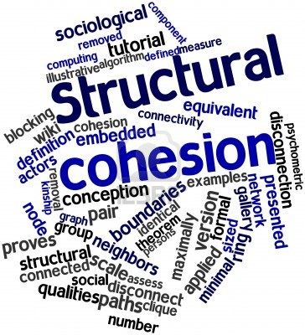
Cliques and Cohesion
Theoretical concept: Social Solidarity
  However, concept riddled with (operational) ambiguity.
  Network science to the rescue!
Two components:
  Ideational (identification)
  Relational (connectivity)
Network theory is useful for specifying relational solidarity (structural cohesion)

Slide 2
Cliques and Cohesion
Key theoretical insight:
  Cohesion implies nested groups
Operational definition
  A group is more cohesive to the extent to that it depends on a majority of members to retain it character as a group
  Less cohesive groups depend on a few individuals (at the limit one) to remain connected
Structural cohesion is simultaneously a property of
  Persons
  Groups

Slide 3
Cliques and Cohesion
Definition 1: A collectivity is structurally cohesive to the extent that the social relations of its members hold it together.
  Describes how a collection of actors is held together
  Group-level property
  Continuous concept (some groups are more or less cohesive)
  Depends on relational data
  Independent of size

Slide 4
Cliques and Cohesion
Minimal requirements:
  Unconnected individuals are not cohesive
  Cohesive individuals must be connected by some path
  The most cohesive groups connect individuals via multiple paths
  The more cohesive the group, the more redundant paths we can trace between any two individuals

Slide 5
Cliques and Cohesion
Definition 2: A group is structurally cohesive to the extent that multiple independent relational paths among all pairs of members hold it together.
  A group is cohesive to the extent that is connectivity is robust to the removal of any single individual

Slide 6
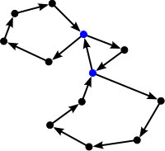
Graph Theory: Walks, Trails, Paths
A walk is an alternating sequence of vertices and edges {u₁, e₁₂, u₂, e₂₃, u₃....u_{n}} starting with an origin vertex u₁ ending with a destination vertex u_{n} such that each vertex in the sequence (excluding the origin and destination vertices) is adjacent to the vertex the precedes it and he vertex that follows it
  The length of the walk is the number of edges contained in the sequence
  The starting vertex is the origin vertex and the end vertex is the destination vertex.
  Taking the powers of the adjacency matrix A^{k} generates successive matrices where ij^{th} entry is the number of paths of length k between i and j

Slide 7
Graph Theory: Walks, Trails, Paths
A walk is called a trail if all edges appear only once in the sequence (no edge is traversed more than once)
A walk is called a path if all edges and all vertices appear only once in the sequence
  All paths are trails and all trails are walks, but not every walk is a trail and not every trail is a path.
  A cycle is a path in which the origin and destination vertices are the same
  In weighted graphs, the path-weight is the sum of the weights corresponding to all of the edges contained in a path.

Slide 8
Graph Theory: Shortest paths
Two paths are vertex-disjoint if they share no vertices
Two paths are edge-disjoint if they share no edges
A geodesic (graph-theoretic distance) is the shortest-path between two distinct vertices
  May be represented as a pairwise matrix D, with Dij = geodesic distance between i and j

Slide 9
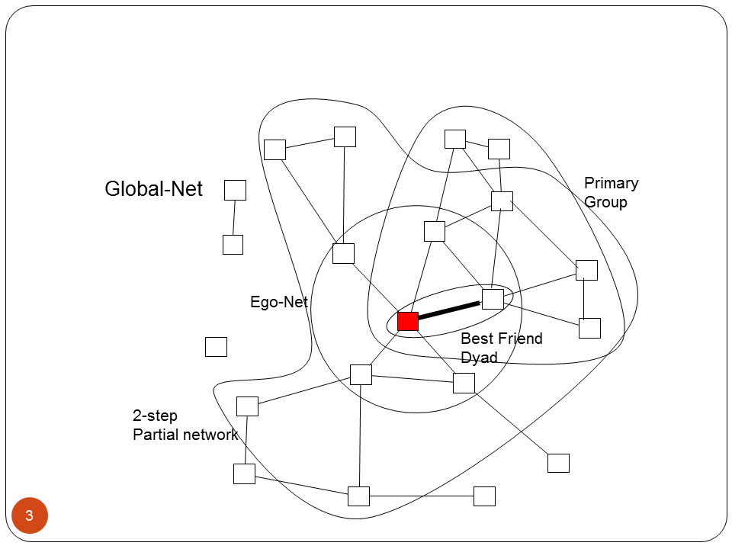
Graph Theory: Connectivity
A graph is connected if there exists a (finite) path between each vertex
  Otherwise the graph is disconnected
A maximal connected subgraph is called a component
  In a graph, the connected subgraph that contains the largest proportion of vertices is called the giant component

Slide 10
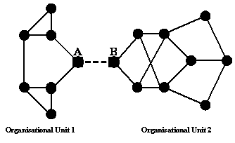
Graph Theory: Cutpoints and Cutsets
A cutpoint is a vertex v that would disconnect the graph upon removal
  A block is subgraph G' that contains no cutpoints
A cutset is a set of vertices {v₁, v,₂,...v_{n}} that would disconnect the graph upon removal
  A minimal cutset is the smallest number of vertices n whose removal would disconnect the graph

Slide 11
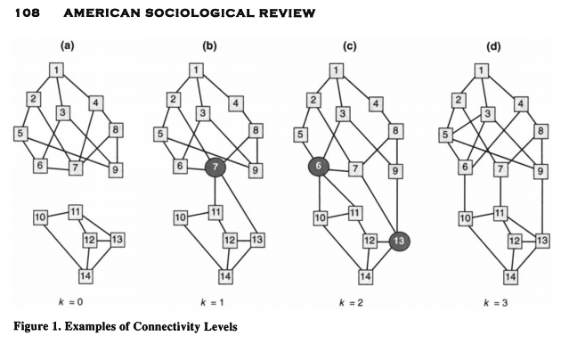
Cliques and Cohesion

Slide 12
Graph Theory: K-connectivity
A graph with a minimal cutset of size k, is said to be k-connected
The k-connectivity of any two vertices {u, v} in graph G, is the number of vertices that must be removed to disconnect u and v
  Thus, if it takes removing three nodes to disconnect two vertices, u and v are said to be three-connected.

Slide 13
Graph Theory: Edge-connectivity
A bridge is an edge uv in graph G whose removal would disconnect the graph
The edgecut is the set of edges E' whose removal would disconnect the graph
  The edgecut for a pair of vertices u, v is defined in the same way
  The miminal edgecut is the smallest number of edges m whose removal would disconnect the graph
  The edge connectivity of a graph is the size of the minimal edgecut

Slide 14
Graph Theory: Menger's Theorem
Menger's theorem states that for any pair of vertices u, v in a graph G:
  The edgecut that disconnects u and v is equal to the number of edge-disjoint paths that connect u and v
And, for any subgraph of a graph G:
  The k-connectivity of a subgraph is identical to the minimal number of edge-independent paths connecting any two vertices

Slide 15
Cliques and Cohesion
Definition 3a: A group's structural cohesion is equal to the minimum number of actors who, if removed from the group, would disconnect the group.
Definition 3b: A group's structural cohesion is equal to the minimum number of independent paths linking each pair of actors in the group

Slide 16

Cliques and Cohesion
Cohesive blocking:
  Identify the k-connectivity of the input graph
  Remove the k-cutset (vertices)
  Do the same on the resulting subgraphs until no more subdivisions can be obtained

Slide 17
Cliques and Cohesion
Cohesive blocking identifies two types of subgroups
  Exclusive (non-overlapping) subgroups
  Nested subgroups (Core-periphery)

Slide 18
Cliques and Cohesion

Slide 19
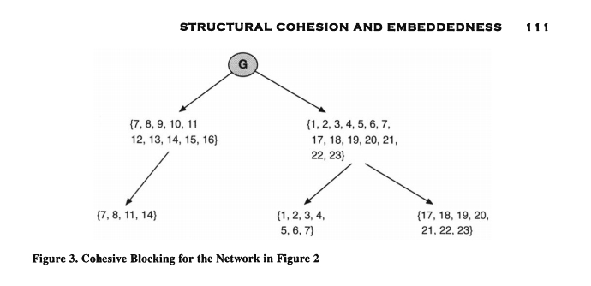
Cliques and Cohesion

Slide 20
Cliques and Cohesion
Vertices may belong to multiple cohesive subgroups
Such vertices are positionally equivalent with respect to the subgroups that they connect

Slide 21
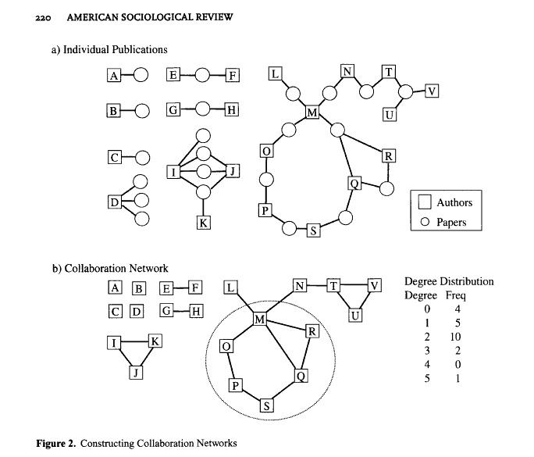
Cliques and Cohesion

