Slide 1
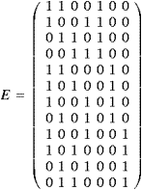
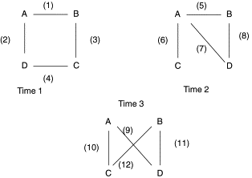
Hyperedges: Another way to represent data in “network” form
A B C D t1 t2 t3

Slide 2
What is a clique?
Let us now turn to the concept of a clique. In a very intuitive way, when we use the term sociometric clique, we mean a highly cohesive subgroup of individuals. Cohesiveness, however, has two possible dimensions.
  In one dimension, which we will call completeness, a cohesive subgroup would be one in which a high proportion of its pairs possess the appropriate relation.
  In the other, which we will call the centripetal-centrifugal dimension, a cohesive subgroup would be one in which relations among members of the subgroup are more important or more numerous than relations between members and non-members.
We will return later to a formalization of these two dimensions. It is interesting to note that many informal definitions of cliques (Spilerman, 1966; Abelson, 1966) have referred solely to the centripetal-centrifugal dimension of cohesiveness, while Luce and Perry (1949) present a formalization of the completeness dimension of cohesiveness (Alba 1973: 115-116).

Slide 3
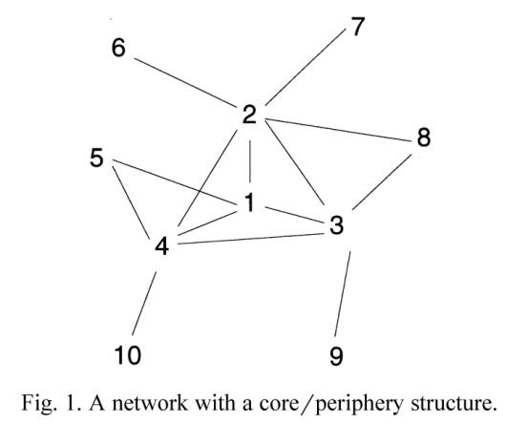
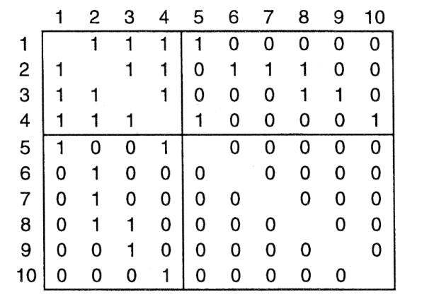
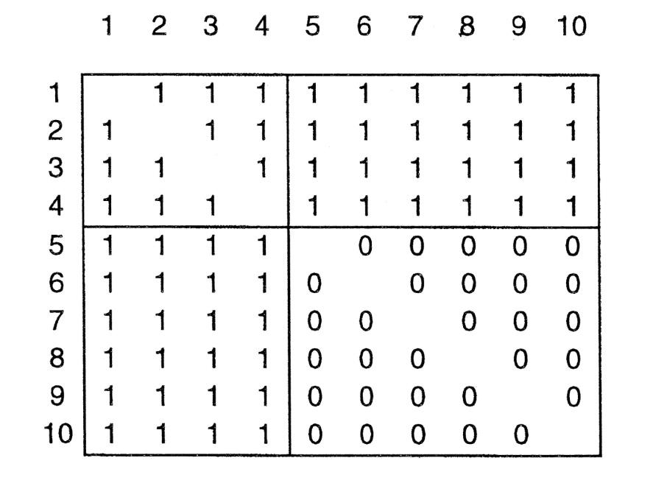
?
Observed Adjacency Matrix
Ideal Adjacency Matrix
Exhibiting Core/Periphery Structure

Slide 4


