Slide 1
Ties in Social Networks

Slide 2

When do people have a social tie?
Four criteria network analysts use to say people are connected
  People are connected via similarity if they have something in common:
    Being in the same place at the same time
    Belonging to the same group or club
    Sharing a socio-demographic attribute (gender, national, or ethnoracial, identity)
Borgatti, S. P., Mehra, A., Brass, D. J., & Labianca, G. (2009). Network analysis in the social sciences. Science, 323(5916), 892-895.

Slide 3
When do people have a social tie?
Four criteria network analysts use to say people are connected
  People are connected via relations if they acknowledge one another via a culturally recognized label or have some feeling (positive or negative) toward one another:
    Friends, enemies, frenemies, brother, sister, parent,
    Neighbor, acquaintance, boss, husband, girlfriend, nemesis
Borgatti, S. P., Mehra, A., Brass, D. J., & Labianca, G. (2009). Network analysis in the social sciences. Science, 323(5916), 892-895.

Slide 4
When do people have a social tie?
Four criteria network analysts use to say people are connected
  People are connected via interactions if they regularly communicate or direct some kind of behavior (negative or positive) toward one another:
    Texting, pen pals, talking, bullying, teasing, helping, have sex with
Borgatti, S. P., Mehra, A., Brass, D. J., & Labianca, G. (2009). Network analysis in the social sciences. Science, 323(5916), 892-895.

Slide 5
When do people have a social tie?
Four criteria network analysts use to say people are connected
  People are connected via flows if something is transmitted or passed along from one person to another:
    Communicating, infecting, lending, borrowing, influencing, convincing, advising
Borgatti, S. P., Mehra, A., Brass, D. J., & Labianca, G. (2009). Network analysis in the social sciences. Science, 323(5916), 892-895.

Slide 6
When do people have a social tie?
We can divide the four different types of social ties into two clusters:
  Similarities and relations are types of states (static situations)
  Interactions and flows are types of events (processes in time)
Borgatti, S. P., Mehra, A., Brass, D. J., & Labianca, G. (2009). Network analysis in the social sciences. Science, 323(5916), 892-895.

Slide 7
Types of Social Ties: Sociological Classification
Social Tie Types
States
Events
Similarities
Social Relations
Interactions
Flows
Friendship
Liking/Disliking
Helping
Hanging Out
Same Organization
Same Gender
Knowing Someone
Texting
Have Sex

Slide 8
Types of Ties: Graph Theory Classification
Symmetric
  If it exists, if A is linked to B, then B is necessarily linked to A
A
B
Symmetric Tie

Slide 9
Types of Ties: Graph Theory Classification
Symmetric
  If it exists, if A is linked to B, then B is necessarily linked to A
Asymmetric
  If it exists then if A is linked to B, then it is not a necessity that b is linked to A (but can happen)
A
B
Symmetric Tie
A
B
Asymmetric Tie

Slide 10
Types of Ties: Graph Theory Classification
Symmetric
  If it exists, if A is linked to B, then B is necessarily linked to A
Asymmetric
  If it exists then if A is linked to B, then it is not a necessity that b is linked to A (but can happen)
Antisymmetric
  If it exists then is A is linked to B, then B cannot by necessity be linked to A
A
B
Symmetric Tie
A
B
Asymmetric Tie
A
B
Antisymmetric Tie

Slide 11
Types of Ties: Graph Theory Classification
Asymmetric ties can be of two kinds:
  Reciprocal: If edges going in both directions exist
    You like me and I like you
    You help me and I help you
  Nonreciprocal: Edges only go in one direction
    You don’t like me, but I like you
    You help me but I don’t help you
  Reciprocity is only defined for asymmetric ties!
A
B
Reciprocal Tie
A
B
Nonreciprocal Tie

Slide 12
Types of Ties: Graph theory classification
Graph Theory Tie Types
Symmetric
Asymmetric
Antisymmetric
A
B
A
B
Reciprocal
Nonreciprocal
A
B
A
B

Slide 13

Linking sociological and graph theoretic types
Different sociological types have different graph theoretic properties:
  Similarities (propinquity, memberships) are by necessity symmetric
    If you are similar to someone they are also similar to you
Similarities
A
B
Symmetric Tie

Slide 14


Linking sociological and graph theoretic types
Different sociological types have different graph theoretic properties:
  Similarities (propinquity, memberships) are by necessity symmetric
    If you are similar to someone they are also similar to you
  Some role relations are by necessity symmetric:
    Being somebody’s friend
    Being somebody’s sibling
    Being somebody’s spouse
  But other role relations are by necessity anti-symmetric:
    Being somebody’s boss
    Being somebody’s parent
    Being somebody’s teacher
Role Relations
A
B
A
B
Symmetric Tie
Anti-symmetric Tie

Slide 15

Linking sociological and graph theoretic types
Different sociological types have different graph theoretic properties:
  Some relationships (e.g., cognitive, affective) are necessarily asymmetric
    You can text without being texted back
    You can like without being liked back
    You can know (of) somebody without them knowing you
  Interaction and exchanges are necessarily asymmetric
    You can give advice without receiving it from the same person
    You can bully without getting bullied back by the same person
    You help without getting helped back by the same person
  This means that reciprocity and non-reciprocity is possible in all these relations!
Interactions
A
B
A
B
Reciprocal Tie
Non-reciprocal Tie

Slide 16


Graph Theory Tie Types
Asymmetric
Symmetric
Antisymmetric
Reciprocal
Nonreciprocal

Slide 17
Linking sociological and graph theoretic types
Hanging Out
A
B
Similarities
Same Nationality
Same Class
Symmetric
Sibling/Parent
Social Relations
A
B
Knowing Someone
Liking/Disliking
Asymmetric
Texting
A
B
Interactions and Flows
Helping
Having Sex
Antisymmetric

Slide 18
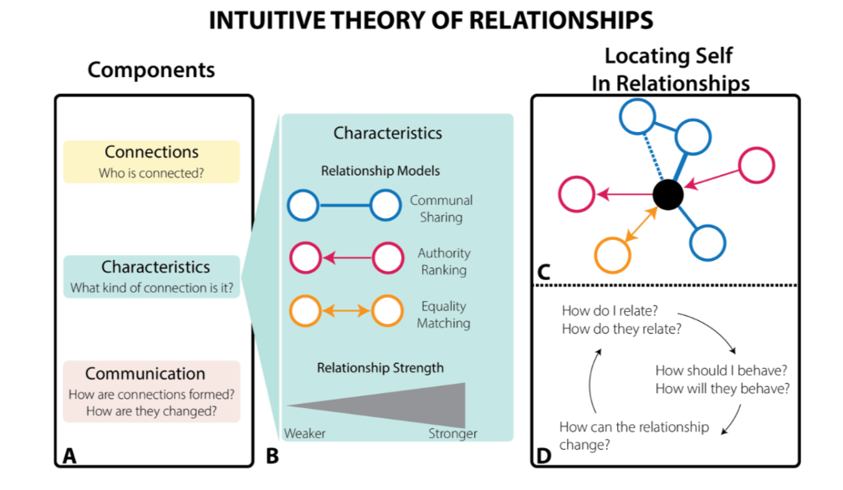
The Anthropological Classification of Ties

Slide 19
Real Networks as Combinations of Ties
Ed
Executives
Antisymmetric work (boss, supervisor)
Faith
Naomi
Managers
Simbi
Keryl
Staff

Slide 20
Real Networks as Combinations of Ties
Ed
Executives
Antisymmetric work (boss, supervisor)
Symmetric work (coworker, officemate)
Faith
Naomi
Managers
Simbi
Keryl
Staff

Slide 21
Real Networks as Combinations of Ties
Ed
Executives
Antisymmetric work (boss, supervisor)
Symmetric work (coworker, officemate)
Asymmetric work (like, dislike)
Faith
Naomi
Managers
Simbi
Keryl
Staff

Slide 22
Real Networks as Combinations of Ties
Ed
Executives
Antisymmetric work (boss, supervisor)
Symmetric work (coworker, officemate)
Asymmetric work (like, dislike)
Faith
Naomi
Managers
Different types of ties have different properties
Social Relations (Liking/Disliking) can be reciprocal and non-reciprocal
  Simbi and Keryl have a reciprocal liking relationship
  Faith and Naomi have a non-reciprocal liking relationship
Simbi
Keryl
Staff

Slide 23
Real Networks as Combinations of Ties
Ed
Executives
Anti-symmetric authority ties have the property of transitivity
Transitivity is a relation between node triples
  If Ed has authority over Naomi, and Naomi has authority over Keryl:
  Then Ed necessarily has authority over Keryl
Faith
Naomi
Managers
Simbi
Keryl
Staff
a
b
c

Slide 24
Real Networks as Combinations of Ties
Ed
Executives
Antisymmetric work (boss, supervisor)
Symmetric work (coworker, officemate)
Asymmetric work (like, dislike)
Faith
Naomi
Managers
In Hierarchies or Organizations:
  Same authority level ties are symmetric
    Implying equality
  Cross-Authority level ties antisymmetric
    Implying inequality
Simbi
Keryl
Staff

Slide 25
Linking sociological and graph theoretic types
Symmetric kin (being a sibling of)
a
d
1st Generation
Antisymmetric kin (parent of, uncle of)
In Families:
  Same generation ties are symmetric
    Sibling/Cousin
  Cross-Generation ties antisymmetric
    Parent/Uncle/Parent’s parent
b
e
Second Generation
c
f
Third Generation
Family network

Slide 26
Linking sociological and graph theoretic types
Symmetric kin (being a sibling of)
a
d
1st Generation
Antisymmetric kin (parent of, uncle of)
Transitivity also applies to inter-generational family ties:
  If a is related to b and b is related to c
  Then a is necessarily related to c
b
e
Second Generation
c
f
a
b
Third Generation
Family network
c

Slide 27
Multiplexity in Social Relations
Ed
People are usually linked by different types of ties at the same time
  This is called multiplexity
Example:
  People joined via a either symmetric or antisymmetric role relations (e.g., supervisor, coworkers)
  Can also be linked via an asymmetric sentiment relation (liking, disliking)
  Ed and Faith have a multiplex relation because they are linked via both authority and liking ties
Executives
Faith
Naomi
Managers
Simbi
Keryl
Staff

Slide 28
Multiplexity in Social Relations
Gma
1st Generation
People are usually linked by different types of ties at the same time
  This is called multiplexity
Example:
  People joined via a either symmetric or antisymmetric role relations (e.g., parent of sibling)
  Can also be linked via an asymmetric social support relation
  You and Sis have a symmetric sibling tie but also have a reciprocal social support tie
Mom
Unc
Second Generation
You
Sis
Third Generation

Slide 29
Linking sociological and graph theoretic types
Symmetric kin (being a sibling of)
Family 1
Family 2
Antisymmetric kin (parent of, uncle of)
Asymmetric non-kin (romantic)
Parent
Parent
Parent
Parent
Networks grow by linking ties of different types across different networks
You
Sis
Riley
Bro

Slide 30
Linking sociological and graph theoretic types
Symmetric kin (being a sibling of)
Family 1
Family 2
Antisymmetric kin (parent of, uncle of)
Asymmetric non-kin (romantic)
Parent
Parent
Parent
Parent
You and Riley are in love: Yay!
You
Sis
Riley
Bro

Slide 31
Linking sociological and graph theoretic types
Symmetric kin (being a sibling of)
Family 1
Family 2
Antisymmetric kin (parent of, uncle of)
Asymmetric non-kin (romantic)
Parent
Parent
Parent
Parent
You and Riley are in love: Yay!
You and Riley got married: Excellent!
You
Sis
Riley
Bro

Slide 32
Linking sociological and graph theoretic types
Symmetric kin (being a sibling of)
Family 1
Family 2
Antisymmetric kin (parent of, uncle of)
Asymmetric non-kin (romantic)
Parent
Parent
Parent
Parent
Whoops! Things are getting complicated: “In law” ties
Both symmetric (sibling in law) and anti-symmetric (father/mother in law)
You
Sis
Riley
Bro

Slide 33
Linking sociological and graph theoretic types
Symmetric kin (being a sibling of)
Family 1
Family 2
Antisymmetric kin (parent of, uncle of)
Asymmetric non-kin (romantic)
Parent
Parent
Parent
Parent
You and Riley had a baby. Great!
You
Sis
Riley
Bro
Baby

Slide 34
Linking sociological and graph theoretic types
Symmetric kin (being a sibling of)
Family 1
Family 2
Antisymmetric kin (parent of, uncle of)
Asymmetric non-kin (romantic)
Parent
Parent
Parent
Parent
You and Riley had a baby. Great!
Argh. More complication!
Baby has an anti-symmetric kin ties to everyone (grandson/daughter, niece/nephew, etc.)
You
Sis
Riley
Bro
Baby

