Slide 1
Centrality: What is it?
"Central" notion in network analysis (Freeman 1979)
  However, ill-defined conceptually
  Intuitively, vertex-level index of prominence or importance
  Dozens and dozens of centrality have and continue to be proposed
  Only agreement is that centrality is a vertex-level construct

Slide 2
Centrality: What is it?
Plethora of (sometimes inconsistent) substantive interpretations
  Autonomy
  Control
  Risk
  Exposure
  Influence
  Belongingness
  Brokerage
  Independence
  Power
  Strategic Location

Slide 3
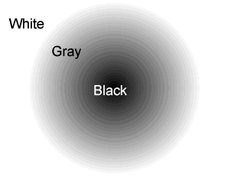
Centrality: A coherent category?
Is there any criterion that is definitional of the notion of a centrality index?
Is there anything that all measures of centrality have in common?
Are there any structural properties of a vertex that are not a centrality measure?

Slide 4

Radial centralities: Degree C_{d}(v_{i})
Simplest (local) centrality measure to compute
  Most criterion and face validity
  Based on the original adjacency matrix
  In undirected graphs:
    Given by the row sum vector
  In directed graphs:
    Outdegree given by the row sum vector
    Indegree given by the column sum vector

Slide 5
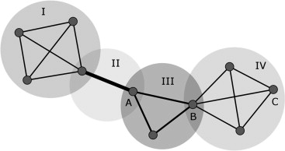
Radial centralities: K-path centrality C_{k-path}(v_{i})
First proposed by Sade (1989)
Given by the sum of all paths of length k that have vertex v_{i} as their first element
  Can be thought of as a generalization of degree centrality
  Degree centrality = 1-path centrality, since all entries in the adjacency matrix indicate a path of length 1 from i to j
  Procedure: take the row sum of matrix W, where Wij is the number of paths of length k from i to j

Slide 6
Radial centralities: K-path centrality C_{k-path}(v_{i})
Further variations of k-path centrality can be obtained by restricting the kind of path over which it is computed
  Geodesic (shortest paths) k-path centrality
  Vertex disjoint (minimal cutset) k-path centrality
  Edge-disjoint (minimal edgecut) k-path centrality
  All of these are measures of reachability (closeness)

Slide 7
Radial centralities: K-path centrality C_{k-path}(v_{i})
Even further variations remove the restriction that only true graph theoretic paths are considered:
  Katz's (1953) Status Index C_{Katz}(v_{i}) is a (weighted) sum of all walks of length k (with longer walks made to count for less) that originate at v_{i}
    Computationally equivalent measures have been proposed by Hubell (1965), Bonacich (1972), and Friedkin (1991)
  Walk-based measures are non-local, because the centrality of a vertex becomes a function of the centrality of the vertices that can be reached from that location.
    These are also known as feedback centralities

Slide 8
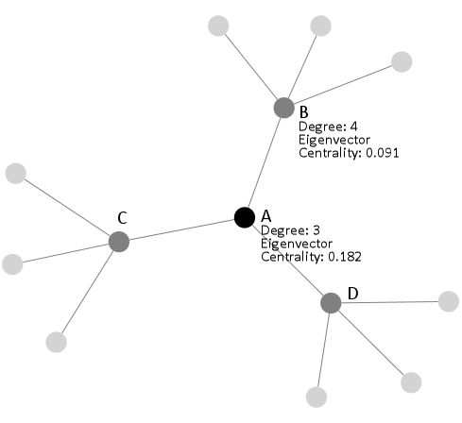
Feedback centralities
Basic idea: A vertex is more central, the more central its neighbors are
  Katz's (1953) Status Index
  Hubell's (1965) Centrality Index
  Bonacich's (1972) Eigenvector Centrality
  Friedkin's (1991) Total Effects Centrality

Slide 9
Feedback centralities: Bonacich Eigevector Centrality
Bonacich's Eigenvector centrality subsumes all radial (walk-based) measures based on feedback and "total effects"
  We can compute the Eigenvector centrality of a vertex (v_{i}) as follows:
    Factorize the adjacency matrix A using the Singular Value Decomposition (SVD):
    A = UWV
    Generate vector u from the first column of the matrix U
    Create a new matrix (W) where
      Wij = Aij x Uj
    C_{Eigenvector}(v_{i}) = the sum of the i^{th} row of W

Slide 10
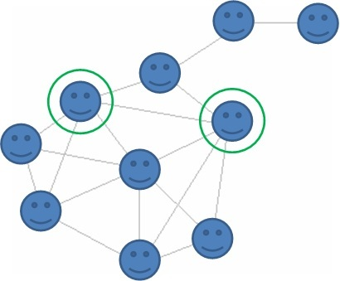
Medial Centralities: Shortest paths
Sabidussi's (1966) closeness centrality: C_{c}(v_{i})
  How many other vertices can v_{i} reach easily?
  Reciprocal of the sum of of the number of shortest paths that originate in v_{i} and end in all other vertices
  Only defined for connected graphs

Slide 11
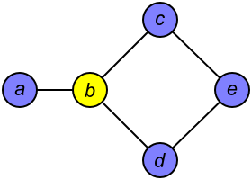
Medial Centralities: Shortest paths
Shimbel's (1953) "stress" centrality: C_{s}(v_{i})
  How much flow goes through v_{i} in the network?
  Sum of of the number of shortest paths in G between all other pairs of vertices {v_{j}, v_{k}} that contain v_{i}

Slide 12
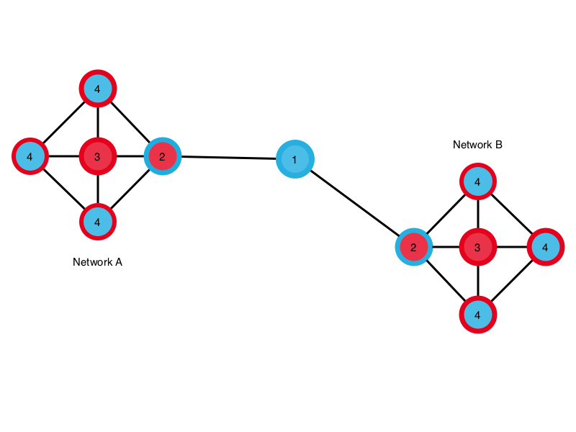
Medial Centralities: Shortest paths
Freeman's (1977) Betweenness centrality: C_{b}(v_{i})
  What share of the entire network flow is controlled by v_{i}?
  Sum of of the proportion of shortest paths in G between all other pairs of vertices {v_{j}, v_{k}} that contain v_{i}
  Defined for both connected and unconnected graphs

Slide 13
A typology of centrality measures
Centrality measures appear to cluster around some key dimensions
What they all have in common is that:
  They all somehow index the importance of the vertex in the walk structure of the network
  Their computation is based on a matrix the pairwise closeness, amount of interaction, reachability, etc. between all pairs of vertices in the graph

Slide 14
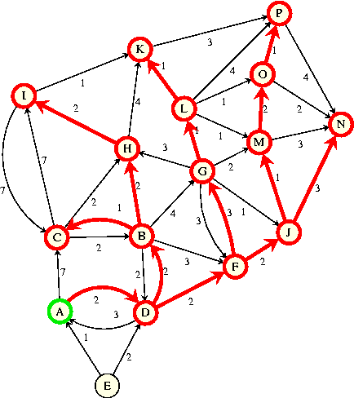
Key dimension: Walk Position
A vertex is central insofar as a lot of walks of a certain type either:
  Feature that node as their origin (or endpoint)
    These are "radial" measures (e.g. degree)
  Contain that node in the walk sequence
    These are "medial" measures (e.g. betweenness)

Slide 15
Key dimension: Walk Type
Within the radial and medial categories we may distinguish centralities measures that either:
  Restrict the type of walk to be considered
    Geodesics (shortest paths)
    k-paths
    Trails
    edge(vertex)-disjoint
  Do not restrict the type of walk to be considered

Slide 16
Key dimension: Walk Property
Finally, we can distinguish measures depending on whether we are interested in either
  The number of walks of a certain type that either originate or contain a vertex (volume)
  Or the size of walks of a certain type that either originate in or contain a vertex (length)

Slide 17
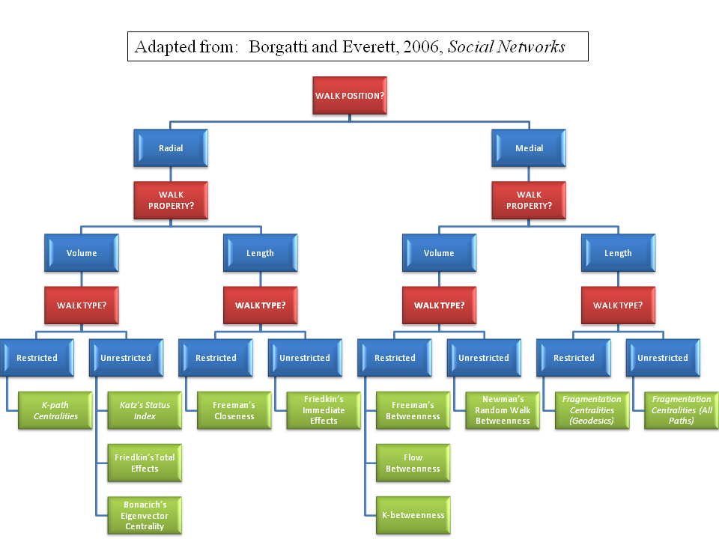

Slide 18
How to compute a radial centrality measure
Use the original adjacency matrix A to construct a matrix W that summarizes the strength of dyadic interactions across all pairs nodes.
  w_{ij}= 1/d_{ij}, where d_{ij} is the distance between node and i and node j.
  The distance measure is determined by the walk type and the walk property chosen:
    Number of geodesics (shortest paths)
    Number of k-paths (e.g. degree centrality is based on the number of 1-paths)
    Weighted measures (vertex strength)
  Decide on an aggregation strategy:
    Sum across rows (e.g. C_{j} = ∑w_{ij}).
    Row average (e.g. C_{i}= 1/k_{i}∑w_{ij}).
    Row median, mode, maximum, etc.

Slide 19
How to compute a medial centrality measure
Use the original adjacency matrix A to construct a matrix W that summarizes the strength of dyadic interactions across all pairs nodes.
  w_{ij} may be the total number of paths through which something can flow or be transmitted from node i to node j.
Construct a new matrix ^{k}A, with row k and column k removed (with k being the node that we are interested in computing the centrality measure for).
Construct a new matrix ^{k}W*that summarizes the strength of dyadic interactions across all pairs nodes without including the focal node.
  Compute the quantity: C_{k}= 1/^{k}A(^{k}W − ^{k}W*_{i,j})
  Repeat for each node k.

Slide 20
A model-based perspective on centrality
So far we have considered centrality strictly from a graph-theoretic perspective
However, we may also consider centrality measures from a model-based perspective
  A model-based perspective leads to a classification of centrality measures based on the substantive assumptions that each measure encodes about how things flow through the network (e.g. step by step, via shortest-paths, over vertex-disjoint paths, unrestrictedly, etc.)

Slide 21

A classification of flow processes: Used goods
Discrete, indivisible objects
  Flows from vertex to vertex (spreads by transfer)
  Can only be under the control of one vertex at a time
  The same vertex may send the object multiple times but not via a previously used edge
    Object can only flow via "trails" (edge-disjoint paths) in the network

Slide 22

A classification of flow processes: Money
Discrete, indivisible objects whose use value remains constant after multiple uses
  Flows from vertex to vertex (spreads by transfer)
  Can only be under the control of one vertex at a time
  The same vertex may send the object multiple times via a previously used edge
    Object flows unrestrictedly via "walks" in the network

Slide 23

A classification of flow processes: Gossip
Discrete piece of information
  Flows from vertex to vertex (spreads by transfer) but remains under the sender control thereafter (replication)
  Can exist in multiple places at once
  The same vertex may send information multiple times but not via a previously used edge
    Object flows via "trails" in the network

Slide 24

A classification of flow processes: Email
Discrete piece of information
  Flows from vertex to vertex (spreads by transfer) but remains under the sender control thereafter (replication)
  Can exist in multiple places at once
  Can be sent via multiple edges at once (parallel duplication - broadcasting)
  The same vertex may send information multiple times but not via a previously used edge
    Object flows via "trails" in the network

Slide 25
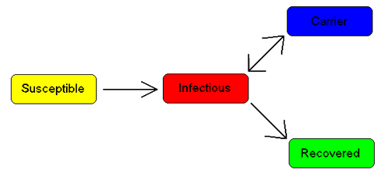
A classification of flow processes: Infection
Virus or infection (with immunity)
  This flow process is just like information (transfer, replication)
  Except that persons cannot "receive" (become affected by) the same infection twice (due to immunity)
  This means that (effectively) senders only use the same edge once
    Infections spread via trails

Slide 26
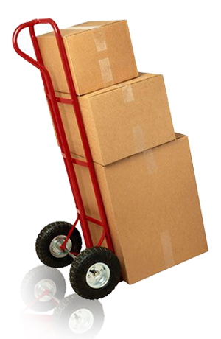
A classification of flow processes: Packages
Packages have:
  Fixed destination (single-path)
  Strategic selection (shortest path)
  Senders only send a package once
  Receivers only receive it once
    Packages travel via geodesics (shortest paths) in the network

Slide 27
A Typology of Flow Processes (Borgatti 2005: 59)
 | Parallel Duplication | Serial Duplication | Transfer
Geodesics (SPs) | -- | -- | Package
Paths | -- | Virus/Infection | Mooching
Trails | Email | Gossip/Information | Used Goods
Walks | Influence | Emotional Support | Money

Slide 28
Basic guidelines
Choose a measure that corresponds to the corresponding flow process
  For instance, closeness centrality (which assumes that flow happens by SPs) should not be used if you are interested in who is more central in the gossip or information network
  The reason for this is that information travels via trails not SPs
  If the thing that flows through the network does not follow restricted walks (such as SPs) a less restrictive measure should be used (e.g. Bonacich's Eigenvector centrality)

Slide 29
Basic guidelines
Beware of the implicit assumptions built into the construction of the measure
  For instance, Freeman's betweenness centrality is meant to provide you with a measure of the extent to which a given vertex monopolizes the flow between all other vertices
  This makes sense if
    Things flow serially (no broadcast)
    Via SPs (not walks or trails)
    It is intended for a target (flow is intentional rather than random)
    This assumptions only apply to a very narrow range of flow processes
    It excludes information, gossip, or emotional support

Slide 30
Basic guidelines
Centrality measures constructed from restricted walks (e.g. shortest paths, trails) or from the length of walks of a given type are appropriate for:
  Serial, transfer-based flow processes with intended targets removed from the sender by more than one step
    This includes flows of particular objects (e.g. letters, postcards, packages)
    Flow of persons (migration from country to country)

Slide 31
Basic guidelines
Centrality measures constructed from unrestricted walks or from the volume of walks of a given type number are appropriate for:
  Parallel, duplication-based flow processes with intended or unintended targets directly connected to the sender, and with non-intended targets farther down the line
    This includes gossip, information, emotional support (intended) or disease/infection (presumably unintended)
    Influence both intended (command, leadership) and unintended (obesity, depression)

Slide 32
