Slide 1
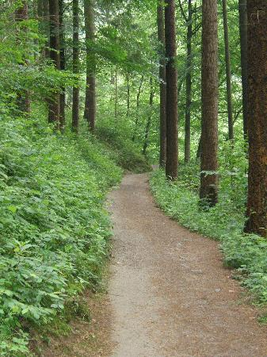
Graph Theory: Walks, Trails, Paths
A walk is a connected sequence of edges that begins at some origin node U_{o} and ends and some destinaton node U_{d}
The length of the walk is the number of edges contained in the sequence
The starting vertex is the origin vertex and the end vertex is the destination vertex.

Slide 2
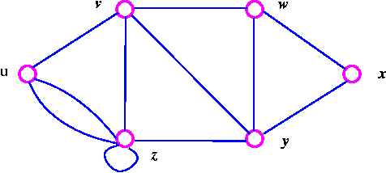
Graph Theory: Walks, Trails, Paths

Slide 3
Graph Theory: Walks, Trails, Paths
A walk is called a trail if all edges appear only once in the sequence (no edge is traversed more than once)
A walk is called a path if all edges and all vertices appear only once in the sequence
  All paths are trails and all trails are walks, but not every walk is a trail and not every trail is a path.
  A cycle is a path in which the origin and destination vertices are the same
.

Slide 4
Graph Theory: Shortest paths
Two paths are vertex-disjoint if they share no vertices
  Two paths are edge-disjoint if they share no edges
  A geodesic (graph-theoretic distance) is the shortest-path between two distinct vertices

Slide 5

A classification of flow processes: Used goods
Discrete, indivisible objects whose use value declines to zero after one use
  Flows from vertex to vertex (spreads by transfer)
  Can only be under the control of one vertex at a time
  The same vertex may send the object multiple times but not via a previously used edge
    Object can only flow via "trails" (edge-disjoint paths) in the network

Slide 6

A classification of flow processes: Money
Discrete, indivisible objects whose use value remains constant after multiple uses
  Flows from vertex to vertex (spreads by transfer)
  Can only be under the control
  The same vertex may send the object multiple times via a previously used edge
    Object flows unrestrictedly via "walks" in the network

Slide 7

A classification of flow processes: Gossip
Discrete piece of information
  Flows from vertex to vertex (spreads by transfer) but remains under the sender control thereafter (replication)
  Can exist in multiple places at once
  The same vertex may send information multiple times but not via a previously used edge
    Object flows via "trails" in the network

Slide 8

A classification of flow processes: Email
Discrete piece of information
  Flows from vertex to vertex (spreads by transfer) but remains under the sender control thereafter (replication)
  Can exist in multiple places at once
  Can be sent via multiple edges at once
  The same vertex may send information multiple times but not via a previously used edge
    Object flows via "trails" in the network

Slide 9
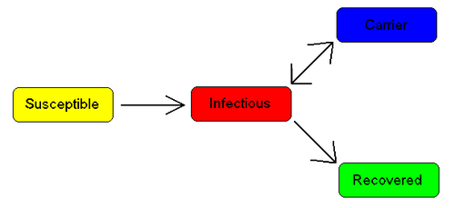
A classification of flow processes: Infection
Virus or infection (with immunity)
  This flow process is just like information (transfer, replication)
  Except that persons cannot "receive" (become affected by) the same infection twice (due to immunity)
  This means that (effectively) senders only use the same edge once
    Infections spread via trails

Slide 10

A classification of flow processes: Packages
Packages have:
  Fixed destination (single-path)
  Strategic selection (shortest path)
  Senders only send a package once
  Receivers only receive it once
    Packages travel via geodesics (shortest paths) in the network

Slide 11
A Typology of Flow Processes (Borgatti 2005: 59)
 | Parallel Duplication | Serial Duplication | Transfer
Geodesics (SPs) | -- | -- | Package
Paths | -- | Virus/Infection | Mooching
Trails | Email | Gossip/Information | Used Goods
Walks | Influence | Emotional Support | Money

