Slide 1
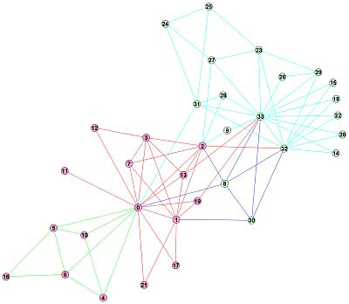
Detecting Communities in networks
Basic task:
  To discover groups or clusters in networks, usually referred to as communities
  A community is densely connected set of vertices with sparse connections with other groups
These are referred to as community detection methods

Slide 2
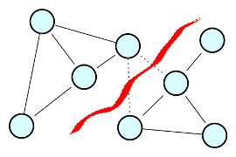
Detecting Communities in networks
Community detection is distinct from graph partitioning
A common graph partitioning task is to divide the network into two disjoint sets:
  Such that the number of edges between the two is minimized
  This is useful when a network is too large and we wish to simplify the analysis

Slide 3
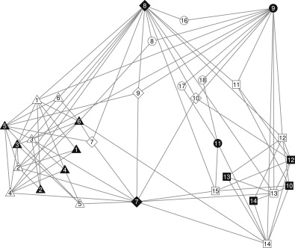
Detecting Communities in networks
In a community detection task the number and size of the groups is not determined advance
  The key is to let the data itself tell us where the interesting divisions in the network are
  We have seen an example of this in Moody and White's (2003) "Cohesive Blocking" strategy

Slide 4
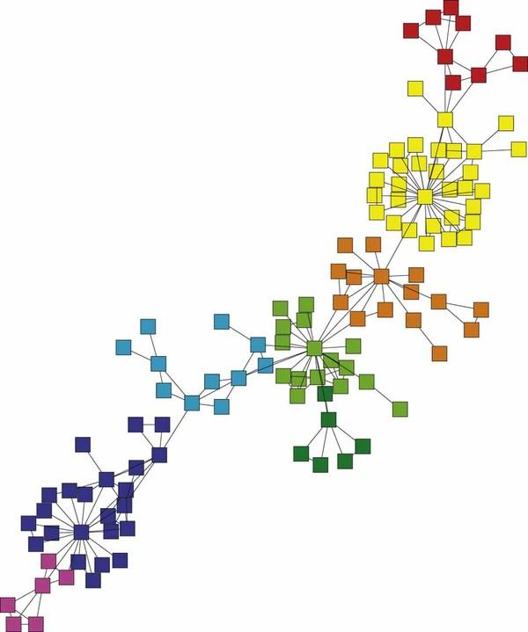
Detecting Communities in networks
Several approaches have been proposed in the literature:
  A "minimum cut" strategy such as Moody and White's (2003) uses graph connectivity as a criterion to sort vertices into groups
  However, there is no benchmark that tell us whether the connection within groups is larger or smaller than we would expect by chance

Slide 5
Detecting Communities in networks
The basic idea is that a network has "community structure" if the edges are arranged in a "statistically surprising" way
  A quantity known as the modularity can be used for this purpose

Slide 6
Detecting Communities in networks
In words, for a partition of the graph into C groups, the modularity is defined as:
  The observed number of edges falling within groups minus the expected number of edges in the same network if these were placed at random
  Positive values indicate the presence of community structure

Slide 7


Detecting Communities in networks
In a network the observed number of edges between vertices i and j is given by the corresponding entry in the adjacency matrix Aij (usually 0 or 1)
The expected number of edges between i and j is simply a function of their respective degrees:

Slide 8

Detecting Communities in networks
The modularity (Q) is then given by the sum of the difference between observed minus expected across each pair of vertices that belong to the same group:
Where s_{i}= 1 if vertex i belongs to group 1 and s_{i}= -1 if vertex belongs to group 2

Slide 9

Detecting Communities in networks
The modularity (Q) is then given by the sum of the difference between observed minus expected across each pair of vertices that belong to the same group:
Where s_{i}= 1 if vertex i belongs to group 1 and s_{i}= -1 if vertex belongs to group 2
The matrix containing observed minus expected differences for each pair of vertices is known as the modularity matrix:

Slide 10
Detecting Communities in networks
Newman (2006) proposes an algorithm for partitioning a network into two communities based on the B matrix:
  Compute the leading eigenvector of the modularity matrix
    For a matrix the leading eigenvector is the one associated with the largest (most positive) eigenvalue following a factorization of the matrix
  Assign vertices into two disjoint groups based on the sign of the corresponding element in the vector
    Vertices with positive values go in one group
    Vertices with negative values go into the other group

