Slide 1
What is diffusion?
Spread of objects, ideas, information, concepts, fashions, tastes, practices etc. in a social network
  Elements of diffusion:
    Actors
      Usually people but also groups, organizations, etc.
    Flow
      From source to adopter
    Mechanism
      Imitation, influence, transfer, etc.
    Outcome
      Adoption, conversion, infection

Slide 2
What is diffusion?
Spread of objects, ideas, information, concepts, fashions, tastes, practices etc. in a social network
  Elements of diffusion:
    Actors
      Usually people but also groups, organizations, etc.
    Flow
      From source to adopter
    Mechanism
      Imitation, influence, transfer, etc.
    Outcome
      Adoption, conversion, infection

Slide 3
What is diffusion?
Spread of objects, ideas, information, concepts, fashions, tastes, practices etc. in a social network
  Elements of diffusion:
    Actors
      Usually people but also groups, organizations, etc.
    Flow
      From source to adopter
    Mechanism
      Imitation, influence, transfer, etc.
    Outcome
      Adoption, conversion, infection

Slide 4
What is diffusion?
Spread of objects, ideas, information, concepts, fashions, tastes, practices etc. in a social network
  Elements of diffusion:
    Actors
      Usually people but also groups, organizations, etc.
    Flow
      From source to adopter
    Mechanism
      Imitation, influence, transfer, etc.
    Outcome
      Adoption, conversion, infection

Slide 5
What is diffusion?
Spread of objects, ideas, information, concepts, fashions, tastes, practices etc. in a social network
  Elements of diffusion:
    Actors
      Usually people but also groups, organizations, etc.
    Flow
      From source to adopter
    Mechanism
      Imitation, influence, transfer, etc.
    Outcome
      Adoption, conversion, infection

Slide 6
Question: Why do things diffuse?
Three Factors
  Characteristics of the object being diffused
    Familiar/unfamiliar
    High risk (consequential) v. low risk
    Cost/benefit ratio
  Characteristics of the source and adopter
    Individual versus collective actor
    High status v. Low status actor
    Similar v. dissimilar
  Environmental Context
    Proximity
    Social Foci
    Network Structure

Slide 7
Question: Why do things diffuse?
Overall something diffuses faster if:
  It is familiar rather than unfamiliar
  It is relatively inconsequential
  Benefits outweigh costs
  The source is high status
  Source and target share social attributes
  Source and target are geographically proximate
  Source and target share overlapping social foci
  The network structure is conducive to diffusion
    Centralization v. De-Centralization
    Connectivity v. Segmentation
    Density v. Sparseness
    Strong ties v. Weak ties
    Bridging v. Redundant Ties

Slide 8
Social network models of diffusion
Diffusion via cohesion and opinion leaders
Diffusion via positional equivalence
Diffusion via weak-ties
Network Threshold Models
  Global threshold
  Local threshold
  “Complex” versus “simplex” contagion

Slide 9
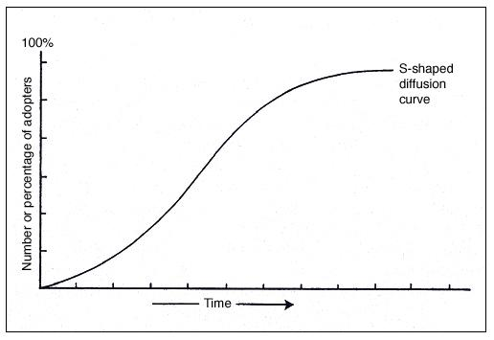
How do things spread? The S curve
Typical S-shaped pattern of cumulative adoptions
  Initial slow uptake
  Rapid spread
  Final slow saturation

Slide 10

Social network models of diffusion
Ryan, B. and N.C. Gross (1943) The Diffusion of Hybrid Seed Corn in Two Iowa Communities, Rural Sociology, 8: 15-24.

Slide 11
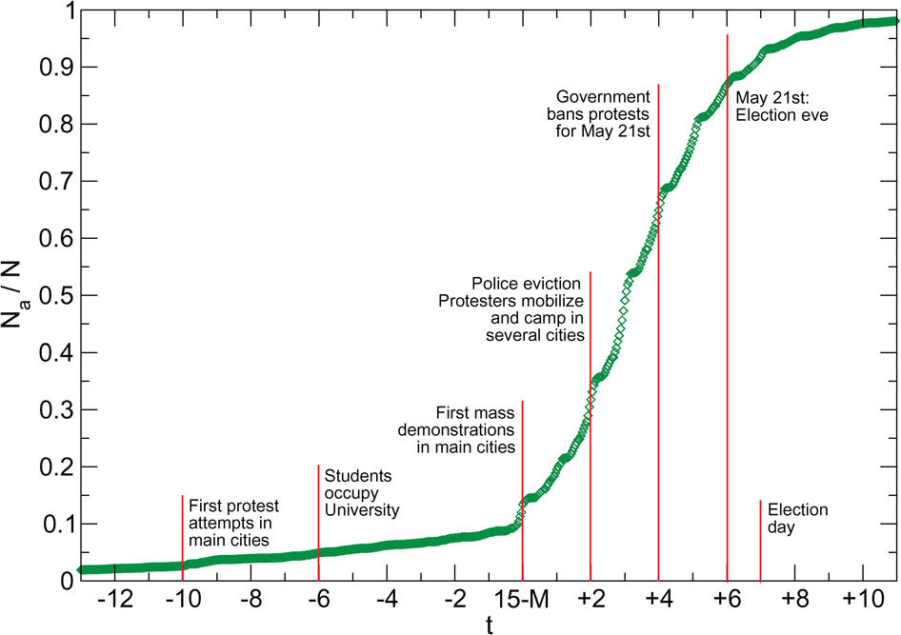
González-Bailón, S., Borge-Holthoefer, J., Rivero, A., & Moreno, Y. (2011). The dynamics of protest recruitment through an online network. Nature Scientific reports, 1.

Slide 12
Granovetter’s threshold model
If your friend jumped off a bridge would you?
  Better question:
    How many of your friends would have to jump before you did?
  What is your q?
Each actor (i) has a “threshold” for adoption q(i)
    0 > q(i) < 1
  (i) adopts when the proportion of people who have adopted (p) is equal to q(i)

Slide 13
Granovetter’s threshold model
Persons with low thresholds are high risk early adopters
Persons with high thresholds are risk averse late adopters
  People have different q values
    Some high
    Some Low
    Most in the Middle (a bell curve)
    This explains the S-shaped pattern
      Slow uptake when adoption is concentrated among a few low q people
      Faster as the majority of middle q people join in
      Slow again as the last few high q people finally adopt

Slide 14
Granovetter’s threshold model
Persons with low thresholds are high risk early adopters
Persons with high thresholds are risk averse late adopters
  People have different q values
    Some high
    Some Low
    Most in the Middle (a bell curve)
    This explains the S-shaped pattern
      Slow uptake when adoption is concentrated among a few low q people
      Faster as the majority of middle q people join in
      Slow again as the last few high q people finally adopt

Slide 15
Granovetter’s threshold model
Persons with low thresholds are high risk early adopters
Persons with high thresholds are risk averse late adopters
  People have different q values
    Some high
    Some Low
    Most in the Middle (a bell curve)
    This explains the S-shaped pattern
      Slow uptake when adoption is concentrated among a few low q people
      Faster as the majority of middle q people join in
      Slow again as the last few high q people finally adopt

Slide 16

The Rogers Classification
Rogers, E.M.(1962) The Diffusion of Innovations, Free Press, New York.

Slide 17
The Rogers Classification
Tipping point
Rogers, E.M.(1962) The Diffusion of Innovations, Free Press, New York.

Slide 18
The Rogers Classification
Failed Innovations die before reaching the tipping point
Rogers, E.M.(1962) The Diffusion of Innovations, Free Press, New York.

Slide 19
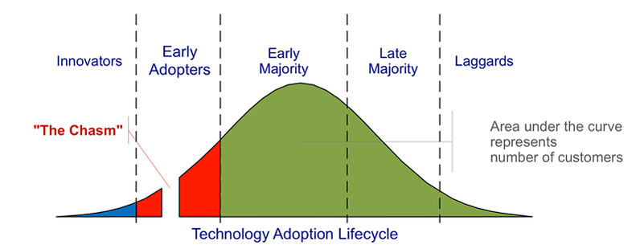
The Rogers Classification
Area under the curve represents number of adopters
Kastelle, T (2012) Two Problems Caused by the Innovation Diffusion Curve
http://timkastelle.org/blog/2012/02/two-problems-caused-by-the-innovation-diffusion-curve/ (last accessed October 9th 2014)

Slide 20
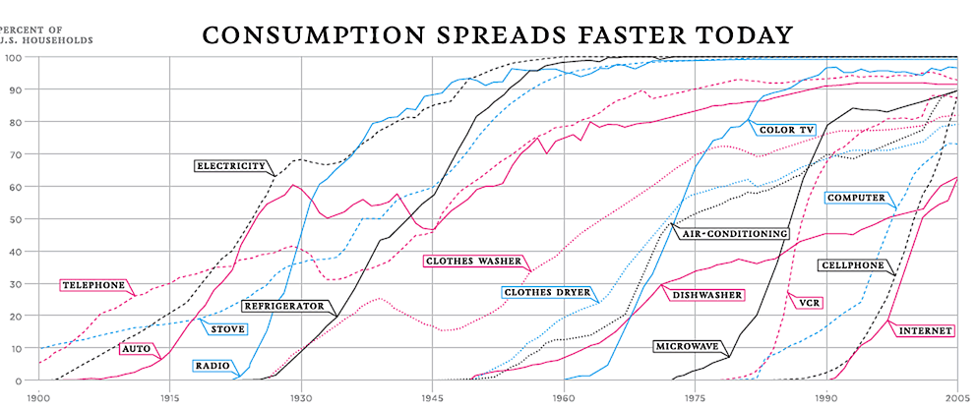
Thompson, D. (2012) The 100-Year March of Technology in 1 Graph. http://www.theatlantic.com/technology/archive/2012/04/the-100-year-march-of-technology-in-1-graph/255573/ (last accessed October 9th 2014)

Slide 21
The Rogers Classification
Innovators and Early adopters
  Individuals whose time-of-adoption is greater than one standard deviation earlier than the average time-of-adoption
Early and late majorities
  Individuals whose time-of-adoption is bounded by one standard deviation earlier and later than the average
Laggards
  Individuals who adopted later than one standard deviation from the average

Slide 22
Valente’s Network Threshold Model
Global threshold models are appropriate for adoptions of behaviors that are public and observable
  Not always the case
The network threshold model relaxes the assumption that persons have global information on all adoptions
  They only know what their contacts are doing
  Individuals adopt when some proportion of their friends adopt
    More appropriate for the adoption of practices, behaviors and ideas

Slide 23
Valente’s Network Threshold Model
Also appropriate when adoption behavior entails uncertainty and risk
  Each person (i) has some exposure e(i)
  e(i) = proportion of i’s friends who adopted
Person 1: q = 0.25
Person 2: q = 0.75
Time 1
Time 2
Time 1
Time 2
Time 3
Time 4
Time 3
Time 4

Slide 24
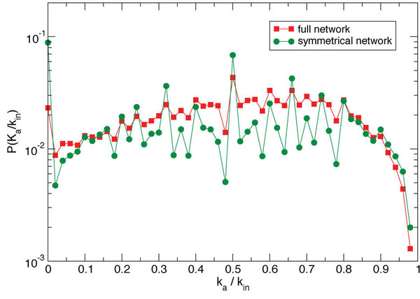
González-Bailón, S., Borge-Holthoefer, J., Rivero, A., & Moreno, Y. (2011). The dynamics of protest recruitment through an online network. Nature Scientific reports, 1.

Slide 25
Valente’s Network Threshold Model
Just like before, everybody has a threshold q(i)
  When the proportion of neighbors who have adopted equals q(i), the person adopts
  We can then redefine adopter categories (e.g. innovators) as either
    Relative to everybody
    Relative to your friend
  For instance you can be an innovator in the grand scheme of things
    But be a relative laggard compared to your friends
    If all of your friends are innovators

Slide 26
Valente’s Network Threshold Model
Just like before, everybody has a threshold q(i)
  When the proportion of neighbors who have adopted equals q(i), the person adopts
  We can then redefine adopter categories (e.g. innovators) as either
    Relative to everybody
    Relative to your friend
  You can be a laggard in the grand scheme of things
    But be an innovator among your friends
    Because you are surrounded by even bigger laggards!

Slide 27
Valente’s Network Threshold Model
The network threshold model makes sense of a lot of classic findings
  For instance, early adopters adopt from media or weak ties
  Late adopters adopt from their friends/strong ties
    This seems to reflect a local/Cosmopolitan split
  Cosmopolitan innovators tend to be early adopters relative to the system and have very low threshold relative to their network

Slide 28
Valente’s Network Threshold Model
Revisiting the Roger’s classification using Valente’s model
Whole Network Threshold
Low High
Low
High
True innovators (influentials) | Isolates
Connected Bandwagon | Resistant rearguard
Personal Network Threshold

Slide 29
Valente’s Network Threshold Model
Revisiting the Roger’s classification using Valente’s model
  Who's an “opinion leader”?
    Early adopters who convince those with high network thresholds (but similar system threshold) to adopt
Whole Network Threshold
Low High
Low
High
True innovators (influentials) | Isolates
Connected Bandwagon | Resistant rearguard
Personal Network Threshold

Slide 30
Basic findings of research on innovation diffusion
Early adopters (innovators, opinion leaders) are well-connected
  Central, well-integrated, prominent
  Well connected persons more likely to adopt innovations with low cost/benefit ratios
Peripheral persons more likely to adopt risky innovations
  Cost/benefit ratio is high; uncertainty in payoff
  Risk-taking linked to reputation
Social isolates more likely to be “laggards”
Being a bridge is associated with early adoption
  Betweenness, structural holes

Slide 31
Complex versus simplex contagion
We have seen that heterogeneity in the propensity to adopt an innovation can be modeled as a threshold process
  However, thresholds may not be fixed for individuals regardless of what is being diffused
  Thresholds may depend on the characteristics of what is being diffused
    Low threshold -> Low risk
    High threshold -> High risk

Slide 32
Complex versus simplex contagion
Innovations that entail risk, ostracism, potential loss of resources, may elicit higher thresholds from all actors in the network
  Persons require exposure to multiple sources to adopt
Innovations (e.g. gossip) that carry little risk may in their turn elicit a very low threshold
  In the limiting case, the person adopts as soon as one of their neighbors adopts

Slide 33
Complex versus simplex contagion
Innovations that entail risk, ostracism, potential loss of resources, may elicit higher thresholds from all actors in the network
  Persons require exposure to multiple sources to adopt
This is the difference between simplex and complex contagion
  The basic idea is that certain innovations can only diffuse via complex contagion

Slide 34
Complex versus simplex contagion
Examples of simplex contagion:
  Information, disease
Examples of complex contagion:
  High risk social movement participation, religious conversion, migration, etc.

Slide 35
Complex versus simplex contagion
Four social mechanisms that require that innovations diffuse via complex contagion:
  Strategic complementarity: (adoption cost declines as a function of existing adopters)
  Legitimacy: Resistance to challenge, collective acceptance, and taken-for-grantedness increases in the number of adopters
  Credibility: Innovations appears are more trustworthy and less risky when high status members of the community also adopt
  Emotional contagion: Cumulative interaction with a large number of adopters leads persons to adopt

Slide 36
Complex versus simplex contagion
Four social mechanisms that require that innovations diffuse via complex contagion:

Slide 37
Complex versus simplex contagion
Weakness of long ties argument:
  Long ties might be appropriate for simplex diffusion
  However, they are not up to task when it comes to complex contagion
  The reason for this is that in addition to length, complex contagions require bridges to be wide

