Slide 1
From Vertices to Edges
Focus so far on Vertices (Nodes)
  Actors/Agents
  Classical "variable" sociology: Property Agent --> Behavior
  Structural (Network) Property: Centrality, CC, Degree (Network Size), Network Composition
  Ego Networks
G = (V, E) with N vertices and M Edges
What about the edges (dyads)
Critical for dynamic analysis
  tie formation and persistence (or decay)
  flows and weighted edges based on interaction events
  generative processes - network evolution model (rules)

Slide 2
The Problem
Binary arc data (presence/absence)
Dyadic Census - 3 states
  Null Dyad
  Asymmetric Dyad
  Mutual Dyad
Tie formation (link prediction) & persistence
  Longitudinal Data
  Formation or Persistence
  Next time: (choice) homophily --> tie formation
Prior work
  Mutuals persist, asymmetric --> null than mutual (Hallinan1978)
  1997 Social Networks Special Issue (ego networks)
Notes:
1997 Social Networks Special Issue
Wellman: Community Lost, Saved, Liberated; strong ties; life-course effects; not densisty or degree
Morgan: Core and Periphery ties
Bidert Life course 3 types of trajectories
Martin: Ego and dyad effect, e.g. homopholy, embeddedness.

Slide 3
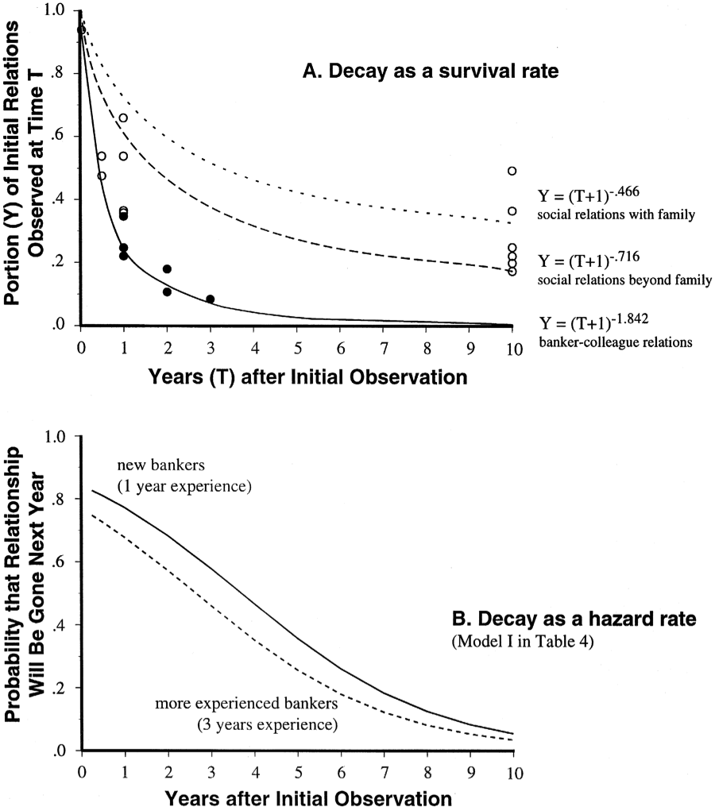
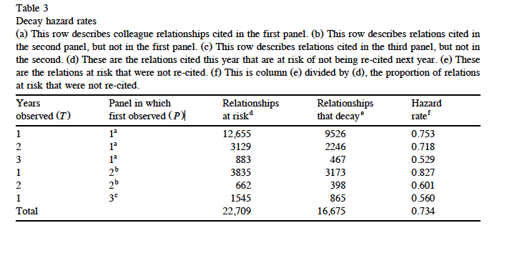
Burt: Tie Decay
formation vs. persistence
liability of newness:
  longer in a state less likely to leave the state
Notes:
compatibility, learning

Slide 4
Burt: Tie Decay - Predictors
Node Age
Tie Age
Strength (subjective measure)
Colleague availability
Homophily
  minimal rank homophily
  Gender: M-M lower
  Age
Embeddedness (number of third parties connecting A & B)
  lowers decay, increases persistence
  explains homophily effects
  disruptive embedding (cascading tie decay)

Slide 5
Social Ties and Interaction Events
What is a social tie?
Dyadic social interactions
  playing tennis, having sex, talking with, collaborating together on, exchanging with, giving to, receiving from)
Events: instances of interaction
  event traits: initiating, waiting times, sequencing
Communicative interactions
  Initiating, who provides information, time talking, length of messages
Aggregating events by time period
  Tie: at least one event in a given time period
Notes:
need measures of both direction of event and intensity of flow

Slide 6
Social Ties and Interaction Events
Tie: Link through which events occur
  Through ties events (interactions) "flow"
Directed flow: initiated of event, sender and receiver
Strong ties: Large flows (number of events), bandwidth
Reciprocal ties: Balanced flows
  Balanced counts aggregated from information on the occurrence and traits of interactional events within a time window
  A temporal event sequence A->B->A->B

Slide 7
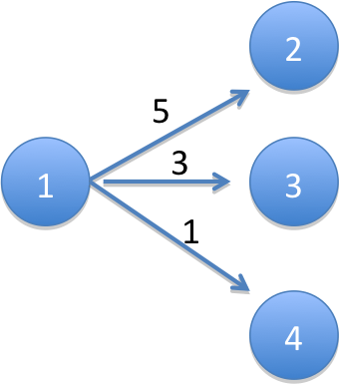
Directed Weighted Edge Graphs
Arc (x_{ij} = 1): if there was an interaction between i and j within a given time period and i initiated that interaction (e.g., a call from i to j)
Outflow Parameter (m_{ij}): Count of the number of interactions between i and j that were initiated by i in a given time period (e.g., number of calls made by i to j)
x₁₂ = x₁₃ = x₁₄ = 1
m₁₂ = 5
m₁₃ = 3
m₁₄ = 1

Slide 8


Node Level Properties
Out-degree (d_{i}): count of number of j nodes that i has initiated interaction with in a given time period (e.g., number of people i called)
Vertex Strength (m_{i+}): activity level of a node, i.e. Count of the number of interactions initiated by i with all i’s j neighbors in a given time period (e.g., total number of calls made by i)
d₁ = 3
m₁₊ = 5+3+1 = 9

Slide 9


Arc Flows & Vertex Strength
conditional transition probability: probability, given that an event has been initiated by i, that it is with j.
p₁₂ = 5/9 = .556
p₁₃ = 3/9 = .333
p₁₄ = 1/9 = .111
m₁₂ = (m₁₊) (p₁₂)
5 = 9*(5/9)

Slide 10

Tie (Arc) Strength
Arc Flow: m_{ij} = (m_{i+}) (p_{ij})
Transition Probability: p_{ij}
Relative Strength: m_{ij}/max(m_{ik})
Vertex Strength: m_{i+}
Dyadic Edge Strength
(bandwidth)

Slide 11
Reciprocity: Simple Model
Norm of Reciprocity: Agents more likely to dissolve a tie if non-reciprocal
R_{ij}(1) = |m_{ij} - m_{ji}|
R_{ij}(2) = ln(m_{ij}) - ln(m_{ji}) = ln(m_{ij}/m_{ji})

Slide 12
Reciprocity: Behavioral Model
Why would j initiate interaction (call) with i more (less) than i initiates interaction?
Local knowledge:
  i knows: m_{ij}, m_{ji}, d_{i}, m_{i+}
  i does not know: d_{j}, m_{j+}
  assumes m_{j+} = m_{i+}, d_{j}= d_{i}
Weight m_{ij} by m_{j+}/m_{i+}
Rij(3) = |m_{ij}(m_{j+}/m_{i+}) - m_{ji}|
Rij(4) = |ln[m_{ij}(m_{j+}/m_{i+})] - ln[m_{ji}]|
= |ln[(m_{ij}/m_{i+})/(m_{ji}/m_{j+})]|
= |ln (p_{ij}/p_{ji})|= |ln(p_{ij}) - ln(p_{ji})|
Notes:
logged means Rij = 0 when pij = pji
note if mi+ = mj+ reduces to

Slide 13
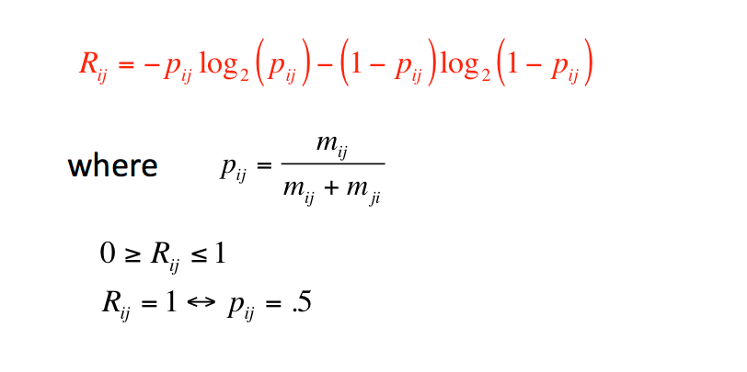
Reciprocity: Information Gain

Slide 14


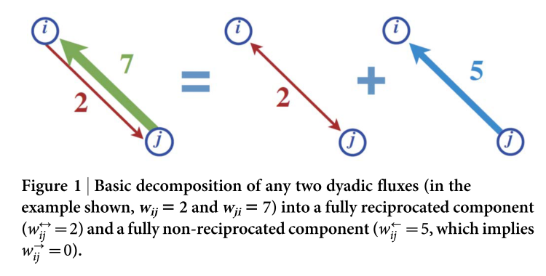
Directional Reciprocity

Slide 15
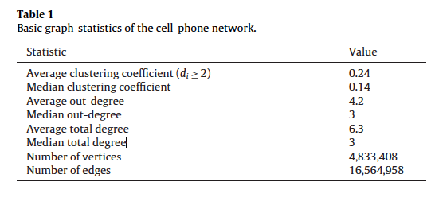
Tie Decay Revisited
Cell phone data

Slide 16
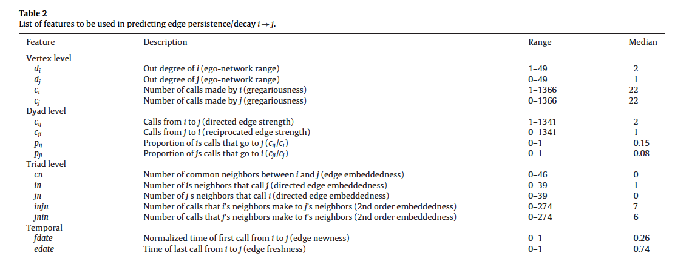
Possible Predictors of Tie Decay

Slide 17
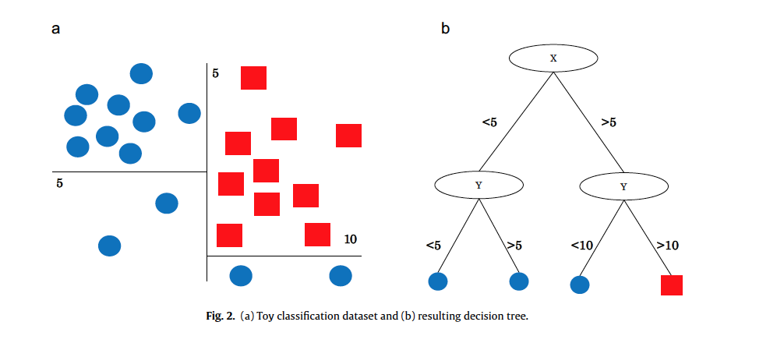
Machine Learning Logic

Slide 18
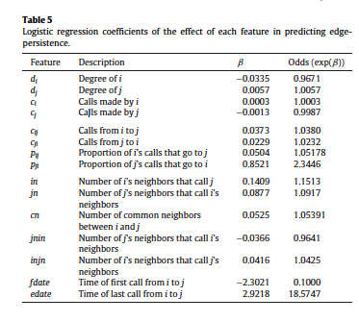
Regression Results

Slide 19
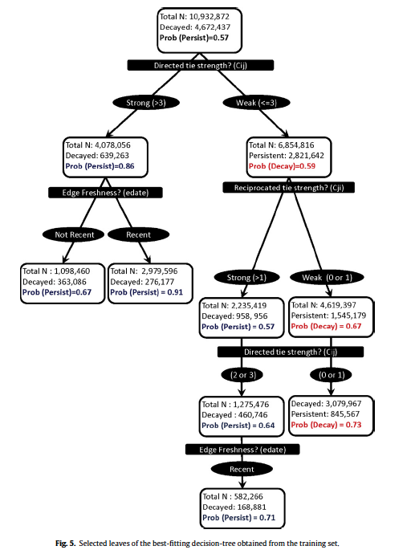
Decision-Tree Results
Path 1
  directed tie strength > 3
  recent activation
Path 2
  somewhat weak tie
  reciprocated
  recent activation
Strong ties persist
Weaker ties can persist if they become reciprocate
  They then can also strengthen with time
Net of this, embeddedness not important.

Slide 20
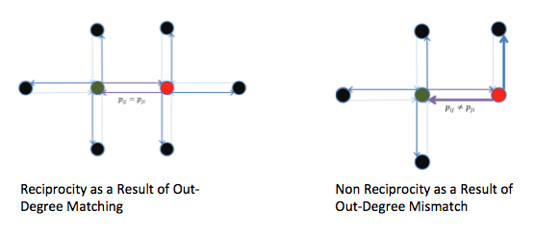
Explaining (Non-)Reciprocity
Out-Degree Mismatch

Slide 21
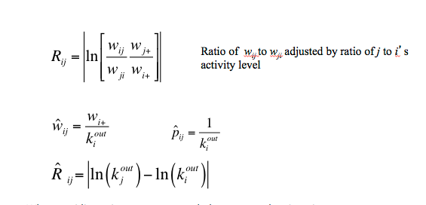
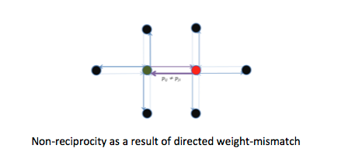
Explaining (Non-)Reciprocity
Unequal dispersion: p_{ij} ≠ p_{ik}
when equidispersion, vertex strength drops out and reciprocity a function of degree differences
degree differences --> non-reciprocity
unequal dispersion --> non-reciprocity
same degree
red vertice overdisperses

Slide 22
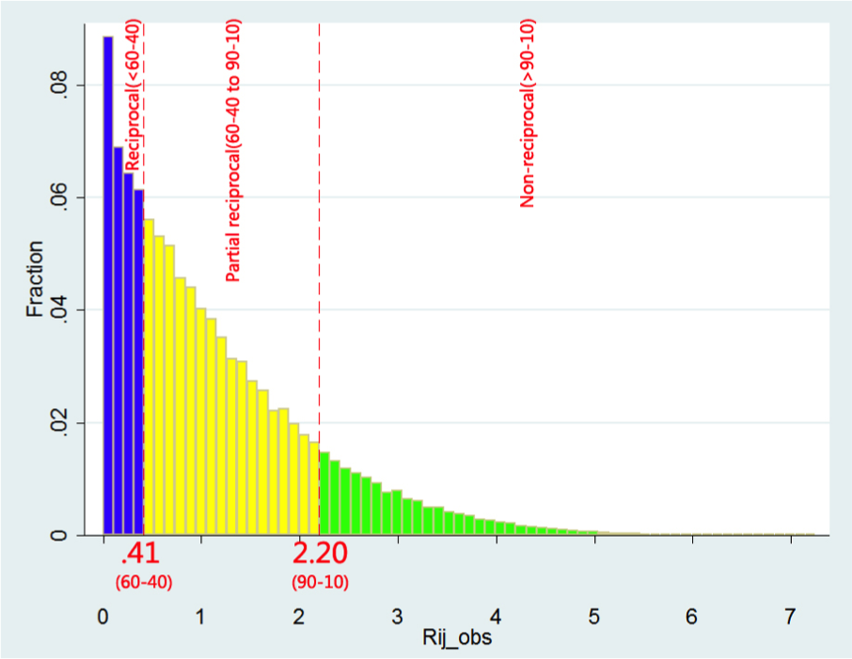
Reciprocity Distribution
27% of mutual dyads are reciprocal
58% partially reciprocal
14% non-reciprocal

Slide 23
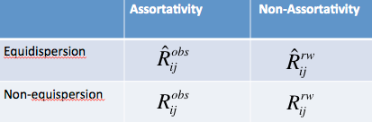
Four Variants of Reciprocity
Observed Network: Assortative & non-equidispersed
Equi-dispersed Model: Assortative & equidispersed
Rewired: Non-assortative and non-equidispersed
Rewired with Equi-dispersion

Slide 24
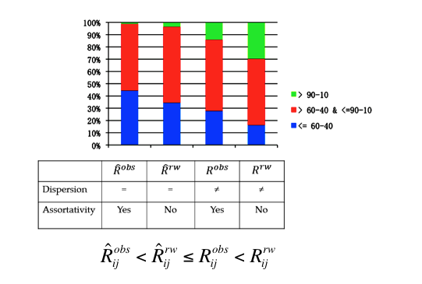
Results
Social Networks exhibit non-reciprocity because
  not fully degree assortative
  Unequal dispersion

Slide 25
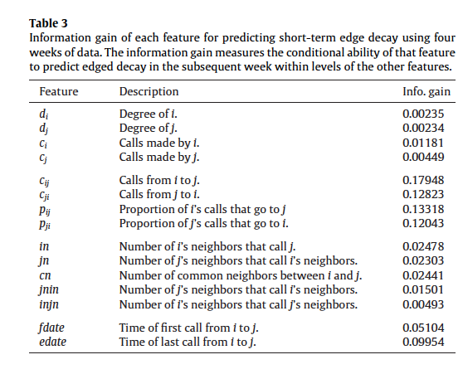
Predictiveness

