Slide 1

Ego (personal) networks
A focal ego (j) with k neighbors (alters, contacts)
Properties of personal networks
  Size (ego-network degree, "range")
  Diversity (e.g. Std. Dev. of Age, education, etc.)
  Composition (Prop. Kin)
  Homophily (Prop. Same Gender)
  Clustering (Density)
k = 7
Notes:
Who is likely to have more diverse networks
Why diversity important
*

Slide 2
Ego (personal) networks
Correlates of Diversity (personal network level)
  Structural
    Size
    N. of weak ties (e.g. acquaintances)
    Redundancy/density
    Proportion Kin
Notes:
Who is likely to have more diverse networks
Why diversity important
*

Slide 3
Ego (personal) networks
Correlates of Diversity (Node level)
  Node Level:
    Age (Life course stage)
    Family status
    Gender
    Race
    Occupation
    Education
    [...]
Notes:
Who is likely to have more diverse networks
Why diversity important
*

Slide 4

Homophily, chicken, eggs, circles, Foci, relations
What comes first? Choice or context of choice?
  Choices embedded in contexts
  Social “circles”
  Social “Foci”

Slide 5

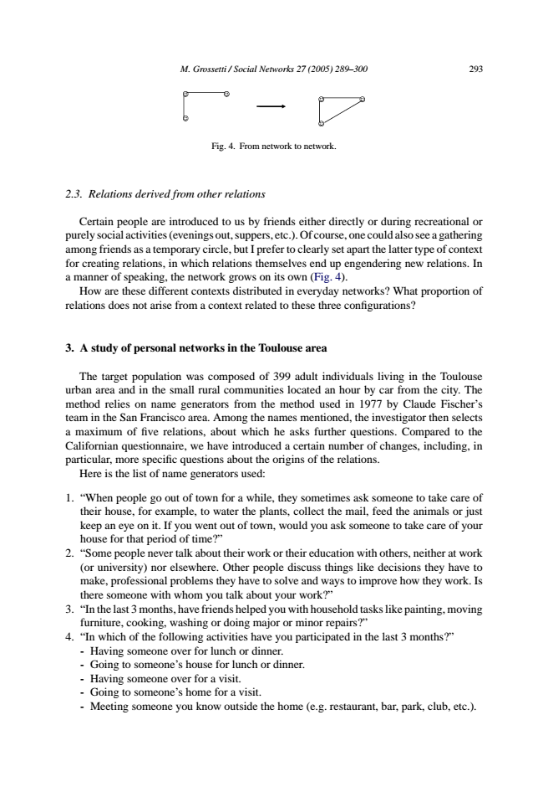
Homophily, chicken, eggs, circles, Foci, relations
What comes first? Choice or context of choice?
  What do circles do?
    Provide common “contexts” for interaction
    Bring together people with common interests
(a) From circle to relation
(b) From common activity to relation
(c) From common relation to relation

Slide 6
Psychological sources of ego network structure
Ego network structure is constrained by psychological and cognitive characteristics of persons
  How many people can you (actively) know?
Ego network “layers” arranged hierarchically by size

Slide 7
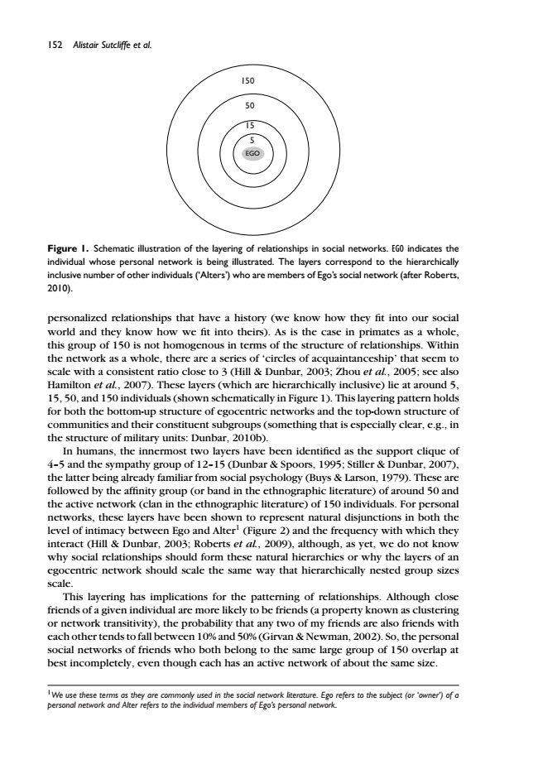
Psychological sources of ego network structure
Primates (including humans) optimized for group living
  Social brain Hypothesis
    Brain size ~ group size
  Groups provide benefits...
  But also costs
    Forming intimate groups solves that
Ego network “layers” arranged hierarchically by size

Slide 8
Psychological sources of ego network structure
Different relationships entails different “maintenance costs”
  Costs determine the number of persons in each layer
    Support clique (~ 4 - 5)
    Sympathy group (~12 - 15)
    Affinity group (~ 45 - 50)
    Active Network (~120 - 150)

Slide 9
Psychological sources of ego network structure
Different relationships entails different “maintenance costs”
  Each Layer has different functions (e.g. support, sociability, intimacy, etc.)
    Support clique (~ 4 - 5)
    Sympathy group (~12 - 15)
    Affinity group (~ 45 - 50)
    Active Network (~120 - 150)
 | Degree (1)
Shannon | 12.00
Matt | 18.00
Megan | 14.00
Rebecca | 7.00
Amanda | 16.00
Amy | 12.00
Won Lee | 13.00
Coley | 13.00
Molly | 9.00
Ha Young | 8.00
Average | 12.20

Slide 10
Psychological sources of ego network structure
Different relationships entails different “maintenance costs”
  Each Layer has different functions (e.g. support, sociability, intimacy, etc.)
    Support clique (~ 4 - 5)
    Sympathy group (~12 - 15)
    Affinity group (~ 45 - 50)
    Active Network (~120 - 150)
 | Degree (1)
Shannon | 12.00
Matt | 18.00
Megan | 14.00
Rebecca | 7.00
Amanda | 16.00
Amy | 12.00
Won Lee | 13.00
Coley | 13.00
Molly | 9.00
Ha Young | 8.00
Average | 12.20

Slide 11
Psychological sources of ego network structure
As we move “farther up” across layers…
  Transitivity declines
  Emotional closeness declines
  Frequency of interaction declines
  Social support declines
Ego network “layers” arranged hierarchically by size

Slide 12

Are your networks “biased”?
How would you know?
And by how much?
  Gender bias?
  Racial/Ethnic bias?
  Religious bias?
  Education bias?
  Age bias?
  [...]
    The Blau Effect: In the absence of bias networks should reflect population distributions

Slide 13
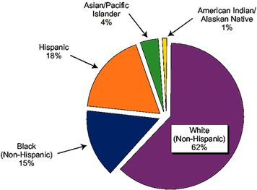
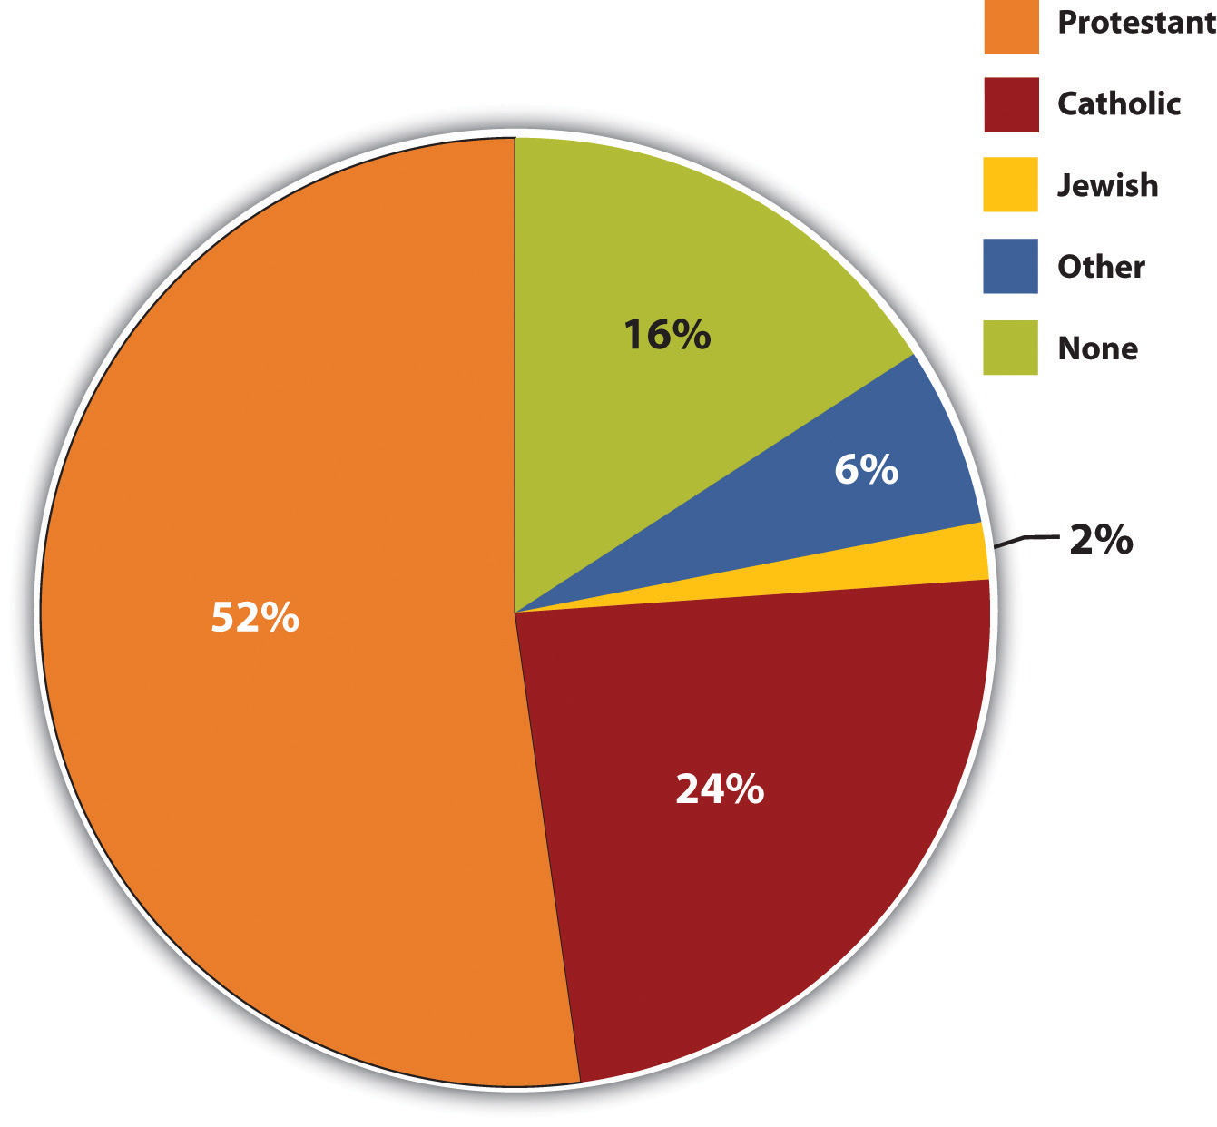
Are your networks “biased”?
    The Blau Effect: In the absence of bias networks should reflect population distributions

Slide 14
Are your networks “biased”?
    Ego Network Bias:
      B = (Observed Percentage) - (Expected Percentage)

Slide 15
Are your networks “biased”?
Some “structural” reasons for why your networks look the way they do
  Group size paradox:
    Minorities will have more diverse networks than majorities even if everybody prefers to be with similar people
  Why?

Slide 16
Are your networks “biased”?
Some “structural” reasons for why your networks look the way they do
  Multiform Heterogeneity/Homogeneity
    Your networks can get more/less diverse even if you prefer less/more diversity when you select on an attribute that is correlated with another.
  Why?

Slide 17

Are your networks “biased”?
For instance, the Racial Diversity of Catholic Networks will be “skewed” in predictable ways:

Slide 18
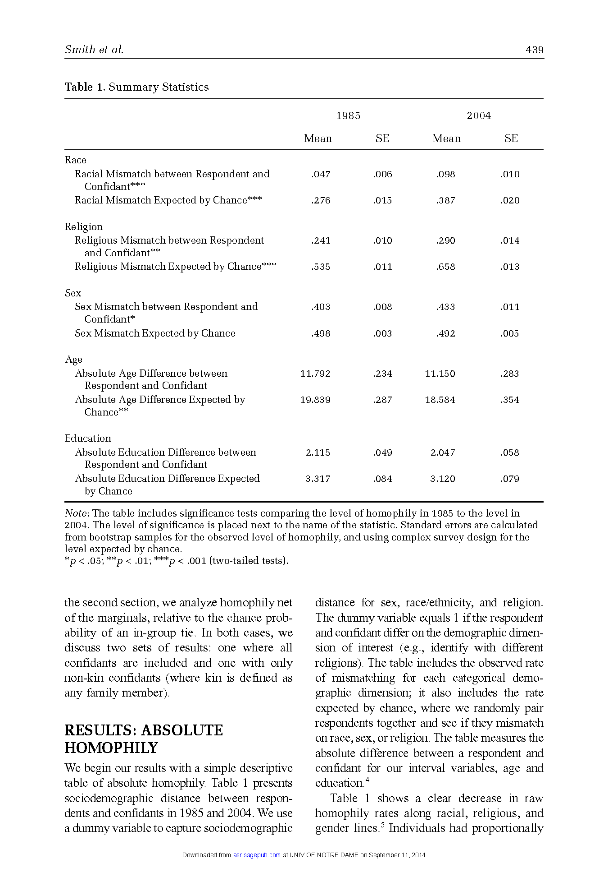
Are your networks “biased”?
    Ego Network Bias:
      B = (1 - Exp. %) - (1 - Obs. %)

Slide 19
Are your networks “biased”?
    Ego Network Bias:
      B = Obs(|Ego - Alter|) - Exp(|Ego - Alter|)

Slide 20
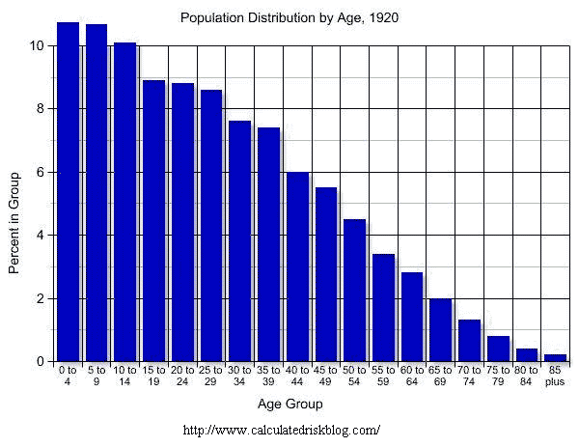
Are your networks “biased”?
    Ego Network Bias:
      B = Obs(|Ego - Alter|) - Exp(|Ego - Alter|)

Slide 21
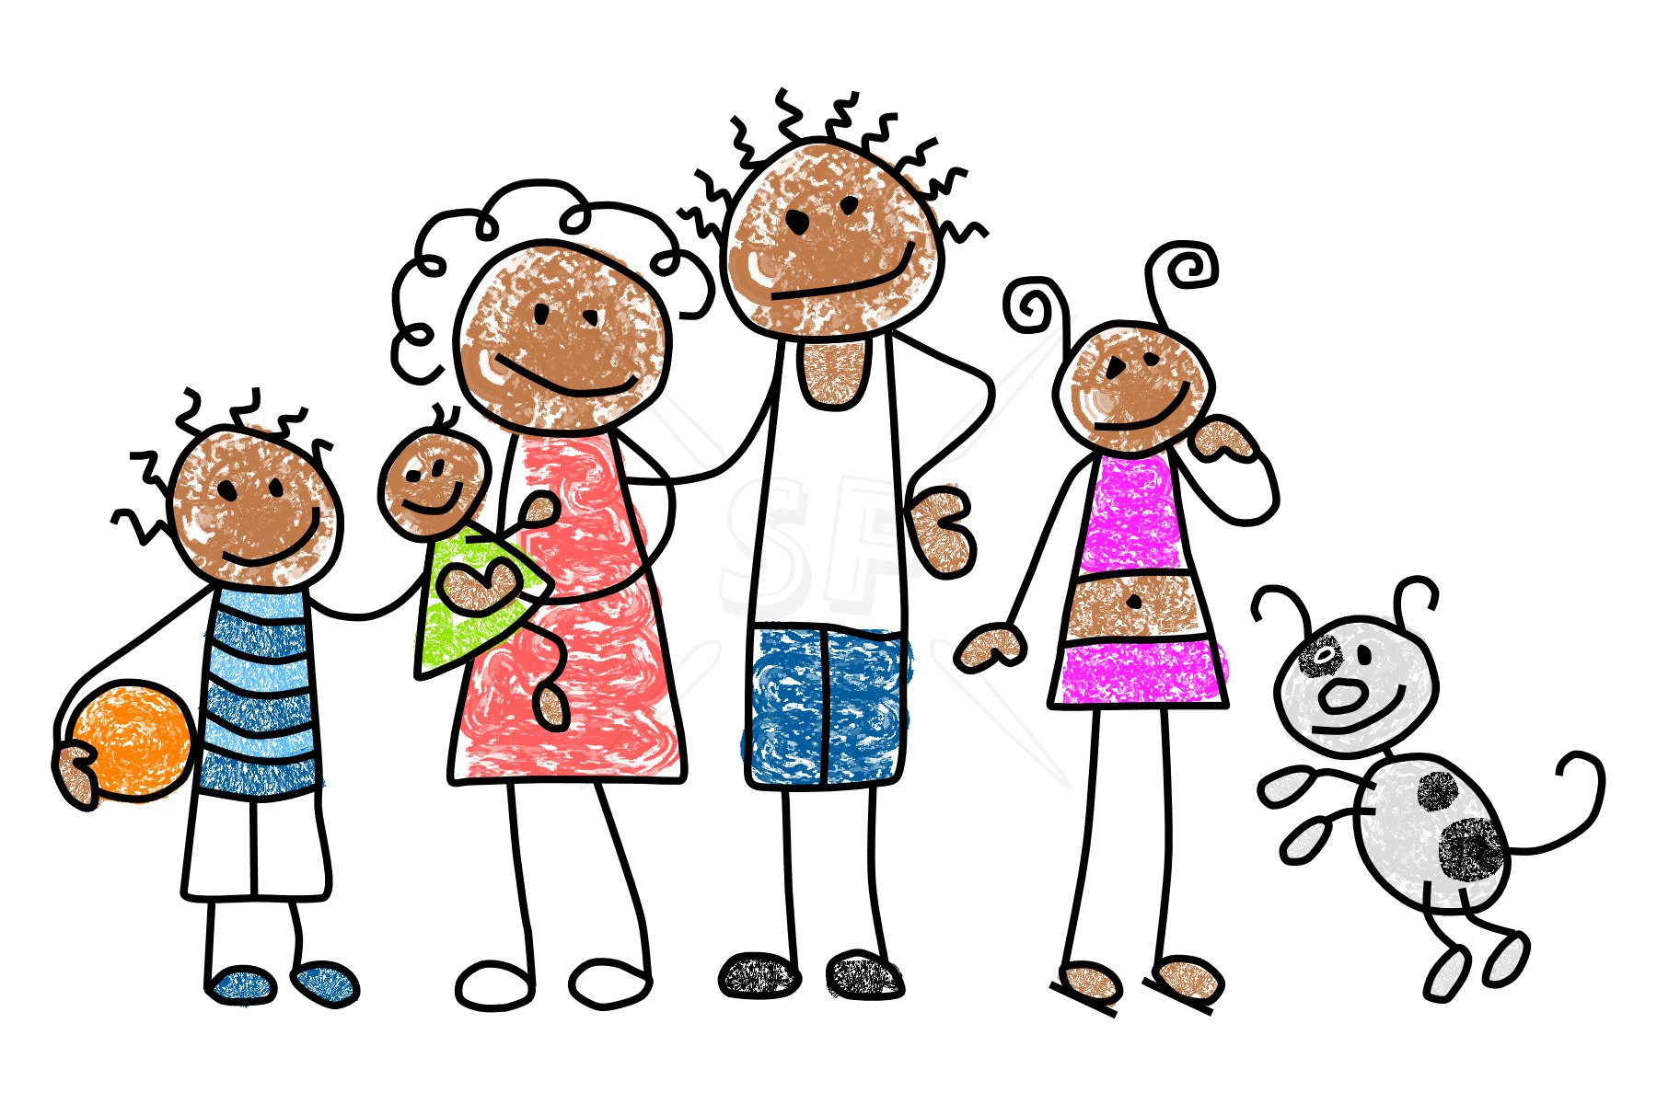
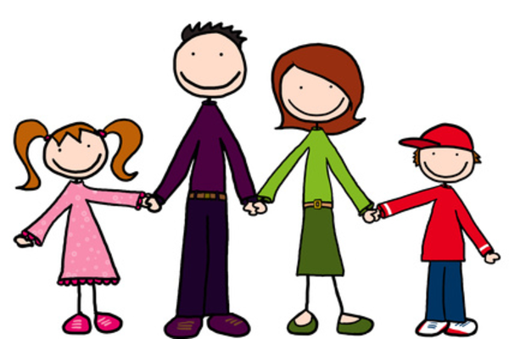
Eliciting Personal Networks
Kinds of relations in ego-networks*
  Cultural Label for Relation (Mother, Daughter, Neighbor, Co-worker, Acquaintance)
  Subjective Closeness (Close, distant, emotional, exciting)
  Type of content exchanged (Material, Emotional, Advice, information, sexual favors)
    *Fischer (1982: 35)

Slide 22
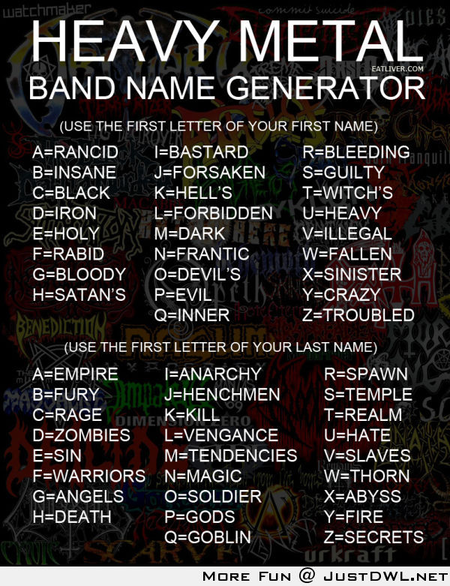
Name generators
Primary methodological tool in survey based research.
Almost infinite variety:
  "Important matters" (GSS 1985, 2004)
  Go to for personal/professional advice
  "Have over for dinner" (Laumann 1966)
  Ask for favor/borrow money
  "Feel close to"
  etc., etc., etc.

Slide 23
A Typology of Personal Relations¹
Role-Relation Approach
  Neighbors, Friends, Kin
Interaction Approach
  Frequency/Duration of Contact
Affective Approach
  Significant/Close
Exchange Approach
  Information, favors, resources
[1] Marin, A., & Hampton, K. N. (2007). Simplifying the Personal Network Name Generator Alternatives to Traditional Multiple and Single Name Generators.Field Methods, 19(2), 163-193.

Slide 24
Methodological Issues
Role-Relation Approach
  Problem: low reliability, cultural specificity issues, cross-respondent heterogeneity in label interpretation (what is a "friend"?)
Interaction Approach
  Frequency does not equal importance/closeness
Affective Approach
  Same reliability issues as role-relation items but useful for eliciting strong or subjectively significant ties
Exchange Approach
  Less reliability problems, useful for social capital studies, but not appropriate for all purposes

Slide 25
Name interpreters
Follow up questions designed to elicit information on named alters.
  Socio-demographic characteristics of alter
    Gender, Age, Race, Years of Education
  Role-relations
  Subjective feelings
    Loving, exciting, significant (Zablocki)
  Exchanges
  Relationship "context" (focus, see Feld 1982)
    Meet at church, work, voluntary association, etc.
  Alter's relationship with the rest of ego's neighbors
    Does alter k know alter i?
    Are they close or just acquaintances?

Slide 26
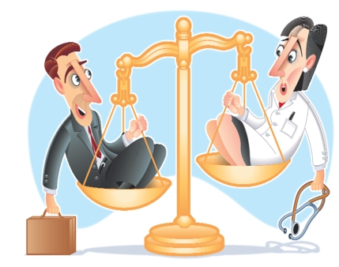
Position Generators
Simple, easily understood item.
"Do you know/are close to anybody who is a/an"
  Doctor, Lawyer, Teacher, Truck Driver, etc.
A rather under-utilized method.
We can then calculate features of the respondent's "position ego-network" using exogenous information on the occupational label
  Average occupational prestige, SEI score, etc.
  Standard deviation (social diversity of contacts)
  "Gendered versions" (how many men/women do you know who are a/an" (Erickson 2004)

Slide 27
Position Generators
Advantages:
  High criterion and face validity (e.g. Lin 1999)
  Quick and dirty (not lengthy)
  Occupational labels are easily understood by informants
  Easily standardized (occupational census codes)
  Captures lots of information with minimal strain
  Ideal for studies of social capital and access to resources (Lin and Dumin 1986)
  Good measure of an individual's relational position in the occupational structure

Slide 28
Resource Generators
"Resource Generators" (Van Der Gaag and Snijders 2005, Social Networks) combine the pragmatic virtues of the position generator with the specificity and breadth of coverage of the name generator.
"Do you know anyone who..."
  Can repair a car, bike, etc.
  Is handy repairing household equipment
  Can speak and write a foreign language
  Can work with a personal computer
  Has good contacts with a newspaper, radio or TV station
  Has knowledge about financial matters (taxes, subsidies)
  Can help when moving house (packing, lifting)
  [...] And whatever else you can imagine

Slide 29
Sociological Findings - Marsden
Core networks tend to be dense (have high clustering)
Core networks are more homogenous on age, education, race, sex
  There is age and education heterogeneity
Age, Education, Sex, Race and Place Correlates of network size, density and heterogeneity (Tables 3 & 4)

Slide 30
Dimensions of Discussion Groups
A more diverse network is one in which ties with alters vary in their content
Form and Content
  Three dimensions:
    Frequency
    Closeness
    Kin Status

Slide 31
Dimensions of Discussion Groups
Core discussion networks connect people to alters that a person sees more often, are close to, and are kin
Distinction between different types of alters increases with status and declines with age
  High status people have more kin, but they also have nonkin they see frequency (co-workers) AND close people beyond family and co-workers.
  Younger people have kin, but also non-kin that they see frequently and close people who are not kin
  middle aged people keep kin (but now children), less daily contact with others

Slide 32
