Slide 1

Ego (personal) networks
A focal ego (j) with k neighbors (alters, contacts)
Properties of personal networks
  Size (ego-network degree, "range")
  Diversity (e.g. Std. Dev. of Age, education, etc.)
  Composition (Prop. Kin)
  Homophily
  Clustering
  Second (or n^{th}) order quantities (e.g. average nearest neighbor degree, clustering, etc.)
j
d = 7
Notes:
Who is likely to have more diverse networks
Why diversity important
*

Slide 2
Ego (personal) networks
Correlates of Diversity (personal network level)
  Size
  N. of weak ties (e.g. acquaintances)
  redundancy/density
  Proportion Kin
  Node-level properties (personality, socio-demographic characteristics)
Notes:
Who is likely to have more diverse networks
Why diversity important
*

Slide 3
Ego (personal) networks
Correlates of Diversity (Node level)
  Age (Life course stage)
  Family status
  Gender
  Race
  Urban status
  Occupation
  Socio-economic status
  Education
  [...]
Notes:
Who is likely to have more diverse networks
Why diversity important
*

Slide 4
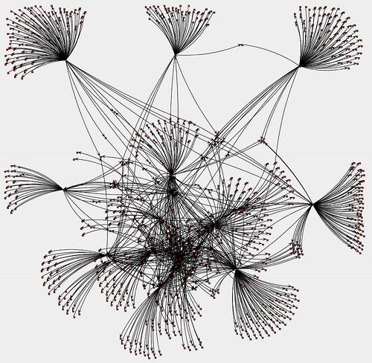
Eliciting Personal Networks
Kinds of relations in ego-networks (from Fischer (1982: 35)):
  Cultural Label for Relation (Mother, Daughter, Neighbor, Co-worker, Acquaintance)
  Subjective Closeness (Close, distant, emotional, exciting)
  Type of content exchanged (Material, Emotional, Advice, information, sexual favors)

Slide 5
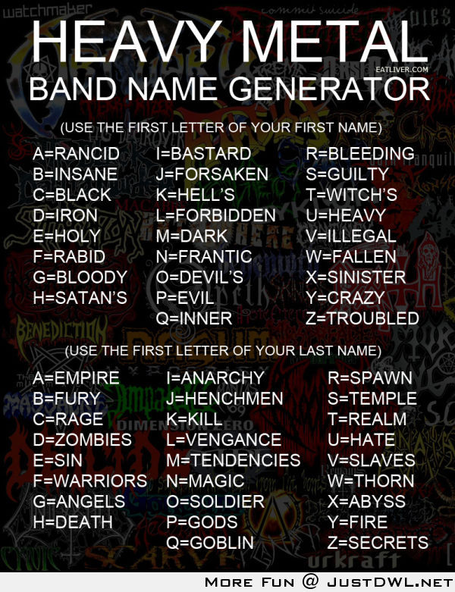
Name generators
Primary methodological tool in survey based research.
Almost infinite variety:
  "Important matters" (GSS 1985, 2004)
  Go to for personal/professional advice
  "Have over for dinner" (Laumann 1966)
  Ask for favor/borrow money
  "Feel close to"
  etc., etc., etc.

Slide 6
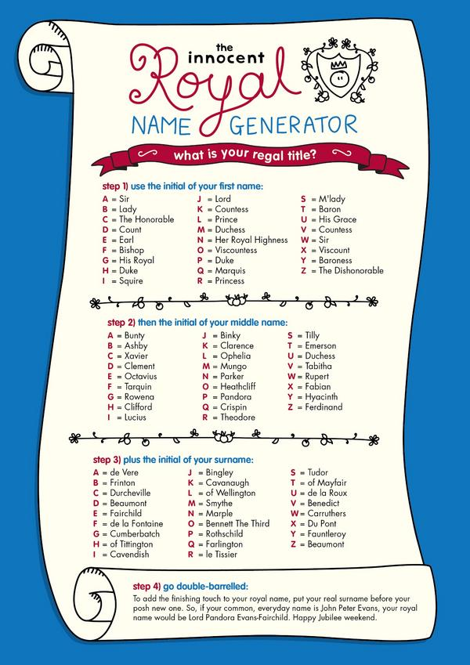
A Typology of Personal Relations¹
Role-Relation Approach
  Neighbors, Friends, Kin
Interaction Approach
  Frequency/Duration of Contact
Affective Approach
  Significant/Close
Exchange Approach
  Information, favors, resources
[1] Marin, A., & Hampton, K. N. (2007). Simplifying the Personal Network Name Generator Alternatives to Traditional Multiple and Single Name Generators.Field Methods, 19(2), 163-193.

Slide 7
Methodological Issues
Role-Relation Approach
  Problem: low reliability, cultural specificity issues, cross-respondent heterogeneity in label interpretation (what is a "friend"?)
Interaction Approach
  Frequency does not equal importance/closeness
Affective Approach
  Same reliability issues as role-relation items but useful for eliciting strong or subjectively significant ties
Exchange Approach
  Less reliability problems, useful for social capital studies, but not appropriate for all purposes

Slide 8
Name interpreters
Follow up questions designed to elicit information on named alters.
  Socio-demographic characteristics of alter
    Gender, Age, Race, Years of Education
  Role-relations
  Subjective feelings
    Loving, exciting, significant (Zablocki)
  Exchanges
  Relationship "context" (focus, see Feld 1982)
    Meet at church, work, voluntary association, etc.
  Alter's relationship with the rest of ego's neighbors
    Does alter k know alter i?
    Are they close or just acquaintances?

Slide 9
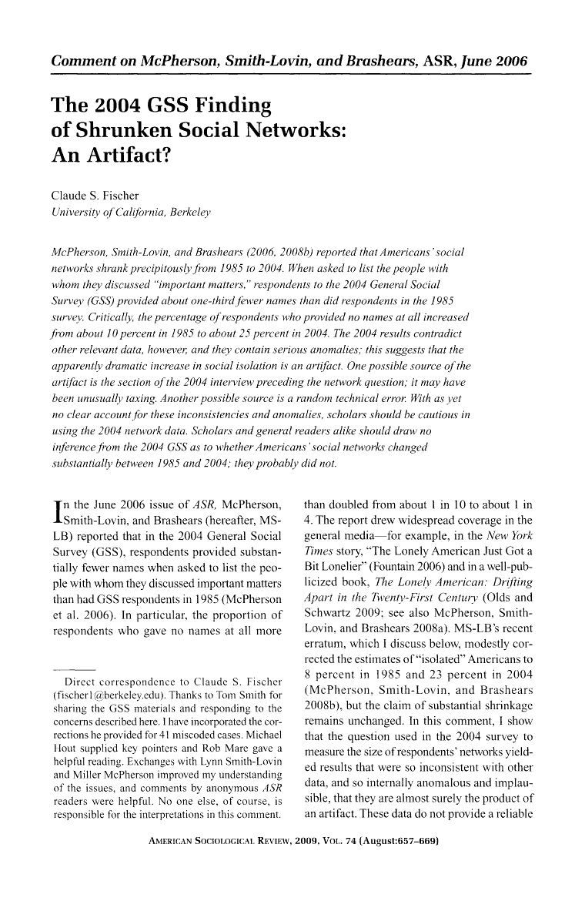
Name interpreters
A cautionary tale: Respondent fatigue as a result of long name interpreter follow-ups.
  Did Americans become increasingly isolated (no one to "discuss important matters with") between 1985 and 2004? (McPherson, Smith-Lovin and Brashears 2006)
  No. Likely the artifactual result of respondent fatigue (Fischer 2009)

Slide 10
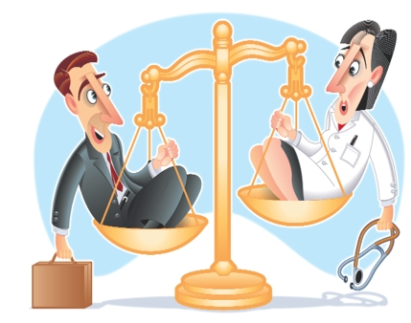
Position Generators
Simple, easily understood item.
"Do you know/are close to anybody who is a/an"
  Doctor, Lawyer, Teacher, Truck Driver, etc.
A rather under-utilized method.
We can then calculate features of the respondent's "position ego-network" using exogenous information on the occupational label
  Average occupational prestige, SEI score, etc.
  Standard deviation (social diversity of contacts)
  "Gendered versions" (how many men/women do you know who are a/an" (Erickson 2004)

Slide 11
Position Generators
Advantages:
  High criterion and face validity (e.g. Lin 1999)
  Quick and dirty (not lengthy)
  Occupational labels are easily understood by informants
  Easily standardized (occupational census codes)
  Captures lots of information with minimal strain
  Ideal for studies of social capital and access to resources (Lin and Dumin 1986)
  Good measure of an individual's relational position in the occupational structure
    However, not a panacea; only useful for a restricted range of analytical purposes (e.g. social capital research)

Slide 12
Resource Generators
"Resource Generators" (Van Der Gaag and Snijders 2005, Social Networks) combine the pragmatic virtues of the position generator with the specificity and breadth of coverage of the name generator.
"Do you know anyone who..."
  Can repair a car, bike, etc.
  Is handy repairing household equipment
  Can speak and write a foreign language
  Can work with a personal computer
  Has good contacts with a newspaper, radio or TV station
  Has knowledge about financial matters (taxes, subsidies)
  Can give advice concerning a conflict at work
  Can help when moving house (packing, lifting)
  Can help with small jobs around the house (carpenting, painting)
  [...] And whatever else you can imagine

Slide 13
Sociological Findings - Marsden
Core networks tend to be dense (have high clustering)
Core networks are more homogenous on age, education, race, sex
  There is age and education heterogeneity
Age, Education, Sex, Race and Place Correlates of network size, density and heterogeneity (Tables 3 & 4)

Slide 14
Burt – Discussion Groups
A more diverse network is one in which ties with alters vary in their content
Form and Content
Three dimensions: Frequency, Closeness, and Kin

Slide 15
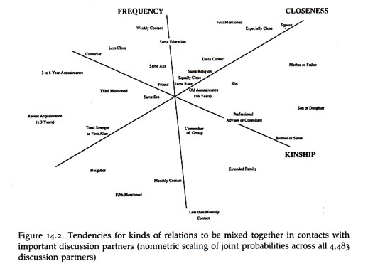
Burt Discussion Groups

Slide 16
Burt Findings
The predominant character of core discussion groups is that they connect people to alters that a person sees more often, are close to, and are kin
Distinction between different types of alters increases with status and declines with age
  High status people have kin, but they also have nonkin they see frequently (co-workers) AND close people beyond family and co-workers.
  Younger people have kin, but also non-kin that they see frequently and close people who are not kin
  middle aged people keep kin (but now children), less daily contact with others

Slide 17
Granovetter: Strength of Weak Ties
Getting a better job
Job Search & Information
How do people find out about jobs?
Measure whether job is better and type of contact used to find a job
Type of contact: family/friend vs. acquaintance
Finding: Odds of getting better job increases when a person hears about the job through an acquaintance (weak tie)
Explanation: weak ties are to non-redundant alters who are more likely to know about jobs than ego’s strong ties

Slide 18
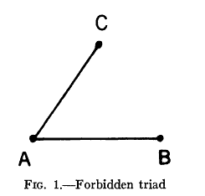
Granovetter Assumptions
Acquaintance = Weak Tie
Weak Tie = Non-redundant tie

Slide 19
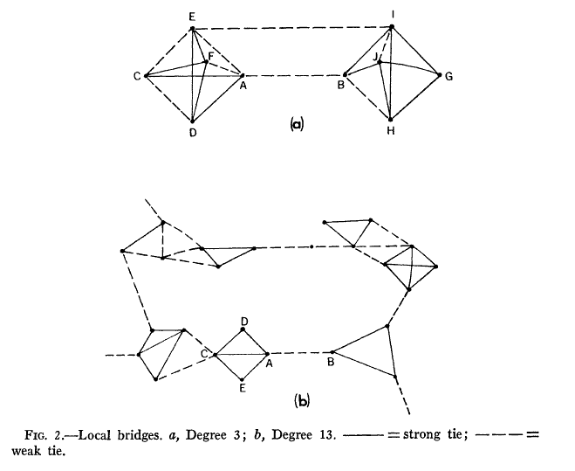
Granovetter Assumptions
Weak ties are more likely to be “bridges”

Slide 20
Burt – Structural Holes
High degree with high density → less diverse network
Dense networks are redundant, i.e. not diverse
Structural Hole: Separation (lack of direct or indirect ties) between nonredundant contact
  Network benefits of each alter additive (no overlap)
  Tie between ego and non-redundant alter is a bridge

Slide 21
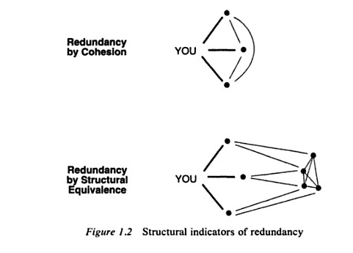
Redundancy
Notes:
does struct equiv lead to cohesion as triangle closes
*

Slide 22
Efficiency & Effectiveness
Efficiency: Maximize the number of non-redundant alters
Effectiveness: Draw your alters from different social worlds

Slide 23
Weak Ties & Structural Holes
Hypothesis: The ties with non-redundant alters that form a structural hole tend to be weak

Slide 24

Structural Holes & Weak Ties
Notes:
Ties within clusters tend to be strong (why?)
Some ties within clusters are weak (indirect transitive closing ties)
But some ties of a node within a cluster are weak and to a node in another cluster
If that tie was strong, then closure, i.e. ego would have ties (maybe weak) to the bridges alters
*

Slide 25
Effective Size (ES) and Clustering Coefficient (CC)
Consider the subgraph consisting only of the alters of an ego, along with the edges connecting them (i.e. remove ego from graph).
N = number of alters, i.e. degree of ego
M = number of edges among the N alters
Av. Degree = 2M/N
CC = density = 2M/(N(N-1))
ES = N - (2M/N) = N - CC(N-1) = N - Av. D
Efficiency = ES/N
Reach efficiency =
Size 2nd order Neigh./Sum(Degree of Alters)

Slide 26
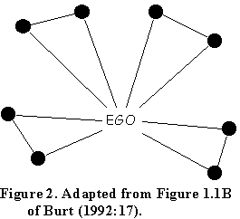
Effective Size (ES) and Clustering Coefficient (CC) - Example
N = 8
M = 4
Av D = (2*4)/8 = 1
CC = 2*4/8*7 = .143
ES = 8 - (2*4)/8 = 7
ES = 8 -.143(7) = 7
ES = 8 -1
Efficiency = 7/8 = .875
Reach eff = 8/(8*1) = .5

Slide 27
Effective Size (ES) and Clustering Coefficient (CC) - Example
N = 7
M = 6
Av D = 2*6/7 = 1.7
CC = (2*6)/(7*6) = .286
ES = 7 - (2*6)/7 = 5.285
ES = 7 -.286(6) = 5.284
ES = 7 - 1.7 = 5.3
Reach eff = 7/(3+5+2+1+1+3+4)= .368

Slide 28
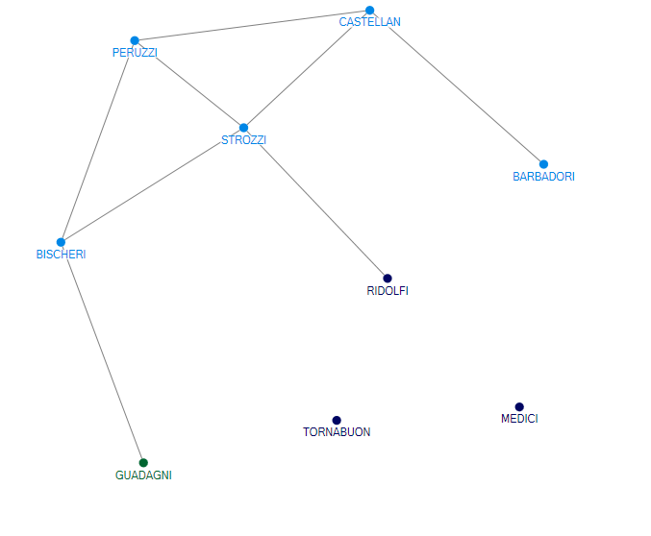
Effective Size (ES) and Clustering Coefficient (CC) - Peruzzi
N = 3
M = 2
CC = 2*2/3*2 = .667
ES = 3 - (2*2)/3 = 1.667
ES = 3 -.667(2) = 1.667
Efficiency =1.667/3 = .556
Reach eff = 6/(3+4+3)= .6

Slide 29
Other Issues
Intermediation (Bridges)
Core/Periphery Network
  Alters with different edge weights

Slide 30
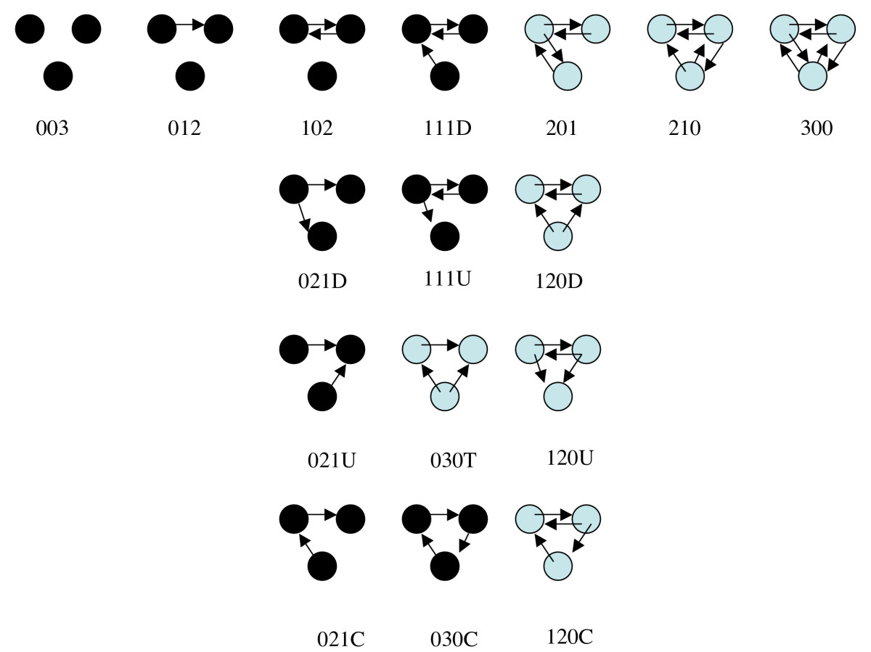
Social Network Motifs
Notes:
Fully connected (balanced) triads are more likely to appear in friendship networks than expected by chance. Cycles tend to be rarer.
*

