Slide 1
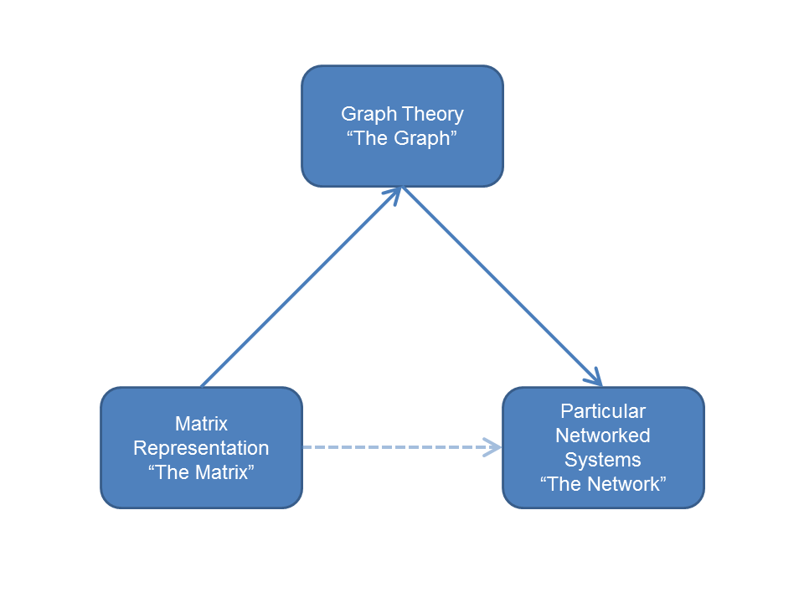

Slide 2
Three ways of talking about "networks"
The point is that the specification of processes occurring in networked systems (such as social systems)---so-called "network theory"--occurs in natural language and relies on substantive intuitions
  The relevant "concepts" are by their nature "fuzzy" (e.g. Borgatti 2005, Social Networks on centrality)
Graph theory is a branch of mathematics and allows for the specification of "analogues" of fuzzy concepts stated in natural language in less ambiguous terms
  However, the mapping from network theory to graph theory can be one to many (e.g. different conceptualizations of "centrality")
  This is not "calculation" or "operationalization"
Matrix algebra is a branch of mathematics that has an applied aspect
  Linking graph theoretic concepts to their matrix representation allows for calculation and the development of "measures" and other metric representations of graph theoretic concepts

Slide 3
Three ways of talking about "networks"
However, note that matrix representations are not direct operationalizations of networks
  Instead, the matrix representation links to the graph theoretic concept
  The graph theoretic concept, in its turn is seen as the analogue of a process that occurs in "real" networks
This can lead to a criterion useful in differentiating "network theory" from "network analysis"
  Network Theory consists in the (sometimes imaginative) linking of some really existing process in a networked system (such as a social system) to a mathematical representation (usually but not exclusively, a graph-theoretic representation)
  Network Analysis consists in proposing of metric representations of network-theoretic concepts (usually, but not exclusively, in terms of matrix-algebra) for purposes of:
    Calculation/Measurement
    Operationalization in substantive research

Slide 4
Three ways of talking about "networks"
This leads to some slippage in terminology:
  Terms used to refer to "real life" states or processes occurring in a networked system
    Reciprocity in social relations
    The "popularity" or "expansiveness" of an actor's social relations
  Terms used to refer to the graph-theoretic notion that is the analogue of that state or process
    The presence of directed edge (arc) joining two vertices
    The cardinality of the set of edges terminating or originating at at a given vertex
  Terms used to the matrix algebraic representation of the graph-theoretic analogue of that state or process
    Whether the product a_{ij} x a_{ji} in the adjacency matrix is 1 (reciprocity) or 0 (non-reciprocity)
    The sum Σ_{j}a_{ij} (outdegree) or the sum Σ_{i}a_{ij} (indegree) in the adjacency matrix

Slide 5
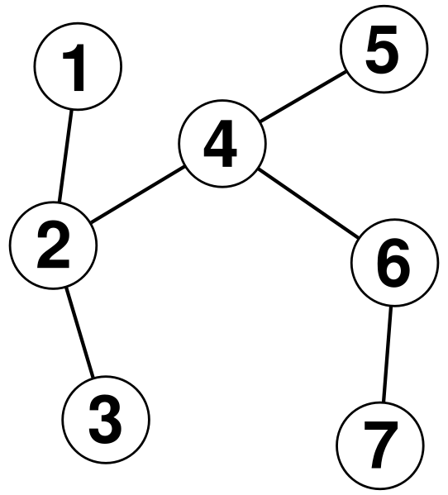
Graph Theory: Graph definition
A graph (G) is an abstract mathematical object (not a picture!) consisting of:
  A set of V vertices V(G)
    {v₁, v₂, v₃, v₄, v₅, v₆, v₇}
    Also called nodes, actors
  A set of E edges, E(G)
  {v₁v₂, v₂v₃, v₂v₄, v₄v₅, v₄v₆, v₆v₇}
    Also called links, ties
  Such that G = (V, E)

Slide 6
Graph Theory: Graph definition
The cardinality (size) of the set V is usually denoted by N
  This is the order of the graph
The cardinality of the set E is usually denoted by M
  The size of the graph is the maximal number of edges (N(N-1))/2
  The Density (d) of the graph is the ratio of the observed to the maximum number of edges
  A complete graph has d = 1
  Low density graphs are called sparse

Slide 7
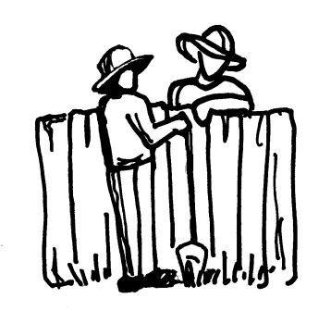
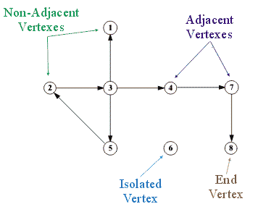
Graph Theory: Adjacency and Types of graphs
Two vertices in the same graph may be joined by an edge, in which case, they are adjacent
  Adjacent vertices are also called neighbors
Graphs can either be undirected and directed
  Directed graphs are sometimes called digraphs

Slide 8
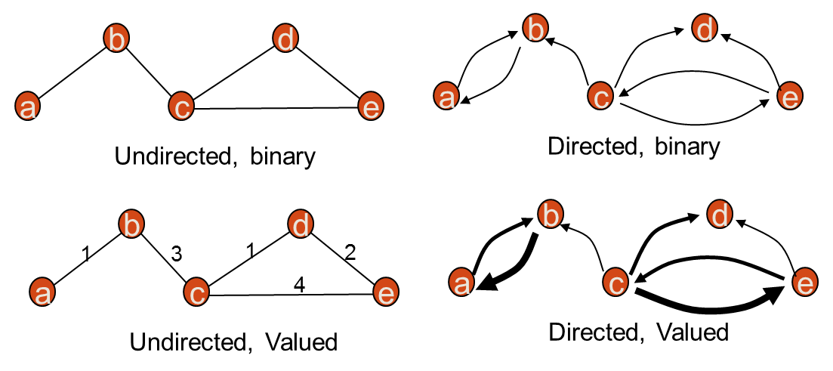
Graph Theory: Edges and Arcs
In an undirected graph an edge joining vertices u, v belonging to E, is denoted uv
When u = v, the edge is a self-edge (also called reflexive, self-loop)
A set of edges joining the same vertices {u, v} are a multiedge
In directed graphs an edge (arc) has an origin and a destination
An undirected graph with no self-edges or multi-edges is called a simple graph

Slide 9

Graph Theory: Weighted Graphs
Often it is useful to associate numerical values with an edge uv: This is called the edge weight (w_{uv})
  This may be used to represent the "strength" of the relationship joining u and v
Graphs that featured edge weights are called weighted (valued) graphs
  An "unweighted" graph is simply the special case of a weighted graph in which the weights are constrained to be either zero (0) or one (1)

Slide 10
Graph Theory: Vertex Degree
The degree of a vertex d(v) in an undirected graph is the number of edges that have v as their destination (origin) vertex
  The set of neighbors of v is denoted N(v)
  In a directed graph, the outdegree of vertex v d^{out}(v) is the number of edges that originate in v
  In a directed graph, the indegree of vertex d^{in}(v) is the number of edges that terminate in v
  Degree may be considered an index of a node's centrality
A variety of graph properties depend on degree
  Mean degree = Σ_{i}d(v_{i})/N = 2M/N
  Graph Density = M/[N(N-1)/2] = 2M/[N(N-1)] = D/N-1

Slide 11
Graph Theory: Degree in weighted graphs
In a weighted graph, the sum of the weights that have v as their origin is called vertex strength s(v)
  s(v_{i}) = Σ_{j in N(vi)}w_{ij}
In a weighted graph, we may also be interested in the variance (inequality, dispersion, disparity) of the weights originating at v_{i}
  var(v_{i}) = Σ_{j in N(vi)} [w_{ij} / s(v_{i})]²

Slide 12
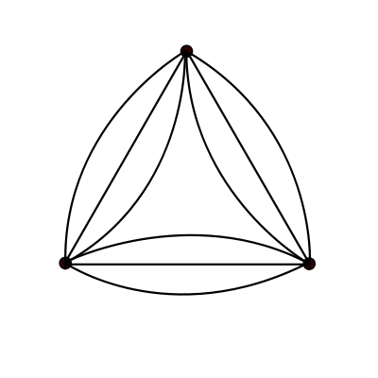
Graph Theory: Multigraphs
In both directed and undirected graphs, the same vertices may be joined by more than one distinct edge
  Such graphs are called multigraphs
In social networks, multigraphs may be used to represent multiplex relationships (e.g. advisor and friend)

Slide 13
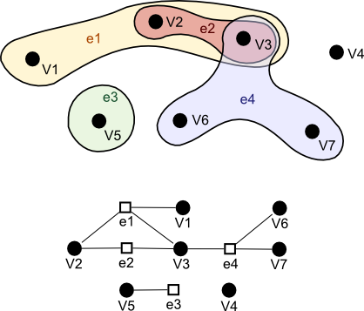
Graph Theory: Hypergraphs
A hypergraph is a graph in which an edge can join more than two types of vertices
  A market transaction may join three parties, a buyer, a seller and an agent
A hyperedge e' joins a subset v' of vertices from G
  For instance, a hyperedge of size 3 that joins vertices {u, w, v} is denoted by uwv

Slide 14

Adjacency Matrix Representation
Mathematically, it is useful to represent a graph as an adjacency matrix (A) of dimensions N x N such that:
  A_{ij} = 1, if {i, j} belongs to E
  A_{ij} = 0 if {i, j} does not belong to E

Slide 15
Adjacency Matrix Representation: Multi-edges and self-edges
In a network with no self-edges, the diagonals of the adjacency matrix are set to zero
Multiedges can represented in adjacency matrix by the cardinality of the multiedge set linking two nodes
  Undirected graphs result in symmetric adjacency matrices
  Digraphs result in asymmetric adjacency matrices
  When self-edges are present and the graph is undirected they are represented by inserting a 2 in the corresponding diagonal cell (Newman 2010: 112)
  Weighted graphs can be represented by inserting the value of the edge-weight in the corresponding cell of the adjacency matrix

Slide 16
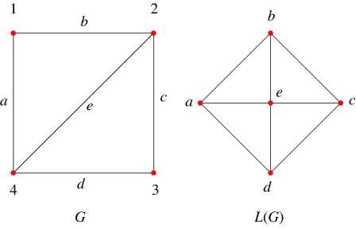
Adjacency Matrix Representation: The line graph
For any given graph G = (V, E) with N vertices and M Edges represented by adjacency matrix A of dimensions N x N, we may obtain the corresponding line graph (or edge graph) by:
  Creating a graph L(G) represented by adjacency matrix B, of dimensions M x M with:
    B_{ij} = 1 if e_{i} and e_{j} share a common vertex v_{k}
    B_{ij} = 0 if e_{i} and e_{j} do not share a common vertex

Slide 17
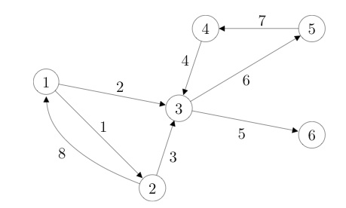
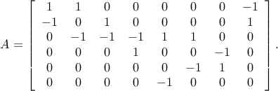
Incidence Matrix Representation
Directed graphs may also be represented as an incidence matrix (B) of dimensions N x M such that:
  B_{ij} = -1, if v_{i} is at the origin of e_{j}
  B_{ij} = 1, if v_{i} is at the destination of e_{j}
  B_{ij} = 0, otherwise

Slide 18
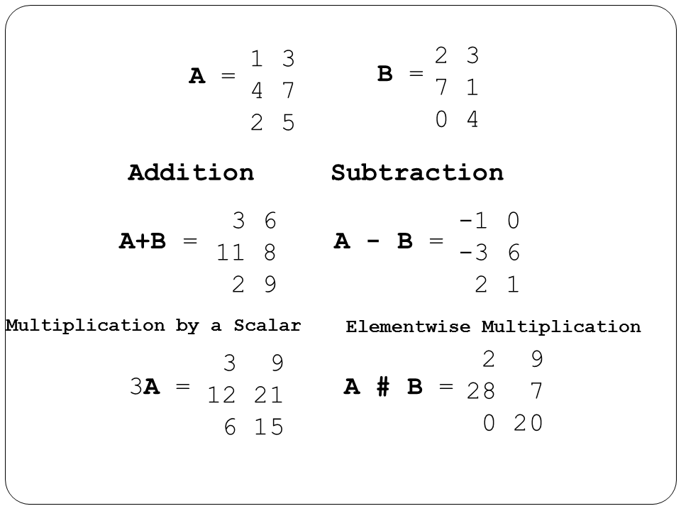
Matrix Operations: Element-wise operations
Matrix operations work on the elements of the matrix in particular ways. To do so, the matrices must be conformable. That means the respective sizes allow the operation
For addition (+), subtraction (-), or elementwise multiplication (#), both matrices must have the same number of rows and columns
For these operations, the matrix value is the operation applied to the corresponding cell values

Slide 19
Matrix Operations: The Transpose
The transpose (' or ^{T}) of a matrix reverses the row and column dimensions.
  A_{ij}^{T}= A_{ji}
So a M x N matrix becomes an N x M matrix
A
A^{T}
a | b
d | e
g | h
a | c | e
b | d | f

Slide 20
Matrix Operations: Matrix Multiplication
The matrix multiplication (x) of two matrices involves all elements of the matrix, and will often result in a matrix of new dimensions.
  In general, to be conformable, the inner dimensions (red) of both matrices must match.
  The resulting matrix has the dimensions a x b, where a is the outer dimension (green) of the left multiplier and b is the outer dimension (blue) of the right multiplier. So:
A_{3 x 2} x B_{2 x 4} = C_{3 x 4}
A_{3 x 2} x B_{3 x 4} = Not defined
Inner dims. match
Inner dimensions do not match
Outer dims.

Slide 21


Matrix Operations: Matrix Multiplication
a | b
c | d
e | f
g | h
ae+bq | af+bh
ce+dq | df+dh
X
=
2 x 2
2 x 2
2 x 2
a | b
c | d
e | f
ag+bj | ah+bk | ai + bl
cg+dj | ch+dk | ci + dl
eg+fj | eh+fk | ei + fl
g | h | i
j | k | l
X
=
2 x 3
2 x 2
3 x 3
Not commutative! A X B does not equal B X A
But Associative and Distributive

Slide 22
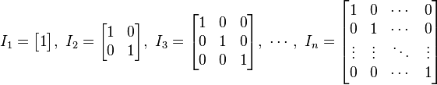
Matrix operations: Powers
The powers (square, cube, etc) of a matrix are just the matrix times itself that many times
  A² = A x A
  A³ = A x A x A
  A^{k} = A x A x A .... A
  A⁰ = I
  Where I is the Identity Matrix
k times

Slide 23
Graph Theory: Subgraphs
A graph G' = (V', E') is a subgraph of a graph G iff:
  V' is a subset of V and E' is a subset of E
Subgraphs may induced by either:
  Sampling a group of vertices and the selecting the subset of edges that link them
  Sampling a group of edges and the selecting of the vertices that are the destination (origin) of each edge.
  For any given set of vertices V' and a given graph property , a maximal subgraph is a subgraph G' formed from V' such that there is no subgraph G'' whose vertices are a subset of V' and satisfy that same property

Slide 24
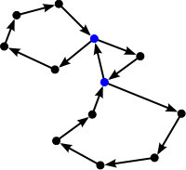
Graph Theory: Walks, Trails, Paths
A walk is an alternating sequence of vertices and edges {u₁, e₁₂, u₂, e₂₃, u₃....u_{n}} starting with an origin vertex u₁ ending with a destination vertex u_{n} such that each vertex in the sequence (excluding the origin and destination vertices) is adjacent to the vertex the precedes it and the vertex that follows it
  The length of the walk is the number of edges contained in the sequence
  The starting vertex is the origin vertex and the end vertex is the destination vertex.
  Taking the powers of the adjacency matrix A^{k} generates successive matrices where ij^{th} entry is the number of paths of length k between i and j

Slide 25
Graph Theory: Walks, Trails, Paths
A walk is called a trail if all edges appear only once in the sequence (no edge is traversed more than once)
A walk is called a path if all edges and all vertices appear only once in the sequence
  All paths are trails and all trails are walks, but not every walk is a trail and not every trail is a path.
  A cycle is a path in which the origin and destination vertices are the same
  In weighted graphs, the path-weight is the sum of the weights corresponding to all of the edges contained in a path.

Slide 26
Graph Theory: Shortest paths
Two paths are vertex-disjoint if they share no vertices
Two paths are edge-disjoint if they share no edges
A geodesic (graph-theoretic distance) is the shortest-path between two distinct vertices
  May be represented as a pairwise matrix D, with Dij = geodesic distance between i and j

Slide 27
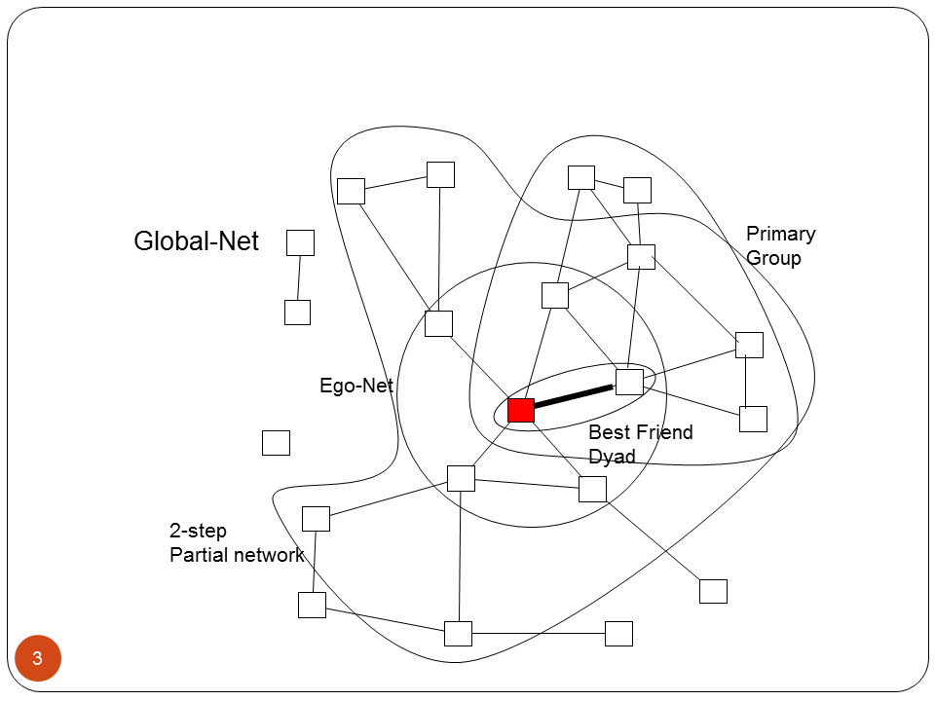
Graph Theory: Connectivity
A graph is connected if there exists a (finite) path between each vertex
  Otherwise the graph is disconnected
A maximal connected subgraph is called a component
  In a graph, the connected subgraph that contains the largest proportion of vertices is called the giant component

Slide 28
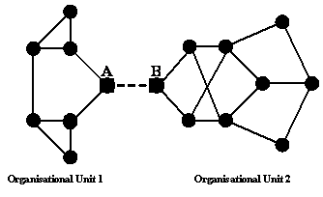
Graph Theory: Cutpoints and Cutsets
A cutpoint is a vertex v that would disconnect the graph upon removal
  A block is subgraph G' that contains no cutpoints
A cutset is a set of vertices {v₁, v,₂,...v_{n}} that would disconnect the graph upon removal
  A minimal cutset is the smallest number of vertices n whose removal would disconnect the graph

Slide 29
Graph Theory: K-connectivity
A graph with a minimal cutset of size k, is said to be k-connected
The k-connectivity of any two vertices {u, v} in graph G, is the number of vertices that must be removed to disconnect u and v
  Thus, if it takes removing three nodes to disconnect two vertices, u and v are said to be three-connected.

Slide 30
Graph Theory: Edge-connectivity
A bridge is an edge uv in graph G whose removal would disconnect the graph
The edgecut is the set of edges E' whose removal would disconnect the graph
  The edgecut for a pair of vertices u, v is defined in the same way
  The miminal edgecut is the smallest number of edges m whose removal would disconnect the graph
  The edge connectivity of a graph is the size of the minimal edgecut

Slide 31
Graph Theory: Menger's Theorem
Menger's theorem states that for any pair of vertices u, v in a graph G:
  The edgecut that disconnects u and v is equal to the number of edge-disjoint paths that connect u and v
And, for any subgraph of a graph G:
  The k-connectivity of a subgraph is identical to the minimal number of edge-independent paths connecting any two vertices

Slide 32
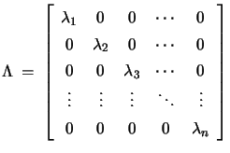
Matrix Algebra: Eigenvectors and Eigenvalues
For a square matrix A (such as an adjacency matrix) and eigenvector is a vector v, such that:
  Av = Bv
  Where B is a scalar

Slide 33
Matrix Algebra: Eigenvectors and Eigenvalues
The Singular Value Decomposition (also called the spectral decomposition) of an N x N matrix A (such as an adjacency matrix) is a factorization of the form:
  A = UWV
  Where,
    W is an N x N diagonal matrix with each diagonal entry containing an eigenvalue of A
    U and V are N x N matrices, such that the i^{th} row(column) of U(V) is an eigenvector of A and the i^{th} diagonal entry of W is its corresponding eigenvalue
    U₁ x W₁₁ is the best (least squares) approximation of A

