Slide 1
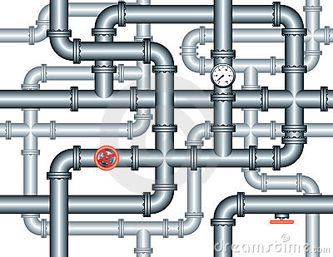
The pipes, flows and influence model
Static model of network ties
"Network position” causes social behaviors
Network ties are relatively stable “pipes” through which things – objects, information or behavioral influence – flow (Borgatti 2005)

Slide 2
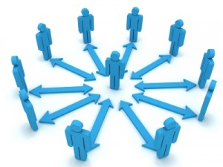
The pipes, flows and influence model
Network ties operate as causes
Mechanisms producing similarity:
  Lateral influence via role-modeling of socio-demographically proximate alters (Mark 2003)
  Hierarchical influence via the adoption of the behaviors of high status individuals (Friedkin 2006)

Slide 3
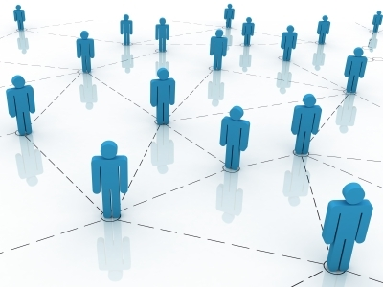
From static flows to dynamic evolution and self-selection
Recent research and theory on the dynamics of dyadic relationships reveals a different picture
Rather than being relatively static pipes, network ties are formed, dissolved and re-negotiated in relatively narrow time-windows (Burt, 2000; Burt, 2002; Raeder et al 2011)

Slide 4
From static flows to dynamic evolution and self-selection
Neither flow nor positional processes can be conceptualized independently from these fine-grained temporal dynamics (Moody 2002; Gibson 2005).
If social relations are constantly evolving, they cannot always be causes, since they in all probability are changing at a faster rate than the majority of the behavioral outcomes that they are putatively causing (Lizardo 2006; Lizardo and Vaisey 2010; Vaisey and Miles 2013).

Slide 5
From static flows to dynamic evolution and self-selection
Most of the time, it is persons (within environmental and structural constraints) that are doing things to network relations (e.g. enacting them, neglecting them, choosing to keep them or dissolving them)
Processes of agency, (self) selection and dynamic change that were under-theorized in the flows and pipes model are now being considered in a new light and their implications have been more explicitly articulated

Slide 6
From static flows to dynamic evolution and self-selection
This emphasis has brought back a concern with classical questions regarding:
  The origins and short-term fate of personal relationships (e.g. Lazarsfeld and Merton 1954; DiMaggio 1993)
  The factors that account for their persistence through time (Burt, 2000; Burt, 2002; Raeder, Lizardo, Hachen, & Chawla, 2011) .
    Network ties may result in the strengthening or weakening of behavioral propensities
    The emergence of certain behavioral propensities may be responsible for the strengthening and weakening of network ties

Slide 7
Behavioral effects on network structure
Individuals who report being in poor health tend to have smaller networks, occupy less central positions in comparison to their healthy peers (Haas et al 2010, Cornwell 2009)
Depressed individuals occupy more peripheral positions because they withdraw from social contact, and thus end up befriending similarly peripheral persons who are also more likely to be depressed persons (Schaefer et al 2011)

Slide 8
Behavioral effects on network structure
High self monitors (persons who consciously strategize as to how they present themselves to others) are more likely to occupy central positions in networks (Mehra, Kilduff and Brass 2001)
Persons who have (implicit) self-understandings as collaborative are more likely to form ties across organizational divisions (Srivastava and Banaji 2011)
High self-monitors tend to attract more new friends, bridge structural holes, and "churn" through more ties than low self monitors (Sasovova et al 2010)

Slide 9
Adjudicating between competing processes and mechanisms
Persons tend to associate with persons who share similar behaviors, practices and tastes as themselves
  Socio-demographic "homophily" (McPherson et al 2001) has been proposed as a possible mechanism for this type of "behavioral homophily"
  Preferences for matching on social characteristics leads to adoption of behaviors and preferences
This has inspired a (small cottage industry) of research on the general process of "social contagion" (Christakis and Fowler 2010)
  This research primarily departs from the pipes, flows, and influence model

Slide 10
Adjudicating between competing processes and mechanisms
The mechanisms that produce the behavioral homophily phenomenon however, continue to be the subject of intense dispute
"Social contagion theory” (Christakis and Fowler 2010) proposes that this occurs primarily via an influence/imitation process (Friedkin 2006; McFarland & Pals 2005)
  In spite of the intuitive appeal of the social contagion hypothesis we also know that a host of alternative mechanisms may also produce the same effect.

Slide 11
Adjudicating between competing processes and mechanisms
Alternative mechanisms include:
  Self-selection into relationships that exhibit behavioral matching prior to interaction
  Matching via correlated but substantively unrelated behaviors
  Joint exposure to concurrent exogenous factors
  Differential dynamic viability of relationships that fail to exhibit matching (Noel and Nyhan 2011)

Slide 12
Behavioral homophily via influence or imitation
Accounts for the fact that the distribution of behaviors across persons in sociodemographic space is “lumpy” and clustered in proximal regions of this space.
The model explains this clustering by suggesting that the dynamics of the acquisition and transmission of tastes and practices is best envisioned as a “local bandwagon” process of network-based imitation, influence and dyadic role-modeling

Slide 13
Behavioral homophily via influence or imitation
This role-modeling may be dyadic or it may depend on the number of persons in the individual’s relational environment that engage in the practice.
The latter, what are often called “threshold” models, are popular in network-based diffusion studies (Granovetter and Soong 1988) also referred to as "complex contagion" models Centola and Macy 2005)

Slide 14

Behavioral homophily via influence or imitation
The basic assumption here is that people are highly susceptible to the influence of their current contacts
Behavioral propensities are seen not as enduring aspects of the person but as malleable personal attributes liable to change when network ties change.

Slide 15
Behavioral homophily via influence or imitation
According to this model, behavioral change must come after interaction:
  Individuals first form relationships and only later do their behavioral outcomes become similar through influence/mimicking processes.
This model implies a relative asymmetry in the “speed” of the temporal dynamics of relational and behavioral change:
  Relational dynamics must be relatively stable in comparison to behavioral dynamics, otherwise social relationships could not be a “cause” of behavioral change

Slide 16
Behavioral homophily via influence or imitation
The assumption that network structure is relatively stable in relation to behavioral patterns is rarely directly tested in social contagion studies
Validly assessing the strength of the contagion mechanism can only be ascertained with dynamic data
Preferably data that contains comprehensive (i.e. not artificially censored by the data collection mechanism) on the individual’s relational environment

Slide 17
Behavioral homophily via preference and self-selection
Persons may already display substantial behavioral similarity prior to the formation of the relevant relationships
  This “choice homophily” model postulates that behavioral and other personal attributes serve as a self-selection mechanism in tie formation.
  According to this model, interaction comes after the fact of behavioral matching: individuals first develop durable (e.g. habitual) behavioral dispositions and only later select friends based on their similarity on the relevant behavioral attributes

Slide 18
Behavioral homophily via preference and self-selection
Here the assumption is that individual behavioral predispositions are durable and exhibit “slower” dynamics than more volatile social relations (Bidart and Lavenu 2005; Vaisey and Lizardo 2006)
If behaviors change at a slower rate than personal relationships, matching occurs via non-random tie formation processes
  Individuals are more likely to select as their friends those who exhibit the same behavioral dispositions as they do

Slide 19
Behavioral Homophily via selective avoidance or withdrawal
Contagion and selection theories presuppose that network-behavior matching occurs via processes either completely or partially under the actor’s control.
  Recent research provides evidence for the operation of an alternative set of mechanisms capable of producing behavioral homophily
These mechanisms may operate independently of influence and biased-choice processes

Slide 20
Behavioral Homophily via selective avoidance or withdrawal
According to this model behavioral homophily emerges via the evolution of sociable interaction in the network
  This happens if the behavioral trait in question:
    Is correlated with sociability(from ego’s perspective)
    Is correlated with social desirability (from alter’s perspective)
This leaves persons with no other partners to connect to other than those who share the behavioral trait
  But there is no active selection based on the trait

Slide 21
Behavioral Homophily via selective avoidance or withdrawal
According to this model behavioral homophily emerges via the evolution of sociable interaction in the network
  This happens if the behavioral trait in question:
    Is correlated with sociability(from ego’s perspective)
    Is correlated with social desirability (from alter’s perspective)
This leaves persons with no other partners to connect to other than those who share the behavioral trait
  But there is no active selection based on the trait

Slide 22
Behavioral homophily via dyadic evolution processes
Social networks are dynamic, self-organizing structures
  Research has begun to focus on understanding the “life-span” of dyadic ties and their evolutionary dynamic (Kilduff et al 2006)
These network evolution processes are partially governed by mechanisms that are inherent to the social tie itself
They are thus analytically and empirically independent from the actor-based mechanisms discussed so far

Slide 23
Behavioral homophily via dyadic evolution processes
From this perspective, high probabilities of tie dissolution after formation are the result of strong selective pressures that operate early in the relationship building process.
Persons learn whether or not they are similar to someone they have met, and/or they experience imbalance in the relationship (non-reciprocity), leading them to stop interacting with the other person

Slide 24
Behavioral homophily via dyadic evolution processes
This is consistent with recent work that shows that so-called “assortative mixing” may be as much a result of:
  The selective dissolution of social ties characterized by behavioral mismatch (presuming initial random mixing) than the active choice of similar partners to form a relationship (Noel and Nyhan 2011)
  According to this endogenous evolutionary model, persons do not (initially) “choose” their partners based on behavioral commonality, possibly because they lack relevant information on the behavioral propensities of acquaintances prior to interacting with them

Slide 25
Behavioral homophily via dyadic evolution processes
Instead behavioral matching emerges in a population as:
  Mismatched ties are selectively removed (due to their higher mortality hazard)
  Matched ties are selectively retained (due to their slower decay propensities).
Ignoring these fine-grained dynamics, we can end up with data in which social ties endogenously self-select into the observation set (Noel and Nyhan 2011)

Slide 26
Behavioral homophily via shared interaction contexts
Ego and alter may share an overarching social context making them similar on some traits and more likely to form a social tie.
  Often referred to as a "common social focus" in network theory (Feld, 1981) and as the problem of confounding contextual effects in econometrics (Cohen-Cole & Fletcher, 2008a)
  When this mechanism operates, observed network-behavior correlations could be spurious, the result of a common cause (context) that affects both the probability of forming a tie and of having a behavioral trait

Slide 27
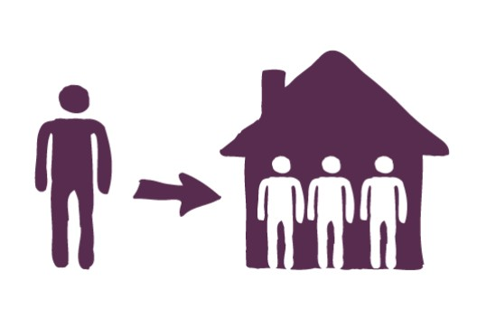
Behavioral homophily via shared interaction contexts
Controlling for confounding contextual factors requires either:
  Studying a population for whom the context is fixed and in which the choice of context is shared by all
  Measuring affiliations (e.g., club membership, classes taken) and statistically adjusting for shared interaction contexts when modeling both tie formation, decay, and social influence

