Slide 1
Social Network Seminar
Introductions: Us & You
The Seminar
  Objectives
  Topics & Readings
  Requirements
  Using RefWorks

Slide 2


Our Interests
David Hachen's Interests in Networks
  Job mobility, vacancy chains, event history analysis
  Granovetter & Burt: Finding jobs
  Web Group: Barabasi and others,
  iCeNSA
  Research Projects
Omar Lizardo's Interests in Networks
  Cultural tastes and networks
  Cultural worldviews and homophily
  Mechanisms of relationship maintenance, dissolution and decay

Slide 3
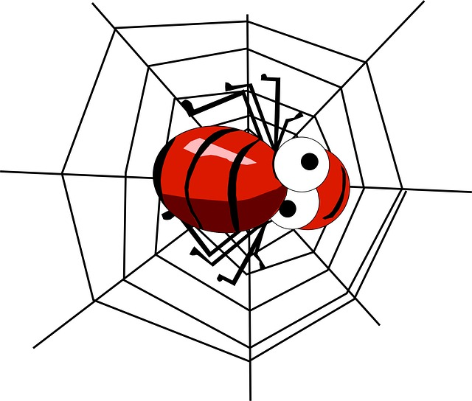
Seeing Networks
Networks as connectors
  Other connectors: social relationships, groups, organizations, social circles
Connect the Dots Metaphor
  Dots: Nodes
    People, organizations, places, ideas
  Lines: Ties (edges)
    Interaction, friendship, exchange, authority, lineage
  Flows
    Information
    resources
    evaluations (like, dislike)
    people
    Objects and commodities
Notes:
Flows
Communication/Information
energy
resources, exchanges, goods & services, trade
evaluations, like and dislike
influence
people
authority
kinship

Slide 4
What Do Social Networks Do?
Diffusion
  Ideas, behavior, information, moods, practices, disease, techniques
Exchange
  Advice, money, commodities, information, political favors
Support
  Financial, emotional, security
Inclusion/Exclusion (Access)
  Homophily, social closure, hiring, secrecy, monopoly

Slide 5
Why Study Networks: Network Theorizing
A Typology of Network Theorizing (Borgatti and Haldin 2011):
  (Classical) Network Theory (NT): networks as determinants of behavior, network effects, social influence, performance outcomes (e.g. getting a job, promotions, etc.)
    Strength of Weak Ties Theory (SWT)
    Structural Holes Theory (SH)
  Theory of Networks (TN): Origins of networks, tie formation, cognitive and social balance mechanisms, exchange processes, power-dependence processes
  Network Theory of Networks (NTN): Networks causing networks, Coupled dynamics, Formation and dissolution processes, tie-aging dynamics, homophily dynamics, structural influences on dyadic and triadic processes.

Slide 6
The Network Field: Six Sources
Mathematics: Graph Theory, Matrix Algebra, Dynamic Systems
Anthropology: Kinship and patronage networks
Psychology: Moreno's sociometry, Balance theory (Heider, Festinger), Small World Studies, Newcomb's Fraternity Study
Sociology: Lazarsfeld and Merton on opinion diffusion, Urban community studies (e.g. Laumann), urban sociology (Fischer)
Social Network Analysis (INSNA): Post 1978
Network Science (NetSci): Post 1998
Current State of Research:
  Exponential Growth
  Interdisciplinary
  Game changing
    complex, dynamic, distributed systems
  Social Media (Facebook, Twitter)

Slide 7

Levels of Analysis
Node (Vertices)
Dyads (Ties, Edges)
Triads
Higher Order Motifs (Quadruplets, Quintuplets, etc.)
Clusters (communities)
Whole Network
Multiple Networks

Slide 8
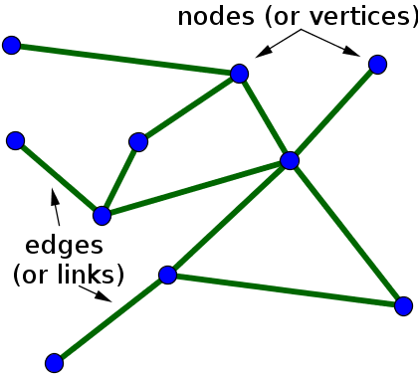
Node (Vertices)
Degree
  Network size
  Neighbor
  Popularity (indegree)
  Expansiveness (outdegree)
Centrality
  Betweenness
  Closeness
Gregariousness (activity level)
Composition
Redundancy/Clustering
Average characteristics

Slide 9
Dyad (Ties, Edges)
Strength (Weight)
  Frequency, duration, closeness
Directionality (Martin, p, 12, 21): Three Forms
  Mutual, Symmetric: e.g., "spend time together," friendship, alliance
  Antisymmetric: e.g, "employed by", domination, hierarchy
  Asymmetric: e.g, "exchange with", can be reciprocated
Social Distance, Homophily
Persistence/Decay
Formation

Slide 10
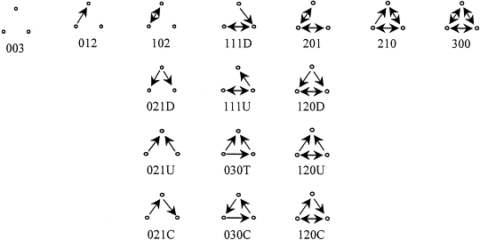
Triads and Clusters
Triads
  Transitivity
  Closure
  Embeddedness
  Triadic Census
Clusters (Communities)
  Cliques
  Bridges (cross cutting ties)

Slide 11
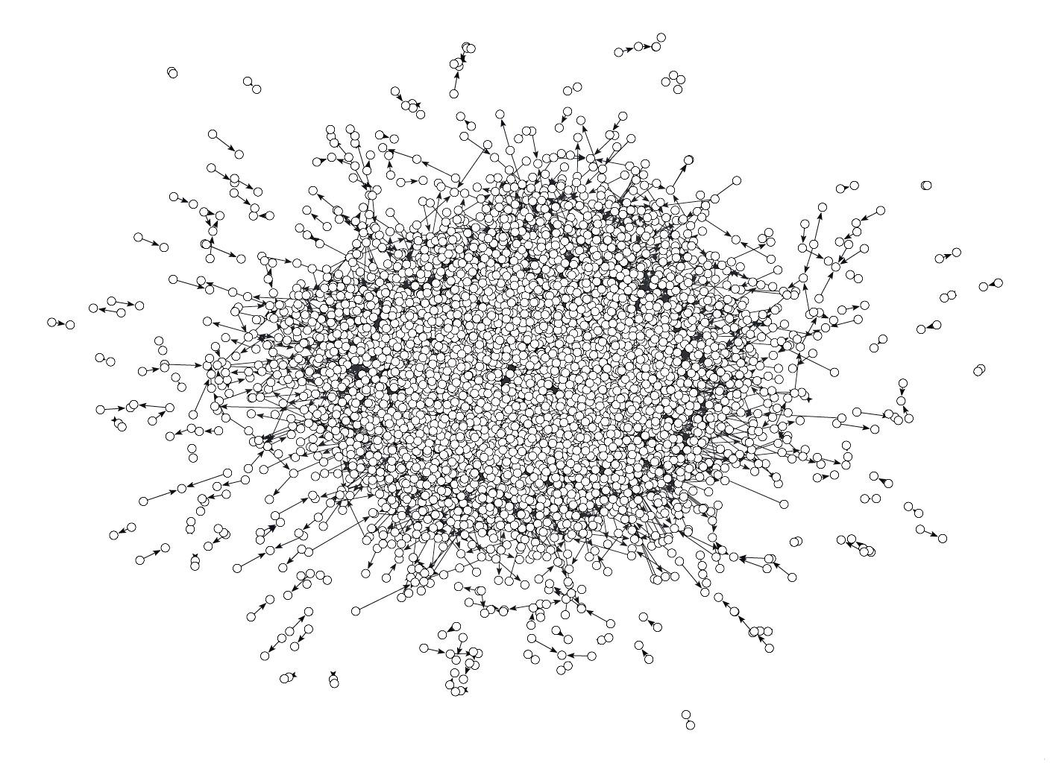
Whole Network
Size/Density
Degree distribution
Network topologies
  Core/Periphery
  Rich Club
Clustering/Connectivity
  Giant Component
  Resilience
Geodesic distance/size/diameter
  Small World
Mixing Patterns (assortativity)
  Degree Assortativity
Stability

Slide 12
Research Issues
Strength of weak ties (SWT) and Structural Holes (SH)
  Cross-cutting ties
  Bridging and bonding social capital
Intermediation/Brokerage
Scale-free networks
  Non-normal distributions (Power-law/Exponential)
  Hubs and Spokes Configuration
Core/Periphery structures
  Motifs
Weights and Reciprocity
Notes:
Models
Path Model
Evolutionary Model
Generative Model: simple rules governing processes which generate observed patterns (emerge); grow network
Demographic models (states and flows)
Distributions
e.g. normal, gassian, gen process random variation

Slide 13
Research Issues (continued)
Emergence, self-organization
  local → global
  Agent based models
Network Evolution
  Tie Formation vs. Persistence
  Assembling Networks
  Generative Models (Martin, pp. 68-9)
    Preferential attachment
    Norm of reciprocity
    Transitivity
Diffusion, influence, contagion
  Network effects

Slide 14
Research Issues
What is different about social networks?
What is a “good” network? What properties can networks maximize?
Connections among networks (social, technical, information, semantic)

