Slide 1
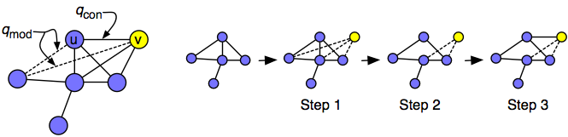
Social network models
Two purposes for modelling social networks
  Helps us understand the rules that govern the formation of network structures (Martin 2009)
  Specify the interaction structure underlying processes of interest (e.g. diffusion)
  Lots of different models have (and continue to be) proposed

Slide 2
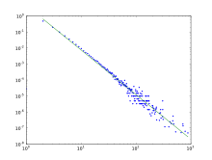
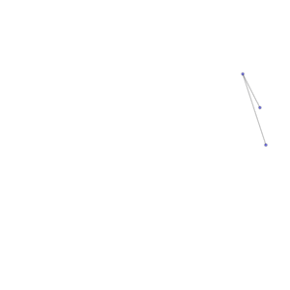
Network evolution models (NEMs)
The purpose of NEMs is to test the hypothesis that:
  Local network growth mechanisms
lead to:
  Specific global structures
    Clustering
    Given degree distribution
    Clustering
    Community structure
    Short diameter
    Degree correlations
    etc.

Slide 3
Social network models
General idea is “emergentist”:
  Global properties are generated from microlevel mechanisms
  Sometimes the local and global properties “match”
    E.g. choice homophily (rule) lead to global clustering by traits (macro property)

Slide 4
Network evolution models
General idea is “emergentist”:
  Global properties are generated from microlevel mechanisms
  Sometimes the global property is “surprising”:
    E.g. Preferential attachment (rule) leads to a small diameter (macro property)

Slide 5
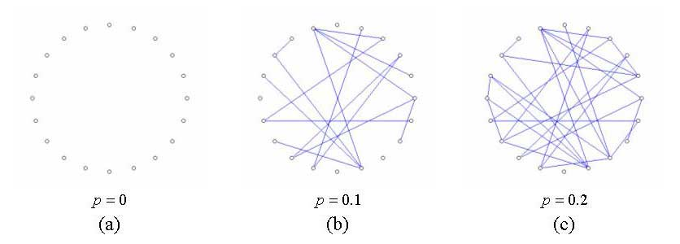
Network evolution models
You’ve already seen a few “network growth” models
  Erdos and Renyi (1960)
    Begin with a set of nodes N
    Pick two at random and link with probability p
    Repeat N(N-1) times

Slide 6
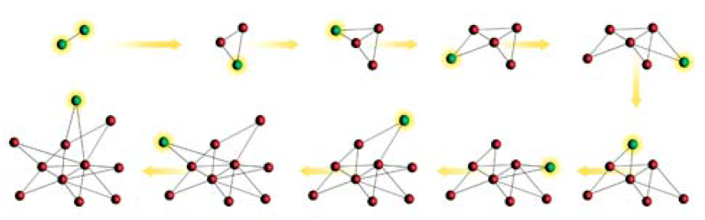
Network evolution models
You’ve already seen a few “network growth” models
  Barabasi and Albert (1999)
    Begin with two nodes
    New nodes connect to existing ones with p ~ k(i)
    Where k is the degree of node i

Slide 7
Typology of social network models (Toivonen et al 2009)
Growing Models
Network Evolution Models
Dynamical Models
Social Network Models
Node Attribute Models
Exponential Random Graph Models*
*Not a real growth model

Slide 8
Social network models (Toivonen et al 2009, Social Networks)
Four main categories of models
  Nodal Attribute Models (NAMs)
    Probability of a link depends on attributes of the nodes
  Network Evolution Models (NEMs)
    The addition of new links depend on the local network structure
    Two main subcategories of NEMs
      Dynamical Models
      Growing Models

Slide 9
Social network models (Toivonen et al 2009, Social Networks)
Dynamical Models:
  We add and/or remove ties on (starting) fixed set (N) of nodes:
    A fixed number of times M
    Until the structure of the network approaches equilibrium
      The Erdos-Renyi (1960) random graph model is a “dynamical model” by this definition

Slide 10
Social network models (Toivonen et al 2009, Social Networks)
Growing Models:
  Nodes are added (and link according to some rule)
    Until the network contains the desired number (N) of nodes
    The Barabasi-Albert preferential attachment model is a growing model by this definition

Slide 11
Network evolution models (NEMs)
Some network realization G is produced by an iterative process that starts from an initial network configuration G(t₀)
  Dynamical models begin an empty graph
  Growing models begin with a (small) seed network (sometimes a single node with “stubs”)

Slide 12
Network evolution models (NEMs)
The rules determine allowed transitions from one network G(t_{k−1})
to the next G(t_{k})
  the iterative process generates a single network realization G = G(t_{end}).

Slide 13
Network evolution models (NEMs)
The analyst must specify the stochastic rules by which the network evolves
  For instance, we may delete or add a subset of links at each time step
  We may “rewire” a set of existing links

Slide 14
Network evolution models (NEMs)
There are two stopping criteria for NEMs:
  For a growing NEM, the algorithm finishes when a network reaches a predetermined size
    Once the network is large enough the relevant statistical properties (e.g. degree distribution are fixed)
    For a dynamical NEM the algorithm finishes when the network reaches a steady state

Slide 15
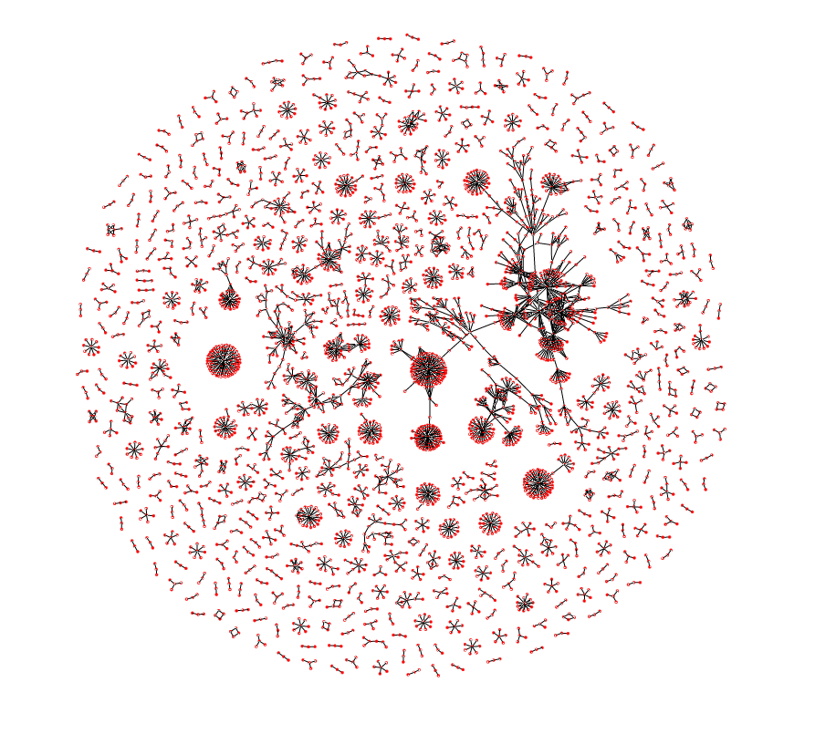
Nodal Attribute models (NEMs)
In nodal attribute models:
  The probability of an edge e_{ij} is a function of the attributes of i and j only
    e.g. p(e_{ij}) ~ d(i, j)
    Where d is distance in some socio-demographic dimension
  NAMs are thus models of the effect of homophily on network structure
  These are also referred to as spatial models

Slide 16
Nodal Attribute models (NEMs)
ERGMs (so-called "statistical" models) are not true models of network structure
  NEMs explicitly specify the rules of network evolution
  ERMGs tell us that some rule or mechanism is in operation but do not specify which one
  Mechanisms generating network structure are made explicit in NEMs but remain implicit in ERGMs

Slide 17
Example Dynamical NEMs (Toivonen et al 2009, SN)
DEB (Davidsen et al., 2002)
Parameters | Mechanisms (number of nodes N fixed; repeat steps for (I) adding ties and (II) deleting ties until stationary distributions are reached)
2 free, N, p | (I) Select a node i randomly, and
 | (a) if i has fewer than two ties, introduce it to a randomnode,
 | (b) otherwise pick two neighbors of i and introduce them if they are not already acquainted.
 | (II) Select a random node and with prob. p remove all of its ties.

Slide 18
Example Dynamical NEMs (Toivonen et al 2009, SN)
MVS(Marsili et al., 2004)
Parameters | Mechanisms (number of nodes N fixed; repeat steps for (I) adding ties and (II) deleting ties until stationary distributions are reached)
3 free, N, ξ, η | (I) Select a node i randomly, and
(λ=0.001) | (a) connect i to another random node with probability η
 | (b) Select a friend’s friend of i (by uniformly random search) with probability ξ and introduce i to it if not already acquainted.
 | (II) Select a random tie and delete it with probability λ.

Slide 19
Example Growing NEMs (Toivonen et al 2009, SN)
TOSHK(Toivonen et al., 2006)
Parameters | Mechanism (repeat steps for (I) adding nodes and ties (II) adding ties only until network contains N nodes)
3 free, N, p, k (simplified) | (I) Add a new node i to the network, connecting it to one random initial contact with probability p, or two with probability 1−p.
 | (II) For each random initial contact j, draw a number msec of secondary connections from the distribution U[0,k] and connect i to msec neighbors of j if available.

Slide 20
Example Growing NEMs (Toivonen et al 2009, SN)
Váz(Vázquez, 2003)
Parameters | Mechanism (repeat steps for (I) adding nodes and ties (II) adding ties only until network contains N nodes)
2 free N, u | (I) With probability 1−u, add a new node to the network, connecting it to a random node i. Potential edges are created between the newcomer n and the neighbors j of i (a potential edge means that n and j have a common neighbor, i, but no direct link between them).
 | (II) With probability u, convert one of such potential edges generated on any previous time step to an edge. Potential edges generated by converting an edge are ignored.

Slide 21
Example NAMs (Toivonen et al 2009, SN)
BPDA(Boguñá et al., 2004)
Parameters | Mechanism
3 free, N, α, b | Distribute N nodes with uniform probability in a (one-dimensional) social space (a segment of length hmax). Link nodes with prob. p=1/(1+(d/b)α), where d is their distance in the social space. (hmax can be absorbed within b). If treated many-dimensionally, similarity along one of the social dimensions is sufficient for the nodes to be seen as similar.

Slide 22
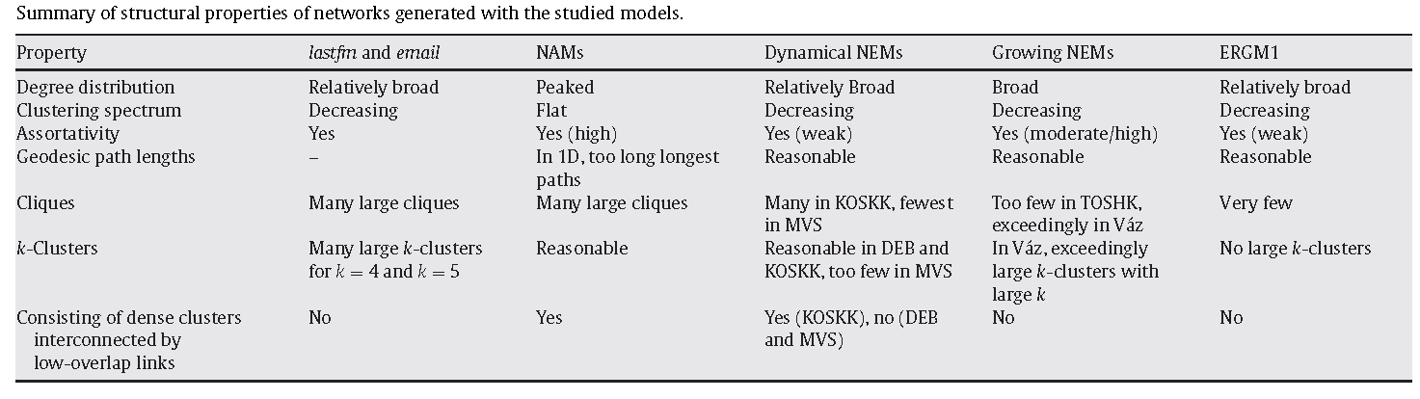
Results of comparison of model predictions against real world data
Most models reproduce average degree and size of largest component fairly well
  Simpler (one-parameter) models (DEB, Vaz) overstate clustering; other models did not have this problem

Slide 23
Results of comparison of model predictions against real world data
NAM (homophily-based) models do not generate realistic levels of clustering
  They also fail to produce heterogeneous (long-tailed) degree distributions
  They do generate clique and community structure

Slide 24
Results of comparison of model predictions against real world data
NEMs generate realistic level of degree-heterogeneity and clustering
  They also generate realistic levels of clustering and giant component size
  But assortativity falls short of empirical results
  Taking weights into account improves performance

Slide 25
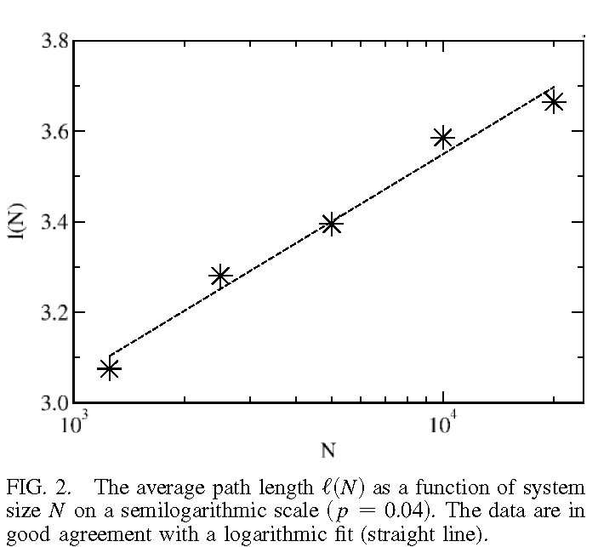
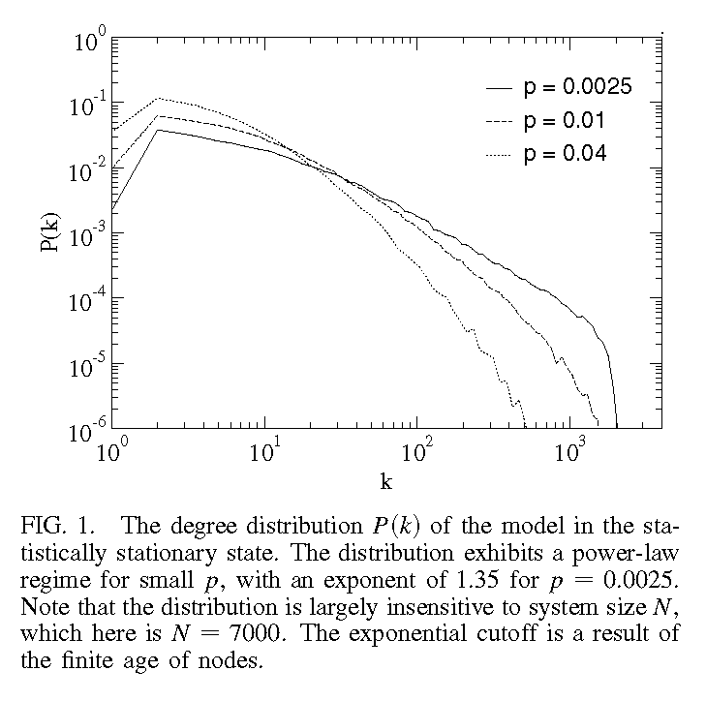
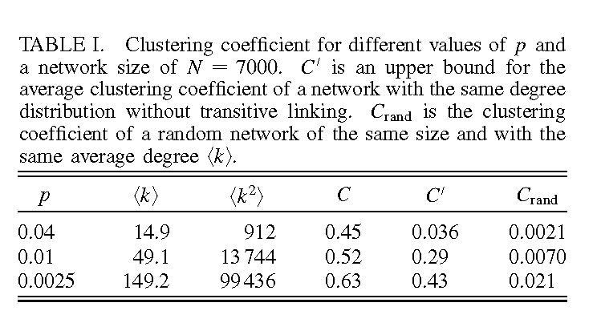
Davidson, Ebel, and Bornholdt (2002), Physical Review Letters

Slide 26
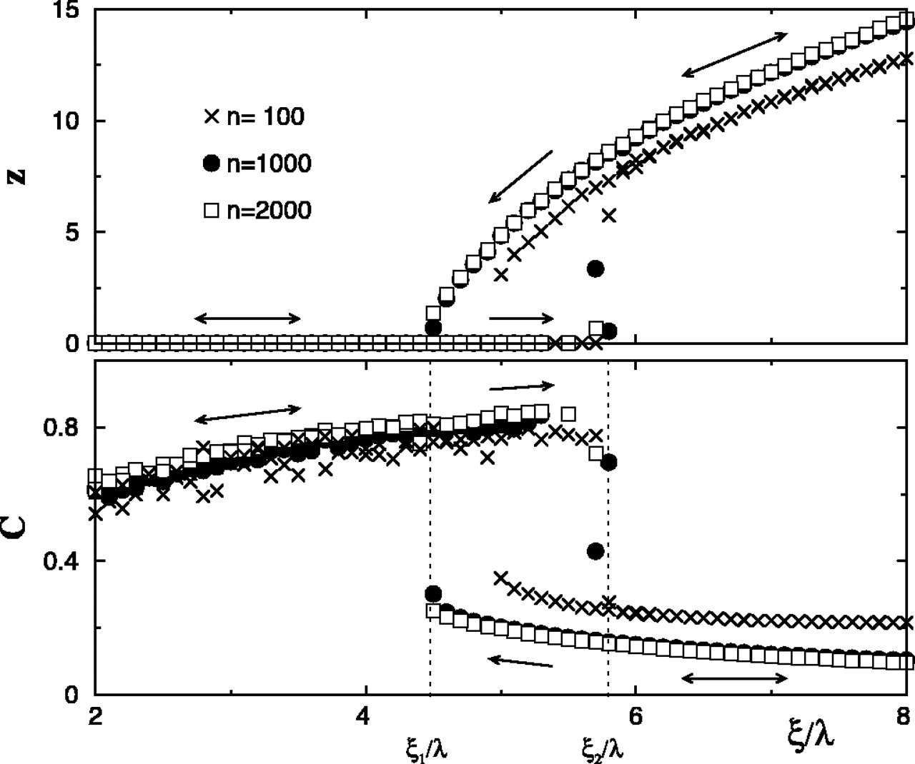
Marsili, Vega-Redondo, and Slanina (2003, PNAS)
Average degree z (Upper) and clustering coefficient C (Lower) from numerical simulations with η = 0.001 and λ = 0.1 for populations of size n = 100, 1,000, and 2,000.

Slide 27
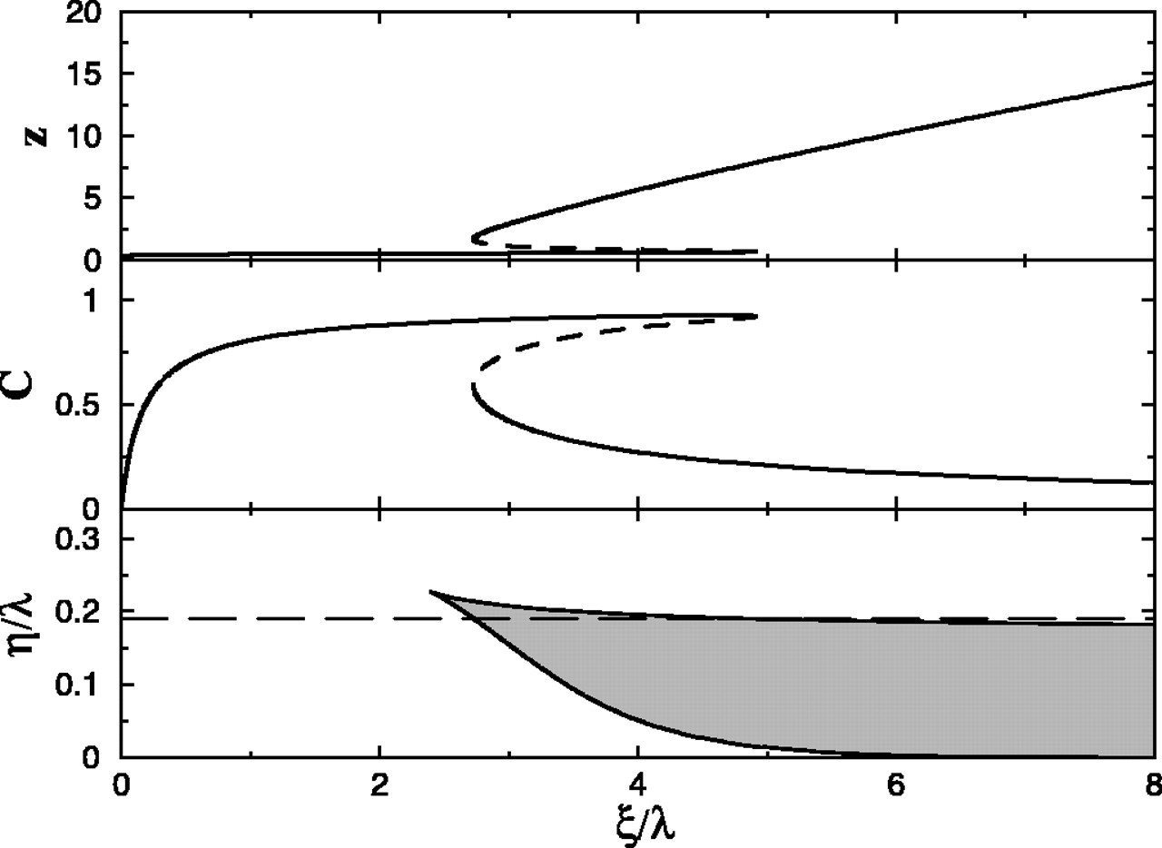
Marsili, Vega-Redondo, and Slanina (2003, PNAS)
Mean degree z (Top) and clustering coefficient C (Middle) as a function of ξ/λ for η/λ = 0.19. (Bottom) Phase diagram in the mean field approximation. The behavior of z and C along the dashed line corresponds to the simulation scenario reported above.

Slide 28
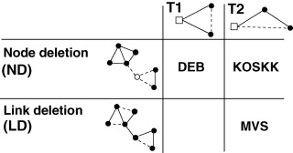
Classification of Dynamical NEMs
Fig. 2. The dynamical network evolution models DEB, KOSKK, and MVS, classified according to the mechanisms for triadic closure and link deletion employed in them.

Slide 29
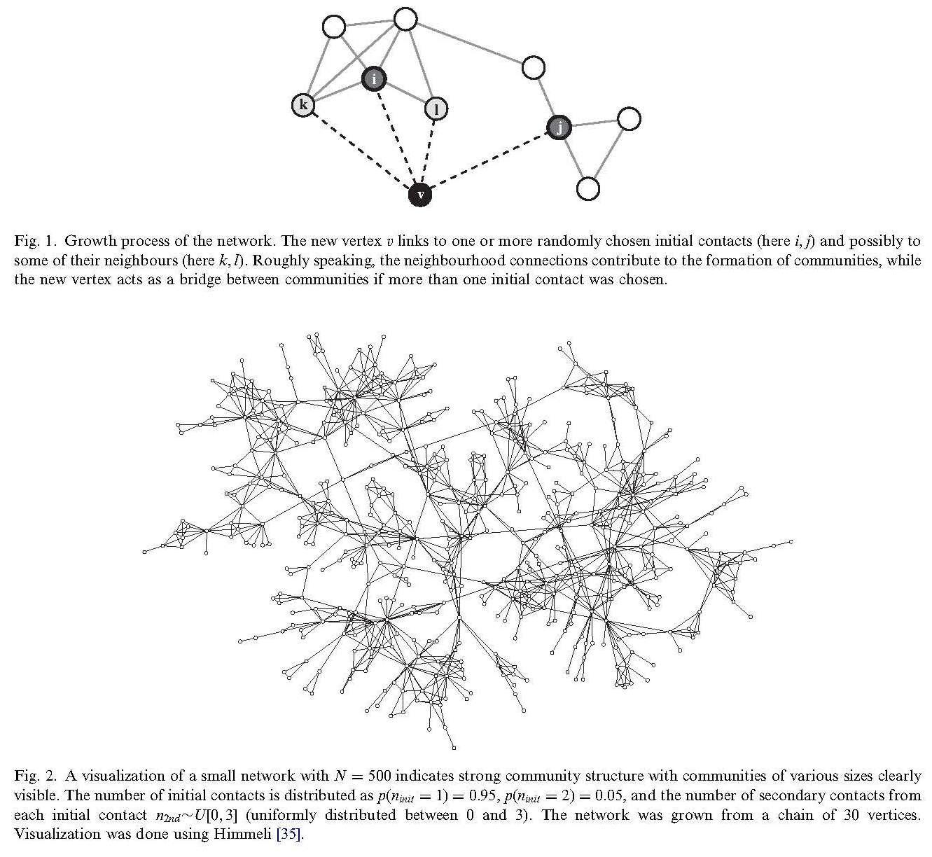
Toivonen, Onnela, Saramaki, Hyvonen, and Kaski (2006, Physica A)

Slide 30
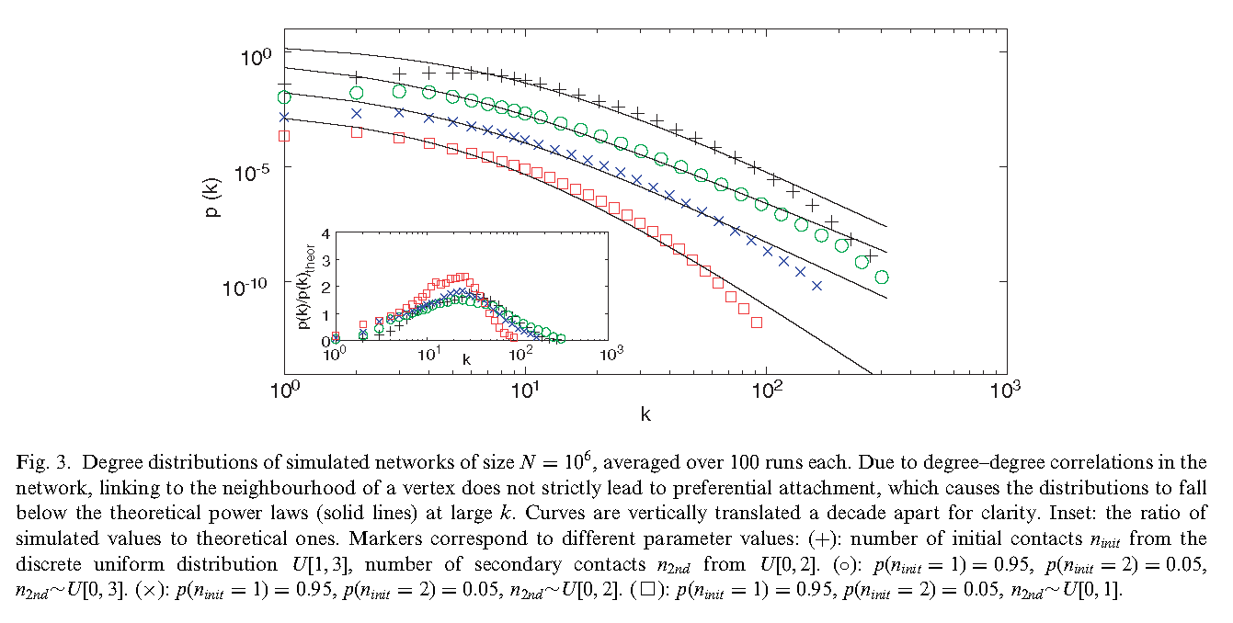
Toivonen, Onnela, Saramaki, Hyvonen, and Kaski (2006, Physica A)

Slide 31
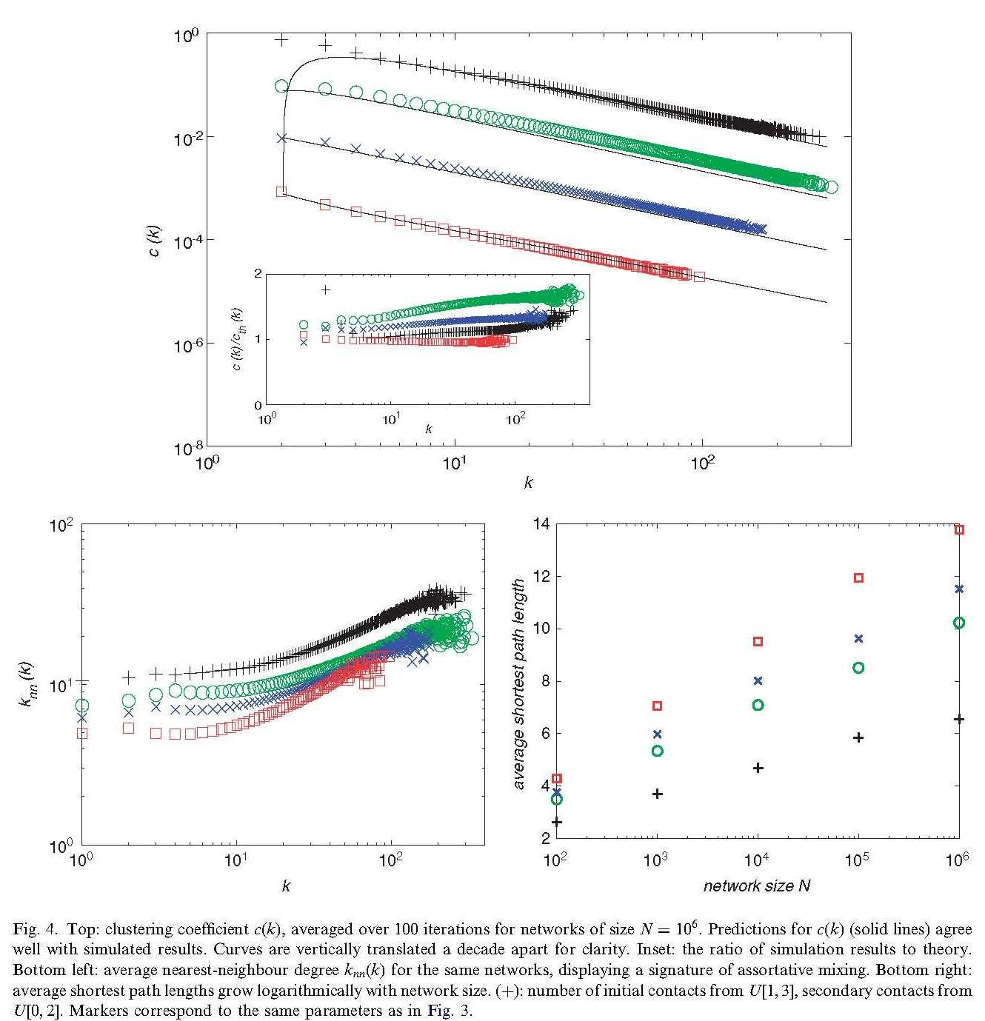
Toivonen, Onnela, Saramaki, Hyvonen, and Kaski (2006, Physica A)

Slide 32
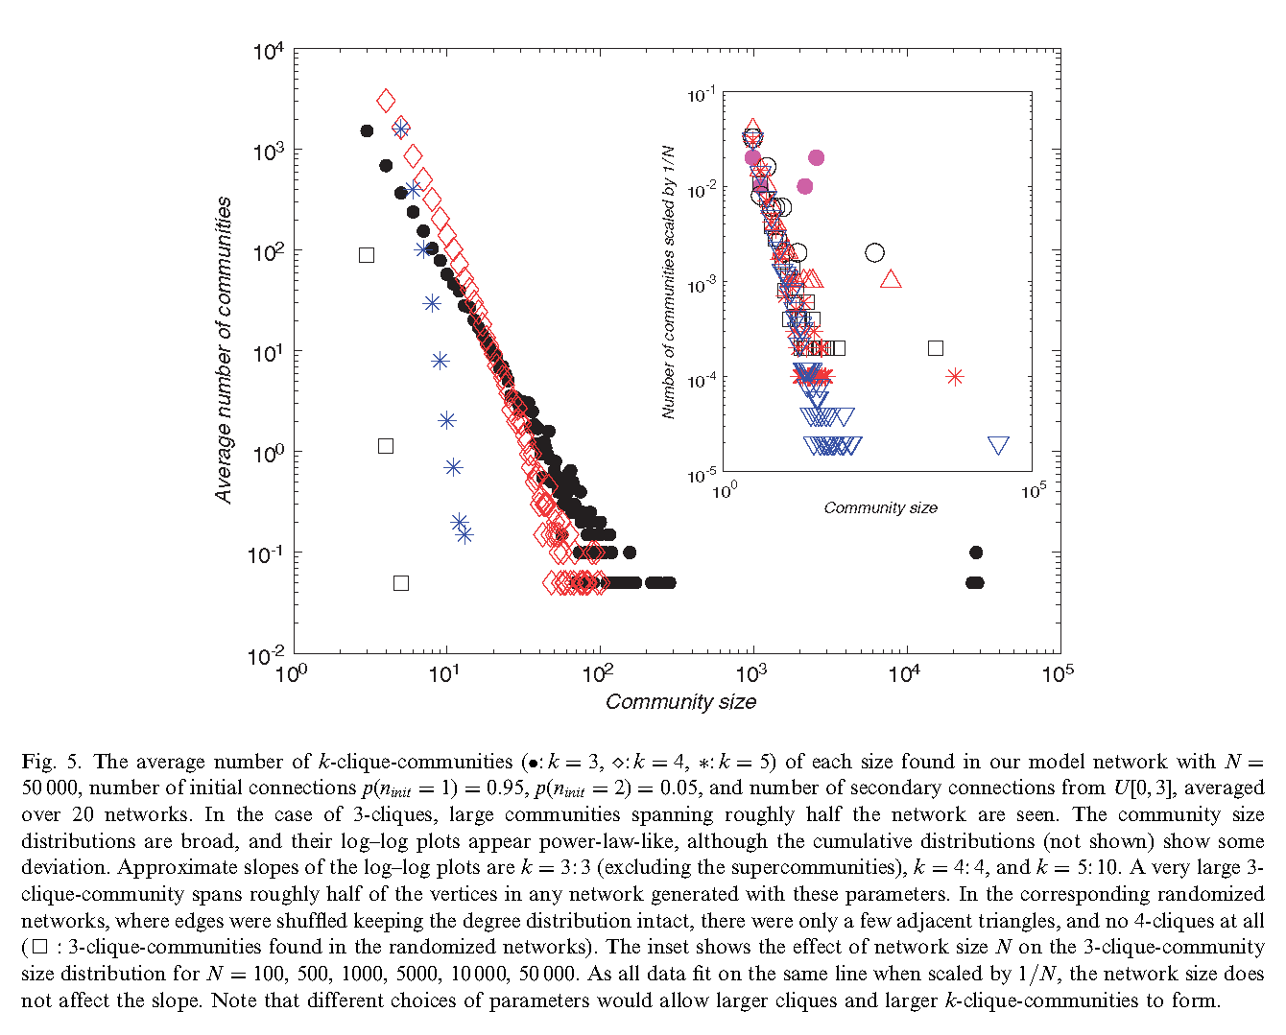
Toivonen, Onnela, Saramaki, Hyvonen, and Kaski (2006, Physica A)

