Slide 1
Power laws, Pareto distribution and Zipf's law
M. E. J. Newman
Presented by:
Abdulkareem Alali
Notes:
*

Slide 2
Intro: Measurements distribution
One noticed observation on measuring quantities that they are scaled or centered around a typical value. As an example:
  would be the heights of human beings. Most adult human beings are about 180cm tall. tallest and shortest adult men as having had heights 272cm and 57cm respectively, making the ratio 4.8.
  another example of a quantity with a typical scale the speeds in miles per hour of cars on the motorway. Speeds are strongly peaked around 75mph.
Notes:
*

Slide 3
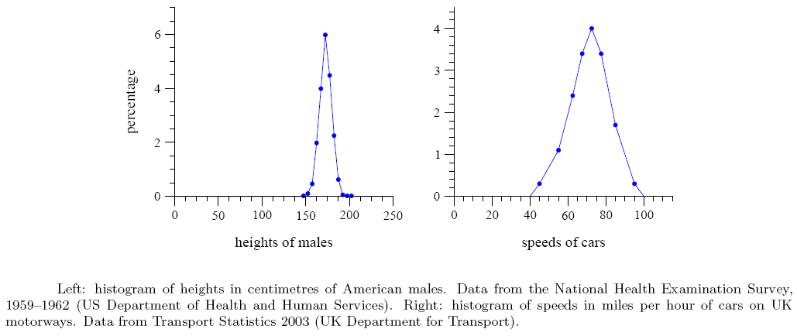
Intro: Measurements distribution
Notes:
*

Slide 4
Intro: Measurements distribution
Another observation not all things we measure are peaked around a typical value. Some vary over an enormous dynamic range sometimes many orders of magnitude. As an example:
The largest population of any city in the US is 8.00 million for New York City (2000). America’s smallest town is Duffield, Virginia, with a population of 52. the ratio of largest to smallest population is at least 150 000.
Notes:
*

Slide 5
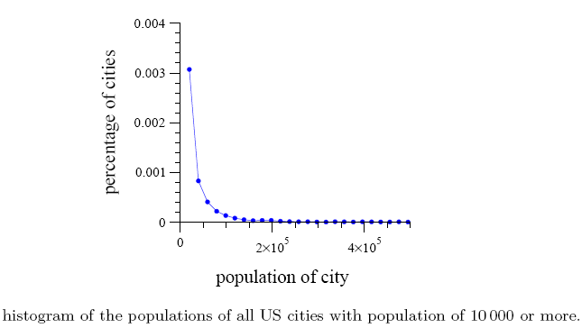
Intro: Measurements distribution
Notes:
*

Slide 6
Intro: Measurements distribution
America with a total population of 300 million people, you could at most have about 40 cities the size of New York. And the 2700 cities cannot have a mean population of more than 110,000.
A histogram of city sizes plotted with logarithmic horizontal and vertical axes follows quite closely a straight line.
Notes:
*

Slide 7
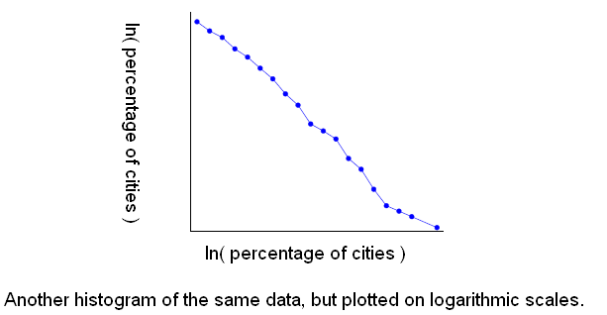
Intro: Measurements distribution
Notes:
*

Slide 8
Intro: Measurements distribution
Such histogram can be represented as
ln(y) = A ln(x) + c
Let p(x)dx be the fraction of cities with population between x and x + dx. If the histogram is a straight line on log-log scales, then
ln(p(x)) = -α ln(x) + c
⇒ p(x) = C x^{−α} , C = e^{c}
Notes:
*

Slide 9
Intro: power low distribution
This kind of distribution p(x) = C x^{−α} is called the power low distribution.
Power low implies that small occurrences are extremely common, whereas large instances are extremely rare.
Notes:
*

Slide 10
Next:
Ways of detecting power-law behavior.
Give empirical evidence for power laws in a variety of systems.
Notes:
*

Slide 11
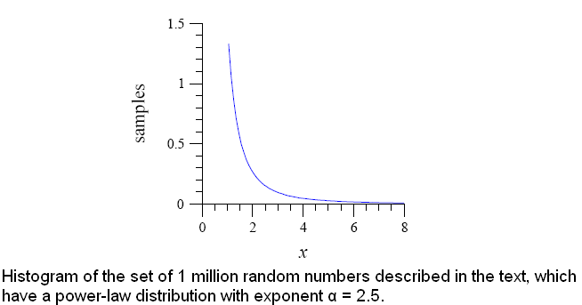
Example on an artificially generated data set
Take 1 million random numbers from a distribution with α = 2.5
A normal histogram of the numbers, produced by binning them into bins of equal size 0.1. That is, the first bin goes from 1 to 1.1, the second from 1.1 to 1.2, and so forth. On the linear scales used this produces a nice smooth curve.
Notes:
*

Slide 12
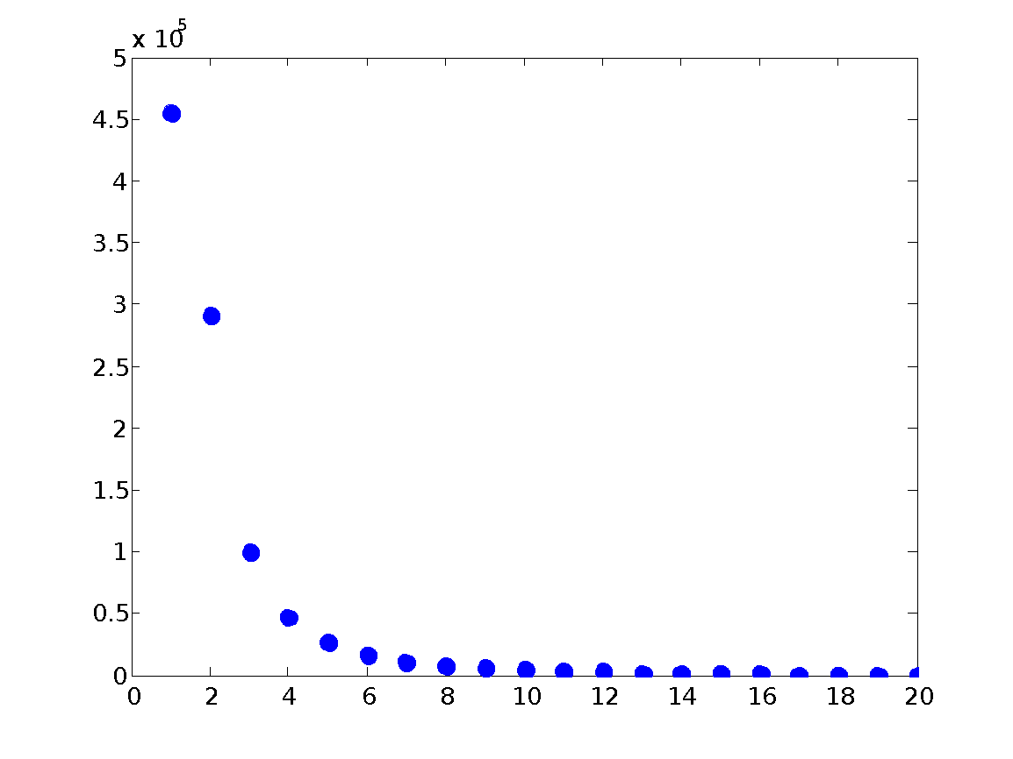
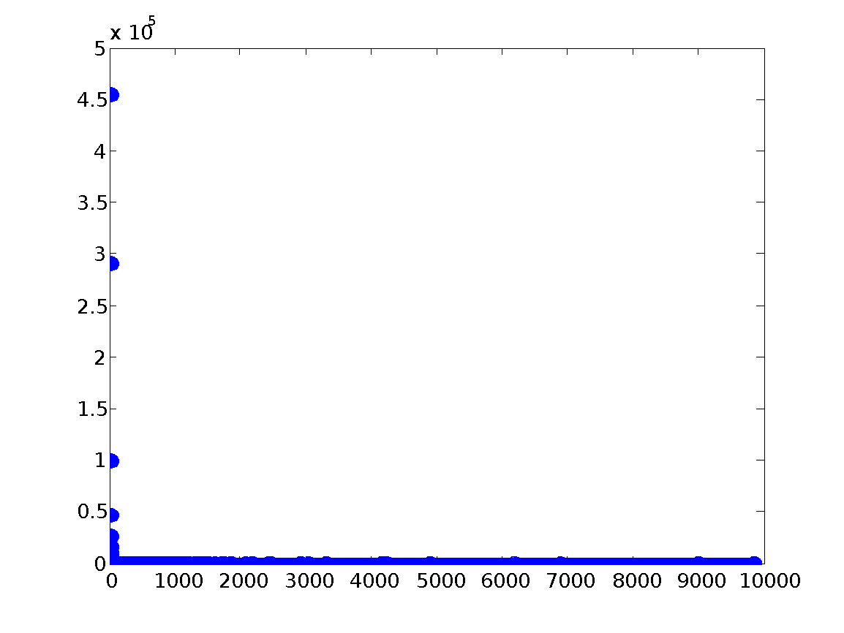
problem with Linear scale plot of straight bin of the data
How many times did the number 1 or 3843 or 99723 occur, Power-law relationship not as apparent, Only makes sense to look at smallest bins
first few bins
whole range
Notes:
*

Slide 13
I. Measuring Power Laws
The author presents 3 ways to identifying power-law behavior:
Log-log plot
Logarithmic binning
Cumulative distribution function
Notes:
*

Slide 14
1. Log-log plot
Logarithmic axes : powers of a number will be uniformly spaced
1
2
3
10
20
30
100
200
2⁰=1, 2¹=2, 2²=4, 2³=8, 2⁴=16, 2⁵=32, 2⁶=64, ….
Notes:
*

Slide 15
1. Log-log plot
To fit power-law distributions the most common and not very accurate method:
  Bin the different values of x and create a frequency histogram
ln (# of times x occurred)
ln(x)
Notes:
*

Slide 16
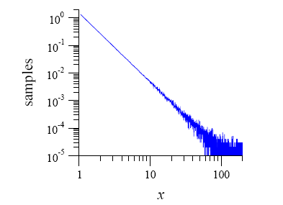
problem with the Linear scale log-log plot of straight bin of the data
the right-hand end of the distribution is noisy. Each bin only has a few samples in it, if any. So the fractional fluctuations in the bin counts are large and this appears as a noisy curve on the plot.
here we have tens of thousands of observations
when x < 10
Noise in the tail, less data in bins
Notes:
*

Slide 17
Solution1:
2. Logarithmic binning
is to vary the width of the bins in the histogram. Normalizing the sample counts by the width of the bins they fall in.
Number samples in a bin of width Δ x should be divided by Δ x to get a count per unit interval of x.
The normalized sample count becomes independent of bin width on average.
Most common choice is a fixed multiple wider bin than the one before it.
Notes:
*

Slide 18
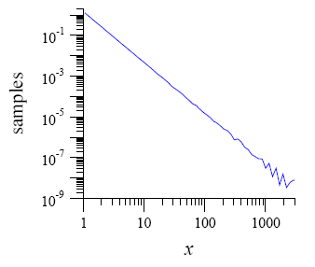
Logarithmic binning
Example : Choose a multiplier of 2 and create bins that span the intervals 1 to 1.1, 1.1 to 1.3, 1.3 to 1.7 and so forth (i.e., the sizes of the bins are 0.1, 0.2, 0.4 and so forth). This means the bins in the tail of the distribution get more samples than they would if bin sizes were fixed. Bins appear more equally spaced.
Logarithmic binning still have noise at the tail.
Notes:
*

Slide 19
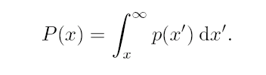
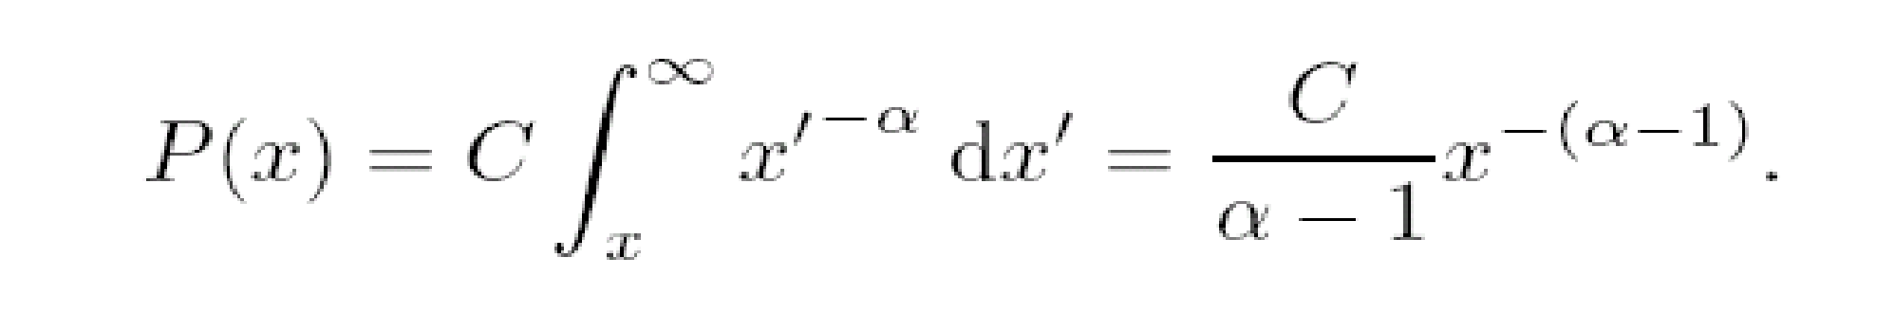
Solution2:
3. Cumulative distribution function
No loss of information
  No need to bin, has value at each observed value of x.
To have a cumulative distribution
  i.e. how many of the values of x are at least x.
  The cumulative probability of a power law probability distribution is also power law but with an exponent α – 1.
Notes:
*

Slide 20
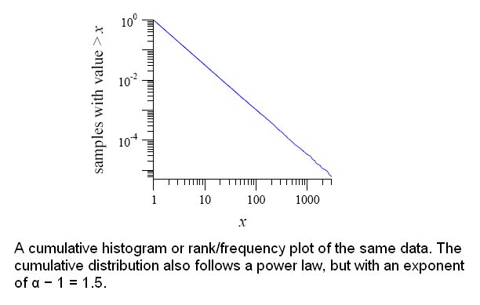
Cumulative distribution function
Notes:
*

Slide 21
Power laws, Pareto distribution and Zipf's law
Cumulative distributions are sometimes also called rank/frequency. Cumulative distributions with a power-law form are sometimes said to follow Zipf’s law or a Pareto distribution, after two early researchers.
“Zipf’s law” and “Pareto distribution” are effectively synonymous with “power-law distribution”.
Zipf’s law and the Pareto distribution differ from one another in the way the cumulative distribution is plotted—Zipf made his plots with x on the horizontal axis and P(x) on the vertical one; Pareto did it the other way around. This causes much confusion in the literature, but the data depicted in the plots are of course identical.
Notes:
*

Slide 22
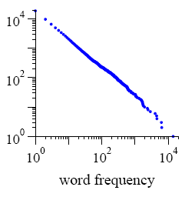
Cumulative distributions vs. rank/frequency
Sorting and ranking measurements and then plotting rank against those measurements is usually the quickest way to construct a plot of the cumulative distribution of a quantity. This the way the author used to plot all of the cumulative distributions in his paper.
Notes:
*

Slide 23
Cumulative distributions vs. rank/frequency
Plotting of the cumulative distribution function P(x) of the frequency with which words appear in a body of text:
We start by making a list of all the words along with their frequency of occurrence. Now the cumulative distribution of the frequency is defined such that P(x) is the fraction of words with frequency greater than or equal to x (P(X≥ x) ).
Alternatively one could simply plot the number of words with frequency greater than or equal to x.
Notes:
*

Slide 24
Cumulative distributions vs. rank/frequency
For example : The most frequent word, which is “the” in most written English texts. If x is the frequency with which this word occurs, then clearly there is exactly one word with frequency greater than or equal to x, since no other word is more frequent.
Similarly, for the frequency of the second most common word—usually “of”—there are two words with that frequency or greater, namely “of” and “the”. And so forth.
In other words, if we rank the words in order, then by definition there are n words with frequency greater than or equal to that of the nth most common word. Thus the cumulative distribution P(x) is simply proportional to the rank n of a word. This means that to make a plot of P(x) all we need do is sort the words in decreasing order of frequency, number them starting from 1, and then plot their ranks as a function of their frequency.
Such a plot of rank against frequency was called by Zipf a rank/frequency plot.
Notes:
*

Slide 25
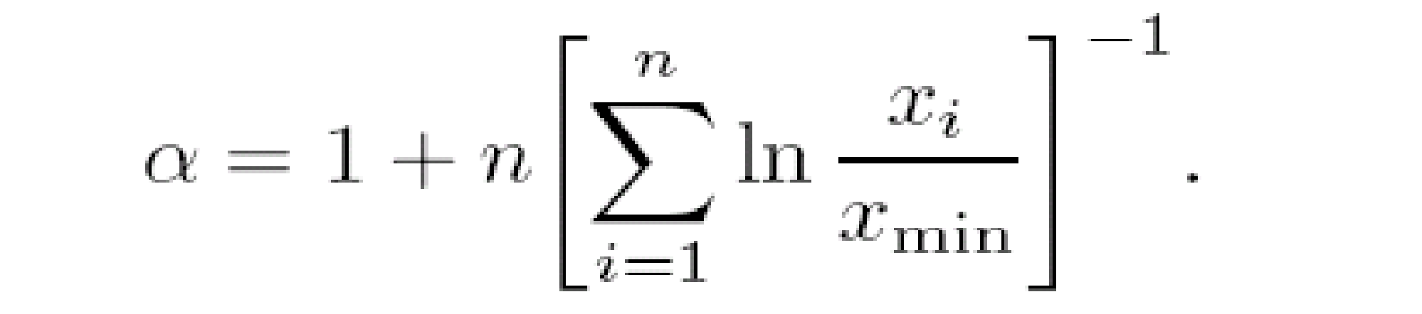
Estimate α from observed data
One way is to fit the slope of the line in plots and this is the most commonly used method. For example, for the plot that was generated by Logarithmic binning gives α = 2.26 ± 0.02, which is incompatible with the known value of α = 2.5 from which the data were generated.
An alternative, simple and reliable method for extracting the exponent is to employ the formula which gives α = 2.500 ± 0.002 to the generated data.
Notes:
*

Slide 26
Examples of power laws
Word frequency: Estoup.
Citations of scientific papers: Price.
Web hits: Adamic and Huberman
Copies of books sold.
Diameter of moon craters: Neukum & Ivanov.
Intensity of solar flares: Lu and Hamilton.
Intensity of wars: Small and Singer.
Wealth of the richest people.
Frequencies of family names: e.g. US & Japan not Korea.
Populations of cities.
Notes:
*

Slide 27
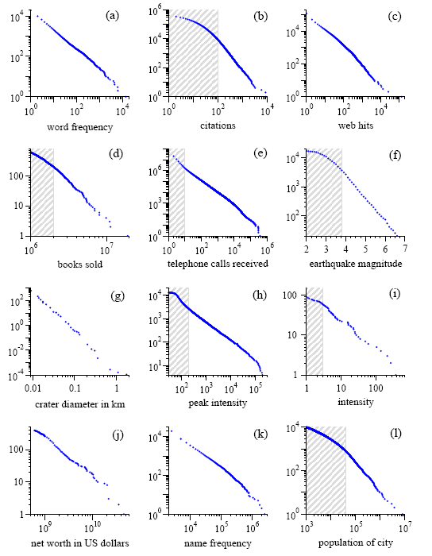
The following graph is plotted using Cumulative distributions
Notes:
*

Slide 28
Real world data for x_{min} and α
 | x_{min} | α
frequency of use of words | 1 | 2.20
number of citations to papers | 100 | 3.04
number of hits on web sites | 1 | 2.40
copies of books sold in the US | 2 000 000 | 3.51
telephone calls received | 10 | 2.22
magnitude of earthquakes | 3.8 | 3.04
diameter of moon craters | 0.01 | 3.14
intensity of solar flares | 200 | 1.83
intensity of wars | 3 | 1.80
net worth of Americans | $600m | 2.09
frequency of family names | 10 000 | 1.94
population of US cities | 40 000 | 2.30
Notes:
*

Slide 29
Not everything is a power law
The abundance of North American bird species.
The number of entries in people’s email address
The distribution of the sizes of forest fires.
Notes:
*

Slide 30
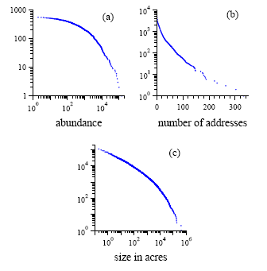
Not everything is a power law
Notes:
*

Slide 31
Conclusion
The power-law statistical distributions seen in a wide variety of natural and man-made phenomena, from earthquakes and solar flares to populations of cities and sales of books.
We have seen examples of power-law distributions in real data and seen 3 ways that have been used to measuring power laws.
Notes:
*

Slide 32
References
Power laws, Pareto distributions and Zipf’s law. M. E. J. Newman, Department of Physics and Center for the Study of Complex Systems, University of Michigan, Ann Arbor, MI 48109. U.S.A.
Notes:
*

Slide 33
End
Notes:
*

