Slide 1
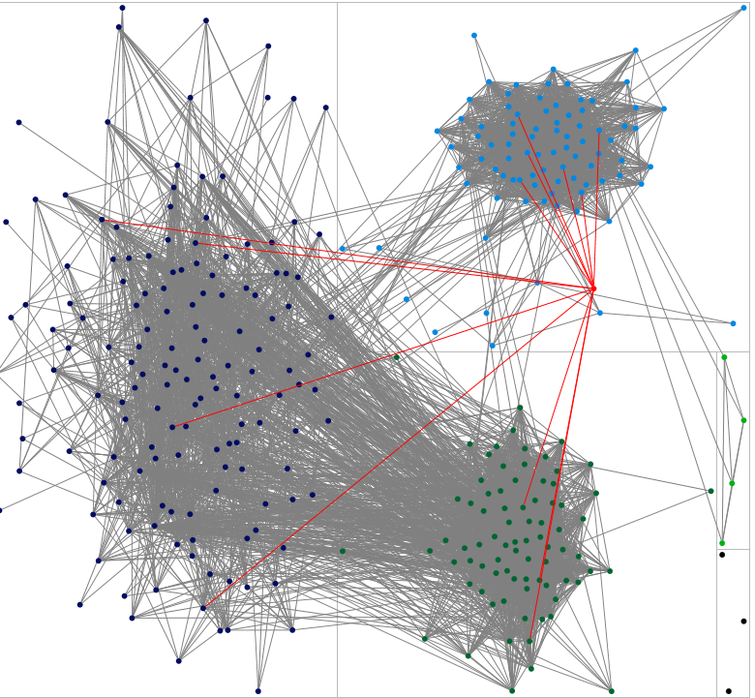
Amy’s facebook network

Slide 2
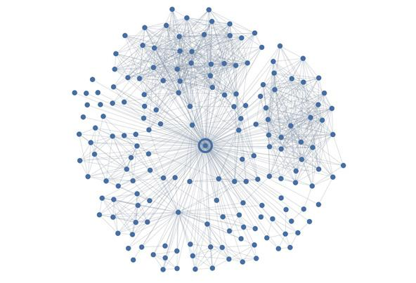
Backstrom and Kleinberg
You

Slide 3
Backstrom and Kleinberg
You
Why?
Significant Other?

Slide 4
Two simple ideas
Network connections not just pipes through which things flow; also prisms reflecting who we are to others
If we know the rules people follow when they connect, then we can guess some things about the whole network

Slide 5
Two simple ideas
Network connections not just pipes through which things flow; also prisms reflecting who we are to others
If we know the rules people follow when they connect, then we can guess some things about the whole network

Slide 6
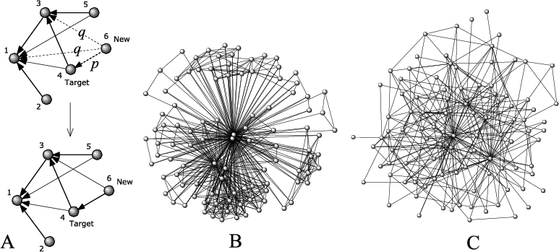
From “statics” to “dynamics”
We have talked about networks as static structures (flow model)
  But networks have a history
  The “grow” over time
    How do they grow?

Slide 7
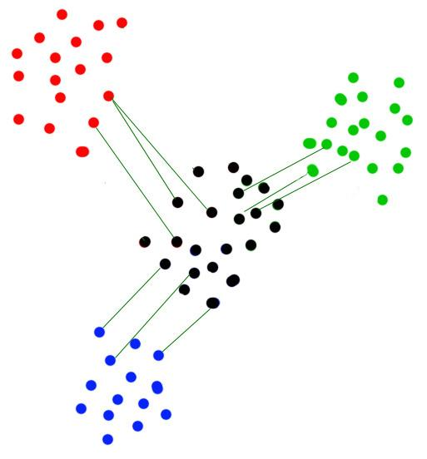
From “statics” to “dynamics”
We have seen one possible growth mechanism
  Like connects to like (homophily)
    Not the only possible one
  Why?

Slide 8
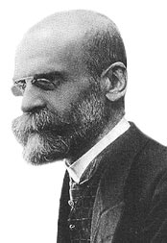
From “statics” to “dynamics”
Durkheim:
  Mechanical solidarity
    Social unity via sameness
  Organic solidarity
    Social unity via differences
  When?

Slide 9
From “statics” to “dynamics”
Organic solidarity
  Social unity via differences
    Market Exchange
    Complementarity
    General case:
      Somebody has something we lack
      Connecting to others connects us to that something

Slide 10
How to form a network: Two rules
Mechanical solidarity
  Connect to those who share your trait
Organic solidarity
  Connect to those that do not share your trait

Slide 11
How to form a network: Two rules
Two cases of organic solidarity
  “Uninteresting”
    The trait is “exogenous” to the network: beauty, money, expertise, etc.
  “Interesting”
    The trait is “endogenous” to the network (e.g. How many friends the other person has)

Slide 12
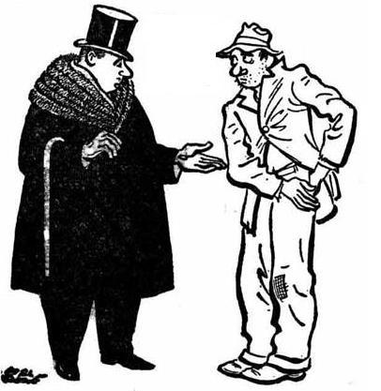
How to form a network
Why is the “endogenous” case interesting?
  Agents follow a local rule generate “global” consequences
    “Rich get richer,” even though nobody “wanted” it

Slide 13
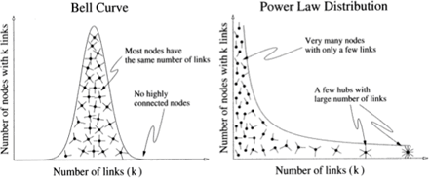
How to form a network
If persons prefer to connect with those who are already connected…
    The distribution of connections gets a little funny

Slide 14
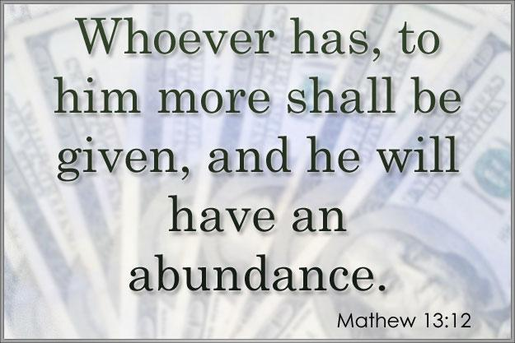
How to form a network

Slide 15
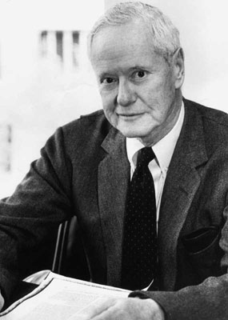
How to form a network
The “Matthew Effect”
  First noted by sociologist Robert Merton in the context of citations in science
    The consequence?

Slide 16
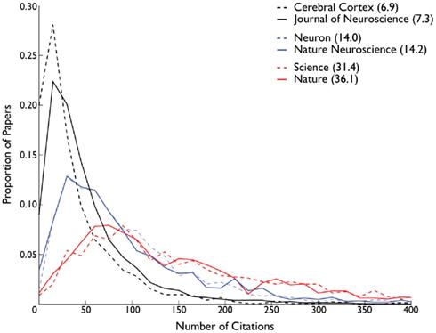
How to form a network
Papers that already have a lot of citations…
  More likely to be cited in the future

Slide 17
How to form a network
Papers that don’t have a lot of citations…
  Less likely to be cited in the future

Slide 18
How to form a network
The “Matthew Effect”:
  Does it “work” for other things?
    The World Wide Web (not to be confused with the internet!)
    Sexual networks (success breeds success)
    Corporate partnerships
    Hollywood actors
  Why?
    Each setting probably has its own “explanation”

Slide 19
How to form a network
The “Matthew Effect”:
  Does it “work” for other things?
    The World Wide Web (not to be confused with the internet!)
    Sexual networks (success breeds success)
    Corporate partnerships
    Hollywood actors
  Why?
    Each setting probably has its own “explanation”
      But general idea is that previous history of connections signals something desirable about that person

Slide 20
How to form a network
The “Matthew Effect”:
  Does it “work” for other things?
    The World Wide Web (not to be confused with the internet!)
    Sexual networks (success breeds success)
    Corporate partnerships
    Hollywood actors
  Why?
    Each setting probably has its own “explanation”
      e.g. “Rating/Dating” complex

Slide 21
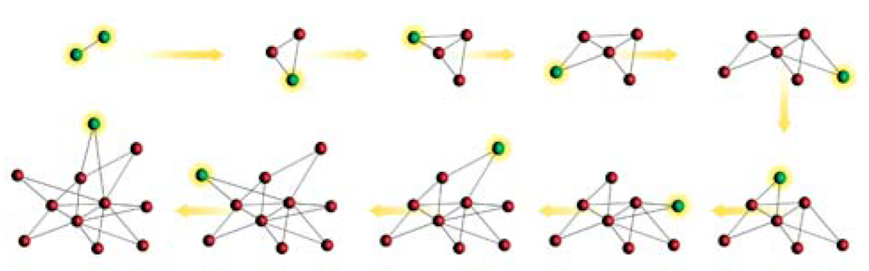
Forming a (scale free) network
General model:
    New people come into the network (network grows)
    When people enter the network they prefer to connect to people that already have a lot of connections

Slide 22
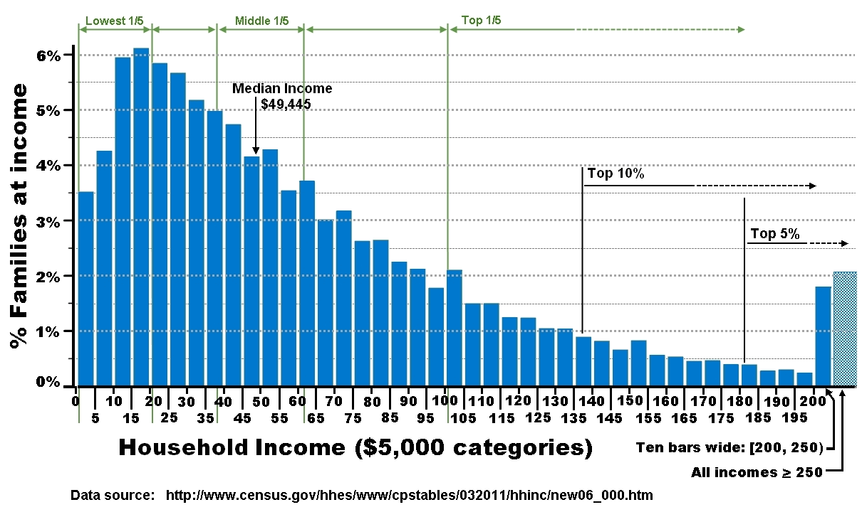
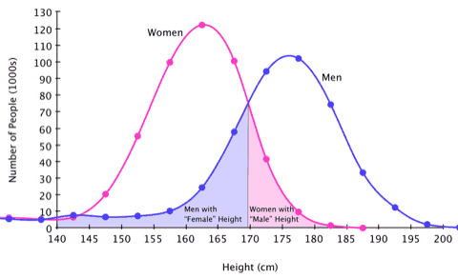
Forming a (scale free) network
This process generates a “scale free” network (in terms of ‘degree”)
  What the heck is a “scale”?
    It’s a statistic that objects don’t stray far from what you’d expect

Slide 23
Forming a (scale free) network
Scale free networks have a number of “good” properties
    They are resistant to disruption by the removal of any one single actor
      Why?

Slide 24
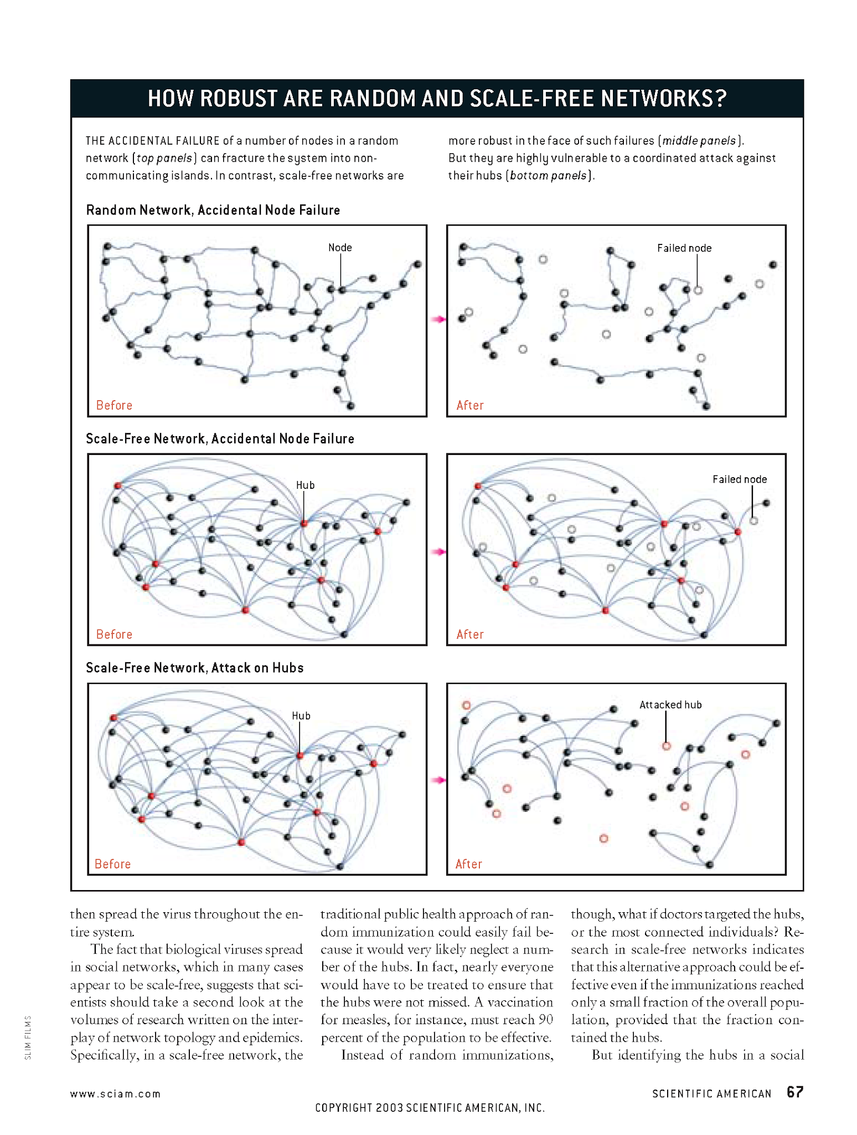
Properties of scale free nets
“Scale free” networks have a number of “good” properties
    They are resistant to disruption by the removal of any one single actor
      Why?

Slide 25
Properties of scale free nets
Scale free networks have a number of “good” properties
    They are good at transmitting things
      Why?
      Is this always good?

Slide 26
Properties of scale free nets
Scale free networks have a number of “good” properties
    But they are vulnerable to targeted attacks
      Why?

Slide 27
Properties of scale free nets
Scale free networks have a number of “good” properties
    But they are vulnerable to targeted attacks
      Why?

