Slide 1
Ego Networks
Alter and k egos
Nodel degree (k)
How diverse is an ego’s network?
Correlates of “diversity”
  Degree
  heterogeneity (composition)
  weak ties
  redundancy/density
Notes:
Who is likely to have more diverse networks
Why diversity important

Slide 2
Marsden Findings
  core network is dense (.61)
  core network is more homogenous on age, education, race, sex
    though there is age and education heterogenity
  Age, Education, Sex, Race and Place Correlates of network size, density and heteogeneity (Tables 3 &4)

Slide 3
Burt – Discussion Groups
More diverse network is one in which ties with alters vary in their content
Form and Content
Form: Three dimensions: Frequency, Closeness, and Kin

Slide 4
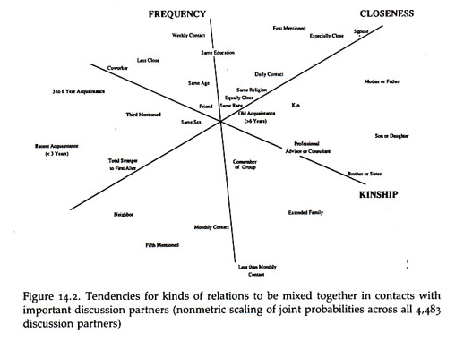
Burt Discussion Groups

Slide 5
Burt Findings
The predominant character of core discussin groups is that they connect people to alters that a person sees more often, are close to, and are kin
Distinction between different types of alters increases with status and declines with age
  High status people have kin, but they also have nonkin they see frequency (co-workers) AND close people beyond family and co-workers.
  Younger people have kin, but also no-kin that they see frequently and close people who are not kin
    middle aged keep kin (but now children), less daily contact
Notes:
Older peoples nets are composed of people who are both close, seen frequently and kin
Low status people’s nets are composed of people who are close, freqauent and kin (so relations are ambiguous)

Slide 6
Burt - Range
Degree (number of alters)
Number of types of alters
Redundancy
Notes:
for types need a variable trait of alters, like educaiton, SES
2 alters of same type count only once
caveat – cohesiness of status group

Slide 7
Grovetter – Strength of Weak Ties
Getting a better job
Job Search & Information
How do people get jobs – contacts
Measure whether job is better and type of contact used to find job
Type of contact: family/friend vs. acquaintance
Finding: Odd getting better job increases when a person heard about the job through an acquaintance (weak tie)

Slide 8
Granovter
Acquaintance = Weak Tie
Weak Tie = Non-redundant tie

Slide 9
Burt – Structural Holes
High degree and high density → less diverse network
Dense networks are redundant, i.e. not diverse
Structural Hole: Seperation (lack of direct or indirect ties) beween nonredundant contact
  Network benefits of each alter additive (no overlap)
  Tie between ego and non-redundant alter is a bridge
Notes:
redundancy and omiting

Slide 10
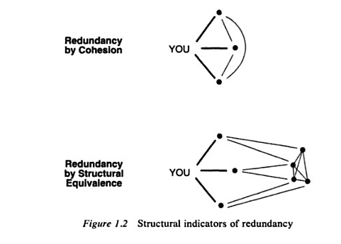
Redundancy
Notes:
does struct equiv lead to cohesion as triangle close

Slide 11
Efficiency & Effectivness
Efficiency: Maximize the number of non-redundant alters
Effectivness: Draw your alters from different social worlds
Notes:
Effectivness concerns connecting to hubs within a cluster
reachability : number of 2 degree neighbors.

Slide 12
Weak Ties & Structural Holes
Hypothesis: The ties with non-redundant alters that form a structural hole tend to be weak

Slide 13
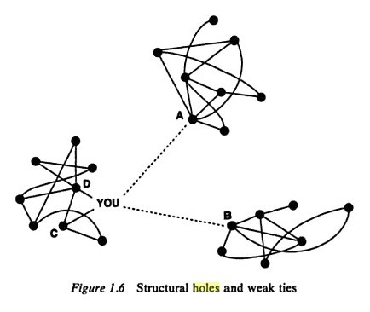
Structural Holes & Weak Ties
Notes:
Ties within clusters tend to be strong (why?)
Some ties within clusters are weak (indirect transitive closing ties)
But some ties of a node within a cluster are weak and to a node in another cluster
If that tie was strong, then closure, i.e. ego would have ties (maybe weak) to the bridges alters

Slide 14
Redundancy: 2 Steps
Calculate how important each alter is to ego (relative strength of a tie)
Calculate redundancy of each alter

Slide 15

Redundancy
Burt defines redundancy as:

