Slide 1
Ego Networks
Alter (j) and k egos
Nodal degree (k)
How diverse is an ego’s network?
Correlates of “diversity”
  Degree
  heterogeneity (composition)
  weak ties
  redundancy/density
Notes:
Who is likely to have more diverse networks
Why diversity important

Slide 2
Sociological Findings
Core network tend to dense (have high clustering)
Core network is more homogenous on age, education, race, sex
  though there is age and education heterogeneity
Notes:
discuss important matters

Slide 3
Burt – Discussion Groups
A more diverse network is one in which ties with alters vary in their content
Form and Content
Three dimensions: Frequency, Closeness, and Kin

Slide 4
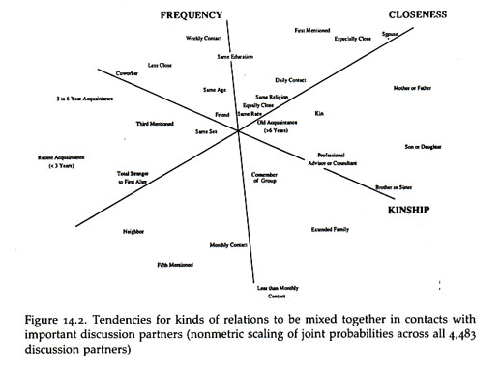
Burt Discussion Groups

Slide 5
Burt Findings
The predominant character of core discussing groups is that they connect people to alters that a person sees more often, are close to, and are kin
Distinction between different types of alters increases with status and declines with age
  High status people have kin, but they also have nonkin they see frequency (co-workers) AND close people beyond family and co-workers.
  Younger people have kin, but also non-kin that they see frequently and close people who are not kin
  middle aged keep kin (but now children), less daily contact
Notes:
Older peoples nets are composed of people who are both close, seen frequently and kin
Low status people’s nets are composed of people who are close, freqauent and kin (so relations are ambiguous)

Slide 6
Granovetter:
Strength of Weak Ties
Getting a better job
Job Search & Information
How do people find out about jobs?
Measure whether job is better and type of contact used to find a job
Type of contact: family/friend vs. acquaintance
Finding: Odds of getting better job increases when a person hears about the job through an acquaintance (weak tie)
Explanation: weak ties are to non-redundant alters who are more likely to know about jobs than ego’s strong ties
Notes:
Different ways to find out about jobs: newspapers, signs, word of mouth

Slide 7
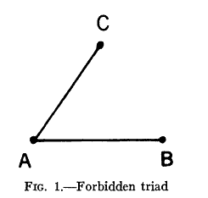
Granovetter Assumptions
Acquaintance = Weak Tie
Weak Tie = Non-redundant tie
Notes:
A “Forbidden Triad” is more likely to happen when the two constituent ties are weak.

Slide 8
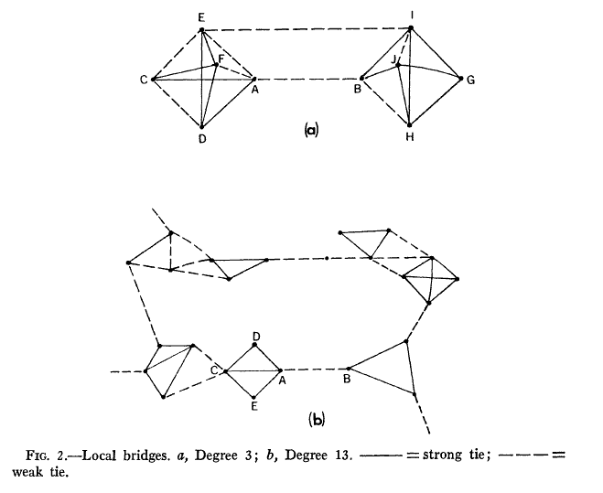
Granovetter Assumptions
Weak ties are more likely to be “bridges”
Notes:
Bridges connect otherwise disconnected cliques in the social structure

Slide 9
Burt – Structural Holes
High degree and high density → less diverse network
Dense networks are redundant, i.e. not diverse
Structural Hole: Seperation (lack of direct or indirect ties) between nonredundant contact
  Network benefits of each alter additive (no overlap)
  Tie between ego and non-redundant alter is a bridge
Notes:
redundancy and omiting

Slide 10
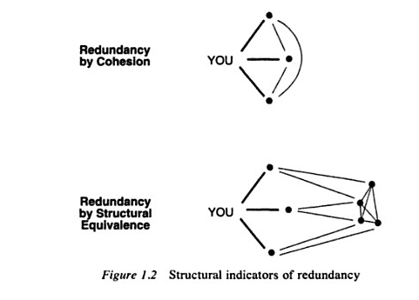
Redundancy
Notes:
does struct equiv lead to cohesion as triangle close

Slide 11
Efficiency & Effectiveness
Efficiency: Maximize the number of non-redundant alters
Effectiveness: Draw your alters from different social worlds
Notes:
Effectivness concerns connecting to hubs within a cluster
reachability : number of 2 degree neighbors.

Slide 12
Weak Ties & Structural Holes
Hypothesis: The ties with non-redundant alters that form a structural hole tend to be weak

Slide 13
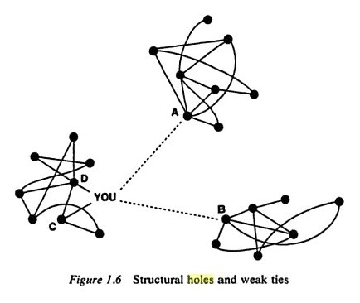
Structural Holes & Weak Ties
Notes:
Ties within clusters tend to be strong (why?)
Some ties within clusters are weak (indirect transitive closing ties)
But some ties of a node within a cluster are weak and to a node in another cluster
If that tie was strong, then closure, i.e. ego would have ties (maybe weak) to the bridges alters

Slide 14
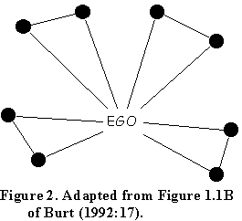
Redundancy and Reach
Effective Size = 8 – (2*4)/8 = 7
Efficiency = 7/8 = .875
Reach effciency = size of 2nd order neighborhood divided by sum of degrees of alters = 8/16 = .5

Slide 15
Other Issues
Intermediation (Bridges)
Core/Periphery Network
  Alters with different edge weights

Slide 16
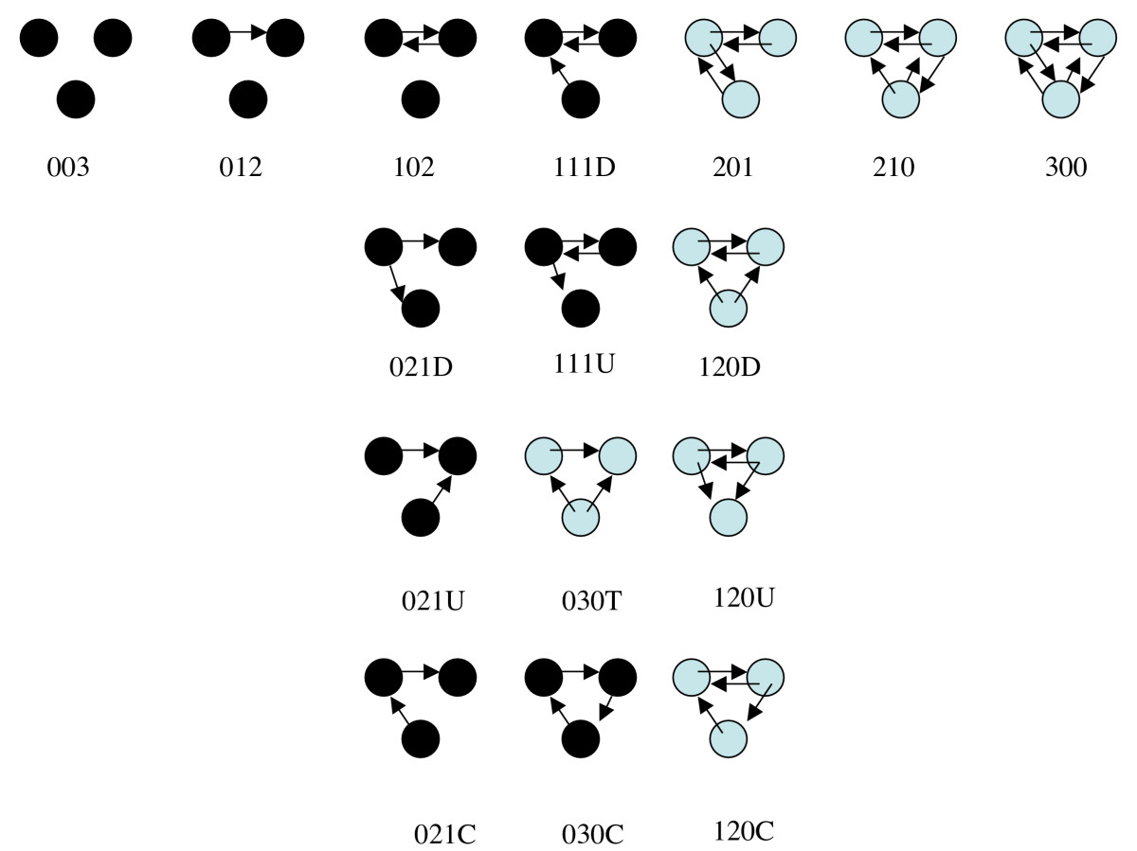
Social Network Motifs
Notes:
Fully connected (balanced) triads are more likely to appear in friendship networks than expected by chance. Cycles tend to be rater.

