Slide 1
Social Networks
An Introduction

Slide 2
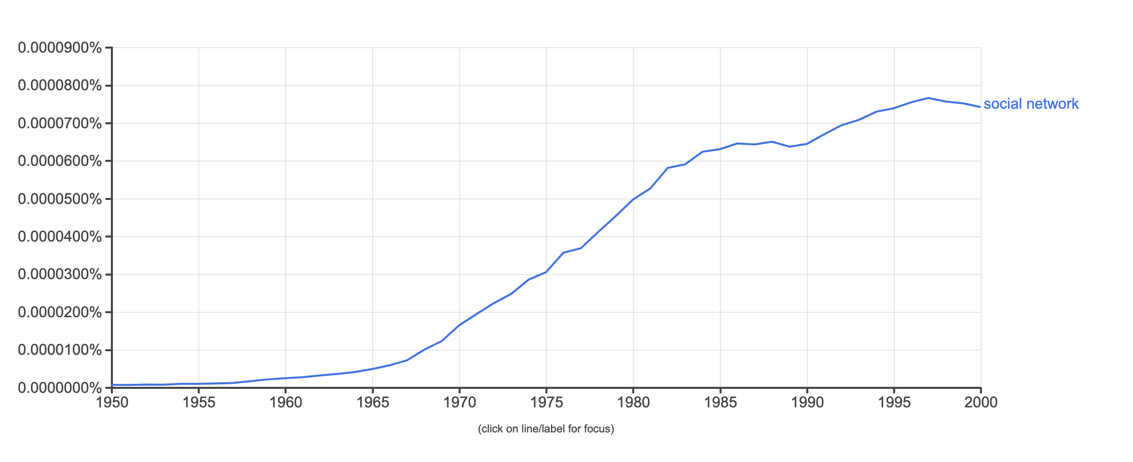
Social Networks are In
Facebook, Twitter, Social Media
Networking
Viral spreading
Exponential growth in network research, papers, articles

Slide 3
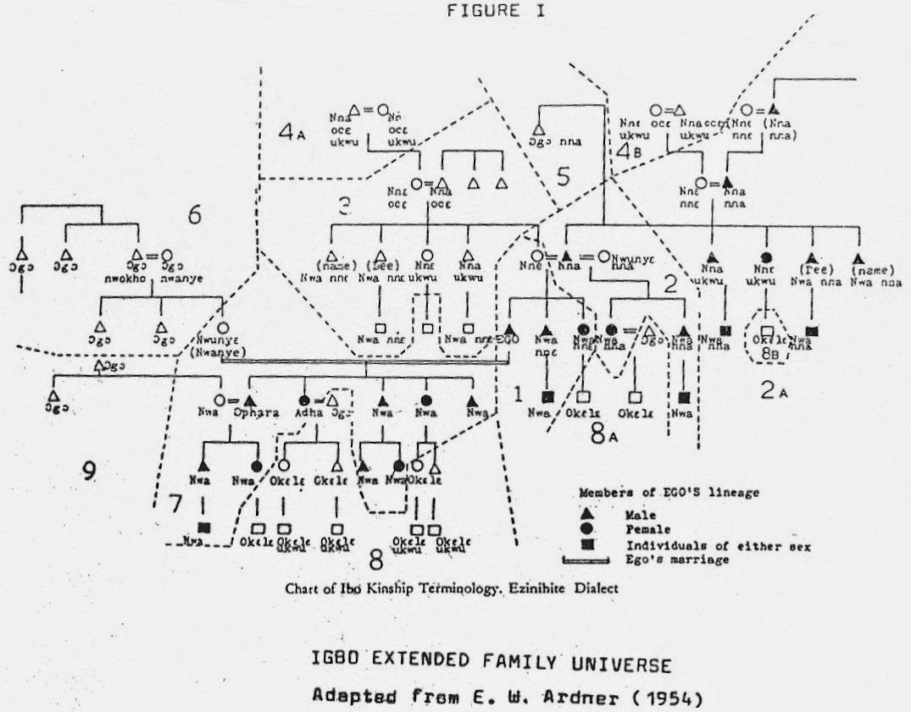
Social Networks Have Always Existed
Kinship networks
Friendship networks
Trading networks
Transportation networks
Alliances between countries

Slide 4
Explaining Human Behavior
But people, including sociologists, usually do not think in “network” terms
How do we typically explain behavior?
  E.g., If you wanted to know why some students drink a lot, others drink very little, how would you go about explain such differences?
Look for other traits of a person (attitudes, values, personality, past experiences, demographic traits) that are correlated with the behavior

Slide 5

The Network Perspective: A Different Approach
Peer influence (pressure?)
Who someone is connected to can affect what they do
Key ideas (Relational Sociology):
  Human beings are embedded in social relations with other people
  We interact with others and form relationships
  So explanations of human behavior should also look at who people interact with and our social ties to other people

Slide 6
Social Organization
Sociology is not just about human behavior
Also about social organization -- the various ways we connect to other people
How do you connect to other people?
  Groups: clubs, classes, teams, dorm
  Organizations: Notre Dame, Rec Sports, work, stores, online (Amazon)
  Social Relationships & Roles: friendships, parent-child, teacher-student, boss-worker
  Networks

Slide 7
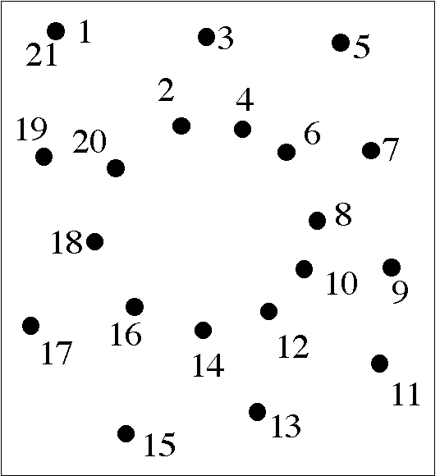
Seeing Networks
Connect the dots metaphor
  Dots: Nodes (vertices)
    People, organizations, places, ideas
  Lines: Ties (edges)
    Interaction, friendship, exchange, authority, lineage
  Flows
    information, resources, evaluations (like, dislike), people

Slide 8
Why Study Networks?
Determinants of human behavior
  Standard theories: Categories (taxonomies)
  Network Theory: network effects, social influence
Non-independence
Intermediation & indirect ties

Slide 9
What Do Social Networks Do?
Connection
  Friendship, mentorship, gossip, information
Diffusion
  Ideas, behavior, information, moods, practices, disease, techniques
Exchange
  Advice, money, commodities, information, political favors
Support
  Financial, emotional, security
Inclusion/Exclusion (Access)
  Homophily, social closure, hiring, secrecy, monopoly

Slide 10
The Social Network Field: Historical Sources
Mathematics: Graph Theory, Matrix Algebra, Dynamic Systems
Anthropology: Kinship, family, and patronage networks, “law of reciprocity”
Psychology: Moreno's sociometry, Balance theory (Heider, Festinger), Small World Studies, Newcomb's Fraternity Study
Sociology: Network studies of roles and positions (Lorrain, White, Breiger), strength of weak ties and social capital (Granovetter, Burt), dyadic relationship formation processes (Merton, Lazarsfeld, Krackhardt)
Social Network Analysis (INSNA): Post 1978
Network Science (NetSci): Post 1998

Slide 11
Social Network Analysis versus “Network Science”
Social Network Analysis
  Concerns with measure social network properties at the node level
  Concern with linking network properties to substantive outcomes
  Concern with specificities of each network context
  Reliance on both subject (e.g. cognitive) and behavioral indicators of interactions
Network Science
  Concern with measuring broad properties at whole network level
  Concern with comparing properties across different types of networks and seeing general patterns
  Use of baseline “generative” models (e.g. Erdos-Renyi)
  Reliance on “objective” interaction indicators (big data) instead of subjective measures derived from self-reports

Slide 12
Current State of Research - A Social Science Revolution
Exponential growth
Interdisciplinary
Game changing
  complex, dynamic, distributed systems
Big Data
  Communications Data
  Social Media (Facebook, Twitter)
  Digitalalized Text

Slide 13
Levels of Analysis
Node (Vertices)
Dyad (Ties, Edges)
Triad
Clusters (communities)
Whole Network

Slide 14
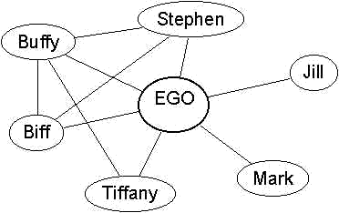
Node (Vertices) – Ego Networks
Degree (network size, neighbors, popularity, in & out degree)
Centrality
Gregariousness (activity level)
Composition (percentage of friends who are women)
Redundancy, Clustering (ties among alters)

Slide 15
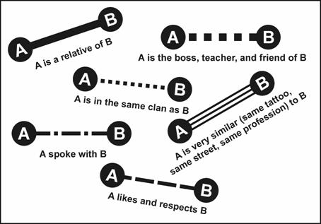
Dyads (Ties, Edges)
Strength (Weight)
  Frequency, duration, closeness
Reciprocity (Mutuality, Symmetry)
Social Distance, Homophily
Hierarchy
Persistence/Decay
Formation

Slide 16

Dyads as Social Ties

Slide 17
Types of ties in social networks
Role relations (states)
  Friends, kin, business partners
Interpersonal sentiments and cognitions
  Liking, trusting, acquaintanceship
Behavioral Social Interactions
  Calling, texting, citing, supporting, resource exchange
Opportunity structure for exchange
  Structural holes, brokerage, intermediation
    “Non-ties” matter here

Slide 18
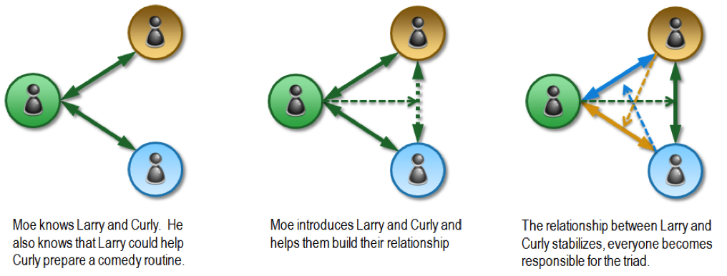
Triads
Transitivity (a friend of a friend is my friend)
Triadic closure
Tie embeddedness
Brokerage (intermediation)

Slide 19
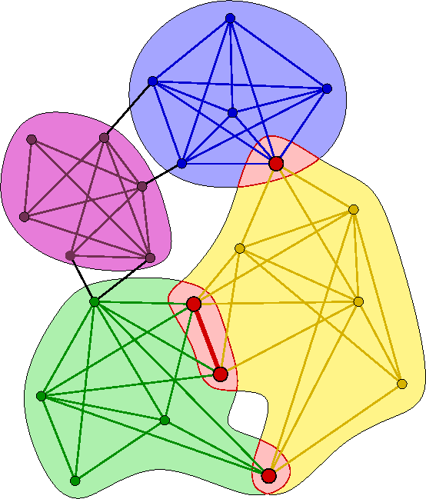
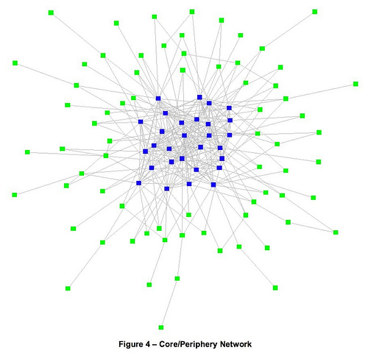
Clusters (Communities)
Cliques
Distinct communities with bridges
Core-Periphery Structures

Slide 20
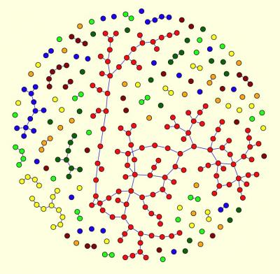
Whole Network
Size
Density
Degree distribution
Clustering
Connectivity
  giant component
  resilience
Geodesic distance/size/diameter
  Small World
Mixing Patterns (assortativity)
  degree assortativity
Stability

Slide 21
Big Ideas / Issues
Strength of weak ties
Intermediation & Brokerage
Bridging & Bonding social capital
Embededness
Homophily: Behavior-Network Clustering
Emergence: local action, global consequences

Slide 22
Big Ideas / Issues
Scale-Free Networks
  Degree Distribution
  Non-random networks
Network Evolution
  tie formation & dissolution
  Building (assembling) networks
Small World
Diffusion and influence

Slide 23
Big Research Issues
Co-evolution of networks and behavior
What is different about social networks?
What is a “good” network? What properties can networks maximize?
Connections among networks (social, technical, information, semantic, cultural)

Slide 24
The Study Social Networks: Three Faces
Network Theory (Ideas)
  Macrostructural Theory and Social Foci
  Balance Theory and Transitivity
  Small Worlds
  Strength of Weak Ties
  Bridging and Bonding Social Capital
  Structural Holes
  Brokerage and Intermediation
  Homophily, nodal trait clustering
  Simmelian Ties
  Multiplexity
  Diffusion

Slide 25
The Study Social Networks: Three Faces
Network Measurement (Mathematical Tools)
  Centrality and Prominence
  Person to Group Affiliations (bipartite, affiliation networks)
  Ego-Networks
  Balance and Transitivity
  Reciprocity
  Brokerage and Structural Holes
  Simmelian Ties
  Tie Formation and Decay
  Social Roles and Positions
  Group and Community Structure
  Statistical Models of Network Structure and Evolution

Slide 26
The Study Social Networks: Three Faces
Network Research (Topics)
  Core Discussion Networks
  Creativity and Intellectual Innovation
  Economic and Inter-Organizational Relations
  Effect of Context on Personal Networks
  Social Support and Social Exchange
  Evolution of Personal Networks through the Life Course
  Cultural Matching and Personal Networks
  Diffusion of Innovations and Social Contagion
  Cultural Consumption and Production
    Just a small sampling
    The list is open-ended
    You can study any topic from a networks perspective!

Slide 27
Research Issues
Strength of weak ties (SWT) and Structural Holes (SH)
  Cross-cutting ties
  Bridging and bonding social capital
Intermediation/Brokerage
Scale-free networks
  Non-normal distributions (Power-law/Exponential)
  Hubs and Spokes Configuration
Core/Periphery structures
  Motifs
Weights and Reciprocity
Notes:
Models
Path Model
Evolutionary Model
Generative Model: simple rules governing processes which generate observed patterns (emerge); grow network
Demographic models (states and flows)
Distributions
e.g. normal, gassian, gen process random variation

Slide 28
Research Issues (continued)
Emergence, self-organization
  local → global
  Agent based models
Network Evolution
  Tie Formation vs. Persistence
  Assembling Networks
  Generative Models (Martin, pp. 68-9)
    Preferential attachment
    Norm of reciprocity
    Transitivity
Diffusion, influence, contagion
  Network effects

