Slide 1
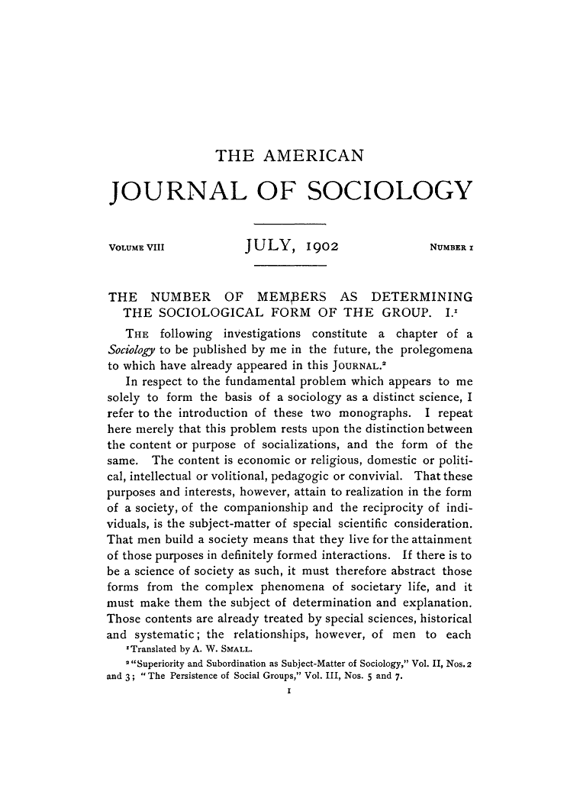

Slide 2
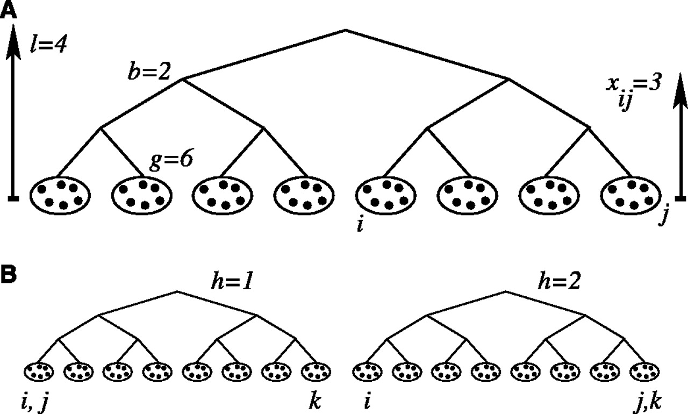

D. J. Watts et al., Science 296, 1302 -1305 (2002)
Published by AAAS

Slide 3
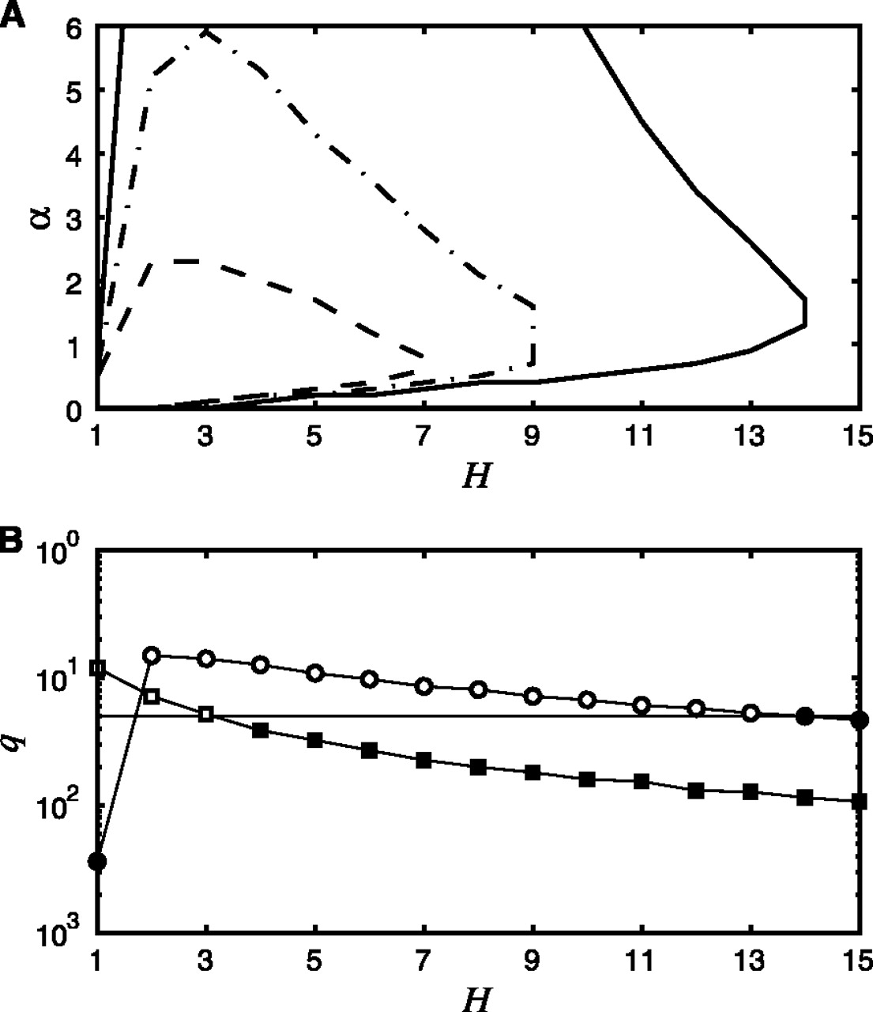
D. J. Watts et al., Science 296, 1302 -1305 (2002)
Published by AAAS

Slide 4
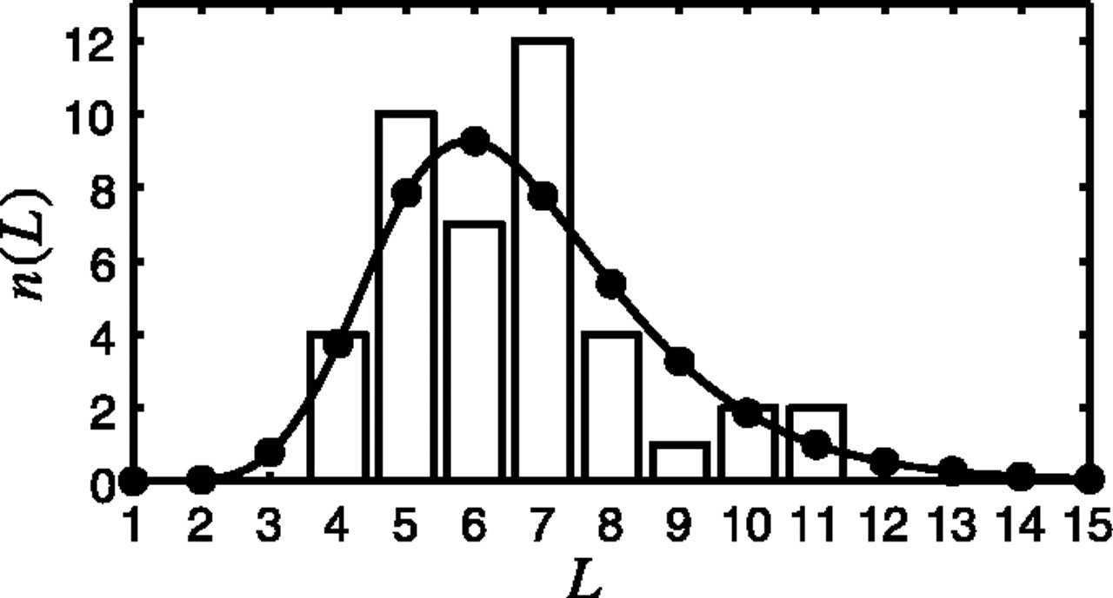
Comparison between n(L), the number Comparison between n(L), the number of completed chains of length L of completed chains of length L
D. J. Watts et al., Science 296, 1302 -1305 (2002)
Published by AAAS

Slide 5
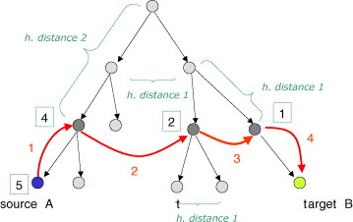
Fig. 2. Example illustrating a search path using information about the target’s position in the organizational hierarchy to direct a message. Numbers in the square give the h-distance from the target.

Slide 6
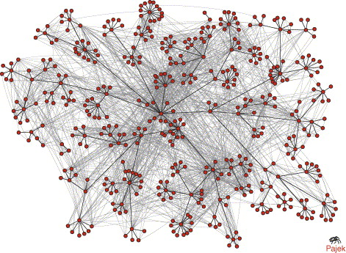
Fig. 3. HP Labs’ email communication (light grey lines) mapped onto the organizational hierarchy (black lines). Note that communication tends to “cling” to the formal organizational chart.

Slide 7
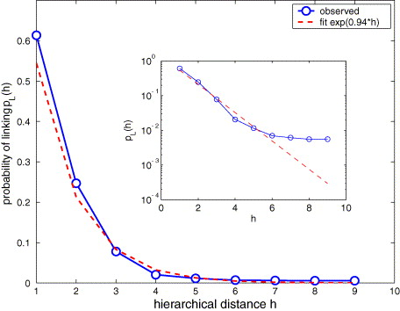
Fig. 4. Probability of linking as a function of the separation in the organizational hierarchy. The exponential parameter α=0.94, is in the searchable range of the Watts model Watts et al., 2002 D.J. Watts, P.S. Dodds and M.E.J. Newman, Identity and search in social networks, Science 296 (2002), pp. 1302–1305.

Slide 8
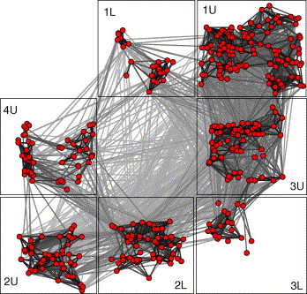
Fig. 6. Email communications within HP Labs mapped onto approximate physical location based on the nearest post number and building given for each employee. Each box represents a different floor in a building. The lines are shaded according to the physical distance between the correspondents: dark for nearby individuals, light for far away contacts.

Slide 9
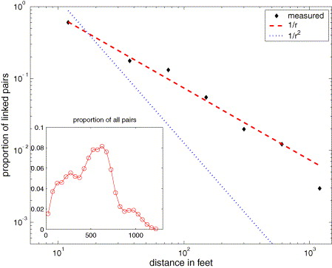
Fig. 7. Probability of two individuals corresponding by email as a function of the distance between their cubicles. The inset shows how many people in total sit at a given distance from one another.

Slide 10
Table 1. Search times using various strategies . The actual average shortest path is 3.1.
Strategy | Median number of steps | Mean number of steps
High degree | 16 | 43.2
Organizational hierarchy | 4 | 5.0
Geography | 6 | 11.7

