Slide 1
(Post-9/11) national pride as affective attachment to a large group: a choice-process analysis
Omar Lizardo
University of Notre Dame
olizardo@nd.edu
Warning: you may only blog about this talk if you are going to say nice things about it

Slide 2


Slide 3


Slide 4


Slide 5
Where does national pride come from? Psychological social psychology
In the following national pride will be considered an example of affective attachment to a collectivity
Two major set of perspectives in psychology
The “psychological needs” view
Affective attachment to groups rooted in the ability of those groups to satisfy individual needs for self-esteem, identity, prestige, etc.
The “irrational” conservatism view
Affective attachment to the nation as unquestioning submission and loyalty

Slide 6
Where does national pride come from? The needs based model
Individuals become attached to national groups in the very same way that they become attached to any other group
Attachment to national groups is likely if the group is perceived as meeting emotional needs
Most important among these needs are those related to self-esteem, prestige and a sense of efficacy and belonging

Slide 7
Where does national pride come from? The needs based model
Social Identity Theory and Self-Categorization Theory can be considered “need” based theories
Self-enhancement motive leads individuals to become affectively attached to prestigious national collectivities
Self-identity and self-categorization is attained by defining the ingroup in relation to the outgroup
Affective attachment to the nation usually accompanied by feelings of superiority and dominance in relation to other national groups

Slide 8
Where does national pride come from? The irrational conservatism model
National pride is usually correlated with manifestations of “blind patriotism” (Schatz, Staub and Lavine 1999)
“Patriotic” respondents much more likely (Sullivan et al 1992):
to support militarism
to reject national criticism
to show uncritical support for government policies
to be ideologically conservative
“Excessive” attachment to national groups is usually regarded as pathological (Adorno et al 1950)

Slide 9
A sociological perspective?
What does sociology have to say?

Slide 10
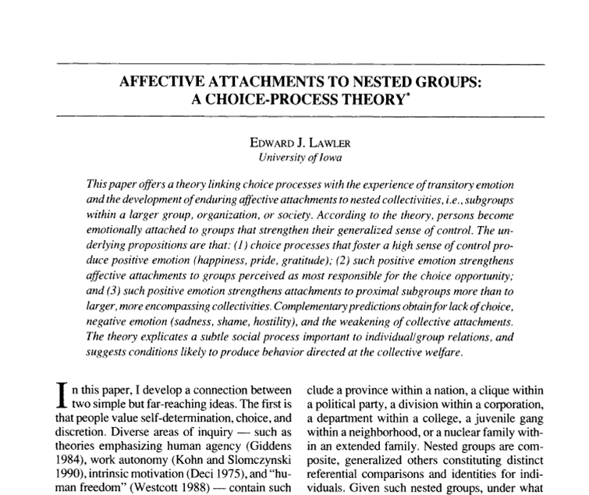

Slide 11
Lawler’s choice-process theory
Persons value individuality, freedom and self efficacy
Persons form individual-to-individual affective attachments
Persons form individual-to-collectivity affective attachments
These two types of attachments are empirically and analytically distinct (Parsons 1951)

Slide 12
Lawler’s choice-process theory
Persons are usually embedded in social structures composed of nested groups
Persons engage in structured action within these concrete social contexts
Groups provide individuals with a “context of choice” within which successful purposive action occurs
Positive emotions produced by the sense of autonomy and control afforded by the group unleash an attribution process

Slide 13
Lawler’s choice-process theory
National groups will be the object of strong positive affective attachments to the extent that they are perceived as responsible for giving the person
A sense of autonomy and freedom
A sense of control over their environment (self-efficacy)

Slide 14
Lawler’s choice-process theory
National groups will be the object of strong positive affective attachments to the extent that they are perceived as responsible for giving the person
A structured “menu” of choices
“Responsibility rules” prescribe a “distal” over a “proximal” allocation of affect

Slide 15
Lawler’s choice-process theory
National groups will be the object of strong positive affective attachments to the extent that they are perceived as responsible for giving the person
The individual is embedded in nested groups that allow for the transfer of positive affect from smaller to larger collectivities (Etzioni 1968)

Slide 16
The choice process
Efficacious action in a structured context
(perceived freedom of choice)
Positive Emotion
Attribution process
(group is seen as responsible for the opportunity to act freely)
“Responsibility Rules”
(Proximal versus Distal)
Affective attachment to the collectivity

Slide 17
The theoretical status of 9/11
From both need-based and irrational conservatism perspectives, 9/11 is an external “shock” that
Increases ingroup-outgroup differentiation
Leads to processes of self-categorization and ingroup-outgroup bias
Results in more intense feelings of affective attachment to the collectivity

Slide 18
The theoretical status of 9/11
Therefore we should expect that Increased feelings of national pride should be more likely among
those with the largest psychological needs for identification with a prestigious group (lower status individuals)
those more initially predisposed toward ingroup-outgroup bias (the “blindly patriotic”)

Slide 19
The theoretical status of 9/11
Low SES individuals
Tend to display more ethnocentric, militaristic attitudes and more “blindly patriotic” sentiments (Sullivan et al 1992; Schatz et al 1999)
Are less likely to have social outlets that meet their needs for self-esteem and group belongingness
May “compensate” by becoming “excessively” attached to the nation
Post 9/11 increases in national affective attachment in the U.S. should thus be concentrated in this group

Slide 20
The theoretical status of 9/11
From the choice-process perspective on the other hand
9/11 can instead be seen as a “shock” to the cultural rules that govern the attribution of responsibility for the positive feelings engendered by the choice process
Normally in individualistic societies like the U.S., the proximal rule dominates
Local groups tend to garner stronger feelings of attachment than global groups (Lawler 1992)

Slide 21
The theoretical status of 9/11
From the choice-process perspective on the other hand
Post 9/11 there has been a weakening of the proximal rule and the emergence of a distal rule
Under a distal responsibility regime, the nation becomes more salient as the ultimate source of choice-opportunities
This sense of saliency should be stronger for individuals embedded in nested subgroups

Slide 22
The theoretical status of 9/11
From the choice-process perspective on the other hand
Efficacious action in structured social arenas and embeddedness in nested subgroups should be positively connected affective attachment to the national collectivity when the proximal rule is weakened

Slide 23
The theoretical status of 9/11
High SES individuals
Are more likely to engage in high autonomy everyday behavior in structured social contexts
Are more likely to belong to multiple nested subgroups
Post 9/11 increases in national affective attachment in the U.S. should thus be concentrated in this group

Slide 24
Data Source
General Social Survey 1996 and 2004 waves (N=2557)
Module on attitudes toward the U.S.
“National Pride” and “nationalism” series

Slide 25
Data and variables: national pride
How proud are you of America in each of the following? (1=very proud, 2=somewhat proud, 3=not very proud, 4=not proud at all, 5=can’t choose)
The way democracy works
Its political influence in the world
America's economic achievements
Its social security system
Its scientific and technological achievements
Its achievements in sports
Its achievements in the arts and literature
America's armed forces
Its history
Its fair and equal treatment of all groups in society
Additive scale created using the number of “very proud” responses (Cronbach’s alpha=0.73; range: 0-10)

Slide 26
Data and variables: nationalism
How much do you agree or disagree with the following statements? (1=agree strongly, 2=agree, 3=neither agree or disagree, 4=disagree, 5=disagree strongly)
I would rather be a citizen of America than of any other country in the world
The world would be a better place if people from other countries were more like the Americans
Generally speaking, America is a better country than most other countries
People should support their country even if the country is in the wrong
Scale created by computing the mean across responses (Cronbach’s alpha=0.63; range 1-5, reverse coded)

Slide 27
Data and variables: nested subgroups
Number of memberships in voluntary associations (2004 only)
Fifteen total types (range 0-13; mean=1.6, SD=1.9):
Fraternal
Service
Veteran
Political Club
Labor Union
Sports Club
Youth Group
School Service
Hobby Club
School Fraternity
Nationality Group
Farm Organization
Literary or Art
Professional Society
Church

Slide 28
The 9/11 effect
Median and interquartile range

Slide 29



Slide 30
The period effect: by item
How proud are you of America in each of the following? | exp(b) | X-squared | p-value
The way democracy works | 1.61 | 81.06 | 0.0000
Its political influence in the world | 1.26 | 15.75 | 0.0001
America's economic achievements | 1.85 | 144.49 | 0.0000
Its social security system | 1.27 | 11.37 | 0.0007
Its scientific and technological achievements | 1.58 | 91.76 | 0.0000
Its achievements in sports | 1.37 | 42.70 | 0.0000
Its achievements in the arts and literature | 1.82 | 139.19 | 0.0000
America's armed forces | 3.73 | 641.00 | 0.0000
Its history | 2.01 | 204.40 | 0.0000
Its fair and equal treatment of all groups in society | 1.85 | 110.97 | 0.0000

Slide 31
Empirical expectations
Which subgroups experienced the most dramatic increase in their national attachment patterns post 9/11?
Need-based and “irrational conservatism” theories predict that
those with the largest needs for self-esteem or those more initially predisposed toward ethnocentric bias should become more attached
The choice process view on the other hand, predicts that
those who experience the most autonomy in their day to day life and those embedded in nested groups should become more attached

Slide 34
 | 1996 | 2004
Education | -0.0508 | 0.139*
 | (-0.90) | (2.36)
Cohort | -0.0452*** | -0.0278***
 | (-9.97) | (-5.89)
Constant | 91.60*** | 58.04***
 | (10.37) | (6.26)
N | 1309 | 1212
t-statistics in parentheses
* p<0.05, ** p<0.01, *** p<0.001

Slide 35
 | 1996 | 2004
Nako-Treas SEI Score | 0.00230 | 0.0102**
 | (0.58) | (2.59)
Cohort | -0.0473*** | -0.0268***
 | (-10.13) | (-5.43)
Constant | 95.40*** | 56.11***
 | (10.45) | (5.78)
N | 1255 | 1152
t-statistics in parentheses
* p<0.05, ** p<0.01, *** p<0.001

Slide 37
 | 1996 | 2004
Nationalism Scale Score | 1.284*** | 1.199***
 | (12.12) | (11.27)
Cohort | -0.0324*** | -0.0176***
 | (-7.33) | (-3.82)
Constant | 61.66*** | 33.98***
 | (7.07) | (3.73)
N | 1302 | 1212
t-statistics in parentheses
* p<0.05, ** p<0.01, *** p<0.001

Slide 38
 | U.S. Pride | Nationalism
Education | -0.0300 | -0.0572***
 | (-1.15) | (-9.06)
Period | 1.155*** | 0.149***
 | (10.55) | (5.53)
Education x Period | 0.102** | 0.00609
 | (2.70) | (0.65)
Cohort | -0.0370*** | -0.00844***
 | (-11.28) | (-10.51)
Constant | 75.41*** | 20.16***
 | (11.77) | (12.86)
N | 2521 | 2561
t-statistics in parentheses
* p<0.05, ** p<0.01, *** p<0.001

Slide 39
 | Model 1 | Model 2
Education | 0.0565* | 0.0252
 | (2.08) | (0.88)
Cohort | -0.0253*** | -0.0238***
 | (-5.41) | (-5.09)
Gender (Women=1) | -0.802*** | -0.780***
 | (-5.34) | (-5.21)
Race (Black=1) | -1.357*** | -1.373***
 | (-5.88) | (-5.97)
Race (Other=1) | -0.153 | -0.0947
 | (-0.54) | (-0.33)
Region (South=1) | 0.390* | 0.390*
 | (2.33) | (2.35)
Number of Memberships (1-2) |  | 0.449*
 |  | (2.54)
Number of Memberships (3+) |  | 0.695***
 |  | (3.46)
Constant | 53.37*** | 50.49***
 | (5.83) | (5.52)
N | 1212 | 1212
t-statistics in parentheses
* p<0.05, ** p<0.01, *** p<0.001

Slide 40
Discussion and Conclusion
After 9/11 U.S. appears to have switched from a “local” to a “national” affective attachment rule
Psychological perspectives on nationalism don’t help us in predicting which individuals were more likely to experience national pride in the most recent period
Needs-based approaches predict that those with the most dire needs for belongingness, self-esteem and prestige (low status groups) should increase their attachment
Irrational conservatism approaches predict that those with high levels of nationalism should have increased their attachment
Neither is the case for the rise in feelings of national pride in post 9/11 U.S.

Slide 41
Discussion and Conclusion
The choice-process perspective predicts that
Efficacious and autonomous action in socially structured contexts increases affective attachment to the national group under a new attribution regime (post 9/11)
Post 9/11, it was precisely those individuals more likely to experience autonomy in their day to day behavior that increased their attachment to the national collectivity
Embeddedness in nested groups accounts for the association between markers of status and autonomy (i.e. education) and higher degrees of affective attachment to the national group after 9/11

Slide 42
Discussion and Conclusion
From the choice-process perspective, after 9/11 lower status individuals less likely to increase their levels of national pride than high status individuals due to the fact that
They are less likely to experience autonomy in their everyday affairs, and thus less likely to be part of the affective choice process
Low status individuals less likely to be embedded in nested groups (low “social capital”)

Slide 43
Discussion and Conclusion
What about those pesky bumper stickers?
An analytical distinction from Hochschild: class-based expression rules must be kept separate from feeling rules.
Lower status individuals more likely to express national pride even as they are less likely as a group to feel it
High-status individuals embedded in nested groups actually more likely to feel national pride (after 9/11), but less likely to express it

Slide 44
Thanks!
Questions?
Comments?
Suggestions?

