Slide 1
(Post-9/11) national pride as affective attachment to a large group: a choice-process analysis
Omar Lizardo
University of Notre Dame

Slide 2


Slide 3


Slide 4
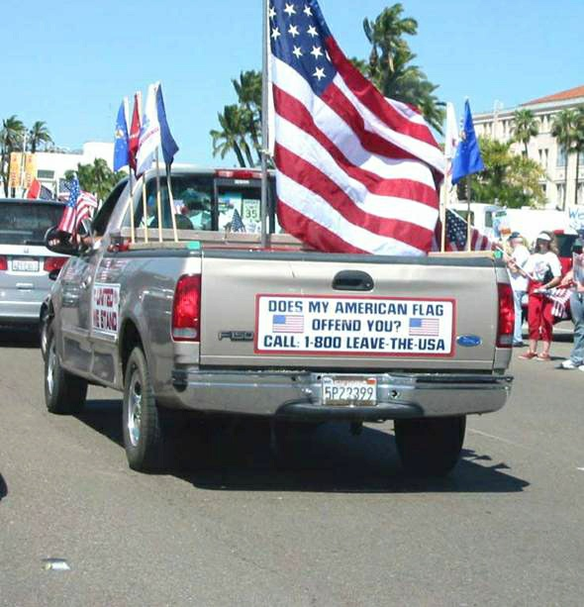

Slide 5
Where does national pride come from? Psychological social psychology
Two major set of perspectives
National pride as a “rational” reaction rooted in the group’s capacities to meet individual needs
National pride as “irrational” conservatism

Slide 6
Where does national pride come from? The needs based model
Individuals become attached to national groups in the very same way that they become attached to any other group.
Attachment to national groups is likely if the group is perceived as meetings emotional and instrumental needs.
Most important among these needs are those related to self-esteem, prestige and a sense of efficacy and belonging

Slide 7
Where does national pride come from? The needs based model
Social Identity Theory and Self-Categorization Theory can be considered “need” based theories of affective attachment to large groups
Need for self-esteem may lead individuals to become affectively attached to prestigious national collectivities
Cognitive need to achieve a sense of self-identity in the face of uncertainty

Slide 8
Where does national pride come from? The needs based model
Needs-based model verges on circularity. Affective attachment to any national group can be explained simply by gerrymandering what are considered the basic “needs.”
Needs proliferate endlessly
There is no clear analytical division between affective and other types of attachment to large groups (i.e. cognitive or normative)

Slide 9
Where does national pride come from? The irrational conservatism model
National pride is usually correlated with manifestations of “blind patriotism” (Schatz, Staub and Lavine1999)
National pride is defined primarily as affective attachment that is “…a strong emotional investment in the nation, and a positive affective orientation to its symbols” (Kelman and Hamilton 1989).

Slide 10
Where does national pride come from? The irrational conservatism model
“Patriotic” respondents much more likely (Sullivan et al 1992):
to support militarism
to reject national criticism
to show uncritical support for government policies
to be ideologically conservative
“Excessive” attachment to national groups is seen as pathological (Adorno et al 1950)

Slide 11
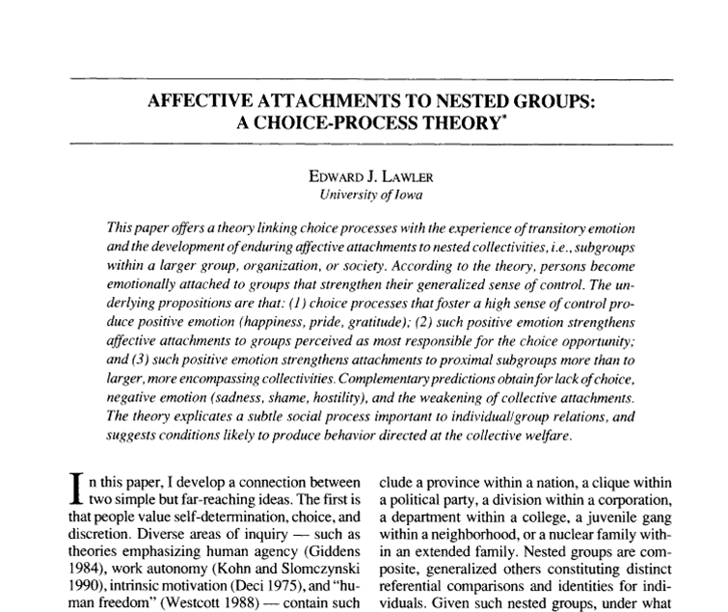

Slide 12
Lawler’s choice-process theory
Persons value individuality, freedom and self efficacy
Persons form individual-to-individual affective attachments
Persons form individual-to-collectivity affective attachments
These two types of attachments are empirically and analytically distinct (Parsons 1951)

Slide 13
Lawler’s choice-process theory
Persons are usually embedded in social structures composed of nested groups
Groups will be the object of strong attachments to the extent that they are perceived as responsible for giving the person
a sense of autonomy
a sense of control over their environment

Slide 14
The choice process
Efficacious action in a structured context
(perceived freedom of choice)
Positive Emotion
Attribution process
(group is seen as responsible for the opportunity to act freely)
“Responsibility Rules”
(Proximal versus Distal)
Affective attachment to the collectivity

Slide 15
The theoretical status of 9/11
From both need-based and irrational conservatism perspectives, 9/11 is an external “shock” that
Increases ingroup-outgroup differentiation
Results in more intense feelings of affective attachment to the collectivity

Slide 16
The theoretical status of 9/11
From both need-based and irrational conservatism perspectives, 9/11 is an external “shock” that
These feelings should be stronger among those with the largest psychological needs for identification with a prestigious group and those more initially predisposed toward ingroup-outgroup bias

Slide 17
The theoretical status of 9/11
From both need-based and irrational conservatism perspectives, 9/11 is an external “shock” that
Low SES and low education individuals display more ethnocentric attitudes and are less likely to have social outlets that meet their needs for self-esteem and attachment
Thus we should expect that low SES individuals and those of lower educational attainment to have increased their attachment to the collectivity after 9/11

Slide 18
The theoretical status of 9/11
From the choice-process perspective on the other hand
9/11 can instead be seen as a “shock” to the cultural rules that govern the attribution of responsibility for the positive feelings engendered by the choice process
Normally in individualistic societies like the U.S., the proximal rule dominates

Slide 19
The theoretical status of 9/11
From the choice-process perspective on the other hand
I propose that 9/11 weakened the proximal rule and strengthened the cultural presence of a distal responsibility rule in which the nation becomes salient as the ultimate source of choice-opportunities
This serves to positively connect efficacious action, positive emotion, attachment to nested subgroups and affective attachment to the national collectivity

Slide 20
The theoretical status of 9/11
From the choice-process perspective on the other hand
We should expect that those more likely to be able to experience positive emotions from their autonomous action should be more likely to have increased their affective attachment to the nation
This means that high SES individuals and persons embedded in nested subgroups should have increased their global affective attachment after 9/11

Slide 21
Data Source
General Social Survey 1996 and 2004 waves (N=2557)
Module on attitudes toward the U.S.
“National Pride” and “nationalism” series

Slide 22
Data and variables: national pride
How proud are you of America in each of the following? (1=very proud, 2=somewhat proud, 3=not very proud, 4=not proud at all, 5=can’t choose)
The way democracy works
Its political influence in the world
America's economic achievements
Its social security system
Its scientific and technological achievements
Its achievements in sports
Its achievements in the arts and literature
America's armed forces
Its history
Its fair and equal treatment of all groups in society
Additive scale created using the number of “very proud” responses (Cronbach’s alpha=0.73; range: 0-10)

Slide 23
Data and variables: nationalism
How much do you agree or disagree with the following statements? (1=agree strongly, 2=agree, 3=neither agree or disagree, 4=disagree, 5=disagree strongly)
I would rather be a citizen of America than of any other country in the world
The world would be a better place if people from other countries were more like the Americans
Generally speaking, America is a better country than most other countries
People should support their country even if the country is in the wrong
Scale created by computing the mean across responses (Cronbach’s alpha=0.63; range 1-5, reverse coded)

Slide 24
Data and variables: nested groups
Number of memberships in voluntary associations (2004 only)
Fifteen total types (range 0-13; mean=1.6, SD=1.9):
Fraternal
Service
Veteran
Political Club
Labor Union
Sports Club
Youth Group
School Service
Hobby Club
School Fraternity
Nationality Group
Farm Organization
Literary or Art
Professional Society
Church

Slide 25
The 9/11 effect
Median and interquartile range

Slide 26



Slide 27
The period effect: by item
How proud are you of America in each of the following? | exp(b) | X-squared | p-value
The way democracy works | 1.61 | 81.06 | 0.0000
Its political influence in the world | 1.26 | 15.75 | 0.0001
America's economic achievements | 1.85 | 144.49 | 0.0000
Its social security system | 1.27 | 11.37 | 0.0007
Its scientific and technological achievements | 1.58 | 91.76 | 0.0000
Its achievements in sports | 1.37 | 42.70 | 0.0000
Its achievements in the arts and literature | 1.82 | 139.19 | 0.0000
America's armed forces | 3.73 | 641.00 | 0.0000
Its history | 2.01 | 204.40 | 0.0000
Its fair and equal treatment of all groups in society | 1.85 | 110.97 | 0.0000

Slide 28
Empirical expectations
Which subgroups experienced the most dramatic increase in their national attachment patterns post 9/11?
Need-based and “irrational conservatism” theories predict that
those with the largest needs for self-esteem or those more initially predisposed toward ethnocentric bias should become more attached
The choice process view on the other hand, predicts that
those who experience the most autonomy in their day to day life and those embedded in nested groups should become more attached

Slide 31
 | 1996 | 2004
Education | -0.0508 | 0.139*
 | (-0.90) | (2.36)
Cohort | -0.0452*** | -0.0278***
 | (-9.97) | (-5.89)
Constant | 91.60*** | 58.04***
 | (10.37) | (6.26)
N | 1309 | 1212
t-statistics in parentheses
* p<0.05, ** p<0.01, *** p<0.001

Slide 32
 | 1996 | 2004
Nako-Treas SEI Score | 0.00230 | 0.0102**
 | (0.58) | (2.59)
Cohort | -0.0473*** | -0.0268***
 | (-10.13) | (-5.43)
Constant | 95.40*** | 56.11***
 | (10.45) | (5.78)
N | 1255 | 1152
t-statistics in parentheses
* p<0.05, ** p<0.01, *** p<0.001

Slide 34
 | 1996 | 2004
Nationalism Scale Score | 1.284*** | 1.199***
 | (12.12) | (11.27)
Cohort | -0.0324*** | -0.0176***
 | (-7.33) | (-3.82)
Constant | 61.66*** | 33.98***
 | (7.07) | (3.73)
N | 1302 | 1212
t-statistics in parentheses
* p<0.05, ** p<0.01, *** p<0.001

Slide 35
 | U.S. Pride | Nationalism
Education | -0.0300 | -0.0572***
 | (-1.15) | (-9.06)
Period | 1.155*** | 0.149***
 | (10.55) | (5.53)
Education x Period | 0.102** | 0.00609
 | (2.70) | (0.65)
Cohort | -0.0370*** | -0.00844***
 | (-11.28) | (-10.51)
Constant | 75.41*** | 20.16***
 | (11.77) | (12.86)
N | 2521 | 2561
t-statistics in parentheses
* p<0.05, ** p<0.01, *** p<0.001

Slide 36
 | Model 1 | Model 2
Education | 0.0565* | 0.0252
 | (2.08) | (0.88)
Cohort | -0.0253*** | -0.0238***
 | (-5.41) | (-5.09)
Gender (Women=1) | -0.802*** | -0.780***
 | (-5.34) | (-5.21)
Race (Black=1) | -1.357*** | -1.373***
 | (-5.88) | (-5.97)
Race (Other=1) | -0.153 | -0.0947
 | (-0.54) | (-0.33)
Region (South=1) | 0.390* | 0.390*
 | (2.33) | (2.35)
N. of Memberships (1-2) |  | 0.449*
 |  | (2.54)
Number of Memberships (3+) |  | 0.695***
 |  | (3.46)
Constant | 53.37*** | 50.49***
 | (5.83) | (5.52)
N | 1212 | 1212
t-statistics in parentheses
* p<0.05, ** p<0.01, *** p<0.001

Slide 37
Discussion and Conclusion
After 9/11 U.S. appears to have switched from a “local” to a “national” affective attachment rule.
Psychological perspectives on nationalism don’t help us in predicting which individuals were more likely to experience national pride.
Needs-based approaches predict that those with the most dire needs for belongingness, self-esteem and prestige (low status groups) should increase their attachment
Irrational conservatism approaches predict that those with high levels of nationalism should have increased their attachment
Neither is the case for the rise in feelings of national pride in post 9/11 U.S.

Slide 38
Discussion and Conclusion
The choice-process perspective predicts that
Efficacious and autonomous action in socially structured contexts increases affective attachment to the national group under a new attribution regime (post 9/11)
Post 9/11, it was precisely those individuals more likely to experience autonomy in their day to day behavior that increased their attachment to the national collectivity
Embeddedness in nested groups accounts for the association between markers of status and autonomy (i.e. education) and higher degrees of affective attachment to the national group

Slide 39
Discussion and Conclusion
After 9/11 lower status individuals less likely to increase their levels of national pride than high status individuals due to the fact that
They are less likely to experience autonomy in their everyday affairs, and thus less likely to be part of the affective choice process
Low status individuals less likely to be embedded in nested groups (low “social capital”)

Slide 40
Discussion and Conclusion
What about those pesky bumper stickers?
An analytical distinction from Hochschild: class-based expression rules must be kept separate from feeling rules.
Lower status individuals more likely to express national pride even as they are less likely as a group to feel it
High-status individuals embedded in nested groups actually more likely to feel national pride (after 9/11), but less likely to express it

