Slide 1
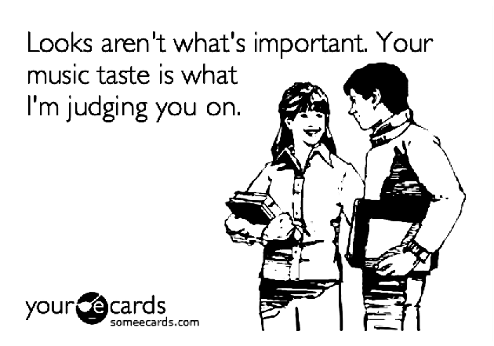
Schematic Logics and Patterns of Cultural Choice
Omar Lizardo
olizardo@nd.edu
UC San Diego
Sociology Colloquium
Speaker Series
March 9th 2017
Linking Cognition and Action in the Sociology of Taste

Slide 2
Introduction
Sociology of taste
Long tradition of studying consumption and taste as “patterns of cultural choice” (Peterson 1983)
Focus on uncovering “dimensions” of cultural taste based on large-scale data
Mass/Elite
Omnivore/Univore
Highbrow/Popular
Voracious/Paucivore
“Varieties” of omnivorousness, univorousness, etc.

Slide 3
Introduction
Sociology of taste
Long tradition of studying consumption and taste as “patterns of cultural choice” (Peterson 1983)
Focus on uncovering “dimensions” of cultural taste based on large-scale data
Mass/Elite
Omnivore/Univore
Highbrow/Popular
Voracious/Paucivore
“Varieties” of omnivorousness, univorousness, etc.

Slide 4
Introduction
Sociology of taste
Equally long tradition of studying socio-demographics correlates of such patterns
Cultural capital theory
Gender and consumption studies
Generational approaches
Ethnoracial correlates culture consumption

Slide 5
Introduction
Culture and Cognition Studies:
Focus on studying the link between shared patterns of thinking/classification and action
Duality of schemas and resources productive of practices (Sewell 1992)
Structured activation of schemas lead to regular action patterns (DiMaggio 1997)
Share social patterns define collective categories and frames (Zerubavel 1999)
Durable cognitive structures emerge from prolonged experiences in a given social location (Bourdieu 1984, 1990)
Schemass and categories are used for purposes of evaluation and choice

Slide 6
Introduction
Culture and Cognition Studies:
Focus on studying the link between shared patterns of thinking/classification and action
Duality of schemas and resources productive of practices (Sewell 1992)
Structured activation of schemas lead to regular action patterns (DiMaggio 1997)
Share social patterns define collective categories and frames (Zerubavel 1999)
Durable cognitive structures emerge from prolonged experiences in a given social location (Bourdieu 1984, 1990)
Schemas and categories are used for purposes of evaluation and choice

Slide 7
Introduction
Generally tenuous link between culture and cognition studies and the sociology of taste
Although Bourdieu (1984) built his own theory of taste on social cognitive foundations (Lizardo 2013)
Recently Goldberg (2011) proposed a theoretical merger between the two fields
Drawing on DiMaggio (1997) Goldberg proposes that overt patterns of cultural choice need to be differentiated from the underlying schema that produces them
Distinct patterns of cultural choice may be produced by the same schema
This is missed by classification/clustering methods based on overt responses

Slide 8
Introduction
Generally tenuous link between culture and cognition studies and the sociology of taste
Although Bourdieu (1984) built his own theory of taste on social cognitive foundations (Lizardo 2013)
Recently Goldberg (2011) proposed a theoretical merger between the two fields
Drawing on DiMaggio (1997) Goldberg proposes that overt patterns of cultural choice need to be differentiated from the underlying schema that produces them
Distinct patterns of cultural choice may be produced by the same schema
This is missed by classification/clustering methods based on overt responses

Slide 9
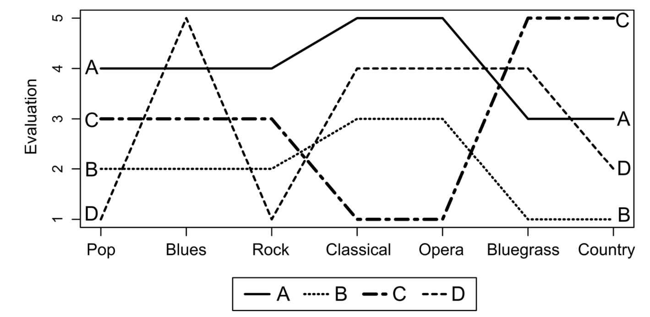
Introduction
Standard approach: (A and B “similar”) but “opposite” of C and different from D

Slide 10
Introduction
Schematic logic approach: A, B, and C Similar, but different from D

Slide 11
Introduction
Methodologically
Goldberg (2011) argues that underlying schemata may be recoverable from overt survey responses
Proposes “Relational Class Analysis” as a procedure that is fit for this task:
Compute “relationality” between each pair of respondents in the survey
Create a weighted network where the link between two respondents is inversely proportional to their relationality distance
Use a community detection algorithm (e.g. modularity maximization) to partition respondents into clusters
Persons in each cluster share the same schema even if they differ in terms of their overt response

Slide 12
Introduction
Methodologically
Goldberg (2011) argues that underlying schemata may be recoverable from overt survey responses
Proposes “Relational Class Analysis” as a procedure that is fit for this task:
Compute “relationality” between each pair of respondents in the survey
Create a weighted network where the link between two respondents is inversely proportional to their relationality distance
Use a community detection algorithm (e.g. modularity maximization) to partition respondents into clusters
Persons in each cluster share the same schema even if they differ in terms of their overt response

Slide 13
Introduction
Methodologically
More recently Boutyline (2016) has shown that the correlation distance outperforms relationality for this task
Argues that both RCA and his proposed “Correlational Class Analysis” can be thought of as special cases of a more general analytic procedure: Schematic Class Analysis
Use a criterion for schematic similarity
Create a network that links respondents according to their schematic similarity distance
Use a partitioning algorithm to segment the network into clusters
Treat persons in the same cluster as belonging to the same schematic class

Slide 14
Introduction
Methodologically
More recently Boutyline (2016) has shown that the correlation distance outperforms relationality for this task
Argues that both RCA and his proposed “Correlational Class Analysis” can be thought of as special cases of a more general analytic procedure: Schematic Class Analysis
Use a criterion for schematic similarity
Correlation, relationality, ??
Create a network that links respondents according to their schematic similarity distance
Use a partitioning algorithm to segment the network into clusters
Modularity maximization, divisive/ agglomerative clustering ??
Treat persons in the same cluster as belonging to the same schematic class

Slide 15
Introduction
Contributions of the present work
Aim to move forward the application of schematic class analysis to studying patterns of cultural taste
Previous work (Goldberg 2011; Boutyline 2016) has been limited empirically
This has led to (unintended) theoretical limitations/hangups
Schematic class analysis at a minimum requires evaluative data on cultural items along a bipolar scale (e.g. like and dislike)
However, for the U.S. only recent source of such data is GSS 1993 (!)

Slide 16
Introduction
Contributions of the present work
More importantly, GSS 1993 is a limited resource for schematic class analysis because
It contains data only on evaluations of cultural objects
This means that analysts (Goldberg 2011; Boutyline 2016) are forced to “read”
Behavioral propensities (e.g. omnivore/univore) from schematic maps obtained from empirical correlations of taste judgments
The question of whether different schematic taste logics lead to different behavioral patterns remains unanswered
The answer is yes!

Slide 17
Introduction
Contributions of the present work
Culture and cognition researchers are clear that a given schema only provides a blueprint for (diverse forms) of behavior
There is no one-to-one linkage between schema and behavior
This is most evident in labelling some of the schemas “omnivore/univore”
All taste schemas may have potential for distinct forms of omnivorousness
Make a contribution to recent work on “varieties of omnivorousness”
Warde et al 2007; Van Eijck and Lievens 2008; Ollivier 2008

Slide 18
Introduction
Contributions of the present work
What is required?
Data containing information on taste evaluations
To elicit schematic classes
Data containing independent information on behavioral choices
In order to ascertain the behavioral potential of different schemas
Empirically, rather than definitionally or speculatively
Data on a more recent sample of Americans to examine issues of schema durability or change
Some culture and cognition theorists (e.g. Bourdieu) posit schematic durability over time
Others (DiMaggio 1997; Swidler 2001) point to change responsive to structural changes
See Vaisey and Lizardo (2016)
Many macrolevel transformations since 1993!

Slide 19
Introduction
Contributions of the present work
Guess what? We have the data
Attempt to replicate GSS 1993 “Culture Module”
Collected information on:
Patterns of likes/dislikes
Patterns of choices (“regularly listen to”)
Sociodemographic characteristics
Across 20 musical genres
N = 2100
Collected by Survey Sample International (SSI)
Approximates a representative sample of the U.S.
Previous work (Lizardo and Skiles 2015, 2016) shows it to have good validity

Slide 20
Introduction
Contributions of the present work
Guess what? We have the data
Attempt to replicate GSS 1993 “Culture Module”
Genres:
Rock, Rap/Hip Hop, Opera/Operetta, Broadway Musicals, Heavy Metal/Hard Rock, Latin/Spanish/Salsa, Jazz, Hymn/Gospel/Religious, Folk, Mood/Easy Listening, Country, Classical, Bluegrass, Blues/R&B, Dance/Techno, Alternative, Pop/Top 40, Big Band, Mood/Easy Listening, Reggae, Contemporary Rock
GSS asked about “new age”; we didn’t (substituted Dance/Techno)
GSS did not ask about “Alternative Rock” or Pop/Top 40; we did

Slide 21
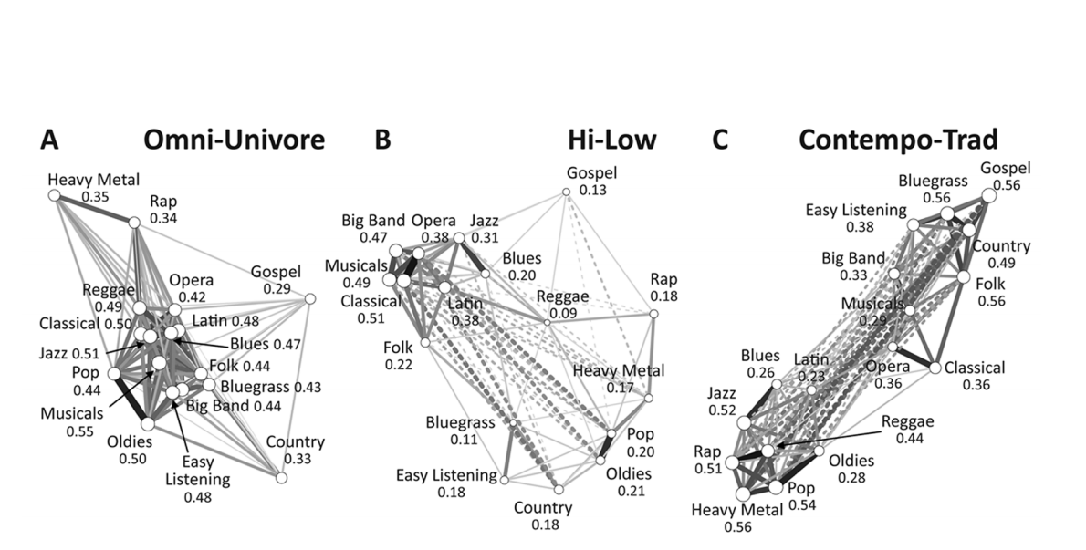
Empirical Expectations
Previous work on SCA using GSS 1993 sets the expectations for our analysis
Goldberg (2011) using relationality as a similarity criterion finds three schematic classes in the U.S. Population
Omni-Univore
Hi-Low
Contempo Trad

Slide 22
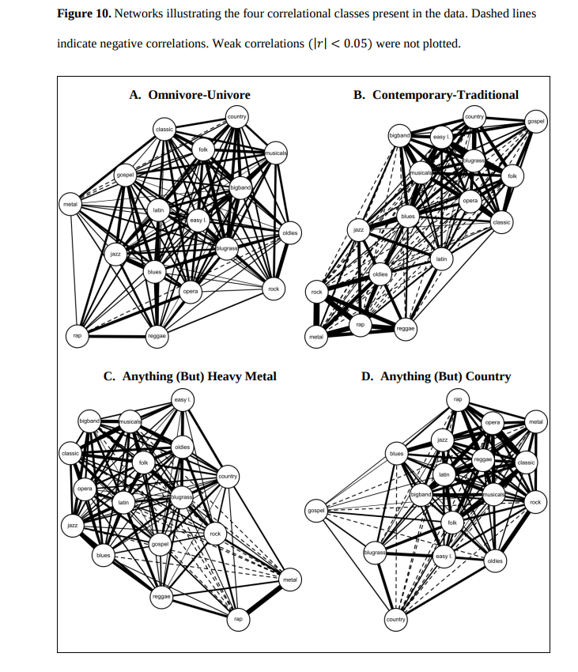
Empirical Expectations
Previous work on SCA using GSS 1993 sets the expectations for our analysis
Boutyline (2016) reanalyzed the same data using correlation as the similarity criterion finding the U.S. population to be more schematically diverse:
Omni-Univore
Contempo-Trad
No Heavy Metal
No Country

Slide 23
Empirical Expectations
Previous work on SCA using GSS 1993 sets the expectations for our analysis
Following Boutyline, we use correlation as our schematic distance criterion
Like both efforts we use modularity maximization to elicit classes
Boutyline’s CCA package for R

Slide 24
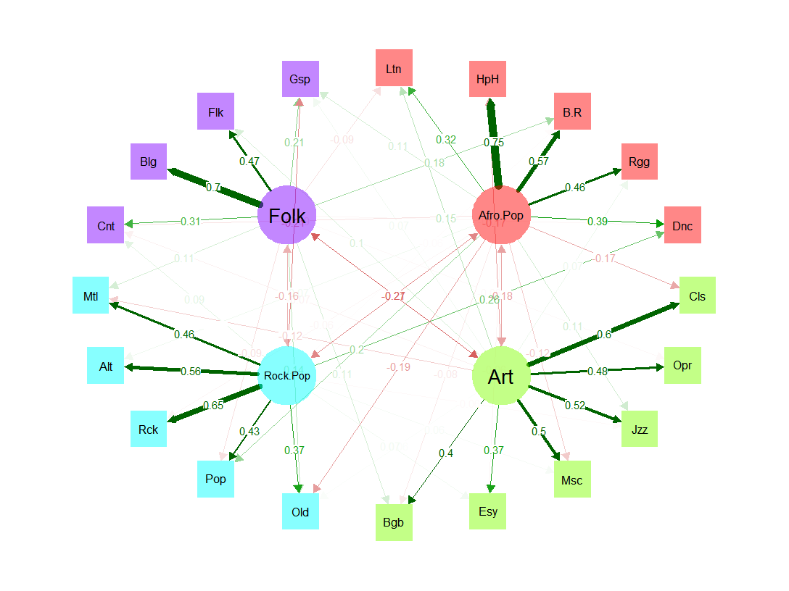
Correlation networks
Node color:
Grouping of genres based on exploratory factor analysis of behavioral choices
Four overt choice patterns:
Folk
Art
Rock Pop
Afro Pop
In line with previous work (Frith 1998; Van Eijck 2001)

Slide 25
Correlation networks
Node color:
Grouping of genres based on exploratory factor analysis of behavioral choices
Most genres load strongly on factor
Two ambiguous genres:
Dance/Techno
Rock/Afro
Gospel/Religious
Folk/Afro
Classified by highest loading

Slide 26
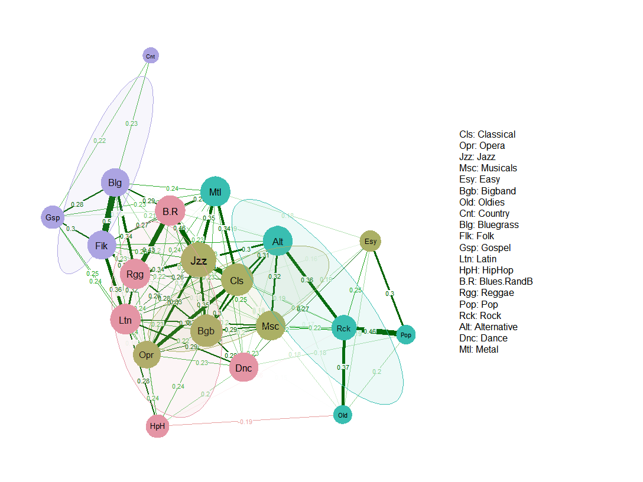
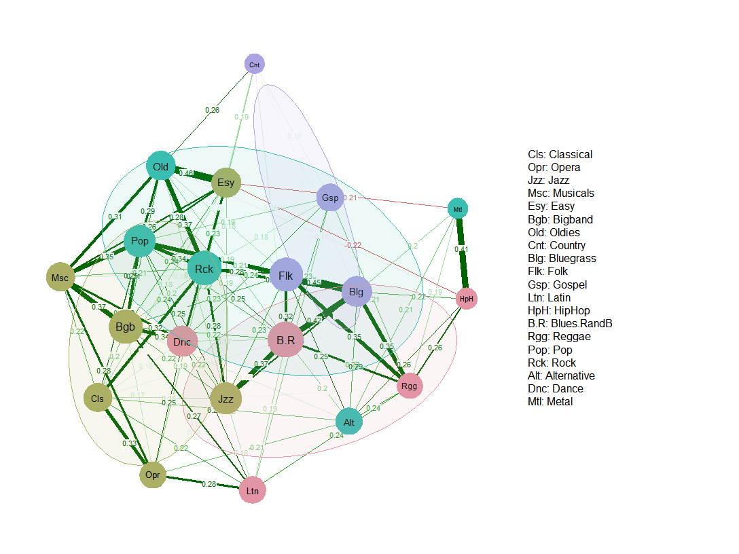
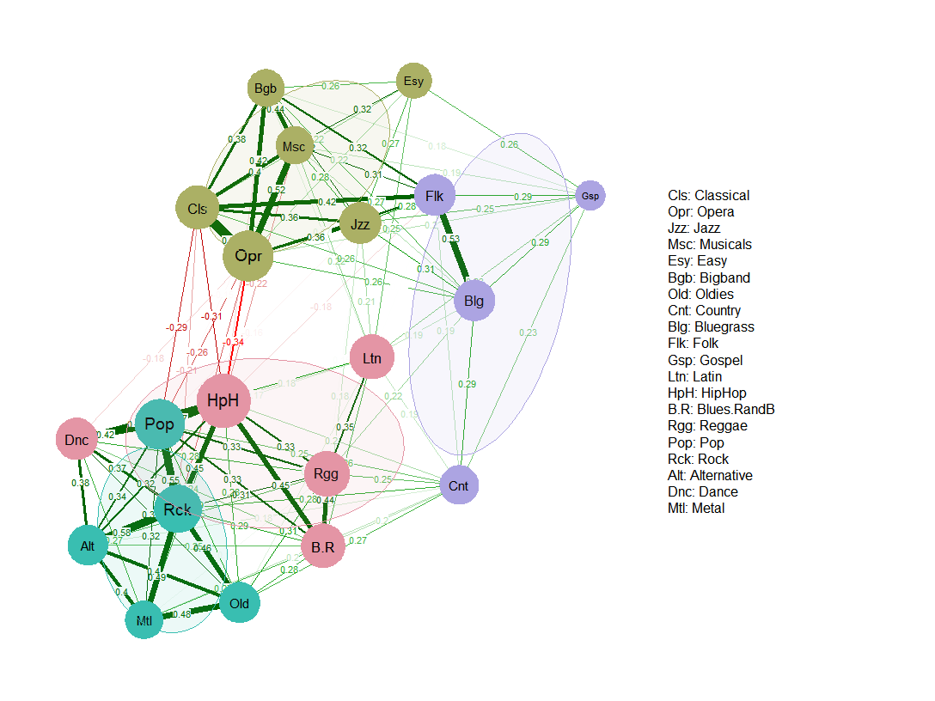
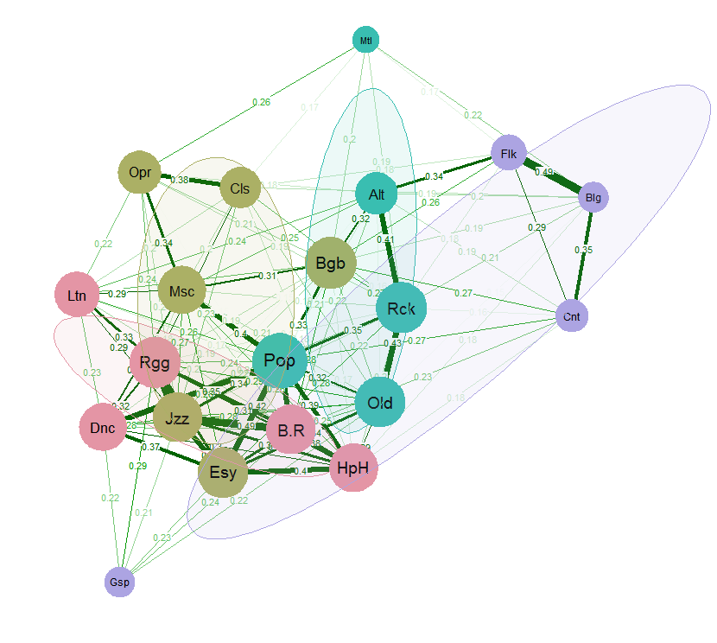
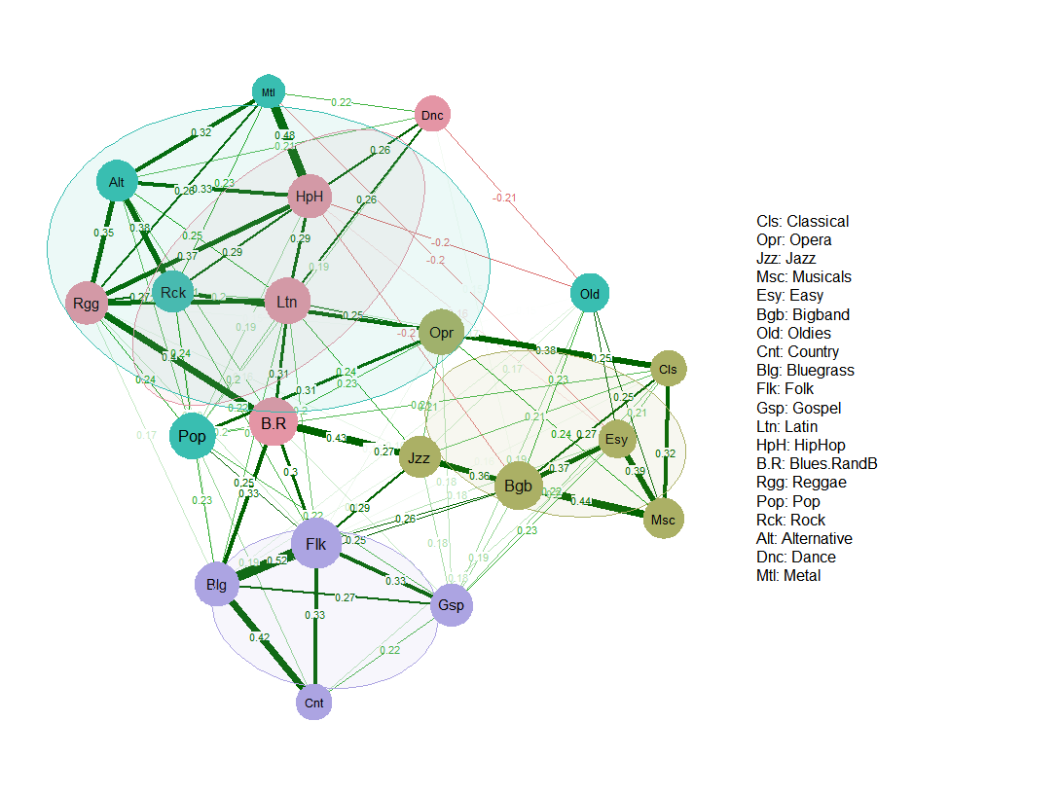
Findings
Folk
Previous work on SCA using GSS 1993 sets the expectations for our analysis
Our results overlap with both Goldberg and Boutyline
But we uncover more schematic diversity:
Five rather than four classes
Splitter-Clumper distinction
Rock-Pop
Afro-Pop
Artistic
Avant-Garde Clumper
Folksy Clumper
Generational Splitter
Multicultural Clumper
Conventional Splitter

Slide 27
Findings
Folk
Previous work on SCA using GSS 1993 sets the expectations for our analysis
Our results overlap with both Goldberg and Boutyline
But we uncover more schematic diversity:
Five rather than four classes
Schematic conservation rather than radical change
(Classes can be identified using the Goldberg/Boutyline labels)
Rock-Pop
Afro-Pop
Artistic
Anything (but Country)
Anything (but Heavy Metal)
Contempo-Traditional
Omnivore-Univore
High-Low

Slide 28
Findings
Folk
Avant-Garde Clumpers:
Perceive Strong Evaluative Linkages Between Artistic and Afro-Pop Genres
Decouple their judgment of these genres from those of Rock-Pop and Folk Genres (Esp. Country and Hip Hop)
Folksy Clumpers:
Tend to make strong local evaluative linkages
But beyond not much organization to the schema
Decouple Country from the rest of their judgments
Rock-Pop
Afro-Pop
Artistic
Avant-Garde Clumper
Folksy Clumper
Generational Splitter
Multicultural Clumper
Conventional Splitter

Slide 29
Findings
Folk
Generational Splitters
Evaluative Link all “Pop” Genres from and all “Artistic” genres
But with opposite valence across the divide
Folk Genres don’t have a strong evaluative fit
Multicultural Clumpers
Link all “Pop” (Afro and Rock) and “Artistic” styles
But decouple these from their judgment of Folk genres, Heavy Metal and Gospel
Rock-Pop
Afro-Pop
Artistic
Avant-Garde Clumper
Folksy Clumper
Generational Splitter
Multicultural Clumper
Conventional Splitter

Slide 30
Findings
Folk
Conventional Splitters
Organize their evaluative judgment according to a (conventional) tripartite logic:
Rock, Artistic, Folk
But evaluative couple “classic/rock/Oldies” with artistic genres and oppose it to more contemporary Pop genres
Rock-Pop
Afro-Pop
Artistic
Avant-Garde Clumper
Folksy Clumper
Generational Splitter
Multicultural Clumper
Conventional Splitter

Slide 31
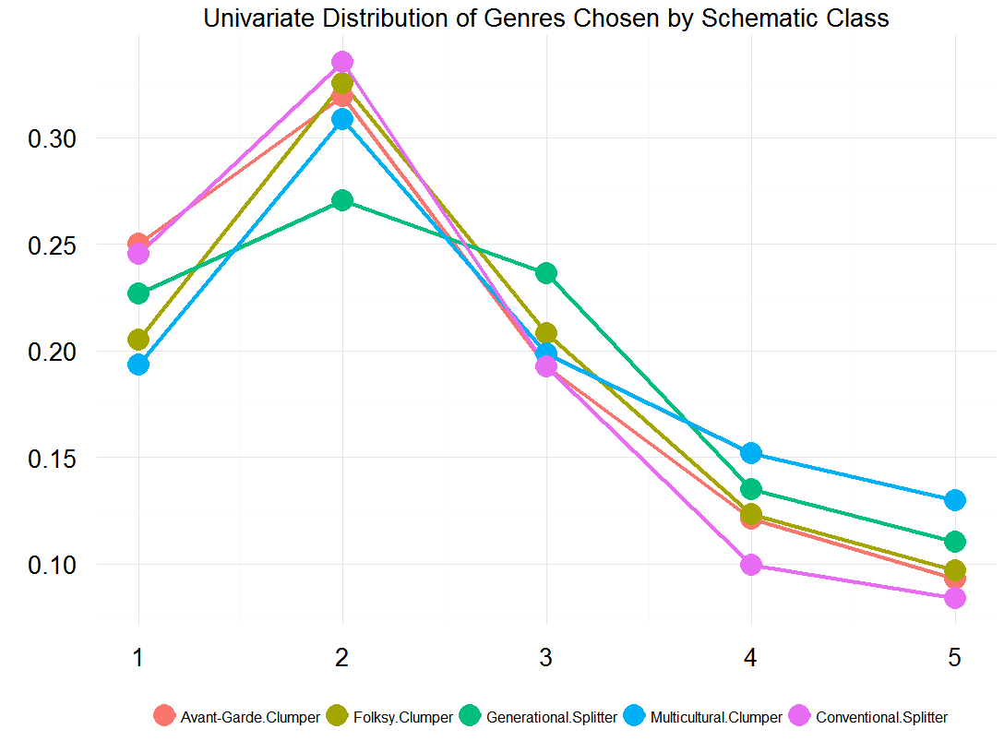
Are there omnivores and univores in every class?
All schematic classes have some behavioral potential for omnivorousness
Hence a mistake to label any one of them “omnivore/univore”

Slide 32
Are there omnivores and univores in every class?
Some classes display less behavioral potential for omnivorousness:
Traditionals
Avant-Gardes
Folksy
Some classes seem to be more disposed:
Generational Splitters
Multicultural Clmpers

Slide 33
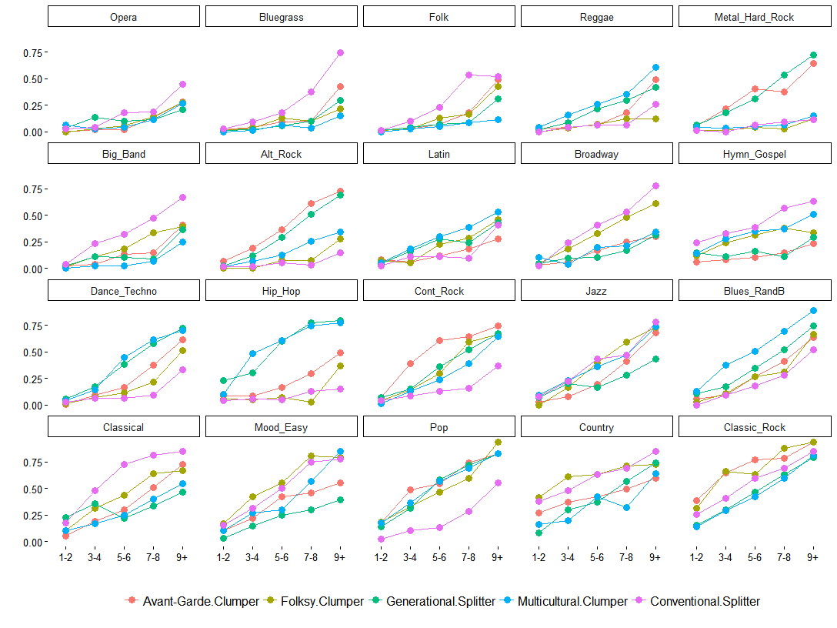
A Window into the Omnivore Listening choices of each class
Plotting the probability of listening to each genre by the number of genres listened to (x-axis) by schematic class reveals that different genres have different change of:
Being into the omnivore consumption pattern of each class

Slide 34
A Window into the Omnivore Listening choices of each class
Plotting the probability of listening to each genre by the number of genres listened to (x-axis) by schematic class reveals that different genres have different change of:
Being into the omnivore consumption pattern of each class

Slide 35
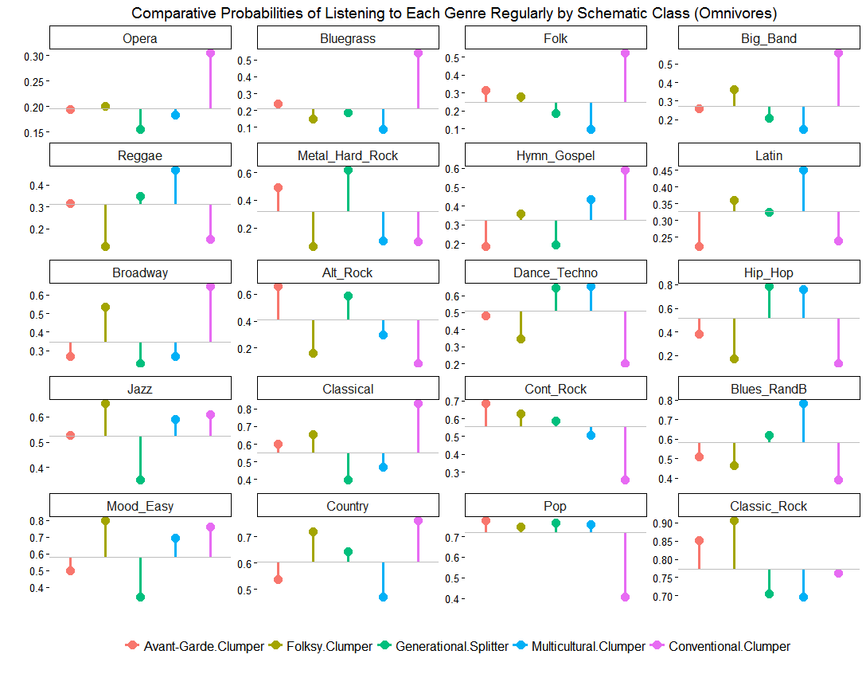
A Window into the Omnivore Listening choices of each class
Each schematic class displays a distinct behavioral potential for Omnivorousness:
Avant-Gardes:
Bluegrass, Folk, Metal, Alt-Rock, Classical, Cont-Rock, Pop, Classic-Rock
Folksies:
Folk, Big Band, Gospel, Latin, Musicals, Jazz, Classical, Cont-Rock, Easy, Country, Pop, Classic-Rock

Slide 36
A Window into the Omnivore Listening choices of each class
Each schematic class displays a distinct behavioral potential for Omnivorousness:
Generationals:
Reggae, Metal, Alt-Rock, Dance/Techno, Hip Hop, Cont-Rock, Blues/R&B, Country, Pop
Multiculturals:
Reggae, Gospel, Latin, Dance/Techno, Hip Hop, Jazz, Blues/R&B, Easy, Pop

Slide 37
A Window into the Omnivore Listening choices of each class
Each schematic class displays a distinct behavioral potential for Omnivorousness:
Traditionals:
Opera, Bluegrass, Folk, Big Band, Gospel, Musicals, Jazz, Classical, Easy, Country

Slide 38
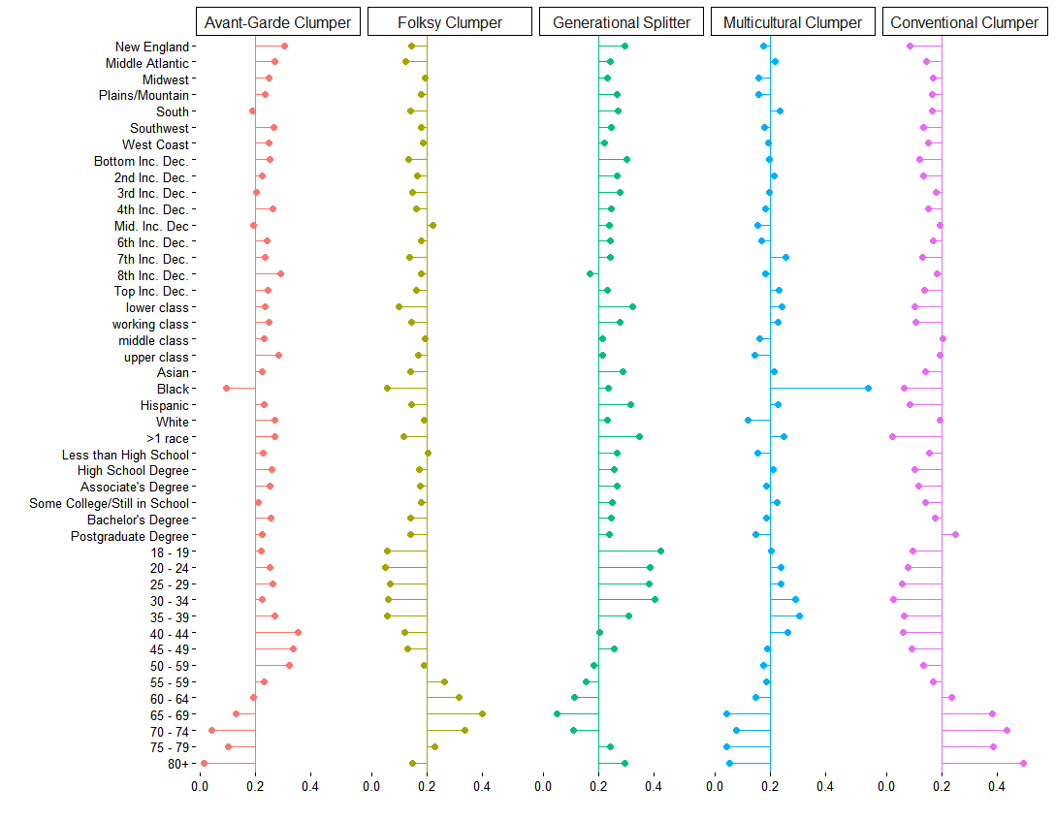
Sociodemographic profile of schematic classes

Slide 39
Sociodemographic profile of schematic classes
Some classes skew old:
Folksy Clumpers
Conventional Clumpers
Some skew young
Multicultural Clumpers
Some are bimodal on age
Generational Splitters
Some are fairly balanced
Avant-Garde-Clumpers

Slide 40
Sociodemographic profile of schematic classes
Blacks are extremely overrepresented among
Multicultural Clumpers
Whites are overrepresented among
Avant-Garde Clumpers
Generational Splitters tend to have a good representation of nonwhites
Nonwhites are underrepresented among conventional splitters

Slide 41
Sociodemographic profile of schematic classes
No strong structuration of schematic classes by education
Low education people are underrepresented among conventional clumpers
But people with the highest degree are overrepresented in the same group

Slide 42
Sociodemographic profile of schematic classes
No strong structuration of schematic classes by education
High Education people are underrepresented among Folksy Clumpers
Both Avant-Garde Clumpers and Generational Splitters have a fairly diverse distribution across levels of education

Slide 43
Discussion
In all results are consistent with:
(Mostly) continuity over time
Surprising consistency with both Goldberg’s and Boutyline’s results
In spite of very different data source collected 19 years later
Consistent with the idea that schematic patterns are durable across time
Not subject to dramatic transformation
But may have increased in diversity

Slide 44
Discussion
In all results are consistent with:
Folksy and Conventional Clumpers being at opposite (in terms of class) ends of an “Traditional” Spectrum
Similar choice style separated by SES
Avant-Garde and Multicultural Clumpers being opposed to tradition in ways that cross-cut class but are racially coded
Avant-Gardes gravitate towards white-dominated contemporary forms
Multicultural build around Black and Afro-Caribbean forms

Slide 45
Discussion
In all results are consistent with:
Multicultural Clumpers building a form omnivorousness around Black and Afro-Caribbean rhythms
Display strongest potential for omnivorousness
Conventionals using a more traditional highbrow/lowbrow lens
Closest to a High/Low divide (Goldberg 2011)
Folksies hunker around a safer, middlebrow aesthetic
Reject genres based on generational and racial codes
Generationals use a consistent age-based classification gradient
But only those who gravitate toward the contemporary side become omnivores

Slide 46
Discussion
Only some of these patterns are “readable” from schematic oppositions particular to each class
Justifies the separation of schemas and behavior
Allows for the empirical separation of forms of univorousness and omnivorousness within schematic classes
Accounts for demographic diversity within schematic classes
Strange bedfellows effect
Redeems intuition that each class has behavioral potential for different forms of omnivorousness
And univorousness

Slide 47
Questions? Comments? Please!
olizardo@nd.edu

Slide 48
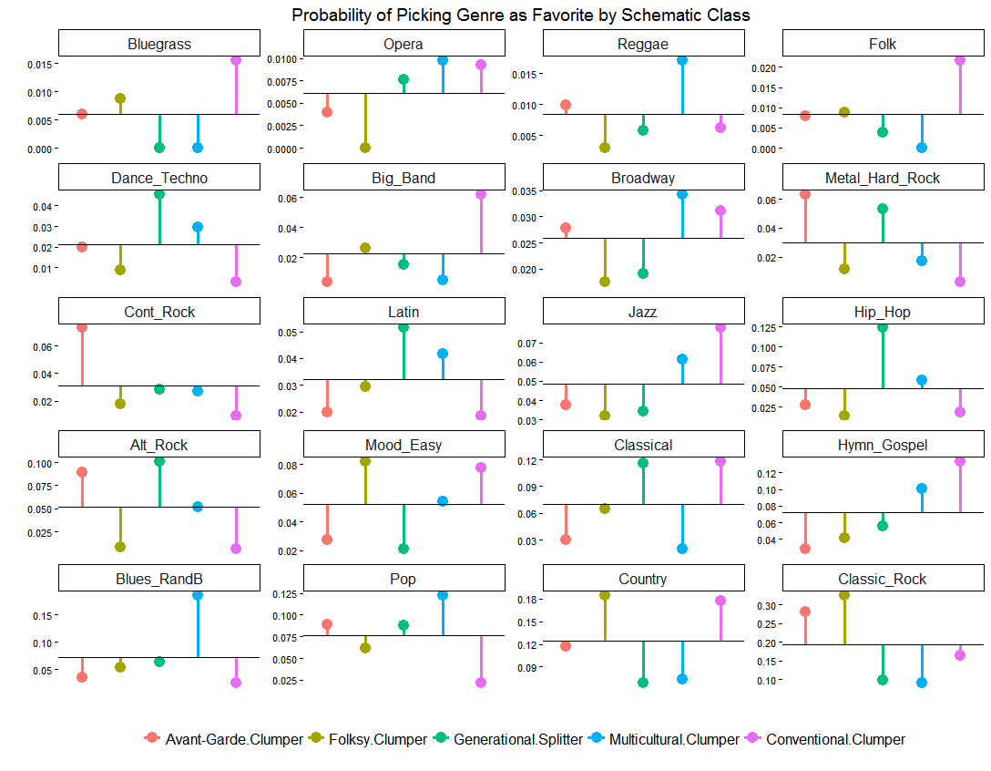

Slide 49
Correlation networks
Exploring schematic classes via correlation networks
Nodes: Musical Styles
Edges: Correlations of evaluative judgments
Link presence:
Indicative of evaluative linkage between genres

Slide 50
Correlation networks
Exploring schematic classes via correlation networks
Nodes: Musical Styles
Edges: Correlations of evaluative judgments
Positive links:
Likes (dislikes) of one genre are associated with likes (dislikes) of the other

Slide 51
Correlation networks
Exploring schematic classes via correlation networks
Nodes: Musical Styles
Edges: Correlations of evaluative judgments
Negative links:
Likes (dislikes) of one genre are associated with dislikes (likes) of the other

Slide 52
Correlation networks
Exploring schematic classes via correlation networks
Nodes: Musical Styles
Edges: Correlations of evaluative judgments
Link weight:
Indicates magnitude of the correlation (linkage)
Node proximity:
Belong to clusters of interconnected genres in schematic logic

Slide 53
Correlation networks
Exploring schematic classes via correlation networks
Nodes: Musical Styles
Edges: Correlations of evaluative judgments
Link absence:
Indicative of evaluative decoupling
Likes (dislikes) of one genre not informative about evaluations of the other genre
Only r > 0.20 shown

Slide 54
“Avant-Gardist Clumper” Schema
Evaluative schema with relatively little number of negative oppositions or breaks
Majority of styles evaluatively coupled by positive links
Organizes taste schemas by grouping genres from all four meta-groups together

Slide 55
“Avant-Gardist Clumper” Schema
Evaluative schema with relatively little number of negative oppositions or breaks
Evaluation of Country is either decoupled or negatively coupled from other styles
Similar to Boutyline’s (2016) “Anything but Country” omnivore class

Slide 56
“Avant-Gardist Clumper” Schema
Evaluative schema with relatively little number of negative oppositions or breaks
However, Hip Hop also relatively decoupled from other taste judgments
Evaluatively coupled (in a negative way) to Rock and Pop genres

Slide 57
“Avant-Gardist Clumper” Schema
Evaluative schema with relatively little number of negative oppositions or breaks
Seems to oppose a discerning type of omnivorousness centered on a mixture of tradition and contemporaneity against a “country” or “pop” univorousness
Some potential for strong omnivorousness

Slide 58
“Folksy Clumper” Schema
Taste schema featuring another relatively connected cluster without many negative oppositions
Potential for another form of omnivorousness

Slide 59
“Folksy Clumper” Schema
Taste schema featuring another relatively connected cluster without many negative oppositions
Decouples Alt Rock and Metal from the rest of Rock/Pop Genres
Does not organize their judgments in Afro/Pop genres in a systematic way
Decouples country from other Folk Genres
Decouples Classical/Opera

Slide 60
“Folksy Clumper” Schema
Taste schema featuring another relatively connected cluster without many negative oppositions
Strong evaluative link between Metal and Hip Hop
Negative link between Metal and Hip Hop and Easy Listening styles
Similar to Boutyline’s (2016) “Anything (but) Heavy Metal” Class

Slide 61
“Folksy Clumper” Schema
Taste schema featuring another relatively connected cluster without many negative oppositions
Core set of positive evaluative link centered on Folk, Rock, Oldies, Bluegrass, Blues
Contrasts a more conventional omnivore aesthetic against youth music univores

Slide 62
“Generational Splitter” Schema
Same as the “Contempo/Trad” class uncovered by Goldberg (2011) and Boutyline (2016)

Slide 63
“Generational Splitter” Schema
Same as the “Contempo/Trad” class uncovered by Goldberg (2011) and Boutyline (2016)
Relatively “simple” schema partitioning two clumps of genre evaluations along a “contemporary/traditional” axis
With “Art” genres in traditional clump
And Rock/Pop and Afro/Pop genres in contemporary clump

Slide 64
“Generational Splitter” Schema
Same as the “Contempo/Trad” class uncovered by Goldberg (2011) and Boutyline (2016)
Strong negative evaluative links between the Classical/Opera couplet and Hip Hop and Pop music couplet

Slide 65
“Generational Splitter” Schema
Same as the “Contempo/Trad” class uncovered by Goldberg (2011) and Boutyline (2016)
Latin music, along with all folk genres (country music, bluegrass, folk, and gospel) seem to be “ambiguous” genres and thus relatively decoupled from main binary

Slide 66
“Generational Splitter” Schema
Same as the “Contempo/Trad” class uncovered by Goldberg (2011) and Boutyline (2016)
Country, Latin, and Bluegrass have potential to serve as brokers across contemporary/traditional evaluative barrier

Slide 67
“Generational Splitter” Schema
Same as the “Contempo/Trad” class uncovered by Goldberg (2011) and Boutyline (2016)
Potential to generate strong (e.g. boundary spanning) forms of omnivorousness
If consumers of either contemporary or traditional forms can incorporate broker genres

Slide 68
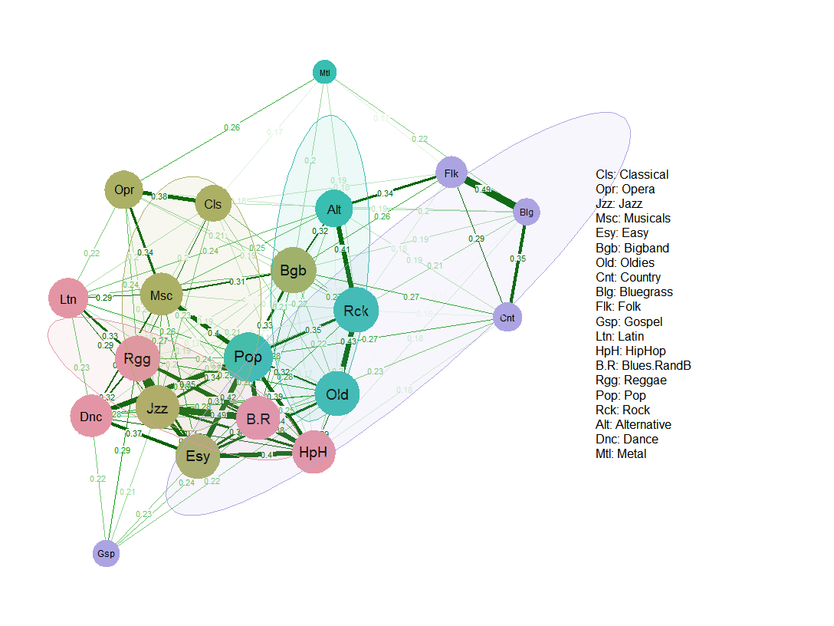
“Multiculturalist Clumper” Schema
Very few negative links
Most densely interconnected positive coupling network
Combines Art, Rock/Pop and most significantly Afro/Pop rhythm into omnivorous core
Similar to Goldberg’s (2011) and Boutyline’s (2016) unqualified “Omnivore/Univore” class

Slide 69
“Multiculturalist Clumper” Schema
Very few negative links
Decouples judgment of all folk genres from gospel

Slide 70
“Multiculturalist Clumper” Schema
Very few negative links
Decouples judgment of all folk genres from gospel
Decouples judgment of Metal and to a lesser extent alternative from other Rock/Pop genres

Slide 71
“Multiculturalist Clumper” Schema
Very few negative links
Decouples judgment of all folk genres from gospel
Decouples judgment of Metal and to a lesser extent alternative from other Rock/Pop genres
Classical, Opera and Musicals are evaluatively linked but relatively decoupled from Jazz

Slide 72
“Conventional Clumper” Schema

Slide 73
“Conventional Clumper” Schema
Contemporary
Network partitions of the taste schema suggest stronger dependencies based on traditional genre classifications
Folk
Contemporary
Artistic
Artistic
Folk

Slide 74
“Conventional Clumper” Schema
Contemporary
Network partitions of the taste schema suggest stronger dependencies based on traditional genre classifications
Folk
Contemporary
Artistic
With negative dependencies across the contemporary artistic divide
In this respect similar to Goldberg’s “Hi-Low” schema
Artistic

Slide 75
“Conventional Clumper” Schema
Network partitions of the taste schema suggest stronger dependencies based on traditional genre classifications
Folk
Contemporary
Artistic
Suggests a command of conventional categories and an aversion to mixing indiscriminately

Slide 76
“Conventional Clumper” Schema
Network partitions of the taste schema suggest stronger dependencies based on traditional genre classifications
Folk
Contemporary
Artistic
Less potential for strong levels of omnivorousness

Slide 77
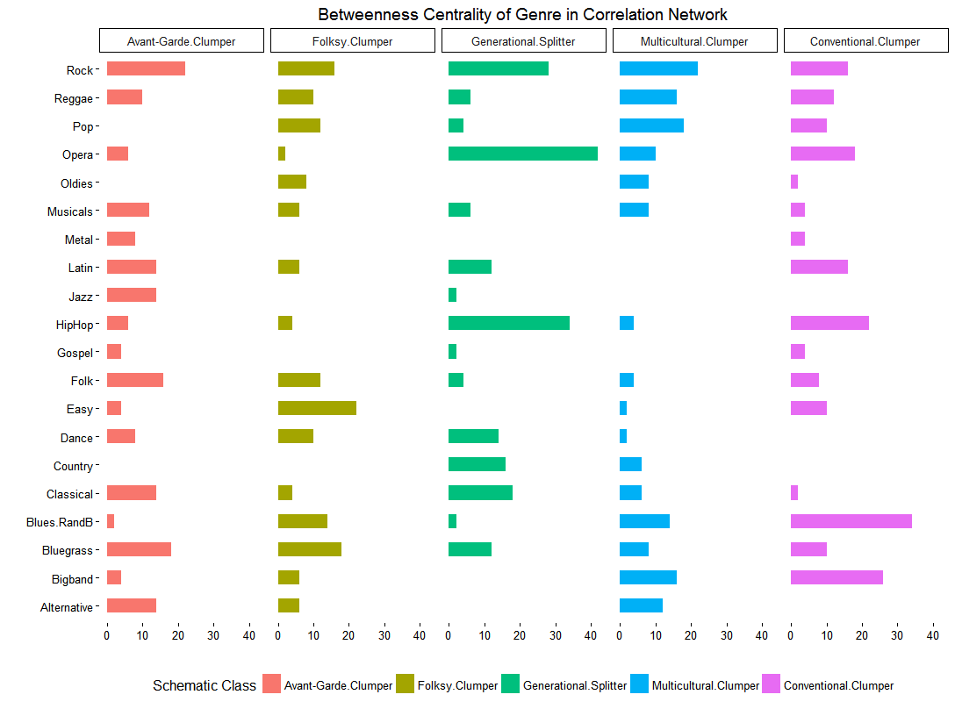
Genre betweenness in correlation network
Correlation networks featuring genres with extremely high betweenness are more fragmented
Indicative of strong splitting tendencies
Gen. Splitters
Conventional Clumpers

Slide 78
Genre betweenness in correlation network
Correlation networks featuring genres with extremely high betweenness are more fragmented
Indicative of strong splitting tendencies
Gen. Splitters
Conventional Clumpers
However no systematic link between schema fragmentation and potential for behavioral omnivorousness

