Slide 1
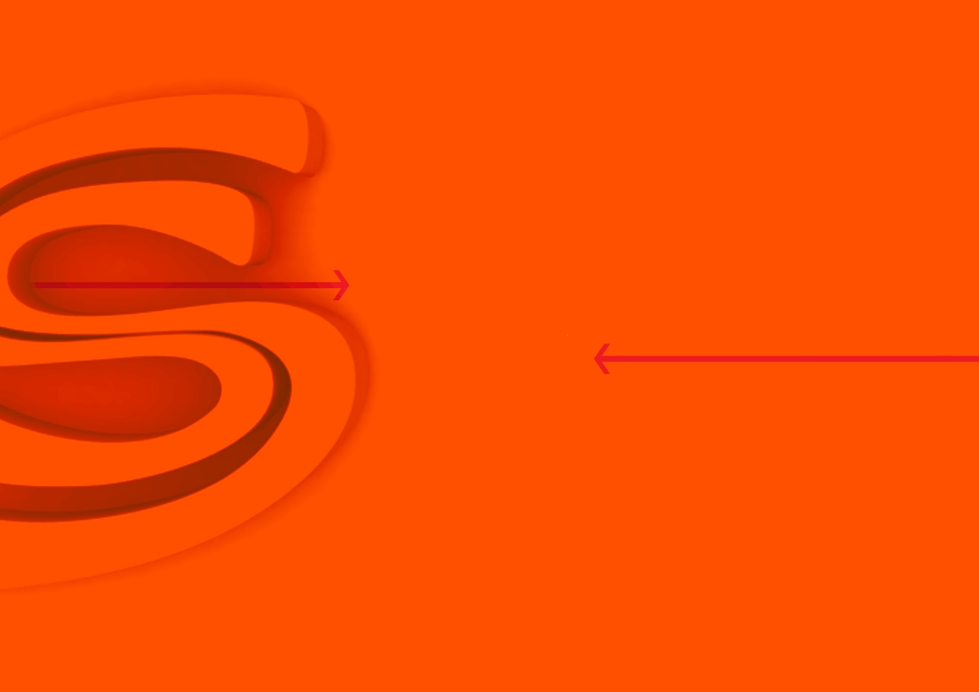

JSF Framework
Presentation by Sadygov Ruslan
SoftServe, Inc.

Slide 2
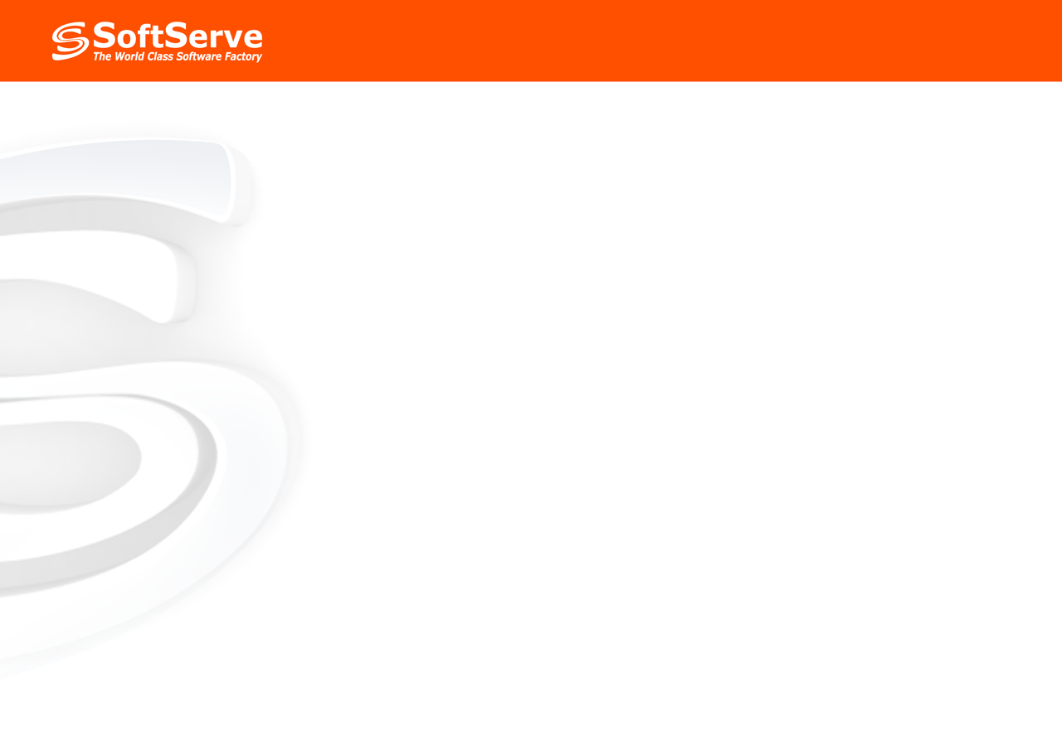
Agenda
General overview
Main features
Example

Slide 3
General Overview

Slide 4
What is JSF?
- JSF is framework for developing web applications based on Java technologies.
- JSF is based on well established Model-View-Controller (MVC) design pattern.
- Competitor for ASP.NET
- Works with JSP, but doesn't require it
- Enables RAD approach to Web development

Slide 5
Benefits of JSF
Simple configuration (only faces-config.xml)‏
Big variety of standard, reusable components for creating user interfaces
Base set of validators
Base set of converters
Base set of renderers for HTML
I18N support
Component based architecture
Extremely extensible

Slide 6
Main Features

Slide 7
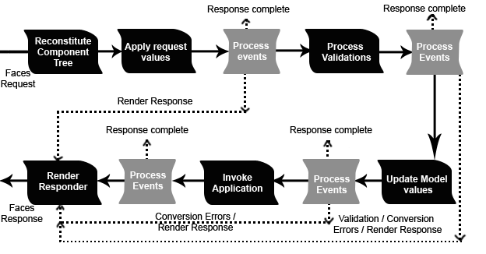
JSF Life Cycle

Slide 8
JSF Tags
JSF Core Tags Library
        <%@ taglib uri=”http://java.sun.com/jsf/core “ prefix=”f” %>
JSF Html Tags Library
        <%@ taglib uri=”http://java.sun.com/jsf/html “ prefix=”h” %>
JSTL can be used (but it may cause a conflicts)‏

Slide 9
JSF UIComponents
  JSF provides rich set of UI components for data input and for outputting data
  UI components can have their output/state rendered diffrently by using different renderers
        <h:inputText value="#{user.name}"/>
        <h:outputText value="#{user.name}"/>
        <h:inputSecret value="#{user.password}"/>

Slide 10
JSF Event Handling
  JSF is event based framework
  UI components can generate events that can be «listened to» and act upon by listeners
  Two types of events: ActionEvent and ValueChangedEvent
  To capture events you need to write event listener (implement javax.faces.event.FacesListener)‏
  Event infrastructure built on top of java.util.event code
        <h:commandButton image="images/header.jpg" actionListener="#{changeLocale.listen}"/>

Slide 11
JSF Page Navigation
  JSF supports declarative page navigation that gets defined in an application configuration file (faces-config.xml)‏
  Navigation can be based off of what page was submitted (if coming from page_1 go to page_2)‏
  Navigation can be based off of the outcome an action (conditional navigation)‏
        <navigation-rule>
        <from-view-id>/index.jsp</from-view-id>
        <navigation-case>
        <to-view-id>/welcome.jsp</to-view-id>
        </navigation-case>
        </navigation-rule>

Slide 12
JSF Validators
  JSF provides mechanism for performing data validation for application input
  Intended to handle syntax validators not semantic (business) validations
  Natively support internationalization
  JSF provides well-defined easy to use interface for creating new validators
        <h:inputSecret id="password" value="#{userBean.password}">
        <f:validateLength minimum="3" maximum="7"/>
        </h:inputSecret>

Slide 13
JSF Convertors
  JSF provides mechanism for performing data conversion for application input and ouput
  JSF comes with several pre-built convertors
  JSF provides well-defined easy to use interface for creating new convertors
        <h:inputText value="#{payment.date}"> <f:convertDateTime pattern="MM/yyyy"/>
        </h:inputText>

Slide 14
Example

Slide 15
Useful tools and links
  //IF005/Install/Jsf/
  http://icefaces.org
  http://myfaces.apache.org

Slide 16
Questions?

