Slide 1
MySensors Clock Network
Topology

Slide 2
Topology: Star Distribution
- SensbenderTempHum – 27
- Bedroom – 97 (Patio)
Node 95
livingroom
Node 27
Pergola
Node 96
Office
Node 97
Bedroom

Slide 3
Topology: Star Distribution Original solution
Node 96
NodeId=2
Livingroom
time
Indoor temp
Outdoor temp
Outdoor humidity
UV-Index
Air pressure
Node 27
Pergola
Temp/Hum
time
Indoor temp
Outdoor temp
Outdoor humidity
UV-Index
Air pressure
Node 97
NodeId=3
Bedroom
Temp/Hum
Node 95
Node Id = 1
Patio
Node 31
Pergola
UVI/Air pressure
Node 98
NodeId=4
Office
time
Indoor temp
Outdoor temp
Outdoor humidity
UV-Index
Air pressure
Node 99
NodeId=5
Kitchen
time
Indoor temp
Outdoor temp
Outdoor humidity
UV-Index
Air pressure

Slide 4
Topology: Star Distribution Frontyard side
Node 9
Porch
Temp/Hum
Temp/Hum
Node 85
Node Id = 1
Patio
Node 86
NodeId=2
Office
time
Indoor temp
Outdoor temp
Outdoor humidity
UV-Index
Air pressure
Node 5
Frontyard
UVI/Air pressure

Slide 5
Topology: Star Distribution Garden side
Node 27
Pergola
Temp/Hum
Node 96
NodeId=2
Livingroom
time
Indoor temp
Outdoor temp
Outdoor humidity
UV-Index
Air pressure
Temp/Hum
Node 95
Node Id = 1
Patio
Node 31
Pergola
UVI/Air pressure
Node 97
NodeId=3
Bedroom
time
Indoor temp
Outdoor temp
Outdoor humidity
UV-Index
Air pressure

Slide 6
Toplogy Sequential Distribution
Node 27
Pergola
Temp/Hum
Node 96
NodeId=2
Livingroom
Node 97
NodeId=3
Bedroom
Temp/Hum
Node 95
Node Id = 1
Patio
time
Indoor temp
Outdoor temp
Outdoor humidity
UV-Index
Air pressure
time
Indoor temp
Outdoor temp
Outdoor humidity
UV-Index
Air pressure
Node 31
Pergola
UVI/Air pressure
Node 99
NodeId=5
Kitchen
Node 98
NodeId=4
Office
time
Indoor temp
Outdoor temp
Outdoor humidity
UV-Index
Air pressure
time
Indoor temp
Outdoor temp
Outdoor humidity
UV-Index
Air pressure

Slide 7
Cyclic presentation of Sensor data
Current time (20 sec)
Current time (2 sec)
Current time (2 sec)
30 seconds
Current time (2 sec)
Current time (2 sec)
Current time (2 sec)

Slide 8
Programing- and temperature port
RJ45
DTR
RxD
RxT
VCC
CTS
GND
DATA
VCC
View from cable side
Orange
Blue
Green
W/Orange
W/Green
W/Ble
Brown
W/Brown
+
Data
DS18B20
-
DTR
RxD
RxT
VCC
CTS
GND

Slide 9
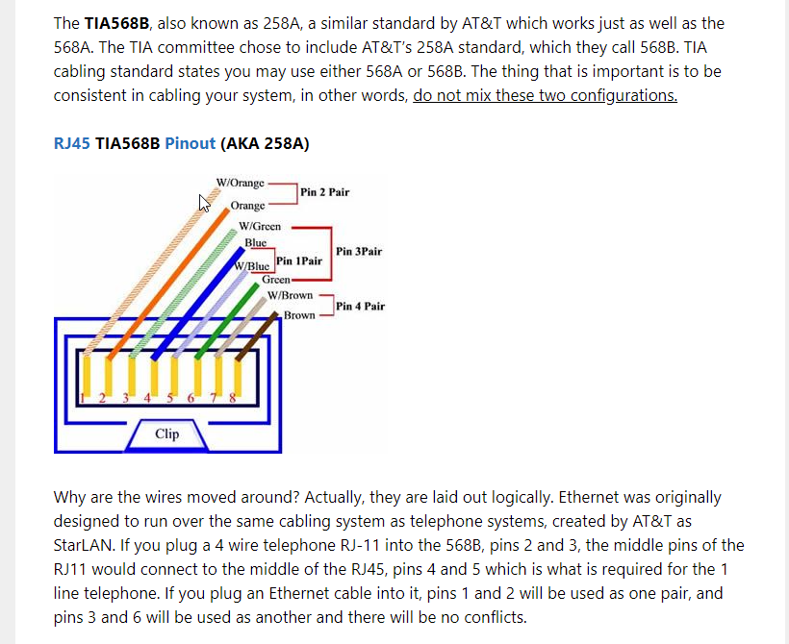
RJ45 color codes

